Slide 1
Cerritos College
Crisis Assessment, Intervention, & Response (CAIR) Team
This presentation reviews the CAIR Team, and strategies to respond to students exhibiting distressing, disruptive, disturbing, and dangerous behaviors. If you would like a presentation for your department, please contact Dr. Miller at emiller@Cerritos.edu. Presentation options can range from 15 to 60 minutes.

Slide 2
Presentation Goals
Provide an overview of the CAIR Team and its purpose, what it does/does not do, membership, and your role with CAIR;
Recognize the warning signs of distressed, disruptive, and threatening behaviors;
Gain tools and strategies for responding to such behaviors;
Learn what, to whom, and how to report behaviors of concern.
Notes:
Liz

Slide 3
Cerritos College CAIR Team Purpose
The Crisis Assessment, Intervention, and Response (CAIR) Team is a multidisciplinary partnership which contributes to the health and safety of the campus. The team consists of Cerritos College administrators that evaluate and assess distressing and disturbing behaviors exhibited by students, coordinate and develop a centralized response to provide assistance and intervention for students of concern, and evaluate and monitor any ongoing related issue(s).
Notes:
Liz

Slide 4
CAIR: Who we are & what we do
The CAIR Team’s responsibilities include, but are not limited to, the following:
To receive and review reports regarding students in crisis and/or of concern submitted by members of the campus community and the general public;
To develop a collaborative and coordinated action or intervention plan to respond to students of concern and follow-up plans, when necessary;
To initiate threat assessments and risk determination, when warranted;
To create protocols, processes, procedures, and recommend policies to enhance the effectiveness of the CAIR Team;
To assess and monitor national trends and events that may impact the institution; and
To educate the campus community about the resources available provided by the CAIR Team and available in the broader community.
Notes:
Liz

Slide 5
CAIR: What we are not
First responders. We do not have specialized training or capacity to be the first to arrive and provide assistance at the scene of an emergency, such as a student in crisis, accident, or incident of violence.
A referral service. Students should not be “referred” to the CAIR Team for services (or told they are being referred to the CAIR Team), instead direct referrals should be made to service areas (i.e. SHS, DSPS, Fin Aid. etc.), with a follow-up CAIR report submitted.
A case management service. The CAIR Team reviews reports to provide a coordinated response through aligning services, it does not manage individual student cases, but refers to offices on campus that can assist the student directly.
In instances where a student reports food, housing, or financial instability, we unfortunately do not have the capacity to assist students one-on-one with connecting to county/city resources. We will direct students to online resources to find this information, and campus resources such as Financial Aid. Individual reporters are encouraged to do the same.
Notes:
Liz

Slide 6
CAIR Team Membership
Dean of Students Services (Co-Chair)
College Psychologist (Co-Chair)
Director, Diversity, Compliance and Title IX Coordinator
Dean of Disabled Student Programs and Services (DSPS)
Dean of Student Support Services
CCPD Police Chief
CCPD Police Captain
Associate Dean of Student Health and Wellness Services
Dean of Counseling
VP Student Services
Notes:
Liz

Slide 7
Your Role with CAIR
Submit reports regarding students of concern
Provide direct referral of a student to campus services
Provide outreach to the student or another party
May provide Team insight into the report, incident, or student
May be invited to attend a portion of a meeting or a smaller constituent group when you may have insight
Notes:
Humberto

Slide 8
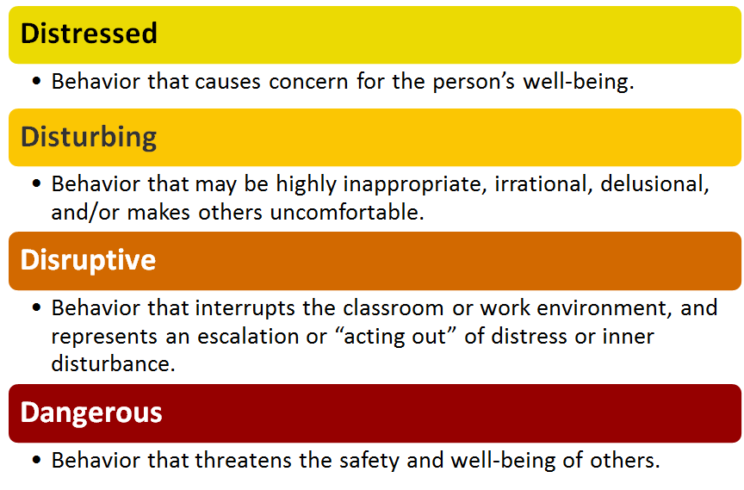
Behaviors on a Continuum
Notes:
Humberto

Slide 9
Students in Distress
Potential triggers for distress:
Food insecurity Housing insecurity Physical health concerns
Relationship problems
(e.g., break-up, conflict with professor)
Failing or retaking classes
Family issues
Sexual assault and/or domestic violence
Financial problems
Unemployment
Sleep difficulties
Death of loved one
Victim of crime
Mental health concerns
Notes:
Hillary
Ask audience what other triggers there may be that are not listed

Slide 10
Signs of Distress
A student with persistent behaviors such as:
Sad
Overly anxious
Irritable
Withdrawn
Confused
Lacks motivation and/or concentration
Seeks constant attention
Demonstrates bizarre or erratic behavior (including written/electronic communication)
Expresses suicidal thoughts
Notes:
Hillary

Slide 11
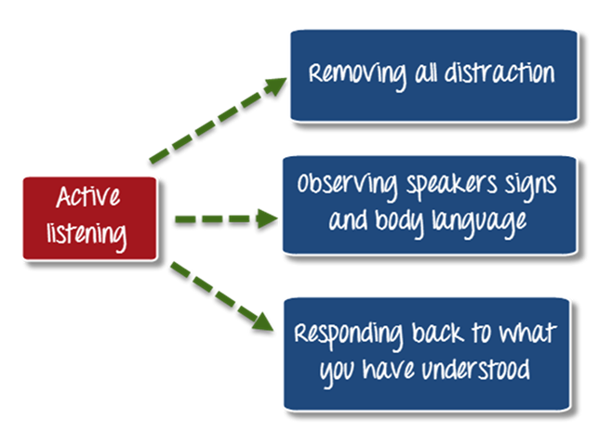
What can I do?
Interpersonally:
Talk in private
Give hope - help student realize there are options
Suggest resources (SHS, Fin Aid, Adult Re-Entry, DSPS, EOPS/LINC/CARE, Veterans Resource Center, etc.)
Help them with relaxation skills
Avoid sarcasm, jokes, overly personal remarks
Intrapersonally:
Try to understand where they are coming from
Avoid judging, evaluating, and criticizing
Notes:
Humberto

Slide 12
Useful phrases
What I hear you saying is…
Let me see if I have this right…[repeat what they said to you]….
It sounds like you are saying….
Please stand back you are too close…
I can see why that may be upsetting, let’s see if we can solve this together…
I can see that you are frustrated, unfortunately the rules are…
Tell me more about….
Let me see if I can find someone to help…
Notes:
Humberto
Emphasize tone of voice, context.
Looking to solve a problem, do not take issue personally and become defensive.

Slide 13
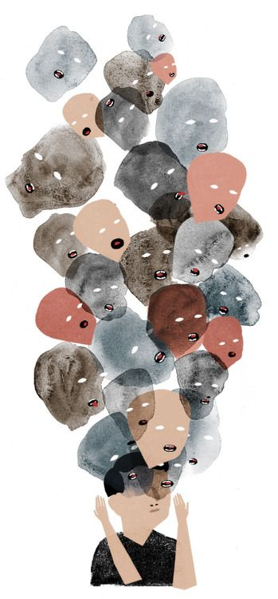
Disturbed Behaviors
Verbal aggression (yelling, excessively loud)
Not complying with instructions
Inability to communicate clearly
Loss of contact with reality (seeing or hearing things that others cannot see or hear; irrational beliefs or fears that others may be conspiring against them)
Stalking behaviors and/or inappropriate communications
Suicidal thoughts and/or attempts to kill self
Under the influence of drugs and/or alcohol
Notes:
Humberto
Note that loss of contact with reality does not mean the person is or has the capacity to be violent.

Slide 14
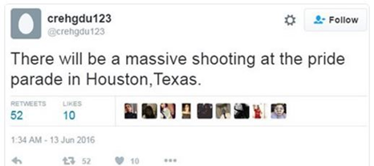
Disruptive & Potentially Dangerous Behaviors
Verbal aggression (yelling, excessively loud)
Not complying with instructions
Inability to communicate clearly
Loss of contact with reality (seeing or hearing things that others cannot see or hear; irrational beliefs or fears that others may be conspiring against them)
Stalking behaviors and/or inappropriate communications
Suicidal thoughts and/or attempts to kill self
Under the influence of Drugs and/or Alcohol
Threats of violence
Actual acts of violence towards others
Uncontrolled expression of anger, frustration, impulsivity
Interest in explosive devices, bombs, or fire
Preoccupation with weapons or violence as a way to solve a problem
Writing or use of social media that cause concern
“Injustice Collector”
Notes:
Hillary
Talk about change in behavior (from baseline) as a red flag.
Context and interest in weapons - i.e. marksman, military vet, police officer, fireperson may have interest without it being malicious

Slide 15
Remember...
We cannot predict or prevent all acts of campus/workplace violence.
There is no single demographic profile of an “active shooter.”
Notes:
Hillary

Slide 16
What should I do? (Immediate)
Disruptive
If safety does not seem like an immediate concern, attempt to de-escalate the situation; offer to find someone to assist in problem-solving.
Instructors may (and should) remove a disruptive student from class.
Administrative Procedure 5520: Student Discipline Procedures (lines 115-125)
Removal from Class (Education Code Section 76032): Any instructor may order a student removed from his/her class for the day of the removal and the next class meeting.
The instructor shall immediately report the removal to the Faculty Coordinator for Student Conduct and Grievance and complete a Student Conduct Incident Form. The Faculty Coordinator or designee shall arrange for a conference between the student and the instructor regarding the removal. If the instructor or the student requests, the Faculty Coordinator or designee shall attend the conference. The student shall not be returned to the class during the period of the removal without the concurrence of the instructor. Nothing herein will prevent the Faculty Coordinator, or designee from recommending further disciplinary procedures in accordance with these procedures based on the facts which led to the removal.
Notes:
Liz
Emphasize that everything is situational

Slide 17
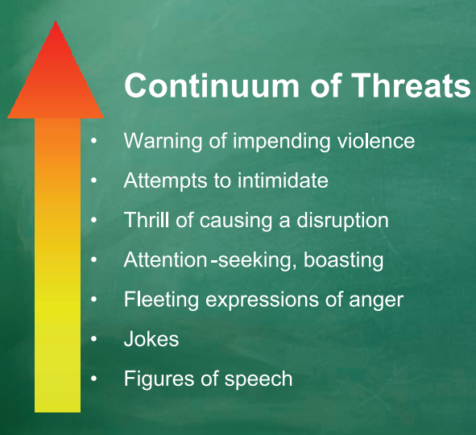
What should I do? Cont’d (Immediate)
Dangerous
If safe to do so, remove yourself and others from the room.
Ask about the possibility of harm to self or others
ASK: Are you thinking of killing yourself? Are you thinking of or planning to harm someone?
Remember - it is not our role to diagnose and treat.
When physical safety of student(s) or others is of immediate concern,
or the student acts in a highly irrational or disruptive way, call:
911 or 562-402-3674 (Cerritos College Police)
Notes:
Liz
Emphasize that everything is situational

Slide 18
What should I do? (Secondary)
Submit a Report
Why? Allows the District to:
Record the incident from your perspective
Review for additional services available to the student
Monitor trends occuring on campus
Provide a safe learning and working environment!
How? It’s easy and online!
To access the report visit the CAIR webpage.
Notes:
Liz

Slide 19
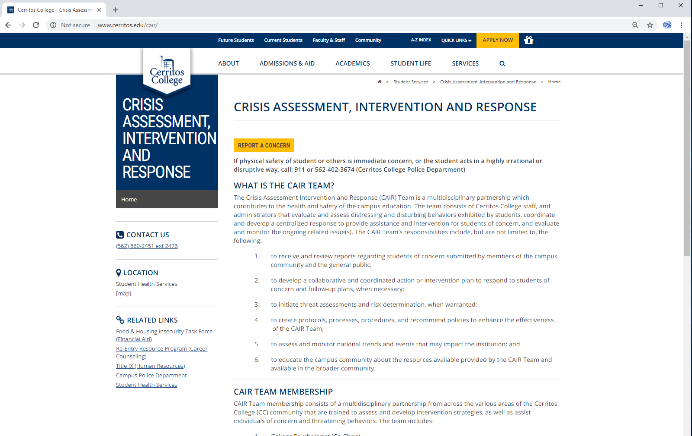
CAIR Website
Notes:
Liz

Slide 20
Report Writing Tips: Observations, facts and objectivity
A bout the person (name, relationship to reporter and the College)
B ehaviors observed (body language, phrases stated, tone of voice, actions)
C ontext (when, location of incident, if it occurred in a class what class did this take
place in, any unique factors of the setting)
D etails (witnesses, times of incidents, anything else objective that is relevant)
E ffect (impact to others, impact to you)
F ollow-up/response (did anyone try to intervene, how did the individual receive that
intervention, has the incident been reported to the police)
Notes:
Liz
Pass out the report writing guide hand-out

Slide 21
What happens next…
After a report is submitted, it is immediately received via email by:
Dr. Humberto Hernandez (point person for reports regarding student wellness concerns)
Dr. Elizabeth Miller (point person for reports regarding concerning or unusual behavior)
Dr. Valyncia Raphael (point person for reports including discrimination, sexual/partner violence, harassment, stalking, etc.)
Dr. Hillary Mennella
Vice President of Student Services
Expect a response within 1-3 business days. You may also email any additional information and updates to Dr. Hernandez and Dr. Miller.
The CAIR Team will review by next scheduled meeting, and discuss additional resources or responses.
Notes:
Liz

Slide 22
Practice
Review the case study assigned to your group.
One group member should be prepared to read out your responses.
Notes:
Hillary

Slide 23
Confidentiality, Privacy, & Discretion
For most of us, we cannot guarantee confidentiality to students in the roles we serve.
Only Student Health Services may guarantee confidentiality.
We may and should promise discretion and privacy.
If you are concerned with submitting a report due to privacy, please call one of the individuals below to talk through your concern.
Dr. Elizabeth Miller, Dean of Student Services, x2476
Dr. Humberto Hernandez, College Psychologist, x2321
Dr. Hillary Mennella, Associate Dean of Student Health & Wellness, x7830
Dr. Valyncia Raphael, Director, Diversity, Compliance, & Title IX Coordinator, x2276
NOTE: Staff above will not share information known about students, but will listen, and provide advice and consultation.
Notes:
Hillary

Slide 24
Confidentiality, Privacy, & Discretion cont’d
To comply with FERPA and avoid accidentally giving unlawful/incorrect advice, it is best that faculty and staff serve only as a resource and emotional support.
Any materials written about students could be reviewable by the student per FERPA. That includes student conduct and CAIR reports.
FERPA grants exceptions in emergencies to protect health & safety.
Additional FERPA training in the CCCCO Professional Learning Network (Skillsoft Portal):
Keenan module on FERPA Confidentiality of Records (15 minutes)
FERPA for Higher Education (30 minutes).
Information and resources are available on the US Department of Education Website.
Notes:
Hillary

Slide 25
Helpful Resource Links (slide 1 of 3)
CalWORKS (California Work Opportunity and Responsibility to Kids) – assists students receiving aid from the Department of Social Services to achieve educational goals and long term economic self-sufficiency.
Campus Police Department – ensures campus safety with a trained 24/7 police force, campus safety escorts, and emergency preparedness resources and activities.
Cooperative Agencies Resources for Education (CARE) - provides resources and support necessary for CalWORKs/TANF recipients to improve their educational opportunities through enrollment and completion of a degree or job training program.
Disabled Student Programs and Services (DSPS) – provides support services and instruction to students with disabilities.
Extended Opportunity Program and Services (EOPS) - provide over and above programs and services to economically and educationally disadvantaged students.
Financial Aid Office - provide students a better understanding of financial aid programs and services available. The office is responsible for the review and dissemination of financial resources to assist students in meeting their educational expenses and achieving their educational goals. They also provide financial aid application assistance and workshops.
Notes:
Hillary

Slide 26
Helpful Resource Links (slide 2 of 3)
Food and Housing Insecurity Task Force – provides advocacy and resources for students experiencing food and/or housing insecurity. Website contains LA Food Bank distribution dates, and resource guides related to food and housing insecurity.
LGBTQ+ Resources (Safe Zone) – information related to LGBTQ+ student experiences and challenges, and the Safe Zone Ally training program available to employees and students.
Leaders Involved in Creating Change (LINC) – provides support and services to foster youth including counseling, workshops, financial assistance, and tutoring.
Office of International Student Services – provides assistance to international students with F-1 status, including admission, academic counseling, advising, cross-cultural adjustment, and compliance requirements.
Office of Student Conduct & Grievances – supports implementation of District policy related to the Student Code of Conduct, student discipline, and the student grievance process.
Re-Entry Resource Program - assist and supports adult students returning to school after a gap in their education.
Student Health Services - provide students the opportunity to have low-cost professional medical services which assist in achieving and maintaining optimum physical, mental, and emotional health.
Notes:
Hillary

Slide 27
Helpful Resource Links (slide 3 of 3)
Title IX (Human Resources) – provides advocacy and resources related to issues of sex discrimination and harassment, including sexual violence and pregnancy rights. Web resources include a faculty & staff tool kit.
UndocuAlly Taskforce – provides guidance and resources for undocumented students including financial aid assistance, counseling, career information, legal services, training to campus employees, students, and educators in the community.
Notes:
Hillary

Slide 28
Thanks!
Any questions?
CAIR Team Co-Chairs:
Dr. Humberto Hernandez, hhernandez@cerritos.edu
Dr. Elizabeth Miller, emiller@cerritos.edu

