Slide 1
Chapter 7
Systems Analysis and Design in a Changing World, 7th Edition - Chapter 7 ©2016. Cengage Learning. All rights reserved.

Slide 2
Defining the System Architecture
Chapter 7
Systems Analysis and Design in a Changing World 7th Ed Satzinger, Jackson & Burd

Slide 3
Chapter 7: Outline
Anatomy of a Modern Information System
Architectural Concepts
Interoperability
Architectural Diagrams
Describing the Environment
Designing Application Components

Slide 4
Learning Objectives
Explain architectural concepts that influence system design, including ubiquitous computing and software, components, protocols, interoperability, and distributed architectures
Describe and draw location, network, and deployment diagrams
Describe a system’s environment by drawing architectural diagrams and answering key questions
Design larger application components based on use cases and other analysis models

Slide 5
Overview
An important part of new system development is choosing appropriate technologies
Explain and provide a summary of technology and architectural concepts
describe the details for the activity – Describe the Environment
Describe the details for the activity – Design the application components

Slide 6
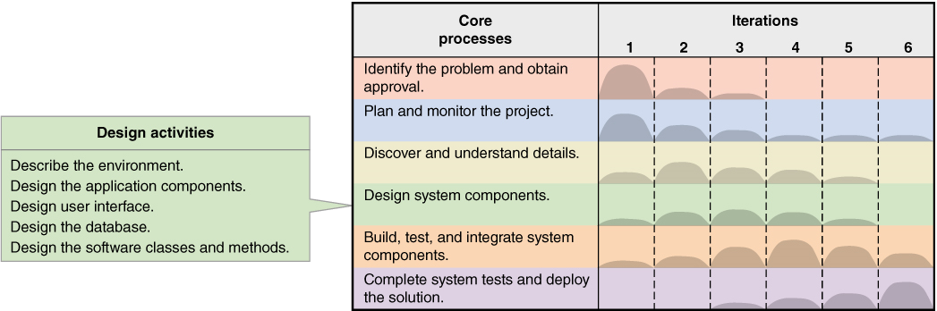
Activities of “Design System Components”

Slide 7
Anatomy of a Modern System – Computing Devices
Server – manages shared resources and enables users and other computers access to these resources
Personal computing devices or clients
  Desktops, laptops, tablets, smartphones…

Slide 8
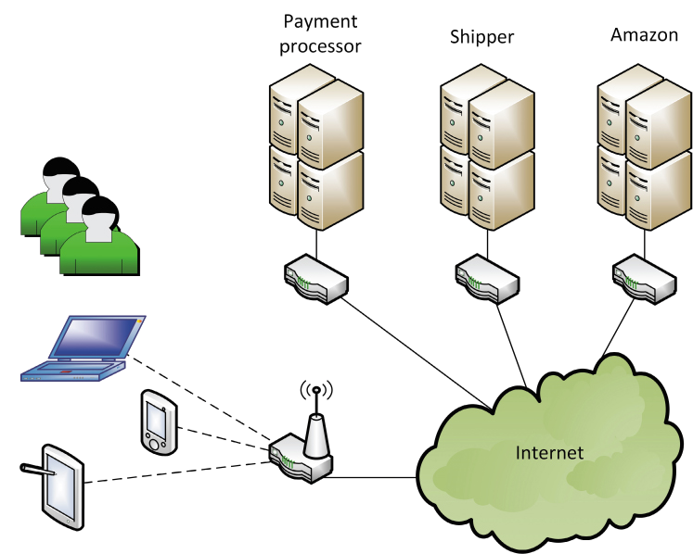
Simplified architecture for application (Amazon.com)

Slide 9

Server Farm –
Very large databases and very high use

Slide 10
Anatomy - Networks (1 of 2)
Computer network – hardware, software, transmission media
Internet backbone –
  High-capacity with high-bandwidth trunk lines and large high-speed computers
  Owned by governments and telecom companies
Local area network (L A N) –
  Small network for a single site
World Wide Web (W W W)
  All the interconnected resources accessed through the Internet

Slide 11
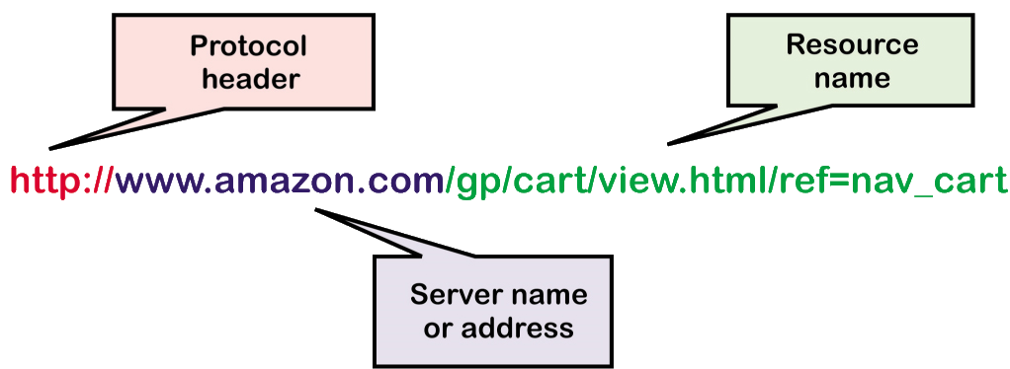
Anatomy - Networks (2 of 2)
Uniform Resource Locator (U R L)
  The identifier for the Web to locate a particular resource
Hyperlink –
  The U R L of a resource embedded within another resource

Slide 12
Anatomy – Software (1 of 3)
Application software – programs that perform work for users
  Either a custom app or a Web-based application
App –
  A custom program usually for a laptop or smartphone
System Software –
  Behind the scene software, works as glue to hold everything together

Slide 13
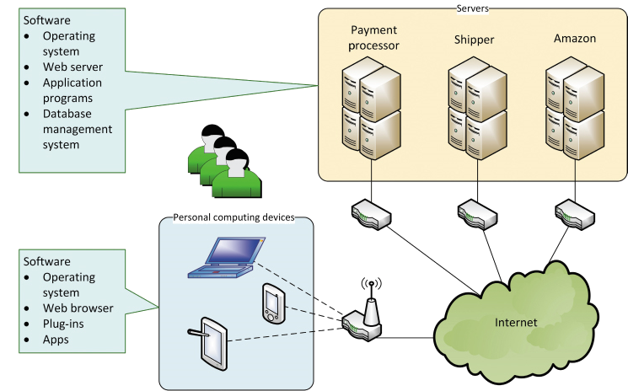
Anatomy – Software (2 of 3)

Slide 14
Anatomy – Software (3 of 3)
Web-Based Applications
  Uses a web browser
  Accessed through a U R L
  Resides on a Web server
  Uses standard I P protocols
Embedded Software
  Software apps or functions embedded within another app, such as within a browser or O/S
  Toolbars, Plug-ins, Widgets

Slide 15
Anatomy – Protocols
Protocol
  A set of languages and rules to ensure communication and data exchange between hardware and software
Network protocols
  Virtual Private Network (V P N)
    Creates a private network but on the Internet by using secure technologies and encryption

Slide 16
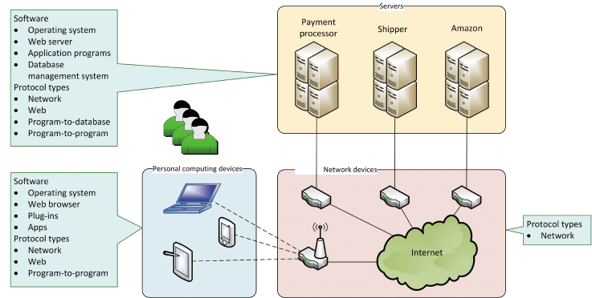
Anatomy – Software and Protocols

Slide 17
Anatomy – Web Protocols
H T M L (hypertext markup language)
  Protocol for the structure and content of a Web page
X M L (extensible markup language)
  An extensions of H T M L that enables defining semantics of tags
H T T P (hypertext transfer protocol)
  Defines format and content for transfer of Web documents
H T T P S (hypertext transfer protocol secure)
  Encrypted and secure http transfers

Slide 18
Architectural Concepts
Technology architecture
  Computers, network computers and hardware, and system software
Application architecture
  The software programs and their configuration

Slide 19
Software as a Service (SaaS)
SaaS
  No software is installed on the user’s device
  Application services is accessed remotely
  User data is isolated and stored on common servers

Slide 20
Web Services
Web service
  Software function that is executed with Web standards
    Access via a U R L
    Inputs sent via the U R L
    Executes remotely
    Data returned within a Web page

Slide 21
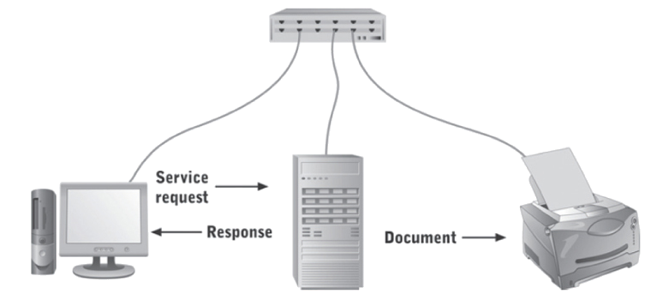
Distributed Architectures
Client/Server architecture
  Software design with part of the application on a server and part on the client

Slide 22
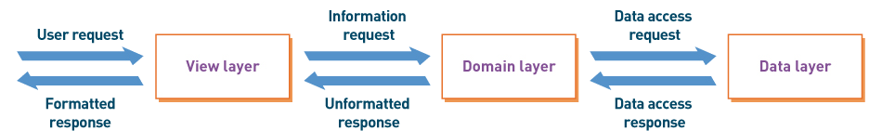
Distributed Architecture
Three-Layer architecture
  Client/server architecture with application divided into view layer, logic layer, and data layer
  View layer – the user interface
  logic layer – program logic to implement the functions
  data layer – the functions to access the data

Slide 23
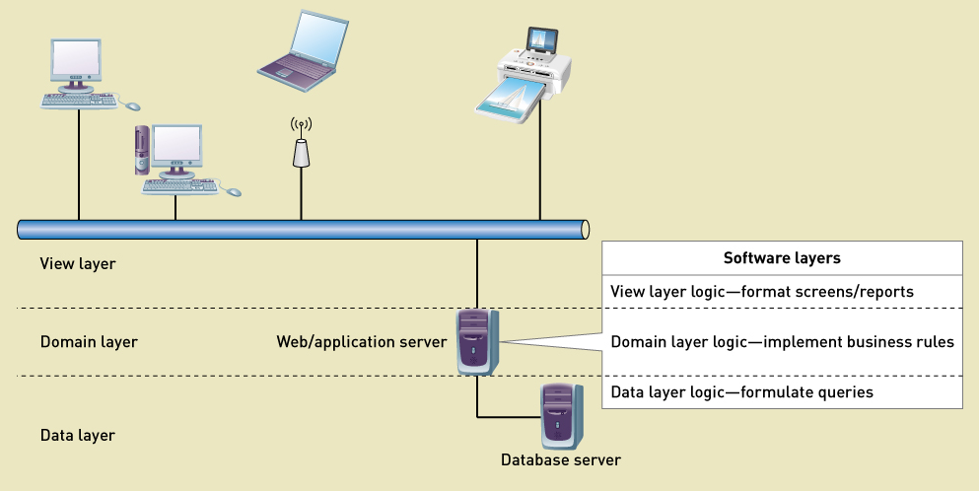
Three Layer Architecture

Slide 24
Interoperability
Interoperability
  The ability of an application to interact with other software
Important characteristic in current development projects
  Understand the environment
  Reuse software existing components (purchased or in-house)
  Build components considering interoperability
  Combine all components into a solution system

Slide 25
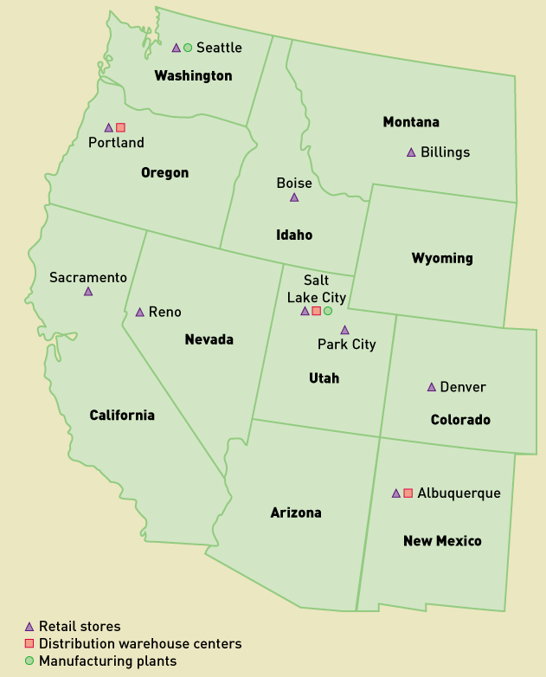
Diagrams for System Architectures
Location Diagrams
  Identify geographical placement of hardware, software, and users

Slide 26
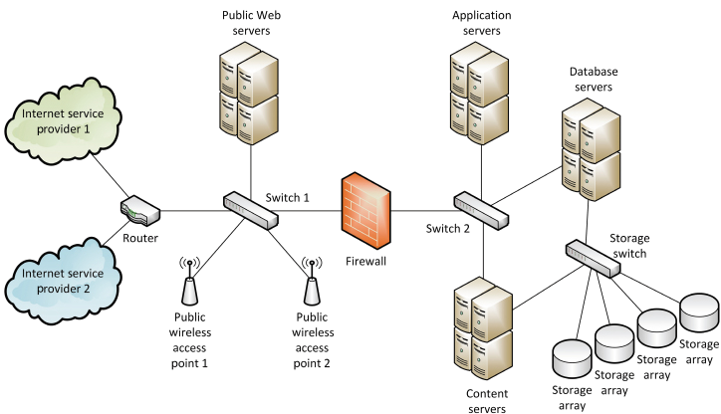
Diagrams for System Architecture (1 of 2)
Network Diagrams
  How the application software is deployed across the hardware and system software

Slide 27
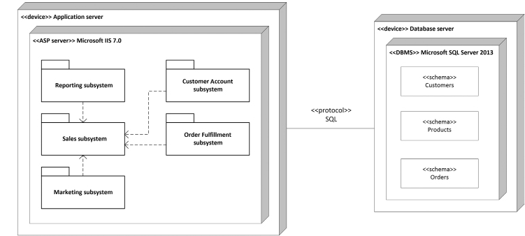
Diagrams for System Architecture (2 of 2)
Deployment Diagrams
  How the components of a network are interconnected

Slide 28
Describing the Environment (1 of 2)
Key Questions to help describe accurately
  What are the key features of existing or new environment
    O/S, system software, networks, tools
  What are the external systems or D B M S s
    What kind of interaction
    What is the data
    What are the protocols
    What kind of security

Slide 29
Describing the Environment (2 of 2)
Key Questions to help describe accurately
  What devices will be required
    Protocols for devices
    Security
    What A P I s
  What user-interface technology will be used
    Where and who are users, and what skills
    What hardware and devices
    What client O/S will be used
    Security requirements
    What A P I s are needed

Slide 30
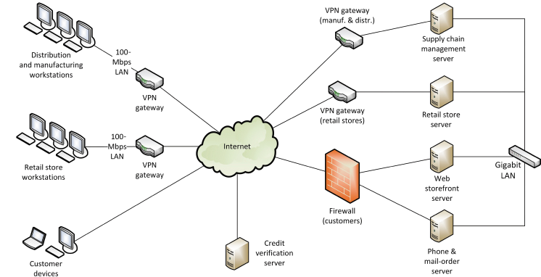
R M O Environment - Existing
Current environment prior to new development

Slide 31
R M O Environment – Proposed (1 of 2)
More mobile devices and apps
Web application software and content
Social networking applications
Security issues
External hosting of portions

Slide 32
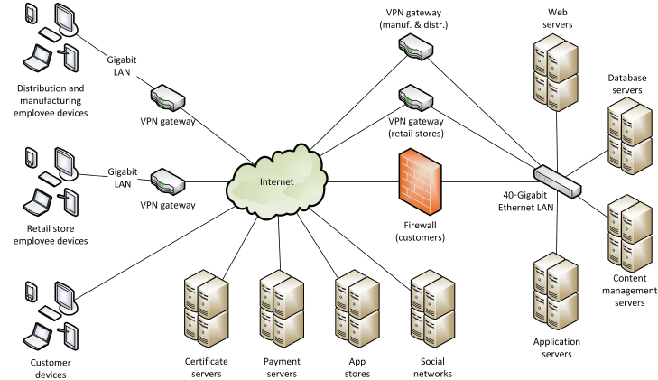
R M O Environment – Proposed (2 of 2)

Slide 33
Designing Application Components
Application Component Boundaries
  Which components perform which functions
  How to group functions to build components
    Actors – what functions to particular actors use
    Shared data – what functions use the same data
    Events – what functions occur in common business events

Slide 34
R M O C S M S Application Architecture (1 of 3)
Grouping by customer actor – part 1
Use case | User/actor | Domain class(es) | Event(s) | Group
Create phone sale | Phone sales representative | ProductItem, InventoryItem, saleItem, Sale, SaleTrans | Customer request while shopping by phone | A
Create store sale | Store sales representative | ProductItem, InventoryItem, saleItem, Sale, SaleTrans | Customer request while shopping in store | B
Create/update customer account | Customer, phone or store sales representative | Customer, Account, Address | Customer request or sale to a new customer | C
Look up order status | Shipping, customer, management, phone or store sales representative | ProductItem, InventoryItem, SaleItem, Sale, SaleTrans, Shipment, ReturnItem | Customer, representative, shipping, or management request | C
Track shipment | Shipping, customer, management, phone or store sales representative | Shipment, Shipper, SaleItem | Customer, representative, shipping, or management request | C
Create item return | Customer, phone or store sales representative | SaleItem, ReturnItem | Customer requests return | C
Search for item | Customer, phone or store sales representative | ProductItem | Customer request while shopping online, by phone, or in store | C
View product comments and ratings | Customer, phone or store sales representative | ProductItem, ProductComment | Customer request while shopping online, by phone, or in store | C
View accessory combinations | Customer, phone or store sales representative | ProductItem, AccessoryPackage | Customer request while shopping online, by phone, or in store | C

Slide 35
R M O C S M S Application Architecture (2 of 3)
Grouping by customer actor – part 2
Use case | User/actor | Domain class(es) | Event(s) | Group
Fill shopping cart | Customer | ProductItem, InventoryItem, CartItem, OnlineCart | Customer request usually after sale completed | D
Empty shopping cart | Customer | ProductItem, InventoryItem, CartItem, OnlineCart | Customer request while shopping online | D
Check out shopping cart | Customer | ProductItem, InventoryItem, CartItem, OnlineCart, saleItem, Sale, SaleTrans | Customer request while shopping online | D
Fill reserve cart | Customer | ProductItem, InventoryItem, CartItem, OnlineCart | Customer request while shopping online | D
Empty reserve cart | Customer | ProductItem, InventoryItem, CartItem, OnlineCart | Customer request while shopping online | D
Convert reserve cart | Customer | ProductItem, InventoryItem, CartItem, OnlineCart | Customer request while shopping online | D

Slide 36
R M O C S M S Application Architecture (3 of 3)
Grouping by customer actor – part 2
Use case | User/actor | Domain class(es) | Event(s) | Group
Rate and comment on product | Customer | Customer, ProductComment, ProductItem | Customer request usually after sale completed | E
Provide suggestion | Customer | Customer, Suggestion | Customer request while shopping online | E
Send message | Customer | Customer, Message | Customer request while shopping online | E
Browse messages | Customer | Customer, Message | Customer request while shopping online | E
Request friend linkup | Customer | Customer, FriendLink | Customer request while shopping online | E
Reply to linkup request | Customer | Customer, FriendLink | Customer request while shopping online | E
Send/receive partner credits | Customer | Customer, CustPartnerCredit, PromoPartner | Customer request while shopping online | E
View ”mountain bucks” | Customer | Customer, Sale | Customer request while shopping online | E
Transfer ”mountain bucks” | Customer | Customer, Sale | Customer request while shopping online | E

Slide 37
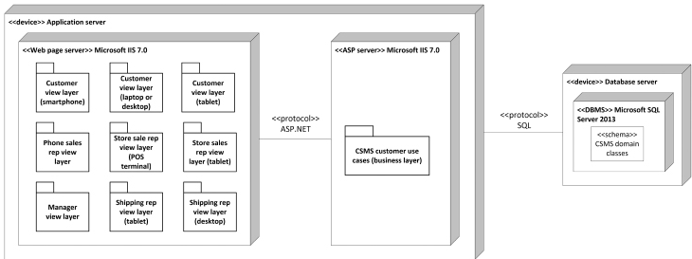
R M O C S M S Deployment Diagram
Three-layer design with user components grouped by user functions

Slide 38
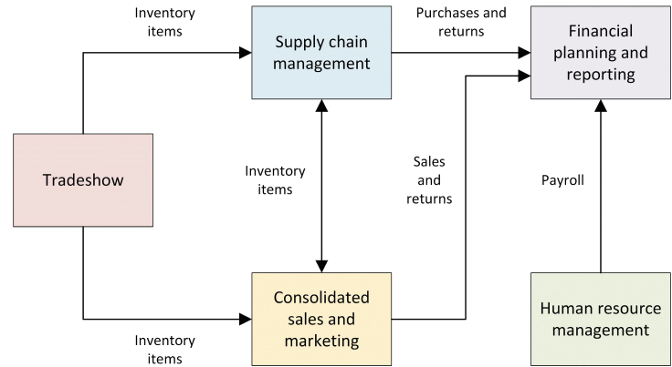
R M O C S M S Component Integration
Subsystem integration and data flows

Slide 39
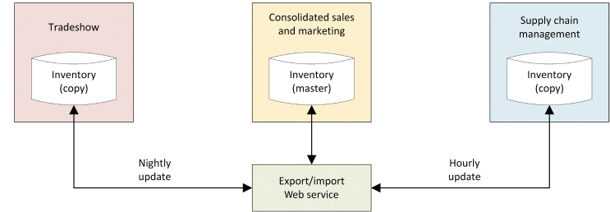
R M O C S M S Data Ownership
Who “owns” the data
  System of record
    What system is responsible to maintain the data
    What system has a copy or can access the data

Slide 40
Summary (1 of 3)
Anatomy of a Modern Information System
  Consist of computing devices, networks, software, and protocols
  Deployed as stand-alone software, network based, Web based
Architectural Concepts
  SaaS – software as a service
  Web services
  Distributed architectures
    Client/server and three-layer architecture

Slide 41
Summary (2 of 3)
Interoperability
  Getting all the components to work together
Architectural diagrams
  Location diagrams
  Network diagrams
  Deployment diagrams

Slide 42
Summary (3 of 3)
Describing the Environment
  External systems
  Technology architecture
  Key questions requiring answers
Designing Application Components
  Application component boundaries
  Grouping functions into components
  System of record – who owns the data

