Slide 1
Chapter 9
Systems Analysis and Design in a Changing World, 7th Edition - Chapter 9 ©2016. Cengage Learning. All rights reserved.

Slide 2
Designing the Database
Chapter 9
Systems Analysis and Design in a Changing World 7th Ed Satzinger, Jackson & Burd

Slide 3
Chapter 9: Outline
Databases and Database Management Systems
Database Design and Administration
Relational Databases
Distributed Database Architectures
Protecting the Database

Slide 4
Learning Objectives
Explain the responsibilities of the data administrator and database administrator
Design a relational database schema based on a class diagram
Evaluate and improve the quality of a database schema
Describe the different methods for configuring distributed databases
Explain the importance of and methods for protecting the database

Slide 5
Overview
Databases and database management systems are important components of a modern information system
Database design transforms the domain model class diagram into a detailed database model for the system
A database management system is used to implement and interact with the database

Slide 6
Databases and D B M S s
Database (D B) -- an integrated collection of stored data that is centrally managed and controlled
Database management system (D B M S) -- a system software component that manages and controls one or more databases
Schema -- database component that contains descriptive information about the data stored in the physical data store (sometimes called metadata)
Structured Query Language -- the standard query language to access and update data in a relational D B M S

Slide 7
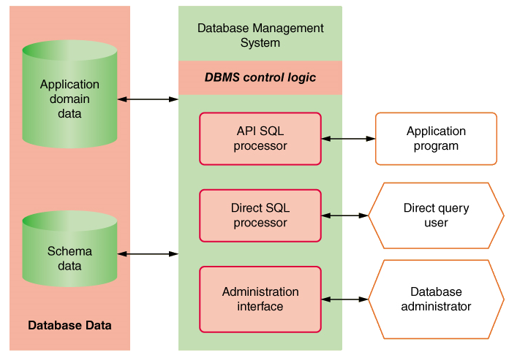
D B M S Components

Slide 8
Database Schema
Organization of individual stored data items into higher level groups, such as tables
Associations among tables or classes
Details of physical data store organization, including types, lengths, locations, and indexing of data items
Access and content controls, including allowable values for specific data items, value dependencies among multiple data items, and lists of users allowed to read or update data items

Slide 9
Characteristics of a D B M S
Simultaneous access by many users and many applications
Direct access to data with a data interface
Uniform and consistent access
Integration and distribution of data across multiple servers

Slide 10
Database Design and Administration (1 of 4)
How does database design integrate within the existing technology architecture?
Technology Architecture – hardware and networks
  Single desktop – single copy of database
  Shared database – residing on local L A N
  Large database – multiple servers within a single data farm
  Very large database – multiple servers across multiple data farms (global)

Slide 11
Database Design and Administration (2 of 4)
How does database design integrate within the project plan?
Water-fall development – design and implement database first
Iterative development – database is foundational, early iterations need to focus on data and key portions of the database
Iterative development – important to consider database impacts of all subsystems

Slide 12
Database Design and Administration (3 of 4)
Who is involved in database design?
Data Administrator (D A) – person in charge of structure and integrity of the data
  Data standards – naming, definition, data typing
  Data use – ownership, accessibility, confidentiality
  Data quality – validation rules, completeness, currency

Slide 13
Database Design and Administration (4 of 4)
Who is involved in database design?
Database Administrator (D B A) – person in charge of safety and the operation of the database
  Manage multiple D B M S environment
  Protect the database and data – authentication
  Maintain high-performance level
  Backup data and define recovery procedures

Slide 14
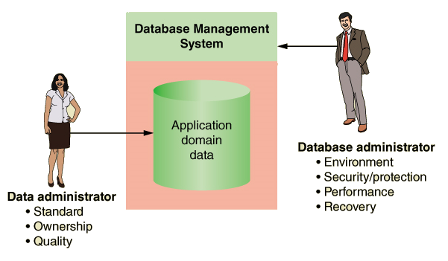
D A and D B A Responsibilities

Slide 15
Relational Databases (1 of 2)
Relational database management system (R D B M S) -- a D B M S that organizes data in tables (relations)
Table -- a two-dimensional data structure of columns and rows
Row -- one horizontal group of data attribute values
Attribute -- one vertical group of data attribute values
Attribute value -- the value held in a single table cell

Slide 16
Relational Databases (2 of 2)
Key – an attribute or set of attributes, the values of which occur only once in all the rows of the table
Candidate Key – an attribute or set of attributes that could server as the primary key
Primary key – the key chosen by a database designer to represent relationships among rows in different tables
Foreign key – an attribute that duplicates the primary key of a different (or foreign) table

Slide 17
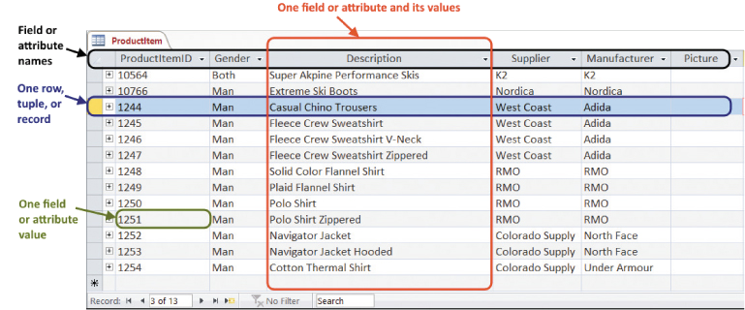
Partial Display of a Relational Database Table

Slide 18
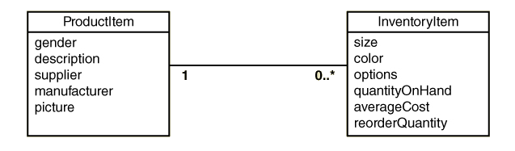
An Association Between Two Classes

Slide 19
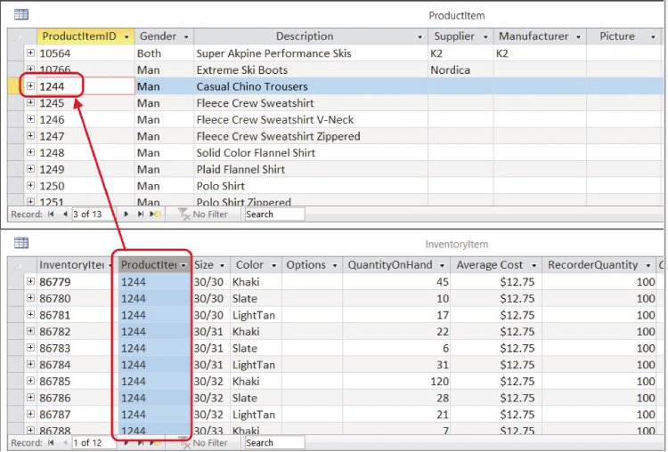
An Association Between Rows in Two Tables (key and foreign key)

Slide 20
Designing Relational Databases: Based on the Domain Model Class Diagram
  Create a table for each class
  Choose a primary key for each table (invent one, if necessary)
  Add foreign keys to represent one-to-many associations
  Create new tables to represent many-to-many associations
  Represent classification hierarchies
  Define referential integrity constraints
  Evaluate schema quality and make necessary improvements
  Choose appropriate data types
  Incorporate integrity and security controls

Slide 21
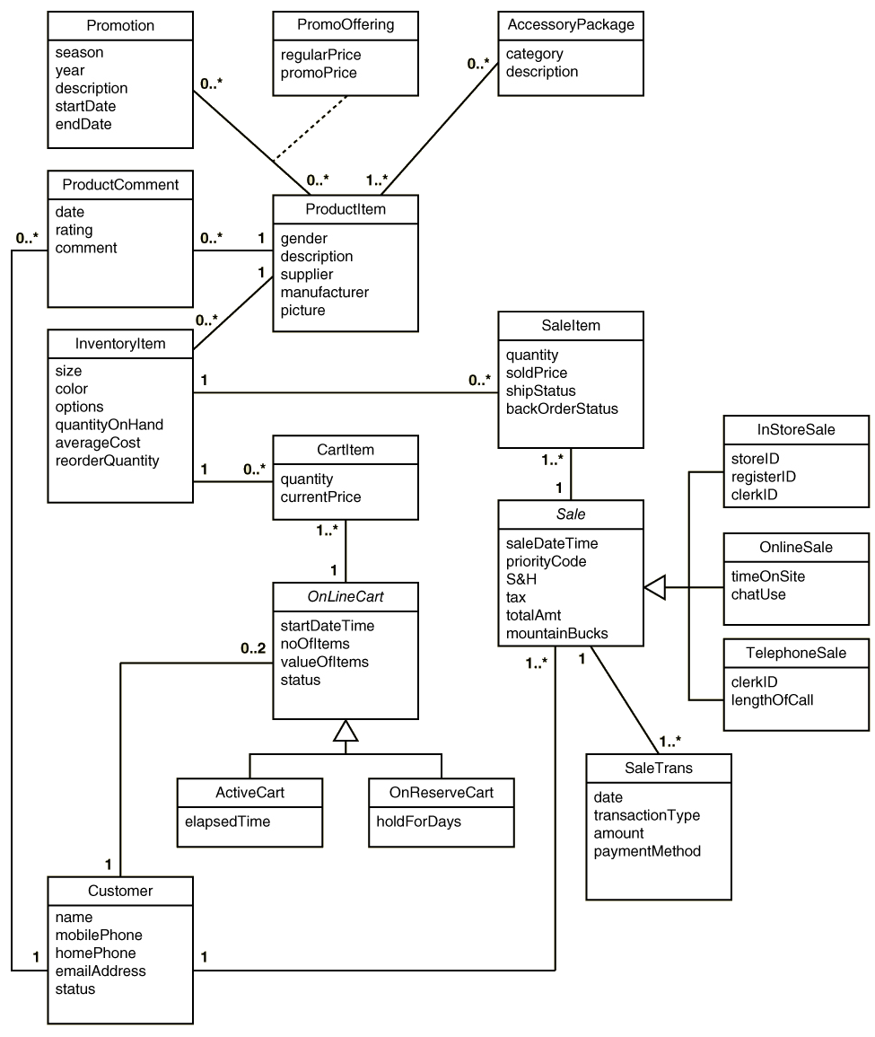
R M O Classes

Slide 22
Initial Set of Tables: Based on R M O Domain Classes
Table | Attributes
AccessoryPackage | Category, Description
CartItem | Quantity, CurrentPrice
Customer | Name, MobilePhone, HomePhone, EmailAddress, Status
InventoryItem | Size, Color, Options, QuantityOnHand, AverageCost, ReorderQuantity
OnlineCart | StartDateTime, NumberOfItems, ValueOfItems, Status, ElapsedTime, HoldForDays
ProductComment | Date, Rating, Comment
ProductItem | Gender, Description, Supplier, Manufacturer, Picture
PromoOffering | RegularPrice, PromoPrice
Promotion | Season, Year, Description, StartDate, EndDate
Sale | SaleDateTime, PriorityCode, ShippingAndHandling, Tax, TotalAmount, MountainBucks, StoreID, RegisterID, ClerkID, TimeOnSite, ChatUse, LengthOfCall
SaleItem | Quantity, SoldPrice, ShipStatus, BackOrderStatus
SaleTransaction | Date, TransactionType, Amount, PaymentMethod

Slide 23
Initial Set of Tables: With Primary Keys Added (bold)
Table | Attributes
AccessoryPackage | AccessoryPackageID, Category, Description
CartItem | CartItemID, Quantity, CurrentPrice
Customer | AccountNumber, Name, MobilePhone, HomePhone, EmailAddress, Status
InventoryItem | InventoryItemID, Size, Color, Options, QuantityOnHand, AverageCost, ReorderQuantity
OnlineCart | OnlineCartID, StartDateTime, NumberOfItems, ValueOfItems, Status, ElapsedTime, HoldForDays
ProductComment | ProductCommentID, Date, Rating, Comment
ProductItem | ProductItemID, Gender, Description, Supplier, Manufacturer, Picture
PromoOffering | PromoOfferingID, RegularPrice, PromoPrice
Promotion | PromotionID, Season, Year, Description, StartDate, EndDate
Sale | SaleID, SaleDateTime, PriorityCode, ShippingAndHandling, Tax, TotalAmount, MountainBucks, StoreID, RegisterID, ClerkID, TimeOnSite, ChatUse, LengthOfCall
SaleItem | SaleItemID, Quantity, SoldPrice, ShipStatus, BackOrderStatus
SaleTransaction | SaleTransactionID, Date, TransactionType, Amount, PaymentMethod

Slide 24
Representing Associations
One-to-Many – Add primary key attribute of the “one” class to the “many” class as a foreign key
Many-to-Many –
  With an Association Class – Add primary keys of endpoint classes as foreign keys and as candidate keys. May also become primary key
  Without an Association Class – Create new table. Add primary keys of endpoint classes as foreign keys and as candidate keys.

Slide 25
Initial Set of Tables: With Foreign Keys Added (in italics)
Table | Attributes
Accessory Package | AccessoryPackageID, Category, Description
Cartitem | CartItemID, InventoryItemID, OnlineCartID, Quantity, CurrentPrice
Customer | AccountNumber, Name, MobilePhone, HomePhone, EmailAddress, Status
InventoryItem | InventoryItemID, ProductItemID, Size, Color, Options, QuantityOnHand, AverageCost, ReorderQuantity
OnlineCart | OnlineCartID, CustomerAccountNumber, StartDateTime, NumberOfItems, ValueOfItems, Status, ElapsedTime, HoldForDays
ProductComment | ProductCommentID, ProductItemID, CustomerAccountNumber, Date, Rating, Comment
ProductItem | ProductItemID, Gender, Description, Supplier, Manufacturer, Picture
PromoOffering | PromoOfferingID, RegularPrice, PromoPrice
Promotion | PromotionID, Season, Year, Description, StartDate, EndDate
Sale | SaleID, CustomerAccountNumber, SaleDateTime, PriorityCode, ShippingAndHandling, Tax, TotalAmount, MountainBucks, StoreID, RegisterID, ClerkID, TimeOnSite, ChatUse, LengthOfCall
SaleItem | SaleItemID, InventoryItemID, SaleID, Quantity, SoldPrice, ShipStatus, BackOrderStatus
SaleTransaction | SaleTransactionID, SaleID, Date, TransactionType, Amount, PaymentMethod

Slide 26
Association Class: PromoOffering added from association class to table with two keys
Table | Attributes
AccessoryPackage | AccessoryPackageID, AccessoryCategory, Description
AccessoryPackageContents | AccessoryPackageID, ProductItemID
CartItem | InventoryItemID, OnlineCartID, Quantity, CurrentPrice
Customer | AccountNumber, Name, MobilePhone, HomePhone, EmailAddress, Status
InventoryItem | InventoryItemID, ProductItemID, Size, Color, Options, QuantityOnHand, AverageCost, ReorderQuantity
OnlineCart | OnlineCartID, CustomerAccountID, StartDateTime, NumberOfItems, ValueOfItems, Status, ElapsedTime, HoldForDays
ProductComment | ProductCommentID, ProductItemID, CustomerAccountNumber, Date, Rating, Comment
ProductItem | ProductItemID, Gender, Description, Supplier, Manufacturer, Picture
PromoOffering | PromotionID, ProductItemID, RegularPrice, PromoPrice
Promotion | PromotionID, Season, Year, Description, StartDate, EndDate
Sale | SaleID, CustomerAccountNumber, SaleDateTime, PriorityCode, ShippingAndHandling, Tax, TotalAmount, MountainBucks, StoreID, RegisterID, ClerkID, TimeOnSite, ChatUse, LengthOfCall
SaleItem | InventoryItemID, SaleID, Quantity, SoldPrice, ShipStatus, BackOrderStatus
SaleTransaction | SaleTransactionID, SaleID, Date, TransactionType, Amount, PaymentMethod

Slide 27
Final Tables: Specialized subclasses included within OnlineCart and Sale tables
Table | Attributes
AccessoryPackage | AccessoryPackageID, AccessoryCategory, Description
AccessoryPackageContents | AccessoryPackageID, ProductItemID
CartItem | InventoryItemID, OnlineCartID, Quantity, CurrentPrice
Customer | AccountNumber, Name, MobilePhone, HomePhone, EmailAddress, Status
InventoryItem | InventoryItemID, ProductItemID, Size, Color, Options, QuantityOnHand, AverageCost, ReorderQuantity
OnlineCart | OnlineCartID, CustomerAccountID, StartDateTime, NumberOfItems, ValueOfItems, Status, ElapsedTime, HoldForDays
ProductComment | ProductCommentID, ProductItemID, CustomerAccountNumber, Date, Rating, Comment
ProductItem | ProductItemID, Gender, Description, Supplier, Manufacturer, Picture
PromoOffering | PromotionID, ProductItemID, RegularPrice, PromoPrice
Promotion | PromotionID, Season, Year, Description, StartDate, EndDate
Sale | SaleID, CustomerAccountNumber, SaleDateTime, PriorityCode, ShippingAndHandling, Tax, TotalAmount, MountainBucks, StoreID, RegisterID, ClerkID, TimeOnSite, ChatUse, LengthOfCall
SaleItem | InventoryItemID, SaleID, Quantity, SoldPrice, ShipStatus, BackOrderStatus
SaleTransaction | SaleTransactionID, SaleID, Date, TransactionType, Amount, PaymentMethod

Slide 28
Final Tables: Specialized subclasses as separate tables (1 of 2)
Table | Attributes
AccessoryPackage | AccessoryPackageID, AccessoryCategory, Description
AccessoryPackageContents | AccessoryPackageID, ProductItemID
CartItem | InventoryItemID, OnlineCartID, Quantity, CurrentPrice
Customer | AccountNumber, Name, MobilePhone, HomePhone, EmailAddress, Status
InventoryItem | InventoryItemID, ProductItemID, Size, Color, Options, QuantityOnHand, AverageCost, ReorderQuantity
OnlineCart | OnlineCartID, CustomerAccountID, StartDateTime, NumberOfItems, ValueOfItems, Status, ElapsedTime, HoldForDays
ActiveCart | OnlineCartID, ElapsedTime
OnReserveCart | OnlineCartID, HoldForDays
ProductComment | ProductCommentID, ProductItemID, CustomerAccountNumber, Date, Rating, Comment

Slide 29
Final Tables: Specialized subclasses as separate tables (2 of 2)
Table | Attributes
ProductItem | ProductItemID, Gender, Description, Supplier, Manufacturer, Picture
PromoOffering | PromotionID, ProductItemID, RegularPrice, PromoPrice
Promotion | PromotionID, Season, Year, Description, StartDate, EndDate
Sale | SaleID, CustomerAccountNumber, SaleDateTime, PriorityCode, ShippingAndHandling, Tax, TotalAmount, MountainBucks
InStoreSale | SaleID, StoreID, RegisterID, ClerkID
OnlineSale | SaleID, TimeOnSite, ChatUse
TelephoneSale | SaleID, ClerkID, LengthOfCall
SaleItem | InventoryItemID, SaleID, Quantity, SoldPrice, ShipStatus, BackOrderStatus
SaleTransaction | SaleTransactionID, SaleID, Date, TransactionType, Amount, PaymentMethod

Slide 30
Designing Relational Databases: Referential Integrity and Schema Quality
Referential integrity -- a consistent state among foreign key and primary key values
Referential integrity constraint -- a constraint, stored in the schema, that the D B M S uses to automatically enforce referential integrity

Slide 31
Designing Relational Databases: Referential Integrity and Normalization
A normalized relational database schema has these features:
  Flexibility or ease of implementing future data model changes
  Lack of redundant data
  Protects against insertion, deletion and update anomolies
Normalization -- a formal technique for evaluating and improving the quality of a relational database schema
  First Normal Form –
  Second Normal Form –
  Third Normal Form –

Slide 32
First Normal Form
A table is in first normal form if every field contains only one value.
  Not multiple values in an attribute
S S N | Name | Department | Salary | Dependants
11-22-3333 | Mary Smith | Accounting | 40,000 | John, Alice, Dave
222-33-4444 | Jose Pena | Marketing | 50,000 | ---
333-44-5555 | Frank Collins | Production | 35,000 | Jan, Julia
  Not varying number of columns
S S N | Name | Department | Salary | Dependent | Dependent | Dependent
11-22-3333 | Mary Smith | Accounting | 40,000 | John | Alice | Dave
222-33-4444 | Jose Pena | Marketing | 50,000 | Blank | Blank | Blank
333-44-5555 | Frank Collins | Production | 35,000 | Jan | Julia | Blank

Slide 33
First Normal Form - Solution
Solution is to put multivalued attribute in a separate table.
S S N | Name | Department | Salary
111-22-3333 | Mary Smith | Accounting | 40,000
222-33-4444 | Jose Pena | Marketing | 50,000
333-44-5555 | Frank Collins | Production | 35,000
RecordID | SSN | Dependant
1 | 111-22-3333 | John
2 | 111-22-3333 | Alice
3 | 111-22-3333 | Dave
4 | 333-44-5555 | Jan
5 | 333-44-5555 | Julia

Slide 34
Functional Dependency (1 of 2)
A relationship between attributes such that the values in the first attribute (or set) always determine the values in the second attribute (or set)
Attribute B is functionally dependent on attribute A if for each value of attribute A there is only one corresponding value of attribute B.
  Written as F D: A → B.
  Also stated as A functionally determines B

Slide 35
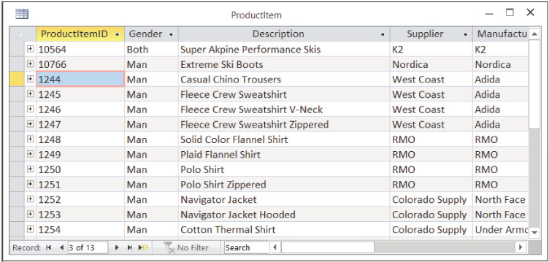
Functional Dependency (2 of 2)
ProductID → Supplier
But NOT Supplier → ProductI D

Slide 36
Second Normal Form (1 of 2)
A table is in Second Normal Form if it is First Normal Form and each non-key attribute is only functionally dependent on the entire primary key.
  This situation only arises with tables that have multiple attribute keys

Slide 37
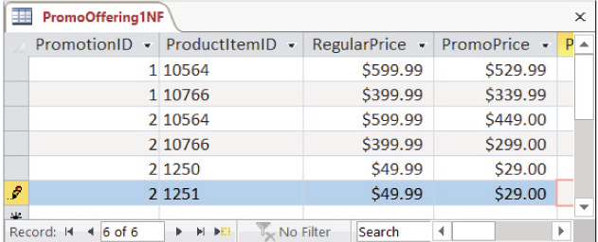
Second Normal Form (2 of 2)
PromoOffering table is NOT in 2NF
  PromotionID, ProductItemID → PromoPrice
  ProductItemID → RegularPrice -- Violation of 2NF
  Solution is to remove RegularPrice from this table

Slide 38
Third Normal Form (1 of 2)
A table is in Third Normal Form if it is in 2NF and NO non-key attribute (or set) is functionally dependent on any other non-key attribute (or set)
  In other words, no FDs among any non-key attributes

Slide 39
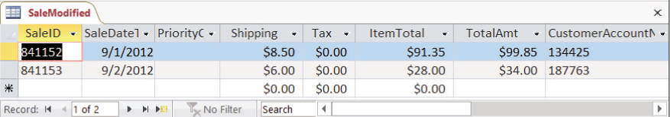
Third Normal Form (2 of 2)
This version of Sale table violates 3NF
  Shipping + Tax +Item Total = TotalAmt
  i.e., F D: Shipping, Tax, ItemTotal → TotalAmt
  Solution is to remove TotalAmt. It is not needed

Slide 40
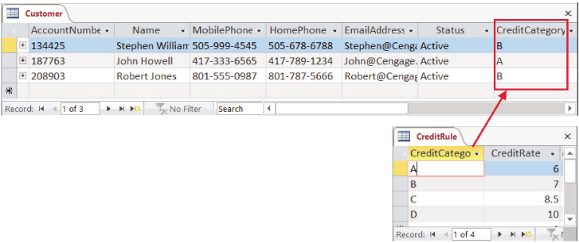
Third Normal Form - Solution
Another solution is to either move offending attribute to a new table.
  Violation = Customer table had CreditCategory and CreditRate
  Solution = Make new table of CreditRule with CreditRate

Slide 41
Data Types
The data type defines the storage format and allowable content of an attribute (field)
Primitive data types – data types supported directly by the D B M S
Complex data types – combinations or compositions of primitive data types. User defined

Slide 42
Standard Primitive Data Types
Type(s) | Description
datetimeoffset | Date, time, and time zone
int, small int, and bigint | Whole numeric values
float and real | Numeric values with fractional quantities
money | Currency values and related symbols (e.g., $ and €)
nchar and nvarchar | Fixed- and variable-length Unicode string
varbinary | Variable-length byte sequence up to 2GB
xml | XML document up to 2GB

Slide 43
Distributed Database Architectures
Decentralized database is stored at many locations but not requiring interconnectivity or synchronization
Homogeneous distributed database is stored at multiple locations, with all locations using the same D B M S. Coordinated with a global schema
Heterogeneous distribute database is stored at multiple locations and with different D B M S and may have local schemas.

Slide 44
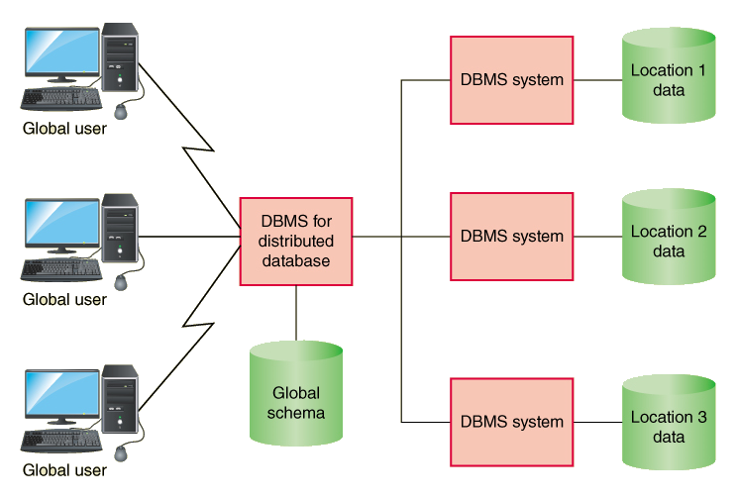
Homogeneous Distributed Database
Access is through a common D B M S and schema

Slide 45
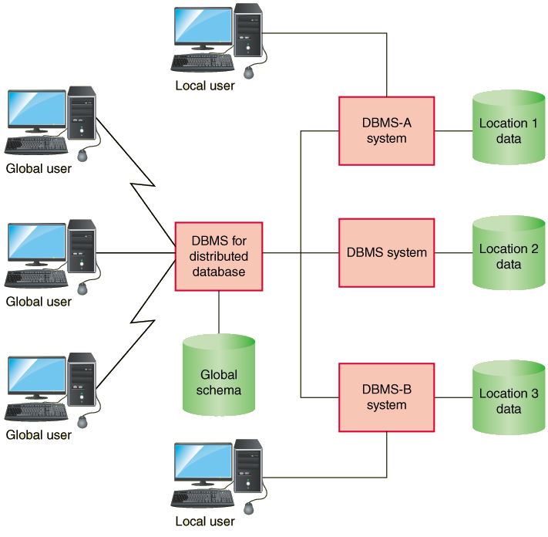
Heterogeneous Distributed Database
Access is through distinct D B M S s. May have global and local schemas in operation

Slide 46
Implementation Approaches (1 of 3)
Data replication – each location has its own copy
  Synchronization – updating every copy with changes made to every other copy

Slide 47
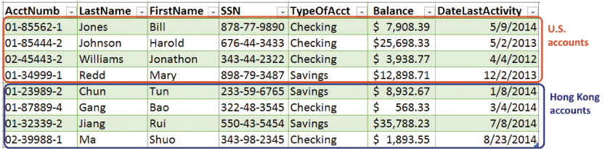
Implementation Approaches (2 of 3)
Horizontal Partition – different rows are stored at different locations.

Slide 48
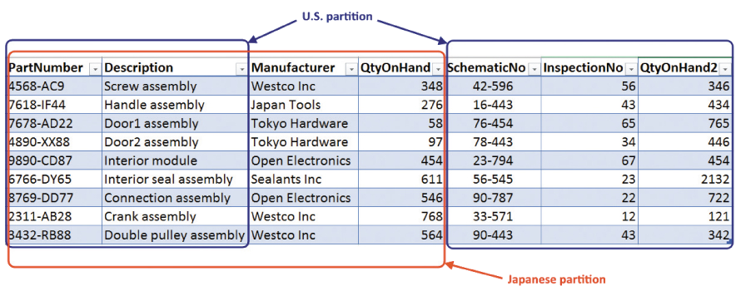
Implementation Approaches (3 of 3)
Vertical Partition – Different columns are stored at different locations.
Combinations of replication, horizontal, and vertical

Slide 49
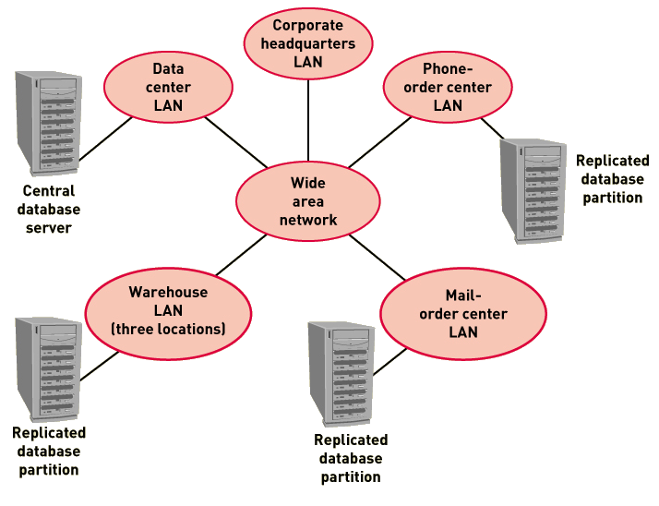
Architecture for R M O: Replicated and Partitioned Database

Slide 50
Protecting the Database (1 of 2)
Transaction Logging – a technique to record all updates including change, date, time, user
  Helps to prevent fraud
  Recovery mechanism for failures

Slide 51
Protecting the Database (2 of 2)
Concurrency and Update Controls
  Transaction – a piece of work with several steps, either all must complete or none must be accepted
  Database lock – technique to apply exclusive control to a portion of the database to one user at a time
  Shared or read lock – a lock where multiple transactions (users) may read the data
  Exclusive or write lock – a lock where only one transaction (user) may access the locked portion of the database

Slide 52
Summary
Most modern information systems store data and access data using a database management systems (D B M S)
The most common database model is a relational database (R D B M S), which is a collection of data stored in tables
The relational database schema is developed based on the domain model class diagram Each class is represented as a table. One to many associations are represented by adding foreign keys
Normalization is the process to produce high-quality databases without update, insertion or delete anomalies
Distributed databases are necessary for very large databases
Database locks permit concurrent use of databases

