Slide 1
Chapter 10
Systems Analysis and Design in a Changing World, 7th Edition - Chapter 10 ©2016. Cengage Learning. All rights reserved.

Slide 2
Approaches to System Development
Chapter 10
Systems Analysis and Design in a Changing World 6th Ed
Satzinger, Jackson & Burd

Slide 3
Chapter 10: Outline
The System Development Life Cycle
Methodologies, Models, Tools, and Techniques
Agile Development
The Unified Process, Extreme Programming, and Scrum

Slide 4
Learning Objectives
Compare the underlying assumptions and uses of a predictive and an adaptive system development life cycle (S D L C)
Explain what makes up a system development methodology—the S D L C as well as models, tools, and techniques
Describe the key features of Agile development
Understand and describe the key features of the Unified Process, Extreme Programming, and Scrum Agile system development methodologies

Slide 5
Overview
Chapter 1 demonstrated a system development project that used an iterative and agile system development life cycle (S D L C)
Later chapters focused on Systems Analysis activities and tasks and some System Design activities and tasks
Now we return to look at the S D L C and related concepts in more detail
  Predictive versus Adaptive S D L C variations
  Activities and Tasks of System Support
  Models, Methodologies, Tools and Techniques
  Agile Development
Specific S D L C Approaches
  Unified Process (U P)
  Extreme Programming (X P)
  Scrum

Slide 6
The System Development Life Cycle (S D L C) (1 of 2)
There are two general approaches to the S D L C
Predictive Approach to the S D L C
  Waterfall model
  Assumes the project can be planned in advance and that the information system can be developed according to the plan
  Requirements are well understood and/or low technical risk
Adaptive Approach to the S D L C
  Iterative model (as see in this text)
  Assumes the project must be more flexible and adapt to changing needs as the project progresses
  Requirements and needs are uncertain and/or high technical risk

Slide 7
The System Development Life Cycle (S D L C) (2 of 2)
Most projects fall on a continuum between Predictive and Adaptive

Slide 8
Traditional Predictive S D L C
Earlier approach based on engineering
Typically have sequential Phases
  Phases are related groups of development activities, such as planning, analysis, design, implementation, and deployment
Waterfall model
  S D L C that assumes phases can be completed sequentially with no overlap or iteration
  Once one phase is completed, you fall over the waterfall to the next phase, no going back

Slide 9
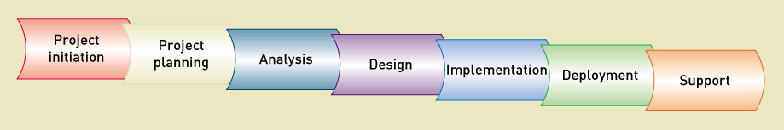
Tradition I S Development Phases

Slide 10
Waterfall Predictive S D L C

Slide 11
Modified Waterfall with Overlapping Phases
More flexibility, but still assumes predictive planning and sequential phases

Slide 12
Newer Adaptive S D L C
Emerged in response to increasingly complex requirements and uncertain technological environments
Always includes iterations where some of design and implementation is done from the beginning
Many developers claim it is the only way to develop information systems
Many I S managers are still sceptical due to apparent lack of overall plan

Slide 13
Adaptive Approaches
Incremental development
  Completes portions of the system in small increments and integrated as the project progresses
  Sometimes considered “growing” a system
Walking Skeleton
  The complete system structure is built first, but with bare-bones functionality

Slide 14
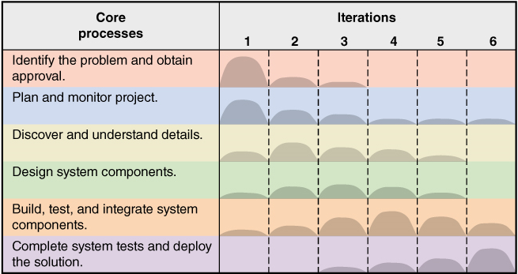
A Generic Adaptive Approach
Six Core Processes go across iterations
Multiple Iterations as required

Slide 15
Methodologies, Models, Tools, and Techniques (1 of 6)
Methodologies
  Provides guidelines for every facet of system development: What to do when, why and how
  Specifies an S D L C with activities and tasks
  Specifies project planning and project management models and reporting
  Specifies analysis and design models to create
  Specifies implementation and testing techniques
  Specifies deployment and support techniques
Other term used is System Development Process

Slide 16
Methodologies
A Methodology includes a collection of techniques that are used to complete activities and tasks, including modeling, for every aspect of the project

Slide 17
Methodologies, Models, Tools, and Techniques (2 of 6)
Model
  An abstraction of an important aspect of the real world.
  Makes it possible to understand a complex concept by focusing only on a relevant part
  Each model shows a different aspect of the concept
  Crucial for communicating project information
In I S, some models are of system components that will be developed
Other models are used to manage the development process

Slide 18
Methodologies, Models, Tools, and Techniques (3 of 6)
Some models of system components
Use case diagram
Domain model class diagram
Design class diagram
Sequence diagram
Package diagram
Screen design template
Dialog design storyboard
Entity-relationship diagram (E R D)
Database schema
Some models used to manage the development process
Gantt chart
Organizational hierarchy chart
Financial analysis models—N P V, payback period
System development life-cycle model
Stakeholders list
Iteration plan

Slide 19
Methodologies, Models, Tools, and Techniques (4 of 6)
Tools
  Software applications that assists developers in creating models or other components required for a project
Integrated Development Environment (I D E)
  set of tools that work together to provide a comprehensive development environment
Visual Modeling Tools
  Tools to create graphical models

Slide 20
Methodologies, Models, Tools, and Techniques (5 of 6)
Some typical tools
Project management application
Drawing/graphics application
Word processor/text editor
Visual modeling tool
Integrated development environment (I D E)
Database management application
Reverse-engineering tool
Code generator tool

Slide 21
Methodologies, Models, Tools, and Techniques (6 of 6)
Technique
  A collection of guidelines that help an analyst complete an activity or task
  Learning techniques is the key to having expertise in a field
Strategic planning techniques
Project management techniques
User-interviewing techniques
Data-modeling techniques
Relational database design techniques
Structured programming techniques
Software-testing techniques
Process modeling techniques
Domain modeling techniques
Use case modeling techniques
Object-oriented programming techniques
Architectural design techniques
User-interface design techniques

Slide 22
Agile Development (1 of 2)
A guiding philosophy and set of guidelines for developing information systems in an unknown, rapidly changing environment
Chaordic
  A term for adaptive projects – chaotic yet ordered

Slide 23
Agile Development (2 of 2)
Agile Values in “Manifesto for Agile Software Development”
  Value responding to change over following a plan
  Value individuals and interactions over processes and tools
  Value working software over comprehensive documentation
  Value customer collaboration over contract negotiation

Slide 24
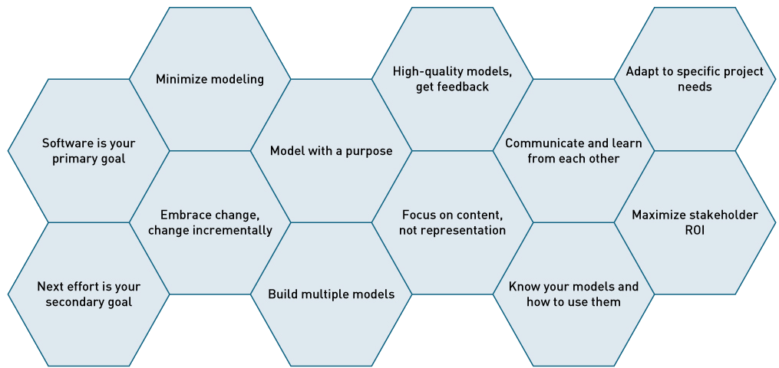
Agile Modeling Principles
Agile Modeling (A M) – 12 Principles
  A philosophy – build only necessary models that are useful and at the right level of detail

Slide 25
Agile Principles (1 of 3)
Develop software as the primary goal
  Don’t get distracted by documentation or models
Enable the next effort as your secondary goal
  Be aware of next step versions or revisions
Minimize your modeling activity
  Only build what helps move the project forward
Embrace change and change incrementally
  Take small steps that keep you on-track and that can be reversed if necessary

Slide 26
Agile Principles (2 of 3)
Model with a purpose
  Model to understand
  Model to communicate
Build multiple models
  Look at problems from different perspectives
Build high-quality models and get feedback
Focus on content rather than representation
  Informal hand-drawn models are sometimes okay
  Always focus on stakeholder needs

Slide 27
Agile Principles (3 of 3)
Learn from each other with open communication
Know your models and how to use them
Adapt to specific project needs
Maximize stakeholder R M I

Slide 28
The Unified Process (U P)
The U P was the early leader in adaptive approaches
U P and U M L (Unified Modeling Language) were developed together

Slide 29
The Unified Process (U P) – Phases
U P Phases organize iterations into four primary areas of focus during a project
  Inception phase – getting the project started
  Elaboration – understanding the system requirements
  Construction – building the system
  Transitions – preparing for and moving to deploying the new system

Slide 30
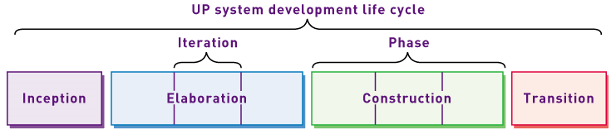
Unified Process (U P) – Phases (1 of 2)
U P S D L C divides iterations into four phases

Slide 31
Unified Process (U P) – Phases (2 of 2)
Objectives of each phase
U P Phase | Objective
Inception | Develop an approximate vision of the system, make the business case, define the scope, and produce rough estimates for cost and schedule.
Elaboration | Define the vision, identify and describe all requirements, finalize the scope, design and implement the core architecture and functions, resolve high risks, and produce realistic estimates for cost and schedule.
Construction | Iteratively implement the remaining lower-risk, predicable, and easier elements and prepare for deployment.
Transition | Complete the beta test and deployment so users have a working system and are ready to benefit as expected.

Slide 32
Unified Process – Disciplines (1 of 4)
A set of functionally related development activities
  Each discipline are all the activities related to achieving one objective in the development project
  Two types of disciplines
    Development disciplines
    Management – planning and control disciplines

Slide 33
Unified Process – Disciplines (2 of 4)
Development Disciplines
  Business modeling
  Requirements
  Design
  Implementation
  Testing
  Deployment

Slide 34
Unified Process – Disciplines (3 of 4)
Planning and Control disciplines
  Configuration and change management
  Project management
  Environment

Slide 35
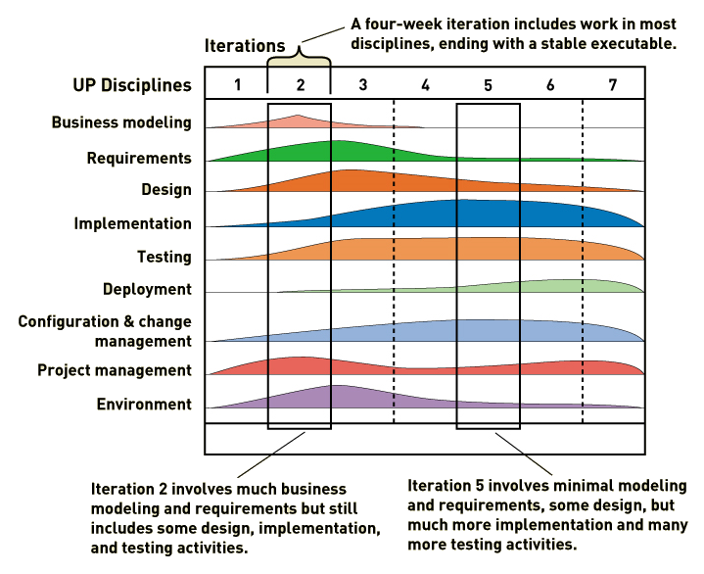
Unified Process – Disciplines (4 of 4)
Disciplines are used across all iterations

Slide 36
Extreme Programming (X P) (1 of 3)
Takes the best practices of software development and extends them “to the extreme”
  Focus intensely on proven industry practices
  Combine them in unique ways to get better results
X P Core Values
  Communication
  Simplicity
  Feedback
  Courage

Slide 37
Extreme Programming (X P) (2 of 3)
X P Practices
  Planning – based on user stories
  Testing – thorough testing at every step
  Pair Programming – watch, inspect, trade off
  Simple Designs – Agile modeling principles
  Refactoring – redo and cleanup as you go
  Owning the code collectively – egoless development, anyone can review and improve code

Slide 38
Extreme Programming (X P) (3 of 3)
X P Practices
  Continuous integration – grow the software continuously
  On-site customer – get sign-off as you go
  System metaphor – what should the final system look like
  Small releases – turn over to user frequently
  Forty-hour work week – don’t overload the developers
  Coding standards – follow standards for code

Slide 39
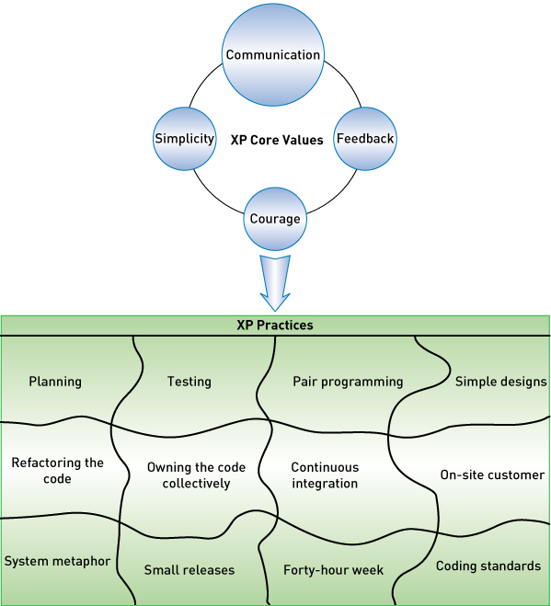
X P Core Values and Practices

Slide 40
X P Project Approach (1 of 2)
Three level approach (three rings)
  Outside ring – create user stories and define acceptance tests
  Middle ring – conduct tests and do overall planning
  Inside ring – iterations of coding and testing

Slide 41
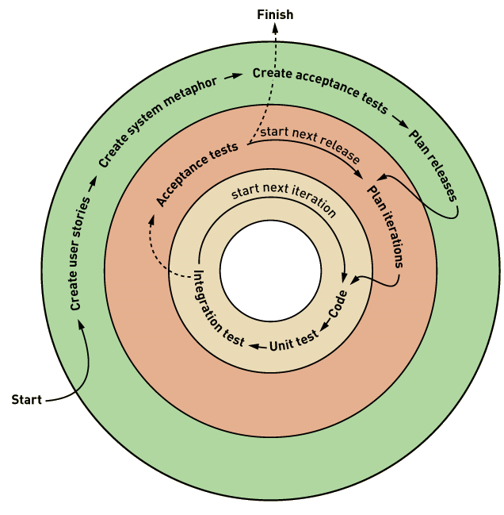
X P Project Approach (2 of 2)

Slide 42
SCRUM
Combination of principles of Rugby and Agile
  Intense effort involving the entire team for a defined period of time
Product backlog
  Prioritized list of user requirements
Product owner
  The client stakeholder who controls backlog
Scrum master
  Scrum project manager

Slide 43
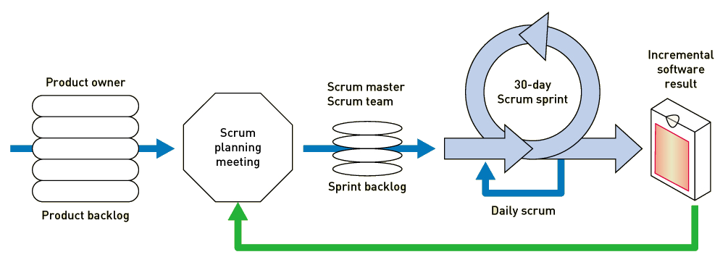
Scrum Sprint
Scrum sprint
  A time-controlled mini-project to implement part of the system

Slide 44
Scrum Practices
Scope of each sprint is frozen (but can be reduced if necessary)
Time period is kept constant
Daily Scrum meeting
  What have you done since the last daily Scrum (during the last 24 hours)?
  What will you do by the next daily Scrum?
  What kept you or is keeping you from completing your work?

Slide 45
Summary (1 of 2)
This chapter covers approaches to system development in more detail
There are two approaches to the S D L C: Predictive and Adaptive
A predictive S D L C, also known as the waterfall model, is used when it is possible to plan the project completely in advance
An Adaptive S D L C, which uses iteration, is used when the requirements are less certain and the project will need to react to changes

Slide 46
Summary (2 of 2)
All new System development project use a methodology (or development process) and many are available. A methodology includes an S D L C and tools, techniques, and models
Agile development is the current trend in system development
Unified Process is a formal iterative approach which uses U M L models (with Agile philosophy) and U P disciplines
Extreme Programming (X P) is an iterative approach which takes good practices to the extreme
Scrum is an iterative approach using a Scrum Sprint

