Slide 1
Cerritos College
Crisis Assessment, Intervention, & Response (CAIR) Team

Slide 2
Cerritos College CAIR Team Purpose
The Crisis Assessment, Intervention, and Response (CAIR) Team is a multidisciplinary partnership which contributes to the health and safety of the campus. The team consists of Cerritos College administrators and faculty that evaluate and assess distressing and disturbing behaviors exhibited by students, coordinate and develop a centralized response to provide assistance and intervention for students of concern, and evaluate and monitor any ongoing related issue(s).
Notes:
Liz

Slide 3
CAIR: Who we are & what we do
The CAIR Team’s responsibilities include, but are not limited to, the following:
To receive and review reports regarding students in crisis and/or of concern submitted by members of the campus community and the general public;
To develop a collaborative and coordinated action or intervention plan to respond to students of concern and follow-up plans, when necessary;
To initiate threat assessments and risk determination, when warranted;
To create protocols, processes, procedures, and recommend policies to enhance the effectiveness of the CAIR Team;
To assess and monitor national trends and events that may impact the institution; and
To educate the campus community about the resources available provided by the CAIR Team and available in the broader community.
Notes:
Liz

Slide 4
CAIR: What we are not
First responders. We generally do not have specialized training or capacity to be the first to arrive and provide assistance at the scene of an emergency, such as a student in crisis, accident, or incident of violence. In these circumstances, contact Campus Police immediately.
A referral service. Students should not be “referred” to the CAIR Team for services (or told they are being referred to the CAIR Team), instead direct referrals should be made to service areas (i.e. SHS, SAS, Falcon’s Next, Fin Aid. etc.), with a follow-up CAIR report submitted.
A case management service. The CAIR Team reviews reports to provide a coordinated response through aligning services, it does not manage individual student cases, but refers to offices on campus that can assist the student directly.
Notes:
Liz

Slide 5
CAIR Team Membership
Dean of Students Services (Chair)
Case Manager, Falcon’s Nest (Co-Chair)
Associate Dean of Student Health and Wellness Services
College Psychologist
Dean of Student Accessibility Services (SAS)
Director, Diversity, Compliance and Title IX Coordinator
Faculty Coordinator of Student Conduct
CCPD Police Chief
CCPD Police Captain
VP Student Services
Notes:
Liz

Slide 6
Your Role with CAIR
Submit reports regarding students of concern
Provide direct referral of a student to campus services
Provide outreach to the student or another party
May provide Team insight into the report, incident, or student
May be invited to attend a portion of a meeting or a smaller constituent group when you may have insight
Notes:
Humberto

Slide 7
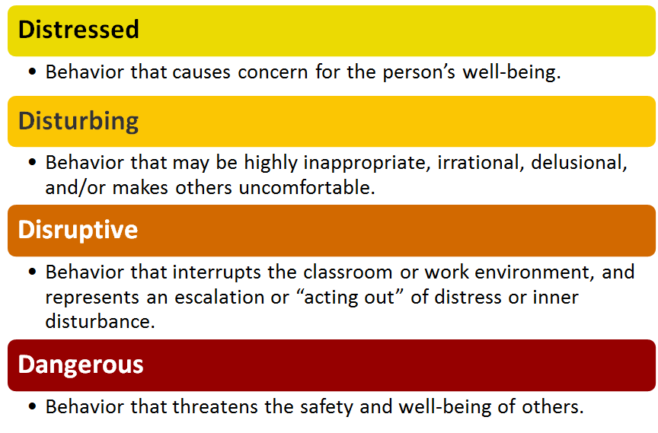
Behaviors on a Continuum
Notes:
Humberto

Slide 8
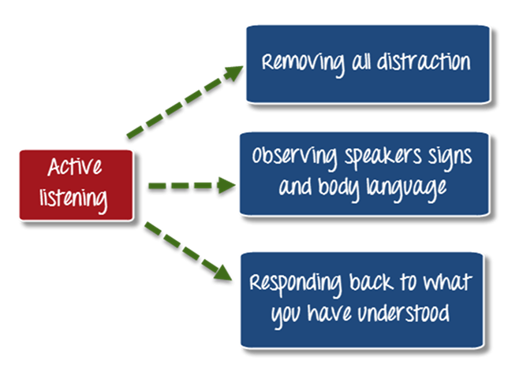
What can I do?
Interpersonally:
Talk in private
Give hope - help student realize there are options
Suggest resources (SHS, Fin Aid, Falcon’s Nest, Adult Re-Entry, SAS, EOPS/LINC/CARE, Veterans Resource Center, etc.)
Help them with relaxation skills
Avoid sarcasm, jokes, overly personal remarks
Intrapersonally:
Try to understand where they are coming from
Avoid judging, evaluating, criticizing, or diagnosing
Notes:
Humberto

Slide 9
What should I do? (Immediate)
Disruptive
If safety does not seem like an immediate concern, attempt to de-escalate the situation; offer to find someone to assist in problem-solving.
Instructors may (and should) remove a disruptive student from class.
Administrative Procedure 5520: Student Discipline Procedures (lines 115-125)
Removal from Class (Education Code Section 76032): Any instructor may order a student removed from his/her class for the day of the removal and the next class meeting.
The instructor shall immediately report the removal to the Faculty Coordinator for Student Conduct and Grievance and complete a Student Conduct Incident Form. The Faculty Coordinator or designee shall arrange for a conference between the student and the instructor regarding the removal. If the instructor or the student requests, the Faculty Coordinator or designee shall attend the conference. The student shall not be returned to the class during the period of the removal without the concurrence of the instructor. Nothing herein will prevent the Faculty Coordinator, or designee from recommending further disciplinary procedures in accordance with these procedures based on the facts which led to the removal.
Notes:
Liz
Emphasize that everything is situational

Slide 10
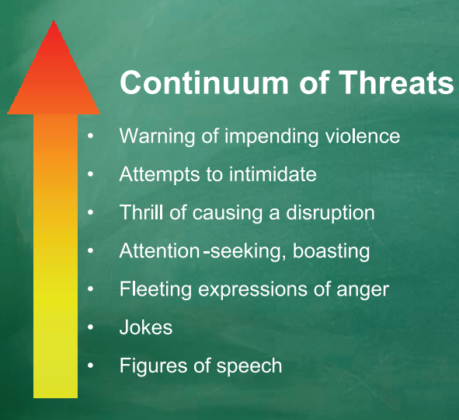
What should I do? Cont’d (Immediate)
Dangerous
If safe to do so, remove yourself and others from the room.
Ask about the possibility of harm to self or others
ASK: Are you thinking of killing yourself? Are you thinking of or planning to harm someone?
Remember - it is not our role to diagnose and treat.
When physical safety of student(s) or others is of immediate concern,
or the student acts in a highly irrational or disruptive way, call:
911 or 562-402-3674 (Cerritos College Police)
Notes:
Liz
Emphasize that everything is situational

Slide 11
Remember...
We cannot predict or prevent all acts of campus/workplace violence.
There is no single demographic profile of an “active shooter.”
Notes:
Hillary

Slide 12
What should I do? (Secondary)
Submit a Report
Why? Allows the District to:
Record the incident from your perspective
Review for additional services available to the student
Monitor trends occuring on campus
Provide a safe learning and working environment!
How? It’s easy and online!
To access the report visit the CAIR webpage.
Notes:
Liz

Slide 13
What happens next…
After a report is submitted, it is immediately received via email by:
Dr. Elizabeth Miller
Ms. Pamela Sepulveda
Dr. Lauren Elan Helsper
Dr. Humberto Hernandez
Dr. Dilcie Perez
Expect a response within 1-3 business days. You may also email any additional information and updates to Dr. Miller to include in the student’s file.
The CAIR Team will review by next scheduled meeting, and discuss additional resources or responses.
Notes:
Liz

Slide 14
Confidentiality, Privacy, & Discretion
For most of us, we cannot guarantee confidentiality to students in the roles we serve.
Only Student Health Services may guarantee confidentiality.
We may and should promise discretion and privacy.
If you are concerned with submitting a report due to privacy, please contact one of the individuals below to talk through your concern.
Dr. Elizabeth Miller, Dean of Student Services, emiller@cerritos.edu
Ms. Pamela Sepulveda, Case Manager, psepulveda@cerritos.edu
Dr. Lauren Elan Helsper, Director, Diversity, Compliance, & Title IX Coordinator, lelanhelsper@Cerritos.edu
NOTE: Staff above will not share information known about students, but will listen, and provide advice and consultation.
Notes:
Hillary

Slide 15
Confidentiality, Privacy, & Discretion cont’d
To comply with FERPA and avoid accidentally giving unlawful/incorrect advice, it is best that faculty and staff serve only as a resource and emotional support.
Any materials written about students could be reviewable by the student per FERPA. That includes student conduct and CAIR reports.
FERPA grants exceptions in emergencies to protect health & safety.
Additional FERPA training in the CCCCO Professional Learning Network (Skillsoft Portal):
Keenan module on FERPA Confidentiality of Records (15 minutes)
FERPA for Higher Education (30 minutes).
Information and resources are available on the US Department of Education Website.
Notes:
Hillary

Slide 16
Thanks!
Any questions?
CAIR Team Chair:
Dr. Elizabeth Miller, emiller@cerritos.edu

