Slide 1
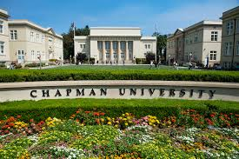
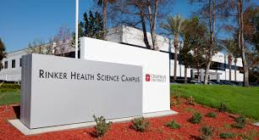
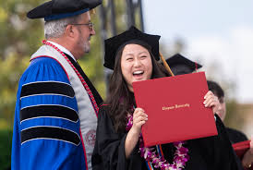
Pathway to Pharmacist in just 5 years
High School
Cerritos College Articulation Agreement
2 years of Pre-Requisite Courses
School of Pharmacy
Chapman University
3 years of Pharm.D.
California Pharmacist License Exam (NAPLEX)
California Law Exam
Doctor of Pharmacy
Licensed Pharmacist

