Slide 1


Slide 2
DEGREE PROGRAMS
PROFESSIONAL
BAKING & PASTRY
22 units Certificate
  39 units G.E. for A.S.
400 hours of bakery production
Operate 4 foodservice outlets
7 units transfer to university
PROFESSIONAL
COOKING
39 units Certificate
  39 units G.E. for A.S.
800+ hours of kitchen production
Operate 3 foodservice outlets
19 units transfer to university California Polytechnic Pomona University

Slide 3
Culinary Arts Management
49 units Certificate
  39 units G.E. for A.S.
800 hours of kitchen production
Operate 3 foodservice outlets
Management courses
Focus on transfer
25 units transfer to California Poly Pomona
12 units transfer to California State University, Long Beach

Slide 4
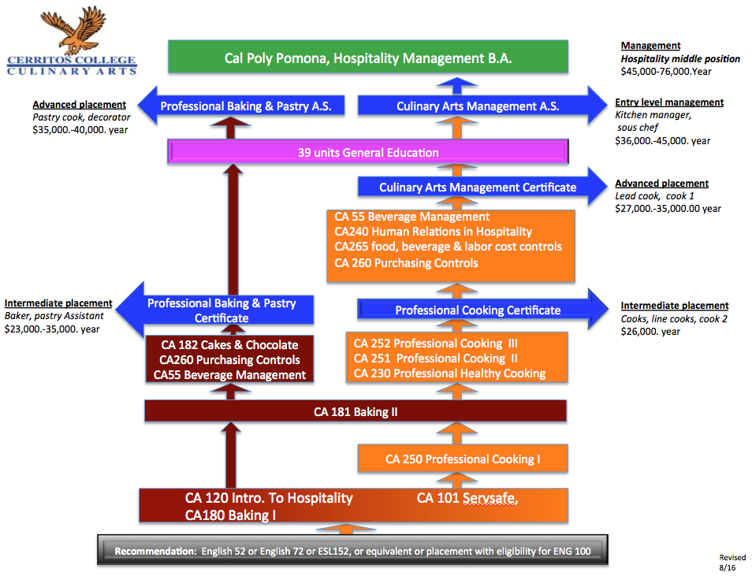

Slide 5
PROFESSIONAL BAKING & PASTRY
Certificate requirements
Course | First Semester | Units
CA 101 | Safety and Sanitation | 1
CA 180 | Introduction to Baking Skills | 4
CA 120 | Intro to Hospitality | 3
 | Second Semester
CA 181 | Baking & Pastry I | 5
CA 260 | Foods Purchase and Control | 3
 | Third Semester
CA 182 | Baking & Pastry II | 5
CA 55 | Responsible Alcohol Service | 1

Slide 6
PROFESSIONAL COOKING
Certificate requirements
Course | First Semester | Units
CA 101 | Safety and Sanitation | 1
CA 180 | Introduction to Baking Skills | 4
CA 120 | Intro to Hospitality | 3
 | Second Semester
CA 181 | Baking & Pastry I | 5
CA 250 | Professional Cooking I | 7
 | Third Semester
CA 230 | Professional Healthy Cooking | 3
CA 251 | Professional Cooking II | 8
 | Fourth Semester
CA 252 | Professional Cooking III | 8

Slide 7
CULINARY ARTS MANAGEMENT
Certificate requirements
Course | First Semester | Units
CA 101 | Safety and Sanitation | 1
CA 180 | Introduction to Baking Skills | 4
CA 120 | Intro to Hospitality | 3
 | Second Semester
CA 181 | Baking & Pastry I | 5
CA 250 | Professional Cooking I | 7
 | Third Semester
CA 230 | Professional Healthy Cooking | 3
CA 251 | Professional Cooking II | 8
 | Fourth Semester
CA 252 | Professional Cooking III | 8
CA 55 | Responsible Alcohol Service | 1
CA 260 | Foods Purchase and Control | 3
 | Summer Session
CA 240 | Human Relations in Hospitality | 3
CA 265 | Food, Beverage & Labor Cost Control | 3

Slide 8

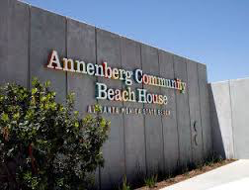





SPRING 2016 GRADUATE EMPLOYERS:

Slide 9
WHAT WILL IT COST?
Uniforms: New Chef uniforms
2 jackets, 2 pants, work shoes, hats
Kitchen Kits: Chef Toys
Knife roll
Baking box
Text Books: varies
Price varies by semester
Tuition:
$46. per unit
Lab Fees:
Covers aprons, towels, tasting
$3,900

Slide 10
What will a Certificate in Culinary Arts do for me?
$23-36K per year
Should I get my Associates Degree?
$40-45K per year
Should I get my Bachelors Degree?
$45-76K per year

Slide 11


The Collins College of Hospitality Management
CSULB Hospitality Management

Slide 12
The New Culinary Arts Kitchen
FINE DINING FULL SERVICE RESTAURANT
HIGH VOLUME CAFÉ
BANQUET & CATERING SERVICES

Slide 13
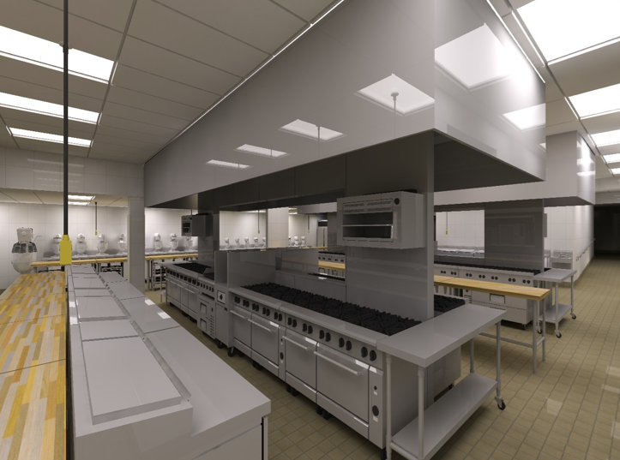
PRODUCTION KITCHEN
100’ OF HOT COOKING LINE
3 SEPARATE CLASSROOM AREAS
BANQUETE KITCHEN
SOUS VIDE STATION
3 VIDEO CAMERAS WITH 8 LCD SCREENS WITH AUDIO

Slide 14
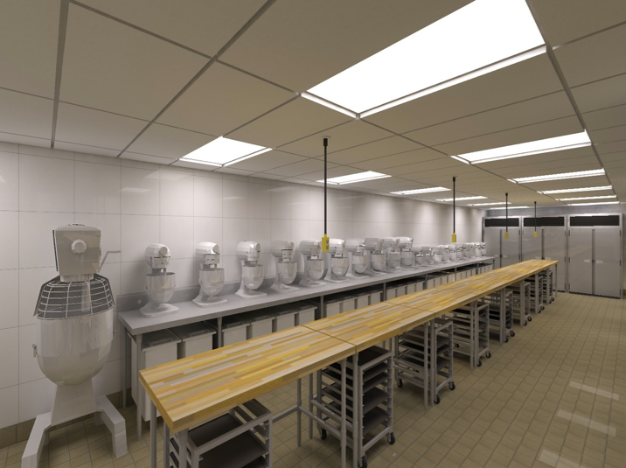
BAKING & PASTRY KITCHEN
21 MIXERS/1 PER STUDENT
24 SHEET PAN PICARD OVEN
1 COMBI OVEN 2 CONVECTION OVENS 2 STEAM OVENS

Slide 15
THANK YOU FOR JOINING OUR FAMILY!
Facebook Alumni Page

