Slide 1
Career Development,
Internships and Research for
Undergraduate STEM Students
Patty George
Department of Mathematics
Science, Engineering and Mathematics Division
Cerritos College

Slide 2
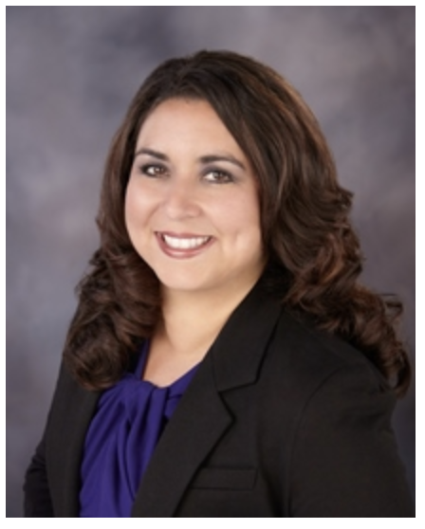
Marisa Perez
Cerritos College Board of Trustees
STEM Professional
Participant in STEM Undergraduate Research

Slide 3
Cerritos College Students –
Exploring New Universes
Cerritos College STEM students are participating in many exciting and varied career development programs.

Slide 4
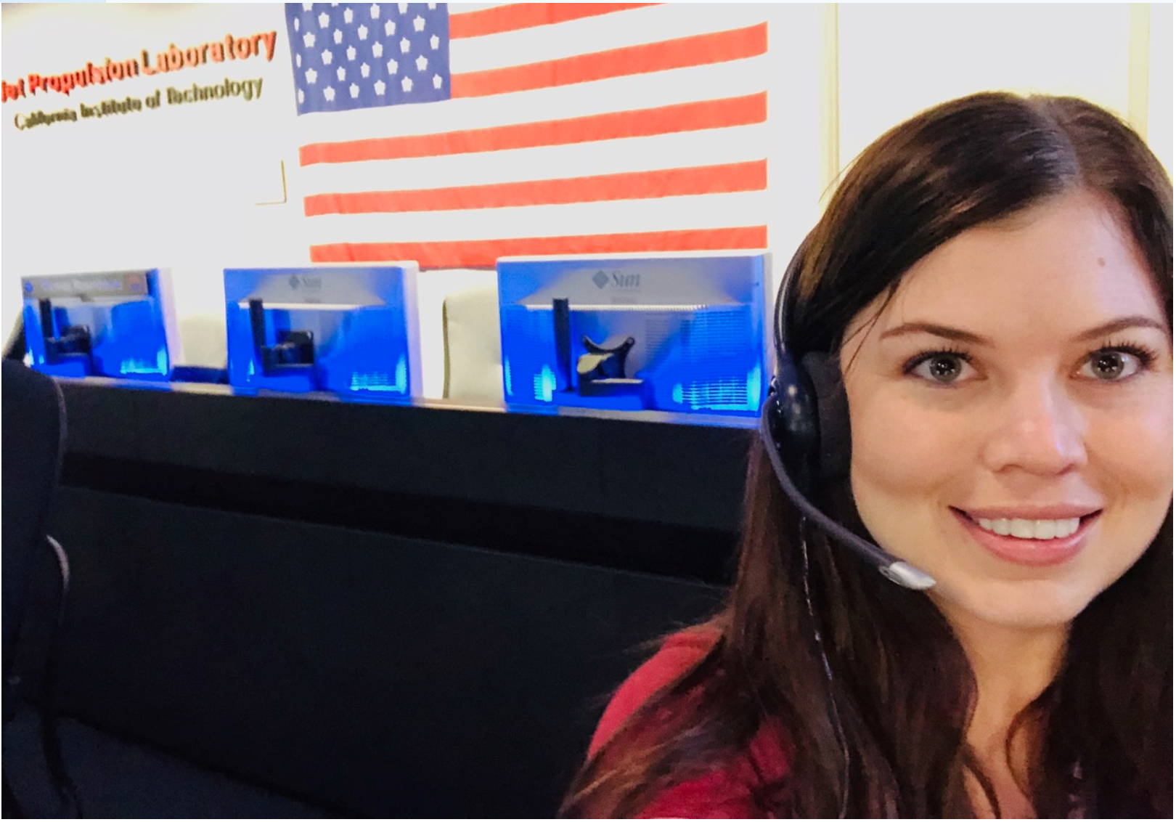
Shelby Flowers at the Jet Proplusion Laboratory with NCAS

Slide 5
https://youtu.be/EDohp7Q6rLQ.
Shelby Flowers and
The National Community College Aerospace Scholars (NCAS)

Slide 6
Participating in career development activities such as these develop skills, professional relationships and friendships that will influence your future.

Slide 7
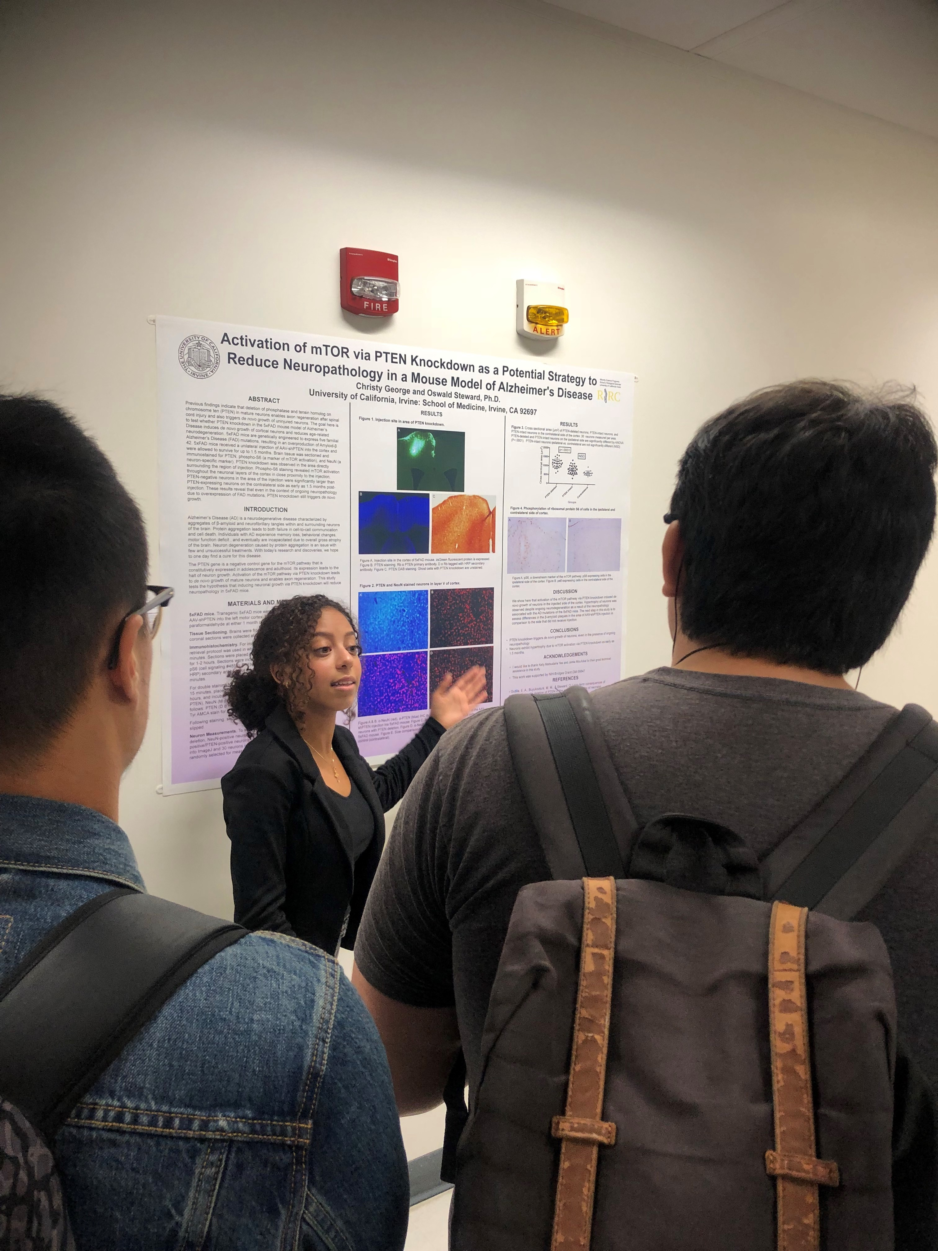
Christy George and
University of CaIifornia, Irvine,
School of Medicine

Slide 8
Many STEM career development programs not only focus on developing skills required, but also emphasize the importance of building an academic, cultural, and social community.

Slide 9
Do Khym and
The Research Experience for Undergraduates at the University of Northern Iowa

Slide 10
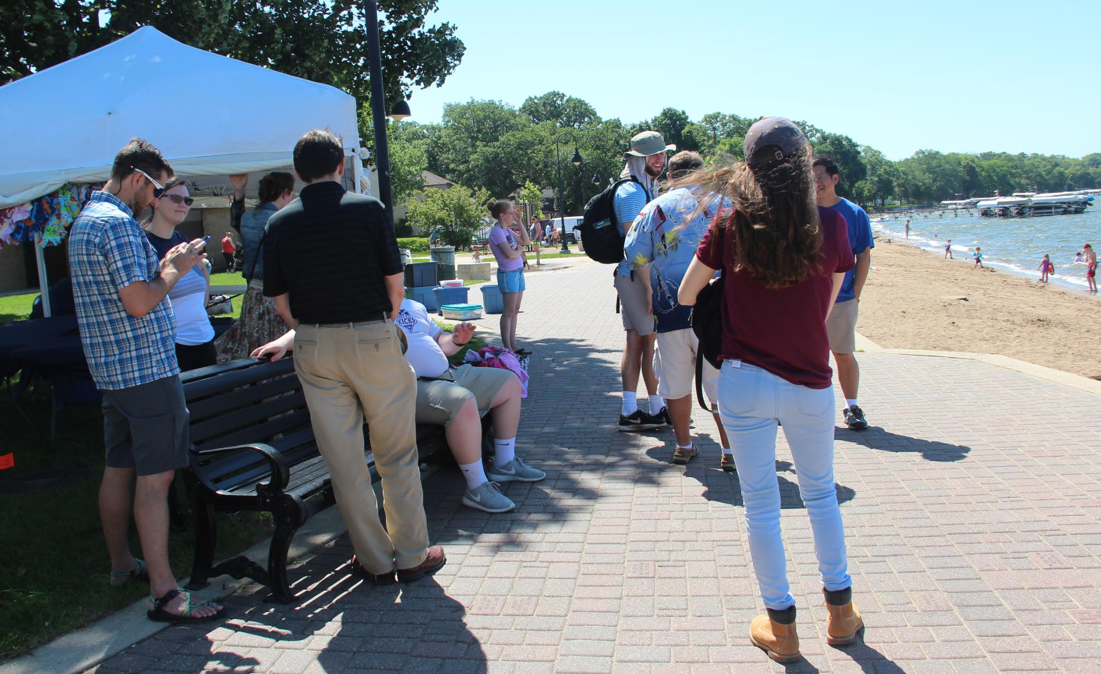

Slide 11
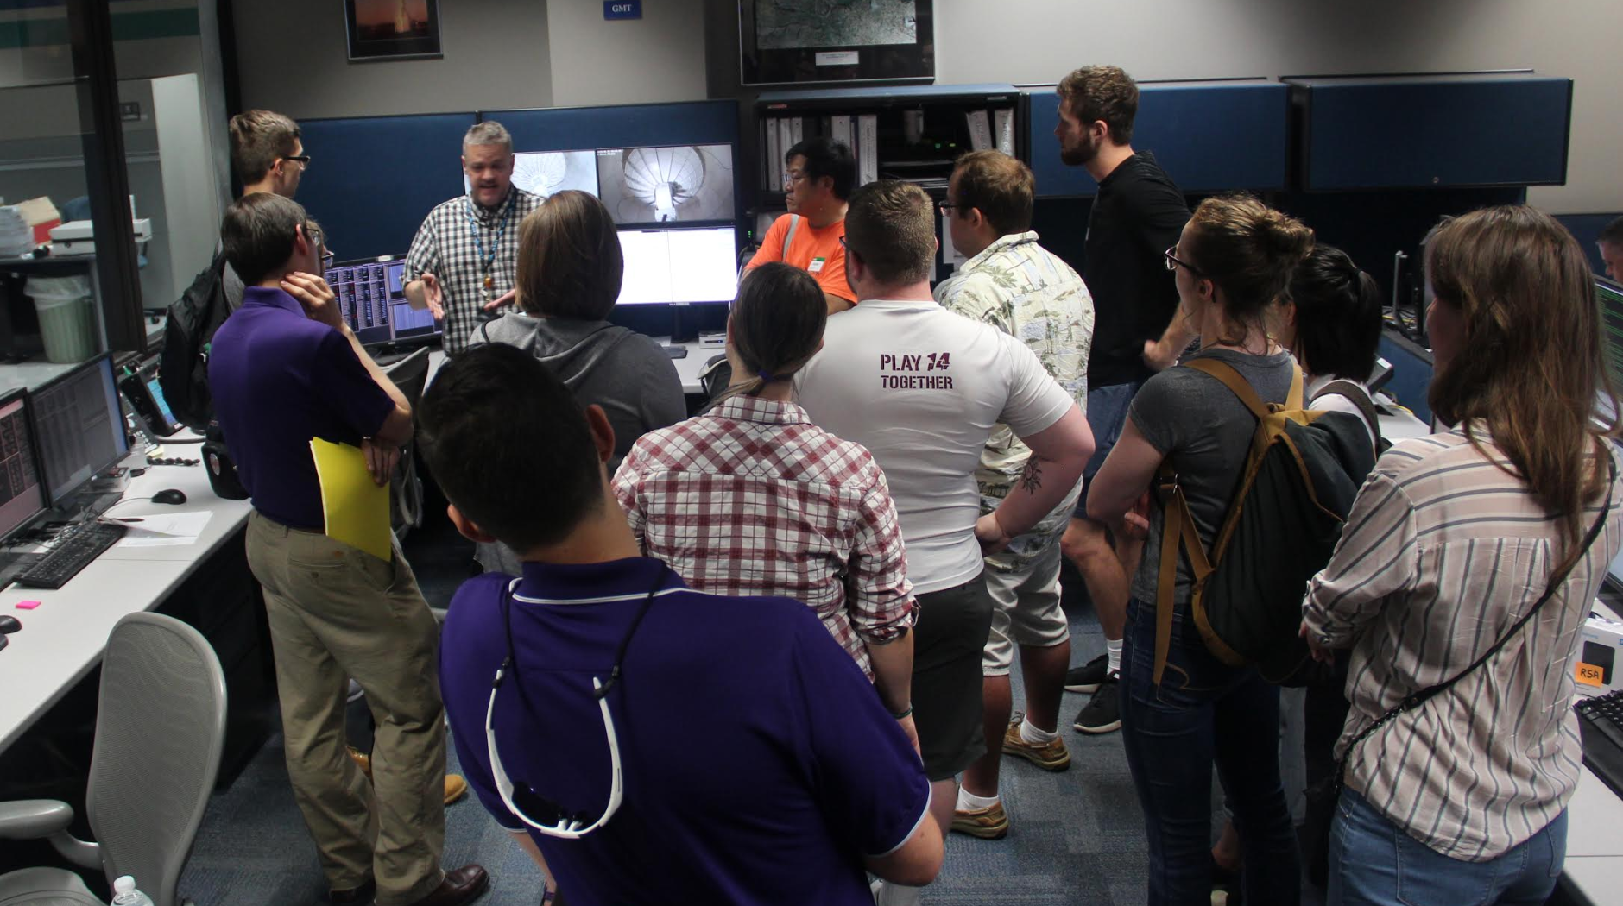

Slide 12
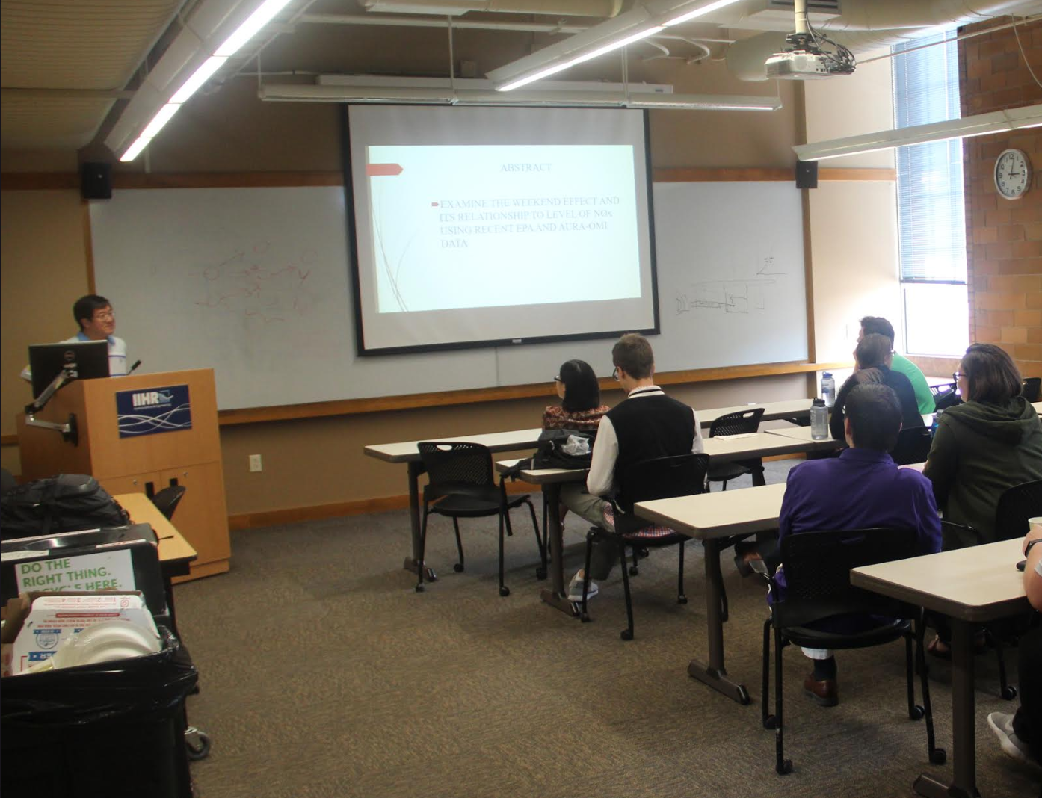

Slide 13
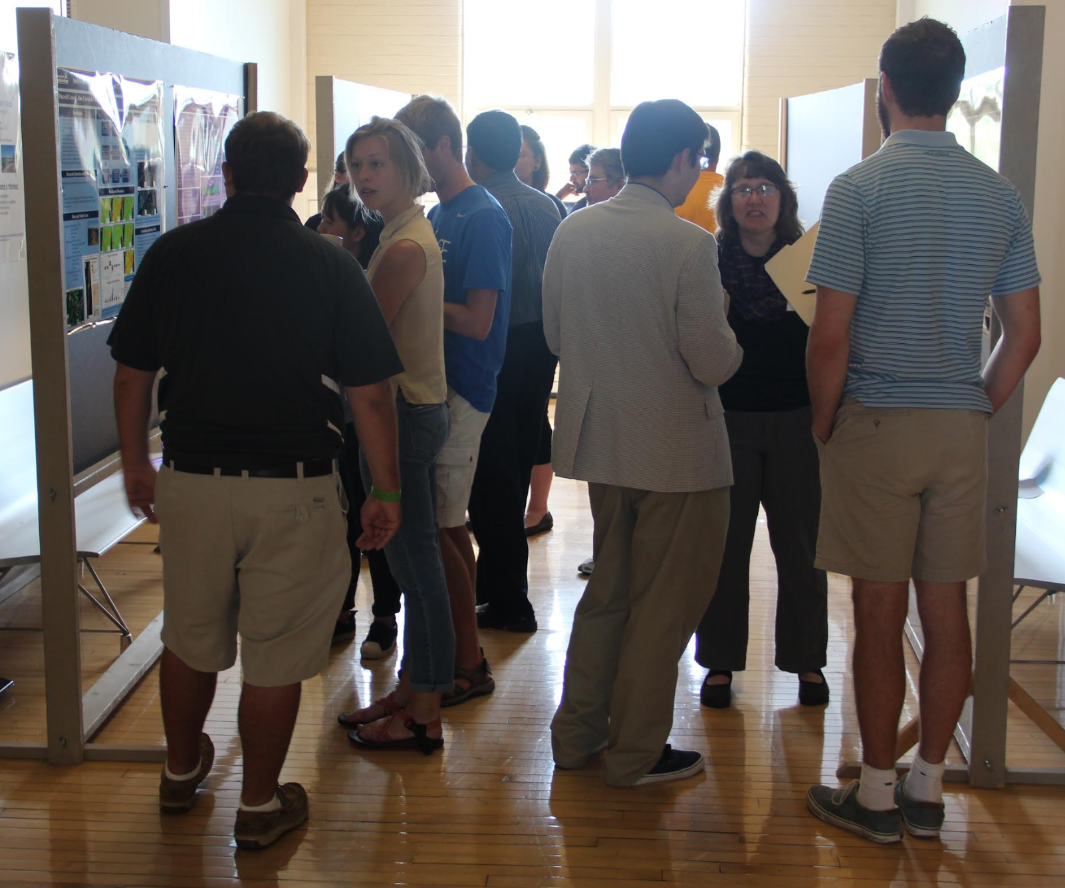

Slide 14
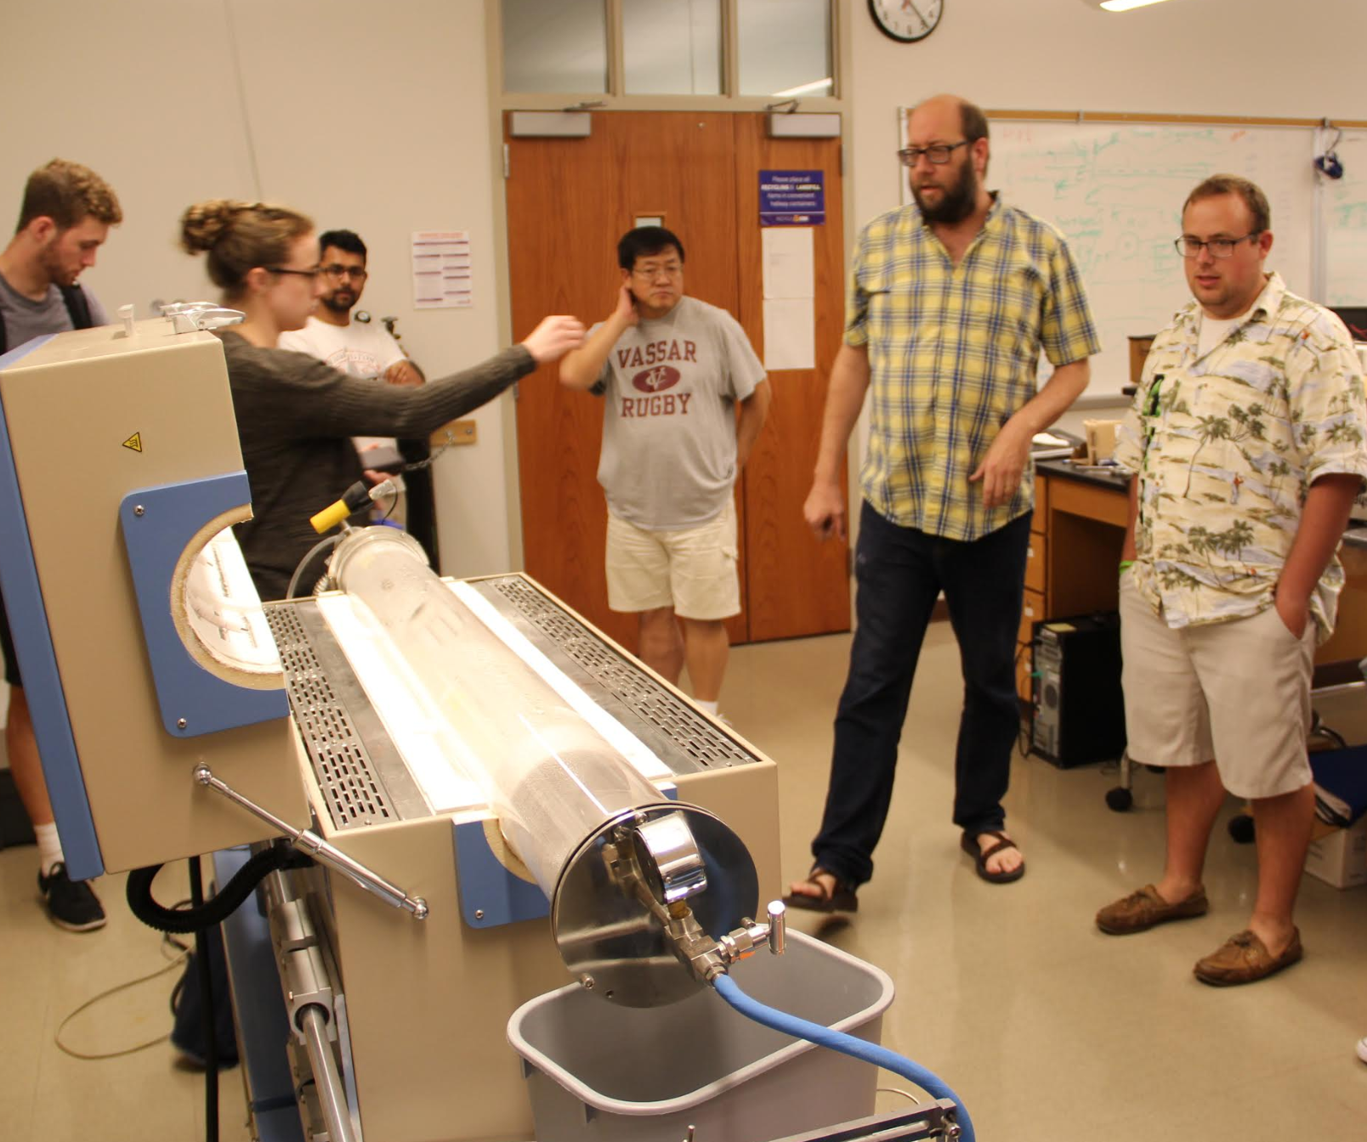

Slide 15
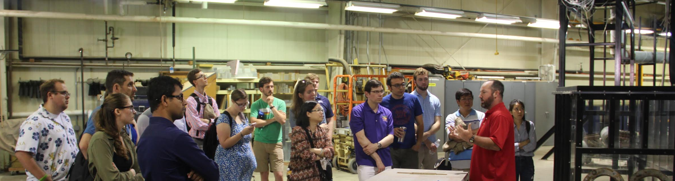

Slide 16
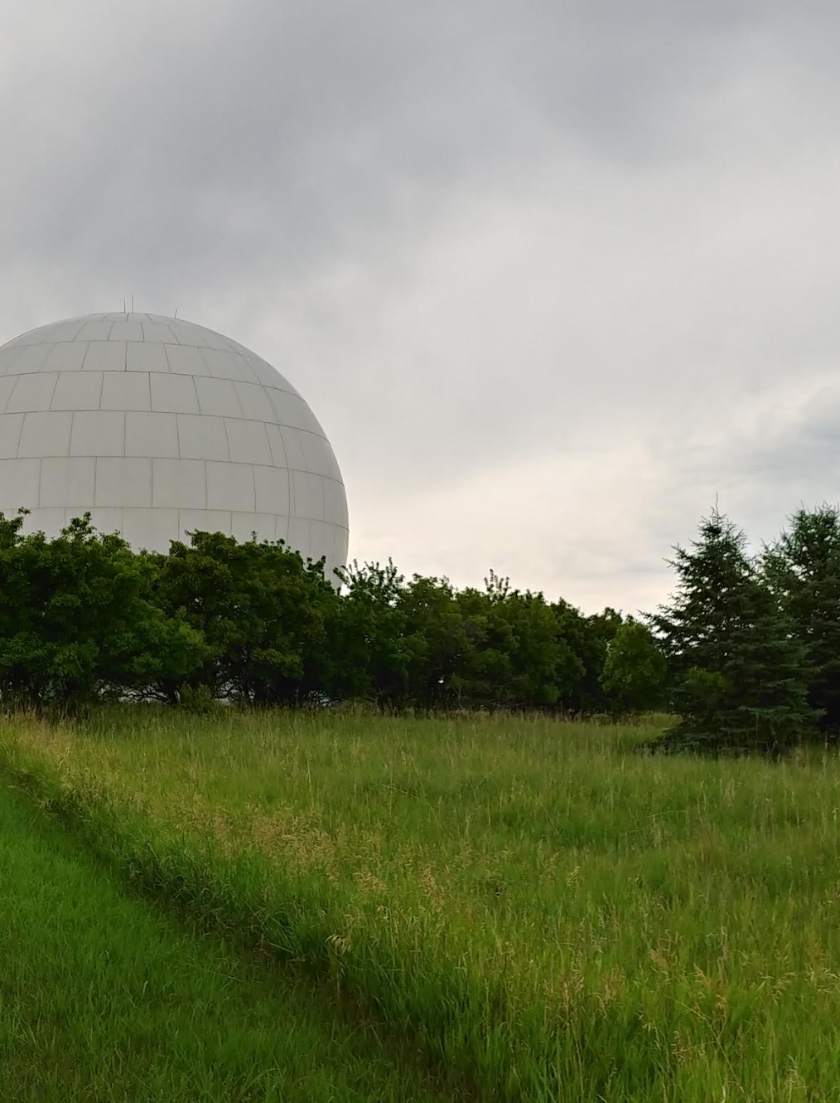
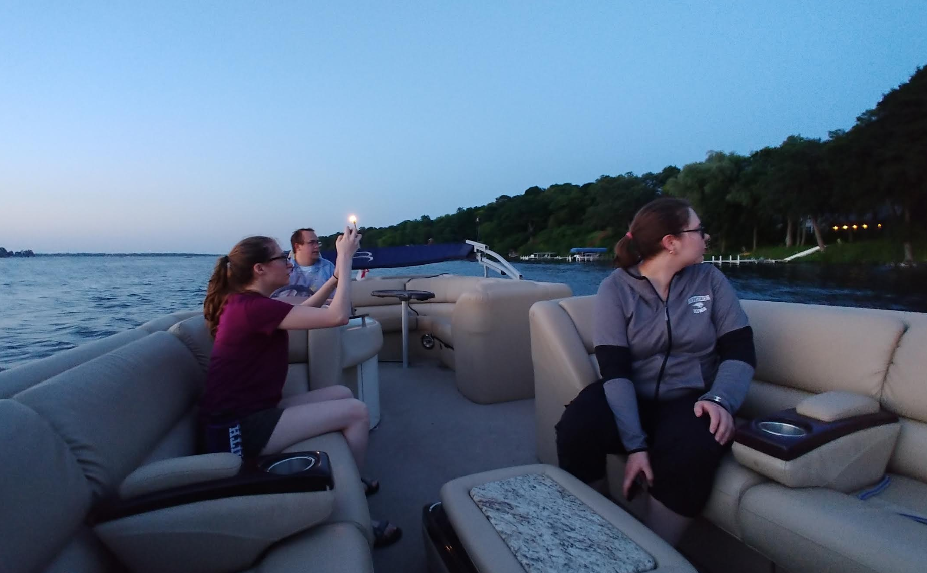
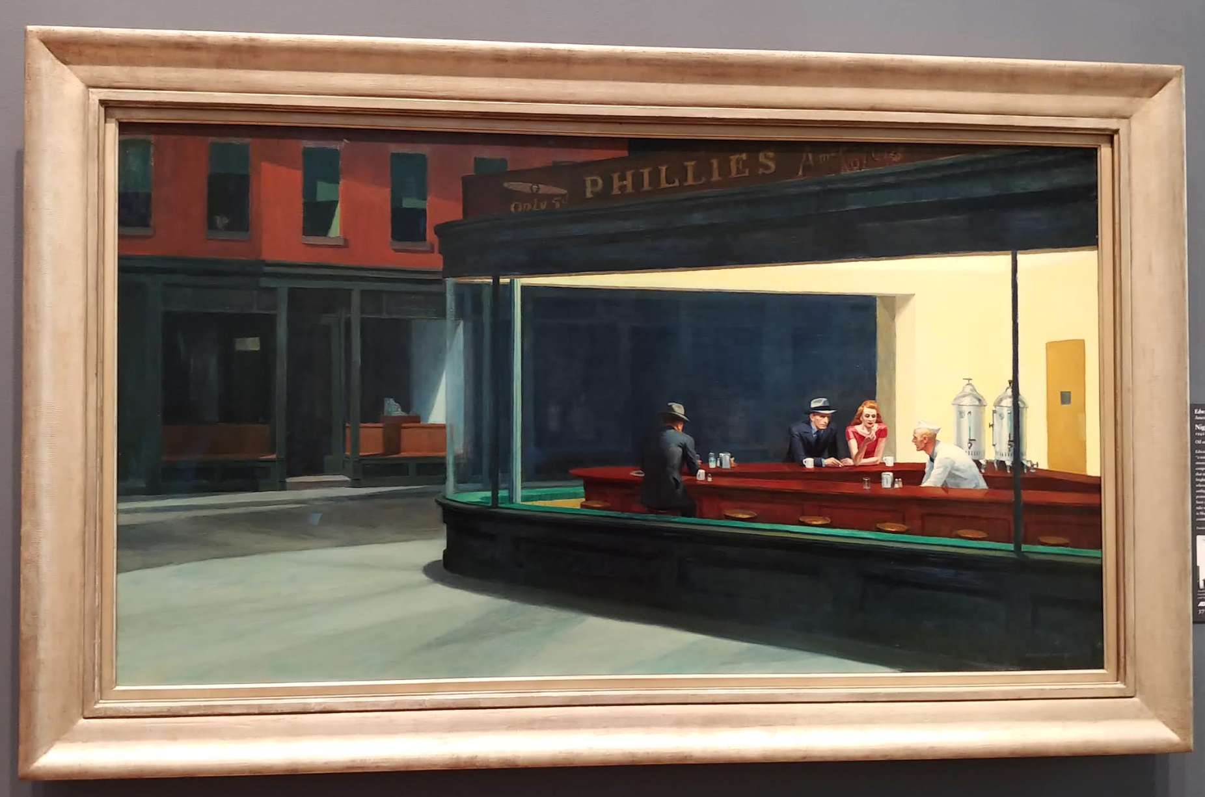

Slide 17
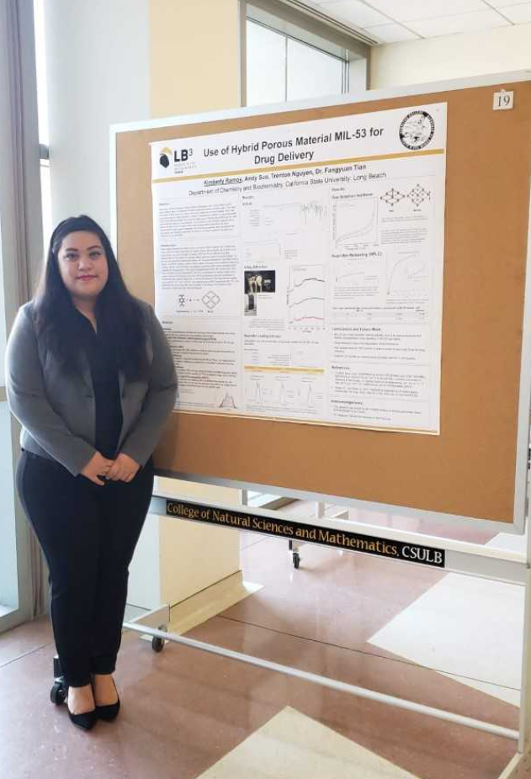
Kimberly Ramos
and California State University,
Long Beach,
Bridges to the Baccalaureate

Slide 18
Allen Malfavon is
Beginning an Internship
at the
California Institute of Technology
through the Support of Base11

Slide 19
Why are career development, internships and research opportunities so important?

Slide 20
Internships and Research
--Why?
Learn by doing
Use tools that may not be available at Cerritos College
Document your experience
Network
Prepare for graduate school
Prepare for a career
Travel

Slide 21
Internships and Research
--Is it a financial possibility?
Paid and unpaid opportunities
Housing
Meals
Travel Expenses

Slide 22
Internships and Research
--How do you find them?
NSF – National Science Foundation
  https://www.nsf.gov/crssprgm/reu/

Slide 23
Internships and Research
--How do I find them?
NIH – National Institute of Health
  Specifically for community college students
  https://www.training.nih.gov/ccsep_home_page

Slide 24
Internships and Research
--How do I find them?
National Park Service
  https://www.training.nih.gov/ccsep_home_page

Slide 25
Internships and Research
--How do I find them?
NASA – National Aeronautics and Space Administration
  https://cms.cerritos.edu/physics/nasa-grant.htm

Slide 26
Internships and Research
--How do I find them?
Professional Organizations
  American Mathematical Society
    http://www.ams.org/programs/students/emp-internships
  American Chemical Society
    https://www.acs.org/content/acs/en/education/students/college/experienceopp.html
  American Physical Society
    https://www.aps.org/careers/employment/internships.cfm#undergrad

Slide 27
Internships and Research
--Where can I get help in applying?

Slide 28
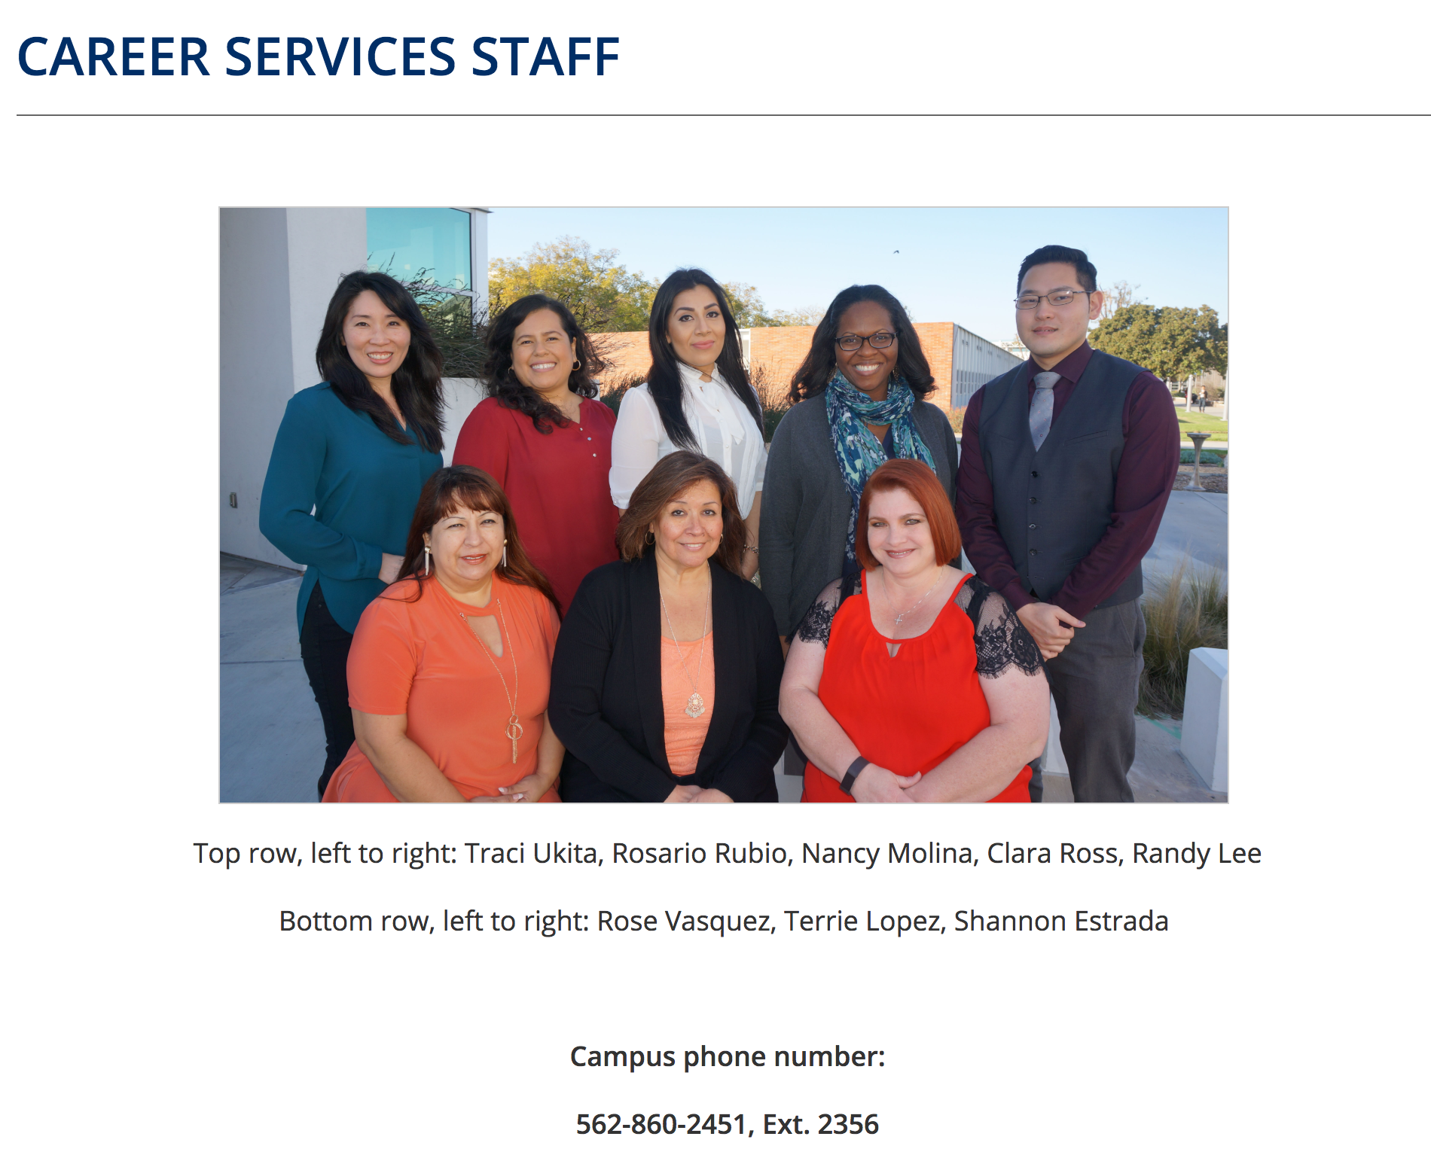

Slide 29
Internships and Research
-- Preparing to Apply
Cover Letters
Letters of Recommendation
Personal Statement or Statement of Purpose
Resume or Curriculum Vitae

Slide 30
Internships and Research
-- Preparing to Apply
Career Counselors are located in the Multi-Purpose Bldg, Room 201
Clara Ross-Jones
Randy Lee
Traci Ukita
David Young
Allison Fujii
Call (562) 860-2451 extension 2356

Slide 31
Internships and Research
--How do I find them? … go directly to the company
Aerospace Corp
  http://www.aerospace.org/careers/college-students/internships/
Apple
  https://www.apple.com/jobs/us/students.html
Boeing
  https://jobs.boeing.com/search-jobs/internship/185/1
Genentech
  https://www.gene.com/careers/university-and-early-career/interns-co-ops
Google
  https://careers.google.com/students/

Slide 32
Internships and Research
--Where else can you get help?
For general introduction to the search, contact me, Patty George pgeorge@cerritos.edu
Contact Linda Waldman or Matt Covill for information about the CSULB Bridges Program
Contact Janet McLarty or Carlos Mera for information about the NASA Program
Contact Tor Lacy or Niki Bilsley for information about Geoscience internships
Go to the Career Development Center

Slide 33
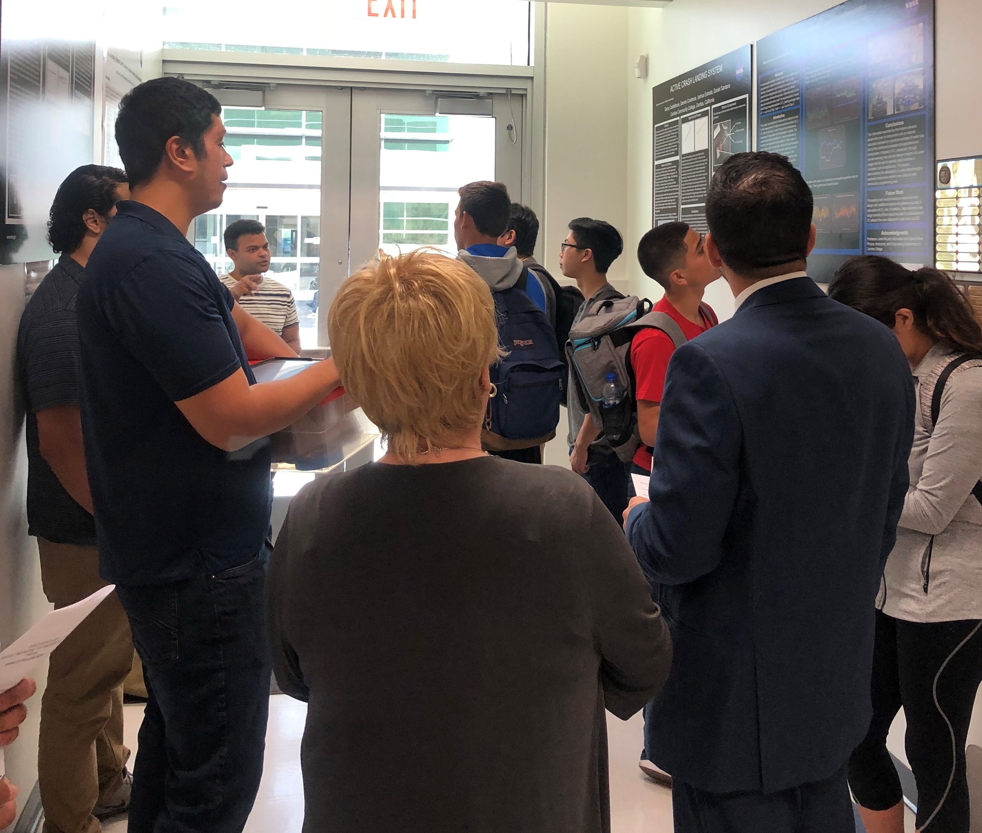

Slide 34
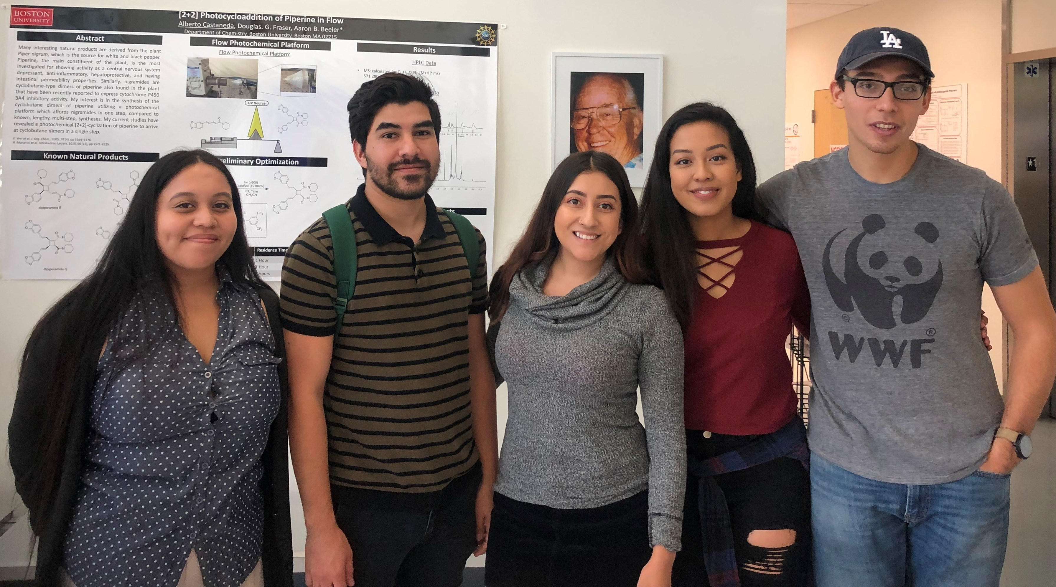

Slide 35
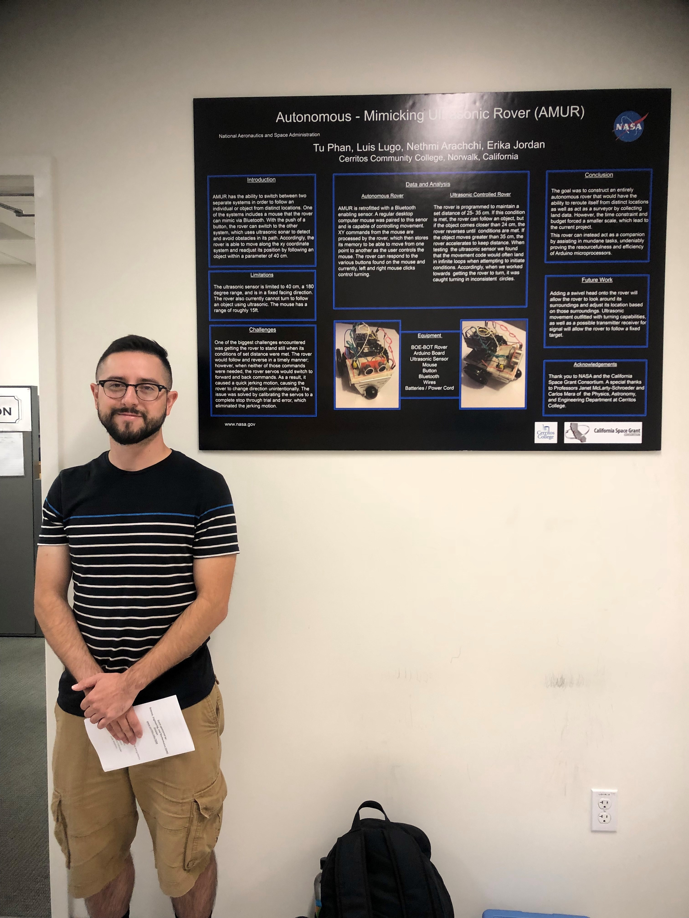

Slide 36
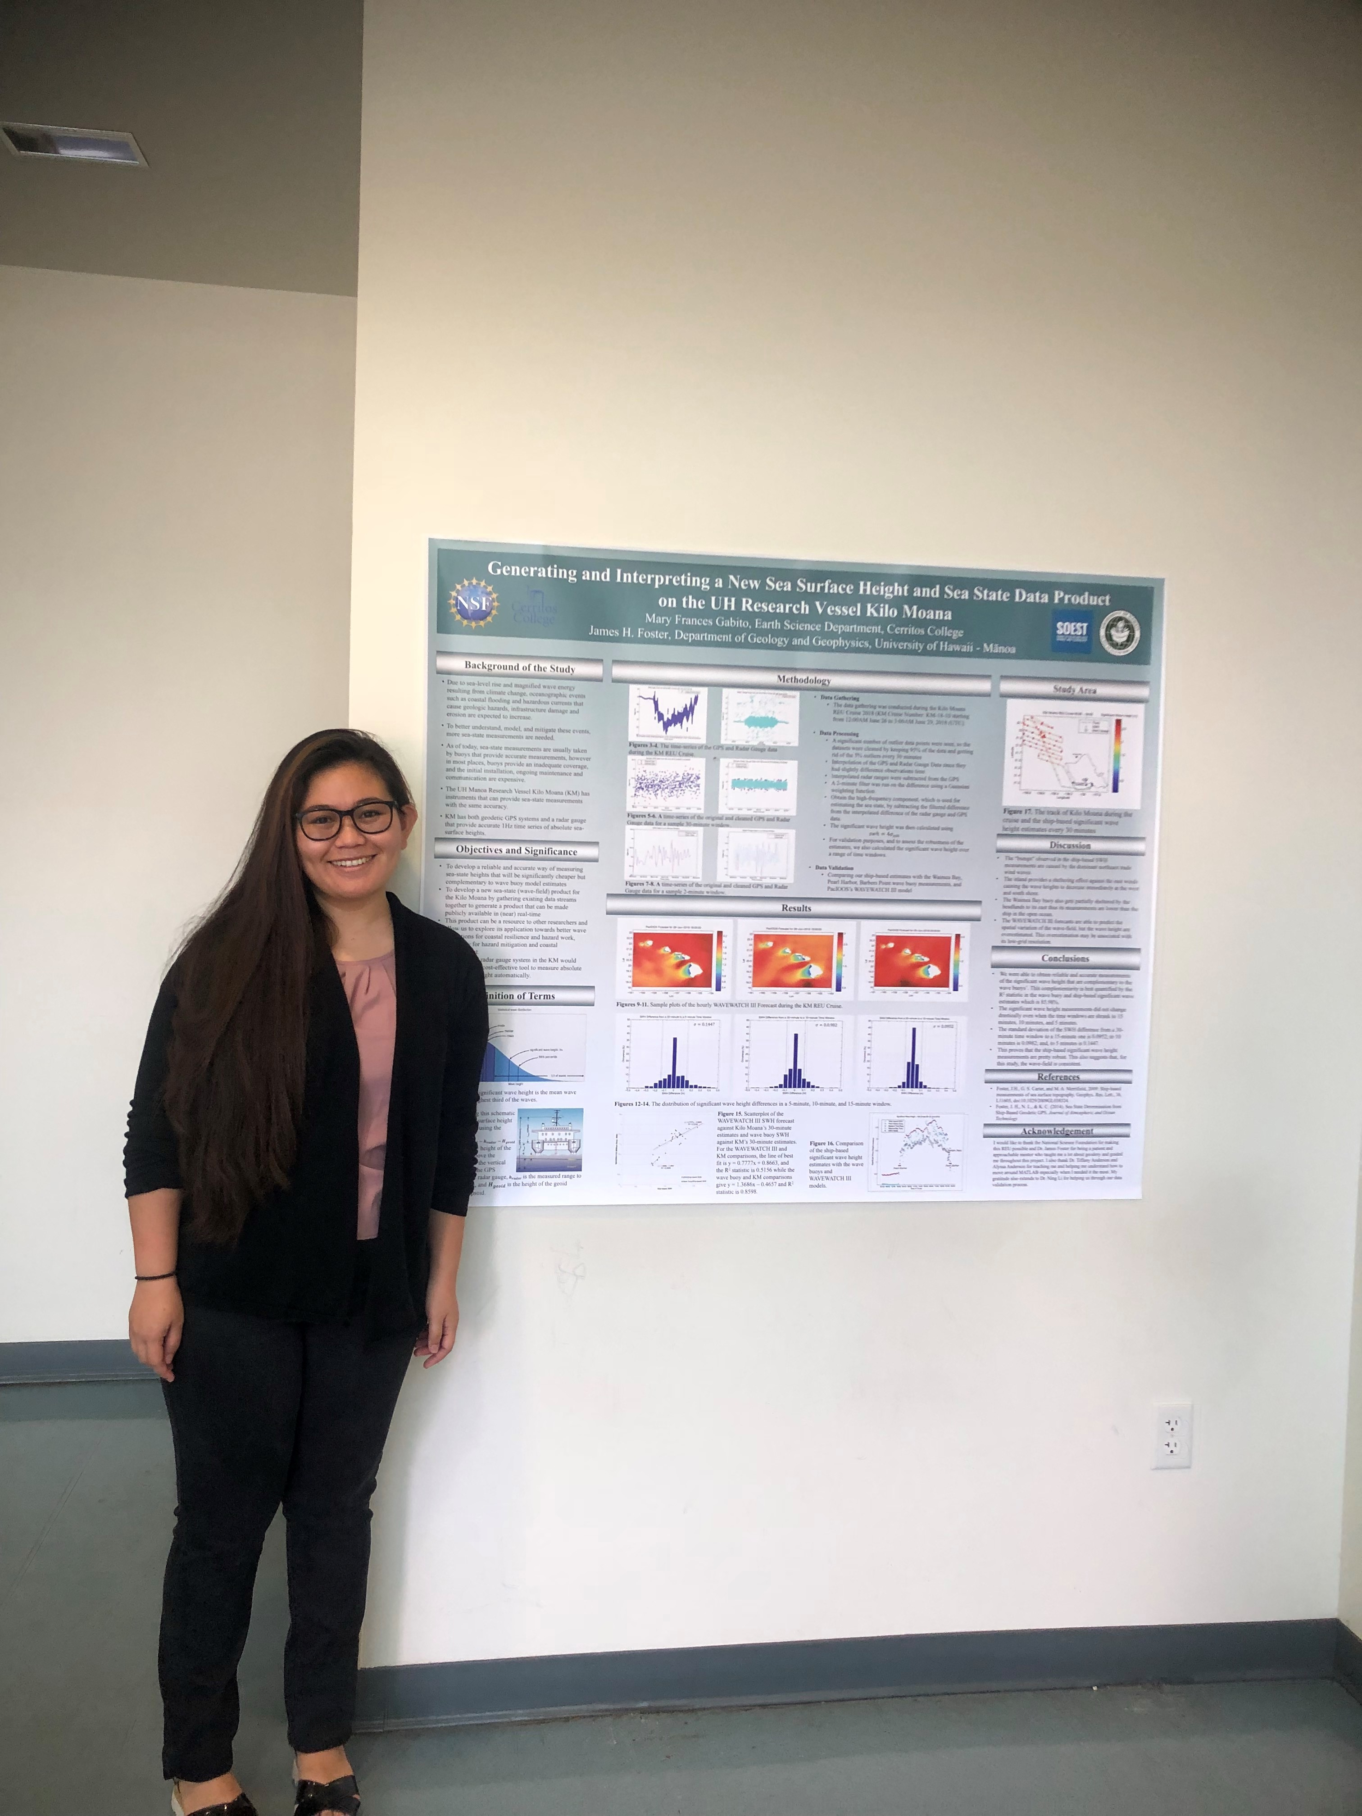

Slide 37
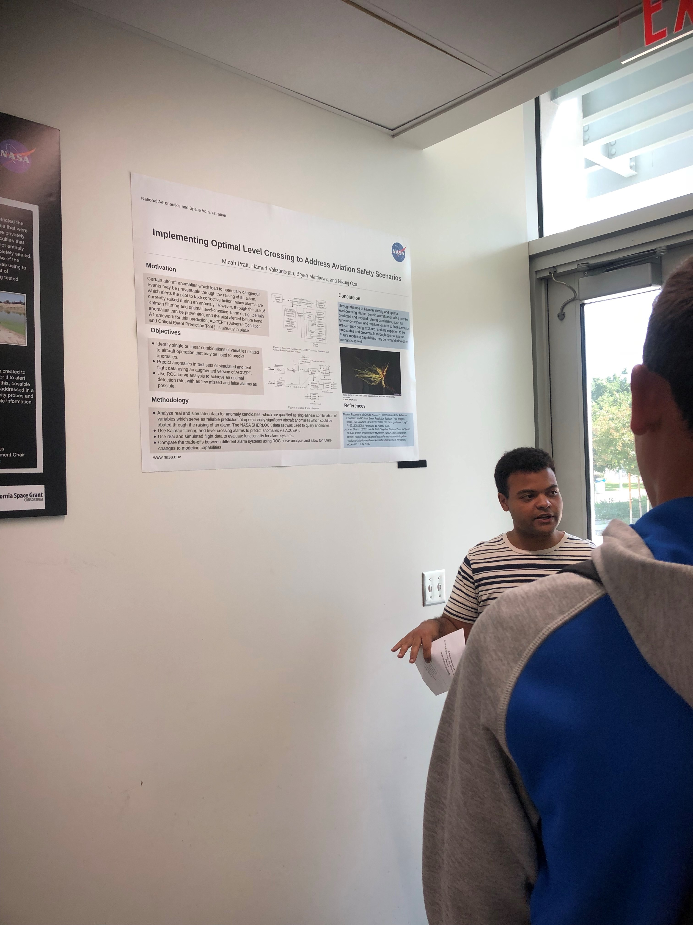

Slide 38
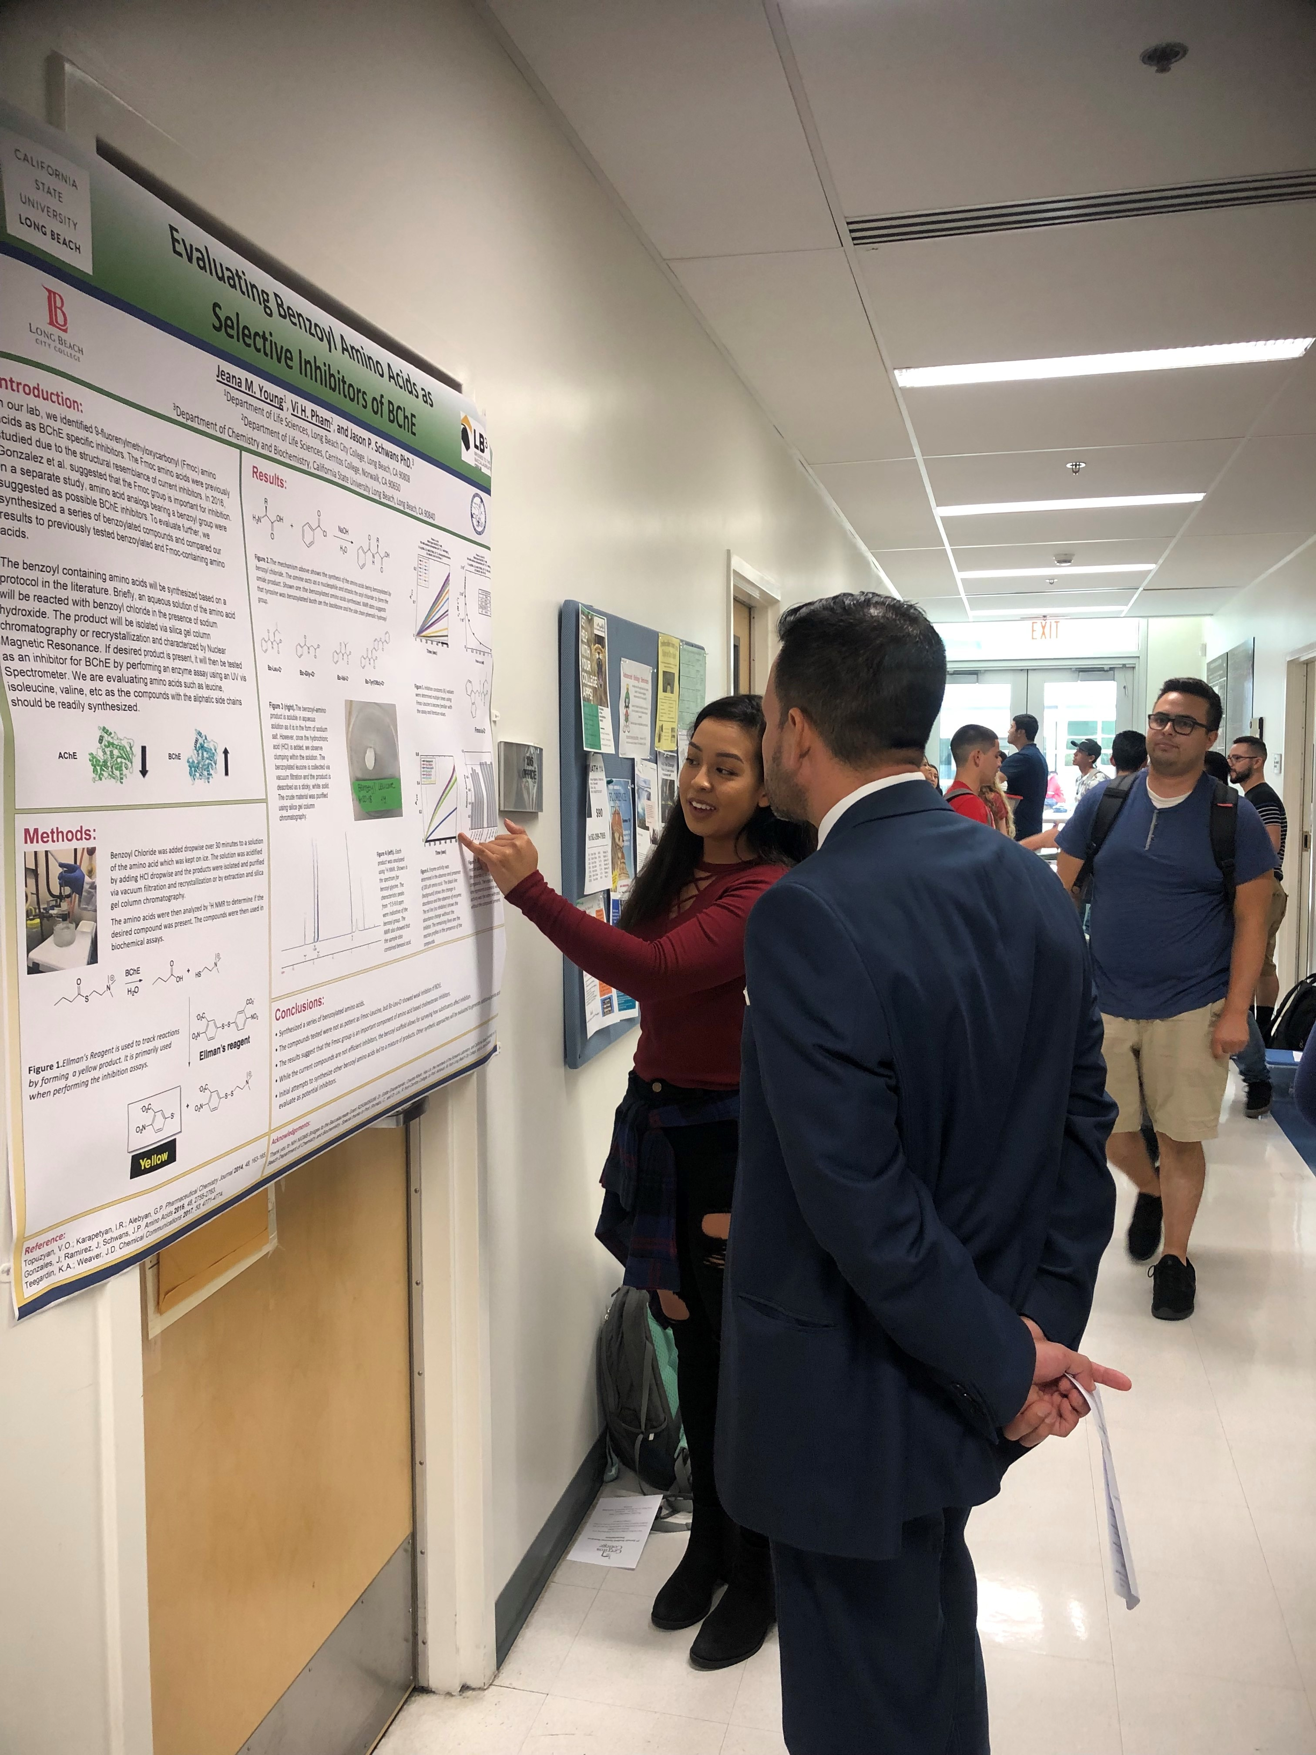

Slide 39
