Slide 1
Ray Tracing Lab

Slide 2
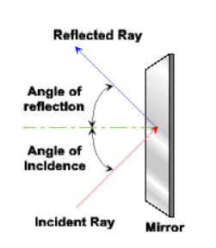
Flat Mirror

Slide 3
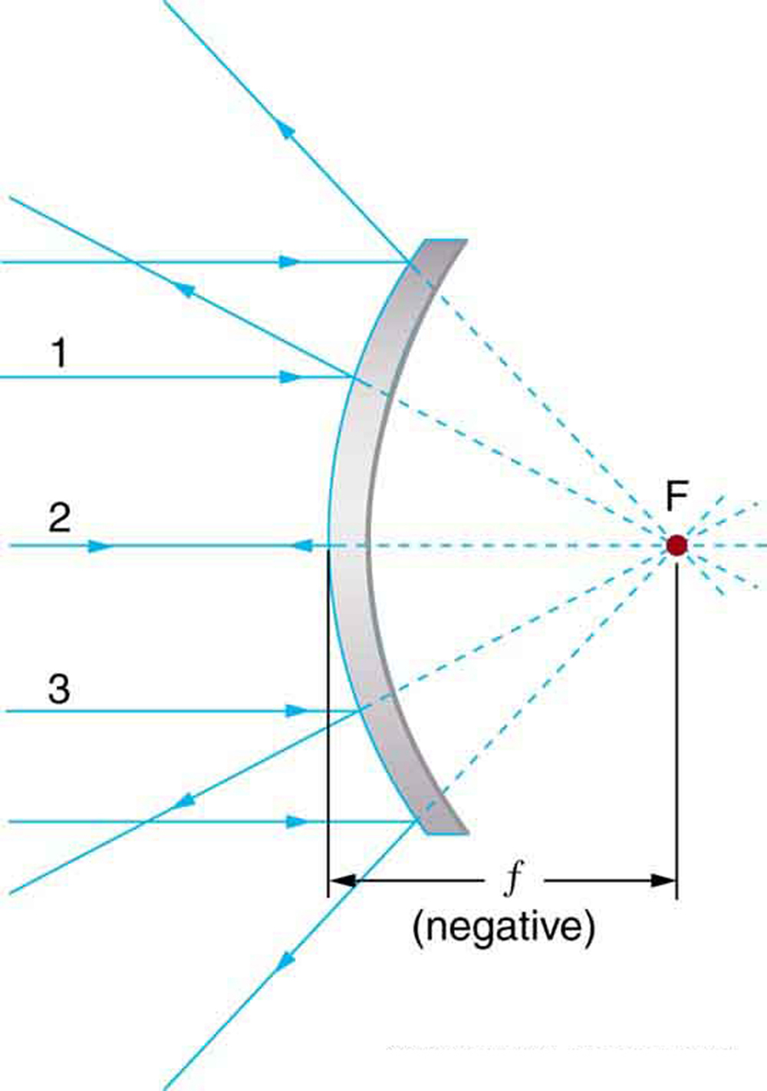
Convex Mirror

Slide 4
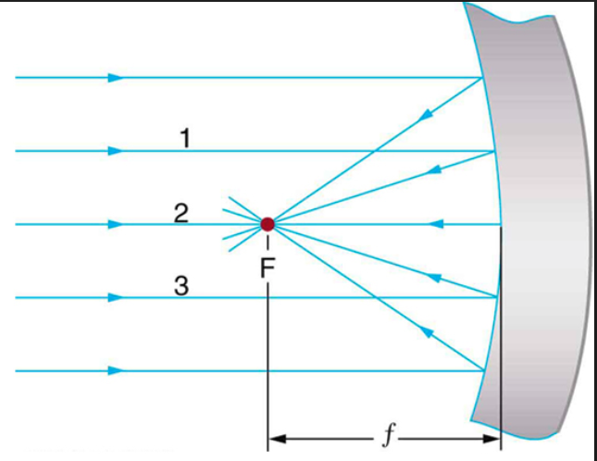
Concave Mirror

Slide 5
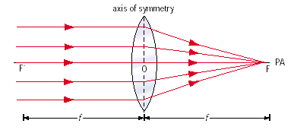
Convex (converging) Lens

Slide 6
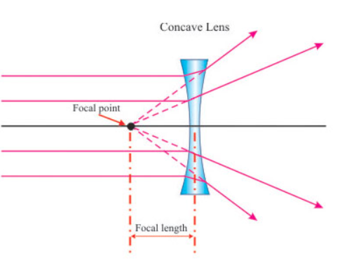
Concave (divergence) Lens

