Slide 1

College Accounting
A Contemporary Approach
Fourth Edition
Chapter 2
Analyzing Business Transactions
Copyright © 2017 McGraw-Hill Education. All rights reserved. No reproduction or distribution without the prior written consent of McGraw-Hill Education.
Notes:
PowerPoint Presentations for
College Accounting: A Contemporary Approach, 4th edition
By Haddock, Price, and Farina
Chapter 2-- Analyzing Business Transactions

Slide 2
Learning Objectives (1 of 2)
  SECTION 1: Property and Financial Interests
  2-1 Record in equation form the financial effects of a business transaction.
  2-2 Define, identify, and understand the relationship between asset, liability, and owner’s equity accounts.
  SECTION 2: The Accounting Equation and Financial Statements
  2-3 Analyze the effects of business transactions on a firm’s assets, liabilities, and owner’s equity and record these effects in accounting equation form.
Notes:
Chapter 1 introduced accounting by (1) defining accounting, (2) describing accounting career opportunities, and (3) identifying users of financial information. Chapter 2 illustrates basic accounting procedures by analyzing the business transactions of a sole proprietorship in a service business. The objectives of this chapter are listed here.
SECTION 1: Property and Financial Interests
2-1 Record in equation form the financial effects of a business transaction.
2-2 Define, identify, and understand the relationship between asset, liability, and owner’s equity accounts.
SECTION 2: The Accounting Equation and Financial Statements
2-3 Analyze the effects of business transactions on a firm’s assets, liabilities, and owner’s equity and record these effects in accounting equation form.
2-4 Prepare an income statement.
2-5 Prepare a statement of owner’s equity and a balance sheet.
2-6 Define the accounting terms new to this chapter.

Slide 3
Learning Objectives (2 of 2)
  2-4 Prepare an income statement.
  2-5 Prepare a statement of owner’s equity and a balance sheet.
  2-6 Define the accounting terms new to this chapter.

Slide 4
Meet Eli’s Consulting Services
Eli’s Consulting Services is a firm that provides a wide range of accounting and consulting services.
Trayton Eli, CPA is the sole proprietor of the firm.
Carlos Valdez is the office manager of the firm.
Every month the firm bills clients for the services provided that month.
Customers can also pay in cash when the services are provided.
Notes:
The accounting process starts with the analysis of business transactions. The accountant analyzes each business transaction to decide what information to record and where to record it. For example, purchases, sales, payments, and receipts of cash are all business transactions.
Let’s analyze some of the transactions of Eli’s Consulting Services. This is a brand new business.

Slide 5
Steps to Analyze the Effect of a Business Transaction
Describe the financial event.
  Identify the property.
  Identify who owns the property.
  Determine the amount of increase or decrease.
Make sure the equation is in balance.
Property (asset) = Financial Interest (creditors and owners)
Notes:
Let’s start from the beginning. Trayton Eli obtained the funds to start the business by withdrawing $100,000 from his personal savings account. The separate bank account helps Eli keep financial interest in the business separate from his personal funds.
When a business transaction occurs, it is analyzed to identify how it affects the equation property equals financial interest. This equation reflects the fact that in a free enterprise system, all property is owned by someone. The basic equation is Property (assets) = Financial Interest (creditor’s and owner’s). Property is anything of value the business “owns” (its assets) and financial interest represents what the business “owes” to its creditors or its owner.

Slide 6
Section 1: Property and Financial Interests
Learning Objective 2-1: Record in equation form the financial effects of a business transaction.
Notes:
Learning Objective 2-1: Record in equation form the financial effects of a business transaction.

Slide 7
Business Transaction (1 of 7)
Section 1, Objective 2-1: Record in equation form the financial effects of a business transaction.
Trayton Eli withdrew $100,000 from personal savings and deposited it in a new checking account in the name of Eli’s Consulting Services.
Analysis:
The business received $100,000 of property in the form of cash.
Eli has a $100,000 financial interest in the business.

Slide 8
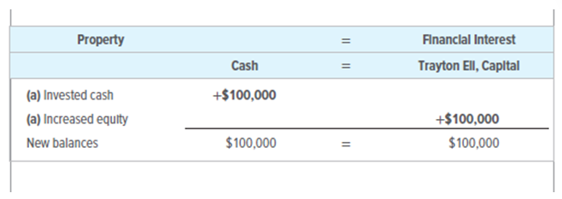
Business Transaction (2 of 7)
Section 1, Objective 2-1: Record in equation form the financial effects of a business transaction.
The owner invested cash into the business
Trayton Eli now has $100,000 equity in Eli’s Consulting Services.
Notes:
Objective 2-1:
To record this transaction, we increase Cash by $100,000. Cash is considered property in the business. To keep the equation in balance, we have to increase the right side of the equation by the same amount. Since the $100,000 came from the owner’s personal account, we increase the Trayton Eli, Capital account to show an increase in the amount the business “owes” the owner. After recording this transaction, the equation is still in balance.
What is equity? Equity or capital is the owner’s financial interest in a business. As the owner invests more of his/her personal funds into the business, his/her financial interest in the business increases. Equity is the amount that the business “owes” the owner.

Slide 9
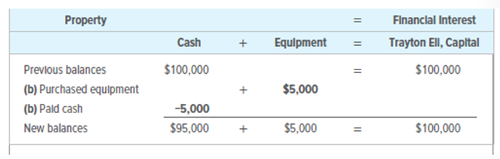
Business Transaction (3 of 7)
Section 1, Objective 2-1: Record in equation form the financial effects of a business transaction.
The company buys equipment for $5,000 cash
$100,000 = $100,000
Notes:
Objective 2-1:
In order to do business, the company needs to use some of the cash to purchase equipment. Eli’s Consulting Services issued a $5,000 check to purchase a computer and other equipment. In this transaction, cash was exchanged for equipment. Both cash and equipment are considered “property” so only the left side of the equation is affected.
To record the transaction, Cash decreases by $5,000, Equipment increases by $5,000. The left side of the equation totals $100,000 and the right side equals $100,000. After recording the purchase of the equipment in the equation, it shows that the total value of the property remains the same, Trayton Eli’s financial interest, or equity, is also unchanged.
Now lets see what happens when Eli’s Consulting purchases some additional equipment – this time on account or on credit.

Slide 10
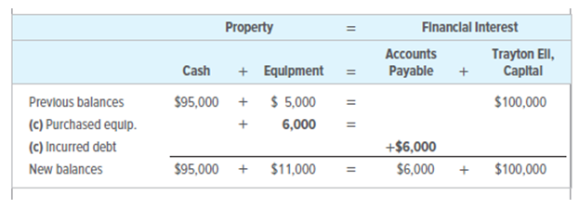
Business Transaction (4 of 7)
Section 1, Objective 2-1: Record in equation form the financial effects of a business transaction.
The company buys $6,000 of equipment on account (on credit)
$106,000 = $106,000
Notice the new claim against the firm’s property – the creditor’s claim of $6,000.
Notes:
Objective 2-1:
When a business is allowed to charge for a purchase and then pay for it at a later date, this is called buying “on account”. The business that is allowing you to purchase items on account is referred to as a “creditor.” A business needs to keep track of how much it owes to creditors. An account called Accounts Payable is used to accumulate the amount a business owes to creditors. In this account, the company purchases $6,000 of equipment on account. Take a look at the equation and how it changed.
After recording this transaction, the accounting equation remains in balance—the left side, total property increases to $106,000 and the right side has also increased to $106,000.

Slide 11
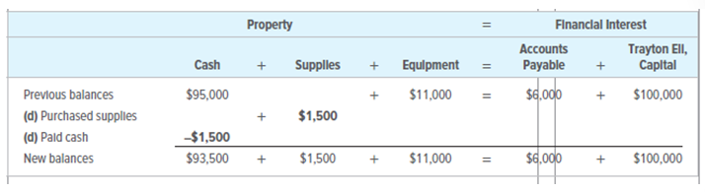
Business Transaction (5 of 7)
Section 1, Objective 2-1: Record in equation form the financial effects of a business transaction.
The firm purchases supplies for $1,500 cash
$106,000 = $106,000
Notes:
Objective 2-1:
In this transaction, the business purchased $1,500 of supplies so that it could start operations. Again we analyze the transaction to determine how to enter or record it into the equation.
An analysis of this transaction is as follows:
(d) The firm purchased office supplies that cost $1,500.
(d) The firm paid $1,500 in cash.
To record the transaction, we subtract $1,500 from cash. Supplies are a form of property now owned by the business so we increase it by $1,500. Since the transaction both increased and decreased only the left side of the equation for the same amount, the equation continues to equal $106,000 and it remains in balance.

Slide 12
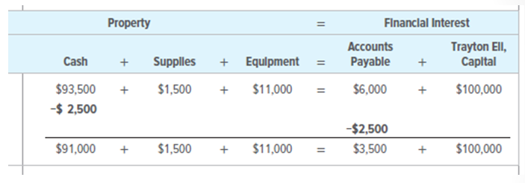
Business Transaction (6 of 7)
Section 1, Objective 2-1: Record in equation form the financial effects of a business transaction.
The firm makes a payment of $2,500 on account
$103,500 = $103,500
Notes:
Objective 2-1:
In this next transaction, the business is going to pay off part of its debt for the office equipment purchased earlier. In order to reduce its debt, Eli’s Consulting Services issued a check for $2,500 to an office supply store.
To record the transaction in the equation, cash decreased by $2,500 and Accounts Payable decreased by $2,500. Now Eli’s Consulting only owes $3,500 on the equipment purchase. After recording the transaction, the equation remains in balance. The left side (Property) equals $103,500 and the right side (Financial Interest) also equals $103,500.

Slide 13
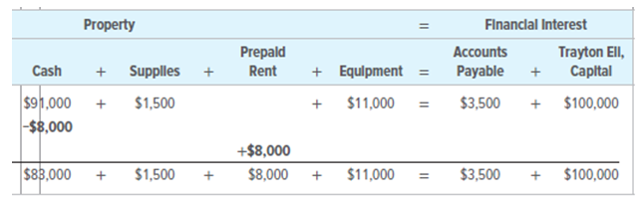
Business Transaction (7 of 7)
Section 1, Objective 2-1: Record in equation form the financial effects of a business transaction.
The firm makes a payment of $8,000 rent in advance
$103,500 = $103,500
Notes:
Objective 2-1:
The business’s landlord requires the first two months of rent to be paid in advance. As a result, the firm obtained the right to occupy facilities for a two-month period. In accounting this right is considered a form of property.
To record the transaction, we reduce cash by $8,000. We also need to add a new account ‘Prepaid Rent’ to the left side of the equation. We increase this account by $8,000. After recording the transaction, the accounting equation remains in balance $103,500 on the left and $103,500 on the right.

Slide 14
Section 1: Property and Financial Interests
Learning Objective 2-2: Define, identify, and understand the relationship between asset, liability, and owner’s equity accounts.
Notes:
Section 1: Learning Objective 2-2: Define, identify, and understand the relationship between asset, liability, and owner’s equity accounts.

Slide 15
Assets, Liabilities, and Owner’s Equity
Section 1, Objective 2-1: Record in equation form the financial effects of a business transaction.
QUESTION:
What are assets?
ANSWER:
Assets are property owned by a business.
Notes:
Section 1, Objective 2-2: Define, identify, and understand the relationship between asset, liability, and owner’s equity accounts.
The second objective of chapter 2 is to define, identify, and understand the relationship between asset, liability, and owner’s equity accounts.
Accountants use special accounting terms when they refer to property and financial interests. For example, they refer to the property that a business owns as assets. The value of an asset is tied to its revenue-generating capacity.

Slide 16
Liabilities and Equity
Section 1, Objective 2-2: Define, identify, and understand the relationship between asset, liability, and owner’s equity accounts.
QUESTION:
What are liabilities?
ANSWER:
Liabilities are debts or obligations of a business
QUESTION:
What is owner’s equity?
ANSWER:
Owner’s equity is the term used by sole proprietorships. It is the financial interest of an owner of a business. It is also called proprietorship or net worth.
Notes:
Objective 2-2:
Accountants refer to the debts or obligations of the business as liabilities. A good example of a liability is the Accounts Payable or debt the business incurred when it purchased equipment on account.
Owner’s Equity is the term used by accountants to keep track of the owner’s financial interest in the business.

Slide 17
Balance Sheet (1 of 2)
Section 1, Objective 2-2: Define, identify, and understand the relationship between asset, liability, and owner’s equity accounts.
QUESTION:
What is a Balance Sheet?
ANSWER:
A balance sheet is a formal report of the financial position of a business on a certain date. It reports the assets, liabilities, and owner’s equity of the business
Notes:
Objective 2-2:
At regular intervals Trayton reviews the status of the firm’s assets, liabilities and owner’s equity in a financial statement called a balance sheet.
The balance sheet shows the firm’s financial position on a given date. It reports the assets, liabilities, and owner’s equity of the business.

Slide 18
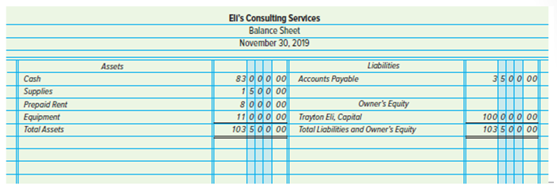
Balance Sheet (2 of 2)
Section 1, Objective 2-2: Define, identify, and understand the relationship between asset, liability, and owner’s equity accounts.
10350000: Assets – the amount and types of property owned by the business
350000: Liabilities – the amount owed to the creditors
10350000: Equity – the owner’s interest
Notes:
Objective 2-2:
If we look at Eli’s Consulting Services’ balance sheet, which was prepared on November 30 after its first month of operations, we can see that the business has total assets of $103,500 and owes $3,500 to creditors. The owner’s financial interest in the business (Trayton Eli, Capital) is $100,000.

Slide 19
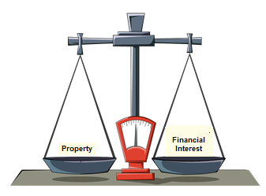
Property Equals Financial Interest
Section 1, Objective 2-2: Define, identify, and understand the relationship between asset, liability, and owner’s equity accounts.

Slide 20
Section 2: The Accounting Equation and Financial statements
Learning Objective 2-3: Analyze the effects of business transactions on a firm’s assets, liabilities, and owner’s equity and record these effects in accounting equation form.
Notes:
Section 2, Objective 2-3: The third objective of chapter 2 is to analyze the effects of business transactions on a firm’s assets, liabilities, and owner’s equity and record these effects in accounting equation form. In this section we will also learn how to prepare financial statements.
We will continue to record transactions for Eli’s Consulting Services using this fundamental accounting equation.

Slide 21
The Fundamental Accounting Equation (1 of 2)
Section 2, Objective 2-3: Analyze the effects of business transactions on a firm’s assets, liabilities, and owner’s equity and record these effects in accounting equation form.
QUESTION:
What is the fundamental accounting equation?
ANSWER:
The fundamental accounting equation is the relationship between assets and liabilities plus owner’s equity.
Notes:
In accounting terms the firm’s assets must equal the total of its liabilities and owner’s equity. We use the fundamental accounting equation to ensure that this relationship is in place.

Slide 22
The Fundamental Accounting Equation (2 of 2)
Section 2, Objective 2-3: Analyze the effects of business transactions on a firm’s assets, liabilities, and owner’s equity and record these effects in accounting equation form.
In accounting terms the firm’s assets must equal the total of its liabilities and owner’s equity.
This equality can be expressed in equation form as:
Assets = Liabilities + Owner’s Equity
The entire accounting process of analyzing, recording and reporting business transactions is based on the fundamental accounting equation.
If any two parts of the equation are known, the third part can be determined.
Notes:
This equality can be expressed in equation form. The relationship between assets and liabilities plus owner’s equity is called the fundamental accounting equation. All business transactions are recorded with this accounting equation in mind. It must always remain in balance.

Slide 23
Revenues
Section 2, Objective 2-3: Analyze the effects of business transactions on a firm’s assets, liabilities, and owner’s equity and record these effects in accounting equation form.
QUESTION:
What is revenue?
ANSWER:
A revenue is an inflow of money or other assets that results from the sales of goods or services or from the use of money or property. It is also called income.
Notes:
When a business performs a service or sells a product it generates revenue. Eli’s Consulting Services earns revenue by performing accounting and bookkeeping services for its clients.

Slide 24
Expenses
Section 2, Objective 2-3: Analyze the effects of business transactions on a firm’s assets, liabilities, and owner’s equity and record these effects in accounting equation form.
QUESTION:
What is an expense?
ANSWER:
An expense is an outflow of cash, use of other assets, or incurring of a liability.
Notes:
Expenses on the other hand, involve the outflow of money, the use of other assets, or the incurring of a liability. Expenses include the costs of any materials, labor, supplies, and services used to produce revenue.

Slide 25
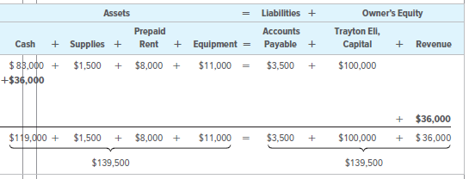
Business Transaction (1 of 6)
Section 2, Objective 2-3: Analyze the effects of business transactions on a firm’s assets, liabilities, and owner’s equity and record these effects in accounting equation form.
The firm receives $36,000 in cash for services provided to clients
Notes:
Consider this transaction: During the month of December, Eli’s Consulting Services earned a total of $36,000 in revenue in cash from clients.
An increase in revenue is an increase in owner’s equity. When the business earns revenue, it is really the owner who benefits.
Here is an analysis of the transaction:
(g) The firm received $36,000 in cash for services provided to clients. Increase cash to show that our bank account increased with the influx of the cash received.
(g) Revenues increased by $36,000, which results in a $36,000 increase in owner’s equity.
Notice that revenue amounts are recorded in a separate column under owner’s equity. Keeping revenue separate from the owner’s equity will help the firm compute total revenue more easily when the financial statements are prepared.
Let’s take a look at how a transaction for services provided on account would be recorded next.

Slide 26
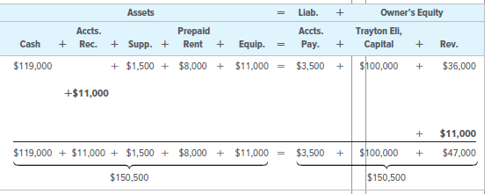
Business Transaction (2 of 6)
Section 2, Objective 2-3: Analyze the effects of business transactions on a firm’s assets, liabilities, and owner’s equity and record these effects in accounting equation form.
The company performs services on account for $11,000
Notes:
Here we see accounts receivable, an asset, has been added to the accounting equation. We use accounts receivable when someone owes us money for something. To record the earning of the $11,000 of revenue on account, we increase accounts receivable by $11,000 and increase the revenue account by the same amount. The accounting equation remains in balance.

Slide 27
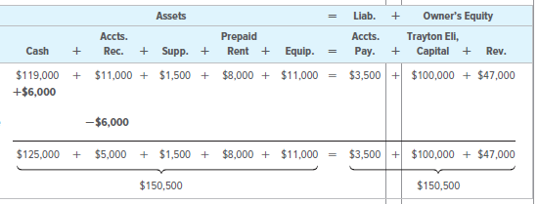
Business Transaction (3 of 6)
Section 2, Objective 2-3: Analyze the effects of business transactions on a firm’s assets, liabilities, and owner’s equity and record these effects in accounting equation form.
Collection of $6,000 from customers on account
Notes:
Previously, the business recorded some revenue earned from providing customers with services on credit. Now, some of those customers are paying the amount they owe.
During December Eli’s Consulting Services received $6,000 on account from clients who owed money for services previously billed. The effect of these transactions is analyzed below.
The firm received $6,000 in cash and accounts receivable went down by $6,000
Notice that cash is going up and accounts receivable is going down. This is called a “shift” in assets because we are replacing one asset for a different asset. The amount still owed by charge clients after the collection is $5,000. After recording the transaction, the accounting equation remains in balance, $150,500 = $150,500.
Notice that when we collect from a client on account, we do not increase the revenue account again for this transaction. This would duplicate the revenue for the same work.

Slide 28
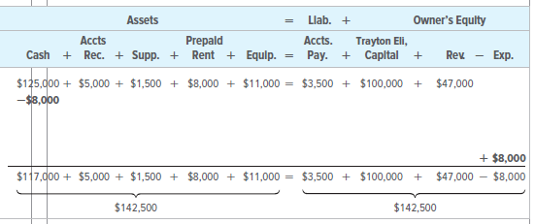
Business Transaction (4 of 6)
Section 2, Objective 2-3: Analyze the effects of business transactions on a firm’s assets, liabilities, and owner’s equity and record these effects in accounting equation form.
The firm pays $8,000 in salaries expense for the month
Notes:
So far the business has been doing well, but running a business costs money and these expenses reduce owner’s equity. During the first month of operation, Eli’s Consulting Services hired an accounting clerk and now it is time to pay her for her work. Her salary is considered an expense to the firm.
In December Eli’s Consulting Services paid $8,000 in salaries for the accounting clerk and the office manager. The effect of this transaction is analyzed below.
(j) The firm decreased its cash balance by $8,000.
(j) The firm paid salaries expense in the amount of $8,000, which decreased owner’s equity.
To record this payment of the accountant’s salary, the cash account is reduced by $8,000 and the Owner’s Equity is also reduced by $8,000. We are going to keep track of expenses in a separate column under owner’s equity heading called “expenses”. Notice that total assets and total liabilities plus owner’s equity both equal $142,500. Notice too, that while expenses are added to that column (+), the total of expenses is always subtracted since expenses DECREASE owner’s equity.

Slide 29
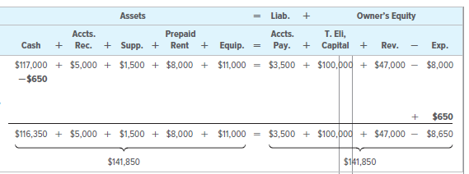
Business Transaction (5 of 6)
Section 2, Objective 2-3: Analyze the effects of business transactions on a firm’s assets, liabilities, and owner’s equity and record these effects in accounting equation form.
The firm pays $650 for utilities expenses
Notes:
Heat, light, telephone and water are all utility expenses which the firm incurs in doing business. As these bills come in, the business must record the expenses.
Eli’s Consulting Services issued a check for $650 to pay the utilities bill. The effect of this transaction is analyzed below.
(k) The firm decreased its cash balance by $650.
(k) The firm paid utilities expense of $650, which decreased owner’s equity.
In the accounting equation, cash is reduced by the $650 check payment and owner’s equity is also decreased by the same amount. Notice that as total expenses go up, it causes the total owner’s equity to go down. The accounting equation remains in balance.

Slide 30
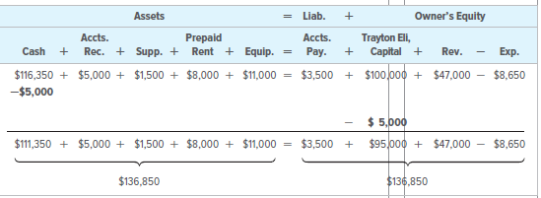
Business Transaction (6 of 6)
Section 2, Objective 2-3: Analyze the effects of business transactions on a firm’s assets, liabilities, and owner’s equity and record these effects in accounting equation form.
The firm records a withdrawal by the owner of $5,000
Notes:
At the end of December, Trayton Eli withdrew $5,000 in cash for personal use. The effect of this transaction is analyzed below:
Withdrawals are not considered a business expense but a decrease in the owner’s equity.
Cash is going down by the $5,000 withdrawal of cash and the total owner’s equity is going down by the same amount. Remember that when we recorded the investment in the business, we recorded an increase in Trayton Eli, Capital account. Now, when the owner withdraws funds for personal use, we decrease the Trayton Eli, Capital account for the withdrawal. After recording the withdrawal, the owner’s capital account has a balance of $95,000. The accounting equation still remains in balance. Notice that while amounts taken out of the business by the owner decrease owner’s capital, in practice, we use a separate account called “drawing” which acts like an expense account; it is INCREASED every time there is a withdrawal of assets by the owner for personal use, but like expenses, the drawing account DECREASES owner’s equity.

Slide 31
Section 2:The Accounting Equation and Financial Statements
Learning Objective 2-4: Prepare an Income Statement
Notes:
Section 2: Learning Objective 2-4: Prepare an Income Statement

Slide 32
Income Statement (1 of 3)
Section 2, Objective 2-4: Prepare an Income Statement
QUESTION:
What is an income statement?
ANSWER:
An income statement is a formal report of business operations covering a specific period of time. It is also called a profit and loss statement or a statement of income and expenses.
Notes:
Section 2, Objective 2-4: Prepare an Income Statement
Earlier in the chapter, we looked at one financial statement called the balance sheet which showed total assets, total liabilities or debts, and total owner’s equity. In objective 4 of the chapter, we are going to look at another financial statement of the business which is called the income statement.
Unlike the balance sheet which is dated on a specific date, the income statement is for a period of time such as a month, a quarter, or a year and it is the first financial statement prepared for an accounting period. The income statement shows the revenue earned and the expenses incurred for that specified period of time. You may hear it referred to as a profit and loss statement or a statement of income and expenses.
If total revenue is greater than total expenses, then the difference is called “net income.” However, if during the period expenses are greater then total revenue, then the difference is a net loss.
In the rare case when revenue and expenses are equal, the firm is said to break even.

Slide 33
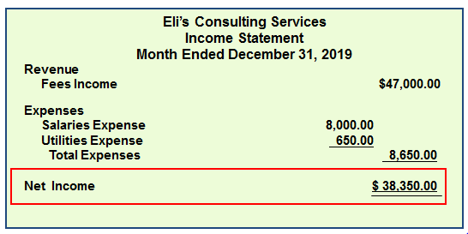
Income Statement (2 of 3)
Section 2, Objective 2-4: Prepare an Income Statement
Notes:
Objective 2-4: Prepare an Income Statement
In preparing a formal income statement for a business, the heading contains three lines: Who, What, When. The top line contains the name of the business. The second line shows the name of the financial statement and the third line called the date line, describes the period of time for which the financial statement covers. This financial statement is only for one month’s worth of revenues and expenses.

Slide 34
Income Statement (3 of 3)
Section 2, Objective 2-4: Prepare an Income Statement
The income statement has a three-line heading
The third line shows that the report covers operations over a period of time
The income statement reports revenue
The income statement also reports expenses
The result is net income or net loss for the period
Notes:
Objective 2-4: Prepare an Income Statement
Under the heading of Revenues, there is only one listed revenue account—Fees Income. For the month of December, total Fees Income was $47,000.
Below the Revenue section is the Expenses section. All expenses are listed individually and then totaled. For the month of December, total expenses are $8,650.
For the month of December, Eli’s Consulting Services earned $47,000 of revenues and had total expenses of $8,650. The difference of $38,350 is the net income for the month. (If the expenses would have been more than the revenues, the bottom line of the Income Statement would have been a Net Loss.)

Slide 35
Section 2: The Accounting Equation and Financial Statements
Learning Objective 2-5: Prepare a Statement of Owner’s Equity and Balance Sheet
Notes:
Section 2, Learning Objective 2-5: Prepare a Statement of Owner’s Equity and Balance Sheet

Slide 36
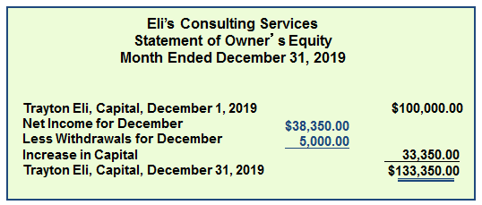
A Statement of Owner’s Equity
Section 2, Objective 2-5: Prepare a Statement of Owner’s Equity and Balance Sheet
Notes:
Learning Objective 2-5: Prepare a Statement of Owner’s Equity and Balance Sheet
Note that the statement of owner’s equity has a three-line heading: who, what, and when. Let’s take a look at this statement on a line item by line item basis:
The first line is the amount of the owner’s capital at the start of the period.
The next line is net income which caused owner’s equity to go up. If there had been a net loss reported on the income statement, then the net loss would have caused a decrease in owner’s equity.
Withdrawals by the owner are a decrease to owner’s equity.
The total of changes in equity is reported on the line “Increase in Capital” or (“Decrease in Capital”). This is the difference between the net income and the withdrawals.
The last line of the statement of owner’s equity is the capital balance at the end of the period.

Slide 37
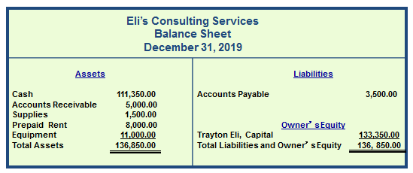
The Balance Sheet
Section 2, Objective 2-5: Prepare a Statement of Owner’s Equity and Balance Sheet
A single line shows that the amounts above it are being added or subtracted.
A double line indicates final amounts for the column or section of a report.
Notes:
Learning Objective 2-5: Prepare a Statement of Owner’s Equity and Balance Sheet
In preparing a balance sheet, remember the three line heading: who, what and when.
The when (date) line on the balance sheet is only good for one day but the other two financial statement date lines show a period of time. Put another way, the income statement and the statement of owner’s equity are like a movie covering a period of time but the balance sheet is only a snap shot of one day.
Note that the ending capital balance from the statement of owner’s equity is also used to prepare the balance sheet. Dollar signs are omitted when financial statements are prepared on paper with ruled columns.

Slide 38
The Importance of Financial Statements (1 of 2)
Section 2, Objective 2-5: Prepare a Statement of Owner’s Equity and Balance Sheet
Business managers and owners use the balance sheet and the income statement to control current operations and plan for the future.
Creditors, prospective investors, governmental agencies, and others are interested in the profits of the business and in the asset and equity structure.
Notes:
Learning Objective 2-5: Prepare a Statement of Owner’s Equity and Balance Sheet
Preparing financial statements is one of the accountant’s most important jobs. Each day millions of business decisions are made based on the information in financial statements.

Slide 39
The Importance of Financial Statements (2 of 2)
Section 2, Objective 2-5: Prepare a Statement of Owner’s Equity and Balance Sheet
  Financial statements are always prepared in a specific order
  1st Income Statement
  2nd Statement of Owner’s equity
  3rd Balance Sheet
Notes:
Learning Objective 2-5: Prepare a Statement of Owner’s Equity and Balance Sheet
Financial statements are always prepared in a certain order.

Slide 40
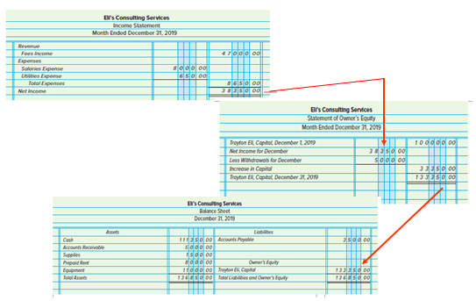
Financial Statements (1 of 2)
Section 2, Objective 2-5: Prepare a Statement of Owner’s Equity and Balance Sheet
Notes:
Learning Objective 2-5: Prepare a Statement of Owner’s Equity and Balance Sheet
Spend a few more minutes reviewing the flow of the data from one financial statement to another. Notice that net income (or loss) is transferred to the statement of owner’s equity. The ending capital balance is then transferred to the balance sheet. These financial statements will be used throughout the term. They are very important. Make sure you are familiar with them and can prepare them before moving on to the next chapter.

Slide 41
Financial Statements (2 of 2)
Section 2, Objective 2-5: Prepare a Statement of Owner’s Equity and Balance Sheet
Net income (or loss) is transferred to the statement of owner’s equity.
The ending capital balance is transferred to the balance sheet.

