Slide 1
College Accounting A Contemporary Approach
Fourth Edition
Chapter 3
Analyzing Business Transactions Using T Accounts
Copyright © 2017 McGraw-Hill Education. All rights reserved. No reproduction or distribution without the prior written consent of McGraw-Hill Education.
Notes:
Chapter 3--Analyzing Business Transactions Using T Accounts
Price, Haddock, and Farina College Accounting, 15th Edition
Chapter 3--Analyzing Business Transactions Using T Accounts

Slide 2
Learning Objectives (1 of 2)
SECTION 1: Transactions That Affect Assets, Liabilities, and Owner’s Equity
3-1 Set up T accounts for assets, liabilities, and owner’s equity.
3-2 Analyze business transactions and enter them in the accounts.
3-3 Determine the balance of an account.
Notes:
Chapter 2 illustrated basic relationships in the accounting equation and showed how to prepare financial statements. Chapter 3 introduces tools accountants use to analyze business transactions, as well as the chart of accounts.
The objectives of this chapter are listed here.
SECTION 1: Transactions That Affect Assets, Liabilities, and Owner’s Equity
3-1 Set up T accounts for assets, liabilities, and owner’s equity.
3-2 Analyze business transactions and enter them in the accounts.
3-3 Determine the balance of an account.
SECTION 2: Transactions That Affect Revenue, Expenses, and Withdrawals
3-4 Set up T accounts for revenue and expenses.
3-5 Prepare a trial balance from T accounts.
3-6 Prepare an income statement, a statement of owner’s equity, and a balance sheet.
3-7 Develop a chart of accounts.
3-8 Define the accounting terms new to this chapter.

Slide 3
Learning Objectives (2 of 2)
SECTION 2: Transactions That Affect Revenue, Expenses, and Withdrawals
3-4 Set up T accounts for revenue and expenses.
3-5 Prepare a trial balance from T accounts.
3-6 Prepare an income statement, a statement of owner’s equity, and a balance sheet.
3-7 Develop a chart of accounts.
3-8 Define the accounting terms new to this chapter.

Slide 4
Section 1: Transactions That Affect Assets, Liabilities, and Owner’s Equity
Learning Objective 3-1: Set up T accounts for assets, liabilities, and owner’s equity.
Notes:
Learning Objective 3-1: Set up T accounts for assets, liabilities, and owner’s equity.

Slide 5
The Accounting Equation
Section 1, Objective 3-1: Set up T accounts for assets, liabilities, and owner’s equity.
ASSETS (The property a business owns) = LIABILITIES (The debts of the business) + OWNER’S EQUITY (The owner’s financial interest in the business)
Notes:
Section 1, Objective 3-1:
In the first objective of the chapter we will learn how to set up T accounts for all assets, liabilities, and owner’s equity accounts.
The accounting equation is one tool for analyzing the effects of business transactions. However, businesses do not record transactions in equation form. Instead, businesses establish separate records, called accounts for assets, liabilities, and owner’s equity. Accounts are written records of the assets, liabilities, and owner’s equity of a business. Use of accounts helps owners and staff analyze, classify, record, summarize, and report financial information.

Slide 6
Classification of Accounts
Section 1, Objective 3-1: Set up T accounts for assets, liabilities, and owner’s equity.
Asset Accounts: Asset accounts show the property a business owns.
Liability Accounts: Liability accounts show the debts of the business.
Owner’s Equity Accounts: Owner’s equity accounts show the owner’s financial interest in the business.
Notes:
Section 1, Objective 3-1:
Accounts are recognized by their classification as assets, liabilities, or owner’s equity.
Asset accounts show the property a business owns. Liability accounts show the debts of the business. Owner’s equity accounts show the owner’s financial interest in the business.

Slide 7
T Accounts
Section 1, Objective 3-1: Set up T accounts for assets, liabilities, and owner’s equity.
Accountants use T accounts to analyze transactions. A T account consists of a vertical line and a horizontal line that resembles the letter T. T accounts are helpful when analyzing transactions.
These are examples of T accounts for assets, liabilities, and owner’s equity.
Notes:
Section 1, Objective 3-1:
Objective one is to set up T-accounts for assets, liabilities, and owner’s equity accounts. Accountants use T accounts to analyze transactions. A T-account consists of a vertical line and a horizontal line that resembles the letter T. T- accounts are helpful when analyzing transactions.
Above are examples of T accounts for assets, liabilities, and owner’s equity. Using T accounts simplifies recordkeeping by grouping all transactions of a particular type together. Note that Assets are on the left side of the accounting equation, to increase any asset account you have to record the $ amount on the left side of the T account. Since Liabilities and Owner’s Capital are on the right side of the accounting equation, to increase those accounts you would record the $ amount on the right side of the T account.

Slide 8
Section 1: Transactions That Affect Assets, Liabilities, and Owner’s Equity
Learning Objective 3-2: Analyze business transactions and enter them in the accounts.
Notes:
Learning Objective 3-2: Analyze business transactions and enter them in the accounts.

Slide 9
Effects of Business Transactions
Section 1, Objective 3-2: Analyze business transactions and enter them in the accounts.
Steps to analyze the effects of the business transactions:
Analyze the financial event.
Identify the accounts affected.
Classify the accounts affected.
Determine the amount of increase or decrease for each account.
Apply the left-side-right-side rules for each account affected.
Make the entry in T-account form.
Notes:
Section 1, Objective 3-2:
Objective two is to analyze business transactions and enter them in the accounts. Take a look at the three steps shown and keep them in mind as we go through the transactions. Now that we know the rules regarding increasing and decreasing asset, liability and the owner’s capital account, let’s record some transactions.

Slide 10
Initial Investment
Section 1, Objective 3-2: Analyze business transactions and enter them in the accounts.
Trayton Eli withdrew $100,000 from personal savings and deposited it in the new business checking account for Eli’s Consulting Services.
LEFT Increases to asset accounts are recorded on the left side of the T account.
RIGHT Increases to owner’s equity accounts are recorded on the right side of the T account.
Notes:
Section 1, Objective 3-2:
Let’s consider the initial investment of an owner. For this transaction, lets assume that Trayton Eli withdrew $100,000 from personal savings and deposited it in the new business checking account for Eli’s Consulting Services.
Remember that assets are on the left side of the accounting equation so to increase them we would record the entry on the left. Because owner’s equity is on the right side of the accounting equation, to increase them we would record the entry on the right side of the T account.
Analysis:
(a) The asset account, Cash, is increased by $100,000.
(a) The owner’s equity account, Trayton Eli, Capital, is increased by $100,000.
Since investments cause cash to go up, we would record the $100,000 cash increase on the left side of the Cash T account. Since the investment causes the owner’s capital account to go up, we would record the $100,000 investment on the right side of the Capital account.
Remember that debits must always equal credits! ALWAYS!

Slide 11
Business Transaction
Section 1, Objective 3-2: Analyze business transactions and enter them in the accounts.
Eli’s Consulting Services issued a $5,000 check to purchase a computer and other equipment.
Analysis:
(b) The asset account, Equipment, is increased by $5,000.
(b) The asset account, Cash, is decreased by $5,000.
Notes:
Section 1, Objective 3-2:
Our next transaction is when the business purchased equipment for cash.
Eli’s Consulting Services issued a $5,000 check to purchase a computer and other equipment.
Analysis:
(b) The asset account, Equipment, is increased by $5,000.
(b) The asset account, Cash, is decreased by $5,000.
Since equipment is going up, we would record the $5,000 equipment increase on the left side of the Equipment T account. Since the check causes the Cash account to go down, we would record the $5,000 outlay of cash on the right side of the Cash account.

Slide 12
Purchase of Equipment on Account (1 of 2)
Section 1, Objective 3-2: Analyze business transactions and enter them in the accounts.
The firm bought office equipment for $6,000 on account from Office Plus.
Analysis:
(c) The asset account, Equipment, is increased by $6,000.
(c) The liability account, Accounts Payable, is increased by $6,000.
Notes:
Section 1, Objective 3-2:
Our next transaction for the purchase of office supplies can also be recorded using T accounts. Since Supplies is going up, and it is an asset, we will increase this account on the left. Cash is the other account affected. It is also an asset, so we would decrease it by an entry on the right side of the T account.

Slide 13
Purchase of Equipment on Account (2 of 2)
Section 1, Objective 3-2: Analyze business transactions and enter them in the accounts.

Slide 14
Purchase of Supplies for Cash (1 of 2)
Section 1, Objective 3-2: Analyze business transactions and enter them in the accounts.
Eli’s Consulting Services issued a check for $1,500 to Office Delux Inc. to purchase office supplies.
Analysis:
(d) The asset account, Supplies, is increased by $1,500.
(d) The asset account, Cash, is decreased by $1,500.
Notes:
Section 1, Objective 3-2:
Our next transaction for the purchase of office supplies can also be recorded using T accounts. Since Supplies is going up, and it is an asset, we will increase this account on the left. Cash is the other account affected. It is also an asset, so we would decrease it by an entry on the right side of the T account.

Slide 15
Purchase of Supplies for Cash (2 of 2)
Section 1, Objective 3-2: Analyze business transactions and enter them in the accounts.

Slide 16
Payment of a Liability (1 of 2)
Section 1, Objective 3-2: Analyze business transactions and enter them in the accounts.
Eli’s Consulting Services issued a check in the amount of $2,500 to Office Plus.
Analysis:
(e) The asset account, Cash, is decreased by $2,500.
(e) The liability account, Accounts Payable, is decreased by $2,500.
Notes:
Section 1, Objective 3-2:
Recall that the firm purchased equipment earlier on account. It is now paying part of that liability by issuing a check to the vendor, Office Plus.
Remember that assets are on the left side of the accounting equation so to increase them we would record the entry on the left. However, since this transaction involves a decrease in an asset account, we need to record the entry on the right side of the asset account. Because liabilities are on the right side of the accounting equation, to increase them we would record the entry on the right side of the T account. However, in this transaction, since we want to decrease the liability account, we need to record the dollar amount on the left side of the T account. Since Accounts Payable is going down, we will decrease it by entering a $2,500 entry on the left side of the T account. Since the Cash account is going down by the same amount, we will enter the $2,500 amount in the right side of the Cash T account.

Slide 17
Payment of a Liability (2 of 2)
Section 1, Objective 3-2: Analyze business transactions and enter them in the accounts.

Slide 18
Prepayment of Rent (1 of 2)
Section 1, Objective 3-2: Analyze business transactions and enter them in the accounts.
Eli’s Consulting Services issued a check for $8,000 to pay rent for the months of December and January.
Analysis:
(f) The asset account, Prepaid Rent, is increased by $8,000.
(f) The asset account, Cash, is decreased by $8,000.
Notes:
Section 1, Objective 3-2:
When the business pays for two or more months of rent in advance, they are exchanging one asset, Cash, for another asset, Prepaid Rent. Remember that assets are on the left side of the accounting equation so to increase them we would record the entry on the left. Since we also want to decrease a different asset account, we need to record the entry on the right side of that asset account.
Since the Prepaid Rent account is going up, we will increase it by entering a $8,000 entry on the left side of the T account. Since the Cash account is going down by the same amount, we will enter the $8,000 amount in the right side of the Cash T account,

Slide 19
Prepayment of Rent (2 of 2)
Section 1, Objective 3-2: Analyze business transactions and enter them in the accounts.
Notes:
Section 1, Objective 3-2:
When the business pays for two or more months of rent in advance, they are exchanging one asset, Cash, for another asset, Prepaid Rent. Remember that assets are on the left side of the accounting equation so to increase them we would record the entry on the left. Since we also want to decrease a different asset account, we need to record the entry on the right side of that asset account.
Since the Prepaid Rent account is going up, we will increase it by entering a $8,000 entry on the left side of the T account. Since the Cash account is going down by the same amount, we will enter the $8,000 amount in the right side of the Cash T account,

Slide 20
Section 1: Transactions That Affect Assets, Liabilities, and Owner’s Equity
Learning Objective 3-3: Determine the balance of an account
Notes:
Learning Objective 3-3: Determine the balance of an account

Slide 21
Account Balance
Section 1, Objective 3-3: Determine the balance of an account
An account balance is the difference between the amounts recorded on the two sides of an account.
A footing is a small pencil figure written at the base of an amount column showing the sum of the entries in the column.
Notes:
Section 1, Objective 3-3:
Objective three shows us how to determine the balance of a T account. An account balance is the difference between the amounts recorded on the two sides of an account. It can be computed at any time.
When we “foot” a column, this means to add down and write the total at the bottom of the column. Subtract the smaller of the two totals from the larger of the two totals– the result is the account balance.

Slide 22
Recording Account Balances
Section 1, Objective 3-3: Determine the balance of an account
IF | THEN
The total on the right side is larger than the total on the left side, | The balance is recorded on the right side.
The total on the left side is larger, | The balance is recorded on the left side.
An account shows only one amount, | That amount is the balance.
An account contains entries on only one side, | The total of those entries is the account balance.
Notes:
Section 1, Objective 3-3:
When we determine the balance of an account, we add both sides of the T account and then subtract the smaller side from the larger side. The difference is the “balance” of the account.
Calculating account balances simply means adding up or “footing” the total of both sides of the T-account. Use footings for columns that have more than one entry. Then subtract the smaller total from the larger total. The result is the account balance. You will see a demonstration of this in the next slide.
This table shows the possible balance alternatives that could exist in an account.

Slide 23
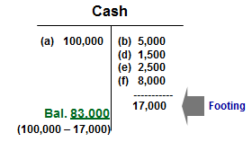
Computing the Account Balance
Section 1, Objective 3-3: Determine the balance of an account
Notes:
Section 1, Objective 3-3:
To determine the balance of the Cash account, we would add (foot) the total of the right side, which equal $17,000. Since this side is smaller than the left side, we would subtract the $17,000 from the larger $100,000 left side. The difference is a left side balance of $83,000 in the Cash account.

Slide 24
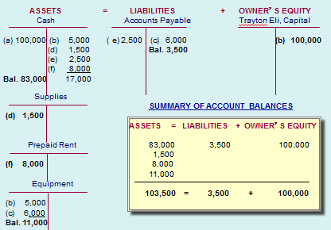
Summary of Account Balances
Section 1, Objective 3-3: Determine the balance of an account
Notes:
Section 1, Objective 3-3:
Here is a visual presentation of the T accounts and their balances at the end of the month. Notice that the total of all the asset account balances equal the total of the liabilities and owner’s equity. $103,500 = $103,500. As you look at this slide, notice which side of the account the balance is on. All accounts have a “normal” balance. This is the side that receives the increase.
You will notice that assets have a normal left side balance, or debit. Liabilities have a normal right side balance, or credit. And the owner’s equity account, specifically capital, has a normal right side or credit balance. It’s important to recognize that all accounts have “normal balances.”

Slide 25
Section 2: Transactions That Affect Revenue, Expenses, and Withdrawals
Learning Objective 3-4: Set up T accounts for revenue and expenses.
Notes:
Learning Objective 3-4: Set up T accounts for revenue and expenses .
Section 2 of this chapter shows us how to record revenue, expense and withdrawal transactions into T accounts. The fourth objective of the chapter explains how to set up T accounts for these additional accounts. Let’s get started.

Slide 26
T-Account for Revenue (1 of 2)
Section 2, Objective 3-4: Set up T accounts for revenue and expenses.
Revenues increase owner’s equity.
Increases in owner’s equity appear on the right side of the T account.
Therefore, increases in revenue appear on the right side of revenue T accounts
Notes:
Section 2, Objective 3-4:
We know that revenues increase owner’s equity. Since we know that increases in owner’s equity appear on the right side of the T account, then increases in revenue will appear on the right side of revenue T accounts as well.

Slide 27
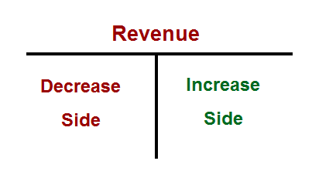
T-Account for Revenue (2 of 2)
Section 2, Objective 3-4: Set up T accounts for revenue and expenses.
The right side of the revenue account shows increases and the left side shows decreases.
Decreases in revenue accounts are rare but might occur because of corrections or transfers.
Notes:
Section 2, Objective 3-4:
To increase a revenue account, we would credit the account. If we would want to decrease the account we would do the opposite, so we would debit the account.

Slide 28
Recording $36,000 of Revenue from Services Sold for Cash
Section 2, Objective 3-4: Set up T accounts for revenue and expenses.
$36,000 is entered on the right side of the Fees Income account.
$36,000 is entered on the left (increase) side of the asset account Cash.
Notes:
Section 2, Objective 3-4:
The next transaction will be to record revenue from services sold for cash. Take a moment to review the transaction.

Slide 29
Recording Revenue from Services Sold on Credit (1 of 2)
Section 2, Objective 3-4: Set up T accounts for revenue and expenses.
In December, Eli’s Consulting Services earned $11,000 from various charge account clients.
Analysis:
(h) The asset account, Accounts Receivable, is increased by $11,000.
(h) The revenue account, Fees Income, is increased by $11,000.
Notes:
Section 2, Objective 3-4:
Let’s consider the transactions where Eli earns $11,000 from various charge account clients. Since we have completed the work and earned the money, we increase or debit our Accounts Receivable for $11,000. We also increase our Fees Income account by recording a credit for $11,000.

Slide 30
Recording Revenue from Services Sold on Credit (2 of 2)
Section 2, Objective 3-4: Set up T accounts for revenue and expenses.

Slide 31
Receipt of Payments on Account (1 of 2)
Section 2, Objective 3-4: Set up T accounts for revenue and expenses.
Charge account clients paid $6,000, reducing the amount owed to Eli’s Consulting Services.
Analysis:
The asset account, Cash, is increased by $6,000.
(i) The asset account, Accounts Receivable, is decreased by $6,000.
Notes:
Section 2, Objective 3-4:
Eli’s Consulting collected some of the money owed by its customers. Let’s see how to record this transaction in our T accounts. Both of the accounts utilized are assets. One asset, cash, is going up, so it is shown with a debit. The other asset, accounts receivable, is going down, so it is shown with a credit.
Here is the transaction which has been entered into both of the affected accounts. Cash is debited by $6,000 and Accounts Receivable is credited by $6,000.

Slide 32
Receipt of Payments on Account (2 of 2)
Section 2, Objective 3-4: Set up T accounts for revenue and expenses.

Slide 33
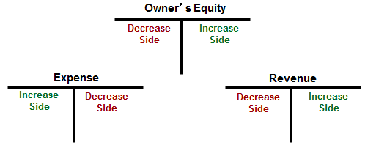
Expenses
Section 2, Objective 3-4: Set up T accounts for revenue and expenses.
Expenses decrease owner’s equity.
Decreases in owner’s equity appear on the left side of the T accounts.
Notes:
Section 2, Objective 3-4:
As the business incurs expenses it causes total owner’s equity to go down. Remember, since owner’s equity is on the right side of the accounting equation, to decrease total owner’s equity, we need to record the entry on the left side of the Expenses T account.

Slide 34
Payment of Salaries (1 of 2)
Section 2, Objective 3-4: Set up T accounts for revenue and expenses.
In December, Eli’s Consulting Services paid $8,000 in salaries.
Analysis:
(j) The asset account, Cash, is decreased by $8,000.
(j) The expense account, Salaries Expense, is increased by $8,000.
Notes:
Section 2, Objective 3-4:
Let’s see how to record a business expense in the T accounts.
Remember, as the business incurs expenses it causes total owner’s equity to go down. Since owner’s equity is on the right side of the accounting equation, to decrease owner’s equity, we would record the dollar amount on the left side or debit side of the expense T account.
Remember that assets are on the left side of the accounting equation so to decrease them we would put the entry on the right or credit side of the account.
We know that Cash is the asset account which needs to be credited for the $8,000 check written. Salaries Expense is the owner’s equity expense account effected for the same amount so we need to debit it for $8,000.

Slide 35
Payment of Salaries (2 of 2)
Section 2, Objective 3-4: Set up T accounts for revenue and expenses.

Slide 36
Payment of Utilities (1 of 2)
Section 2, Objective 3-4: Set up T accounts for revenue and expenses.
Eli’s Consulting Services issued a check for $650 to pay the utilities bill.
Analysis:
(k) The asset account, Cash, is decreased by $650.
(k) The expense account, Utilities Expense, is increased by $650.
Notes:
Section 2, Objective 3-4:
Let’s see how expenses are recorded. Remember, as the business incurs expenses it causes total owner’s equity to go down. Since we incurred the expense, we increase or debit our Utilities Expense account for $650. Cash is going down, so we credit Cash for $650.

Slide 37
Payment of Utilities (2 of 2)
Section 2, Objective 3-4: Set up T accounts for revenue and expenses.

Slide 38
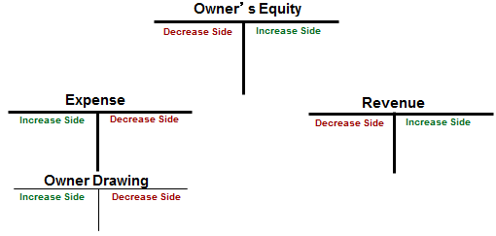
Owner’s Withdrawals
Section 2, Objective 3-4: Set up T accounts for revenue and expenses.
Drawing decreases owner’s equity.
Decreases in owner’s equity appear on the left side of the T accounts.
Notes:
Section 2, Objective 3-4:
Recall that drawings are not expenses of the business but part of the owner’s financial investment which he/she is pulling out of the business for personal use. A drawing account is a special type of owner’s equity account set up to record the owner’s withdrawal of cash (or other assets) from the business.
As the owner withdraws resources for personal use, it causes total owner’s equity to go down. Remember, since owner’s equity is on the right side of the accounting equation, to decrease total owner’s equity we need to record the entry on the left side of the Drawing T account. The Drawing account acts like an expense account – it is increased with a debit and thus it DECREASES owner’s equity.

Slide 39
The Owner Withdraws Funds (1 of 2)
Section 2, Objective 3-4: Set up T accounts for revenue and expenses.
Trayton Eli wrote a check to withdraw $5,000 cash for personal use.
Analysis:
(l) The asset account, Cash, is decreased by $5,000.
(l) The owner’s equity account, Trayton Eli, Drawing, is increased by $5,000.
Notes:
Section 2, Objective 3-4:
Let’s record this withdrawal. . . Remember, as the owner withdraws funds for personal use, it causes total owner’s equity to go down. Since owner’s equity is on the right side of the accounting equation, to decrease owner’s equity we would record $5,000 on the left side or debit side of the Drawing T account. Remember that assets are on the left side of the accounting equation so to decrease them we would record the entry on the opposite side or credit side of the Cash account. Trayton Eli, Drawing is debited for $5,000 and Cash is credited for $5,000.

Slide 40
The Owner Withdraws Funds (2 of 2)
Section 2, Objective 3-4: Set up T accounts for revenue and expenses.

Slide 41
The Rules of Debit and Credit (1 of 3)
Section 2, Objective 3-4: Set up T accounts for revenue and expenses.
A debit is an entry on the left side of an account.
A credit is an entry on the right side of an account.
A double-entry system is an accounting system that involves recording the effects of each transaction as debits and credits in separate accounts.
Every transaction in a Double entry accounting system has at least one debit and one credit.
The total of the debits and credits recorded in the separate accounts must be EQUAL.
Notes:
Section 2, Objective 3-4:
We have been mentioning debit (left) as we discuss T accounts. Have you noticed this? Debit just means left side of the T account. Credit means right side of the T account.

Slide 42
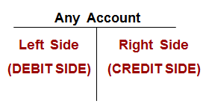
The Rules of Debit and Credit (2 of 3)
Section 2, Objective 3-4: Set up T accounts for revenue and expenses.
Accountants refer to the left side of an account as the debit side instead of saying the left side.
The right side of the account is called the credit side.
Notes:
Section 2, Objective 3-4:
We will be using the terms Debit and Credit from now on to describe how a transaction affects an account.

Slide 43
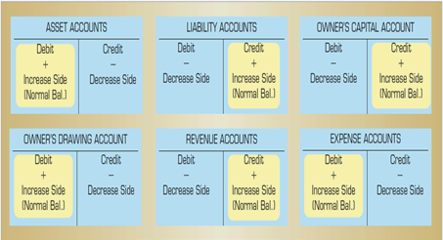
The Rules of Debit and Credit (3 of 3)
Section 2, Objective 3-4: Set up T accounts for revenue and expenses.
Notes:
Section 2, Objective 3-4:
Here are the rules for all asset, liability and owner’s equity accounts. It is important that you study this slide and refer to it often when studying. These are fundamental rules for accounting students to learn.

Slide 44
Section 2: Transactions That Affect Revenue, Expenses, and Withdrawals
Learning Objective 3-5: Prepare a trial balance from T accounts.
Notes:
Learning Objective 3-5: Prepare a trial balance from T accounts.

Slide 45
The Trial Balance (1 of 2)
Section 2, Objective 3-5: Prepare a trial balance from T accounts
Use the proper heading to include who, what, and when information.
List the accounts in chart of account order or in the same order as they appear in the financial statement.
Enter the ending balance of each account in the appropriate Debit or Credit column.
Total the Debit column.
Total the Credit column.
Compare the column totals. They should be equal.
Notes:
Section 2, Objective 3-5:
Our fifth objective is to prepare a trial balance using the balances in our T accounts. A trial balance is a report to test the accuracy of total debits and credits after transactions have been recorded. A Trial Balance just tells us whether total debits equal total credits. You can review the six steps shown.

Slide 46
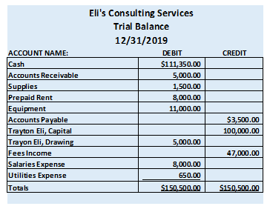
The Trial Balance (2 of 2)
Section 2, Objective 3-5: Prepare a trial balance from T accounts
Notes:
Section 2, Objective 3-5:
This is what a Trial balance looks like. Notice that total debits equal total credits.

Slide 47
Errors (1 of 2)
Section 2, Objective 3-5: Prepare a trial balance from T accounts
Some common errors in a trial balance are:
Adding trial balance columns incorrectly
Recording only half a transaction – for example, recording a debit but not recording a credit, or vice versa
Recording both halves of a transaction as debits or credits rather than recording one debit and one credit
Notes:
Section 2, Objective 3-5:
Sometimes our trial balance does not balance. Review the common errors in a trial balance. If you discover that your trial balance has an error, you can try re-footing it to check for math errors. You should insure that the correct balances from the account were transferred over to the correct debit or credit balance. (If you know what “normal balances” are, this will assist you in locating errors.) You can look to see if a transposition error or slide error occurred. Sometimes just double checking your work will disclose the error. Refer to the textbook section on “Finding Trial Balance errors” for more guidance on this topic.

Slide 48
Errors (2 of 2)
Section 2, Objective 3-5: Prepare a trial balance from T accounts
Recording the incorrect amount for a transaction
Recording a debit for one amount and a credit for a different amount
Mathematical errors in calculating account balances
Forgetting to carry over an account balance to the Trial Balance

Slide 49
Section 2: Transactions That Affect Revenue, Expenses, and Withdrawals
Learning Objective 3-6: Prepare an income statement, a statement of owner’s equity, and a balance sheet.
Notes:
Learning Objective 3-6: Prepare an income statement, a statement of owner’s equity, and a balance sheet.

Slide 50
Income Statement, Statement of Owner’s Equity, and a Balance Sheet (1 of 2)
Section 2, Objective 3-6: Prepare an income statement, a statement of owner’s equity, and a balance sheet
After the trial balance is prepared, the financial statements are prepared.
Net income from the income statement is used on the statement of owner’s equity.
The ending balance of the Trayton Eli, Capital account, computed on the statement of owner’s equity, is used on the balance sheet.
Notes:
Section 2, Objective 3-6:
Objective 6 shows us how to use the trial balance to create our financial statements. We use the information from our trial balance to prepare our financial statements.

Slide 51
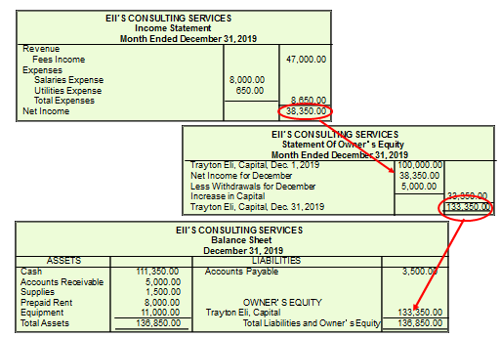
Income Statement, Statement of Owner’s Equity, and a Balance Sheet (2 of 2)
Section 2, Objective 3-6: Prepare an income statement, a statement of owner’s equity, and a balance sheet
Notes:
Section 2, Objective 3-6:
Once the income statement is finished you can do the statement of owner’s equity and use the ending balance of the Trayton Eli, Capital account to complete the balance sheet.

Slide 52
Section 2: Transactions That Affect Revenue, Expenses, and Withdrawals
Learning Objective 3-7: Develop a chart of accounts
Notes:
Learning Objective 3-7: Develop a chart of accounts

Slide 53
Chart of Accounts (1 of 2)
Section 2, Objective 3-7: Develop a chart of accounts
Each account has a number and a name.
The Balance Sheet accounts are listed first, followed by the Statement of Owner’s Equity accounts, ending with the income statement accounts.
The account number is assigned based on the type of account.
Each account should have a number assigned to its title (name)
Balance Sheet accounts are listed before income statement accounts.
Notes:
Section 2, Objective 3-7:
Our last objective is to develop a chart of accounts. This is simply a list of all of the accounts that you use to do the record keeping in your business. Account numbers give more meaning to the chart of accounts. See an example of a numbering system for a chart of accounts on the next page.

Slide 54
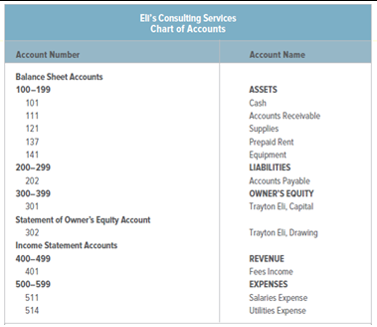
Chart of Accounts (2 of 2)
Section 2, Objective 3-7: Develop a chart of accounts
Notes:
Section 2, Objective 3-7:
Accounts that begin with a 1 are assets. Numbers that begin with a 2 are liabilities, etc. Notice that spaces between account numbers allow you to ADD new accounts or make other changes to your chart of accounts as time passes.

Slide 55
Permanent and Temporary Accounts
Section 2, Objective 3-7: Develop a chart of accounts
A permanent account is an account that is kept open from one accounting period to the next.
A temporary account is an account whose balance is transferred to another account at the end of an accounting period. A temporary account is “zeroed out” at the end of the accounting period.
Notes:
Section 2, Objective 3-7:
Let’s now introduce the concept of permanent and temporary accounts before we end this chapter. Permanent accounts continue to exist from one accounting period to the next. Assets, liabilities and the owner’s capital account are permanent accounts. Another name for permanent accounts is REAL accounts.
Temporary accounts only have a balance for one accounting period. Their balance is not carried over to the next accounting period. Examples of temporary accounts are revenues, expenses, and drawing. Another name for temporary accounts is NOMINAL accounts.
We have covered many important rules in accounting. You may wish to review this chapter one more time before continuing on with the next one.

