Slide 1

College Accounting
A Contemporary Approach
Fourth Edition
Chapter 4
The General Journal and the General Ledger
Copyright © 2017 McGraw-Hill Education. All rights reserved. No reproduction or distribution without the prior written consent of McGraw-Hill Education.
Notes:
PowerPoint Presentations for
College Accounting: A Contemporary Approach, 4th edition
By Haddock, Price, and Farina
Chapter 4--The General Journal and the General Ledger

Slide 2
Learning Objectives
SECTION 1: The General Journal
4-1 Record transactions in the general journal.
4-2 Prepare compound journal entries.
SECTION 2: The General Ledger
4-3 Post journal entries to general ledger accounts.
4-4 Correct errors made in the journal or ledger.
4-5 Define the accounting terms new to this chapter.
Notes:
Chapter 3 explained T accounts and the trial balance, and their usefulness in the preparation of financial statements. Chapter 4 introduces the general journal, the general ledger, and shows how to use both. In the real world, transactions are not recorded using the accounting equation, nor are they recorded using T accounts. Instead, businesses use a Journal to record business transactions.
The objectives of this chapter are listed here.
SECTION 1: The General Journal
4-1 Record transactions in the general journal.
4-2 Prepare compound journal entries.
SECTION 2: The General Ledger
4-3 Post journal entries to general ledger accounts.
4-4 Correct errors made in the journal or ledger.
4-5 Define the accounting terms new to this chapter.

Slide 3
The Accounting Cycle
Step 1: Analyze and classify transactions
Step 2: Journalize transactions
Step 3: Post transactions to the ledger
Step 4: Prepare a worksheet
Step 5: Prepare financial statements
Step 6: Journalize adjusting entries
Step 7: Journalize closing entries
Step 8: Prepare a post closing trial balance
Step 9: Evaluate and communicate financial information
Notes:
Here are the steps in the accounting cycle. The accounting cycle is a series of steps performed during each accounting period to classify, record, and summarize data for a business and to produce needed financial information.
Take a moment to review the steps. Let’s take a look at these steps in more detail.

Slide 4
Section 1: The General Journal
Learning Objective 4-1: Record transactions in the general journal.
Notes:
Learning Objective 4-1: Record transactions in the general journal.

Slide 5
Journal
Section 1, Objective 4-1: Record transactions in the general journal.
A journal is a diary of business activities.
There are different types of accounting journals.
Transactions are entered in the journal in chronological order.
Notes:
Section 1, Objective 4-1:
Our first objective is to learn how to record financial transactions in the general journal.
A journal is a book of original entry. Just like in school when you kept a “diary” or “journal” of your activities, a business or accounting journal does the same thing. The journal keeps a record of the financial events (transactions) in the order that they occurred. We call this chronological order.
Journalizing means to “record” transactions in the journal. A business event (transaction) that has been recorded in the journal is called a journal entry.

Slide 6
Recording a Business Transaction (1 of 3)
Section 1, Objective 4-1: Record transactions in the general journal.
Analyze the financial event.
Identify the accounts affected.
Classify the accounts affected.
Determine the amount of increase or decrease for each account affected.
Apply the rules of debit and credit.
Which account is debited? For what amount?
Which account is credited? For what amount?
Make the entry in T-account form.
Record the complete entry in general journal form.
Let’ look at one
Notes:
Section 1, Objective 4-1:
Here are the steps to record a journal entry.

Slide 7
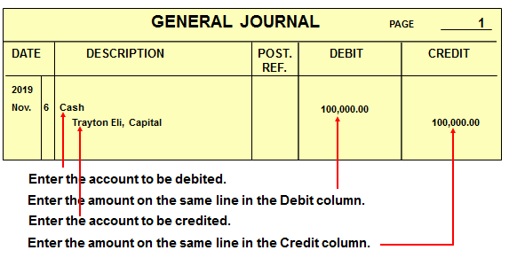
Recording a Business Transaction (2 of 3)
Section 1, Objective 4-1: Record transactions in the general journal.
Transaction: On November 6, Trayton Eli withdrew $100,000 from personal savings and deposited it in a new business checking account for Eli’s Consulting Services.
Notes:
Section 1, Objective 4-1:
Take a look at a journal entry. Trayton Eli, Owner, invested $100,000 cash into the business on November 6. Let’s look at each part of the journal entry.
First you should enter the year and the date of the transaction, then enter the name of the account debited, in this case, the Cash account, flush against the date line, then place the dollar amount in the debit column. Next drop down a line and indent ¼ to ½ inch and write the name of the account credited—in this case Trayton Eli, Capital. Place the dollar amount of the credit in the credit column. .

Slide 8
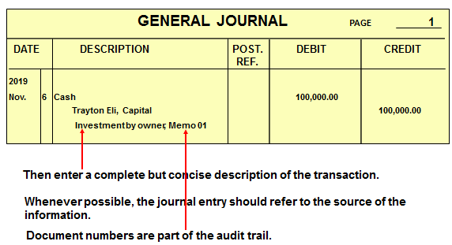
Recording a Business Transaction (3 of 3)
Section 1, Objective 4-1: Record transactions in the general journal.
Transaction: On November 6, Trayton Eli withdrew $100,000 from personal savings and deposited it in a new business checking account for Eli’s Consulting Services.
Notes:
Section 1, Objective 4-1:
Once the transaction has been journalized, we need to indent a little and add an explanation of the event. The audit trail is a chain of references that make it possible to trace information, locate errors, and prevent fraud. This is an important part of each journal entry.

Slide 9
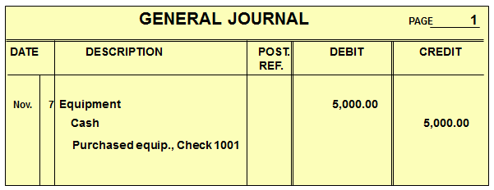
Cash Purchase of Equipment
Section 1, Objective 4-1: Record transactions in the general journal.
On November 7, Eli’s Consulting Services issued Check 1001 for $5,000 to purchase a computer and other equipment.
Notes:
Section 1, Objective 4-1:
On November 7, Eli’s Consulting Services issued Check 1001 for $5,000 to purchase a computer and other equipment. Equipment needs to be debited for $5,000 and Cash needs to be credited for $5,000.
Here is the general journal.

Slide 10
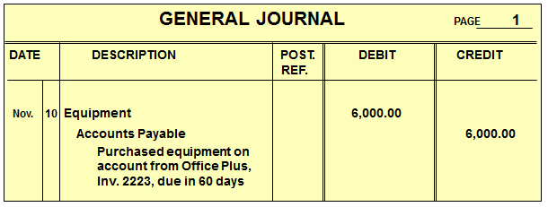
Purchase of Equipment on Credit
Section 1, Objective 4-1: Record transactions in the general journal.
On November 10, Eli’s Consulting Services purchased office equipment on account for $6,000.
Notes:
Section 1, Objective 4-1:
Remember when we previously analyzed this transaction, we decided that we would debit Equipment for $6,000 and credit Accounts Payable for the same amount.
Here is the journal entry. Remember to include all important information in the explanation. This improves the audit trail.

Slide 11
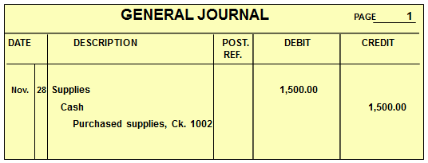
Cash Purchase of Supplies
Section 1, Objective 4-1: Record transactions in the general journal.
On November 28, Eli’s Consulting Services
purchased supplies for $1,500, Check 1002.
Notes:
Section 1, Objective 4-1:
Next, Eli’s Consulting Services purchased supplies for $1,500 cash, so we need to debit Supplies for $1,500 and credit Cash for the same amount.
Here is the general journal entry for the transaction.

Slide 12
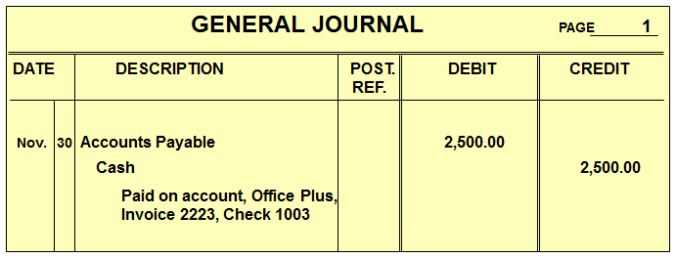
Payment to a Creditor
Section 1, Objective 4-1: Record transactions in the general journal.
On November 30, Eli’s Consulting Services paid Office Plus $2,500 in partial payment of Invoice 2223, Check 1003.
Remember, in the general journal, always enter debits before credits!
Notes:
Section 1, Objective 4-1:
Now let’s look at a partial payment on account to a supplier. On November 30, Eli’s Consulting Services paid Office Plus $2,500 in partial payment of Invoice 2223, Check 1003. When the business pays part of its bill for the equipment purchased earlier, it would debit Accounts Payable and credit Cash for $2,500.
Remember, in the general journal, always enter debits before credits!

Slide 13
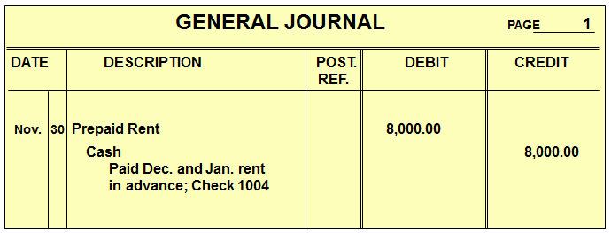
Recording a Prepayment of Rent
Section 1, Objective 4-1: Record transactions in the general journal.
On November 30, Eli’s Consulting Services wrote Check 1004 for $8,000 to prepay rent for December and January.
Notes:
Section 1, Objective 4-1:
On November 30, Eli’s Consulting Services wrote Check 1004 for $8,000 to prepay rent for December and January. When the business pays for two months rent in advance, it debits Prepaid Rent for $8,000 and credits Cash for $8,000. Note that both accounts affected are assets.
Here is the general journal entry.

Slide 14
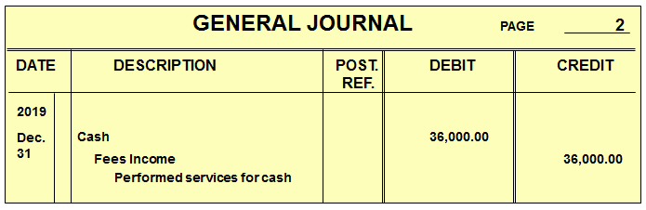
Services Performed for Cash
Section 1, Objective 4-1: Record transactions in the general journal.
Eli’s Consulting performed services for $36,000 in cash.
Notes:
Section 1, Objective 4-1:
Let’s take a look at how transactions affecting revenues and expenses will be recorded in the journal. Let’s look a transaction where the business performed services for $36,000 in cash. When the business performs consulting services and gets paid immediately, Eli’s Consulting will debit Cash for $36,000 and credit Fees Income for the same amount.
Here is the general journal entry.

Slide 15
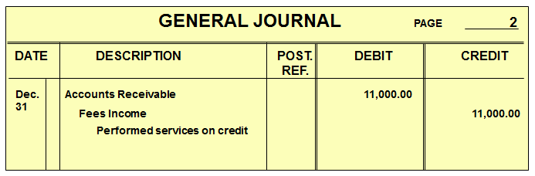
Performed Services on Account
Section 1, Objective 4-1: Record transactions in the general journal.
Eli’s Consulting performed services on account for $11,000.
Notes:
Section 1, Objective 4-1:
Next, let’s assume that the firm performed services for $11,000 on account. Remember that we record the revenue as earned even though we haven’t yet received the cash. When the firm performs services for credit clients, it will debit Accounts Receivable and credit Fees Income for $11,000.
Here is the general journal entry on the 31st.

Slide 16
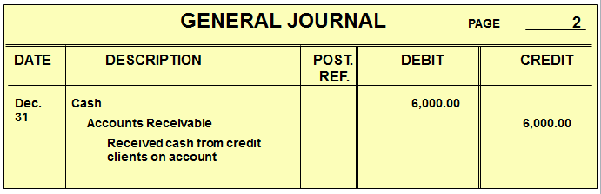
Received Cash From Credit Clients
Section 1, Objective 4-1: Record transactions in the general journal.
Received $6,000 in cash from a credit client on account.
Notes:
Section 1, Objective 4-1:
Now let’s see how we would record the collection of cash for an amount previously billed. When the firm collects $6,000 from credit customers, it needs to debit Cash and credit Accounts Receivable.
Here is the general journal entry.

Slide 17
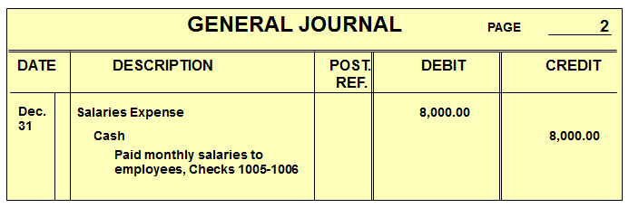
Paid Salaries
Section 1, Objective 4-1: Record transactions in the general journal.
Paid $8,000 for salaries.
Notes:
Section 1, Objective 4-1:
It’s time to review how we would record transactions involving expenses. Our focus will be on journalizing the transaction. When the business pays $8,000 in salaries to its employees, they would debit Salaries Expense for $8,000 and credit Cash for the same amount.
Here is the general journal entry.

Slide 18
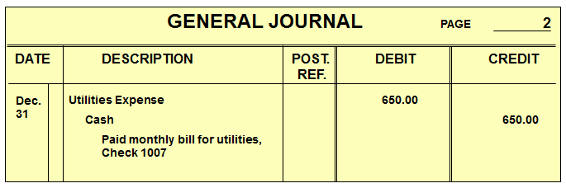
Paid Utility Bill
Section 1, Objective 4-1: Record transactions in the general journal.
Eli’s Consulting paid $650 in cash for a utility bill.
Notes:
Section 1, Objective 4-1:
When the business pays a utility bill of $650, it will debit Utilities Expense and credit Cash for the $650 as shown in the general journal entry.

Slide 19
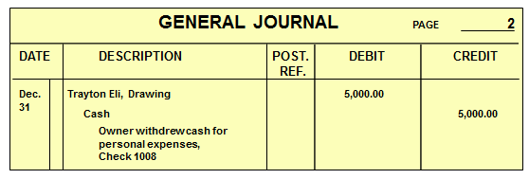
Owner’s Withdrawal
Section 1, Objective 4-1: Record transactions in the general journal.
The owner, Trayton Eli, withdrew $5,000 from the company.
Notes:
Section 1, Objective 4-1:
When the owner withdraws $5,000 for personal use, the accountant will debit the Trayton Eli, Drawing account and credit the Cash account for the $5,000 withdrawal as shown. Remember that the drawing account is an equity account; not an expense.

Slide 20
Section 1: The General Journal
Learning Objective 4-2: Prepare Compound Journal Entries.
Notes:
Learning Objective 4-2: Prepare Compound Journal Entries.

Slide 21
Preparing Compound Entries (1 of 2)
Section 1, Objective 4-2: Preparing compound entries.
Some transactions require a compound entry—a journal entry that contains more than one debit or credit.
BUSINESS TRANSACTION: On November 7, the firm purchased equipment for $5,000, issued Check 1001 for $2,500, and agreed to pay the balance in 30 days.
Notes:
Section 1, Objective 4-2:
PREPARING COMPOUND ENTRIES
So far, each journal entry consists of one debit and one credit. Some transactions require a compound entry—a journal entry that contains more than one debit or credit. In a compound entry, record all debits first, followed by the credits.
On November 7, the firm purchased equipment for $5,000, issued Check 1001 for $2,500, and agreed to pay the balance in 30 days.
Remember: No matter how many accounts are affected by a transaction, total debits must equal total credits.

Slide 22
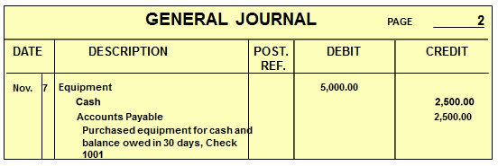
Preparing Compound Entries (2 of 2)
Section 1, Objective 4-2: Preparing compound entries.
Remember: No matter how many accounts are affected by a transaction, total debits must equal total credits.

Slide 23
Ledgers
Section 2.
The ledger contains a separate form for each account.
The third step of the accounting cycle is posting to the ledger.
The process of transferring data from the journal to the ledger is known as posting.
Notes:
We learned how to journalize in our previous section—that was the second step in the accounting cycle, now let’s learn the third step in our accounting cycle: posting to ledgers. A ledger is the record of final entry. It is the last place that accounting transactions are recorded.

Slide 24
Posting
Section 2.
QUESTION:
What is posting?
ANSWER:
Posting is the process of transferring data from a journal to a ledger.
Notes:
When we transfer data from the general journal to the ledger, this is called “posting”. It’s important that we keep a ledger so that we know at all times the cumulative balances in all of the accounts. T accounts represent the accounts in our ledger. All of our journal entries will update accounts in the ledger. A general ledger is a permanent, classified record of all accounts used in a firm’s operation. The general ledger is the master reference file for the business.

Slide 25
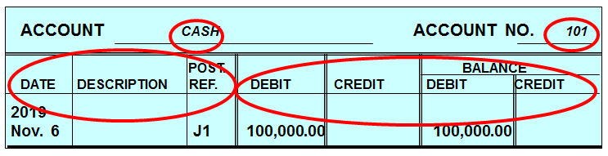
Ledger Account Forms
Section 2.
On the ledger account form shown below, notice the:
Account name and number
Columns for date, description, and posting reference
Columns for debit, credit, debit balance, and credit balance
Notes:
The general ledger looks a lot like the general journal but it has two additional BALANCE columns. We will now post our general journal entries to the general ledger.

Slide 26
Section 2: The General Ledger
Learning Objective 4-3: Post journal entries to general ledger accounts.
Notes:
Learning Objective 4-3: Post journal entries to general ledger accounts.

Slide 27
Five Steps for Posting (1 of 2)
Section 2, Objective 4-3: Post journal entries to general ledger accounts
On the ledger form, enter the date of the transaction. Enter a description of the entry, if necessary. Usually, routine entries do not require descriptions.
On the ledger form, enter the general journal page in the Posting Reference column.
On the ledger form, enter the debit amount in the Debit column or the credit amount in the Credit column.
Notes:
Section 2, Objective 4-3:
Posting is the third objective of this chapter. Let’s review the five steps of posting from the general journal to the general ledger.

Slide 28
Five Steps for Posting (2 of 2)
Section 2, Objective 4-3: Post journal entries to general ledger accounts
On the ledger form, compute the balance and enter it in the Debit Balance column or the Credit Balance column.
On the general journal, enter the ledger account number in the Posting Reference column.

Slide 29
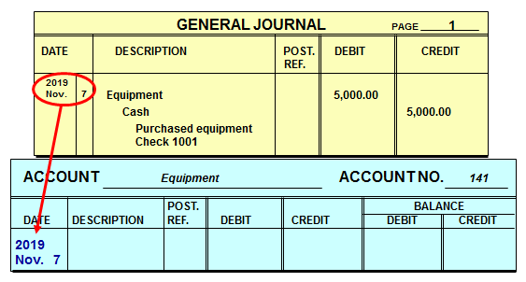
Ledger Form (1 of 5)
Section 2, Objective 4-3: Post journal entries to general ledger accounts
Step 1: On the ledger form, enter the date of the transaction. Enter a description of the entry, if necessary. Usually, routine entries do not require descriptions.
Notes:
Section 2, Objective 4-3:
Step one: transfer the date and description (if necessary).

Slide 30
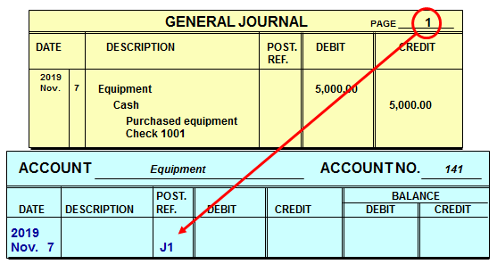
Ledger Form (2 of 5)
Section 2, Objective 4-3: Post journal entries to general ledger accounts
Step 2: On the ledger form, enter the general journal page in the Posting Reference column. The letter J refers to the general journal.
Notes:
Section 2, Objective 4-3:
Next, write the Journal page that the journal entry is recorded on in the Posting Reference column in the General Ledger. “J” refers to journal.

Slide 31
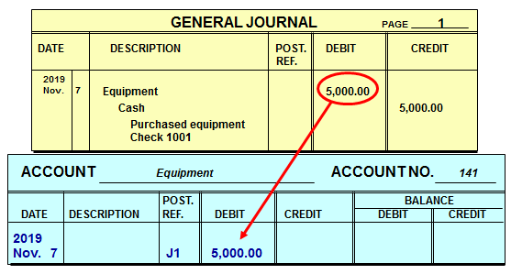
Ledger Form (3 of 5)
Section 2, Objective 4-3: Post journal entries to general ledger accounts
Step 3: On the ledger form, enter the debit amount in the Debit column or the credit amount in the Credit column.
Notes:
Section 2, Objective 4-3:
Next, transfer the dollar amount to either the debit or the credit column of the general ledger “action” columns.

Slide 32
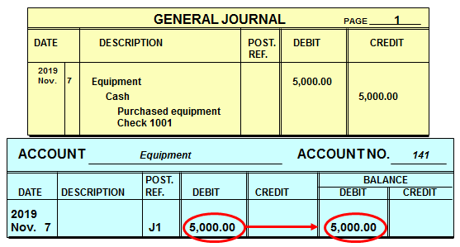
Ledger Form (4 of 5)
Section 2, Objective 4-3: Post journal entries to general ledger accounts
Step 4: On the ledger form, compute the balance and enter it in the Debit Balance column or the Credit Balance column.
Notes:
Section 2, Objective 4-3:
Make sure that you enter the balance of the account after posting from the general journal. (This is the most up-to-date balance in the account.) Make sure you include the previous account balance in your current account balance.

Slide 33
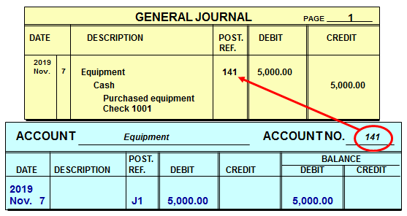
Ledger Form (5 of 5)
Section 2, Objective 4-3: Post journal entries to general ledger accounts
Step 5: On the general journal, enter the ledger account number in the Posting Reference column.
Notes:
Section 2, Objective 4-3:
The last thing you need to do is to write the account number of the account in the POST REF column of the general journal. This indicates that the journal entry has been posted to the general ledger.

Slide 34
General Ledger Accounts
Section 2, Objective 4-3: Post journal entries to general ledger accounts
In the general ledger accounts, the balance sheet accounts appear first and are followed by the income statement accounts. The order is:
Assets
Liabilities
Owner’s equity
Revenue
Expenses
This order of accounts speeds the preparation of the trial balance and the financial statements.
Notes:
Section 2, Objective 4-3:
The general ledger contains all of the accounts that exist in a business and all of their activity. In the general ledger, balance sheet accounts are listed first, then the income statement accounts are listed next.

Slide 35
Section 2: The General Ledger
Learning Objective 4-4: Correct errors made in the journal or ledger.
Notes:
Learning Objective 4-4: Correct errors made in the journal or ledger.

Slide 36
Journal and Ledger Errors
Section 2, Objective 4-4: Correct errors made in the journal or ledger.
Sometimes errors are made when recording transactions in the journal.
The method used to correct an error depends on whether or not the journal entry has been posted to the ledger.
Notes:
Section 2, Objective 4-4:
Sometimes errors are made in journalizing or posting.
If the accountant wants to correct an error, the correction method will depend on whether or not the journal entry has been posted to the general ledger.

Slide 37
Correcting Journal and Ledger Errors
Section 2, Objective 4-4: Correct errors made in the journal or ledger.
If an error is discovered before the entry is posted, neatly cross out the incorrect item and write the correct data above it.
To ensure honesty and provide a clear audit trail, erasures are not made in the journal.
Notes:
Section 2, Objective 4-4:
Here is one correction method.
If an error is discovered before the entry is posted, neatly cross out the incorrect item and write the correct data above it.
To ensure honesty and provide a clear audit trail, erasures are not made in the journal.

Slide 38
Error Correction Before Posting
Section 2, Objective 4-4: Correct errors made in the journal or ledger.
On September 1 an automobile repair shop purchased some shop equipment for $18,000 in cash.
By mistake the journal entry debited the Office Equipment account rather than the Shop Equipment account.
Notes:
Section 2, Objective 4-4:
Let’s practice correcting an error that was discovered before it was posted to the general ledger.

Slide 39
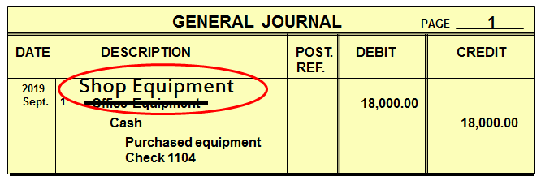
Before Posting
Section 2, Objective 4-4: Correct errors made in the journal or ledger.
The accountant would neatly cross out Office Equipment and write Shop Equipment above it.
The correct account Shop Equipment would be posted to the ledger in the usual manner.
Notes:
Section 2, Objective 4-4:
Cross out the incorrect account and write the correct account above the crossed out one. Post like normal after the correction is made.

Slide 40
Error Correction After Posting (1 of 4)
Section 2, Objective 4-4: Correct errors made in the journal or ledger.
If the error is discovered after posting, a correcting entry is journalized and posted.
Do not erase or change the journal entry or the postings in the ledger accounts.
Note that erasures are never permitted in the journal or ledger.
Notes:
Section 2, Objective 4-4:
What if the error is discovered after posting? It is important never to erase in the journal or the ledger.

Slide 41
Error Correction After Posting (2 of 4)
Section 2, Objective 4-4: Correct errors made in the journal or ledger.
On September 1 an automobile repair shop debited Office Equipment rather than Shop Equipment for $18,000 by mistake.
The debit was posted to the Office Equipment account in the general ledger.
A correcting journal entry must be journalized and posted.
Notes:
Section 2, Objective 4-4:
If the error is discovered after being posted to the general ledger, then a correcting journal entry must be journalized and posted.

Slide 42
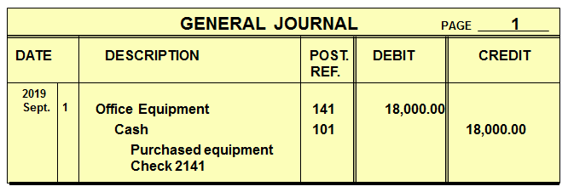
Error Correction After Posting (3 of 4)
Section 2, Objective 4-4: Correct errors made in the journal or ledger.
This erroneous journal entry was posted to the general ledger.
Notes:
Section 2, Objective 4-4:
If you discover an error after posting, it is best to make a correcting entry. A correcting entry is a journal entry made to correct an erroneous entry.
In this journal entry Office Equipment was debited instead of Shop Equipment. To correct this error, a correcting journal entry must be made.

Slide 43
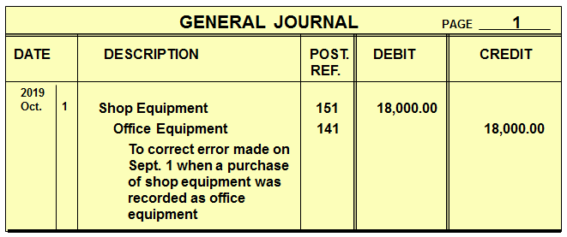
Error Correction After Posting (4 of 4)
Section 2, Objective 4-4: Correct errors made in the journal or ledger.
The correcting journal entry debits Shop Equipment and credits Office Equipment for $18,000.
The entry transfers $18,000 out of the Office Equipment and into the Shop Equipment account.
Notes:
Section 2, Objective 4-4:
Here is the correcting journal entry.

