Slide 1

College Accounting
A Contemporary Approach
Fourth Edition
Chapter 5
Adjustments and the Worksheet
Copyright © 2017 McGraw-Hill Education. All rights reserved. No reproduction or distribution without the prior written consent of McGraw-Hill Education.
Notes:
PowerPoint Presentations for
College Accounting: A Contemporary Approach, 4th edition
By Haddock, Price, and Farina

Slide 2
Learning Objectives
SECTION 1: The Worksheet
5-1 Complete a trial balance on a worksheet.
5-2 Prepare adjustments for unrecorded business transactions.
SECTION 2: Financial Statements
5-3 Complete the worksheet.
5-4 Prepare an income statement, statement of owner's equity, and balance sheet from the completed worksheet.
5-5 Journalize and post the adjusting entries.
5-6 Define the accounting terms new to this chapter.
Notes:
Chapter 4 introduced and explained how to use the general journal and the general ledger. Chapter 5 shows how to complete and use the worksheet. It also shows how to prepare and record adjustments for unrecorded business transactions. We will also continue using the general journal and general ledger to journalize and post the new adjusting entries introduced in the chapter.
The objectives of this chapter are listed here.
SECTION 1: The Worksheet
5-1 Complete a trial balance on a worksheet.
5-2 Prepare adjustments for unrecorded business transactions.
SECTION 2: Financial Statements
5-3 Complete the worksheet.
5-4 Prepare an income statement, statement of
owner's equity, and balance sheet from the
completed worksheet.
5-5 Journalize and post the adjusting entries.
5-6 Define the accounting terms new to this chapter.

Slide 3
Section 1: The Worksheet
Learning Objective 5-1: Complete a trial balance on a worksheet.
Notes:
Learning Objective 5-1: Complete a trial balance on a worksheet.

Slide 4
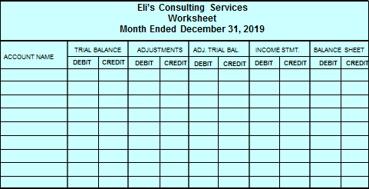
Worksheet
Section 1, Objective 5-1: Complete a trial balance on a worksheet.
The worksheet has an Account Name column
The worksheet also has five sections
Each section has two columns
Notes:
Section 1, Objective 5-1:
Section one of the chapter introduces us to a “worksheet.”
Let’s begin by entering the trial balance on the worksheet.
What is a worksheet? It is a tool that accountants use at the end of an accounting period. The worksheet has three parts to the heading just like a financial statement. The heading answers Who, What and When. The first column of a worksheet is the Account Name column.
The worksheet has five sections. Each section has a debit and a credit column. So, this can also be called a 10-column worksheet.

Slide 5
Worksheet: Trial Balance (1 of 4)
Section 1, Objective 5-1: Complete a trial balance on a worksheet.
Complete the Trial Balance section in four steps:
Enter the general ledger account names.
Transfer the general ledger account balances to the Debit and Credit columns of the Trial Balance section.
Total the Debit and Credit columns to prove that the trial balance is in balance.
Place a double rule under each Trial Balance column to show that the work in that column is complete.
Notes:
Section 1, Objective 5-1:
To enter a trial balance on the worksheet, you would follow these steps:
Enter the general ledger account names.
2. Transfer the general ledger account balances to the Debit and Credit columns of the Trial Balance section.
3. Total the Debit and Credit columns to prove that the trial balance is in balance.
4. Place a double rule under each Trial Balance column to show that the work in that column is complete.

Slide 6
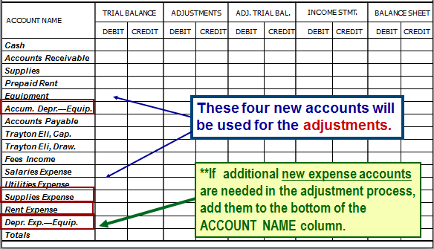
Worksheet: Trial Balance (2 of 4)
Section 1, Objective 5-1: Complete a trial balance on a worksheet.
Eli’s Consulting Services Worksheet Month Ended December 31, 2019
Step 1: Enter the general ledger account names.
Notes:
Section 1, Objective 5-1:
The first step is to enter the general ledger account names. We will need to add four new accounts at this time so that we can make adjustments at the end of the month. If you are not sure whether you need any additional accounts or what those account names will be, remember you can add them at the bottom of the existing list of accounts in that column.

Slide 7
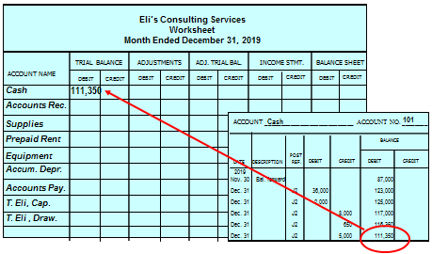
Worksheet: Trial Balance (3 of 4)
Section 1, Objective 5-1: Complete a trial balance on a worksheet.
Step 2: Transfer the general ledger account balances to the Debit and Credit columns of the Trial Balance section.
Notes:
Section 1, Objective 5-1:
Next, using the general ledger, we transfer the account balances to the DEBIT and CREDIT columns of the Trial Balance section.

Slide 8
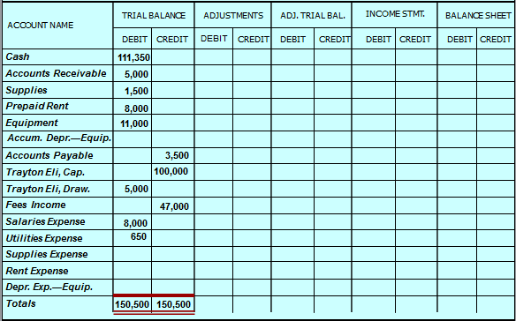
Worksheet: Trial Balance (4 of 4)
Section 1, Objective 5-1: Complete a trial balance on a worksheet.
Step 3: Total the Debit and Credit columns to prove that the trial balance is in balance.
Step 4: Place a double rule under each Trial Balance column to show that the work in that column is complete.
Notes:
Section 1, Objective 5-1:
After entering all of the balances from the general ledger, we need to “foot” the columns in the Trial Balance section. To foot a column means to add the numbers in that column. They MUST BALANCE BEFORE MOVING TO THE NEXT SET OF COLUMNS. When you insure that the debits equal the credits, you are ready to complete step 4 which is to place a double rule underline under the trial balance columns to show that the work in the columns is complete.

Slide 9
Section 1: The Worksheet
Learning Objective 5-2: Prepare adjustments for unrecorded business transactions.
Notes:
Learning Objective 5-2: Prepare adjustments for unrecorded business transactions.

Slide 10
The Supplies Adjustment
Section 1, Objective 5-2: Prepare adjustments for unrecorded business transactions.
  Eli’s Consulting Services began the month with $1,500 in supplies. At the end of the month, $1,000 in supplies remained.
QUESTION:
What dollar amount of supplies was used during the month?
ANSWER:
$ 1,500 – 1,000 = $ 500
Notes:
Section 1, Objective 5-2:
Let’s first discuss the supplies adjustment. The business purchased $1,500 of supplies during the month but by the end of the month, only $1,000 of supplies are left. This implies that we must have used $500 of supplies. Eli’s Consulting Services must make an adjustment to show that the company used $500 in supplies during the month. To do this we debit supplies expense and credit the asset supplies for the $500 used up.

Slide 11
The Prepaid Adjustment
Section 1, Objective 5-2: Prepare adjustments for unrecorded business transactions.
On November 20, 2019, Eli’ s Consulting Services paid $8,000 for the December and January rent. As of December 31, 2019, one month’s rent had already been used up.
QUESTION:
What dollar amount of rent was used during the month of December?
ANSWER:
$ 8,000 – 4,000 = $ 4,000
Notes:
Section 1, Objective 5-2:
Now let’s take a look at the adjustment for expired rent. Recall that the company paid for two months rent in advance. By the end of the month, one month had expired so we need to reduce the Prepaid Rent account by the amount for one month’s rent.

Slide 12
Depreciation
Section 1, Objective 5-2: Prepare adjustments for unrecorded business transactions.
The cost is recorded as an asset and charged to expense over the time the asset is used for the business.
Asset Pie:
Dec 2016 (Expense)
Jan 2017 (Expense)
Feb 2017 (Expense)
This expense is called depreciation
Notes:
Section 1, Objective 5-2:
Now let’s move on to the concept of depreciation. When we buy an asset that will be used for many years, we will expense a portion of the cost of the asset during each of the periods that the asset benefits. This is called depreciation. Depreciation is the process of allocating the cost of long term assets over their useful lives. We do not record the cost as an expense at the time that the asset was purchased. The cost is recorded as an asset (such as equipment or building) and charged to expense over the time the asset is used in the business. This periodic expensing of the original cost is called cost allocation or DEPRECIATION.

Slide 13
Straight-line depreciation
Section 1, Objective 5-2: Prepare adjustments for unrecorded business transactions.
  There are several methods to calculate depreciation. Eli’s Consulting Services uses the straight-line method.
QUESTION:
What is straight-line depreciation?
ANSWER:
Straight-line depreciation (S/L) allocates an asset’s cost in equal amounts to each accounting period of its useful life.
Notes:
Section 1, Objective 5-2:
We will be using the straight-line depreciation method to figure the periodic adjustment for depreciation. The salvage value of an asset represents what we estimate it will be worth at the end of its useful life.

Slide 14
Calculating Depreciation
Section 1, Objective 5-2: Prepare adjustments for unrecorded business transactions.
Eli’s Consulting Services purchased equipment in November, 2019.
Cost = $11,000
Useful life = 5 years or 60 months (5 years x 12 months)
Salvage value = $0
QUESTION:
What dollar amount of depreciation expense should be recorded for the month?
Notes:
Section 1, Objective 5-2:
When figuring depreciation, we need to understand what salvage value means. Salvage value is an estimate of the amount that may be received by selling or disposing of an asset at the end of its useful life.
The equipment does not have any salvage value and we expect to use it for five years in the business. In applying the straight-line formula, we calculate a monthly depreciation amount of $183.

Slide 15
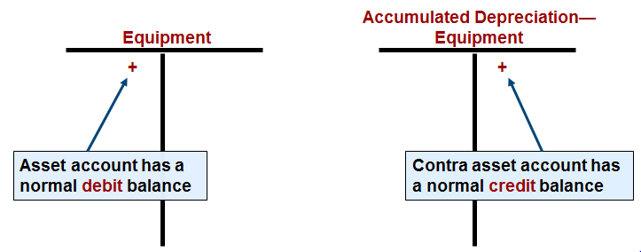
Adjustment for Depreciation
Section 1, Objective 5-2: Prepare adjustments for unrecorded business transactions.
Instead of decreasing the asset account directly, the adjustment for depreciation is recorded in a contra account named Accumulated Depreciation—Equipment.
Notes:
Section 1, Objective 5-2:
In making the $183 depreciation adjustment, we do not credit the asset account directly, instead we credit a different account. We will credit a contra-asset account called Accumulated Depreciation –Equipment. This account will accumulate the amount of the asset’s cost that has been expensed (depreciated) over the life of the asset.

Slide 16
Worksheet: Prepare Adjustments (1 of 2)
Section 1, Objective 5-2: Prepare adjustments for unrecorded business transactions.
Adjusting entries are first entered in the Adjustments section of the worksheet
When all adjustments are entered, total and rule the Adjustments columns.
Notes:
Section 1, Objective 5-2:
Now it is time to move to the next set of columns. We need to prepare adjustments for unrecorded business transactions.
Let’s make some adjustments. The process of updating accounts at the end of an accounting period for unrecorded items that belong to the period is referred to as making adjustments or adjusting entries. The adjustments are made in the ADJUSTMENTS column.
Section 1, Objective 5-2:
We can use the worksheet to show this adjustment. We credit the Supplies account $500 and debit the Supplies Expense account $500. Notice the letter (a) by both of the adjustments. By “keying” the adjustment with a letter reference the accountant can better see the debit and credit amounts of the adjustment.
Section 1, Objective 5-2:
When we originally paid the two months of rent we debited prepaid rent and credited cash. This means that one month of rent was equal to $4,000. Eli’s Consulting Services must make an adjustment to show that $4,000 of the prepaid rent has expired. We will debit the Rent Expense account by $4,000 and credit the Prepaid Rent account by $4,000.
Here is how we enter the adjustment in the worksheet. Notice the letter “b” has been placed next to both the debit and the credit.
Section 1, Objective 5-2:
Letter “c” is written next to the debit and credit of the journal entry in the worksheet that shows the depreciation adjustment. When all of the adjustments have been completed, “foot” the columns to insure that they balance.

Slide 17
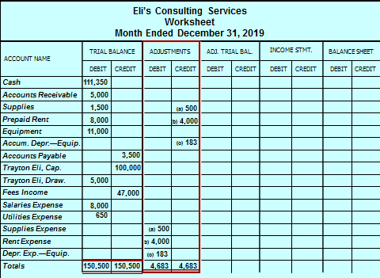
Worksheet: Prepare Adjustments (2 of 2)

Slide 18
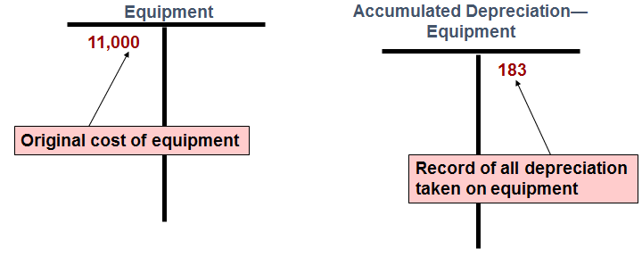
Book Value
Section 1, Objective 5-2: Prepare adjustments for unrecorded business transactions.
Book value = Original cost – Accumulated depreciation = 11,000 – 183 = 10,817
Notes:
Section 1, Objective 5-2:
Book value shows what the asset’s net cost is on the books of the business. By “net cost,” we mean its original cost less the depreciation taken to date. It is the un-expensed portion of the original cost.
The book value of our equipment right after the first depreciation adjustment is $11,000 – $183 = $10,817.

Slide 19
The Accounting Cycle
Section 2.
Step 1: Analyze transactions
Step 2: Journalize the data about transactions
Step 3: Post the data about transactions
Step 4: Prepare a worksheet
Step 5: Prepare financial statements
Step 6: Record adjusting entries
Step 7: Record closing entries
Step 8: Prepare a postclosing trial balance
Step 9: Interpret the financial information
Notes:
Section 2.
Take a look at the steps of the accounting cycle.
The third objective of the chapter is to be able to complete the worksheet.

Slide 20
Section 2: Financial Statements
Learning Objective 5-3: Complete the worksheet.
Notes:
Learning Objective 5-3: Complete the worksheet.

Slide 21
Preparing the Work Sheet
Section 2, Objective 5-3: Complete the worksheet.
You have already seen how to prepare the first two sections of a worksheet:
Trial Balance
Adjustments
You will now learn how to complete a worksheet. Preparing a worksheet is the fourth step of the accounting cycle.
Notes:
Section 2, Objective 5-3:
We are now ready to prepare the next set of columns on the worksheet.

Slide 22
Worksheet: Complete (1 of 4)
Section 2, Objective 5-3: Complete the worksheet.
Step 1: Combine the figures from the Trial Balance section and the Adjustments section. Record the results in the Adjusted Trial Balance columns.
The accounts that do not have adjustments are extended from the Trial Balance section to the Adjusted Trial Balance section.
The Supplies account has a $1,500 debit balance in the Trial Balance section and a $500 credit in the Adjustments section. ($1,500 debit and $500 credit = $1,000)
Step 2: Total the Debit and Credit columns in the Adjusted Trial Balance section. Confirm that debits equal credits.
Notes:
Section 2, Objective 5-3:
Notice that the third section of the work sheet is the Adjusted Trial Balance section. This is where we do “horizontal math” and combine the first set of columns with the second set of adjustments columns.
Section 2, Objective 5-3:
Cash had no adjustments so its balance carries over to the Adjusted Trial balance section. The same with Accounts Receivable and so on.
Section 2, Objective 5-3:
Our first account which had an adjustment is Supplies. It started with a $1,500 debit balance, then we credited it for $500. We carry the new adjusted balance of $1,000 to the Adjusted Trial Balance section. The second adjustment was to record the expired rent. The third adjustment was for depreciation. After each one, the new extended total is carried over to the trial balance.
Section 2, Objective 5-3:
Make sure to “foot” the columns of the Adjusted Trial Balance section to insure that they balance.

Slide 23
Worksheet: Complete (2 of 4)
Section 2, Objective 5-3: Complete the worksheet.
For accounts that appear on the balance sheet, enter the amount in the appropriate column of the Balance Sheet section. For accounts that appear on the income statement, enter the amount in the appropriate column of the Income Statement section.
After all the account balances are transferred to the financial statement sections, total the Debit and Credit columns.
Subtract the smaller total from the larger total in the Income Statement section to find the Net Income or Net Loss.
Notes:
Section 2, Objective 5-3:
Now we move to the final steps of completing the worksheet. Transfer the accounts which belong on the Balance sheet to the Balance Sheet section. Transfer the accounts which belong on the income statement to the Income statement section. Only assets, liabilities, and the owner’s capital account belong on the balance sheet. Revenues and Expenses belong on the income statement. The only exception to this rule of “balance sheet” and “income statement” is the drawing account. This account, when included in the adjusted trial balance is moved over to the “Balance Sheet” section even though it doesn‘t’ show up on that statement; rather it shows up on the statement of Owner’s Equity.
Section 2, Objective 5-3:
After all balances have been transferred, “foot” the four columns. Notice that the totals of the last two sections, “Income Statement” and “Balance Sheet” do NOT balance. More on the next slide.
Section 2, Objective 5-3:
Focus on the Income Statement section and subtract the smaller column total from the larger column total. You will notice that the totals of the columns do not balance. The difference is considered net income or net loss.

Slide 24
Worksheet: Complete (3 of 4)
Section 2, Objective 5-3: Complete the worksheet.
If the credit total is more than the debit total, the firm has net income. . .
Enter the amount on the Net Income line. (47,000 – 13,333 = 33,667)
Total the Income Statement and the Balance Sheet sections
Notes:
Section 2, Objective 5-3:
For Eli’s Consulting Services, they had $33,667 of net income for the period. Place this amount in the debit column so that both of the income statement columns now balance. Place the same amount of $33,667 in the credit column of the Balance Sheet section. After doing this, the two columns of the Balance Sheet section will also balance. This has the effect of “adding” the net income to the owner’s capital account. (Notice it’s on the credit side of the Balance Sheet section.)
Section 2, Objective 5-3:
You can see that the “footed” columns of the Income Statement and Balance Sheet sections now balance.

Slide 25
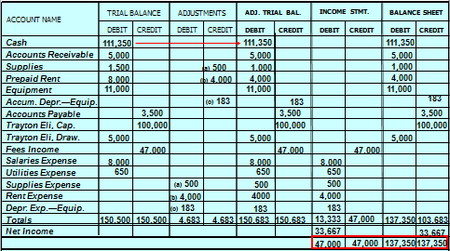
Worksheet: Complete (4 of 4)
Section 2, Objective 5-3: Complete the worksheet.

Slide 26
Section 2: Financial Statements
Learning Objective 5- 4: Prepare financial statements from the worksheet.
Notes:
Learning Objective 5-4: Prepare financial statements from the worksheet.

Slide 27
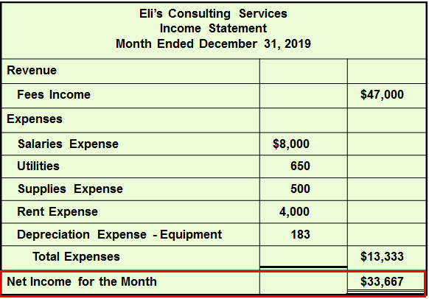
Income Statement (1 of 2)
Section 2, Objective 5-4: Prepare financial statements from the worksheet.
Notes:
Section 2, Objective 5-4:
Objective Four requires that we prepare an income statement, statement of owner’s equity, and balance sheet from the completed worksheet.
Use the Income Statement section of the worksheet for the amounts to carry to the income statement. You can see that the income statement is now easy to prepare. It’s just a matter of transferring the numbers over into a proper income statement format.

Slide 28
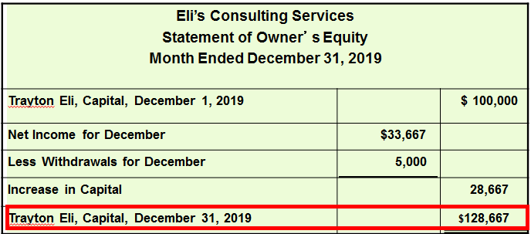
Income Statement (2 of 2)
Section 2, Objective 5-4: Prepare financial statements from the worksheet.
Notes:
Section 2, Objective 5-4:
The statement of owner’s equity reports the changes that have occurred in the owner’s financial interest (the owner’s capital account) during the reporting period. Here is the Statement of Owner’s Equity for Eli’s Consulting Services. The beginning capital balance came from the (unadjusted) trial balance column, the amount of net income came from the worksheet.

Slide 29
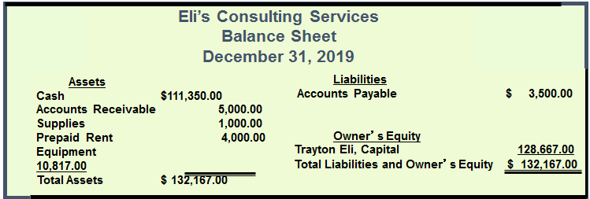
Account Form of Balance Sheet
Section 2, Objective 5-4: Prepare financial statements from the worksheet.
Notes:
Section 2, Objective 5-4:
In addition to the account form of a balance sheet that was previously used in chapter four, there is also a report form of a balance sheet, which shows the balance sheet data in a vertical format. In actual practice the report form is used most often.

Slide 30
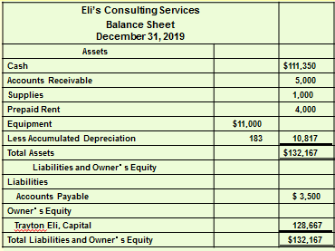
Report Form of Balance Sheet
Section 2, Objective 5-4: Prepare financial statements from the worksheet.
Notes:
Section 2, Objective 5-4:
And here it is. This balance sheet has been prepared using a report form format. All accounts, both asset and liabilities and owner’s equity are listed.

Slide 31
Section 2: Financial Statements
Learning Objective 5-5: Journalize and post the adjusting entries.
Notes:
Learning Objective 5-5: Journalize and post the adjusting entries.

Slide 32
Worksheet
Section 2, Objective 5-5: Journalize and post the adjusting entries.
Remember, a worksheet is just a tool that accountants use.
The worksheet is NOT...
A financial statement
A permanent part of the accounting records
It is only a tool. BUT....
The adjustments shown on the worksheet must become part of the permanent accounting records. Each adjustment is journalized and posted to the general ledger accounts.
Notes:
Section 2, Objective 5-5:
Remember, a worksheet is just a tool that accountants use. It is not a formal financial statement. The adjustments shown on the worksheet must become part of the permanent accounting records. Each adjustment is journalized and posted to the general ledger accounts. The fifth objective of this chapter is to journalize and post the adjusting entries.
Section 2, Objective 5-5:
Remember, a worksheet is just a tool that accountants use. It is not a formal financial statement. The adjustments shown on the worksheet must become part of the permanent accounting records. Each adjustment is journalized and posted to the general ledger accounts. The fifth objective of this chapter is to journalize and post the adjusting entries.

Slide 33
Consulting Services record
Section 2, Objective 5-5: Journalize and post the adjusting entries.
QUESTION:
What adjustments must Eli’s Consulting Services record for the month?
ANSWER:
Adjustment for supplies used.
Adjustment for expired rent.
Adjustment for depreciation.
Notes:
Section 2, Objective 5-5:
Question: What adjustments must Eli’s Consulting Services record for the month?
Answer:
Adjustment for supplies used.
Adjustment for expired rent.
Adjustment for depreciation.

Slide 34
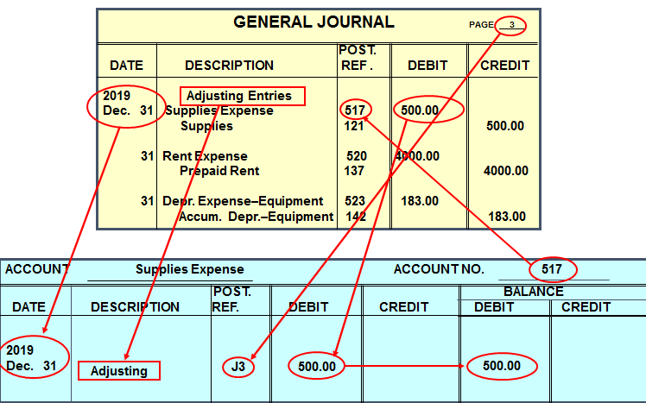
General Journal
Section 2, Objective 5-5: Journalize and post the adjusting entries.
Here is the first adjusting journal entry which has been posted to the Supplies Expense ledger account.
Notes:
Section 2, Objective 5-5:
Here is the first adjusting journal entry which has been posted to the supplies expense ledger account. You can take a moment and review the posting steps. The other ones are posted in a similar manner. After all adjustments have been posted, all accounts in the financial records are up to date. Adjustments are usually made on the last day of the accounting period.

