Slide 1

College Accounting
A Contemporary Approach
Fourth Edition
Chapter 6
Closing Entries and the Postclosing Trial Balance
Copyright © 2017 McGraw-Hill Education. All rights reserved. No reproduction or distribution without the prior written consent of McGraw-Hill Education.
Notes:
PowerPoint Presentations for
College Accounting: A Contemporary Approach, 4th edition
By Haddock, Price, and Farina

Slide 2
Learning Objectives
SECTION 1: Closing Entries
6-1 Journalize and post closing entries.
SECTION 2: Using Accounting Information
6-2 Prepare a post-closing trial balance.
6-3 Interpret financial statements.
6-4 Review the steps in the accounting cycle.
6-5 Define the accounting terms new to this chapter.
Notes:
Chapter 5 introduced and showed how to use the worksheet. It also covered the preparation of adjusting entries and financial statements. Chapter 6 completes the accounting cycle by showing how the books are closed before the next financial period begins.
The objectives of this chapter are listed here.
SECTION 1: Closing Entries
6-1 Journalize and post closing entries.
SECTION 2: Using Accounting Information
6-2 Prepare a postclosing trial balance.
6-3 Interpret financial statements.
6-4 Review the steps in the accounting cycle.
6-5 Define the accounting terms new to this chapter.

Slide 3
The Accounting Cycle
Step 1: Analyze transactions
Step 2: Journalize the data about transactions
Step 3: Post the data about transactions
Step 4: Prepare a worksheet
Step 5: Prepare financial statements
Step 6: Journalize and post adjusting entries
Step 7: Journalize and post closing entries
Step 8: Prepare a post-closing trial balance
Step 9: Interpret the financial information
Notes:
Chap 6, Section 1
In this first section, we learn how to make closing entries.
Journalizing and posting closing entries is the seventh step in the accounting cycle. Closing entries are journal entries which are completed at the end of an accounting cycle so that the business can start fresh in the next accounting period. Closing entries are journal entries that transfer the results of operations (net income or net loss) to owner’s equity and reduce the revenue, expense, and drawing account balances to zero.

Slide 4
Summary Account
QUESTION:
What is the Income Summary account?
ANSWER:
The Income Summary account is a special owner’s equity account that is used only in the closing process to summarize the results of operations.
Notes:
Chap 6, Section 1
The Income Summary account is only used during the closing process.

Slide 5
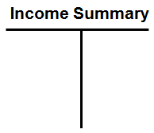
Income Summary Account
Classified as a temporary owner’s equity account.
Does not have a normal balance.
Has a zero balance after the closing process and remains with a zero balance until the closing procedure for the next period.
Notes:
Chap 6, Section 1
The Income Summary account is classified as a temporary owner’s equity account which will have a zero balance at the end of the accounting period.

Slide 6
Section 1: Closing Entries
Learning Objective 6-1: Closing Entries
Notes:
Learning Objective 6-1: Closing Entries.

Slide 7
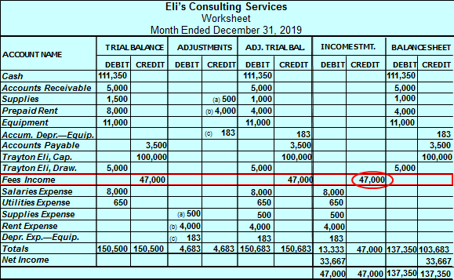
Eli’s Consulting
Section 1, Objective 6-1: Journalize and post closing entries.
Fees Income has a credit balance of $47,000
Notes:
Section 1, Objective 6-1:
The closing process begins by closing out all revenue accounts to zero. By reviewing the worksheet from the previous chapter, we will note that we only have one revenue account, Fees Income. So, we need to close the one revenue account to zero. Currently Fees Income has a $47,000 credit balance on the worksheet. Fees Income is closed to the Income Summary account.

Slide 8
Closing Entries (1 of 15)
Section 1, Objective 6-1: Journalize and post closing entries.
There are four steps in the closing process:
Transfer the revenue account balances to the Income Summary account.
Transfer the expense account balances to the Income Summary account.
Transfer the Income Summary account balance to the owner’s capital account.
Transfer the drawing account balance to the owner’s capital account.
Notes:
Section 1, Objective 6-1:
Let’s further discuss the closing process. Objective one is to journalize and post closing entries. There are four steps in the closing process: close the revenue accounts, close the expense accounts, close the income summary account, and close the drawing account.

Slide 9
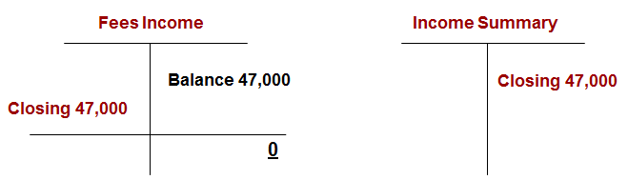
Closing Entries (2 of 15)
Section 1, Objective 6-1: Journalize and post closing entries.
Step 1: Close Revenues to the Income Summary account
Please note that after this closing entry, Fees Income has a zero balance. That was the goal of our closing entry to get the account ready for next year with a starting balance of zero.
Notes:
Section 1, Objective 6-1:
To record a decrease in a revenue account, debit it and then make a corresponding entry into the Income Summary account. The revenue account, Fees Income, is decreased by $47,000 to zero. The $47,000 is transferred to the temporary owner’s equity account, Income Summary.
Fees Income would be debited for $47,000 and Income Summary would be credited for $47,000.
Here is our first closing entry represented in T accounts. Please note that after this closing entry, Fees Income has a zero balance. That was the goal of our closing entry to get the account ready for next year with a starting balance of zero.

Slide 10
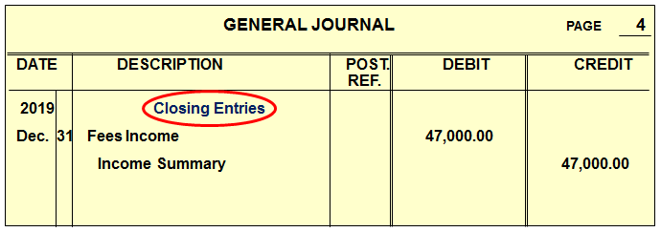
Closing Entries (3 of 15)
Section 1, Objective 6-1: Journalize and post closing entries.
The words “Closing Entries” are written in the Description column of the general journal above our first closing journal entry.
Notes:
Section 1, Objective 6-1:
Here is the first closing general journal entry. Notice that the notation “closing entries” was written above the first closing journal entry.

Slide 11
Closing Entries (4 of 15)
Section 1, Objective 6-1: Journalize and post closing entries.
Step 2: Close all Expenses to the Income Summary account
The Income Statement section of the worksheet for Eli’s Consulting Services lists five expense accounts.
Since expense accounts have debit balances, enter a credit in each account to reduce its balance to zero.
This closing entry transfers total expenses to the Income Summary account.
Notes:
Section 1, Objective 6-1:
Step 2 is to close all of the expense accounts. Since expense accounts have a debit balance, we need to credit them to close their balances to zero.

Slide 12
Closing Entries (5 of 15)
Section 1, Objective 6-1: Journalize and post closing entries.
The five expense account balances are reduced to zero.
The total, $13,333 of expenses are transferred to the temporary owner’s equity account, Income Summary.
Notes:
Section 1, Objective 6-1:
When closing the expense accounts, we will transfer their balances to the Income Summary account.

Slide 13
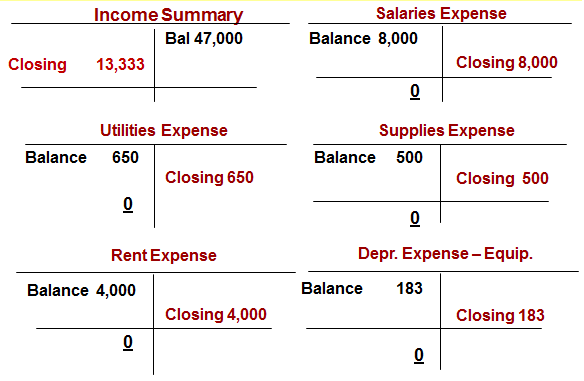
Closing Entries (6 of 15)
Section 1, Objective 6-1: Journalize and post closing entries.
Each expense account will be credited to bring their balance down to zero.
Notes:
Section 1, Objective 6-1:
Since the expense accounts have a debit balance, we need to credit them to close them to zero. A corresponding debit will be made to the Income Summary account. The Income Summary account will be debited for the total of all the credits made to the expense accounts. Each expense account will be credited to bring their balance down to zero.
Here is what the T accounts look like. Each expense account was closed to zero and a corresponding debit was made to the Income Summary account for $13,333.

Slide 14
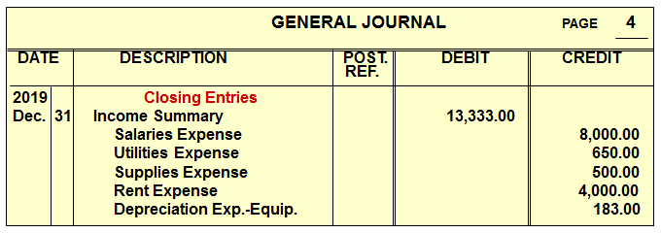
Closing Entries (7 of 15)
Section 1, Objective 6-1: Journalize and post closing entries.
Here is the second closing journal entry.
Notes:
Section 1, Objective 6-1:
Here is the second closing journal entry. Notice that Income Summary is listed first because it is the only debited account.

Slide 15
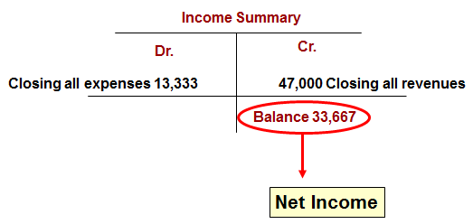
Closing Entries (8 of 15)
Section 1, Objective 6-1: Journalize and post closing entries.
The Income Summary account reflects all entries in the Income Statement section of the worksheet.
After making the first two closing entries, Income Summary has a balance of $33,667.
Notes:
Section 1, Objective 6-1:
After making the first two closing entries, Income Summary has a balance of $33,667. This is the difference between the revenues and the expenses, or net income. This amount will be transferred to the capital account of the owner.

Slide 16
Closing Entries (9 of 15)
Section 1, Objective 6-1: Journalize and post closing entries.
Step 3: Close Net Income to Capital
The journal entry to transfer net income to owner’s equity is a debit to Income Summary, and a credit to Trayton Eli, Capital.
The Income Summary account is reduced to zero.
The net income amount, $33,667, is transferred to the owner’s capital account. Trayton Eli, Capital is increased by $33,667.
Notes:
Section 1, Objective 6-1:
Our third closing entry transfers net income to Trayton Eli, Capital.

Slide 17
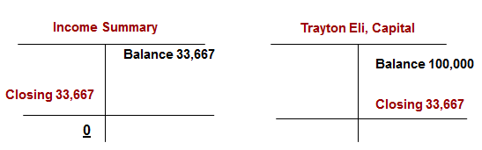
Closing Entries (10 of 15)
Section 1, Objective 6-1: Journalize and post closing entries.
Income Summary has a credit balance of $33,667 at this point, so to close it we would debit it for this amount and make a corresponding credit to the Owner’s capital account for the same amount.
Notes:
Section 1, Objective 6-1:
Income Summary has a credit balance of $33,667 at this point, so to close it we would debit it for this amount and make a corresponding credit to the Owner’s capital account for the same amount. Here is an illustration of what the third closing entry would look like in the T accounts.

Slide 18
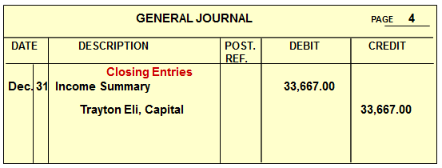
Closing Entries (11 of 15)
Section 1, Objective 6-1: Journalize and post closing entries.
Here is the third closing journal entry.
Notes:
Section 1, Objective 6-1:
Here is the third closing journal entry.

Slide 19
Closing Entries (12 of 15)
Section 1, Objective 6-1: Journalize and post closing entries.
Step 4: Close Drawing to Capital
Withdrawals appear in the statement of owner’s equity as a deduction from capital.
The drawing account is closed directly to the capital account.
The drawing account balance is reduced to zero.
The balance of the drawing account, $5,000, is transferred to the owner’s capital account.
Notes:
Section 1, Objective 6-1:
Our final step is to close the owner’s drawing account.
Step 4—The owner’s drawing account has a debit balance and is closed directly to the owner’s capital account. In this step, we are reducing the drawing account balance of $5,000 to zero.

Slide 20
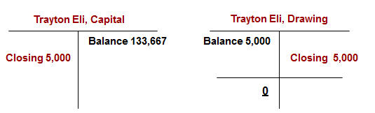
Closing Entries (13 of 15)
Section 1, Objective 6-1: Journalize and post closing entries.
After making the credit to the Drawing account, its balance is zero and the capital account has been reduced by the withdrawals made during the period.
**This was another goal of the closing process; to update the owner’s capital account.
Notes:
Section 1, Objective 6-1:
We need to debit Trayton Eli, Capital for $5,000 and credit Trayton Eli, Drawing for $5,000 to close it to zero.
After making the credit to the Drawing account, its balance is zero and the capital account has been reduced by the withdrawals made during the period. This was another goal of the closing process; to update the owner’s capital account.

Slide 21
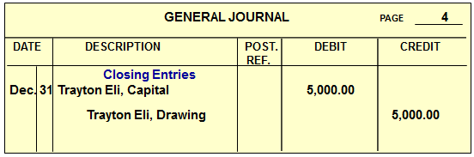
Closing Entries (14 of 15)
Section 1, Objective 6-1: Journalize and post closing entries.
Here is the fourth and last closing journal entry.
Notes:
Section 1, Objective 6-1:
The last closing journal entry is shown here.

Slide 22
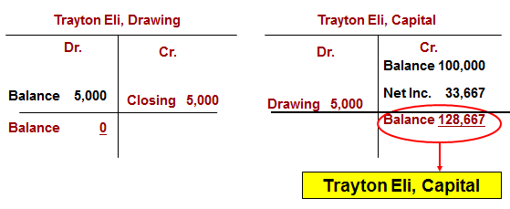
Closing Entries (15 of 15)
Section 1, Objective 6-1: Journalize and post closing entries.
The new balance of the Trayton Eli, Capital account agrees with the amount listed on the balance sheet.
Notes:
Section 1, Objective 6-1:
Trayton Eli, Capital will show a balance of $128,667 on the Balance Sheet.

Slide 23
Summary of Closing Entries (1 of 2)
Section 1, Objective 6-1: Journalize and post closing entries.
Steps:
Close Revenue Account
Close Expense Accounts
Close Income Summary
Close Drawing Account
Notes:
Section 1, Objective 6-1:
Here are all four of the closing journal entries:
Step 1—close the revenue accounts
Step 2—close the expense accounts
Step 3—close the Income Summary account
Step 4—close the Drawing account

Slide 24
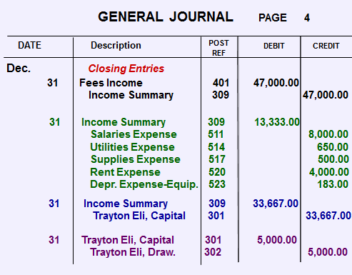
Summary of Closing Entries (2 of 2)
Section 1, Objective 6-1: Journalize and post closing entries.
Notes:
Section 1, Objective 6-1:
Here are all four of the closing journal entries:
Step 1—close the revenue accounts
Step 2—close the expense accounts
Step 3—close the Income Summary account
Step 4—close the Drawing account

Slide 25
Posting the Closing Entries
Section 1, Objective 6-1: Journalize and post closing entries.
All journal entries are posted to the general ledger accounts.
“Closing” is entered in the Description column of the ledger accounts.
The ending balances of the drawing, revenue, and expense accounts are zero.
Notes:
Section 1, Objective 6-1:
Now all of the closing journal entries need to be posted to the general ledger.
When posting the closing entries, make sure you write “closing” in the description column of the general ledger.

Slide 26
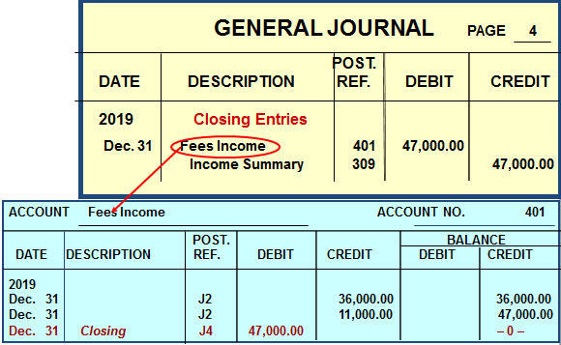
General Journal (1 of 2)
Section 1, Objective 6-1: Journalize and post closing entries.
Steps:
Close Revenue
Notes:
Section 1, Objective 6-1:
Here is the Fees Income account in the general ledger. Notice that after posting the closing journal entry of a $47,000 debit, it now has an end of period balance of zero.

Slide 27
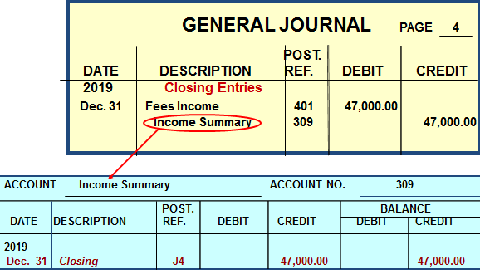
General Journal (2 of 2)
Section 1, Objective 6-1: Journalize and post closing entries.
Notes:
Section 1, Objective 6-1:
After posting to the Fees Income account in the general ledger, we post to the Income Summary. The remaining three closing entries are posted in a similar fashion.

Slide 28
Section 2: Using Accounting Information
Learning Objective 6-2: Prepare a post-closing trial balance
Notes:
Learning Objective 6-2: Prepare a postclosing trial balance.

Slide 29
Trial Balance (1 of 2)
Section 2, Objective 6-2: Prepare a post-closing trial balance.
QUESTION:
What is the post-closing trial balance?
ANSWER:
A post-closing trial balance is a report that is prepared to prove the equality of total debits and credits after the closing process is completed. It verifies that revenue, expense, and drawing accounts have zero balances.
Notes:
Section 2, Objective 6-2:
The postclosing trial balance is prepared after the closing process. It contains only the permanent accounts which were not closed at the end of the period. It proves that debits still equal credits and that all temporary accounts were closed to zero. When we interpret financial information, we are evaluating the financial information presented, and communicating this information to various stakeholders, both inside and outside of the business.

Slide 30
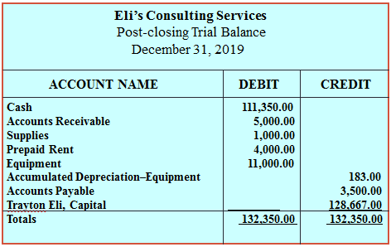
Trial Balance (2 of 2)
Section 2, Objective 6-2: Prepare a post-closing trial balance.
Only permanent accounts appear on the post-closing trial balance.
Notes:
Section 2, Objective 6-2:
Only permanent accounts appear on the postclosing trial balance. This would include all asset and liability accounts, as well as capital. Notice that debits equal credits on the post closing trial balance.

Slide 31
Finding and Correcting Errors
Section 2, Objective 6-2: Prepare a post-closing trial balance.
If the post-closing trial balance does not balance, the accounting records contain errors.
Use the audit trail to trace data through the accounting records.
Notes:
Section 2, Objective 6-2:
We can use the audit trail to help us locate errors. Oftentimes this requires that we backtrack trough the process to find where we may have added or subtracted incorrectly, posted incorrectly, or journalized incorrectly.

Slide 32
Section 2: Using Accounting Information
Learning Objective 6-3: Interpret financial statements
Notes:
Learning Objective 6-3: Interpret financial statements.

Slide 33
Interpret Financial Statements
Section 2, Objective 6-3: Interpret financial statements.
To “Interpret” means to understand and explain the meaning and importance of something.
Financial statements help users make all kinds of decisions.
Financial statements provide important answers to questions such as:
  What is the cash balance?
  How much do customers owe the business?
  How much does the business owe suppliers?
  What is the profit or loss?
Notes:
Section 2, Objective 6-3:
What do users do with the finished financial statements?
In objective three we will learn how users value the information provided in financial statements. Users must interpret the information in the financial statements. To interpret means to understand and explain the meaning and importance of something. Financial statements help users make all kinds of decisions. Financial statements provide important answers to questions such as:
What is the cash balance?
How much do customers owe the business?
How much does the business owe suppliers?
What is the profit or loss?

Slide 34
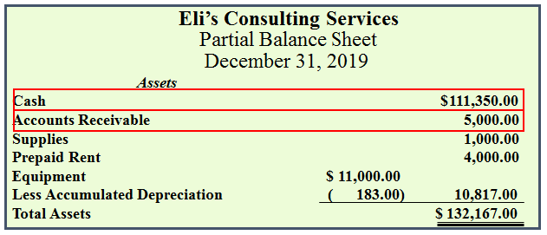
Partial Balance Sheet
Section 2, Objective 6-3: Interpret financial statements.
What is the cash balance?
How much do the customers owe the business?
Notes:
Section 2, Objective 6-3:
From looking at a balance sheet you can see that the Cash account has a balance of $111,350. Let’s look at Accounts Receivable on the balance sheet. You can see that our customers owe us $5,000.

Slide 35
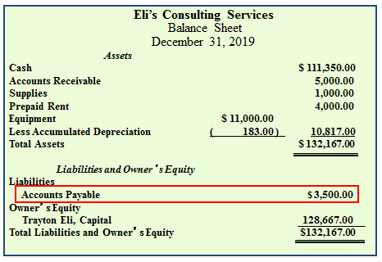
Balance Sheet
Section 2, Objective 6-3: Interpret financial statements.
How much does the business owe its suppliers?
Notes:
Section 2, Objective 6-3:
You can also see what the company owes to its vendors. The business owes $3,500 to creditors.

Slide 36
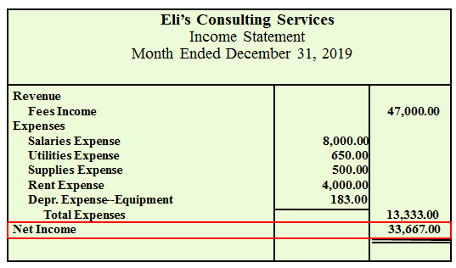
Income Statement
Section 2, Objective 6-3: Interpret financial statements.
What is the profit?
Notes:
Section 2, Objective 6-3:
Did the company generate a profit or loss? You can tell by reviewing the income statement that the business had net income of $33,667.

Slide 37
Section 2: Using Accounting Information
Learning Objective 6- 4: Review the steps in the accounting cycle.
Notes:
Learning Objective 6-4: Review the steps in the accounting cycle.

Slide 38
The Accounting Cycle (1 of 2)
Section 2, Objective 6-4: Review the steps in the accounting cycle.
Step 1: Analyze transactions
Step 2: Journalize the data about transactions
Step 3: Post the data about transactions
Step 4: Prepare a worksheet
Step 5: Prepare financial statements
Income Statement
Statement of Owner’s Equity
Balance Sheet
Notes:
Section 2, Objective 6-4:
In the last objective of this chapter we want to review the final steps in the accounting cycle.
In step 5, we use the worksheet to prepare our financial statements.

Slide 39
The Accounting Cycle (2 of 2)
Section 2, Objective 6-4: Review the steps in the accounting cycle.
Step 1: Analyze transactions
Step 2: Journalize the data about transactions
Step 3: Post the data about transactions
Step 4: Prepare a worksheet
Step 5: Prepare financial statements
Step 6: Journalize and post adjusting entries
Step 7: Journalize and post closing entries
  Transfer net income or net loss to owner’s equity.
  Reduce the balances of the temporary accounts to zero.
Notes:
Section 2, Objective 6-4:
In step 6, we journalize and post adjusting entries. In step 7, we journalize and post our end of period closing entries.

Slide 40
Flow of Data Through a Simple Accounting System
Section 2, Objective 6-4: Review the steps in the accounting cycle.
Source Documents
General journal
General ledger
Worksheet
Financial statements
After studying the accounting cycle of Eli’s Consulting Services, you should have an understanding of how data flows through a simple accounting system for a small business. Let’s review. . .
Notes:
Section 2, Objective 6-4:
After studying the accounting cycle of Eli’s Consulting Services, you should have an understanding of how data flows through a simple accounting system for a small business. Review the flow and make certain that you are comfortable with the documents and reports.

