Slide 1

College Accounting
A Contemporary Approach
Fourth Edition
Chapter 8
Accounting for Purchases, Accounts Payable, and Cash Payments
Copyright © 2017 McGraw-Hill Education. All rights reserved. No reproduction or distribution without the prior written consent of McGraw-Hill Education.
Notes:
PowerPoint Presentations for
College Accounting: A Contemporary Approach, 4th edition
By Haddock, Price, and Farina
Chapter 8 Accounting for Purchases, Accounts Payable, and Cash Payments

Slide 2
Learning Objectives (1 of 2)
SECTION 1: Merchandising Purchases
8-1 Record purchases of merchandise on credit in a general journal.
8-2 Compute the net delivered cost of purchases
SECTION 2: Accounts Payable
8-3 Post from the general journal to the general ledger accounts.
8-4 Post transactions to the accounts payable subsidiary ledger.
Notes:
Chapter 1 Learning Objectives:
Section 1:
1-1 Define accounting.
1-2 Identify and discuss career opportunities in accounting.
1-3 Identify the users of financial information.
1-4 Compare and contrast the three types of business entities.
Section 2:
1-5 Describe the process used to develop generally accepted accounting principles.
1-6 Define the accounting terms new to this chapter.

Slide 3
Learning Objectives (2 of 2)
8-5 Prepare a schedule of accounts payable.
8-6 Demonstrate a knowledge of the procedures for effective internal control of purchases.
8-7 Appendix: Record transactions for a retailer using the perpetual inventory system.
8-8 Define the accounting terms new to this chapter.
Notes:
This chapter shows how a merchandiser manages its purchases of goods for resale and its accounts payable.
The objectives of this chapter are listed here.
SECTION 1: Merchandising Purchases
8-1 Record purchases of merchandise on credit in a general journal.
8-2 Compute the net delivered cost of purchases.
SECTION 2: Accounts Payable
8-3 Post from the general journal to the general ledger accounts.
8-4 Post transactions to the accounts payable subsidiary ledger.
8-5 Prepare a schedule of accounts payable.
8-6 Demonstrate a knowledge of the procedures for effective internal control of purchases.
8-7 Appendix: Record transactions for a retailer using the perpetual inventory system.
8-8 Define the accounting terms new to this chapter.

Slide 4
Accounting for Purchases
Section 1
Most merchandising businesses purchase goods on credit under open-account arrangements.
A large firm usually has a centralized purchasing department that is responsible for locating suppliers, obtaining price quotations, negotiating credit terms, and placing orders.
In small firms purchasing activities are handled by a single individual, usually the owner or manager.
Notes:
Section 1
In this chapter you will learn how Maxx-Out Sporting Goods manages its purchases of goods for resale and its accounts payable.

Slide 5
Purchasing Procedures
Section 1
The Sales Department: sends an authorized purchase requisition to the Purchasing Department
The Purchasing Department: issues an authorized purchase order and sends to the selected supplier
A receiving report is prepared when the merchandise is received
The Accounting Department: receives the invoice and copies of the purchase order and receiving report
Notes:
Section 1
For good internal control, normally three departments will be involved in purchasing merchandise for a company.
You should study basic internal documents that are needed in the purchasing department and become familiar with them. These documents include a purchase requisition, a purchase order, a receiving report, and an invoice.

Slide 6
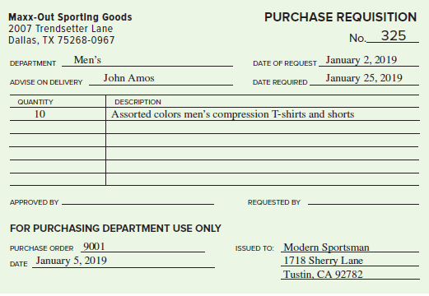
Purchase Requisition and Purchase Order (1 of 2)
Section 1
Lists the items to be ordered
Notes:
Section 1
A purchase requisition lists the items to be ordered. It is signed by someone with the authority to approve requests for merchandise, usually the manager of the sales department.
The purchase order specifies the exact items, quantity, price, and credit terms. It is signed by someone with authority to approve purchases, usually the purchasing agent.
A receiving report is prepared to show the quantity and condition of the goods received. The purchasing department receives a copy of the receiving report and compares it to the purchase order.

Slide 7
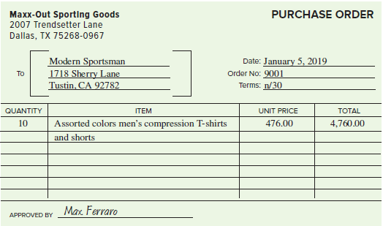
Purchase Requisition and Purchase Order (2 of 2)
Section 1
Specifies the exact items, quantity, price & credit terms.

Slide 8
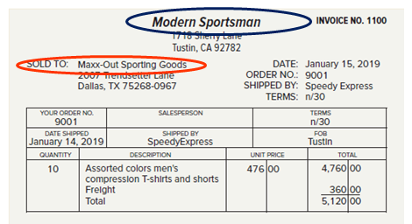
Invoice
Section 1
“SOLD TO: Maxx-Out Sporting Goods” - This is a purchase invoice for the customer
“Modern Sportsman” - This is a sales invoice for the seller
Notes:
Section 1
A purchase invoice is what the customer receives from the seller. It is also the sales invoice for the seller.

Slide 9
Account Classifications
Section 1
In this chapter, we will learn to account for purchases and purchase-related transactions. The new accounts we will be using in this chapter are summarized below:
Name of Accounts | Type of Account | Normal Balance | Used to Record
Purchases | Expense | DR | Purchase of merchandise inventory
Purchases Returns and Allowances | Contra expense | CR | Returns of merchandise inventory to seller on the buyer’s books.
Purchases Discounts | Contra expense | CR | Record cash discounts taken for early payments to the seller by the buyer
Freight In or Transportation In | Expense | DR | Record payment of transportation costs on merchandise inventory purchased
Notes:
Section 1
In Chapter 7, we learned to account for the various sales and sales-related transactions typically engaged in by merchandising firms. In this chapter, we will learn to account for purchases and purchase-related transactions. The new accounts we will be using in this chapter are summarized in the slide.

Slide 10
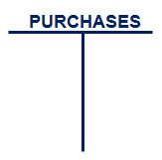
The Purchases Account
Section 1
QUESTION:
What is the Purchases account?
ANSWER:
The Purchases account is an account used to record cost of goods bought for resale during a period.

Slide 11
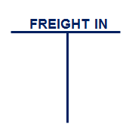
Purchases and Cash Payments With Freight Charges
Section 1
QUESTION:
What is the Freight In account?
ANSWER:
The Freight In account is an account showing transportation charges for items purchased. It is also called Transportation In account.
Notes:
Section 1
Freight In is an expense account, included in cost of goods sold, showing transportation charges for merchandise purchased. It is also known as Transportation In account.

Slide 12
FOB Shipping Point and FOB Destination (1 of 4)
Section 1
(FOB) shipping point:
Buyer pays the freight charge—the cost of shipping the goods from the seller’s warehouse to the buyer’s location
(FOB) destination:
Seller pays the freight charges
Notes:
Section 1
If the freight terms are free on board (FOB) shipping point, the buyer pays the freight charge—the cost of shipping the goods from the seller’s warehouse to the buyer’s location.
If the freight terms are (FOB) destination, the seller pays the freight charges. There are two ways to handle the freight charges paid by the buyer:
The buyer is billed directly by the transportation company for the freight charge. The buyer issues a check directly to the freight company.
The seller pays the freight charge and includes it on the invoice. The invoice includes the price of the goods and the freight charge.

Slide 13
FOB Shipping Point and FOB Destination (2 of 4)
Section 1
Two ways to handle the freight charges paid by the buyer:
Buyer is billed directly by the transportation company for the freight charge.
Seller pays the freight charge and includes it on the invoice.

Slide 14
FOB Shipping Point and FOB Destination (3 of 4)
Section 1
Maxx-Out Sporting Goods purchased merchandise. The vendor paid the freight charge and included it on its invoice. Maxx-Out Sporting Goods would:
Price of goods (debit Purchases) | $4,760.00
Freight charge (debit Freight In) | + 360.00
Total invoice (credit Accounts Payable) | $5,120.00

Slide 15
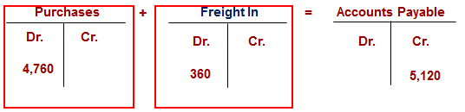
FOB Shipping Point and FOB Destination (4 of 4)
Section 1
The cost of goods sold accounts have normal debit balances
Let’s take a look at the journal entry . . .
Notes:
Section 1
The account is treated as a Cost of Goods Sold account because it increased the cost of the merchandise purchased.

Slide 16
Section 1: Merchandising Purchases
Learning Objective 8-1: Record purchases of merchandise on credit in a general journal.
Notes:
Section 1: Objective 8-1: Record purchases of merchandise on credit in a general journal.

Slide 17
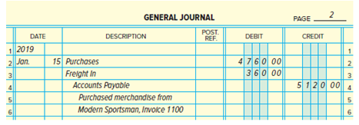
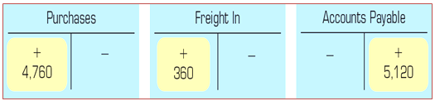
Purchases with Freight
Section 1, Objective 8-1: Record purchases of merchandise on credit in a general journal.
Notes:
Section 1, Objective 8-1:
Here is the journal entry for the purchase we saw on the earlier slide as well as the posting to the respective accounts. Remember, Maxx-Out Sporting Goods purchased merchandise from Modern Sportsman on January 15. Modern Sportsman paid the freight charge and included it on their invoice 1100. Maxx-Out Sporting Goods enters three elements in the accounting records:
Price of goods
Freight charge
Total invoice

Slide 18
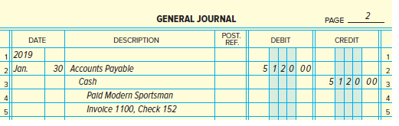
Payment of Invoice with freight
Section 1, Objective 8-1: Record purchases of merchandise on credit in a general journal.
The journal entry to record payment of this invoice on January 30 using check number 152 appears below:
Notes:
Section 1, Objective 8-1:
This is how the journal entry to record this payment should appear.

Slide 19
Purchase Returns and Allowances (1 of 3)
Section 1, Objective 8-1: Record purchases of merchandise on credit in a general journal.
A purchase return is a return of unsatisfactory goods
A purchase allowance is a reduction in the price of the goods
Notes:
Section 1, Objective 8-1:
When merchandise arrives, it is examined to confirm that it is satisfactory. Occasionally, the wrong goods are shipped, or items are damaged or defective. A purchase return is when the business returns the goods. A purchase allowance is when the purchaser keeps the goods but receives a reduction in the price of the goods.

Slide 20
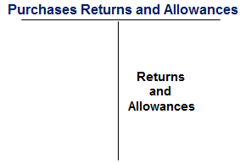
Purchase Returns and Allowances (2 of 3)
Section 1, Objective 8-1: Record purchases of merchandise on credit in a general journal.
A credit to the Purchase Returns and Allowances account is made when a vendor returns something to a supplier.
Notes:
Section 1, Objective 8-1:
Purchases returns and allowances are entered in the Purchases Returns and Allowances account, not in the Purchases account. Managers analyze this account to identify problem suppliers. It is a contra expense under cost of goods sold.
The normal balance of cost of goods sold accounts is a debit. The Purchases Returns and Allowances account has a normal credit balance.

Slide 21
Purchase Returns and Allowances (3 of 3)
Section 1, Objective 8-1: Record purchases of merchandise on credit in a general journal.
A complete record of returns and allowances
A contra cost of goods sold account
Normal credit balance

Slide 22
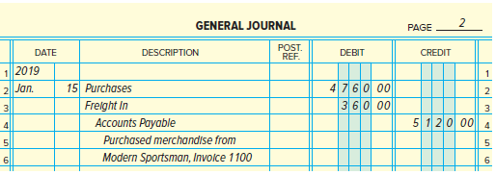
Recording Purchases Returns and Allowances (1 of 2)
Section 1, Objective 8-1: Record purchases of merchandise on credit in a general journal
On January 15, Maxx-Out Sporting Goods received merchandise costing $4,760 from Modern Sportsman with freight charges of $360 paid by Modern Sportsman. This is the original entry that was made on January 15.
Notes:
Section 1, Objective 8-1:
On January 15 Maxx-Out Sporting Goods received merchandise costing $4,760 from Modern Sportsman with freight charges of $360 paid by Modern Sportsman. This is the original entry that was made on January 15.

Slide 23
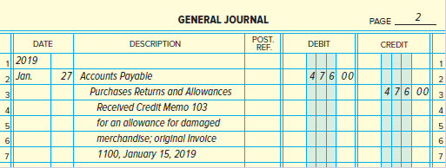
Recording Purchases Returns and Allowances (2 of 2)
Section 1, Objective 8-1: Record purchases of merchandise on credit in a general journal
Some goods received from the January 15 purchase were damaged, and the supplier granted a $476 purchase allowance on their credit memo #103 dated January 27.
Notes:
Section 1, Objective 8-1:
Some goods received from the January 15 purchase were damaged, and the supplier granted a $476 purchase allowance on their credit memo #103 dated January 27.
Notice the entry to record the receipt of the credit memorandum from Modern Sportsman reduces Accounts Payable by debiting it for $476.

Slide 24
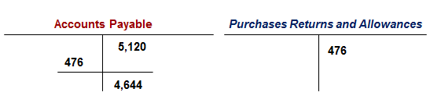
Recording the Payment on Account (1 of 2)
Section 1, Objective 8-1: Record purchases of merchandise on credit in a general journal.
The amount owed to Modern Sportsman, after the purchase allowance, is $4,644 ($5,120 - $476 = $4,644).
Notes:
Section 1, Objective 8-1:
The amount owed to Modern Sportsman, after the purchase allowance, is $4,644 ($5,120 - $476 = $4,644).
The entry to pay the amount owed to Modern Sportsman on January 31 with check number 153 is presented in the slide.

Slide 25
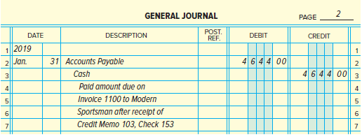
Recording the Payment on Account (2 of 2)
Section 1, Objective 8-1: Record purchases of merchandise on credit in a general journal.

Slide 26
Purchases Discounts
Section 1, Objective 8-1: Record purchases of merchandise on credit in a general journal
Net 30 days or n/30: Payment in full is due 30 days after the date of the invoice.
Net 10 days EOM, or n/10 EOM: Payment in full is due 10 days after the end of the month in which the invoice was issued.
2% 10 days, net 30 days; or 2/10, n/30: If payment is made within 10 days of the invoice date, the customer can take a 2 percent discount. Otherwise, payment in full is due in 30 days.
Notes:
Section 1, Objective 8-1:
A business may be able to take advantage of an early payment discount if it pays the invoice within a certain period of time. Here are some examples of credit terms which a seller might give a firm on a purchase. Take a moment to review the most common ones.
Cash discounts are given to encourage early payment. A cash discount is a discount offered by suppliers for payment received within a specified period of time. If a customer pays within a period of time it may receive a “cash discount” called a purchase discount.

Slide 27
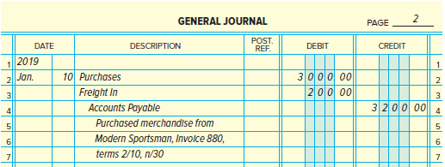
Recording Purchases Discounts (1 of 2)
Section 1, Objective 8-1: Record purchases of merchandise on credit in a general journal.
Maxx-Out Sporting Goods received merchandise costing $3,000 from The Modern Sportsman on January 10, Invoice 880, terms 2/10, n/30, with freight charges of $200 paid by Modern Sportsman and added to the invoice.
Notes:
Section 1, Objective 8-1:
Maxx-Out Sporting Goods recorded the purchase as presented in the slide.

Slide 28
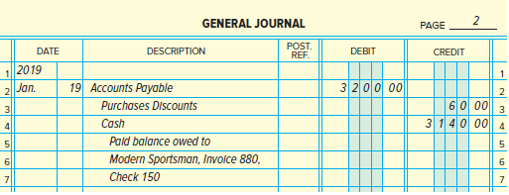
Recording Purchases Discounts (2 of 2)
Section 1, Objective 8-1: Record purchases of merchandise on credit in a general journal.
Maxx-Out Sporting Goods paid the amount due, after deducting a $60 discount ($3,000 * 2%), on January 19 with check number 150.
Notes:
Section 1, Objective 8-1:
he balance owed to Modern Sportsman was paid using check 150.

Slide 29
Purchase Return Processed Within the Discount Period (1 of 2)
Section 1, Objective 8-1: Record purchases of merchandise on credit in a general journal
If there is a purchase return processed within the discount period, the buyer is entitled to take the cash discount only on the balance owed after the return.
Original amount owed | $525
Less: purchase return | -100
Difference | 425
Less: disc | ($400×2%)-8
Amount paid | $417
Notes:
X 2%) - 8
Amount paid $417Section 1, Objective 8-1:
To illustrate, a purchase of $500 from Modern Sportsman on January 11, terms 2/10, n/30, with freight of $25 added, Invoice 910; a return of $100 on January 12, credit memorandum 112; and the final payment on January 20, check 149.
The amount to be paid on January 20 is $417, calculated as follows:
Original amount owed $525
Less: purchase return - 100
Difference = 425
Less: discount ($400

Slide 30
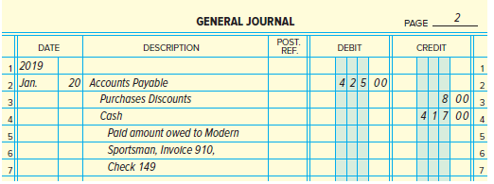
Purchase Return Processed Within the Discount Period (2 of 2)
Section 1, Objective 8-1: Record purchases of merchandise on credit in a general journal.

Slide 31
Section 1: Merchandising Purchases
Learning Objective 8-2: Compute the net delivered cost of purchases.
Notes:
Section 1: Objective 8-2: Compute the net delivered cost of purchases.

Slide 32
Determining the Cost of Purchases
Section 1, Objective 8-2: Compute the net delivered cost of purchases.
The income statement of a merchandising business contains a section showing the total cost of purchases.
This section combines information about
  Cost of the purchases
  Freight in
  Purchases returns and allowances
  Purchase discounts
Notes:
Section 1, Objective 8-2:
The Purchases account accumulates the cost of merchandise bought for resale. The income statement of a merchandising business contains a section showing the total cost of purchases. This section combines information about the cost of the purchases, freight in, purchases returns and allowances, and purchases discounts for the period.

Slide 33
Net Delivered Cost of Purchases
Section 1, Objective 8-2: Compute the net delivered cost of purchases.
The net delivered cost of purchases for Maxx-Out Sporting Goods for January is calculated as follows.
Purchases | $23,315
Freight In | + 1,565
Delivered Cost of Purchases | $24,880
Less Purchases Returns and Allowances | - 476
Less Purchases Discounts | - 124
Net Delivered Cost of Purchases | $24,280
Notes:
Section 1, Objective 8-2:
Take a moment to review the calculation on the slide for the net delivered cost of purchases.
In Chapter 13, you will see how the complete income statement for a merchandising business is prepared. You will learn about the Cost of Goods Sold section and how the net delivered cost of purchases is used in calculating the results of operations.

Slide 34
Accounts Payable (1 of 2)
Section 2
Recording Merchandise Purchased with a Trade Discount
Modern Sportsman offers merchandise for sale with a list price of $1,000, with trade discounts of 20 percent and 10 percent, terms 2/10, n /30.
Maxx- Out Sporting Goods purchases merchandise with a list price from Modern Sportsman.
The amount owed for the purchase is computed as follows.
Notes:
Section 2 of the chapter continues the purchasing process and introduces the accounts payable subsidiary ledger.
Businesses that buy merchandise on credit can conduct more extensive operations and use financial resources more effectively than if they paid cash for all purchases. It is important to pay invoices on time so that the business maintains a good credit reputation with its suppliers.
Recall from Chapter 7 that certain wholesale businesses offer goods to trade customers with the price computed using trade discounts.

Slide 35
Accounts Payable (2 of 2)
Section 2
List price | $1,000.00
Less first discount ($1000 × 20%) | 200.00
Difference | $ 800.00
Less second discount ($800 × 10%) | 80.00
Invoice price | $ 720.00

Slide 36
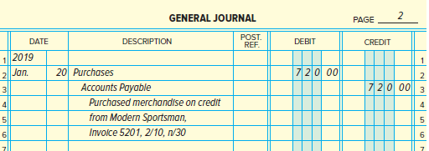
Recording Merchandise Purchased with a Trade Discount (1 of 2)
Section 2
If Maxx-Out Sporting Goods pays the invoice within 10 days, it will be entitled to a $14.40 discount (2% × $720).
Notes:
Section 2
The journal entry to record the purchase on January 20 is presented in the slide.
If Maxx-Out Sporting Goods pays the invoice within 10 days, it will be entitled to a $14.40 discount (2% X $720). The amount paid will be $705.60 ($720 - $14.40 = $705.60). The journal entry to record the payment on January 29 with check number 151 is presented in the slide.

Slide 37
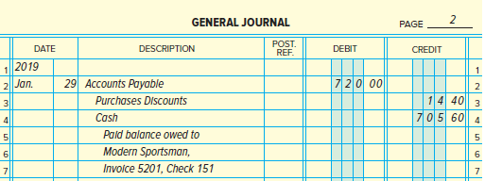
Recording Merchandise Purchased with a Trade Discount (2 of 2)
Section 2

Slide 38
Section 2: Accounts Payable
Learning Objective 8-3: Post from the general journal to the general ledger accounts.
Notes:
Section 2: Objective 8-3: Post from the general journal to the general ledger accounts.

Slide 39
General Ledger
Section 2, Objective 8-3: Post from the general journal to the general ledger accounts.
Post from the general journal to the general ledger accounts
Posting to the general ledger is done in the same manner as demonstrated in Chapter 4.
Notes:
Section 2, Objective 8-3:
The process for posting to the general ledger is done in the same manner as demonstrated in Chapter 4.

Slide 40
Section 2: Accounts Payable
Learning Objective 8-4: Post transactions to the accounts payable subsidiary ledger.
Notes:
Section 2: Objective 8-4: Post transactions to the accounts payable subsidiary ledger.

Slide 41
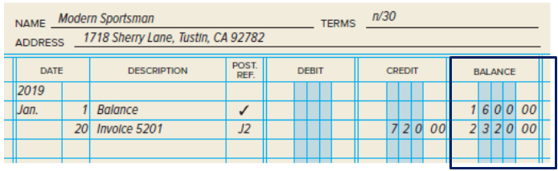
The Accounts Payable Ledger (1 of 2)
Section 2, Objective 8-4: Post transactions to the accounts payable subsidiary ledger.
The accounts payable ledger has three money columns.
The Balance column is presumed to contain credit amounts.
Notes:
Section 2, Objective 8-4:
An accounts payable ledger is a subsidiary ledger that contains a separate account for each creditor. Many businesses use an accounts payable subsidiary ledger to track amounts owed, to whom they are owed, when they are due, and discount terms. This ensures that the firms will have enough cash to pay for obligations.
Let’s review what an accounts payable subsidiary ledger looks like. It is similar to the accounts receivable subsidiary ledger discussed in the previous chapter.

Slide 42
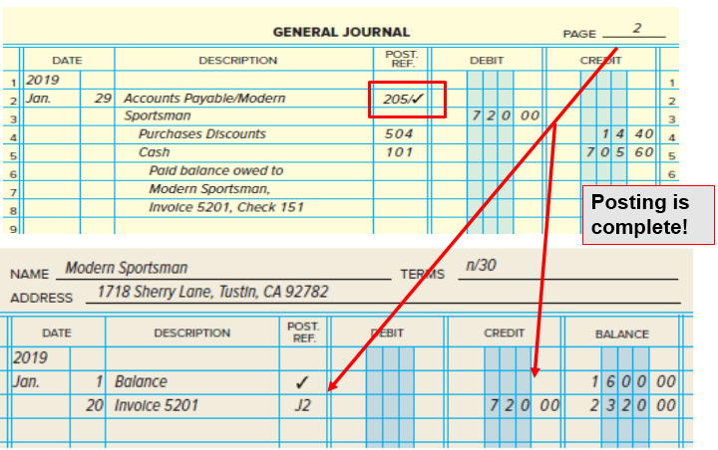
Posting to the Subsidiary Ledger
Section 2, Objective 8-4: Post transactions to the accounts payable subsidiary ledger.
Notes:
Section 2, Objective 8-4:
Posting from the general journal to the accounts payable ledger is similar to posting the accounts receivable subsidiary ledger. The posting to the vendor’s account in the accounts payable subsidiary ledger is signified by entering a “/ ”, followed by a check mark, after the account number for accounts payable in the chart of accounts.

Slide 43
Section 2: Accounts Payable
Learning Objective8-5: Prepare a schedule of accounts payable.
Notes:
Section 2: Objective 8-5: Prepare a schedule of accounts payable.

Slide 44
The Accounts Payable Ledger
Section 2, Objective 8-5: Prepare a schedule of accounts payable.
The total of the individual creditor accounts in the subsidiary ledger must equal the balance of the Accounts Payable control account.
To prove that the control account and the subsidiary ledger are equal, businesses prepare a schedule of accounts payable.
Notes:
Section 2, Objective 8-5:
The schedule of accounts payable displays the balances of the all vendor/creditor accounts. The total of all the vendor accounts will equal the total balance in the general ledger accounts payable control account. The schedule of accounts payable is particularly important to a business owner or accounts payable manager in keeping track of how much money the company owes and when that amount is due.

Slide 45
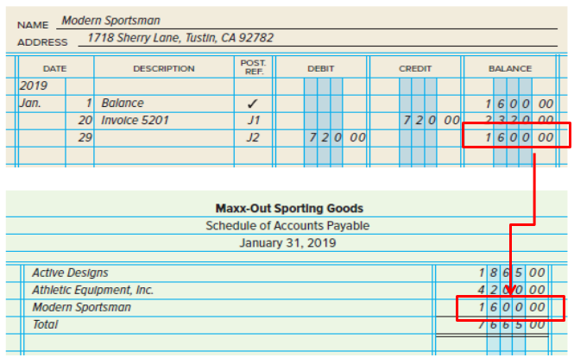
Schedule of Accounts Payable
Section 2, Objective 8-5: Prepare a schedule of accounts payable.
Notes:
Section 2, Objective 8-5:
The total of all vendor balances must equal the total in the accounts payable control account in the general ledger. Notice that the figure on the Schedule of Accounts payable matches the controlling total of Accounts Payable in the ledger.

Slide 46
Section 2: Accounts Payable
Learning Objective 8-6: Demonstrate a knowledge of the procedures for effective internal control of purchases.
Notes:
Section 2: Objective 8-6: Demonstrate a knowledge of the procedures for effective internal control of purchases.

Slide 47
Internal Control of Purchases (1 of 4)
Section 2, Objective 8-6: Demonstrate a knowledge of the procedures for effective internal control of purchases.
The objectives of the controls are to:
Create written proof that purchases and payments are authorized;
Ensure that different people are involved in the process of buying goods, receiving goods, and making payments.
Notes:
Section 2, Objective 8-6:
Because of the large amount of money spent to buy goods, most businesses develop careful procedures for the control of purchases and payments. Some firms have a voucher system, a special system used to achieve internal control. Whether the voucher system is used or not, a business should be sure that its control process includes sufficient safeguards.

Slide 48
Internal Control of Purchases (2 of 4)
Section 2, Objective 8-6: Demonstrate a knowledge of the procedures for effective internal control of purchases.
Effective systems have the following controls in place:
All purchases should be made only after proper authorization has been given in writing.
Goods should be carefully checked when received. They should then be compared with the purchase order and with the invoice received from the supplier.
The purchase order, receiving report, and invoice should be checked to confirm that the information on the documents is in agreement.
Notes:
Section 2, Objective 8-6:
Separating duties among employees provides a system of checks and balances. In a small business with just a few employees, it might be difficult or impossible to separate duties. However, the business should design as effective a set of control procedures as the company’s resources will allow.
Effective systems have controls in place. Take a moment to review these internal controls related to the purchasing process.

Slide 49
Internal Control of Purchases (3 of 4)
Section 2, Objective 8-6: Demonstrate a knowledge of the procedures for effective internal control of purchases
The computations on the invoice should be checked for accuracy.
Authorization for payment should be made by someone other than the person who ordered the goods, and this authorization should be given only after all the verifications have been made.
Another person should write the check for payment.
Notes:
Section 2, Objective 8-6:
All of these controls insure that proper accounting is taking place.

Slide 50
Internal Control of Purchases (4 of 4)
Section 2, Objective 8-6: Demonstrate a knowledge of the procedures for effective internal control of purchases.
Pre-numbered forms should be used for purchase requisitions, purchase orders, and checks. Periodically the numbers of the documents issued should be verified to make sure that all forms can be accounted for.
Notes:
Section 2, Objective 8-6:
All of these controls insure that proper accounting is taking place.

Slide 51
Section 2: Accounts Payable
Learning Objective 8-7: Appendix: Record transactions for a retailer using the perpetual inventory system.
Notes:
Section 2: Objective 8-7: Appendix: Record transactions for a retailer using the perpetual inventory system.
The seventh objective of the chapter is to record purchases, sales, returns, cash payments, and cash receipts using the perpetual inventory system. So far the accounting for sales and purchases discussed in Chapter 7 and so far in Chapter 8 has assumed the use of a periodic system

Slide 52
The Perpetual Inventory System
Section 2, Objective 8-7: Appendix: Record transactions for a retailer using the perpetual inventory system.
When the perpetual system is used, an account called Merchandise Inventory replaces all purchase related accounts.
Additionally, perpetual inventory accounting requires a second entry when sales are made.
Summarized journal entries using both systems are summarized on the next few slides.
Notes:
Section 2, Objective 8-7:
There are significant differences between a periodic inventory system and a perpetual inventory system. When the periodic system is used, the inventory records are only updated when a physical inventory is taken. This system is adequate for most small businesses. When the perpetual system is used, an account called Merchandise Inventory replaces all purchase related accounts.
Larger businesses may require up-to-date information of inventories on hand, and use the perpetual system. Take a moment to review the next few slides which will show the similarities and differences between the two inventory methods.

Slide 53
Purchases - Perpetual Inventory System (1 of 2)
Section 2, Objective 8-7: Appendix: Record transactions for a retailer using the perpetual inventory system.
Merchandise Inventory replaces all purchase related accounts.
Notes:
Section 2, Objective 8-7:
Take a moment to review the journal entries that would be used by a company that uses a period inventory system and compare them to a company that uses a perpetual inventory system. Reminder, when the perpetual inventory system is used, the Merchandise Inventory account is used to record purchases and purchase returns of merchandise inventory. It is also used to record freight costs of merchandise inventory purchased. Merchandise Inventory is an asset account with a normal debit balance.

Slide 54
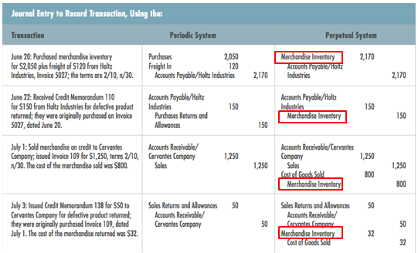
Purchases - Perpetual Inventory System (2 of 2)
Section 2, Objective 8-7: Appendix: Record transactions for a retailer using the perpetual inventory system.

Slide 55
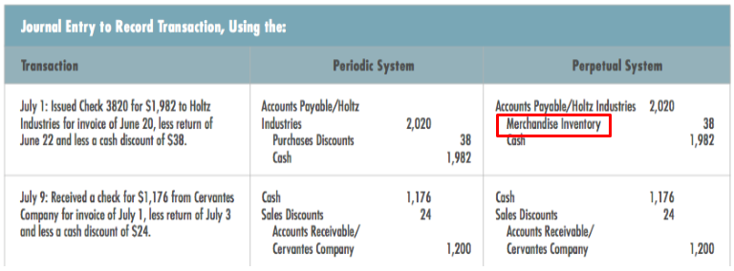
Payments - Perpetual Inventory System
Section 2, Objective 8-7: Appendix: Record transactions for a retailer using the perpetual inventory system.
Notes:
Section 2, Objective 8-7:
Take a moment to review the journal entries for cash payments and receipts using both a periodic system and a perpetual system.

