Slide 1

College Accounting
A Contemporary Approach
Fourth Edition
Chapter 9
Cash
Copyright © 2017 McGraw-Hill Education. All rights reserved. No reproduction or distribution without the prior written consent of McGraw-Hill Education.
Notes:
PowerPoint Presentations for
College Accounting: A Contemporary Approach, 4th edition
By Haddock, Price, and Farina
Chapter 9 Cash

Slide 2
Learning Objectives (1 of 2)
SECTION 1: Cash Receipts
9-1 Account for cash short or over.
SECTION 2: Petty Cash and Internal Controls for Cash
9-2 Demonstrate a knowledge of procedures for a petty cash fund.
9-3 Demonstrate a knowledge of internal control routines for cash.
Notes:
Chapter 8 discussed the relationship of a control account to its subsidiary accounts. Chapter 9 illustrates how there will be a cash short or over. It also discusses the petty cash fund and bank reconciliation. The first objective of the chapter is to illustrate, how to compute cash short or over. In the second section of this chapter, we will learn about the procedures for a petty cash fund and the internal control routines for cash. The last section of this chapter addresses reconciling a bank statement and explains how businesses can use online banking to manage cash activities.
The objectives of this chapter are listed here.
SECTION 1: Cash Receipts
9-1 Account for cash short or over.
SECTION 2: Petty Cash and Internal Controls for Cash
9-2 Demonstrate a knowledge of procedures for a petty cash fund.
9-3 Demonstrate a knowledge of internal control routines for cash.
SECTION 3: Banking Procedures
9-4 Write a check, endorse checks, prepare a bank deposit slip, and maintain a checkbook balance.
9-5 Reconcile the monthly bank statement.
9-6 Record any adjusting entries required from the bank reconciliation.
9-7 Understand how businesses use online banking to manage cash activities.
9-8 Define the accounting terms new to this chapter.

Slide 3
Learning Objectives (2 of 2)
SECTION 3: Banking Procedures
9-4 Write a check, endorse checks, prepare a bank deposit slip, and maintain a checkbook balance.
9-5 Reconcile the monthly bank statement.
9-6 Record any adjusting entries required from the bank reconciliation.
9-7 Understand how businesses use online banking to manage cash activities.
9-8 Define the accounting terms new to this chapter.
Notes:
Chapter 8 discussed the relationship of a control account to its subsidiary accounts. Chapter 9 illustrates how there will be a cash short or over. It also discusses the petty cash fund and bank reconciliation. The first objective of the chapter is to illustrate, how to compute cash short or over. In the second section of this chapter, we will learn about the procedures for a petty cash fund and the internal control routines for cash. The last section of this chapter addresses reconciling a bank statement and explains how businesses can use online banking to manage cash activities.
The objectives of this chapter are listed here.
SECTION 1: Cash Receipts
9-1 Account for cash short or over.
SECTION 2: Petty Cash and Internal Controls for Cash
9-2 Demonstrate a knowledge of procedures for a petty cash fund.
9-3 Demonstrate a knowledge of internal control routines for cash.
SECTION 3: Banking Procedures
9-4 Write a check, endorse checks, prepare a bank deposit slip, and maintain a checkbook balance.
9-5 Reconcile the monthly bank statement.
9-6 Record any adjusting entries required from the bank reconciliation.
9-7 Understand how businesses use online banking to manage cash activities.
9-8 Define the accounting terms new to this chapter.

Slide 4
Cash
Section 1
In accounting, the term cash is used for currency, coins, checks, money orders, and funds on deposit in a bank.
The type of cash receipts depends on the nature of the business.
  Supermarkets receive checks as well as currency and coins.
  Department stores receive checks in the mail from charge account customers.
  Wholesalers usually receive cash in the form of checks.
Notes:
Section 1
In accounting, the term cash is used for currency, coins, checks, money orders, and funds on deposit in a bank.
A business must maintain an adequate cash flow (cash receipts less cash payments).
However, the type of cash receipts depends on the nature of the business. Cash receipts come in many forms for a typical business.

Slide 5
Section 1: Cash
Learning Objective 9-1: Account for cash short or over.
Notes:
Section 1: Objective 9-1: Account for cash short or over.

Slide 6
Occasionally Errors Occur When Making Change
Section 1, Objective 9-1: Account for Cash Short or Over.
The cash in the cash register is either more or less than the cash listed on the cash register tape.
When cash receipts are more than the sales as per the cash register tape, cash is over.
When cash receipts are less than the sales as per the cash register tape, cash is short.
Notes:
Section 1, Objective 9-1:
When cash receipts are more than the sales, cash is over. When cash receipts are less than the sales, cash is short. These errors sometimes occur when employees make change.

Slide 7
How Do We Account For Cash That Is Short Or Over?
Section 1, Objective 9-1: Account for Cash Short or Over.
Cash tends to be short more often than over because customers are more likely to notice and complain if they receive too little change.
Cash short or over amounts are recorded in the Cash Short or Over account.
A credit balance in the account is an overage, that is treated as revenue.
Similarly if there is a debit balance in the account, there is a shortage ( treated as expense).
Notes:
Section 1, Objective 9-1:
How do we account for a cash shortage or overage? Sometimes there is shortage or overage of cash collected. This needs to be accounted for during the month. We will use a new account called Cash Short or Over to account for shortages or overages in cash.

Slide 8
Example #1: Accounting for Cash Short or Over (1 of 3)
Section 1, Objective 9-1: Account for Cash Short or Over.
Royal Jewelry Store, a retail business, keeps a $200 change fund in its cash register.
Royal Jewelry Store started business on September 29.
The cash sales as per the cash register tape on September 29 were $2,200.
The cash count was $2,397. The cash register was short by $3,
calculated as follows.
Notes:
Section 1, Objective 9-1:
Here is an example of how to calculate cash short at the end of the trading day.
On September 29,the change fund was $200, cash sales was $2,200, and at the end of the day cash count was $2,397. So the cash short is $3.

Slide 9
Example #1: Accounting for Cash Short or Over (2 of 3)
Section 1, Objective 9-1: Account for Cash Short or Over.
Cash count | $2,397
Less change fund | 200
Bank deposit | $2,197
Sales per cash register tape | 2,200
Amount short | ($3)
Notes:
Section 1, Objective 9-1:
This is how the journal entry to record the sales and the cash shortage should look. In this case there is a shortage, and so the cash short or over account is debited for three dollars.

Slide 10
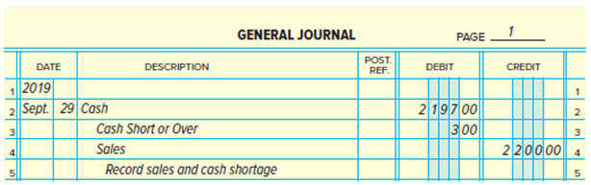
Example #1: Accounting for Cash Short or Over (3 of 3)
Section 1, Objective 9-1: Account for Cash Short or Over.
Journal entry to record the sales and cash shortage:
Notes:
Section 1, Objective 9-1:
Here is an example of how to calculate cash over at the end of the trading day.
On September 30, the change fund was $200, cash sales was $2,100 , and at the end of the day, the cash count was $2,301. So the cash over is $1.

Slide 11
Example #2: Accounting for Cash Short or Over (1 of 3)
Section 1, Objective 9-1: Account for Cash Short or Over.
The cash sales as per the cash register tape on September 30 were $2,100.
The cash count was $2,301.
The cash register was over by $1, calculated as follows.
Notes:
Section 1, Objective 9-1:
To record the overage computed on the previous slide, the cash short or over account is credited for one dollar. After these journal entries have been posted, the balance in the Cash Short or Over account on September 30 is a $2 debit. This will be reported as an expense on the income statement for the period ended September 30.
If the Cash Short or Over account would have had a credit balance. It would have been reported as a revenue on the income statement for the period ended September 30.

Slide 12
Example #2: Accounting for Cash Short or Over (2 of 3)
Section 1, Objective 9-1: Account for Cash Short or Over.
Cash count | $2,301
Less change fund | 200
Bank deposit | $2,101
Sales per cash register tape | 2,100
Amount over | $1
Notes:
Section 1, Objective 9-1:
Maxx-Out Sporting Goods makes sales on account and bills to customers once a month. It sends a statement of account that shows the transactions during the month and the balance owed. Customers are asked to pay within 30 days of receiving the statement. Checks from credit customers are journalized and posted, and then the checks are
deposited in the bank.

Slide 13
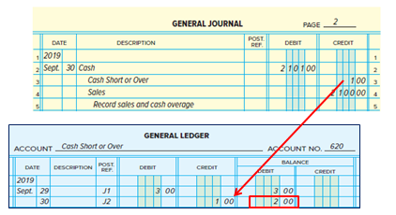
Example #2: Accounting for Cash Short or Over (3 of 3)
Section 1, Objective 9-1: Account for Cash Short or Over.
Journal entry to record the sales and cash overage:
Debit 200: Reported as a revenue on the income statement for the period ended Sept. 30.

Slide 14
Cash Received on Account
Section 1, Objective 9-1: Account for Cash Short or Over.
Generally a business makes sales on account and bills customers once after a specified period
(say, a month.)
It sends a statement of account that shows the transactions during the month and the balance owed.
Checks from credit customers are journalized and posted, and then the checks are deposited in the bank.
Notes:
Section 1, Objective 9-1:
Maxx-Out Sporting Goods makes sales on account and bills to customers once a month. It sends a statement of account that shows the transactions during the month and the balance owed. Customers are asked to pay within 30 days of receiving the statement. Checks from credit customers are journalized and posted, and then the checks are
deposited in the bank.

Slide 15
Promissory Note
Section 1, Objective 9-1: Account for Cash Short or Over.
A promissory note is a written promise to pay a specified amount of money on a certain date.
Promissory notes are specified interest bearing notes.
They are used by businesses to extent credit.
Also used to replace an accounts receivable balance when an account is overdue.
Notes:
Section 1, Objective 9-1:
A promissory note provides a more legal protection than an account receivable. The next slide shows a promissory note.

Slide 16
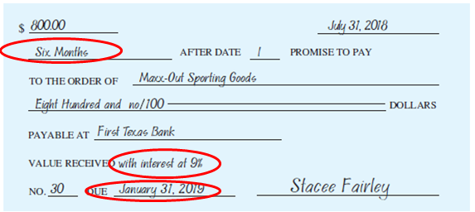
Collection of a Promissory Note and Interest (1 of 3)
Section 1, Objective 9-1: Account for Cash Short or Over.
On July 31 Maxx-Out Sporting Goods accepted a six-month promissory note from Stacee Fairley, who owed $800 on account.
Notes:
Section 1, Objective 9-1:
Sometimes promissory notes are issued on account to satisfy an overdue account. Here is a promissory note accepted from one of Maxx-Out’s customers. The note is due in six months and the customer will have to pay interest at the rate of 9% on the amount of $800.

Slide 17
Collection of a Promissory Note and Interest (2 of 3)
Section 1, Objective 9-1: Account for Cash Short or Over.
On July 31, Maxx-Out Sporting Goods recorded a general journal entry to increase notes receivable and to decrease accounts receivable for $800.
The asset account, Notes Receivable, was debited. The Accounts Receivable account was credited.
Notes:
Section 1, Objective 9-1:
This is the journal entry in the general journal to record receipt of the note from the customer that owed $800. This is sometimes referred to as a conversion journal entry.

Slide 18
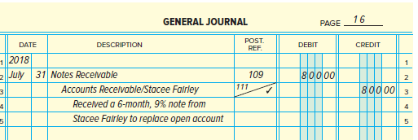
Collection of a Promissory Note and Interest (3 of 3)
Section 1, Objective 9-1: Account for Cash Short or Over.

Slide 19
Computation of Interest (1 of 2)
Section 1, Objective 9-1: Account for Cash Short or Over.
Amount owed = $ 800
Interest rate = 9% per year
Rate for six-month period = (9%) × 6 / 12 mos = 4.5%
Interest amount = $ 800 × 4.5% = $ 36
Total amount with interest = $ 800 + $ 36 = $ 836
Notes:
Section 1, Objective 9-1:
At the end of the note, we will need to compute interest. The interest on the note will be $36 and so the total amount due upon maturity of the note will be $836.

Slide 20
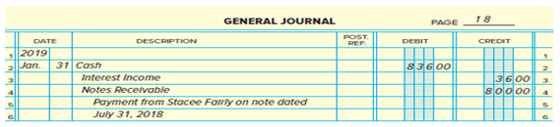
Computation of Interest (2 of 2)
Section 1, Objective 9-1: Account for Cash Short or Over.

Slide 21
Section 2: Petty Cash and Internal Controls for Cash
Learning Objective 9-2: Demonstrate a knowledge of procedures for a petty cash fund
Notes:
Section 2: Objective 9-2: Demonstrate a knowledge of procedures for a petty cash fund.

Slide 22
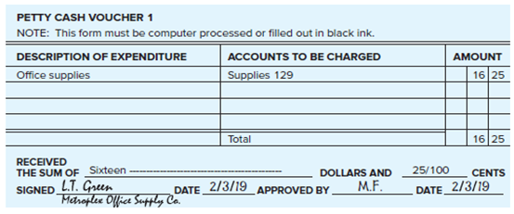
Petty Cash
Section 2, Objective 9-2: Demonstrate a knowledge of procedures for a petty cash fund.
Petty cash funds are set up to make payments for purchases of small items like postage or supplies.
A pre-numbered voucher is used for good internal control.
Notes:
Section 2, Objective 9-2:
Remember, for good internal control, all cash payments should be made by check. Petty cash funds are set up to make payments for purchases of small items like postage or COD items. A fund is established by writing a check to the order of the person who will be in charge of the fund. Usually the office manager, cashier, or assistant is in charge of the petty cash fund.
A pre-numbered voucher is used for good internal control. The amount is recorded. The purpose of the funds is listed. The account which needs to be debited is written in along with its account number.

Slide 23
Establishing the Petty Cash Fund (1 of 2)
Section 2, Objective 9-2: Demonstrate a knowledge of procedures for a petty cash fund.
The amount of petty cash fund depends upon the need of the business.
The cashier is responsible for the petty cash.
The establishment of petty cash fund should be recorded as:
Notes:
Section 2, Objective 9-2:
Here is an example of the establishment of a petty cash fund by Maxx-Out Sporting Goods. Maxx-Out Sporting Goods wrote a $175 check to the cashier on February 1, using check number 160.

Slide 24
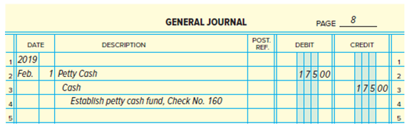
Establishing the Petty Cash Fund (2 of 2)
Section 2, Objective 9-2: Demonstrate a knowledge of procedures for a petty cash fund.

Slide 25
The Petty Cash Analysis Sheet (1 of 4)
Section 2, Objective 9-2: Demonstrate a knowledge of procedures for a petty cash fund.
Used to record transactions involving petty cash.
Contains two major columns: Receipts and Payments.
Contains special columns such as: Supplies, Delivery Expense, and Miscellaneous Expense.
Other Accounts Debit column for entries that do not fit in a special column.
Notes:
Section 2, Objective 9-2:
Most businesses use a petty cash analysis sheet to record transactions involving petty cash. In addition to the main columns Receipts and Payments, the analysis sheet also contains special columns for accounts that are used frequently and an Other Accounts Debit column for entries that do not fit in a special column.

Slide 26
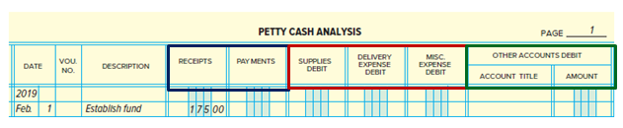
The Petty Cash Analysis Sheet (2 of 4)
Section 2, Objective 9-2: Demonstrate a knowledge of procedures for a petty cash fund.

Slide 27
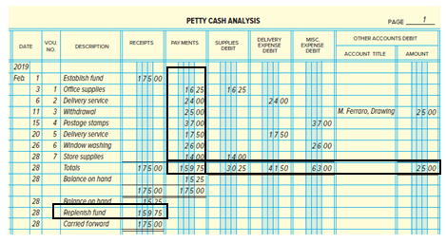
The Petty Cash Analysis Sheet (3 of 4)
Section 2, Objective 9-2: Demonstrate a knowledge of procedures for a petty cash fund.
Notes:
Section 2, Objective 9-2:
This slide shows an example of the Petty Cash Analysis sheet. The total payments during the month are replenished at the end of the month or when needed with the total amount of payments made.

Slide 28
The Petty Cash Analysis Sheet (4 of 4)
Section 2, Objective 9-2: Demonstrate a knowledge of procedures for a petty cash fund.
Total Payment equal Total of individual expense accounts
Replenish fund equals the Total Payments

Slide 29
Replenishing the Fund
Section 2, Objective 9-2: Demonstrate a knowledge of procedures for a petty cash fund.
The total vouchers plus the cash on hand should always be equal to the amount of the fund.
Replenish the petty cash fund at the end of each month or sooner if the fund is low.
A check is written to restore the petty cash fund to its original balance.
A journal entry is prepared to record the check.
Notes:
Section 2, Objective 9-2:
The total vouchers plus the cash on hand should be always equal to the amount of the fund. The fund should be “replenished” at the end of each month or sooner if the fund is low.

Slide 30
Internal Control Procedures (1 of 2)
Section 2, Objective 9-2: Demonstrate a knowledge of procedures for a petty cash fund.
The following internal control procedures apply to petty cash:
Use the petty cash fund only for small payments that cannot conveniently be made by check.
Limit the amount set aside for petty cash to the approximate amount needed to cover one month's payments from the fund.
Notes:
Section 2, Objective 9-2:
Internal controls for petty cash include using only for small payments, limiting the amount, and not writing checks to “Cash.”

Slide 31
Internal Control Procedures (2 of 2)
Section 2, Objective 9-2: Demonstrate a knowledge of procedures for a petty cash fund.
Write petty cash fund checks to the person in charge of the fund, not to the order of "Cash.
Assign one person to control the petty cash fund. This person has sole control of the money and is the only one authorized to make payments from the fund.
Keep petty cash in a safe, a locked cash box, or a locked drawer.
Obtain a petty cash voucher for each payment. The voucher should be signed by the person who receives the money and should show the payment details. This provides an audit trail for the fund.
Notes:
Section 2, Objective 9-2:
Other internal control procedures include: assigning it as one person’s responsibility, keeping cash secure, and obtaining vouchers for payment to provide an audit trail.

Slide 32
Section 2: Petty Cash and Internal Controls for Cash.
Learning Objective 9-3: Demonstrate a knowledge of internal control routines for cash.
Notes:
Section 2: Objective 9-3: Demonstrate a knowledge of internal control routines for cash.

Slide 33
Essential Cash Receipt Controls (1 of 2)
Section 2, Objective 9-2: Demonstrate a knowledge of procedures for a petty cash fund.
Have only designated employees receive and handle cash. In some businesses employees handling cash are bonded.
Keep cash receipts in a cash register, a locked cash drawer, or a safe while they are on the premises.
Make a record of all cash receipts as the funds come into the business.
Notes:
Section 2, Objective 9-3:
The internal control over cash should be tailored to the needs of a business. Accountants play a vital role in designing, establishing, and monitoring the cash control system.
Take a look over the above steps and see if you can understand the importance of these controls.

Slide 34
Essential Cash Receipt Controls (2 of 2)
Section 2, Objective 9-2: Demonstrate a knowledge of procedures for a petty cash fund.
Check the funds to be deposited against the record made when the cash was received.
Deposit cash receipts in the bank promptly. Deposit the funds intact.
Enter cash receipt transactions in the accounting records promptly.
Have the monthly bank statement sent to and reconciled by someone other than the employees who handle, record, and deposit the funds.
Notes:
Section 2, Objective 9-3:
Other controls also include depositing receipt promptly and entering receipt transactions promptly.

Slide 35
Advantage of Handling and Recording Cash Receipts
Section 2, Objective 9-3: Demonstrate a knowledge of internal control routines for cash.
Funds reach the bank sooner.
Cash receipts are not kept on the premises for more than a short time.
Funds are safer and are readily available for paying bills owed by the firm.
Notes:
Section 2, Objective 9-3:
One of the advantages of efficient procedures for handling and recording cash receipts is that the funds reach the bank sooner. Cash receipts are not kept on the premises for more than a short time, which means that the funds are safer and are readily available for paying bills owed by the firm.

Slide 36
Essential Cash Payment Controls (1 of 2)
Section 2, Objective 9-3: Demonstrate a knowledge of internal control routines for cash.
Make all payments by check except for payments from special purpose cash funds such as a petty cash fund.
Issue checks only with an approved bill, invoice, or other document that describes the reason for the payment.
Have only designated personnel approve bills and invoices.
Have checks prepared and recorded in the checkbook or check register by someone other than the person who approves the payments.
Notes:
Section 2, Objective 9-3:
There are many simple routines a business can put in place to provide better control over cash payments, including issuing checks only when an approved bill or invoice is presented…

Slide 37
Essential Cash Payment Controls (2 of 2)
Section 2, Objective 9-3: Demonstrate a knowledge of internal control routines for cash.
Have still another person sign and mail the checks to creditors.
Use pre-numbered check forms.
During the bank reconciliation process, compare the canceled checks to the checkbook or check register.
Enter promptly in the accounting records all cash payment transactions.
Notes:
Section 2, Objective 9-3:
and comparing the canceled checks to the checkbook or check register during the bank reconciliation process.

Slide 38
Section 3: Banking Procedures
Learning Objective 9-4: Write a check, endorse checks, prepare a bank deposit slip, and maintain a checkbook balance.
Notes:
Section 3: Objective 9-4: Write a check, endorse checks, prepare a bank deposit slip, and maintain a checkbook balance.
This is the last section of this chapter and it addresses reconciling a bank statement and explains how businesses can use online banking to manage cash activities.

Slide 39
Check (1 of 2)
Section 3, Objective 9-4: Write a check, endorse checks, prepare a bank deposit slip, and maintain a checkbook balance.
A check is a written order signed by an authorized person instructing a bank to pay a specific sum of money to a designated person or business.
Notes:
Section 3, Objective 9-4:
Objective 4 discusses proper banking procedures involving checks, deposits and maintaining a checkbook. Let’s talk about checks first. A check is a written order signed by an authorized person instructing a bank to pay a specific sum of money to a designated person or business. The drawer is the person or firm issuing a check. The drawee is the bank on which a check is written. The payee is the person or firm to whom a check is payable.

Slide 40
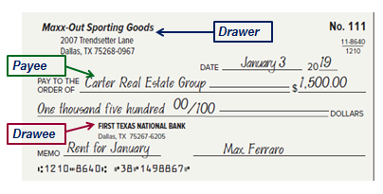
Check (2 of 2)
Section 3, Objective 9-4: Write a check, endorse checks, prepare a bank deposit slip, and maintain a checkbook balance.

Slide 41
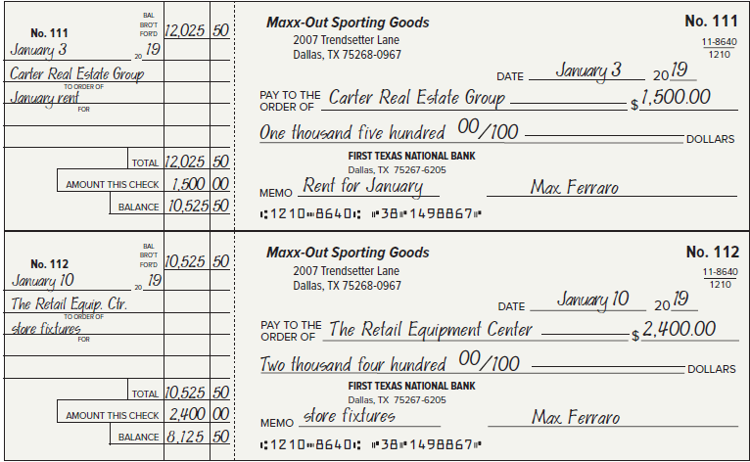
Checks and Check Stubs (1 of 2)
Section 3, Objective 9-4: Write a check, endorse checks, prepare a bank deposit slip, and maintain a checkbook balance.
Notes:
Section 3, Objective 9-4:
Here are two checks. The firsts check to The Maxx-Out Sporting Goods was written for two months rent equaling $1,500. See if you can identify the parties on a check as previously described. Keep in mind that a check is a negotiable instrument. A financial instrument is negotiable if ownership can be transferred to another person or business.

Slide 42
Checks and Check Stubs (2 of 2)
Section 3, Objective 9-4: Write a check, endorse checks, prepare a bank deposit slip, and maintain a checkbook balance.
Can you identify the: Drawers, Drawees and Payees?
These checks are negotiable financial instruments.

Slide 43
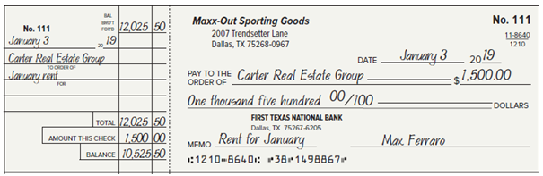
Check Stubs (1 of 2)
Section 3, Objective 9-4: Write a check, endorse checks, prepare a bank deposit slip, and maintain a checkbook balance.
Before writing the check, complete the check stub. The check stub shows:
Notes:
Section 3, Objective 9-4:
The check stub will show the balance before the check was written and then the balance in the checking account, after the check is subtracted. To be valid, checks need an authorized signature. For Maxx-Out Sporting Goods only Max Ferraro, the owner is authorized to sign checks.
Debit cards (also called check cards) look like credit cards or ATM (automated teller machine) cards, but operate like cash or a personal check.

Slide 44
Check Stubs (2 of 2)
Section 3, Objective 9-4: Write a check, endorse checks, prepare a bank deposit slip, and maintain a checkbook balance.
Balance brought forward: $12,025.50
Check amount: $1,500
Balance: $10,525.50

Slide 45
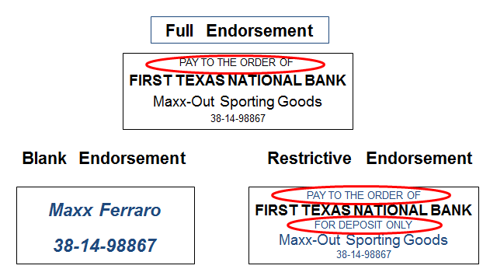
Endorsements
Section 3, Objective 9-4: Write a check, endorse checks, prepare a bank deposit slip, and maintain a checkbook balance.
Notes:
Section 3, Objective 9-4:
An endorsement is a written authorization that transfers ownership of a check. There are three types of endorsements:
Blank endorsement
Full endorsement
Restrictive endorsement
Make sure you know the difference between the three.
Here are examples of all three endorsements.

Slide 46
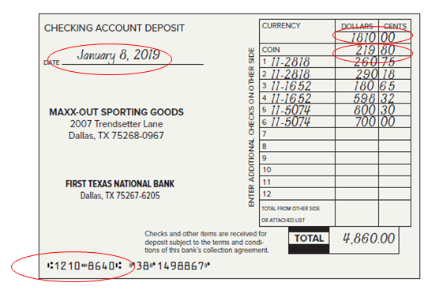
Preparing the Deposit Slip
Section 3, Objective 9-4: Write a check, endorse checks, prepare a bank deposit slip, and maintain a checkbook balance.
Notes:
Section 3, Objective 9-4:
The deposit slip for Maxx-Out Sporting Goods shows the date, January 8. Currency is the paper money, $1,810.00. Coin is the amount in coins, $219.80. The checks and money orders are individually listed. Some banks ask that the American Bankers Association (ABA) transit number for each check be entered on the deposit slip. The transit number appears on the top part of the fraction that appears in the upper right corner of the check. The transit number is 1210-8640.
Occasionally a business will receive a postdated check. A postdated check is dated some time in the future. If the business receives a postdated check, it should not deposit it before the date on the check. Otherwise, the check could be refused by the drawer’s bank.

Slide 47
Section 3: Banking Procedures
Learning Objective 9-5: Reconcile the monthly bank statement.
Notes:
Section 3: Objective 9-5: Reconcile the monthly bank statement.

Slide 48
Bank Statement Balance (1 of 2)
Section 3, Objective 9-5: Reconcile the monthly bank statement.
My Bank statement balance is different than my general ledger Cash (book) balance…Why??
The difference between the bank balance and the book balance is due to errors.
Notes:
Section 3, Objective 9-5:
Objective 5 is to prepare a bank reconciliation. This is done by comparing the bank statement to the accounting records maintained by the company. The bank reconciliation reconciles the two balances. Sometimes the difference between the bank balance and the book balance is due to errors. Sometimes it is due to timing errors. It is important to understand the basic types of reconciling items.

Slide 49
Bank Statement Balance (2 of 2)
Section 3, Objective 9-5: Reconcile the monthly bank statement.
Many banks require that errors in the bank statement be reported within a short period of time, usually 10 days.
Errors made by banks | Errors made by businesses
Arithmetic errors | Arithmetic errors
Giving credit to the wrong depositor | Not recording a check or deposit
Charging a check against the wrong account | Recording a check or deposit for the wrong amount

Slide 50
Why Balances May Not Equal
Section 3, Objective 9-5: Reconcile the monthly bank statement.
Other than errors, there are four reasons why the book balance (G.L. balance) of cash may not agree with the balance on the bank statement.
Outstanding checks.
Deposit in transit.
Service charges and other deductions not recorded in the business records.
Deposits, such as the collection of promissory notes, not recorded in the business records.
Notes:
Section 3, Objective 9-5:
Other than errors, there are four reasons why the book balance of cash may not agree with the balance on the bank statement. It is important that you know the definition of each of these and how they would be recorded on a typical bank reconciliation.
Outstanding checks are checks that have been recorded in the cash payments journal but have not yet been paid by the bank.
Deposit in transit is a deposit that is recorded in the cash receipts journal but that reaches the bank too late to be shown on the monthly bank statement.

Slide 51
Format of a Bank Reconciliation Statement
Section 3, Objective 9-5: Reconcile the monthly bank statement.
First Section |  | Second Section
Bank statement balance + deposits in transit – outstanding checks + or – bank errors | ≠ | Book balance + deposits not recorded – deductions + or – errors in books
Adjusted bank balance | = | Adjusted book balance
Notes:
Section 3, Objective 9-5:
Here is the format of a typical bank reconciliation.

Slide 52
The Bank Side of the Bank Reconciliation (1 of 3)
Section 3, Objective 9-5: Reconcile the monthly bank statement.
Steps to prepare the bank reconciliation statement:
First Section
Enter the balance on the bank statement.
Compare the deposits in the checkbook with the deposits on the bank statement.
List the outstanding checks.
List any bank errors.
Compute the adjusted bank balance.
Notes:
Section 3, Objective 9-5:
Let’s prepare the first section. First, enter the end of month bank statement balance listed on the bank statement, then compare the deposits in the checkbook with the deposits on the bank statement. Next, list the outstanding checks. If the bank has incorrectly debited an account or made any other errors, list those. Finally, compute the adjusted bank balance.

Slide 53
The Book Side of the Bank Reconciliation (2 of 3)
Section 3, Objective 9-5: Reconcile the monthly bank statement.
Steps to prepare the bank reconciliation statement:
Second Section
Enter the balance in books from the Cash account.
Record any deposits made by the bank that have not been recorded in the accounting records.
Notes:
Section 3, Objective 9-5:
Now it is time to prepare the second section of the bank reconciliation. First, enter the balance in books from the Cash account. Second, total and record any deposits made by the bank have not been recorded in the accounting records. Next, record deductions made by the bank, for example, a service charge. Fourth, record any errors uncovered during the reconciliation process. Finally, compute the adjust book balance.
The adjusted bank balance and the adjusted book balance should agree.

Slide 54
The Book Side of the Bank Reconciliation (3 of 3)
Section 3, Objective 9-5: Reconcile the monthly bank statement.
Record deductions made by the bank.
Record any errors in the accounting records that were discovered during the reconciliation process.
Compute the adjusted book balance.
Notes:
Section 3, Objective 9-5:
Now it is time to prepare the second section of the bank reconciliation. First, enter the balance in books from the Cash account. Second, total and record any deposits made by the bank have not been recorded in the accounting records. Next, record deductions made by the bank, for example, a service charge. Fourth, record any errors uncovered during the reconciliation process. Finally, compute the adjust book balance.
The adjusted bank balance and the adjusted book balance should agree.

Slide 55
Section 3: Banking Procedures
Learning Objective 9-6: Record any adjusting entries required from the bank reconciliation.
Notes:
Section 3: Objective 9-6: Record any adjusting entries required from the bank reconciliation.

Slide 56
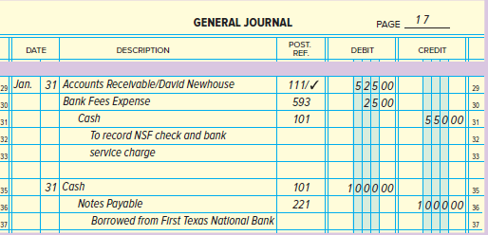
For Maxx-Out Sporting Goods, Two Entries Must Be Made (1 of 2)
Section 3.1, Objective 9-6: Record any adjusting entries required from the bank reconciliation.
Notes:
Section 3, Objective 9-6:
In the bank reconciliation process, steps 2 and 3 in section 2 involve recording additions or deductions made by the bank that are not yet included in the accounting records. A journal entry must be prepared to account for these items. For Maxx-Out Sporting Goods: Debit Accounts Receivable for the NSF check from David Newhouse; Debit Bank Fees Expense for the monthly bank charges and credit the Cash account for the combined total, $525. In the above entry, the two charges are entered as one adjusting entry. The second adjusting entry, shown on this slide is to record the loan received from the bank on January 31. After both entries are posted, the Cash account balance at the end of the month will be correct in the general ledger.

Slide 57
For Maxx-Out Sporting Goods, Two Entries Must Be Made (2 of 2)
Section 3.1, Objective 9-6: Record any adjusting entries required from the bank reconciliation.
The first entry records both the NSF check from David Newhouse as well as the monthly bank service charges.
The second entry is to record the proceeds received from a bank loan. A liability account, Notes Payable, is credited.
The first entry decreases the Cash account balance and the second entry, increases the Cash account balance.
Notes:
Section 3, Objective 9-6:
In the bank reconciliation process, steps 2 and 3 in section 2 involve recording additions or deductions made by the bank that are not yet included in the accounting records. A journal entry must be prepared to account for these items. For Maxx-Out Sporting Goods: Debit Accounts Receivable for the NSF check from David Newhouse; Debit Bank Fees Expense for the monthly bank charges and credit the Cash account for the combined total, $525. In the above entry, the two charges are entered as one adjusting entry. The second adjusting entry, shown on this slide is to record the loan received from the bank on January 31. After both entries are posted, the Cash account balance at the end of the month will be correct in the general ledger.

Slide 58
Section 3: Banking Procedures
Learning Objective 9-7: Understand how businesses use online banking to manage cash activities.
Notes:
Section 3: Objective 9-7: Understand how businesses use online banking to manage cash activities.

Slide 59
Using On-line Banking
Section 3.2, Objective 9-7: Understand how businesses can use online banking to manage cash activities.
Many businesses now manage many transactions online:
Electronic Funds Transfers – EFT’s
Payments to government agencies
Payments from customers
Payments to vendors
Security alerts
Notes:
Section 3, Objective 9-7:
More and more businesses are managing a significant portion of their cash transactions online. Online banking offers efficient features including electronic fund transfers, payments for taxes to government agencies, receipt of EFT payments from customers and payments to vendors. There are usually no source documents for the transactions listed above. Careful attention must be paid to insure all EFT and other transactions initiated electronically are recorded in the accounting records. Many banks offer security alerts for such instances as changes in mailing addresses and ATM and automatic payment withdrawals that exceed specified limits.

