Slide 1
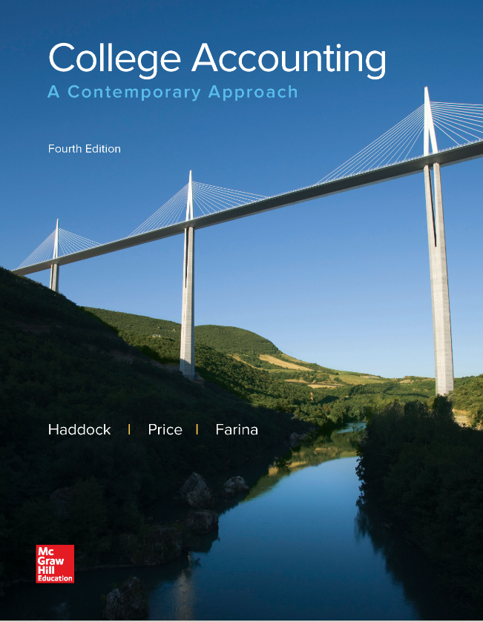
College Accounting
A Contemporary Approach
Fourth Edition
Chapter 13
Financial Statements and Closing Procedures
Copyright © 2017 McGraw-Hill Education. All rights reserved. No reproduction or distribution without the prior written consent of McGraw-Hill Education.
Notes:
PowerPoint Presentations for
College Accounting: A Contemporary Approach, 4th edition
By Haddock, Price, and Farina
Chapter 13 Financial Statements and Closing Procedures

Slide 2
Learning Objectives
SECTION 1: Preparing the Financial Statements
13-1 Prepare a classified income statement from the worksheet.
13-2 Prepare a statement of owner’s equity from the worksheet.
13-3 Prepare a classified balance sheet from the worksheet.
SECTION 2: Completing the Accounting Cycle
13-4 Journalize and post the adjusting entries.
13-5 Journalize and post the closing entries.
13-6 Prepare a post closing trial balance.
13-7 Journalize and post reversing entries.
13-8 Define the accounting terms new to this chapter.
Notes:
Chapter 12 discussed accrual accounting and completion of a worksheet for a merchandising business. Chapter 13 explains how to use worksheets to prepare and record adjusting and closing entries, to prepare a post-closing trial balance, and to prepare financial statements. In this first section, we use the worksheet to prepare the financial statements. Objective 1 is to prepare the income statement from the worksheet.
The objectives of this chapter are listed here
SECTION 1: Preparing the Financial Statements
13-1 Prepare a classified income statement from the worksheet.
13-2 Prepare a statement of owner’s equity from the worksheet.
13-3 Prepare a classified balance sheet from the worksheet.
SECTION 2: Completing the Accounting Cycle
13-4 Journalize and post the adjusting entries.
13-5 Journalize and post the closing entries.
13-6 Prepare a postclosing trial balance.
13-7 Journalize and post reversing entries.
13-8 Define the accounting terms new to this chapter.

Slide 3
Section 1: Calculating and Recording Adjustments
Learning Objective 13-1 : Prepare a classified income statement from the worksheet.
Notes:
Learning Objective 13-1: Prepare a classified income statement from the worksheet.

Slide 4
The Classified Income Statement
Section 1, Objective 13-1: Prepare a classified income statement from the worksheet.
A classified income statement is sometimes called a multiple-step income statement. Items are divided into groups of similar accounts.
There are subtotals within groups.
The classification and order of information depends on the type of business and the expected use of the statement.
Notes:
Section 1, Objective 13-1:
At the end of the period, the three financial statements must be prepared. A newspaper’s classified section is similar to a business’s classified financial statements. Classifying like information together on financial statements makes them easier to interpret.
This type of income statement contains several subtotals which are computed before the net income is calculated.

Slide 5
Single-step Income Statement
Section 1, Objective 13-1: Prepare a classified income statement from the worksheet.
QUESTION:
What is a single-step income statement?
ANSWER:
A single-step income statement is a format in which only one computation is needed to determine the net income.
(Total Revenue – Total Expenses = Net Income)
Notes:
Section 1, Objective 13-1:
A single-step income statement is a format in which only one computation is needed to determine the net income.

Slide 6

Operating Revenue
Section 1, Objective 13-1: Prepare a classified income statement from the worksheet.
549150.00 is the Net sales for Whiteside Antiques
Notes:
Section 1, Objective 13-1:
Operating Revenue is the first section of the income statement and it shows the revenues earned from normal business activities.
The operating revenue for Whiteside Antiques is net sales of merchandise.
Net sales for Whiteside Antiques is $549,150.

Slide 7
Cost of Goods Sold (1 of 3)
Section 1, Objective 13-1: Prepare a classified income statement from the worksheet.
The Cost of Goods Sold section contains information about the cost of the merchandise that was sold during the period.
Three elements are needed to compute the cost of goods sold:
Beginning inventory
Net delivered cost of purchases
Ending inventory
Notes:
Section 1, Objective 13-1:
Cost of goods sold is the next section on a multiple step income statement. It is usually the most challenging section to compute.
Cost of Goods Sold section contains information about the cost of the merchandise that was sold during the period. Three elements are needed to compute the cost of goods sold: Beginning inventory, Net delivered cost of purchases and Ending inventory.

Slide 8
Cost of Goods Sold (2 of 3)
Section 1, Objective 13-1: Prepare a classified income statement from the worksheet.
Beginning Merchandise Inventory + Net Delivered Cost of Purchases = Cost of Goods Available for Sale - Ending Inventory = Cost of Goods Sold
Remember, the Cost of Goods Sold section contains information about the cost of the merchandise that was sold during the period.
Notes:
Section 1, Objective 13-1:
Remember, the Cost of Goods Sold section contains information about the cost of the merchandise that was sold during the period.

Slide 9
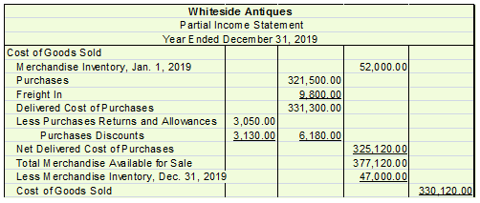
Cost of Goods Sold (3 of 3)
Section 1, Objective 13-1: Prepare a classified income statement from the worksheet.
377,120.00 is the Merchandise available for sale
330,120.00 is the Cost of goods sold
Notes:
Section 1, Objective 13-1:
The net delivered cost of purchases was $325,120. When we add the beginning inventory to these purchases, we get total available inventory for sale of $377,120. After subtracting out the ending inventory still on hand, we get cost of goods sold of $330,120.

Slide 10
Net Delivered Cost of Purchases
Section 1, Objective 13-1: Prepare a classified income statement from the worksheet.
Net Delivered Cost of Purchases is Calculated by: Purchases + Freight In - (Purchases Returns and Allowances) - (Purchases Discounts) = Net Delivered Cost of Purchases
Notes:
Section 1, Objective 13-1:
To calculate the net delivered cost of purchases, one would add purchases and freight in, and then deduct purchases returns and allowances and deduct purchases discounts.

Slide 11
Total Merchandise Available for Sale
Section 1, Objective 13-1: Prepare a classified income statement from the worksheet.
Beginning Merchandise Inventory + Net Delivered Cost of Purchases = Total Merchandise Available for Sale
Cost of Goods Sold
Total Merchandise Available for Sale
- Ending Inventory = Cost of Goods Sold
Notes:
Section 1, Objective 13-1:
To figure the total merchandise available for sale, a business would start with beginning merchandise inventory and add in the net delivered cost of purchases.

Slide 12
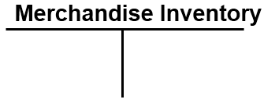
Merchandise Inventory Account
Section 1, Objective 13-1: Prepare a classified income statement from the worksheet.
Merchandise Inventory is the one account that appears on both the income statement and the balance sheet.
Beginning and ending merchandise inventory balances appear on the income statement.
Ending merchandise inventory also appears on the balance sheet in the Assets section.
Notes:
Section 1, Objective 13-1:
Merchandise Inventory is the one account that appears on both the income statement as well as the balance sheet. Ending inventory appears on the Balance sheet and both beginning and ending Merchandise Inventory balances are needed to figure cost of goods sold.

Slide 13
Gross Profit on Sales
Section 1, Objective 13-1: Prepare a classified income statement from the worksheet.
For Whiteside Antiques, net sales is the revenue earned from selling antique items.
Cost of goods sold is what Whiteside Antiques paid for the antiques that were sold during the fiscal period.
Gross profit is what is left to cover operating expenses and provide a profit.
Gross profit is the difference between the net sales and the cost of goods sold.
Notes:
Section 1, Objective 13-1:
Gross profit is what is left to cover operating expenses and provide a profit. For Whiteside Antiques, gross profit is equal to net sales less cost of goods sold.

Slide 14
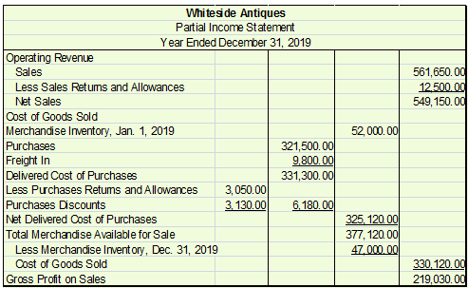
Gross Profit on Sales for Whiteside Antiques
Section 1, Objective 13-1: Prepare a classified income statement from the worksheet.
Notes:
Section 1, Objective 13-1:
Net sales were $549,150. When we subtract the cost of goods sold of $330,120, Whiteside Antiques will report gross profit of $219,030.

Slide 15
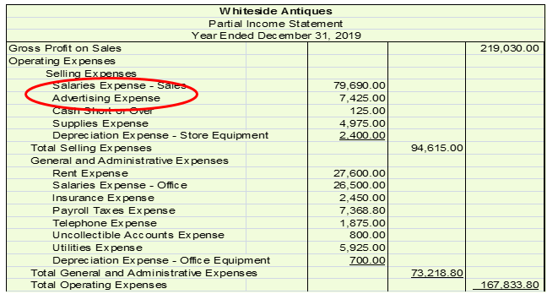
Operating Expenses (1 of 3)
Section 1, Objective 13-1: Prepare a classified income statement from the worksheet.
Salaries for salespersons and advertising are examples of selling expenses
Notes:
Section 1, Objective 13-1:
Operating expenses are separated into two categories:
(1) Selling Expenses and (2) General and Administrative Expenses.
Selling expenses include salesperson salaries and advertising expenses.

Slide 16
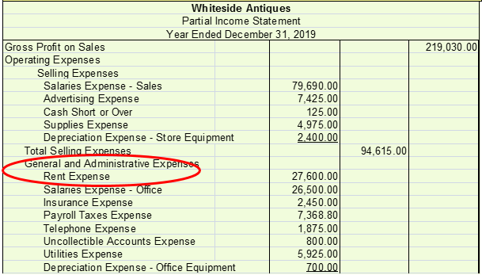
Operating Expenses (2 of 3)
Section 1, Objective 13-1: Prepare a classified income statement from the worksheet
Rent, utilities, and salaries for office employees are examples of general and administrative expenses
Notes:
Section 1, Objective 13-1:
General and Administrative Expenses include Rent Expense and office employees salaries.

Slide 17
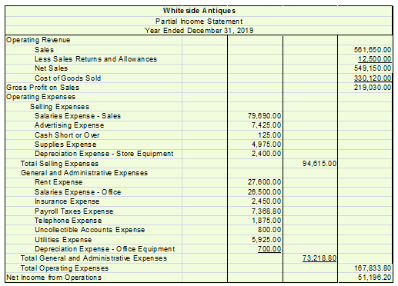
Operating Expenses (3 of 3)
Section 1, Objective 13-1: Prepare a classified income statement from the worksheet.
Net income from operations = 51,196.20
Notes:
Section 1, Objective 13-1:
Finally, after subtracting total operating expenses from our gross profit figure, the business can determine its net income or net loss for operations. Whiteside Antiques is reporting $51,196.20 net income from operations. (Note that the Cost of Goods Sold section has been collapsed to a single total for space considerations in presenting the partial Income Statement.)

Slide 18
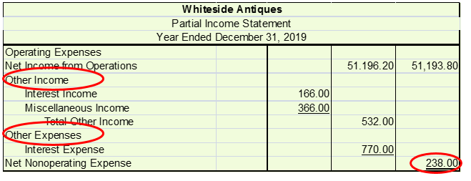
Other Income and Other Expenses (1 of 2)
Section 1, Objective 13-1: Prepare a classified income statement from the worksheet.
Our last section on the multiple step income statement is the Other Income and Other Expenses section.
Notes:
Section 1, Objective 13-1:
Keeping operating and non-operating income separate helps financial statement users learn about the operating efficiency of the firm. Our last section on the multiple step income statement is the Other Income and Other Expenses section. Income that is earned from sources unrelated to the normal business activity is classified as “other income” and would appear in the Other Income section. Expenses which are incurred but not directly connected with business operations appear in the Other Expenses section. (ex. Interest expense).
Total other income was equal to $532 and other expenses totaled $770. The difference was net nonoperating expense of $238.

Slide 19
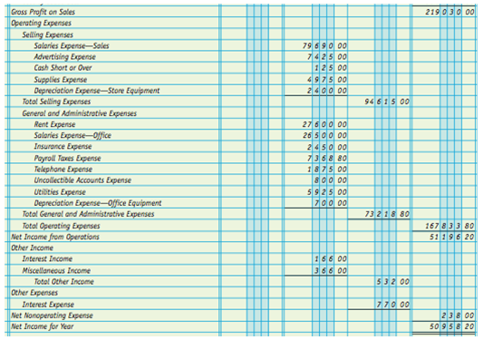
Other Income and Other Expenses (2 of 2)
Section 1, Objective 13-1: Prepare a classified income statement from the worksheet.
Net income from operations = 5095820
Notes:
Section 1, Objective 13-1:
Finally, after subtracting the net nonoperating expenses from our net income from operations figure, the business can determine its net income or net loss for the period – in this case the year. Whiteside Antiques is reporting $50,958.20 of net income for the year.

Slide 20
Section 1: Calculating and Recording Adjustments
Learning Objective 13-2 : Prepare a statement of owner’s equity from the worksheet.
Notes:
Learning Objective 13-2: Prepare a statement of owner’s equity from the worksheet.

Slide 21
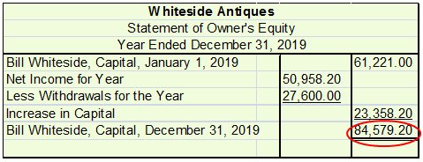
Statement of Owner's Equity
Section 1, Objective 13-2: Prepare a statement of owner’s equity from the worksheet.
The statement of owner's equity reports the changes that occurred in the owner's financial interest during the period.
The ending capital balance for Bill Whiteside, $84,576.80, is used to prepare the balance sheet.
Notes:
Section 1, Objective 13-2:
After we complete the income statement, we prepare the statement of owner’s equity.
The statement of owner's equity reports the changes that occurred in the owner's financial interest during the period. At the end of the period, Bill Whiteside, Capital had a balance of $84,579.20. The statement of owner’s equity analyzes the owner’s capital account for the period. The ending capital balance is used to prepare the Balance Sheet.

Slide 22
Section 1: Calculating and Recording Adjustments
Learning Objective 13-3 : Prepare a classified balance sheet from the worksheet.
Notes:
Learning Objective 13-3: Prepare a classified balance sheet from the worksheet.

Slide 23
Current Assets (1 of 2)
Section 1, Objective 13-3: Prepare a classified balance sheet from the worksheet.
QUESTION:
What are current assets?
ANSWER:
Current assets are assets consisting of cash, items that normally will be converted into cash within one year, and items that will be used up within one year.
Notes:
Section 1, Objective 13-3:
Our next financial statement is the Classified Balance Sheet. Again, we use the worksheet to help us prepare this financial statement. A Classified Balance Sheet is very similar to the Balance Sheets we have already prepared in the past except the assets and liabilities are classified into separate categories. The first section on the classified balance sheet is the current assets section.

Slide 24
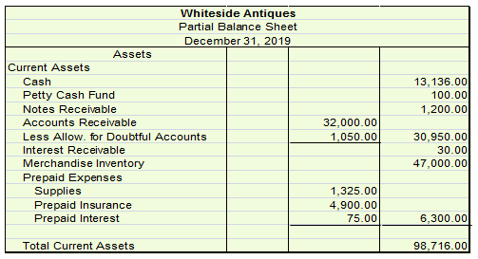
Current Assets (2 of 2)
Section 1, Objective 13-3: Prepare a classified balance sheet from the worksheet.
Current assets for Whiteside Antiques = 98,716.00
Notes:
Section 1, Objective 13-3:
Current assets consist of cash, items that will normally be converted into cash within one year, and items that will be used within one year (cash, accounts receivables, merchandise inventory, supplies etc.). Current assets are usually listed in order of liquidity. Current assets are vital to the survival of a business, because they provide the funds needed to pay bills and meet expenses. Liquidity is the ease with which an item can be converted into cash. Cash is a highly liquid asset, so it is listed first in the current asset section. Total current assets for Whiteside Antiques is $98,716.00.

Slide 25
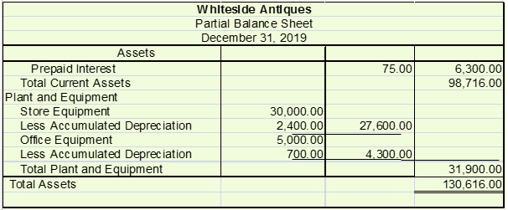
Plant and Equipment
Section 1, Objective 13-3: Prepare a classified balance sheet from the worksheet.
Noncurrent assets are called long-term assets.
An important category of long-term assets is plant and equipment.
For many businesses plant and equipment represents a sizable investment.
Notes:
Section 1, Objective 13-3:
Plant and Equipment is our next asset classification appearing on the classified balance sheet. Plant and equipment is property that will be used in the business for longer than one year. These would include buildings, equipment, and land.
Non-current assets are called long-term assets because they have a life greater than one year. For many businesses plant and equipment represents a sizable investment.
Any accumulated depreciation accounts are shown below their respective accounts. Total plant and equipment for Whiteside Antiques is $31,900.

Slide 26
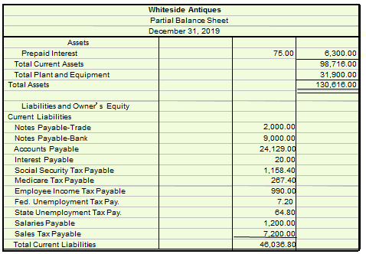
Current Liabilities
Section 1, Objective 13-3: Prepare a classified balance sheet from the worksheet.
Total current liabilities = 46,036.80
Notes:
Section 1, Objective 13-3:
The liabilities section comes next on the classified balance sheet. Liabilities are classified into two sections: current and long term.
Current liabilities are debts that must be paid within one year. Current liabilities are usually listed in order of priority of payment.
Total current liabilities for Whiteside Antiques is $46,036.80.

Slide 27
Long-Term Liabilities
Section 1, Objective 13-3: Prepare a classified balance sheet from the worksheet.
Although repayment of long-term liabilities might not be due for several years, management must make sure that periodic interest is paid promptly.
Long-term liabilities include mortgages, notes payable, and loans payable.
Notes:
Section 1, Objective 13-3:
After current liabilities comes long-term liabilities. Long-term liabilities are debts of a business that are due more than one year in the future.
Long-term liabilities include mortgages, notes payable, and loans payable. There were no long term liabilities for Whiteside Antiques as of December 31, 2019.

Slide 28
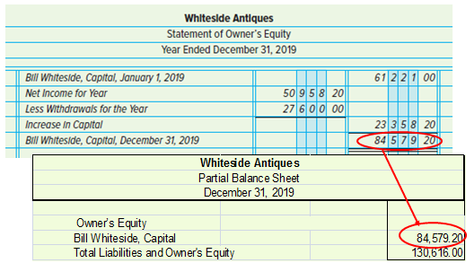
Owner's Equity
Section 1, Objective 13-3: Prepare a classified balance sheet from the worksheet.
The ending balance from the statement of owner’s equity is transferred to the Owner's Equity section of the balance sheet.
Notes:
Section 1, Objective 13-3:
The last section on a classified balance sheet is the owner’s equity. We will use the owner’s capital ending balance off of the statement of owner’s equity prepared earlier.
After transferring the capital account balance from the statement of owner’s equity, we can complete the balance sheet. Total liabilities and owner’s equity is $130,616.00. Note that this total must equal the total assets.

Slide 29
Section 2: Completing the Accounting Cycle
Learning Objective 13-4 : Journalize and post the adjusting entries.
Notes:
Learning Objective 13-4: Journalize and post the adjusting entries.

Slide 30
Adjusting Entries (1 of 2)
Section 2, Objective 13-4: Journalize and post the adjusting entries
All adjustments are shown on the worksheet.
After the financial statements have been prepared, the adjustments are made a permanent part of the accounting records.
They are recorded in the general journal as adjusting journal entries and are posted to the general ledger.
Here is a recap of the adjusting entries that were previously discussed.
Each one of them would need to be journalized and then posted.
Notes:
Section 2, Objective 13-4:
It is time to journalize the adjustments entered on the worksheet and post them to the general ledger accounts.
The adjustments shown on the worksheet need to be recorded in the general journal as adjusting journal entries. They are then posted to the general ledger.

Slide 31
Adjusting Entries (2 of 2)
Section 2, Objective 13-4: Journalize and post the adjusting entries
Type of Adjustment | Worksheet Reference | Purpose
Inventory | (a – b) | Removes beginning inventory and adds ending inventory to the accounting records.
Expense | (c – e) | Matches expense to revenue for the period; the credit is to a contra asset account.
Accrued Expense | (f – i) | Matches expense to revenue for the period; the credit is to a liability account.
Prepaid Expense | (j –l) | Matches expense to revenue for the period; the credit is to an asset account.
Notes:
Section 2, Objective 13-4:
Here is a recap of the adjusting entries that were previously discussed. Each one of them would need to be journalized and then posted. Remember to write the word “Adjusting” before you journalize them. Also write the word “Adjusting” in the description column of the general ledger.

Slide 32
Section 2: Completing the Accounting Cycle
Learning Objective 13-5 : Journalize and Post the Closing Entries.
Notes:
Learning Objective 13-5: Journalize and Post the Closing Entries.

Slide 33
Temporary Accounts
Section 2, Objective 13-5: Journalize and post the closing entries
At the end of the period, the temporary accounts are closed.
The temporary accounts are:
  Revenue accounts
  Cost of goods sold
  Expense accounts
  Drawing account
Notes:
Section 2, Objective 13-5:
The temporary accounts are: Revenue accounts, Cost of goods sold, all expense accounts and the Drawing account.

Slide 34
Four steps in the Closing Process
Section 2, Objective 13-5: Journalize and post the closing entries
Close revenue accounts and cost of goods sold accounts with credit balances to Income Summary.
Close expense accounts, cost of goods sold accounts with debit balances, and any contra revenue accounts with debit balances to Income Summary.
Close Income Summary, which now reflects the net income or loss for the period, to owner's capital.
Close the drawing account to owner's capital.
Notes:
Section 2, Objective 13-5:
During this closing process, changes in the temporary owner equity accounts are transferred to the permanent owner’s capital account.
We will use the same four steps in the merchandiser’s closing process: close revenue accounts and cost of goods sold accounts with credit balances to Income Summary, close expense accounts cost of goods sold accounts with debit balances, and any contra revenue accounts with debit balances to Income Summary, close Income Summary, which now reflects the net income or loss for the period, to owner's capital, and close the drawing account to owner's capital.

Slide 35
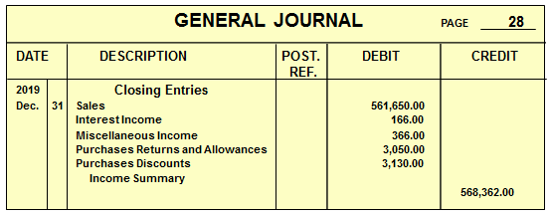
General Journal (1 of 6)
Section 2, Objective 13-5: Journalize and post the closing entries
Step 1: Closing the Revenue Accounts and the Cost of Goods Sold Accounts with credit balances.
When viewing the work sheet, debit each account, except Income Summary, for its balance. Credit Income Summary for the total.
Notes:
Section 2, Objective 13-5:
Step 1: Close the Revenue Accounts and the Cost of Goods Sold Accounts that have credit balances. Make a credit to the Income Summary account.

Slide 36
General Journal (2 of 6)
Section 2, Objective 13-5: Journalize and post the closing entries
Step 2: When looking at the worksheet, close the expense accounts and the Cost of Goods Sold Accounts with debit Balances, as well as any contra revenue accounts with debit balances, to Income Summary.
Notes:
Section 2, Objective 13-5:
Step 2: When looking at the worksheet, close the Expense Accounts and the Cost of Goods Sold Accounts with debit balances as well as any contra revenue accounts with debit balances to Income Summary. Make a corresponding debit to the Income Summary account.

Slide 37
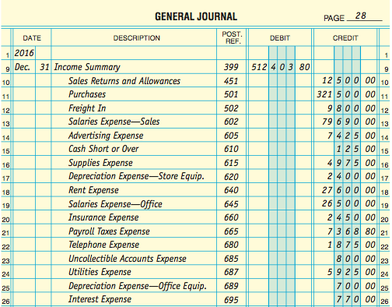
General Journal (3 of 6)
Section 2, Objective 13-5: Journalize and post the closing entries
Credit each account, except Income Summary, for its balance. Debit Income Summary for the total.
Notes:
Section 2, Objective 13-5:
Step 2: When looking at the worksheet, close the Expense Accounts and the Cost of Goods Sold Accounts with debit balances as well as any contra revenue accounts with debit balances to Income Summary. Make a corresponding debit to the Income Summary account.

Slide 38
General Journal (4 of 6)
Section 2, Objective 13-5: Journalize and post the closing entries
Step 3: Closing the Income Summary Account
The third closing entry transfers the Income Summary balance to the owner's capital account.
This closes the Income Summary account, which remains closed until it is used in the end-of-period process for the next year.
For Whiteside Antiques, the third closing entry is as follows:
Notes:
Section 2, Objective 13-5:
Step 3: Closing the Income Summary Account. Close the balance into the owner’s capital account.

Slide 39
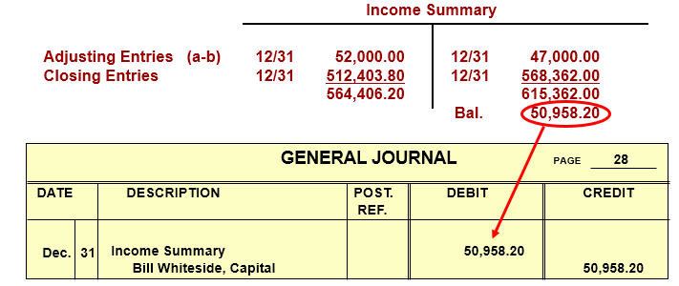
General Journal (5 of 6)
Section 2, Objective 13-5: Journalize and post the closing entries
Notes:
Section 2, Objective 13-5:
Step 3: Closing the Income Summary Account. Close the balance into the owner’s capital account.

Slide 40
General Journal (6 of 6)
Section 2, Objective 13-5: Journalize and post the closing entries
Step 4: Closing the Drawing account
Credit 27,600.00 Entry closes the drawing account and updates the capital account
Notes:
Section 2, Objective 13-5:
Step 4: Closing the Drawing account. Close the balance into the owner’s capital account.

Slide 41
Posting the Closing Entries
Section 2, Objective 13-5: Journalize and post the closing entries
The closing entries are posted from the general journal to the general ledger.
This process brings the temporary account balances to zero.
The word Closing is entered in the Description column.
Notes:
Section 2, Objective 13-5:
This process brings the temporary account balances to zero. Remember to write the word Closing in the Description column.

Slide 42
Section 2: Completing the Accounting Cycle
Learning Objective 13-6 : Preparing a Postclosing Trial Balance
Notes:
Learning Objective 13-6: Preparing a Postclosing Trial Balance

Slide 43
Post Closing Trial Balance (1 of 2)
Section 2, Objective 13-5: Journalize and post the closing entries
Prepare a postclosing trial balance to confirm that the general ledger is in balance.
Only the accounts that have balances – the asset, liability and owner's capital accounts – appear on the postclosing trial balance.
The postclosing trial balance matches the amounts reported on the balance sheet.
To verify this, compare the postclosing trial balance with the balance sheet.
Notes:
Section 2, Objective 13-6:
We prepare a postclosing trial balance to confirm that the general ledger is in balance.
Only the accounts that have balances – the asset, liability and owner's capital accounts – appear on the postclosing trial balance. Remember that the TOTALS for the Postclosing Trial Balance and the Balance Sheet will be different, since on the Balance Sheet, certain credit account balances are subtracted from certain debit account balances; on the Postclosing Trial Balance, all debit and credit balances are shown on either the left side (debit) or right side (credit) of that report.

Slide 44
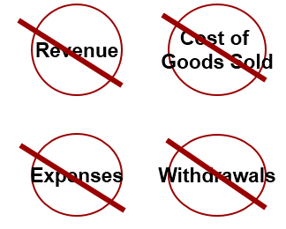
Post Closing Trial Balance (2 of 2)
Section 2, Objective 13-6: Preparing a Postclosing Trial Balance
Only the accounts that have balances—the asset, liability and owner's capital accounts—appear on the postclosing trial balance
Temporary accounts do not appear on the postclosing trial balance
Notes:
Section 2, Objective 13-6:
Only the accounts that have balances – the asset, liability and owner’s capital accounts – appear on the postclosing trial balance. Temporary accounts including revenues, cost of goods sold, expenses and withdrawals do not appear on the postclosing trial balance.

Slide 45
Preparing a Post Closing Trial Balance (1 of 2)
Section 2, Objective 13-6: Preparing a Postclosing Trial Balance
Notice that the only account types that are not closed out are the assets, liabilities, and the owner’s capital account.
Notes:
Section 2, Objective 13-6:
The Postclosing trial balance is presented in the slide. Notice that the only account types that are not closed out are the assets, liabilities, and the owner’s capital account. See the text for a larger printout of the Postclosing trial balance.

Slide 46
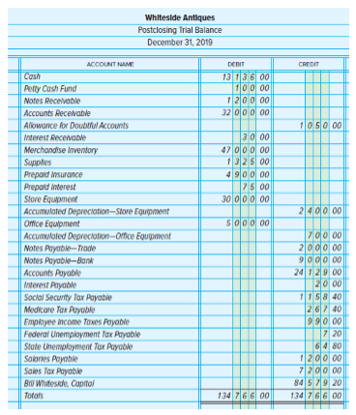
Preparing a Post Closing Trial Balance (2 of 2)
Section 2, Objective 13-6: Preparing a Postclosing Trial Balance

Slide 47
Section 2: Completing the Accounting Cycle
Learning Objective 13-7 : Journalize and post reversing entries
Notes:
Learning Objective 13-7: Journalize and post reversing entries

Slide 48
Reversing Entries
Section 2, Objective 13-6: Preparing a Postclosing Trial Balance
QUESTION:
What are reversing entries?
ANSWER:
Reversing entries are journal entries made to reverse the effect of certain adjusting entries involving accrued income or accrued expenses.
Notes:
Section 2, Objective 13-7:
The last step in the accounting cycle which is actually an optional step is to prepare reversing journal entries. Reversing entries are journal entries made at the beginning of an accounting period that are the opposite of certain adjusting entries, particularly those for accrued expenses and accrued income.
Reversing entries are made to reverse the effect of certain adjustments . This helps prevent errors in recording certain cash payments or cash receipts in the new accounting period.

Slide 49
The Accounting Cycle
Section 2, Objective 13-7: Journalize and post reversing entries
Since reversing entries are optional, they are not included as a formal step in the cycle.
Step 1 : Analyze transactions
Step 2 : Journalize the data about transactions
Step 3 : Post the data about transactions
Step 4 : Prepare a worksheet
Step 5 : Prepare financial statements
Step 6 : Journalize and post adjusting entries
Step 7 : Journalize and post closing entries
Step 8 : Prepare a postclosing trial balance
Step 9 : Interpret the financial information
Notes:
Section 2, Objective 13-7:
Let’s do a quick review of the accounting cycle for a merchandiser.
Here are the nine steps. Since reversing entries are optional, they are not included as a formal step in the cycle.

Slide 50
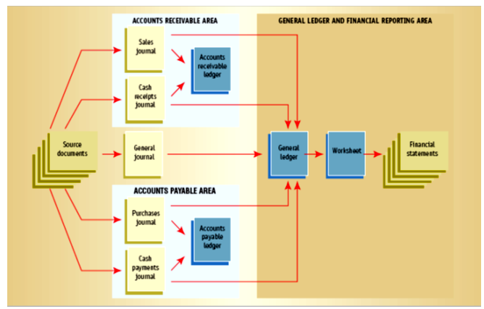
Flow of Financial Data through an Accounting System
Section 2, Objective 13-7: Journalize and post reversing entries
Notes:
Section 2, Objective 13-7:
Take a moment to review the flow of Financial Data through an Accounting System.

