Slide 1
Financial & Managerial Accounting Information for Decisions
Seventh Edition
Chapter 3
Adjusting Accounts For Financial Statements
© McGraw-Hill Education. All rights reserved. Authorized only for instructor use in the classroom. No reproduction or further distribution permitted without the prior written consent of McGraw-Hill Education.

Slide 2
Learning Objectives (1 of 2)
CONCEPTUAL
C1 Explain the importance of periodic reporting and the role of accrual accounting.
C2 Identify steps in the accounting cycle.
C3 Explain and prepare a classified balance sheet.
ANALYTICAL
A1 Compute the profit margin and describe its use in analyzing company performance.
A2 Compute the current ratio and describe what it reveals about a company’s financial condition.

Slide 3
Learning Objectives (2 of 2)
PROCEDURAL
P1 Prepare and explain adjusting entries.
P2 Explain and prepare an adjusted trial balance.
P3 Prepare financial statements from an adjusted trial balance.
P4 Describe and prepare closing entries.
P5 Explain and prepare a post-closing trial balance.
P6 Appendix 3A Explain the alternatives in accounting for prepaids.
P7 Appendix 3B Prepare a work sheet and explain its usefulness.
P8 Appendix 3C Prepare reversing entries and explain their purpose.

Slide 4
Learning Objective C1: Explain the importance of periodic reporting and the role of accrual accounting.

Slide 5
Exhibit 3.1 The Accounting Period
Learning Objective C1: Explain the importance of periodic reporting and the role of accrual accounting.
Notes:
To provide timely information, accounting systems prepare reports at regular intervals. This results in an accounting process impacted by the time period (or periodicity) assumption. The time period assumption presumes that an organization’s activities can be divided into specific time periods such as a month, a three-month quarter, a six-month interval, or a year. Most organizations use a year as their primary accounting period. Many organizations also prepare interim financial statements covering one, three, or six months of activity. Most organizations use a year as their primary accounting period. Reports covering a one-year period are known as annual financial statements.
When we divide business activities into arbitrary fixed periods of time, it is often necessary to have special accounting for transactions that cross from one time period to the next.
Most of our time will be spent looking at the special adjusting process for some of these transactions.

Slide 6
Accrual Basis versus Cash Basis (1 of 4)
Learning Objective C1: Explain the importance of periodic reporting and the role of accrual accounting.
Accrual Basis | Cash Basis
Revenues are recognized when products or services are delivered, and expenses are recognized when incurred. | Revenues are recognized when cash is received and expenses are recorded when cash is paid.
Notes:
Accrual basis accounting applies adjustments so that revenues are recognized when services and products are delivered, and expenses are recognized when incurred (matched with revenues).
Cash basis accounting recognizes revenues when cash is received and records expenses when cash is paid. This means that cash basis income is the difference between cash receipts and cash payments.

Slide 7
Accrual Basis versus Cash Basis (2 of 4)
Learning Objective C1: Explain the importance of periodic reporting and the role of accrual accounting.
Accrual Basis | Cash Basis (Non-GAAP)
Revenues are recognized when products or services are delivered, and expenses are recognized when incurred. | Revenues are recognized when cash is received and expenses are recorded when cash is paid.
Notes:
The cash basis is not considered to be compliant with GAAP. While you may be on the cash basis for your personal transactions, almost all companies follow the accrual basis of accounting.

Slide 8
Accrual Basis versus Cash Basis (3 of 4)
Learning Objective C2: Explain accrual accounting and how it improves financial statements
Exhibit 3.2
On the accrual basis, $100 of insurance expense is recognized in 2017, $1,200 in 2018, and $1,100 in 2019. The expense is matched with the periods benefited by the insurance coverage.
Notes:
On the accrual basis, we would record $100 of insurance expense in the month of December, 2017, $100 for each month in 2018, and $100 for the months January through November in 2019. We match the expense with the periods benefited by the insurance coverage. We believe this is a better cost matching of revenues and expenses.

Slide 9
Accrual Basis versus Cash Basis (4 of 4)
Learning Objective C2: Explain accrual accounting and how it improves financial statements
Exhibit 3.3
On December 1, 2017, FastForward paid $2,400 cash for a twenty-four month business insurance policy.
Using the cash basis, the entire $2,400 would be recognized as insurance expense in 2017. No insurance expense from this policy would be recognized in 2018 or 2019, periods covered by the policy.
Notes:
In our first transaction, on December 1, 2017, FastForward paid $2,400 cash for a twenty-four month business insurance policy.
On the cash basis, the entire $2,400 would be recognized as an expense in 2017 even though the policy provides protection for 2017, 2018, and part of 2019. Let’s look at how this type of transaction is handled in an accrual basis accounting system.

Slide 10
Recognizing Revenues
Learning Objective C1: Explain the importance of periodic reporting and the role of accrual accounting.
The revenue recognition principle states that we recognize revenue when the product or service is provided to our customer and at an amount expected to be received from customers.
Notes:
We rely on two principles in the adjusting process: revenue recognition and expense recognition (the latter is often referred to as matching). Revenue recognition principle requires that revenue be recorded when goods or services are provided to customers and at an amount expected to be received from customers. A major goal of the adjusting process is to have revenue recognized (reported) in the time period when those services and products are delivered.

Slide 11
Recognizing Expenses
Learning Objective C1: Explain the importance of periodic reporting and the role of accrual accounting.
The expense recognition (or matching) principle aims to record expenses in the same accounting period as the revenues that are recognized as a result of those expenses. This matching of expenses with the revenue benefits is a major part of the adjusting process.
Notes:
The matching principle aims to record expenses in the same accounting period as the revenues that are recognized as a result of those expenses. This matching of expenses with the revenue benefits is a major part of the adjusting process.

Slide 12
Learning Objective P1: Prepare and explain adjusting entries.

Slide 13
Framework for Adjustments (1 of 2)
Learning Objective P1: Prepare and explain adjusting entries.
Four types of adjustments for transactions that extend over more than one period.
Prepaid expenses
Unearned revenues
Accrued expenses
Accrued revenues
Notes:
Four types of adjustments are necessary for transactions and events that extend over more than one period. Adjustments are made using a 3-step process.
An adjusting entry is made at the end of an accounting period to reflect a transaction or event that is not yet recorded. Each adjusting entry affects one or more income statement accounts and one or more balance sheet accounts (but never the Cash account).

Slide 14
Framework for Adjustments (2 of 2)
Learning Objective P1: Prepare and explain adjusting entries.
Adjustments made using a 3-step process:
Step 1: Determine what the current account balance equals.
Step 2: Determine what the current account balance should equal.
Step 3: Record an adjusting entry to get from step 1 to step 2

Slide 15
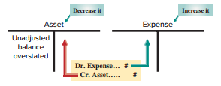
Prepaid (Deferred) Expenses
Learning Objective P1: Prepare and explain adjusting entries.
Prepaid expenses are assets paid for in advance of receiving their benefits.
Examples: Prepaid Insurance, Prepaid Rent, Supplies
Exhibit 3.5
Notes:
Let’s start with the first type of adjusting entries, the payment or receipt of cash before the expense or revenue is recognized.
We will start with a prepaid expense. Prepaid expenses are assets paid for in advance of receiving their benefits.
For all adjustments involving prepaid expenses, we increase, or debit, an expense account and reduce, or credit, an asset account.

Slide 16
Prepaid Insurance (1 of 5)
Learning Objective P1: Prepare and explain adjusting entries.
On December 1, 2017, FastForward paid $2,400 to cover insurance for 24 months that began on December 1 of 2017. Scott recorded the expenditure as Prepaid Insurance on December 1.
Notes:
Step 1: We determine that the current balance of FastForward’s prepaid insurance is equal to its $2,400 payment for 24 months of insurance benefits that began on December 1, 2017.
Step 2: As time passes, the benefits of the insurance gradually expire and a portion of the Prepaid Insurance asset becomes expense. For instance, one month’s insurance coverage expires by December 31, 2017. This expense is $100, or 1/24 of $2,400, which leaves $2,300.
Step 3: The adjusting entry to record this expense will reduce the asset.

Slide 17
Prepaid Insurance (2 of 5)
Learning Objective P1: Prepare and explain adjusting entries.
On 12/31, one month’s worth of insurance has expired.
Step 1: Current balance = $2,400
Step 2: Balance in balance in prepaid insurance should equal $2,300.
Step 3: Current prepaid insurance balance $2,400 – 100 = $2,300

Slide 18
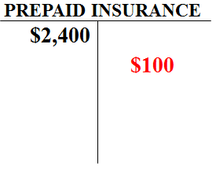
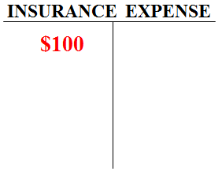
Prepaid Insurance (3 of 5)
Learning Objective P1: Prepare and explain adjusting entries.
$2,400/24 months = $100
Insurance Expense is debited $100 to recognize the amount of insurance coverage for Dec. and Prepaid Insurance is credited for $100 to reduce it’s balance.
Notes:
Now that December is over, we need to remove the cost of one month’s insurance from this account. Insurance expense is debited for $100 and Prepaid insurance is credited for $100.

Slide 19
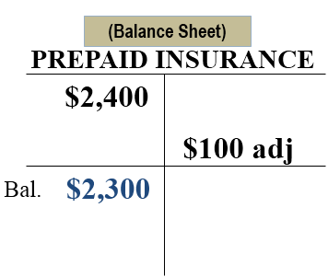
Prepaid Insurance (4 of 5)
Learning Objective P1: Prepare and explain adjusting entries
The Balance Sheet will show $2,300 (23 months) of Prepaid Insurance remaining!
Notes:
After the adjustment, the Prepaid Insurance account will show the correct balance of $2,300 on the Balance sheet and the Insurance Expense account will report the correct amount of expired insurance of $100, on the Income Statement.

Slide 20
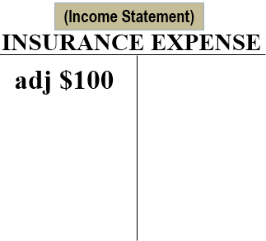
Prepaid Insurance (5 of 5)
Learning Objective P1: Prepare and explain adjusting entries
The Income Statement will show $100 (1 month) of insurance expired!

Slide 21
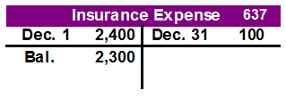
Adjusting Entry - Insurance Expense
Learning Objective P1: Prepare and explain adjusting entries.
The general journal adjustment on Dec. 31 and general ledger account balances are as follows:
Notes:
16
16
The journal entry to record the adjusting entry for expired insurance includes:
Insurance expense is debited for $100 and Prepaid insurance is credited for $100.

Slide 22
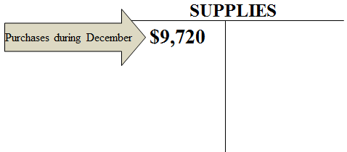
Supplies (1 of 3)
Learning Objective P1: Prepare and explain adjusting entries.
Step 1: FastForward purchased $9,720 of supplies in December. Some of these were used during December.
Step 2: A physical count shows that unused supplies equal $8,670.
Step 3: Adjusting entry reduces Supplies by $1,050 or the difference between the beginning balance and the physical count.
Notes:
FastForward purchased $9,720 of supplies in December. Some of these were used during December.
Step 1: Current balance equals $9,720.
Step 2: A physical count shows that unused supplies equal $8,670.
Step 3: Adjusting entry reduces Supplies by $1,050 or the difference between the beginning balance and the physical count.

Slide 23
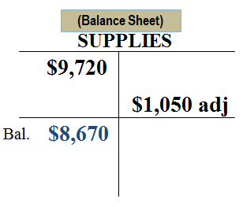
Supplies (2 of 3)
Learning Objective P1: Prepare and explain adjusting entries.
The Balance Sheet will show $8,670 of supplies remaining!
Notes:
After the adjustment, the Supplies account will show the correct balance of $8,670 on the Balance sheet and the Insurance Expense account will report the correct amount of expired insurance of $1,050, on the Income Statement.

Slide 24
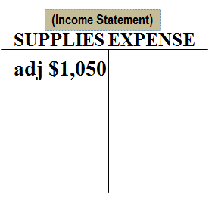
Supplies (3 of 3)
Learning Objective P1: Prepare and explain adjusting entries.
The Income Statement will show $1,050 (1 month) of Supplies expired!

Slide 25
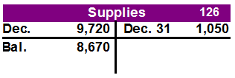
Adjusting Entry for Expired Supplies
Learning Objective P1: Prepare and explain adjusting entries.
We’ve seen the adjustment in the T-accounts but we need to record the adjustment on Dec. 31, in the General Journal
Notes:
16
16
Part I
During December, FastForward paid a total of $9,720 for supplies. FastForward took a physical count of their supplies and determined that they actually had $8,670 on hand. Let’s look at the adjusting entry we would make on December 31, 2017 to show one month of expired rent.
Part II
We would debit, or increase, the supplies expense account for the difference between the beginning supplies balance and the ending supplies balance or $1,050 and credit, or reduce, the asset supplies account. Now we have recorded the rent expense for December, 2017, we would post the adjusting entry to the two ledger accounts in the general ledger.

Slide 26
Depreciation
Learning Objective P1: Prepare and explain adjusting entries.
Instead of expensing the cost of a plant asset (equipment, building, cars, etc.) in the year it is purchased we allocate or spread out the cost over their expected useful lives.
The formula for straight-line depreciation is:
Notes:
19
19
A special category of prepaid expenses is plant assets, which refers to long-term tangible assets used to produce and sell products and services. Plant assets are expected to provide benefits for more than one period. Good examples of plant assets are building, machines, vehicles and fixtures. Depreciation is the process of allocating the cost of a plant asset over its useful life in a systematic and rational manner. At this point in the accounting process, we want to introduce you to a depreciation method known as straight-line depreciation. Straight line depreciation is the most popular method used by companies. They determine the amount of annual depreciation by taking the cost of the plant assets, subtracting the estimated salvage value and dividing that amount by the useful life of the asset. The salvage value is the amount we expect to receive for the asset when we dispose of it at the end of its useful life. In a later chapter, we will discuss other acceptable methods of depreciation. For now, let’s look at the adjusting entry to record depreciation expense.

Slide 27
Useful Life
Learning Objective P1: Prepare and explain adjusting entries.
The period of time that an asset is expected to help produce revenues.
Useful life expires as a result of wear and tear, or because it no longer satisfies the needs of the business.
Notes:
The useful life of a long-term asset is the period of time that an asset is expected to help produce revenues.
Useful life expires as a result of wear and tear, or because it no longer satisfies the needs of the business.

Slide 28
Salvage Value
Learning Objective P1: Prepare and explain adjusting entries.
The expected market value or selling price of an asset at the end of its useful life
Also called:
Scrap Value or
Residual Value
Notes:
The salvage value of an asset is the expected market value or selling price of an asset at the end of its useful life
Also called: Scrap Value or Residual Value.

Slide 29
Depreciation Example
Learning Objective P1: Prepare and explain adjusting entries.
FastForward purchased equipment on Dec 1 for $26,000. It has an estimated useful live of 60 months. The equipment is expected to be worth about $8,000 at the end of five years. They purchased the equipment on Dec 1 but it is now Dec 31.
Because FastForward expects the equipment to be worth $8,000 when the five years are over, only $18,000 of the cost needs to be spread over the next 60 months.
Notes:
Let’s look at a depreciation adjustment for FastForward. The company purchased equipment on Dec 1 for $26,000. It has an estimated useful live of 60 months. The equipment is expected to be worth about $8,000 at the end of five years. They purchased the equipment on Dec 1 but it is now Dec 31. We will depreciate the net cost of $18,000 over its useful life of 60 months. Let’s see how this is done.
Step 1 is the purchase of equipment for $26,000. The equipment’s cost must be depreciated.

Slide 30
Straight-line Method
Learning Objective P1: Prepare and explain adjusting entries.
Calculate Net Cost (amount to depreciate).
FORMULA:
Original Cost – Salvage Value = Net Cost
$26,000 - $8,000 = $18,000
Notes:
To calculate the net cost of the equipment over its useful life, we start with the $26,000 purchase price and subtract the salvage value of $8,000. This leaves a net cost of $18,000 and this is what we will depreciate.

Slide 31
Depreciation Expense –Straight-line Method
Learning Objective P1: Prepare and explain adjusting entries.
Step 1: FastForward purchased equipment on Dec 1 for $26,000.
Step 2: Equipment has an useful live of 5 years. The equipment is expected to be worth $8,000 at the end of five years. FastForward using straight-line depreciation. $18,000 ($26,000 – 8,000) of the cost needs to be spread over the next 60 months. One month = $18,000 / 60 = $300.
Step 3: Record adjusting entry for $300 for one month.
Notes:
The 2nd step to determine depreciation expense for this accounting period (one month) is to use the straight-line depreciation formula. Net cost of $18,000 divided by 60 months of useful life equals a monthly cost of $300. Now that we know depreciation for the month is $300, let’s figure out the adjusting entry. . .

Slide 32
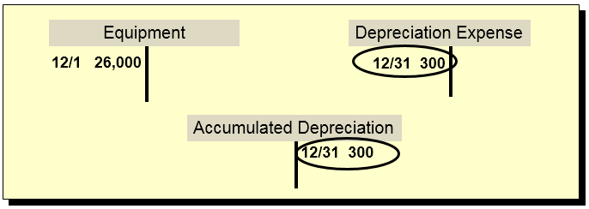
Depreciation Adjustment (1 of 2)
Learning Objective P1: Prepare and explain adjusting entries.
Depreciation adjustment reflected in our T-accounts looks like this:
The depreciation amount of $300 is credited to this account instead of the asset account.
Notes:
The adjustment for depreciation will look like this. We have posted the $300 debit to the Depreciation Expense account and credited a new account called Accumulated Depreciation, for $300. The balance in the Equipment account will remain unchanged by this adjustment. The Accumulated Depreciation account is a contra account and will appear linked to the Equipment account on the Balance sheet. The Depreciation Expense account will appear on our income statement for the year ended December 31, 2017.

Slide 33
Depreciation Adjustment (2 of 2)
Learning Objective P1: Prepare and explain adjusting entries.
Let’ look at the journal entry for the adjustment for Depreciation..
Notes:
24
24
On December 31, 2017, we will debit, or increase, depreciation expense for three hundred dollars and credit a new account called accumulated depreciation – (dash) -- equipment.
Accumulated depreciation is a contra asset account. This is the first time we have seen a contra-account, but it will not be the last. A contra- account means that the amount in the account reduces the related asset account. In our case, accumulated depreciation will reduce the asset account, equipment. Because this is a new type of account, let’s look at the treatment of the contra and related asset account on the balance sheet.

Slide 34
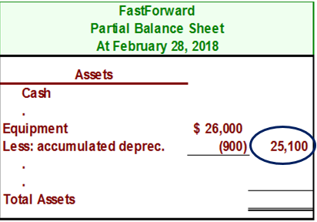
Exhibit 3.7
Learning Objective P1: Prepare and explain adjusting entries.
Depreciation would show up on our balance sheet like this:
After three months of depreciation have been taken, the Equipment is shown net of accumulated depreciation.
Notes:
24
24
The contra-account, accumulated depreciation, will be shown as a reduction in the cost of the asset, equipment.
Cost of a plant asset less accumulated depreciation is known as book value. So the asset, equipment, will be shown on the balance sheet at its net amount, or book value. In the partial balance sheet shown on this slide, three months of depreciation have been taken on the equipment for a total of 3 x $300 or $900 dollars. The equipment account is being reported at $25,100 which is the cost that has not yet been depreciated.
Because the contra account appears on the balance sheet it will not be closed at the end of the period. It will be carried forward to 2018 and used to accumulate the depreciation related to the equipment.
Review what you have learned in the following NEED-TO-KNOW Slides.

Slide 35
NEED-TO-KNOW 3-1 (1 of 11)
Learning Objective P1: Prepare and explain adjusting entries.
For each separate case below, follow the three-step process for adjusting the prepaid asset account.
Step 1: Determine what the current account balance equals.
Step 2: Determine what the current account balance should equal.
Step 3: Record an adjusting entry to get from step 1 to step 2.
Assume no other adjusting entries are made during the year.
Notes:
For each separate case on this slide, follow the three-step process for adjusting the prepaid asset account. Step 1: Determine what the current account balance equals. Step 2: Determine what the current account balance should equal. Step 3: Record an adjusting entry to get from step 1 to step 2. Assume no other adjusting entries are made during the year.

Slide 36
NEED-TO-KNOW 3-1 (2 of 11)
Learning Objective P1: Prepare and explain adjusting entries.
Prepaid Insurance. The Prepaid Insurance account has a $5,000 debit balance to start the year. A review of insurance policies and payments shows that $1,000 of unexpired insurance remains at year-end.
Prepaid Rent. On October 1 of the current year, the company prepaid $12,000 for one year of rent for facilities being occupied from that day forward. The company debited Prepaid Rent and credited Cash for $12,000. December 31 year-end statements must be prepared.

Slide 37
NEED-TO-KNOW 3-1 (3 of 11)
Learning Objective P1: Prepare and explain adjusting entries.
Supplies. The Supplies account has an $1,000 debit balance to start the year. Supplies of $2,000 were purchased during the current year and debited to the Supplies account. A December 31 physical count shows $500 of supplies remaining.
Accumulated Depreciation. The company has only one fixed asset (equipment) that it purchased at the start of this year. That asset had cost $38,000, had an estimated life of 10 years, and is expected to be valued at $8,000 at the end of the 10-year life.

Slide 38
NEED-TO-KNOW 3-1 (4 of 11)
Learning Objective P1: Prepare and explain adjusting entries.
Prepaid Insurance. The Prepaid Insurance account has a $5,000 debit balance to start the year. A review of insurance policies and payments shows that $1,000 of unexpired insurance remains at year-end.
Step 1: Determine what the current account balance equals. $5,000
Step 2: Determine what the current account balance should equal. $1,000
Notes:
Prepaid Insurance. The Prepaid Insurance account has a $5,000 debit balance to start the year. A review of insurance policies and payments shows that $1,000 of unexpired insurance remains at year-end.
Step 1: Determine what the current account balance equals. The current account balance is equal to the $5,000 from the start of the year.
Step 2: Determine what the current account balance should equal. The balance sheet should report the $1,000 of unexpired insurance that remains at year-end.
Step 3: Record an adjusting entry to get from step 1 to step 2. We need to reduce the balance in Prepaid insurance by $4,000. Every adjusting entry affects one income statement account, a revenue or an expense, and one balance sheet account, an asset or a liability. In this case, we're reducing the asset, Prepaid insurance. We credit the balance sheet account, Prepaid insurance, for $4,000. Since we're crediting a balance sheet account, we need to debit an income statement account, Insurance expense, $4,000.

Slide 39
NEED-TO-KNOW 3-1 (5 of 11)
Learning Objective P1: Prepare and explain adjusting entries.
Step 3: Record an adjusting entry to get from step 1 to step 2.
Income Statement
Revenue
Debit Expense
Balance Sheet
Credit Asset
Liability

Slide 40
NEED-TO-KNOW 3-1 (6 of 11)
Learning Objective P1: Prepare and explain adjusting entries.
Prepaid Rent. On October 1 of the current year, the company prepaid $12,000 for one year of rent for facilities being occupied from that day forward. The company debited Prepaid Rent and credited Cash for $12,000. December 31 year-end statements must be prepared.
Step 1: Determine what the current account balance equals. $12,000
Step 2: Determine what the current account balance should equal. $9,000
Notes:
Prepaid Rent. On October 1 of the current year, the company prepaid $12,000 for one year of rent for facilities being occupied from that day forward. The company debited Prepaid Rent and credited Cash for $12,000. December 31 year-end statements must be prepared.
Step 1: The current account balance equals the $12,000 paid on October 1. $12,000 for one year equals $1,000 per month. Three months have elapsed between the payment date, October 1, and the financial statement date, December 31. Nine months of rent remain, and three months of rent have been used. The balance sheet should report the $9,000 that is unused as of December 31. The adjusting entry to get from Step 1 to Step 2 reduces the balance in the balance sheet account, Prepaid Rent. We credit Prepaid Rent for $3,000, and debit the income statement account, Rent expense.

Slide 41
NEED-TO-KNOW 3-1 (7 of 11)
Learning Objective P1: Prepare and explain adjusting entries.
Step 3: Record an adjusting entry to get from step 1 to step 2.

Slide 42
NEED-TO-KNOW 3-1 (8 of 11)
Learning Objective P1: Prepare and explain adjusting entries.
Supplies. The Supplies account has an $1,000 debit balance to start the year. Supplies of $2,000 were purchased during the current year and debited to the Supplies account. A December 31 physical count shows $500 of supplies remaining.
Step 1: Determine what the current account balance equals. $3,000
Step 2: Determine what the current account balance should equal. $500
Notes:
Supplies. The Supplies account has a $1,000 debit balance to start the year. Supplies of $2,000 were purchased during the current year and debited to the Supplies account. A December 31 physical count shows $500 of supplies remaining. The current account balance equals $3,000; the $1,000 from January 1 plus $2,000 purchased during the year. The current account balance should equal $500, as $500 of supplies remain. The adjusting entry to get from Step 1 to Step 2 reduces the balance in Supplies, crediting the balance sheet account, $2,500, and we debit the income statement account, Supplies Expense.

Slide 43
NEED-TO-KNOW 3-1 (9 of 11)
Learning Objective P1: Prepare and explain adjusting entries.
Step 3: Record an adjusting entry to get from step 1 to step 2.

Slide 44
NEED-TO-KNOW 3-1 (10 of 11)
Learning Objective P1: Prepare and explain adjusting entries.
Accumulated Depreciation. The company has only one fixed asset (equipment) that it purchased at the start of this year. That asset had cost $38,000, had an estimated life of 10 years, and is expected to be valued at $8,000 at the end of the 10-year life.
Step 1: Determine what the current account balance equals. $0
Step 2: Determine what the current account balance should equal. $3,000
Notes:
Accumulated Depreciation. The company has only one fixed asset (equipment) that it purchased at the start of this year. That asset cost $38,000, had an estimated life of 10 years, and is expected to be valued at $8,000 at the end of the 10-year life.
Step 1: Determine what the current account balance equals. This is the first year of the asset's life; no depreciation has been taken to date. The current balance in Accumulated Depreciation is $0.
Step 2: Determine what the current account balance should equal. The balance in Accumulated Depreciation at the end of the first year of this asset's life should be $3,000; the cost of $38,000, minus the salvage value of $8,000, divided by 10 years.
Step 3: Record an adjusting entry to get from Step 1 to Step 2. The adjusting entry needs to credit Accumulated Depreciation for $3,000. Since we're crediting the balance sheet account, we need to debit the income statement account, Depreciation Expense. Accumulated Depreciation is referred to as a contra asset. Its purpose is to reduce the value of the equipment, and therefore has a normal credit balance.
Now let’s move on to the second category of adjusting entries, deferred revenues.

Slide 45
NEED-TO-KNOW 3-1 (11 of 11)
Learning Objective P1: Prepare and explain adjusting entries
Step 3: Record an adjusting entry to get from step 1 to step 2.
Income Statement
Revenue
Debit Expense
Balance Sheet
Credit Contra-Asset
Liability

Slide 46
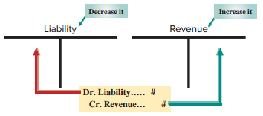
Unearned (Deferred) Revenues (1 of 5)
Learning Objective P1: Prepare and explain adjusting entries.
Exhibit 3.8
Cash received in advance of providing products or services.
Notes:
The term unearned revenues refers to cash received in advance of providing products and services. Unearned revenues, also called deferred revenues, are liabilities.
When accounting for deferred revenues, we are faced with a transaction where cash is received in advance of providing a product or service. In other words, we have received the cash, but have done nothing to earn it. In our example, we will examine accounting for the receipt of cash prior to our company rendering any services.
When we render consulting services, we will prepare an adjustment for deferred revenues (a liability). We always debit, or reduce, a liability account and credit, or increase, a revenue account.

Slide 47
Unearned (Deferred) Revenues (2 of 5)
Learning Objective P1: Prepare and explain adjusting entries.
Step 1: FastForward’s client paid 60-day fee in advance covering the period from 12/27 – 2/24 and recorded:
Notes:
FastForward’s client paid 60-day fee in advance covering the period from 12/27 – 2/24 and recorded a debit to cash and a credit to unearned consulting revenue, a liability account.
Step 1: Current balance equals $3,000.
Step 2: FastForwards earns payment as time passes. At 12/31, 5 days’ service is earned or 5/60 x $3,000 = $250.
Step 3: Adjusting entry reduces liability, Unearned Consulting Revenue, by $250 or 5 days’ worth of revenue. Also, Consulting Revenue of $250 is earned.

Slide 48
Unearned (Deferred) Revenues (3 of 5)
Learning Objective P1: Prepare and explain adjusting entries.
Step 2: FastForwards earns payment as time passes. At 12/31, 5 days’ service is earned or 5/60 × $3,000 = $250.
Step 3: Adjusting entry reduces liability, Unearned Consulting Revenue, by $250 or 5 days’ worth of revenue. Also, Consulting Revenue of $250 is earned.

Slide 49
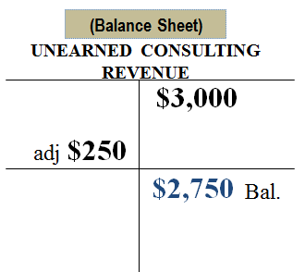
Unearned (Deferred) Revenues (4 of 5)
Learning Objective P1: Prepare and explain adjusting entries.
The Balance Sheet will show $2,750 of Unearned Consulting Revenue unearned.
Notes:
After the adjustment, the Unearned Consulting Revenue account will show the correct balance of $2,750 on the Balance sheet and the Consulting Revenue account will report the correct amount of earned revenue of $6,050, on the Income Statement.

Slide 50
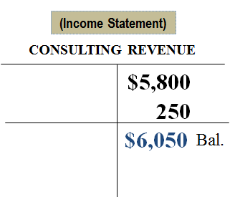
Unearned (Deferred) Revenues (5 of 5)
Learning Objective P1: Prepare and explain adjusting entries.
The Income Statement will show $6,050 total Consulting Revenue earned.

Slide 51
Adjusting Entry for Unearned Revenue
Learning Objective P1: Prepare and explain adjusting entries
Adjusting entry recorded on Dec. 31 to transfer $250 from unearned to earned consulting revenue.
Notes:
16
16
The journal entry to transfer the $250 earned into the revenue account includes a debit to the liability account, Unearned Consulting Revenue and a credit to the revenue account, Consulting Revenue.
Review what you have learned in the following NEED-TO-KNOW Slides.

Slide 52
NEED-TO-KNOW 3-2 (1 of 6)
Learning Objective P1: Prepare and explain adjusting entries.
For each separate case below, follow the three-step process for adjusting the unearned revenue liability account.
Step 1: Determine what the current account balance equals.
Step 2: Determine what the current account balance should equal.
Step 3: Record an adjusting entry to get from step 1 to step 2.
Assume no other adjusting entries are made during the year.
Notes:
For each separate case below, follow the three-step process for adjusting the unearned revenue liability account. Step 1: Determine what the current account balance equals. Step 2: Determine what the current account balance should equal. Step 3: Record an adjusting entry to get from step 1 to step 2.

Slide 53
NEED-TO-KNOW 3-2 (2 of 6)
Learning Objective P1: Prepare and explain adjusting entries.
Unearned Rent Revenue. The company collected $24,000 rent in advance on September 1, debiting Cash and crediting Unearned Rent Revenue. The tenant was paying 12 months rent in advance and occupancy began September 1.
Unearned Services Revenue. The company charges $100 per month to spray a house for insects. A customer paid $600 on November 1 in advance for six treatments, which was recorded with a debit to Cash and a credit to Unearned Services Revenue. At year-end, the company has applied two treatments for the customer.

Slide 54
NEED-TO-KNOW 3-2 (3 of 6)
Learning Objective P1: Prepare and explain adjusting entries.
Unearned Rent Revenue. The company collected $24,000 rent in advance on September 1, debiting Cash and crediting Unearned Rent Revenue. The tenant was paying 12 months rent in advance and occupancy began September 1.
Step 1: Determine what the current account balance equals. $24,000
Step 2: Determine what the current account balance should equal. $16,000
Notes:
Unearned Rent Revenue. The company collected $24,000 rent in advance on September 1, debiting Cash and crediting Unearned Rent Revenue. The tenant was paying 12 months’ rent in advance and occupancy began September 1. Whenever you see the word "unearned,” it always indicates a liability account. Most liability accounts include the word "payable,” as those liabilities will be paid back. An unearned account is a liability that will be worked off, rather than paid off.
Step 1: Determine what the current account balance equals. The current balance in Unearned rent revenue is the $24,000 that was credited to the liability account on September 1.
Step 2: Determine what the current account balance should equal. $24,000 in rent for one year is $2,000 per month. As of December 31, the tenant has occupied the space for four months: September through December. The company still has a liability for the remaining eight months. The account balance should equal $16,000 as of December 31; eight months at $2,000 per month.
Step 3: Record an adjusting entry to get from step 1 to step 2. The adjusting entry needs to reduce the balance in Unearned Rent Revenue, debiting the liability account for $8,000; 4 months at $2,000 per month.
Every adjusting entry affects one income statement account, a revenue or an expense, and one balance sheet account, an asset or a liability. In this case, we're debiting the balance sheet account, Unearned rent revenue, for $8,000. And since we're debiting the balance sheet, we need to credit the income statement. We credit Rent Revenue for $8,000.

Slide 55
NEED-TO-KNOW 3-2 (4 of 6)
Learning Objective P1: Prepare and explain adjusting entries.
Step 3: Record an adjusting entry to get from step 1 to step 2.
Income Statement
Credit Revenue
Expense
Balance Sheet
Asset
Debit Liability

Slide 56
NEED-TO-KNOW 3-2 (5 of 6)
Learning Objective P1: Prepare and explain adjusting entries.
Unearned Services Revenue. The company charges $100 per month to spray a house for insects. A customer paid $600 on November 1 in advance for six treatments, which was recorded with a debit to Cash and a credit to Unearned Services Revenue. At year-end, the company has applied two treatments for the customer.
Step 1: Determine what the current account balance equals. $600
Step 2: Determine what the current account balance should equal. $400
Notes:
Unearned Services Revenue. The company charges $100 per month to spray a house for insects. A customer paid $600 on November 1 in advance for six treatments, which was recorded with a debit to Cash and a credit to Unearned Services Revenue. At year-end, the company has applied two treatments for the customer.
Step 1: Determine what the current account balance equals. The current balance in Unearned services revenue is equal to the $600 cash received in advance.
Step 2: Determine what the current account balance should equal. As of December 31, the company still owes four treatments at $100 per month. The December 31 balance in the liability account should equal $400.
Step 3: Record an adjusting entry to get from step 1 to step 2. The adjusting entry debits the liability account, Unearned Services Revenue, for $200, and since we're debiting the balance sheet, we need to credit the income statement, Credit Services Revenue, $200.

Slide 57
NEED-TO-KNOW 3-2 (6 of 6)
Learning Objective P1: Prepare and explain adjusting entries.
Step 3: Record an adjusting entry to get from step 1 to step 2.

Slide 58
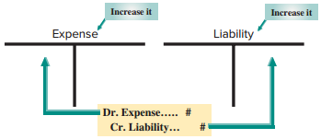
Exhibit 3.9 Accrued Expenses
Learning Objective P1: Prepare and explain adjusting entries.
Costs incurred in a period that are both unpaid and unrecorded.
Notes:
An accrued expense is defined as a cost incurred in the current period that is both unpaid and unrecorded. When you use your credit card, often you do not record the transaction until you pay your monthly invoice; even though you have incurred the cost. Accrued expenses must be reported on the income statement of the period when incurred.
For all accrued expense adjusting entries, we debit, or increase an expense account, and credit, or increase, a liability account.

Slide 59
Accrued Salaries Expense (1 of 3)
Learning Objective P1: Prepare and explain adjusting entries.
Step 1: FastForward’s pays its employee $70 per day, or $350 for a five-day work. Salaries are paid every two weeks on a Friday.
Step 2: 12/31 is a Wednesday, so three day’s salaries are owed at year end which equals $70 × 3 = $210.
Step 3: Adjusting entry increases a liability, Salaries Payable, and increases the Salaries Expense account for $210 with the following journal entry:
Notes:
Step 1: FastForward’s pays its employee $70 per day, or $350 for a five-day work. Salaries are paid every two weeks on a Friday.
Step 2: 12/31 is a Wednesday, so three day’s salaries are owed at year end which equals $70 x 3 = $210.
Step 3: Adjusting entry increases a liability, Salaries Payable, and increases the Salaries Expense account for $210 with the following journal entry:

Slide 60
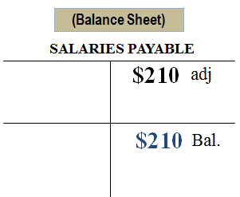
Accrued Salaries Expense (2 of 3)
Learning Objective P1: Prepare and explain adjusting entries.
The Balance Sheet will show $210 of Salaries Payable owed.
Notes:
After the adjustment, the Salaries payable account will show the correct balance of $210 of salaries owed on the Balance sheet and the Salaries expense account will report the correct amount of salaries expense on the Income Statement.

Slide 61
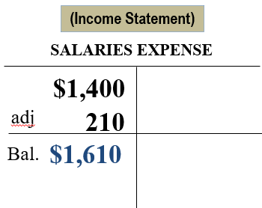
Accrued Salaries Expense (3 of 3)
Learning Objective P1: Prepare and explain adjusting entries.
The Income Statement will show $1,610 total Salaries Expense.

Slide 62
Future Payment of Accrued Expenses
Learning Objective P1: Prepare and explain adjusting entries.
Accrued expenses at the end of one period result in a cash payment in a future period.
On 12/31, FastForward recorded accrued salaries of $210.
On 1/9 of the next year, the following entry will reduce the accrued liability, salaries payable, and record the expense for 7 days work in January.
Notes:
16
16
FastForward recorded accrued salaries of $210. On January 9, the first payday of the next period, the following entry settles the accrued liability (salaries payable) and records salaries expense for seven days of work in January.
The $210 debit reflects the payment of the liability for the three days’ salary accrued on December 31. The $490 debit records the salary for January’s first seven working days (including the New Year’s Day holiday) as an expense of the new accounting period. The $700 credit records the total amount of cash paid to the employee.
Review what you have learned in the following NEED-TO-KNOW Slides.

Slide 63
NEED-TO-KNOW 3-3 (1 of 6)
Learning Objective P1: Prepare and explain adjusting entries.
For each separate case below, follow the three-step process for adjusting the accrued expense account.
Step 1: Determine what the current account balance equals.
Step 2: Determine what the current account balance should equal.
Step 3: Record an adjusting entry to get from step 1 to step 2.
Assume no other adjusting entries are made during the year.
Notes:
For each separate case below, follow the three-step process for adjusting the accrued expense account. Step 1: Determine what the current account balance equals. Step 2: Determine what the current account balance should equal. Step 3: Record an adjusting entry to get from step 1 to step 2.

Slide 64
NEED-TO-KNOW 3-3 (2 of 6)
Learning Objective P1: Prepare and explain adjusting entries.
Salaries Payable. At year-end, salaries expense of $5,000 has been incurred by the company, but is not yet paid to employees.
Interest Payable. At its December 31 year-end, the company holds a mortgage payable that has incurred $1,000 in annual interest that is neither recorded nor paid. The company intends to pay the interest on January 3 of the next year.

Slide 65
NEED-TO-KNOW 3-3 (3 of 6)
Learning Objective P1: Prepare and explain adjusting entries.
Salaries Payable. At year-end, salaries expense of $5,000 has been incurred by the company, but is not yet paid to employees.
Step 1: Determine what the current account balance equals. $0
Step 2: Determine what the current account balance should equal. $5,000
Notes:
Salaries Payable. At year-end, salaries expense of $5,000 has been incurred by the company, but is not yet paid to employees.
Step 1: Determine what the current account balance equals. Because this amount is unrecorded, the balance in Salaries Payable is currently $0.
Step 2: Determine what the current account balance should equal. The balance in the liability account should equal the $5,000 that's due to employees at year-end.
Step 3: Record an adjusting entry to get from step 1 to step 2. We need to increase the balance in Salaries Payable by $5,000.
Every adjusting entry affects one income statement account, a revenue or an expense, and one balance sheet account, an asset or a liability. In this case, we need to credit the liability account, Salaries Payable for $5,000. And since we're crediting the balance sheet, we need to debit the income statement; we debit Salaries Expense for $5,000.

Slide 66
NEED-TO-KNOW 3-3 (4 of 6)
Learning Objective P1: Prepare and explain adjusting entries.
Step 3: Record an adjusting entry to get from step 1 to step 2.
Income Statement
Revenue
Debit Expense
Balance Sheet
Asset
Credit Liability

Slide 67
NEED-TO-KNOW 3-3 (5 of 6)
Learning Objective P1: Prepare and explain adjusting entries.
Interest Payable. At its December 31 year-end, the company holds a mortgage payable that has incurred $1,000 in annual interest that is neither recorded nor paid. The company intends to pay the interest on January 3 of the next year.
Step 1: Determine what the current account balance equals. $0
Step 2: Determine what the current account balance should equal. $1,00
Notes:
Interest Payable. At its December 31 year-end, the company holds a mortgage payable that has incurred $1,000 in annual interest that is neither recorded nor paid. The company intends to pay the interest on January 3 of the next year.
Step 1: Determine what the current account balance equals. Since the amount due is unrecorded, the balance in Interest Payable is currently $0.
Step 2: Determine what the current account balance should equal. The balance in Interest Payable should equal the amount due; $1,000 as of December 31.
Step 3: Record an adjusting entry to get from step 1 to step 2. We need to credit Interest Payable for $1,000, and since we're crediting the balance sheet account, Interest Payable, for $1,000, we need to debit the income statement account, Interest Expense.

Slide 68
NEED-TO-KNOW 3-3 (6 of 6)
Learning Objective P1: Prepare and explain adjusting entries.
Step 3: Record an adjusting entry to get from step 1 to step 2.

Slide 69
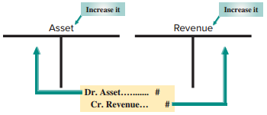
Exhibit 3.11 Accrued Revenues
Learning Objective P1: Prepare and explain adjusting entries.
Accrued revenues are revenues earned in a period that are both unrecorded and not yet received in cash or other assets.
Notes:
The adjusting entry to accrue revenues is needed because many firms have delivered a product or provided a service but have not recorded the revenue in the current period. In our example, a company completes a consulting engagement. The company has earned the revenue, but has not recorded it at year-end. The company has earned interest that will not be paid until the next period as well.
Accrued revenues are revenues earned in a period that are both unrecorded and not yet received in cash (or other assets).
The adjusting entries to record accrued revenue will always debit, or increase, an asset account and credit, or increase, a revenue account.

Slide 70
Accrued Services Revenue (1 of 3)
Learning Objective P1: Prepare and explain adjusting entries.
Step 1: On 12/12, FastForward’s customer agreed to pay $2,700 on 1/10 of the next year for future services over the next 30 days.
Step 2: 12/31, 20 days worth of services have been provided and earned which totals $1,800 ($2,700 × 20/30 days).
Step 3: Adjusting entry increases an asset, Accounts Receivable, and increases the Consulting Revenue account for $1,800 with the following journal entry:
Notes:
Step 1: On 12/12, FastForward’s customer agreed to pay $2,700 on 1/10 of the next year for future services over the next 30 days.
Step 2: 12/31, 20 days worth of services have been provided and earned which totals $1,800 ($2,700 x 20/30 days).
Step 3: Adjusting entry increases an asset, Accounts Receivable, and increases the Consulting Revenue account for $1,800.

Slide 71
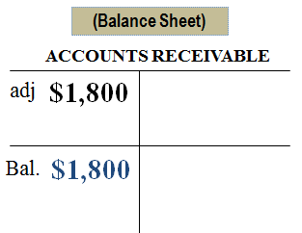
Accrued Services Revenue (2 of 3)
Learning Objective P1: Prepare and explain adjusting entries.
The Balance Sheet will show $1,800 of Accounts Receivable.
Notes:
After the adjustment, the Accounts receivable account will show the correct balance of $1,800 on the Balance sheet and the Consulting Revenue account will report the correct amount of revenue earned on the Income Statement.

Slide 72
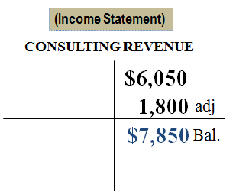
Accrued Services Revenue (3 of 3)
Learning Objective P1: Prepare and explain adjusting entries.
The Income Statement will show $7,850 total Consulting Revenue

Slide 73
Future Receipt of Accrued Revenues
Learning Objective P1: Prepare and explain adjusting entries.
Accrued revenue at the end of one period results in a cash receipt in a future period.
On 12/31, FastForward recorded accrued revenue earned of $1,800.
On 1/10 of the next year, the following entry will reduce the accounts receivable, record revenue earned for 10 days and receipt of $2,700 cash.
Notes:
16
16
FastForward made an adjusting entry for $1,800 to record 20 days’ accrued revenue earned from its consulting contract. When FastForward receives $2,700 cash on January 10 for the entire contract amount, it makes the following entry to remove the accrued asset (accounts receivable) and recognize the revenue earned in January. The $2,700 debit reflects the cash received. The $1,800 credit reflects the removal of the receivable, and the $900 credit records the revenue earned in January.
Review what you have learned in the following NEED-TO-KNOW Slides.

Slide 74
NEED-TO-KNOW 3-4 (1 of 6)
Learning Objective P1: Prepare and explain adjusting entries.
For each separate case below, follow the three-step process for adjusting the accrued revenue account.
Step 1: Determine what the current account balance equals.
Step 2: Determine what the current account balance should equal.
Step 3: Record an adjusting entry to get from step 1 to step 2.
Notes:
For each separate case below, follow the three-step process for adjusting the accrued revenue account. Step 1: Determine what the current account balance equals. Step 2: Determine what the current account balance should equal. Step 3: Record an adjusting entry to get from step 1 to step 2.

Slide 75
NEED-TO-KNOW 3-4 (2 of 6)
Learning Objective P1: Prepare and explain adjusting entries.
Assume no other adjusting entries are made during the year.
Accounts Receivable. At year-end, the company has completed services of $1,000 for a client, but the client has not yet been billed for those services.
Interest Receivable. At year-end, the company has earned, but not yet recorded, $500 of interest earned from its investments in government bonds.

Slide 76
NEED-TO-KNOW 3-4 (3 of 6)
Learning Objective P1: Prepare and explain adjusting entries.
Accounts Receivable. At year-end, the company has completed services of $1,000 for a client, but the client has not yet been billed for those services.
Step 1: Determine what the current account balance equals. $0
Step 2: Determine what the current account balance should equal. $1,000
Notes:
Accounts Receivable. At year-end, the company has completed services of $1,000 for a client, but the client has not yet been billed for those services.
Step 1: Determine what the current account balance equals. Since this amount is unbilled, the balance in Accounts Receivable is $0.
Step 2: Determine what the current account balance should equal. The year-end balance in Accounts Receivable should equal the $1,000 due from the customer.
Step 3: Record an adjusting entry to get from step 1 to step 2. The adjusting entry needs to increase the balance in Accounts Receivable. Every adjusting entry affects one income statement account, a revenue or an expense, and one balance sheet account, an asset or a liability. In this case, we need to debit Accounts Receivable, the asset account, for $1,000. Since we're debiting the balance sheet, we need to credit the income statement. We credit the revenue account, Services Revenue, for $1,000.

Slide 77
NEED-TO-KNOW 3-4 (4 of 6)
Learning Objective P1: Prepare and explain adjusting entries.
Step 3: Record an adjusting entry to get from step 1 to step 2.
Income Statement
Credit Revenue
Expense
Balance Sheet
Debit Asset
Liability

Slide 78
NEED-TO-KNOW 3-4 (5 of 6)
Learning Objective P1: Prepare and explain adjusting entries.
Interest Receivable. At year-end, the company has earned, but not yet recorded, $500 of interest
earned from its investments in government bonds.
Step 1: Determine what the current account balance equals. $0
Step 2: Determine what the current account balance should equal. $500
Notes:
Interest Receivable. At year-end, the company has earned, but not yet recorded, $500 of interest earned from its investments in government bonds.
Step 1: Determine what the current account balance equals. The balance in Interest Receivable is currently $0, as the $500 of interest is unrecorded.
Step 2: Determine what the current account balance should equal. The balance in Interest Receivable on December 31 should equal the $500 earned.
Step 3: Record an adjusting entry to get from step 1 to step 2. We need to debit Interest Receivable for $500. Since we're debiting the balance sheet account, Interest Receivable, for $500, we need to credit the income statement account, Interest Revenue.

Slide 79
NEED-TO-KNOW 3-4 (6 of 6)
Learning Objective P1: Prepare and explain adjusting entries.
Step 3: Record an adjusting entry to get from step 1 to step 2.

Slide 80
Links to Financial Statements (1 of 3)
Learning Objective P1: Prepare and explain adjusting entries.
EXHIBIT 3.12
Summary of Adjustments and Financial Statement Links
Adjustments
Paid (or received) cash before expense (or revenue) recognized
Prepaid (Deferred) expenses†
Adjusting Entry | BEFORE Adjusting
Dr. (increase) Expense | ← Expense understated
Cr. (decrease) Asset* | ← Asset overstated
Notes:
This summary will prove very useful when completing your homework or studying for the next exam. Here is how we read the table. Before we adjust a prepaid expense, the assets of the company are overstated and the expenses are understated in the current period. The proper adjusting entry is to debit, or increase, an expense account and credit, or decrease, an asset account. Remember that each adjusting entry affects one or more income statement (revenue or expense) accounts and one or more balance sheet (asset or liability) accounts, but never the Cash account.
Take a few minutes to go over the remaining three types of adjusting entries before going to the next slide where we will use a spreadsheet to prepare the adjusting entries and financial statements.

Slide 81
Links to Financial Statements (2 of 3)
Learning Objective P1: Prepare and explain adjusting entries.
Unearned (Deferred) revenues†
Adjusting Entry | BEFORE Adjusting
Dr. (decrease) Liability | ← Liability overstated
Cr. (increase) Revenue | ← Revenue understated
Paid (or received) cash after expense (or revenue) recognized
Accrued expenses
Adjusting Entry | BEFORE Adjusting
Dr. (increase) Expense | ← Expense understated
Cr. (increase) Liability | ← Liability understated

Slide 82
Links to Financial Statements (3 of 3)
Learning Objective P1: Prepare and explain adjusting entries.
Accrued revenues
Adjusting Entry | BEFORE Adjusting
Dr. (increase) Asset | ← Asset understated
Cr. (increase) Revenue | ← Revenue understated
*For depreciation, the credit is to Accumulated Depreciation (contra asset).
†Exhibit assumes that prepaid expenses are initially recorded as assets and that unearned revenues are initially recorded as liabilities.

Slide 83
Learning Objective P2: Explain and prepare an adjusted trial balance.

Slide 84
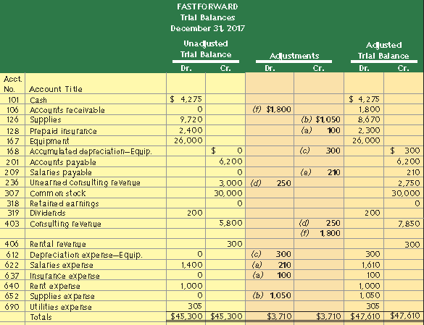
Exhibit 3.13 Adjusted Trial Balance
Learning Objective P2: Explain and prepare an adjusted trial balance.
Notes:
An unadjusted trial balance is a list of accounts and balances prepared before adjustments are recorded. An adjusted trial balance is a list of accounts and balances prepared after adjusting entries have been recorded and posted to the ledger. Here we show both the unadjusted and the adjusted trial balances for FastForward at December 31, 2017. The order of accounts in the trial balance is usually set up to match the order in the chart of accounts. Several new accounts arise from the adjusting entries.
Each adjustment (see middle columns) is identified by a letter in parentheses that links it to an adjusting entry explained earlier. Each amount in the Adjusted Trial Balance columns is computed by taking that account’s amount from the Unadjusted Trial Balance columns and adding or subtracting any adjustment(s).
Next, we will look at how to prepare financial statements from the adjusted trial balance.

Slide 85
Learning Objective P3: Prepare financial statements from an adjusted trial balance.

Slide 86
Preparing Financial Statements from an Adjusted Trial Balance (1 of 2)
Learning Objective P3: Prepare financial statements from an adjusted trial balance.
Step 1 - Prepare income statement using revenue and expense accounts from trial balance.
Step 2 - Prepare statement of retained earnings using retained earnings and dividends from trial balance; and pull net income from step 1.
Step 3 - Prepare balance sheet using asset and liability account from trial balance; and pull updated retained earnings balance from step 2.
Step 4 - Prepare statement of cash flows from changes in cash flows for the period (illustrated later in the book).
Notes:
We can prepare financial statements directly from information in the adjusted trial balance. An adjusted trial balance includes all accounts and balances appearing in financial statements, and is easier to work from than the entire ledger when preparing financial statements.
Steps to Prepare Financial Statements
Step 1 Prepare income statement using revenue and expense accounts from trial balance
Step 2 Prepare statement of retained earnings using retained earnings and dividends from trial balance; and pull net income from step 1.
Step 3 Prepare balance sheet using asset and liability account from trial balance; and pull updated retained earnings balance from step 2
Step 4 Prepare statement of cash flows from changes in cash flows for the period (illustrated later in the book)
Review what you have learned in the following NEED-TO-KNOW Slides.

Slide 87
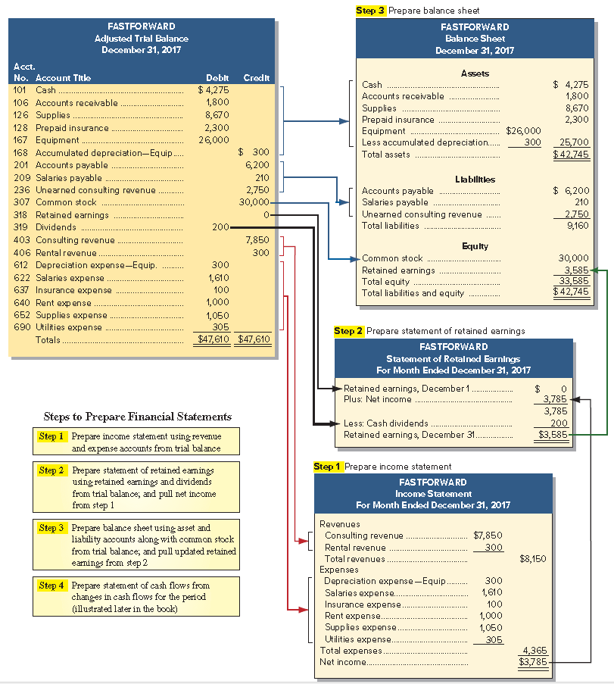
Preparing Financial Statements from an Adjusted Trial Balance (2 of 2)
Learning Objective P3: Prepare financial statements from an adjusted trial balance.
Exhibit 3.14
Notes:
We can prepare financial statements directly from information in the adjusted trial balance. An adjusted trial balance includes all accounts and balances appearing in financial statements, and is easier to work from than the entire ledger when preparing financial statements.
Steps to Prepare Financial Statements
Step 1 Prepare income statement using revenue and expense accounts from trial balance
Step 2 Prepare statement of retained earnings using the beginning retained earnings balance and dividends accounts from trial balance; and pull net income from step 1
Step 3 Prepare balance sheet using asset and liability account from trial balance; and pull updated retained earnings balance
Step 4 Prepare statement of cash flows from changes in cash flows for the period (illustrated later in the book)
Review what you have learned in the following NEED-TO-KNOW Slides.

Slide 88
NEED-TO-KNOW 3-5 (1 of 3)
Learning Objective P3: Prepare financial statements from an adjusted trial balance.
Use the following adjusted trial balance of Magic Company to prepare its (1) income statement, (2) statement of retained earnings, and (3) balance sheet (unclassified), for the year ended, or date of, December 31, 20X2. The Retained earnings account balance is $45,000 at December 31, 20X1.
Notes:
Use the following adjusted trial balance of Magic Company to prepare its (1) income statement, (2) statement of retained earnings, and (3) balance sheet (unclassified), for the year ended, or date of, December 31, 20X2. The retained earnings account balance is $45,000 at December 31, 20X1.

Slide 89
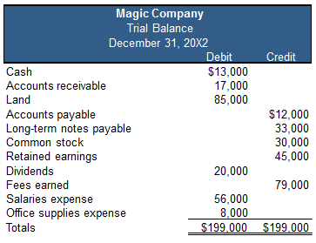
NEED-TO-KNOW 3-5 (2 of 3)
Learning Objective P3: Prepare financial statements from an adjusted trial balance.

Slide 90
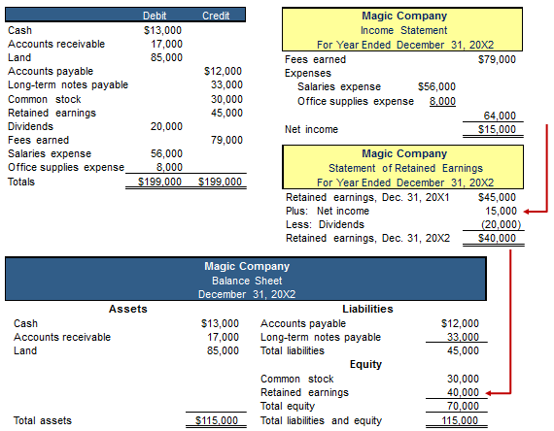
NEED-TO-KNOW 3-5 (3 of 3)
Notes:
Since accounts on the trial balance are listed in financial statement order, assets first followed by liabilities, equity, revenue and expenses, it makes it pretty simple to prepare the financial statements.
Step 1 is to prepare the income statement. Fees earned is a revenue account, and is reported on the income statement. Salaries expense and office supplies expense are expense accounts, and subtracted on the income statement. Total expenses are $64,000, leaving net income of $15,000.
Step 2 is to prepare the statement of retained earnings. Retained earnings is an equity account; its balance is reported on the statement of retained earnings as beginning retained earnings. Dividends are subtracted on the statement of retained earnings. The amount of net income is added on the statement of retained earnings. The balance in retained earnings at the end of 20X2, is $40,000. This amount will be carried to the balance sheet.
Step 3 is to prepare the balance sheet. Magic Company has three assets, Cash, Accounts Receivable and Land, with total assets of $115,000. Liabilities include Accounts Payable and Long-term notes payable, for a total of $45,000. The end-of-year Retained Earnings is transferred to the balance sheet from the statement of retained earnings and the Common Stock account is included as part of equity. Total equity is $70,000. Total liabilities and equity, is $115,000.

Slide 91
Learning Objective P4: Describe and prepare closing entries.

Slide 92
Closing Process
Learning Objective P4: Describe and prepare closing entries.
Resets revenue, expense, and dividends account balances to zero at the end of the period.
Helps summarize a period’s revenues and expenses in the Income Summary account.
Identify accounts for closing.
Record and post closing entries.
Prepare post-closing trial balance.
Notes:
The closing process is an important step at the end of an accounting period after financial statements are completed. It prepares accounts for recording the transactions and the events of the next period. In the closing process we must (1) identify accounts for closing, (2) record and post the closing entries, and (3) prepare a post-closing trial balance. The purpose of the closing process is twofold. First, it resets revenue, expense, and dividends account balances to zero at the end of each period (which also updates the retained earnings account for inclusion on the balance sheet). This is done so that these accounts can properly measure income and dividends for the next period. Second, it helps in summarizing a period’s revenues and expenses.

Slide 93
Temporary and Permanent Accounts
Learning Objective P4: Describe and prepare closing entries.
Temporary Accounts
Revenues
Dividends
Income Summary
Expenses
The closing process applies only to temporary accounts.
Permanent Accounts
Assets
Retained Earnings
Common Stock
Liabilities
Notes:
Temporary accounts accumulate data related to one accounting period. They include all income statement accounts, the dividends account, and the Income Summary account. They are temporary because the accounts are opened at the beginning of a period, used to record transactions and events for that period, and then closed at the end of the period. The closing process applies only to temporary accounts.
Permanent accounts report on activities related to one or more future accounting periods. They include asset, liability, common stock and retained earnings accounts (all balance sheet accounts). Permanent accounts are not closed each period and carry their ending balance into future periods.

Slide 94
Recording Closing Entries (1 of 2)
Learning Objective P4: Describe and prepare closing entries.
Close Credit Balances in Revenue Accounts to Income Summary.
Close Debit Balances in Expense accounts to Income Summary.
Close Income Summary account to Retained Earnings.
Close Dividends to Retained Earnings.
Notes:
Here are the four steps we always follow in the closing process.
Step 1: Close Credit Balances in Revenue Accounts to Income Summary The first closing entry transfers credit balances in revenue (and gain) accounts to the Income Summary account. We bring accounts with credit balances to zero by debiting them.
Step 2: Close Debit Balances in Expense Accounts to Income Summary The second closing entry transfers debit balances in expense (and loss) accounts to the Income Summary account. We bring expense accounts’ debit balances to zero by crediting them. With a balance of zero, these accounts are ready to accumulate a record of expenses for the next period.
Step 3: Close Income Summary to Retained Earnings After steps 1 and 2, the balance of Income Summary is equal to the periods net income. The third closing entry transfers the balance of the Income Summary account to the Retained Earnings account. This entry closes the Income Summary account. The Income Summary account has a zero balance after posting this entry. It continues to have a zero balance until the closing process again occurs at the end of the next period. (If a net loss occurred because expenses exceeded revenues, the third entry is reversed: debit Retained Earnings and credit Income Summary.)
Step 4: Close Dividends Account to Retained Earnings The fourth closing entry transfers any debit balance in the dividends account to the retained earnings account. This entry gives the dividends account a zero balance, and the account is now ready to accumulate next period’s dividends.
Let’s see how this process works. To prevent confusion, when you first try to make closing entries, it is an excellent idea to follow these four steps exactly.
Review what you have learned in the following NEED-TO-KNOW Slides.

Slide 95
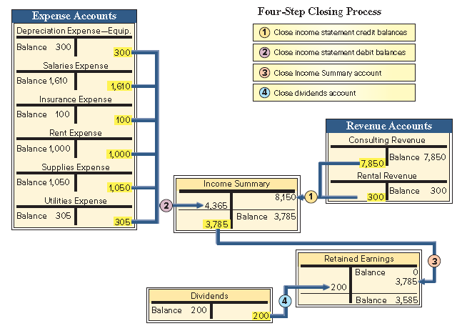
Recording Closing Entries (2 of 2)
Learning Objective P4: Describe and prepare closing entries.
Exhibit 3.15
Notes:
Here are the four steps in the closing process for FastForward:
Step 1: Close Credit Balances in Revenue Accounts to Income Summary The first closing entry transfers credit balances in revenue (and gain) accounts to the Income Summary account. We bring accounts with credit balances to zero by debiting them. The $8,150 credit entry to Income Summary equals total revenues for the period.
Step 2: Close Debit Balances in Expense Accounts to Income Summary The second closing entry transfers debit balances in expense (and loss) accounts to the Income Summary account. We bring expense accounts’ debit balances to zero by crediting them. With a balance of zero, these accounts are ready to accumulate a record of expenses for the next period. Total expenses for FastForward are $4,365.
Step 3: Close Income Summary to Retained Earnings After steps 1 and 2, the balance of Income Summary is equal to the periods net income, $3,785 ($8,150 credit less $4,365 debit) for FastForward. The third closing entry transfers the balance of the Income Summary account to the retained earnings account. This entry closes the Income Summary account. The Income Summary account has a zero balance after posting this entry. It continues to have a zero balance until the closing process again occurs at the end of the next period. (If a net loss occurred because expenses exceeded revenues, the third entry is reversed: debit Retained earnings and credit Income Summary.)
Step 4: Close Dividends account to Retained Earnings The fourth closing entry transfers any debit balance in the dividends account to the retained earnings account. This entry gives the dividends account a zero balance, and the account is now ready to record next period’s dividends. Retained earnings is debited for $200. The balance in the retained earnings account is now $3,585.

Slide 96
Learning Objective P5: Explain and prepare a post-closing trial balance.

Slide 97
Post-Closing Trial Balance (1 of 2)
Learning Objective P5: Explain and prepare a post-closing trial balance.
List of permanent accounts and their balances after posting closing entries.
Total debits and credits must be equal.
Notes:
After all four of our closing entries have been made, we prepare a post-closing trial balance. A post-closing trial balance is a list of permanent accounts and their balances from the ledger after all closing entries have been journalized and posted. It lists the balances for all accounts not closed. These accounts comprise a company’s assets, liabilities, and equity, which are identical to those in the balance sheet. The aim of a post-closing trial balance is to verify that (1) total debits equal total credits for permanent accounts and (2) all temporary accounts have zero balances. The post-closing trial balance usually is the last step in the accounting process.

Slide 98
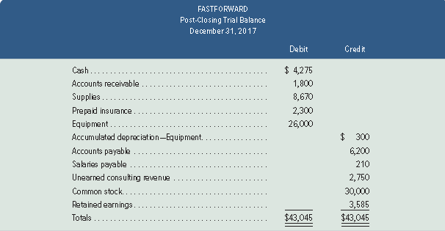
Post-Closing Trial Balance (2 of 2)
Learning Objective P5: Explain and prepare a post-closing trial balance.
Exhibit 3.18
Notes:
FastForward’s post-closing trial balance is shown in this slide. The post-closing trial balance usually is the last step in the accounting process.

Slide 99
Learning Objective C2: Identify steps in the accounting cycle.

Slide 100
Accounting Cycle
Learning Objective C2: Identify steps in the accounting cycle.
Analyze transactions
Journalize
Post
Prepare unadjusted trial balance
Adjust
Prepare adjusted trial balance
Prepare statement
Close
Prepare post-closing trial balance
Reverse (Optional)
Notes:
The term accounting cycle refers to the steps in preparing financial statements. It is called a cycle because the steps are repeated each reporting period. There are ten steps in the cycle which include:
1. Analyze transactions--Analyze transactions to prepare for journalizing.
2. Journalize--Record accounts, including debits and credits, in a journal.
3. Post--Transfer debits and credits from the journal to the ledger.
4. Prepare unadjusted trial balance--Summarize unadjusted ledger accounts and amounts.
5. Adjust--Record adjustments to bring account balances up to date; journalize and post adjustments.
6. Prepare adjusted trial balance--Summarize adjusted ledger accounts and amounts.
7. Prepare statements--Use adjusted trial balance to prepare financial statements.
8. Close--Journalize and post entries to close temporary accounts.
9. Prepare post-closing trial balance--Test clerical accuracy of the closing procedures.
10. Reverse (optional)--Reverse certain adjustments in the next period—optional step.
Notice that we prepare the financial statements before we complete the closing process.

Slide 101
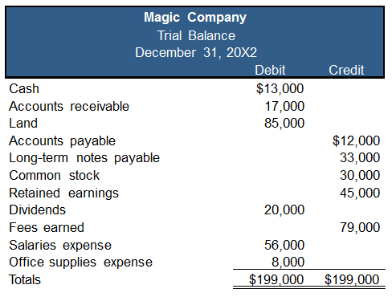
NEED-TO-KNOW 3-6 (1 of 6)
Learning Objective P4: Describe and prepare closing entries.
Use the adjusted trial balance of Magic Company to prepare its closing entries.
Notes:
Use the adjusted trial balance of Magic Company to prepare its closing entries. Every account on the trial balance is an asset, a liability, or a subset of equity.

Slide 102
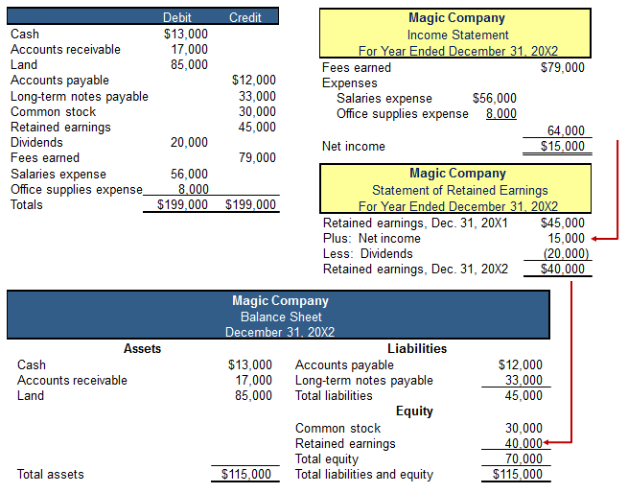
NEED-TO-KNOW 3-6 (2 of 6)
Learning Objective P4: Describe and prepare closing entries.
Notes:
Permanent accounts are balance sheet accounts. The company has total assets of $115,000, total liabilities of $45,000, and the remaining accounts are equity accounts. We know that total liabilities and equity must equal total assets, $115,000. Total equity is $70,000; $115,000 minus the $45,000 in total liabilities.. The income statement reports revenues, $79,000, minus expenses of $64,000; net income is $15,000. Net income is transferred to the statement of retained earnings, where it's added to the beginning retained earnings balance of $45,000. Dividends are subtracted on the statement of retained earnings. The ending retained earnings is $40,000. The closing process is the mechanical process of transferring the dollars from the temporary equity accounts to the permanent equity account, Retained earnings. The closing process parallels the flow of dollars shown on the financial statements.

Slide 103
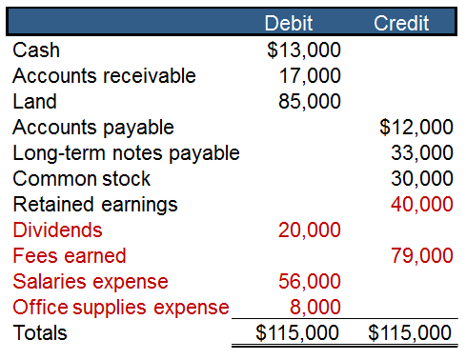
NEED-TO-KNOW 3-6 (3 of 6)
Learning Objective P4: Describe and prepare closing entries.
Notes:
The first closing entry closes the revenue accounts to a new temporary equity account, called Income summary. Fees earned has a credit balance of $79,000. To close this balance we debit Fees earned, $79,000, and credit Income summary. The second closing entry closes the expense accounts, crediting Salaries expense and Office supplies expense and debiting Income summary for the total, $64,000. The balance in Income summary is now equal to the net income amount. The next step in the closing process is to close Income summary to Retained earnings, debiting Income summary and crediting Retained earnings. The final step in the closing process is to close the Dividends account, crediting the Dividends account for $20,000, and debiting Retained Earnings. Notice that the Dividends account is not closed to Income summary, because dividends are not part of the calculation of net income. The balance in Retained earnings at the end of the period is now $40,000.

Slide 104
NEED-TO-KNOW 3-6 (4 of 6)
Learning Objective P4: Describe and prepare closing entries.

Slide 105
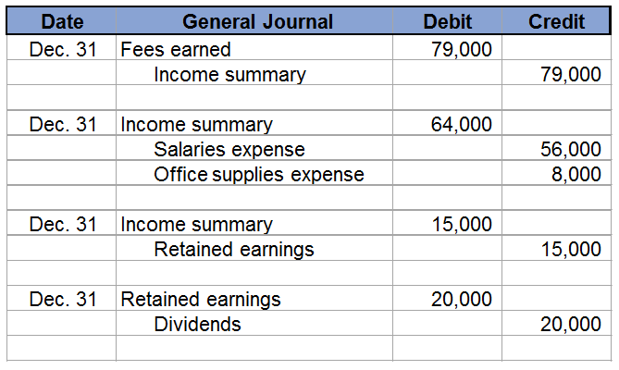
NEED-TO-KNOW 3-6 (5 of 6)
Learning Objective P4: Describe and prepare closing entries.

Slide 106
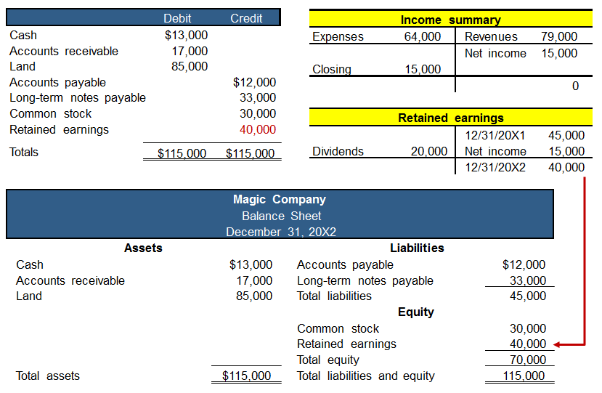
NEED-TO-KNOW 3-6 (6 of 6)
Learning Objective P4: Describe and prepare closing entries.
Notes:
Once all of the revenue, expense, and dividends accounts have been closed, the remaining balances appear on a post-closing trial balance. The ending balance in Retained earnings now agrees with the amount reported on the balance sheet.

Slide 107
Learning Objective C3: Explain and prepare a classified balance sheet.

Slide 108
Classified Balance Sheet
Learning Objective C3: Explain and prepare a classified balance sheet.
Assets | Liabilities and Equity
Current assets | Current liabilities
Noncurrent assets | Noncurrent liabilities
Long-term investments | Equity
Plant assets
Intangible assets
Current items are those expected to come due (both collected and owed) within the longer of one year or the company’s normal operating cycle.
Notes:
A classified balance sheet organizes assets and liabilities into important subgroups that provide more information to decision makers.
A classified balance sheet is the most popular format used by business. On the asset side of the balance sheet, we group assets as current or noncurrent. A current asset is one that is expected to be converted into cash in one year or the company’s normal operating cycle, whichever is longer.
The operating cycle of a company is the time it takes to acquire inventory, sell the inventory, and collect cash. For many companies, the operating cycle is less than one year. These companies would classify an asset as current as long as that asset is expected to be converted into cash within one year.
On the liabilities plus equity side of the balance sheet, we divide liabilities between current and noncurrent. A current liability is one we expect to be paid out of the company’s current assets within the longer of one year or the normal operating cycle.
Let’s see how new classifications appear on the balance sheet.

Slide 109
Current Assets
Learning Objective C3: Explain and prepare a classified balance sheet.
Current assets are expected to be sold, collected, or used within one year or the company’s operating cycle.
Notes:
Current assets are cash and other resources that are expected to be sold, collected, or used within one year or the company’s operating cycle, whichever is longer. Examples are cash, short-term investments, accounts receivable, short-term notes receivable, goods for sale (called merchandise or inventory), and prepaid expenses. The individual prepaid expenses of a company are usually small in amount compared to many other assets and are often combined and shown as a single item. The prepaid expenses likely include items such as prepaid insurance, prepaid rent, office supplies, and store supplies. Prepaid expenses are usually listed last because they will not be converted to cash (instead, they are used).

Slide 110
Long-Term Investments
Learning Objective C3: Explain and prepare a classified balance sheet.
Long-term investments are expected to be held for more than one year or the operating cycle.
Notes:
A second major balance sheet classification is long-term (or noncurrent) investments. Notes receivable and investments in stocks and bonds are long-term assets when they are expected to be held for more than the longer of one year or the operating cycle. Land held for future expansion is a long-term investment because it is not used in operations.

Slide 111
Plant Assets
Learning Objective C3: Explain and prepare a classified balance sheet.
Plant assets are tangible long-lived assets used to produce or sell products and services.
Notes:
Plant assets are tangible assets that are both long-lived and used to produce or sell products and services. Examples are equipment, machinery, buildings, and land that are used to produce or sell products and services. The order listing for plant assets is usually from most liquid to least liquid such as equipment and machinery to buildings and land.

Slide 112
Intangible Assets
Learning Objective C3: Explain and prepare a classified balance sheet.
Intangible assets are long-term resources used to produce or sell products and services and that lack physical form.
Notes:
Intangible assets are long-term resources that benefit business operations, usually lack physical form, and have uncertain benefits. Examples are patents, trademarks, copyrights, franchises, and goodwill. Their value comes from the privileges or rights granted to or held by the owner.

Slide 113
Current Liabilities
Learning Objective C3: Explain and prepare a classified balance sheet.
Current liabilities are obligations due within the longer of one year or the company’s operating cycle.
Notes:
Current liabilities are obligations due to be paid or settled within one year or the operating cycle, whichever is longer. They are usually settled by paying out current assets such as cash. Current liabilities often include accounts payable, notes payable, wages payable, taxes payable, interest payable, and unearned revenues. Also, any portion of a long-term liability due to be paid within one year or the operating cycle, whichever is longer, is a current liability. Unearned revenues are current liabilities when they will be settled by delivering products or services within one year or the operating cycle, whichever is longer. Current liabilities are reported in the order of those to be settled first.

Slide 114
Long-Term Liabilities
Learning Objective C3: Explain and prepare a classified balance sheet.
Long-term liabilities are obligations not due within the longer of one year or the company’s operating cycle.
Notes:
Long-term liabilities are obligations not due within one year or the operating cycle, whichever is longer. Notes payable, mortgages payable, bonds payable, and lease obligations are common long-term liabilities. If a company has both short- and long-term items in each of these categories, they are commonly separated into two accounts in the ledger.

Slide 115
Equity
Learning Objective C3: Explain and prepare a classified balance sheet.
Equity is the owner’s claim on the assets.
Notes:
Equity is the owner’s claim on assets. For a corporation, this claim is reported in the equity section and divided into two main subsections, common stock (contributed capital) and retained earnings.
Review what you have learned in the following NEED-TO-KNOW Slides.

Slide 116
NEED-TO-KNOW 3-7 (1 of 3)
Learning Objective C3: Explain and prepare a classified balance sheet.
Use the adjusted trial balance of Magic Company to prepare its classified balance sheet as of December 31, 20X2. (Hint: The retained earnings account balance is $40,000 at December 31, 20X2.)
Notes:
A classified balance sheet includes subtotals for current assets versus plant assets and current liabilities versus long-term liabilities. Current assets are assets that are either cash, will be converted to cash, or used, within the current year or the current operating cycle, whichever is longer. Plant assets are long-term assets that are used in the generation of net income. Current liabilities are due within one year or one operating cycle, whichever is longer, and long-term liabilities are due beyond the current year or operating cycle. Cash and Accounts receivable are both current assets. Land is a plant asset. Accounts payable is a current liability; it's due usually within 30 days. Long term notes payable is a long-term liability.
The $45,000 balance in Retained earnings is the beginning of the period balance; but it's not hard to calculate ending retained earnings. Ending retained earnings includes all of the income statement and statement of retained earnings activity. Retained earnings at the end of the period equals the beginning retained earnings of, $45,000, plus the revenues, $79,000, minus expenses, $64,000 and dividends, $20,000. The ending balance in the Retained earnings account is $40,000. We calculate the subtotals for each of our categories: total current assets are $30,000; total plant assets, $85,000; total assets, $115,000. Total current liabilities are $12,000, Total liabilities are $45,000. Total equity is $70,000, and total liabilities and equity equals total assets, $115,000.

Slide 117
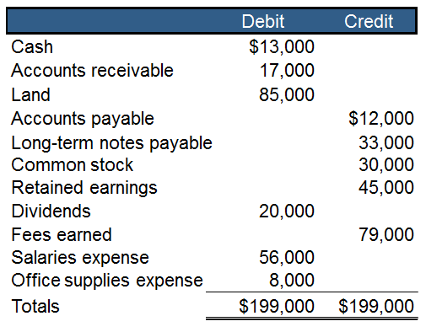
NEED-TO-KNOW 3-7 (2 of 3)
Learning Objective C3: Explain and prepare a classified balance sheet.

Slide 118
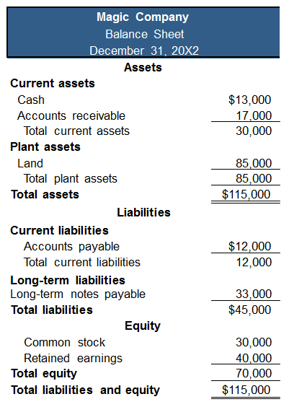
NEED-TO-KNOW 3-7 (3 of 3)
Learning Objective C3: Explain and prepare a classified balance sheet.

Slide 119
Learning Objective A1: Compute profit margin and describe its use in analyzing company performance.

Slide 120
Profit Margin
Learning Objective A1: Compute profit margin and describe its use in analyzing company performance.
The profit margin ratio measures the company’s net income to net sales.
Limited Brands, Inc.
$ millions | 2015 | 2014 | 2013 | 2012 | 2011
Net income…………………………. | $ 1,042 | $ 903 | $ 753 | $ 850 | $ 805
Net sales……………………………. | $ 11,454 | $ 10,773 | $ 10,459 | $ 10,364 | $ 9,613
Profit margin………………. | 9.1% | 8.4% | 7.2% | 8.2% | 8.4%
Industry profit margin………. | 2.8% | 2.5% | 2.0% | 2.2% | 2.1%
Notes:
Profit margin is an important measure in business. It tells us about the relationship between sales and profits or net income. We calculate the ratio by dividing net income for the period by sales revenue. A high profit margin is an indicator of future growth.
You can see the profit margin at Limited Brands for the years 2011 through 2015. Limited’s average profit margin is 8.3% during this five-year period. This favorably compares to the average industry profit margin of 2.3%. Moreover, we see that Limited’s profit margin has rebounded from the recent recessionary period and is at the 7% to 9% margin for the past five years (see margin graph).

Slide 121
Learning Objective A2: Compute the current ratio and describe what it reveals about a company’s financial condition.

Slide 122
Current Ratio
Learning Objective A2: Compute the current ratio and describe what it reveals about a company’s financial condition.
Helps assess the company’s ability to pay its debts in the near future
Limited Brands, Inc.
$ millions | 2015 | 2014 | 2013 | 2012 | 2011 | 2010
Current assets……………………. | $ 3,232 | $ 3,150 | $ 2,205 | $ 2,368 | $ 2,592 | $ 3,250
Current liabilities………………. | $ 1,679 | $ 1,826 | $ 1,538 | $ 1,526 | $ 1,504 | $ 1,322
Current ratio………….……. | 1.9 | 1.7 | 1.4 | 1.6 | 1.7 | 2.5
Industry current ratio………. | 1.8 | 1.7 | 1.5 | 1.6 | 1.7 | 1.9
Notes:
An important use of financial statements is to help assess a company’s ability to pay its debts in the near future. Such analysis affects decisions by suppliers when allowing a company to buy on credit. It also affects decisions by creditors when lending money to a company, including loan terms such as interest rate, due date, and collateral requirements. It can also affect a manager’s decisions about using cash to pay debts when they come due. The current ratio is one measure of a company’s ability to pay its short-term obligations. It is defined above as current assets divided by current liabilities.
Limited Brands’ current ratio averaged 1.8 for its fiscal years 2010 through 2015. The current ratio for each of these years suggests that the company’s short-term obligations can be covered with its short-term assets. However, if its ratio would approach 1.0, Limited would expect to face challenges in covering liabilities. If the ratio were less than 1.0, current liabilities would exceed current assets, and the company’s ability to pay short-term obligations could be in doubt. Limited Brands’ liquidity, as evidenced by its current ratio, declined in 2011, 2012, and 2013, which roughly matches the industry decline.

Slide 123
Learning Objective P6: Appendix 3A Explain the alternative in accounting for prepaids.

Slide 124
Alternative Accounting for Prepayments (1 of 3)
Learning Objective P6: Explain the alternative in accounting for prepaids.
Exhibits 3A.1
An alternative method is to record all prepaid expenses with debits to expense accounts.
Notes:
Appendix 3A: Alternative Accounting for Prepayments
An alternative method is to record all prepaid expenses with debits to expense accounts. If any prepaids remain unused or unexpired at the end of an accounting period, then adjusting entries must transfer the cost of the unused portions from expense accounts to prepaid expense (asset) accounts. This alternative method is acceptable. The financial statements are identical under either method, but the adjusting entries are different. To illustrate the differences between these two methods, let’s look at FastForward’s cash payment of December 6 for 24 months of insurance coverage beginning on December 1. FastForward recorded that payment with a debit to an asset account, but it could have recorded a debit to an expense account. These alternatives are shown on this slide in the first graphic.
At the end of its accounting period on December 31, insurance protection for one month has expired. This means $100 ($2,400/24 months) of insurance coverage has expired and is an expense for December. The adjusting entry depends on how the original payment was recorded. This is shown on this slide in the second graphic.

Slide 125
Alternative Accounting for Prepayments (2 of 3)
Learning Objective P6: Explain the alternative in accounting for prepaids.
Exhibits 3A.2
The adjusting entry depends on how the original payment was recorded.

Slide 126
Alternative Accounting for Prepayments (3 of 3)
Learning Objective P6: Explain the alternative in accounting for prepaids.
Exhibits 3A.3
Notes:
When these entries are posted to the accounts in the ledger, we can see that these two methods give identical results. The December 31 adjusted account balances show Prepaid Insurance of $2,300 and Insurance Expense of $100 for both methods.

Slide 127
Alternative Accounting for Revenues (1 of 3)
Learning Objective P6: Explain the alternative in accounting for prepaids.
Exhibits 3A.4
An alternative method is to record all revenues to a liability account or a revenue account.
Notes:
An alternative method is to record all unearned revenues with credits to revenue accounts. If any revenues are unearned at the end of an accounting period, then adjusting entries must transfer the unearned portions from revenue accounts to unearned revenue (liability) accounts. This alternative method is acceptable. The adjusting entries are different for these two alternatives, but the financial statements are identical.
Assume FastForward’s December 26 receipt of $3,000 for consulting services covering the period December 27 to February 24. FastForward recorded this transaction with a credit to a liability account. The alternative is to record it with a credit to a revenue account.
By the end of its accounting period on December 31, FastForward has earned $250 of this revenue. This means $250 of the liability has been satisfied. Depending on how the initial receipt is recorded, the adjusting entry is as shown.

Slide 128
Alternative Accounting for Revenues (2 of 3)
Learning Objective P6: Explain the alternative in accounting for prepaids.
Exhibits 3A.5
The adjusting entry depends on how the original receipt was recorded.

Slide 129
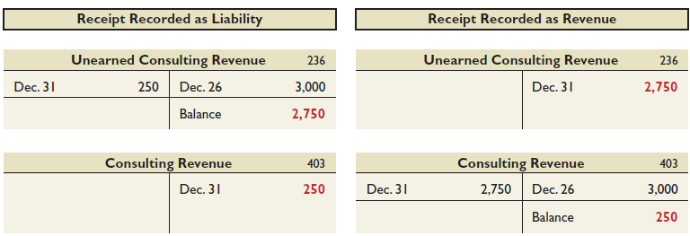
Alternative Accounting for Revenues (3 of 3)
Learning Objective P6: Explain the alternative in accounting for prepaids.
Exhibits 3A.6
Notes:
When these entries are posted to the accounts in the ledger, we can see that these two methods give identical results. The December 31 adjusted account balances show Unearned Consulting Revenue of $2,750 and Consulting Revenue of $250 for both methods.

Slide 130
Learning Objective P7: Appendix 3B Prepare a work sheet and explain its usefulness.

Slide 131
Benefits of a Work Sheet
Learning Objective P7: Prepare a work sheet and explain its usefulness.
Aids the preparation of financial statements.
Reduces risk of errors.
Links accounts and their adjustments.
Helps in preparing interim financial statements.
Shows the effects of proposed transactions.
Not a required report.
Notes:
A work sheet is a document that is used internally by companies to help with adjusting and closing accounts and with preparing financial statements. Specifically, a work sheet:
1. Aids the preparation of financial statements.
Reduces the risk of errors when working with many accounts and adjustments.
Links accounts and adjustments to their impacts in financial statements.
Helps in preparing interim (monthly and quarterly) financial statements when the journalizing and posting of adjusting entries are postponed until year-end.
Shows the effects of proposed or “what-if” transactions.

Slide 132
Use of a Work Sheet (1 of 2)
Learning Objective P7: Prepare a work sheet and explain its usefulness.
Five important steps:
Step 1: Enter Unadjusted Trial Balance
Step 2: Enter Adjustments
Step 3: Prepare Adjusted Trial Balance
Step 4: Sort Adjusted Trial Balance Amounts to Financial Statements
Step 5: Total Statement Columns, Compute Income or Loss, and Balance Columns
Notes:
When a work sheet is used to prepare financial statements, it is constructed at the end of a period before the adjusting process. Preparing the work sheet has five important steps. Each step, 1 through 5, is color-coded and explained with reference to Exhibits 4.1 and 4.2.
Step 1: The first step in preparing a work sheet is to list the title of every account and its account number that appears on its financial statements. This includes all accounts in the ledger plus any new ones from adjusting entries. The unadjusted balance for each account is then entered in the appropriate Debit or Credit column of the unadjusted trial balance columns. The totals of these two columns must be equal.
Step 2: The second step is to enter adjustments in the Adjustments columns.
Step 3: The adjusted trial balance is prepared by combining the adjustments with the unadjusted balances for each account.
Step 4: This step involves sorting account balances from the adjusted trial balance to their proper financial statement columns. Expenses go to the Income Statement Debit column and revenues to the Income Statement Credit column. Assets and withdrawals go to the Balance Sheet & Statement of Owner’s Equity Debit column. Liabilities and owner’s capital go to the Balance Sheet & Statement of Owner’s Equity Credit column.
Step 5: Each financial statement column (from step 4) is totaled. The difference between the Debit and Credit column totals of the Income Statement columns is net income or net loss. This occurs because revenues are entered in the Credit column and expenses in the Debit column. If the Credit total exceeds the Debit total, there is net income. If the Debit total exceeds the Credit total, there is a net loss.

Slide 133
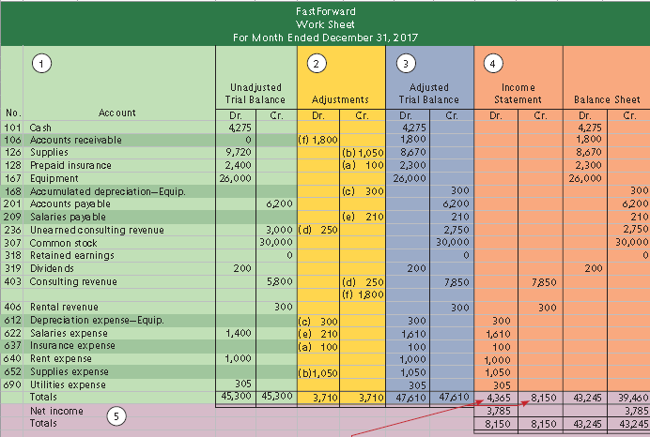
Use of a Work Sheet (2 of 2)
Learning Objective P7: Prepare a work sheet and explain its usefulness.
Exhibit 3B.1
Notes:
A worksheet organizes information used to prepare adjusting entries, financial statements, and closing entries.
Review what you have learned in the following NEED-TO-KNOW Slides.

Slide 134
Learning Objective P8: Appendix 3C Prepare reversing entries and explain their purpose.

Slide 135
Reversing Entries (1 of 3)
Learning Objective P8: Prepare reversing entries and explain their purpose.
Reversing entries are optional. They are recorded in response to accrued assets and accrued liabilities that were created by adjusting entries at the end of a reporting period. The purpose of reversing entries is to simplify a company’s recordkeeping.
Let’s see how the accounting for our payroll accrual will be handled with and without reversing entries.
Notes:
Reversing entries are optional. They are recorded in response to accrued assets and accrued liabilities that were created by adjusting entries at the end of a reporting period. The purpose of reversing entries is to simplify a company’s recordkeeping.
Let’s see how the accounting for our payroll accrual will be handled with and without reversing entries.

Slide 136
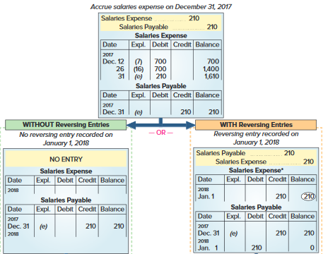
Reversing Entries (2 of 3)
Learning Objective P8: Prepare reversing entries and explain their purpose.
Exhibit 3C.1
Notes:
The purpose of reversing entries is to simplify a company’s recordkeeping. This slide shows an example of FastForward’s reversing entries. The top of the exhibit shows the adjusting entry FastForward recorded on December 31 for its employee’s earned but unpaid salary. The entry recorded three days’ salary of $210, which increased December’s total salary expense to $1,610. The entry also recognized a liability of $210. The expense is reported on December’s income statement. The expense account is then closed. The ledger on January 1, 2018, shows a $210 liability and a zero balance in the Salaries Expense account. At this point, the choice is made between using or not using reversing entries.

Slide 137
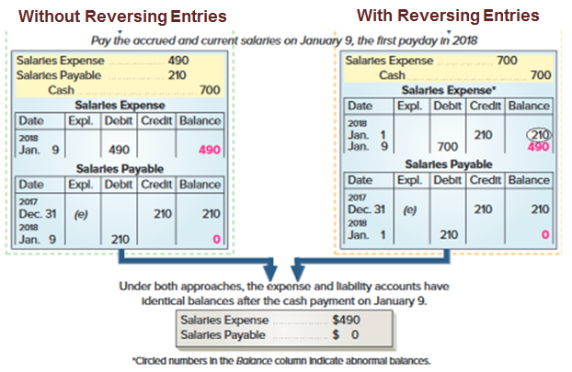
Reversing Entries (3 of 3)
Learning Objective P8: Prepare reversing entries and explain their purpose.
Exhibit 3C.1
Notes:
Accounting without Reversing Entries The path down the left side is described in the chapter. To summarize here, when the next payday occurs on January 9, we record payment with a compound entry that debits both the expense and liability accounts and credits Cash. Posting that entry creates a $490 balance in the expense account and reduces the liability account balance to zero because the debt has been settled. The disadvantage of this approach is the slightly more complex entry required on January 9. Paying the accrued liability means that this entry differs from the routine entries made on all other paydays. To construct the proper entry on January 9, we must recall the effect of the December 31 adjusting entry. Reversing entries overcome this disadvantage.
Accounting with Reversing Entries The right side shows how a reversing entry on January 1 overcomes the disadvantage of the January 9 entry when not using reversing entries. A reversing entry is the exact opposite of an adjusting entry. For FastForward, the Salaries Payable liability account is debited for $210, meaning that this account now has a zero balance after the entry is posted. The Salaries Payable account temporarily understates the liability, but this is not a problem since financial statements are not prepared before the liability is settled on January 9. The credit to the Salaries Expense account is unusual because it gives the account an abnormal credit balance. We highlight an abnormal balance by circling it. Because of the reversing entry, the January 9 entry to record payment is straightforward. This entry debits the Salaries Expense account and credits Cash for the full $700 paid. It is the same as all other entries made to record 10 days’ salary for the employee. Notice that after the payment entry is posted, the Salaries Expense account has a $490 balance that reflects seven days’ salary of $70 per day. The zero balance in the Salaries Payable account is now correct. The lower section shows that the expense and liability accounts have exactly the same balances whether reversing entries are used or not. This means that both approaches yield identical results.

Slide 138
End of Presentation

