Slide 1
Financial & Managerial Accounting Information for Decisions
Seventh Edition
Chapter 4
Accounting for Merchandising Operations
© McGraw-Hill Education. All rights reserved. Authorized only for instructor use in the classroom. No reproduction or further distribution permitted without the prior written consent of McGraw-Hill Education.

Slide 2
Learning Objectives (1 of 3)
CONCEPTUAL
C1 Describe merchandise activities and identify income components for a merchandising company.
C2 Identify and explain the inventory asset and cost flows of a merchandising company.
ANALYTICAL
A1 Compute the acid-test ratio and explain its use it to assess liquidity.
A2 Compute the gross margin ratio and explain its use to assess profitability.

Slide 3
Learning Objectives (2 of 3)
PROCEDURAL
P1 Analyze and record transactions for merchandise purchases using a perpetual system.
P2 Analyze and record transactions for merchandise sales using a perpetual system.
P3 Prepare adjustments and close accounts for a merchandising company.
P4 Define and prepare multiple-step and single-step income statements.

Slide 4
Learning Objectives (3 of 3)
PROCEDURAL
P5 Appendix 4A – Record and compare merchandising transactions using both periodic and perpetual inventory system.
P6 Appendix 4C – Prepare adjustments for discounts, returns and allowances per revenue recognition rules.
P7 Appendix 4D – Record and compare merchandising transactions using the gross method and net method.

Slide 5
Learning Objective C1: Describe merchandise activities and identify income components for a merchandising company.

Slide 6
Reporting Income for a Merchandiser (1 of 4)
Learning Objective C1: Describe merchandise activities and identify income components for a merchandising company.
Service organizations sell time to earn revenue.
Examples: Accounting firms, law firms, and plumbing services
Notes:
Previous chapters emphasized the accounting activities of service companies. A merchandising company’s activities differ from those of a service company. Merchandise consists of products, also called goods, that a company buys to resell to customers.

Slide 7
Reporting Income for a Merchandiser (2 of 4)
Learning Objective C1: Describe merchandise activities and identify income components for a merchandising company.
Merchandising Companies
Notes:
A merchandiser earns net income by buying and selling merchandise. Merchandisers are often wholesalers or retailers. A wholesaler buys products from manufacturers and sells them to retailers. A retailer buys products from manufacturers or wholesalers and sells them to consumers.

Slide 8
Reporting Income for a Merchandiser (3 of 4)
Learning Objective C1: Describe merchandise activities and identify income components for a merchandising company.
Merchandising companies sell products to earn revenue.
Examples: sporting goods, clothing, and auto parts stores
Merchandiser
Notes:
The income statements for a service company, Liberty Tax, and for a merchandiser, Nordstrom, are shown in Exhibit 5.2. The statement for Liberty Tax shows revenues of $173 followed by expenses of $155, which yields $18 in net income. The first two lines of the statement for Nordstrom, a merchandiser, show that products are acquired at a cost of $9,168 and sold for $14,437. The third line shows its $5,269 gross profit, also called gross margin, which equals net sales less cost of goods sold. Additional expenses of $4,669 are reported, which leaves $600 in net income.

Slide 9
Reporting Income for a Merchandiser (4 of 4)
Learning Objective C1: Describe merchandise activities and identify income components for a merchandising company.
Exhibit 4.2
Notes:
The income statements for a service company, Liberty Tax, and for a merchandiser, Nordstrom, are shown in Exhibit 4.2. The statement for Liberty Tax shows revenues of $173 followed by expenses of $155, which yields $18 in net income. The first two lines of the statement for Nordstrom, a merchandiser, show that products are acquired at a cost of $9,168 and sold for $14,437. The third line shows its $5,269 gross profit, also called gross margin, which equals net sales less cost of goods sold. Additional expenses of $4,669 are reported, which leaves $600 in net income.

Slide 10
Learning Objective C2: Identify and explain the inventory asset and cost flows of a merchandising company.

Slide 11
Exhibit 4.3 Operating Cycle for a Merchandiser
Learning Objective C2: Identify and explain the inventory asset and cost flows of a merchandising company.
Begins with the purchase of merchandise and ends with the collection of cash from the sale of merchandise.
Cash
Purchases
Merchandise Inventory
Credit sales
Accounts receivable
Cash collection
Notes:
A merchandising company’s operating cycle begins by purchasing merchandise and ends by collecting cash from selling the merchandise. The length of an operating cycle differs across the types of businesses. Department stores often have operating cycles of two to five months. Operating cycles for grocery merchants usually range from two to eight weeks. A grocer has more operating cycles in a year than clothing or electronics retailers.
This slide illustrates an operating cycle for a merchandiser with credit sales.
The cycle moves from:
(a) cash purchases of merchandise to
(b) inventory for sale to
(c) credit sales to
(d) accounts receivable to
(e) cash.
Companies try to keep their operating cycles short because assets tied up in inventory and receivables are not productive. Cash sales shorten operating cycles.

Slide 12
Exhibit 4.4 Inventory Systems
Learning Objective C2: Identify and explain the inventory asset and cost flows of a merchandising company.
Beginning inventory + Net purchases = Merchandise available for sale
Merchandise available for sale = Ending inventory + Cost of goods sold
Notes:
Exhibit 4.4 shows that a company’s merchandise available for sale consists of what it begins with (beginning inventory) and what it purchases (net purchases). The merchandise available is either sold (cost of goods sold) or kept for future sales (ending inventory).

Slide 13
Inventory Systems
Learning Objective C2: Identify and explain the inventory asset and cost flows of a merchandising company.
Perpetual systems
updates accounting records for each purchase and sale of merchandising
Periodic systems
Updates records for purchase and sale of merchandise only at the end of the accounting period
Notes:
Two alternative inventory accounting systems can be used to collect information about cost of goods sold and cost of inventory: perpetual system or periodic system.
Perpetual inventory system updates accounting records for each purchase and sale of inventory.
Periodic inventory system updates the accounting records for purchases and sales of inventory only at the end of a period.
Technological advances and competitive pressures have dramatically increased the use of the perpetual system. It gives managers immediate access to information on sales and inventory levels, where they can strategically react to increase profit.
Review what you have learned in the following NEED-TO-KNOW Slides.

Slide 14
NEED-TO-KNOW 4-1 (1 of 2)
Learning Objective C1: Describe merchandise activities and identify income components for a merchandising company.
Learning Objective C2: Identify and explain the inventory asset and cost flows of a merchandising company.
Use the following information (in random order) from a merchandising company and from a service company.
Hint: Not all information may be necessary for the solutions.
1. For the merchandiser only, compute:
a. Goods available for sale.
b. Cost of goods sold.
c. Gross profit.
Notes:
Need-to-Know 4-1

Slide 15
NEED-TO-KNOW 5-1 (2 of 2)
Learning Objective C1: Describe merchandise activities and identify income components for a merchandising company.
Learning Objective C2: Identify and explain the inventory asset and cost flows of a merchandising company.
2. Compute net income for each company.
SaveCo Merchandiser
Supplies | $10
Beginning inventory | 100
Ending inventory | 50
Expenses | 20
Net purchases | 80
Net sales | 190
Hi-Tech Services
Expenses | $170
Revenues | 200
Cash | 10
Prepaid rent | 25
Accounts payable | 35
Supplies | 65

Slide 16
NEED-TO-KNOW 5-1 SOLUTION (1 of 3)
Learning Objective C1: Describe merchandise activities and identify income components for a merchandising company.
Learning Objective C2: Identify and explain the inventory asset and cost flows of a merchandising company.
1a. Computation of goods available for sale:
Beginning inventory | $100
Plus: Net purchases | 80
Goods available for sale | $180
1b. Computation of cost of goods sold:
Beginning inventory | $100
Plus: Net purchases | 80
Goods available for sale | 180
Less: Ending inventory | 50
Cost of goods sold | $130
Notes:
Need-to-Know 4-1

Slide 17
NEED-TO-KNOW 5-1 SOLUTION (2 of 3)
Learning Objective C1: Describe merchandise activities and identify income components for a merchandising company.
Learning Objective C2: Identify and explain the inventory asset and cost flows of a merchandising company.
1c. Computation of gross profit:
Net sales | $190
Less: Cost of goods sold | 130
Gross profit | $60

Slide 18
NEED-TO-KNOW 5-1 SOLUTION (3 of 3)
Learning Objective C1: Describe merchandise activities and identify income components for a merchandising company.
Learning Objective C2: Identify and explain the inventory asset and cost flows of a merchandising company.
Compute net income for each company.
SaveCo Merchandiser
Net sales | $190
Less: Cost of goods sold | 130
Gross profit | $60
Less: Expenses | 20
Net income | $40
Hi-Tech Services
Revenues | $200
Less: Expenses | 170
Net income | $30

Slide 19
Learning Objective P1: Analyze and record transactions for merchandise purchases using a perpetual system.

Slide 20
Purchases without Cash Discounts
Learning Objective P1: Analyze and record transactions for merchandise purchases using a perpetual system.
On November 2, Z-Mart purchased $500 of merchandise inventory for cash.
Notes:
To illustrate, Z-Mart records a $500 cash purchase of merchandise on November 2 as follows: debit Merchandise Inventory and credit Cash.
If these goods were instead purchased on credit, and no discounts were offered for early payment, Z-Mart would make the same entry except that Accounts Payable would be credited instead of Cash.

Slide 21
Exhibit 4.5 Credit Terms
Learning Objective P1: Analyze and record transactions for merchandise purchases using a perpetual system.
A deduction from the invoice price granted to induce early payment of the amount due.
Notes:
The purchase of goods on credit requires a clear statement of expected future payments and dates to avoid misunderstandings. Credit terms for a purchase include the amounts and timing of payments from a buyer to a seller. Credit terms usually reflect an industry’s practices. To illustrate, when sellers require payment within 10 days after the end of the month of the invoice date, the invoice will show credit terms as “n/10 EOM,” which stands for net 10 days after end of month (EOM). When sellers require payment within 30 days after the invoice date, the invoice shows credit terms of “n/30,” which stands for net 30 days.
Sellers can grant a cash discount to encourage buyers to pay earlier. A buyer views a cash discount as a purchase discount. A seller views a cash discount as a sales discount. Any cash discounts are described in the credit terms on the invoice. For example, credit terms of “2/10, n/60” mean that full payment is due within a 60-day credit period, but the buyer can deduct 2% of the invoice amount if payment is made within 10 days of the invoice date. This reduced payment applies only for the discount period.

Slide 22
Purchase Discounts
Learning Objective P1: Analyze and record transactions for merchandise purchases using a perpetual system.
2/10, n/30
Discount Percent → 2
Number of Days Discount Is Available → 10
Otherwise, Net (or All) Is Due in 30 Days → n
Credit Period → 30
Notes:
Purchase discount terms are typically written as this slide shows. This particular discount term would be read as “two ten, net thirty.”
The first number represents the discount percentage.
The second number represents the discount period (in days).
The letter “n” stands for the word net.
The last number represents the entire credit period (in days).
In this case, if the customer pays within 10 days, then a 2% discount may be taken. If not, then all of the amount is due within 30 days.

Slide 23
Purchases with Cash Discounts
Learning Objective P1: Analyze and record transactions for merchandise purchases using a perpetual system.
On November 2, Z-Mart purchased $500 of merchandise inventory on account, credit terms are 2/10, n/30.
Notes:
To illustrate how a buyer accounts for a purchases discount, assume that on November 2, Z-Mart purchases $500 of merchandise on credit with terms of 2∕10, n∕30. The amount due, if paid on or before November 12, is $490, computed as $500 − ($500 × 2%)—or alternatively computed as $500 × (100% − 2%). Many buyers take advantage of a purchases discount because of the usually high interest rate implied by not taking it.
If Z-Mart does not pay within the 10-day 2% discount period, it can delay payment by 20 more days, at which point it must pay $500. The gross method for recording purchases enters the full invoice (gross) amount for merchandise. If Z-Mart uses the gross method, it makes the following entry dated as of the invoice date: debit to Merchandise Inventory and credit to Accounts Payable for $500.

Slide 24
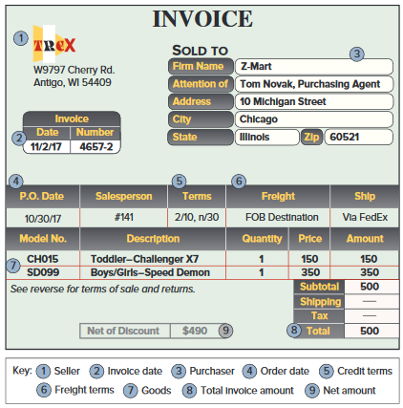
Exhibit 4.6 Trade Discounts
Learning Objective P1: Analyze and record transactions for merchandise purchases using a perpetual system.
Notes:
When a manufacturer or wholesaler prepares a catalog of items it has for sale, it usually gives each item a list price, also called a catalog price. However, an item’s intended selling price equals list price minus a given percent called a trade discount. The amount of trade discount usually depends on whether a buyer is a wholesaler, retailer, or final consumer. A wholesaler buying in large quantities is often granted a larger discount than a retailer buying in smaller quantities. A buyer records the net amount of list price minus trade discount. For example, in the November 2 purchase of merchandise by Z-Mart, the merchandise was listed in the seller’s catalog at $2,000 and Z-Mart received a 40% trade discount. This meant that Z-Mart’s purchase price was $1,200, computed as $2,000 - (40% * $2,000).

Slide 25
Payment within Discount Period (1 of 2)
Learning Objective P1: Analyze and record transactions for merchandise purchases using a perpetual system.
On November 12, Z-Mart paid the amount due on the purchase of November 2.
Notes:
If Z-Mart pays the amount due on (or before) November 12, the entry is a debit for the entire Accounts Payable of $500 which is paid off with a cash payment of $490. The difference of $10 is the purchase discount, which is recorded as a reduction in the cost of the Merchandise Inventory.

Slide 26
Payment within Discount Period (2 of 2)
Learning Objective P1: Analyze and record transactions for merchandise purchases using a perpetual system.
After we post these entries, the accounts involved look like these:
Notes:
The Merchandise Inventory account after these entries reflects the net cost of merchandise purchased, and the Accounts Payable account shows a zero balance.
A buyer’s failure to pay within a discount period can be expensive. If Z-Mart does not pay within the 10-day 2% discount period, it can delay payment by 20 more days. This delay costs Z-Mart $10, computed as 2% x $500. Most buyers take advantage of a purchase discount because of the usually high interest rate implied from not taking it. Also, good cash management means that no invoice is paid until the last day of the discount or credit period.

Slide 27
Payment after Discount Period
Learning Objective P1: Analyze and record transactions for merchandise purchases using a perpetual system.
On December 2, Z-Mart paid the amount due on the purchase of November 2.
Notes:
If the amount is paid after November 12, the discount is lost. For example, if Z-Mart pays the gross amount due on December 2 (the n∕30 due date), it makes the following entry to debit Accounts Payable and credit Cash for $500.

Slide 28
Purchases with Returns and Allowances
Learning Objective P1: Analyze and record transactions for merchandise purchases using a perpetual system.
Purchase Return:
Merchandise returned by the purchaser to the supplier.
Purchase Allowance:
A price reduction to the buyer of defective or unacceptable merchandise.
Notes:
Purchase returns are merchandise a buyer acquires but then returns to the seller. A purchase allowance refers to seller granting a price reduction (allowance) to a buyer of defective or unacceptable merchandise. Buyers often keep defective goods if they can be sold and if the seller grants an acceptable allowance. When a buyer returns or takes an allowance on merchandise, the buyer issues a debit memorandum to inform the seller of a debit made to the account payable in the buyer’s records (debits reduce liabilities).

Slide 29
Purchases Allowances
Learning Objective P1: Analyze and record transactions for merchandise purchases using a perpetual system.
On November 5, Z-Mart (buyer) issues a $30 debit memorandum for an allowance from Trex for defective merchandise.
Notes:
Assume that on November 5, Z-Mart (buyer) issues a $30 debit memorandum for an allowance from Trex for defective merchandise. Z-Mart’s November 5 entry to update its Merchandise Inventory account to reflect the purchase allowance is a debit to Accounts Payable and a credit to Merchandise Inventory for $30. The buyer’s allowance for defective merchandise is subtracted from the buyer’s account payable balance to the seller. When cash is refunded, the Cash account is debited instead of Accounts Payable.

Slide 30
Purchases Returns
Learning Objective P1: Analyze and record transactions for merchandise purchases using a perpetual system.
Z-Mart purchases $250 of merchandise on June 1 with terms 2/10, n/60. On June 3, Z-Mart returns $50 of goods before paying the invoice. When Z-Mart pays on June 11, it takes the 2% discount only on the $200 remaining balance.
Notes:
Returns are recorded at the net costs charged to buyers. To illustrate the accounting for returns, suppose on June 1 that Z-Mart purchases $250 of merchandise with terms 2∕10, n∕60. On June 3, Z-Mart returns $50 of those goods. When Z-Mart pays on June 11, it takes the 2% discount only on the $200 remaining balance ($250 − $50). When goods are returned, a buyer can take a discount on only the remaining balance of the invoice. This means the discount is $4 (computed as $200 × 2%) and the cash payment is $196 ($200 − $4). The entries on this slide reflect this illustration.

Slide 31
Exhibit 4.7 Purchases and Transportation Costs
Learning Objective P1: Analyze and record transactions for merchandise purchases using a perpetual system.
Seller (Shipping point) → Goods in transit → Buyer (Destination)
Shipping Terms | Ownership Transfer at | Goods in Transit Owned by | Transportation Costs Paid by
FOB shipping point | Shipping point | Buyer | Buyer Merchandiser Inventory . . . # Cash. . . . . . . . . . . . . . #
FOB destination | Destination | Seller | Seller Delivery Expense . . . . . . . .# Cash . . . . . . . . . . . . . . #
Notes:
The buyer and seller must agree on who is responsible for paying any freight costs and who bears the risk of loss during transit for merchandising transactions. This is the same as asking at what point ownership transfers from the seller to the buyer. The point of transfer is called the FOB (free on board) point, which determines who pays transportation costs (and often other incidental costs of transit such as insurance). Whoever owns the goods in transit pays the shipping cost.
Exhibit 4.7 identifies two alternative points of transfer. (1) FOB shipping point, also called FOB factory, means the buyer accepts ownership when the goods depart the seller’s place of business. The buyer pays shipping costs and has the risk of loss in transit. The goods are part of the buyer’s inventory when they are in transit since ownership has transferred to the buyer. (2) FOB destination means ownership of goods transfers to the buyer when the goods arrive at the buyer’s place of business. The seller is responsible for paying shipping charges and has the risk of loss in transit.

Slide 32
Transportation Costs
Learning Objective P1: Analyze and record transactions for merchandise purchases using a perpetual system.
Z-Mart purchased merchandise on terms of FOB shipping point. The transportation charge is $75.
Notes:
When a buyer is responsible for paying transportation costs (FOB shipping point), the payment is made to a carrier or directly to the seller depending on the agreement. The cost principle requires that any necessary transportation costs of a buyer (often called transportation-in or freight-in) be included as part of the cost of purchased merchandise. To illustrate, Z-Mart’s entry to record a $75 freight charge from an independent carrier for merchandise purchased FOB shipping point is a debit to Merchandise Inventory and a credit to Cash for $75.

Slide 33
Exhibit 4.8 Purchases and Itemized Costs
Learning Objective P1: Analyze and record transactions for merchandise purchases using a perpetual system.
Notes:
In summary, purchases are recorded as debits to Merchandise Inventory. Any later purchase discounts, returns, and allowances are credited (decreases) to Merchandise Inventory. Transportation-in is debited (added) to Merchandise Inventory. Z-Mart’s itemized costs of merchandise purchases for year 2017 are shown.
Review what you have learned in the following NEED-TO-KNOW Slides.

Slide 34
NEED-TO-KNOW 4-2 (1 of 2)
Learning Objective P1: Analyze and record transactions for merchandise purchases using a perpetual system.
Prepare journal entries to record each of the following purchases transactions of a merchandising company. Assume a perpetual inventory system using the gross method for recording purchases.
Oct. 1 Purchased $1,000 of goods. Terms of the sale are 4/10, n/30, and FOB shipping point; the invoice is dated October 1.
Oct. 3 Paid $30 cash for freight charges from UPS for the October 1 purchase.
Notes:
Prepare journal entries to record each of the following purchases transactions of a merchandising company. Assume a perpetual inventory system.

Slide 35
NEED-TO-KNOW 4-2 (2 of 2)
Learning Objective P1: Analyze and record transactions for merchandise purchases using a perpetual system.
Oct. 7 Returned $50 of the $1,000 of goods from the October 1 purchase and received full credit.
Oct. 11 Paid the amount due from the October 1 purchase, less the return on October 7.
Oct. 31 Assume the October 11 payment was never made and, instead, payment of the amount due on the October 1 purchase, less the return on October 7, occurred on October 31.

Slide 36
NEED-TO-KNOW 4-2 SOLUTION (1 of 6)
Learning Objective P1: Analyze and record transactions for merchandise purchases using a perpetual system.
Oct. 1 Purchased $1,000 of goods. Terms of the sale are 4/10, n/30, and FOB shipping point; the invoice is dated October 1.
Oct. 3 Paid $30 cash for freight charges from UPS for the October 1 purchase.
Oct. 7 Returned $50 of the $1,000 of goods from the October 1 purchase and received full credit.
Oct. 11 Paid the amount due from the October 1 purchase, less the return on October 7.
Notes:
Oct. 1 - Purchased $1,000 of goods. The terms of the sale are 4/10, n/30, and FOB shipping point; the invoice is dated October 1. The journal entry to record the purchase is a debit to merchandise inventory, $1,000, and we credit the liability account, Accounts payable. Under a perpetual inventory system, the balance in the Merchandise inventory account always represents the cost of the inventory on hand.
Oct. 3 - Paid $30 cash for freight charges from UPS for the October 1 purchase. Because the units were shipped FOB shipping point, both the title to the units as well as the responsibility to pay for the freight, transferred to us as soon as the units were shipped. Purchasing units FOB shipping point makes them more expensive. We increase the value of the inventory account to record the additional cost, debiting Merchandise inventory for $30, and we credit Cash.
Oct. 7 - Returned $50 of the October 1 purchase and received full credit. The journal entry reduces the balance in the liability account by $50 and reduces the balance in the asset account, Merchandise inventory.
Oct. 11 - Paid the amount due from the October 1 purchase, less the return on October 7. The terms of the sale are 4/10, net 30. By paying within the 10-day discount period, we are able to reduce the balance due by 4%. The balance due as of October 11 is $950. The journal entry to record full payment is a debit to Accounts payable for $950; credit Merchandise inventory for 4% of $950, $38; and credit Cash for 96% of $950, $912. The balance in merchandise inventory at month-end is $942. This represents the total actual cost of the inventory; $30 for freight less the return and discount.

Slide 37
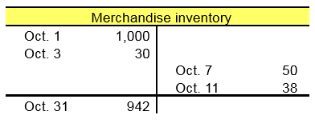
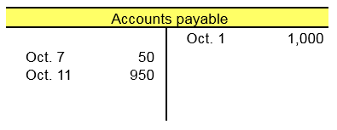
NEED-TO-KNOW 4-2 SOLUTION (2 of 6)
Learning Objective P1: Analyze and record transactions for merchandise purchases using a perpetual system.
Notes:
Need-to-Know 5.2

Slide 38
NEED-TO-KNOW 4-2 SOLUTION (3 of 6)
Learning Objective P1: Analyze and record transactions for merchandise purchases using a perpetual system.
Date | General Journal | Debit | Credit
Oct. 1 | Merchandise inventory | 1,000
 | Accounts payable |  | 1,000
Oct. 3 | Merchandise inventory | 30
 | Cash |  | 30
Oct. 7 | Accounts payable | 50
 | Merchandise inventory |  | 50
Oct. 11 | Accounts payable ($1,000 - $50) | 950
 | Merchandise inventory ($950 x .04) |  | 38
 | Cash |  | 912

Slide 39
NEED-TO-KNOW 4-2 SOLUTION (4 of 6)
Learning Objective P1: Analyze and record transactions for merchandise purchases using a perpetual system.
Oct. 1 Purchased $1,000 of goods. Terms of the sale are 4/10, n/30, and FOB shipping point; the invoice is dated October 1.
Oct. 3 Paid $30 cash for freight charges from UPS for the October 1 purchase.
Oct. 7 Returned $50 of the $1,000 of goods from the October 1 purchase and received full credit
Oct. 31 Assume the October 11 payment was never made and, instead, payment of the amount due on the October 1 purchase, less the return on October 7, occurred on October 31.
Notes:
Oct. 31 - Assume the October 11 payment was never made and, instead, payment of the amount due on the October 1 purchase, less the return on October 7, occurred on October 31. Because we did not pay within the 10-day discount period, no discount is allowed. The journal entry on October 31 is a debit to Accounts payable, $950, and a credit to Cash. The balance in Merchandise inventory at the end of the month is $980.

Slide 40
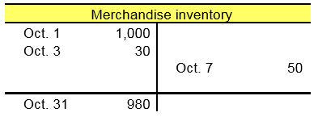
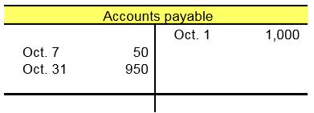
NEED-TO-KNOW 4-2 SOLUTION (5 of 6)
Learning Objective P1: Analyze and record transactions for merchandise purchases using a perpetual system.

Slide 41
NEED-TO-KNOW 4-2 SOLUTION (6 of 6)
Learning Objective P1: Analyze and record transactions for merchandise purchases using a perpetual system.
Date | General Journal | Debit | Credit
Oct. 1 | Merchandise inventory | 1,000
 | Accounts payable |  | 1,000
Oct. 3 | Merchandise inventory | 30
 | Cash |  | 30
Oct. 7 | Accounts payable | 50
 | Merchandise inventory |  | 50
Oct. 31 | Accounts payable | 950
 | Cash |  | 950

Slide 42
Learning Objective P2: Analyze and record transactions for merchandise sales using a perpetual system.

Slide 43
Exhibit 4.9 Accounting for Merchandise Sales
Learning Objective P2: Analyze and record transactions for merchandise sales using a perpetual system.
Notes:
Merchandising companies also must account for sales, sales discounts, sales returns and allowances, and cost of goods sold. A merchandising company such as Z-Mart reflects these items in its gross profit computation.
This shows that customers paid $314,700 for merchandise that cost Z-Mart $230,400, yielding a markup (gross profit) of $84,300.

Slide 44
Sales of Merchandise
Learning Objective P2: Analyze and record transactions for merchandise sales using a perpetual system.
Each sales transaction for a seller of merchandise involves two parts:
Revenue received in the form of an asset from a customer.
Recognition of the cost of merchandise sold to a customer.
Notes:
Each sales transaction for a seller of merchandise involves two parts:
Revenue received in the form of an asset from a customer; and
Recognition of the cost of merchandise sold to a customer.
Accounting for a sales transaction under the perpetual system requires recording information about both parts. This means that each sales transaction for merchandisers, whether for cash or on credit, requires two entries: one for revenue and one for cost.

Slide 45
Sales without Cash Discounts (1 of 2)
Learning Objective P2: Analyze and record transactions for merchandise sales using a perpetual system.
Z-Mart sold $1,000 of merchandise on credit. The merchandise has a cost basis to Z-Mart of $300.
Revenue side journal entry:
Notes:
To illustrate, Z-Mart sold $1,000 of merchandise on credit terms n∕60 on November 12. The revenue part of this transaction is recorded as a debit to Accounts Receivable and a credit to Sales.
The cost side of each sale requires that Merchandise Inventory decrease by that item’s actual cost. For example, the cost of the merchandise Z-Mart sold on November 12 is $300, and the entry to record the cost part of this sales transaction includes a debit to Cost of Goods Sold and a credit to Merchandise Inventory.

Slide 46
Sales without Cash Discounts (2 of 2)
Learning Objective P2: Analyze and record transactions for merchandise sales using a perpetual system.
Cost side journal entry:

Slide 47
Sales Discounts
Learning Objective P2: Analyze and record transactions for merchandise sales using a perpetual system.
Sales discounts on credit sales can benefit a seller by decreasing the delay in receiving cash and reducing future collection efforts.
Notes:
Sales discounts on credit sales can benefit a seller through earlier cash receipts and reduced collection efforts. Many sales discounts are favorable to the buyer, and many buyers will take advantage of them. New revenue recognition rules require that sellers report sales net of expected sales discounts. These rules apply to annual periods of public entities beginning after December 15, 2017 (earlier use is permitted for periods beginning after December 15, 2016).

Slide 48
Sales with Cash Discounts (1 of 2)
Learning Objective P2: Analyze and record transactions for merchandise sales using a perpetual system.
Z-Mart completes a $1,000 credit sale with terms of 2/10, n/45.
Buyer pays within discount period:
Notes:
Z-Mart completes a credit sale for $1,000 on November 12 with terms of 2/10, n/45. The entry to record the revenue part of this sale is to debit Accounts Receivable and credit Cash for $1,000. This entry records the receivable and the revenue as if the customer will pay the full amount.
The customer has two options, however. One option is to pay $980 within a 10-day period ending November 22. If the customer pays on (or before) November 22, Z-Mart records the payment as a debit to Cash for $980, debit Sales Discount for $20 (2% x $1,000), and credit Accounts Receivable for the full $1,000.
The second option is to wait 45 days until January 11 and pay the full $1,000. In this case, Z-Mart records that payment as a debit to cash and a credit to accounts receivable for $1,000.
Sales Discounts is a contra revenue account, meaning the Sales Discounts account is deducted from the Sales account when computing a company’s net sales. Management monitors Sales Discounts to assess the effectiveness and cost of its discount policy.

Slide 49
Sales with Cash Discounts (2 of 2)
Learning Objective P2: Analyze and record transactions for merchandise sales using a perpetual system.
Buyer pays after discount period:

Slide 50
Sales Returns and Allowances
Learning Objective P2: Analyze and record transactions for merchandise sales using a perpetual system.
Sales returns and allowances usually involve dissatisfied customers and the possibility of lost future sales.
Sales returns refer to merchandise that customers return to the seller after a sale.
Sales allowances refer to reductions in the selling price of merchandise sold to customers.
Notes:
Sales returns refer to merchandise that customers return to the seller after a sale. Many companies allow customers to return merchandise for a full refund, sales return, or keep the merchandise along with a partial refund, sales allowance. Most sellers can reliably estimate returns and allowances (abbreviated R&A).

Slide 51
Sales with Returns and Allowances (1 of 2)
Learning Objective P2: Analyze and record transactions for merchandise sales using a perpetual system.
Customer returns merchandise which sold for $15 and cost $9.
Returned Goods - Not Defective:
Notes:
Recall Z-Mart’s sale of merchandise on November 12 for $1,000 that had cost $300. Assume that the customer returns part of the merchandise on November 26, and the returned items sell for $150 and cost $9. The revenue part of this transaction must reflect the decrease in sales from the customer’s return of merchandise by a debit to Sales Returns and Allowances and a credit to Accounts Receivable for $15.
If the merchandise returned to Z-Mart is not defective and can be resold to another customer, Z-Mart returns these goods to its inventory. The entry to restore the cost of such goods to the Merchandise Inventory account is a debit to Merchandise Inventory and a credit to Cost of Goods Sold for $9.
This entry changes if the goods returned are defective. In this case, the returned inventory is recorded at its estimated value, not its cost. To illustrate, if the goods (costing $9) returned to Z-Mart are defective and estimated to be worth $2, the following entry is made: debit Merchandise Inventory for $2, debit Loss from Defective Merchandise for $7, and credit Cost of Goods Sold for $9.

Slide 52
Sales with Returns and Allowances (2 of 2)
Learning Objective P2: Analyze and record transactions for merchandise sales using a perpetual system.
Returned Goods - Are Defective:

Slide 53
Sales Allowances
Learning Objective P2: Analyze and record transactions for merchandise sales using a perpetual system.
Assume that $40 of the merchandise Z-Mart sold on November 12 is defective but the buyer decides to keep it because Z-Mart offers a $10 price reduction.
Notes:
To illustrate sales allowances, assume that $40 of the merchandise Z-Mart sold on November 12 is defective but the buyer decides to keep it because Z-Mart offers a $10 price reduction. Z-Mart records this allowance with a debit to Sales Returns and Allowances and credit to Cash for $10. Note: if the seller had not yet collected cash for the goods sold, the seller could credit the buyer’s Account Receivable.
Sales Returns and Allowances is a contra revenue account, meaning it is deducted from sales when computing net sales. The seller usually prepares a credit memorandum to confirm a buyer’s return or allowance. A seller’s credit memorandum informs a buyer a credit made to the buyer’s accounts receivable account in the seller’s records. In summary, net sales equals sales minus sales discounts and minus sales returns and allowances. This means net sales is the amount customers paid for goods kept.
Review what you have learned in the following NEED-TO-KNOW Slides.

Slide 54
NEED-TO-KNOW 4-3 (1 of 2)
Learning Objective P2: Analyze and record transactions for merchandise sales using a perpetual system.
Prepare journal entries to record each of the following sales transactions of a merchandising company. Assume a perpetual inventory system.
Jun. 1 Sold 50 units of merchandise to a customer for $150 per unit under credit terms of 2/10, n/30, FOB shipping point, and the invoice is dated June 1. The 50 units of merchandise had cost $100 per unit.
Jun. 7 The customer returns 2 units because those units did not fit the customer’s needs. The seller restores those units to its inventory and sends the buyer a $300 credit memo.
Notes:
Prepare journal entries to record each of the following sales transactions of a merchandising company. Assume a perpetual inventory system.

Slide 55
NEED-TO-KNOW 4-3 (2 of 2)
Learning Objective P2: Analyze and record transactions for merchandise sales using a perpetual system.
Jun. 11 The seller receives the balance due from the June 1 sale to the customer less returns and allowances.
Jun. 14 The customer discovers that 10 units have minor damage but keeps them because the seller sends a $50 cash payment allowance to compensate.

Slide 56
NEED-TO-KNOW 4-3 SOLUTION (1 of 5)
Learning Objective P2: Analyze and record transactions for merchandise sales using a perpetual system.
Jun. 1 Sold 50 units of merchandise to a customer for $150 per unit under credit terms of 2/10, n/30, FOB shipping point, and the invoice is dated June 1. The 50 units of merchandise had cost $100 per unit.
Jun. 7 The customer returns 2 units because those units did not fit the customer’s needs. The seller restores those units to its inventory and sends the buyer a $300 credit memo.
Notes:
Under a perpetual inventory system, the balance in merchandise inventory should always reflect the cost of the inventory on hand.
Jun. 1 - Sold 50 units of merchandise to a customer for $150 per unit under credit terms of 2/10, n/30, FOB shipping point, and the invoice is dated June 1. The merchandise had cost $100 per unit. On June 1, we record the sale by debiting Accounts receivable and crediting Sales; 50 units are sold at $150 per unit, a total of $7,500. Because we're using a perpetual inventory system, cost of goods sold is recorded at the time of the sale, debiting Cost of goods sold and crediting Merchandise inventory for the 50 units at their cost of $100 per unit, $5,000.
Jun. 7 - The customer returns 2 units because those units did not fit the customer’s needs. The seller restores those units to its inventory. On June 7, we reverse the impact of the journal entries on June 1. We debit the contra revenue account, Sales returns and allowances, and credit Accounts receivable, for the 2 units at $150 per unit, $300. And we reverse the impact of cost of goods sold, debiting Merchandise inventory and crediting Cost of goods sold, 2 units at $100 per unit, $200.

Slide 57
NEED-TO-KNOW 4-3 SOLUTION (2 of 5)
Learning Objective P2: Analyze and record transactions for merchandise sales using a perpetual system.
Date | General Journal | Debit | Credit
Jun. 1 | Accounts receivable | 7,500
 | Sales (50 @ $150) |  | 7,500
Jun. 1 | Cost of goods sold (50 @ $100) | 5,000
 | Merchandise inventory |  | 5,000
Jun. 7 | Sales returns and allowances (2 @ $150) | 300
 | Accounts receivable |  | 300
Jun. 7 | Merchandise inventory (2 @ $100) | 200
 | Cost of goods sold |  | 200

Slide 58
NEED-TO-KNOW 4-3 SOLUTION (3 of 5)
Learning Objective P2: Analyze and record transactions for merchandise sales using a perpetual system.
Jun. 11 The seller receives the balance due from the June 1 sale to the customer less returns and allowances.
Jun. 14 The customer discovers that 10 units have minor damage but keeps them because the seller sends a $50 cash payment allowance to compensate.
Notes:
June 7 - The customer returns 2 units purchased on June 1. We debit the Sales returns and allowances account for $300, which is 2 times $150. Accounts receivable is credited to reduce this account. Notice that when we reverse the impact of the sales, we don't debit Sales directly. Instead, we use the contra revenue account, Sales returns and allowances. Because the units are not returned to the seller, there is no adjustment to cost of goods sold. Also, the seller restores these units to inventory with a debit to Merchandise inventory and a credit to Cost of goods sold.
June 11 – The seller receives the balance due from the June 1 sale less returns and allowances. Accounts receivable was debited for $7,500 on June 1 and credited for $300 on June 7 for the return, therefore, the balance owed is $7,200. The discount is computed as $7,200 x .02 which equals $144, so the cash received is $7,200 minus $144, or $7,056.
June 14 – The customer discovered that 10 units have minor damage but decides to keep them because the seller sends a $50 cash payment to compensate. This will result in a debit to the Sales returns and allowances account and a credit to cash for $50.

Slide 59
NEED-TO-KNOW 4-3 SOLUTION (4 of 5)
Learning Objective P2: Analyze and record transactions for merchandise sales using a perpetual system.
Date | General Journal | Debit | Credit
Jun. 01 | Accounts receivable | 7,500
 | Sales (50 @ $150) |  | 7,500
Jun. 01 | Cost of goods sold (50 @ $100) | 5,000
 | Merchandise inventory |  | 5,000
Jun. 07 | Sales returns and allowances (2 @ $150) | 300
 | Accounts receivable |  | 300
Jun. 07 | Merchandise inventory (2 @ $100) | 200
 | Cost of goods sold |  | 200
Jun. 11 | Cash | 7,056
 | Sales Discounts ($7,200 x .02) | 144
 | Accounts receivable ($7,500 - $300) |  | 7,200
Jun. 14 | Sales returns and allowances | 50
 | Cash |  | 50

Slide 60
NEED-TO-KNOW 4-3 SOLUTION (5 of 5)
Learning Objective P2: Analyze and record transactions for merchandise sales using a perpetual system.
Sales | $ 7,500
Sales returns and allowance | $ 350
Sales discounts | 144 (494)
Net sales | 7,006
Cost of goods sold | 4,800
Gross margin on sales | $ 2,206
Notes:
The income statement impact of these transactions is as follows: Sales, the original sale of $7,500; less Sales returns and allowances, a total of $350 ($300 from June 7 and $50 from June 14). Sales discounts were $144. Net sales are $7,006, from which we subtract cost of goods sold; $4,800 ($5,000 – the return of $200). Gross profit on sales is $2,206.

Slide 61
Learning Objective P3: Prepare adjustments and close accounts for a merchandising company.

Slide 62
Exhibit 4.10 Merchandising Cost Flow in the Accounting Cycle
Learning Objective P3: Prepare adjustments and close accounts for a merchandising company.
Notes:
This slide shows the flow of merchandising costs during a period and where these costs are reported at period-end. Specifically, beginning inventory plus the net cost of purchases is the merchandise available for sale. As inventory is sold, its cost is recorded in cost of goods sold on the income statement; what remains is ending inventory on the balance sheet. A period’s ending inventory is the next period’s beginning inventory.

Slide 63
Adjusting Entries for Merchandisers (1 of 2)
Learning Objective P3: Prepare adjustments and close accounts for a merchandising company.
Shrinkage: adjustment to reflect loss of merchandise:
Notes:
Adjusting entries are generally the same for merchandising companies and service companies, including those for prepaid expenses (including depreciation), accrued expenses, unearned revenues, and accrued revenues. However, a merchandiser using a perpetual inventory system is usually required to make another adjustment to update the Merchandise Inventory account to reflect any loss of merchandise, including theft and deterioration. Shrinkage is the loss of inventory, and it is computed by comparing a physical count of inventory with recorded amounts. A physical count is usually performed at least once annually.
To illustrate, Z-Mart’s Merchandise Inventory account at the end of year 2017 has a balance of $21,250, but a physical count reveals that only $21,000 of inventory exists. The adjusting entry to record this $250 shrinkage is a debit to Cost of Goods Sold and a credit to Merchandise Inventory for $250.
Sales are to be reported at the net amount expected, which follows new revenue recognition rules. This means that period-end adjusting entries are commonly made for:
Expected sales discounts.
Expected returns and allowances (revenue side).
Expected returns and allowances (cost side).
These three adjustments produce three new accounts: Allowance for Sales Discounts, Sales Refund Payable, and Inventory Returns Estimated. Appendix 5C explains these accounts and the adjusting entries.

Slide 64
Adjusting Entries for Merchandisers (2 of 2)
Learning Objective P3: Prepare adjustments and close accounts for a merchandising company.
Sales Discounts, Returns and Allowances:
New revenue recognition rules require reporting of sales at net amount expected. Adjusting entries required for:
Expected sales discounts
Expected returns and allowances (revenue side)
Expected returns and allowances (cost side)

Slide 65
Exhibit 4.11 Closing Entries for Merchandisers (1 of 4)
Learning Objective P3: Prepare adjustments and close accounts for a merchandising company.
Step 1: Close Credit Balances in Temporary Accounts to Income Summary.
Notes:
Closing entries are similar for service companies and merchandising companies using a perpetual system. The difference is that we must close some new temporary accounts that arise from merchandising activities.
Closing entries are similar for service companies and merchandising companies using a perpetual system. The difference is that we must close some new temporary accounts that arise from merchandising activities. Z-Mart has several temporary accounts unique to merchandisers: Sales (of goods), Sales Discounts, Sales Returns and Allowances, and Cost of Goods Sold. Their existence in the ledger means that the first two closing entries for a merchandiser are slightly different from the ones described in the prior chapter for a service company. These differences are set in red boldface in the closing entries on this slide.
Review what you have learned in the following NEED-TO-KNOW Slides.

Slide 66
Exhibit 4.11 Closing Entries for Merchandisers (2 of 4)
Learning Objective P3: Prepare adjustments and close accounts for a merchandising company.
Step 2: Close Debit Balances in Temporary Accounts to Income Summary.

Slide 67
Exhibit 4.11 Closing Entries for Merchandisers (3 of 4)
Learning Objective P3: Prepare adjustments and close accounts for a merchandising company.
Step 3: Close Income Summary to Retained Earnings.
The third closing entry is identical for a merchandising company and a service company. The $12,900 amount is net income reported on the income statement.

Slide 68
Exhibit 4.11 Closing Entries for Merchandisers (4 of 4)
Learning Objective P3: Prepare adjustments and close accounts for a merchandising company.
Step 4: Close Dividends Account to Retained Earnings.
The fourth closing entry is identical for a merchandising company and a service company. It closes the Dividends account and adjusts the Retained Earnings account to the amount shown on the balance sheet.

Slide 69
NEED-TO-KNOW 4-4 (1 of 3)
Learning Objective P3: Prepare adjustments and close accounts for a merchandising company.
A merchandising company’s ledger on May 31, its fiscal year-end, includes the following selected accounts that have normal balances (it uses the perpetual inventory system). A physical count of its May 31 year-end inventory reveals that the cost of the merchandise inventory still available is $656. (a) Prepare the entry to record any inventory shrinkage. (b) Prepare the four closing entries as of May 31.
Notes:
Need-to-Know 4.4

Slide 70
NEED-TO-KNOW 4-4 (2 of 3)
Learning Objective P3: Prepare adjustments and close accounts for a merchandising company.
Merchandise inventory | $756
Common stock | 1,000
Retained earnings | 1,300
Dividends | 150
Sales | 4,300
Sales discounts | 50
Other operating expenses | $300
Cost of goods sold | 2,100
Depreciation expense | 400
Salaries expense | 600
Sales returns and allowances | 250

Slide 71
NEED-TO-KNOW 4-4 (3 of 3)
Learning Objective P3: Prepare adjustments and close accounts for a merchandising company.
 | Debit | Credit
Merchandise inventory | $756
Common stock |  | $1,000
Retained earnings |  | 1,300
Dividends | 150
Sales |  | 4,300
Sales discounts | 50
Sales returns and allowances | 250
Cost of goods sold | 2,100
Depreciation expense | 400
Salaries expense | 600
Other operating expenses | 300

Slide 72
NEED-TO-KNOW 4-4 SOLUTION (1 of 3)
Learning Objective P3: Prepare adjustments and close accounts for a merchandising company.
A merchandising company’s ledger on May 31, its fiscal year-end, includes the following accounts that have normal balances (it uses the perpetual inventory system). A physical count of its May 31 year-end inventory reveals that the cost of the merchandise inventory still available is $656. (a) Prepare the entry to record any inventory shrinkage. (b) Prepare the four closing entries as of May 31.
Notes:
Merchandise inventory is an asset; it has a normal debit balance. The common stock and retained earnings accounts increase equity, and has a normal credit balance. Dividends reduces equity, and therefore have a normal debit balance. Sales is a temporary revenue account; it increases equity and therefore has a normal credit balance. Sales discounts and Sales returns and allowances are contra revenue accounts. They reduce both net sales and net income, and therefore have normal debit balances. Cost of goods sold, Depreciation expense, Salaries expense, and Other operating expenses are all expense accounts; they decrease equity and have normal debit balances. The company is using a perpetual inventory system. The balance in Merchandise inventory should always represent the cost of the inventory on hand, but certain items, like theft and breakage result in the inventory balance being overstated, as it is here. Once a year, the company will still take a physical inventory, to verify the balance in the asset account, Merchandise inventory. The balance in the ledger account is $756. The inventory on hand is only $656. The journal entry to record the inventory shrinkage credits Merchandise inventory and debits Cost of goods sold for the amount of the overstatement, $100. The balance in Merchandise inventory is now $656, and Cost of goods sold is $2,200.

Slide 73
NEED-TO-KNOW 4-4 SOLUTION (2 of 3)
Learning Objective P3: Prepare adjustments and close accounts for a merchandising company.
 | Debit | Credit
Merchandise inventory | $656
Common stock |  | $1,000
Retained earnings |  | 1,300
Dividends | 150
Sales |  | 4,300
Sales discounts | 50
Sales returns and allowances | 250
Cost of goods sold | 2,200
Depreciation expense | 400
Salaries expense | 600
Other operating expenses | 300

Slide 74
NEED-TO-KNOW 4-4 SOLUTION (3 of 3)
Learning Objective P3: Prepare adjustments and close accounts for a merchandising company.
Date | General Journal | Debit | Credit
May 31 | Cost of goods sold | 100
 | Merchandise inventory ($756-$656) |  | 100

Slide 75
NEED-TO-KNOW 4-4 SOLUTION (1 of 2)
Learning Objective P3: Prepare adjustments and close accounts for a merchandising company.
Prepare the four closing entries as of May 31.
 | Debit | Credit
Merchandise inventory ($756 – $100) | $656
Common stock |  | $1,000
Retained earnings |  | 1,300
Dividends | 150
Sales |  | 4,300
Sales discounts | 50
Sales returns and allowances | 250
Cost of goods sold ($2,100 + $100) | 2,200
Depreciation expense | 400
Salaries expense | 600
Other operating expenses | 300
Notes:
Prepare journal entries to close the balances in temporary revenue and expense accounts. All income statement accounts are closed to Income summary. Sales has a credit balance of $4,300. To close Sales, we debit Sales and credit Income summary. Next we close the income statement accounts with debit balances, crediting the contra revenue accounts, Sales discounts and Sales returns and allowances, and crediting each of the expense accounts, Cost of goods sold, depreciation, salaries and other operating expenses. We debit Income summary for the total, $3,800. Next, we close Income summary for it’s balance of $4,300 minus $3,800, or $500. Income summary is closed to Retained earnings. Finally, the Dividends account is closed to Retained earnings by debiting Retained earnings and crediting the Dividends account for $150.

Slide 76
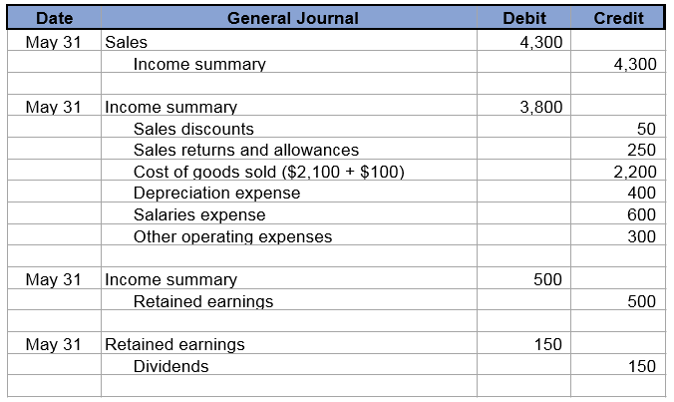
NEED-TO-KNOW 4-4 SOLUTION (2 of 2)
Learning Objective P3: Prepare adjustments and close accounts for a merchandising company.

Slide 77
Learning Objective P4: Define and prepare multiple-step and single-step income statements.

Slide 78
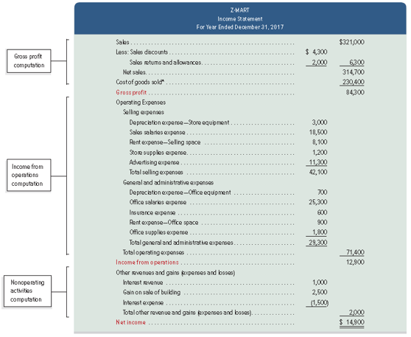
Exhibit 4.13 Multiple-Step Income Statement
Learning Objective P4: Define and prepare multiple-step and single-step income statements.
Notes:
Companies are not required to use any one presentation format for financial statements.
A multiple-step income statement shows detailed computations of net sales and other costs and expenses, and reports subtotals for various classes of items. Exhibit 4.13 shows a multiple-step income statement for Z-Mart. The statement has three main parts: (1) gross profit, determined by net sales less cost of goods sold, (2) income from operations, determined by gross profit less operating expenses, and (3) net income, determined by income from operations adjusted for nonoperating items.
Operating expenses are classified into two sections. Selling expenses include the expenses of advertising merchandise, making sales, and delivering goods to customers. General and administrative expenses support a company’s overall operations and include expenses related to accounting, human resource management, and financial management. Expenses are allocated between sections when they contribute to more than one. Z-Mart allocates rent expense of $9,000 from its store building between two sections: $8,100 to selling expense and $900 to general and administrative expense.
Nonoperating activities consist of other expenses, revenues, losses, and gains that are unrelated to a company’s operations. Other revenues and gains commonly include interest revenue, dividend revenue, rent revenue, and gains from asset disposals. Other expenses and losses commonly include interest expense, losses from asset disposals, and casualty losses. When a company has no reportable nonoperating activities, its income from operations is simply labeled net income.

Slide 79
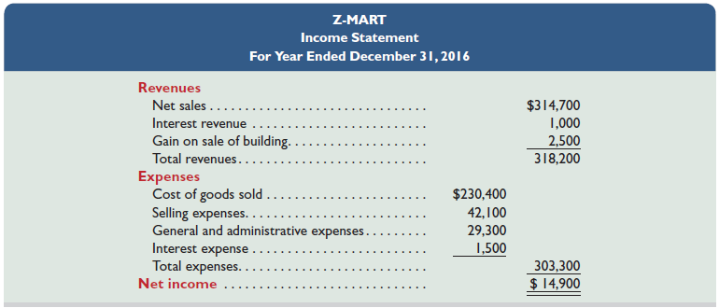
Exhibit 4.14 Single-Step Income Statement
Learning Objective P4: Define and prepare multiple-step and single-step income statements.
Notes:
A single-step income statement is shown in Exhibit 4.14 for Z-Mart. It lists cost of goods sold as another expense and shows only one subtotal for total expenses. Expenses are grouped into very few, if any, categories. Many companies use formats that combine features of both the single- and multiple-step statements. Provided that income statement items are shown sensibly, management can choose the format.
As you can see, net income is the same whether the multi-step or the single-step is used. The only difference is in the amount of detail that is provided on the income statement.

Slide 80
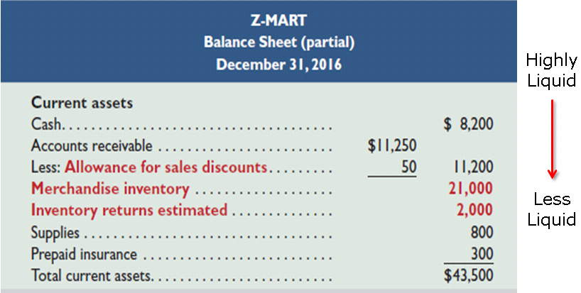
Exhibit 4.15 Classified Balance Sheet
Learning Objective P4: Define and prepare multiple-step and single-step income statements.
Notes:
The classified balance sheet reports merchandise inventory as a current asset, usually after accounts receivable according to an asset’s nearness to liquidity. Inventory is usually less liquid than accounts receivable because inventory must first be sold before cash can be received; but it is more liquid than supplies and prepaid expenses.
This slide shows the current asset section of Z-Mart’s classified balance sheet (other sections are as shown and explained in our previous chapter).
Review what you have learned in the following NEED-TO-KNOW Slides.

Slide 81
NEED-TO-KNOW 4-5 (1 of 2)
Learning Objective P4: Define and prepare multiple-step and single-step income statements.
Assume Taret’s adjusted trial balance on April 30, 2016, its fiscal year-end, follows. (a) Prepare a multiple-step income statement that begins with gross sales, and includes separate categories for: net sales, cost of goods sold, selling expenses and general and administrative expenses. (b) Prepare a single-step income statement that begins with net sales and includes these expense categories: cost of goods sold, selling expenses, and general and administrative expenses.
Notes:
Assume Target’s adjusted trial balance on April 30, 2017, its fiscal year-end, follows. (a) Prepare a multiple-step income statement that includes separate categories for selling expenses and for general and administrative expenses. (b) Prepare a single-step income statement that includes these expense categories: cost of goods sold, selling expenses, and general and administrative expenses.

Slide 82
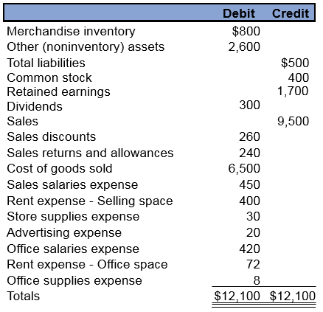
NEED-TO-KNOW 4-5 (2 of 2)
Learning Objective P4: Define and prepare multiple-step and single-step income statements.

Slide 83
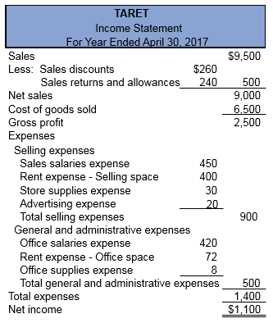
NEED-TO-KNOW 4-5 SOLUTION (1 of 2)
Learning Objective P4: Define and prepare multiple-step and single-step income statements.
Notes:
A multiple-step income statement begins with the calculation of net sales. Sales, $9,500; less Sales discounts, $260; and Sales returns and allowances, $240; equals Net sales of $9,000. From net sales we subtract the first and largest expense of the company, Cost of goods sold, $6,500. Net sales minus cost of goods sold equals gross profit, $2,500. From gross profit we subtract the remaining expenses. The expenses are segregated into selling expenses and general and administrative expenses. An easy way to identify the selling expenses is that these are items that are visible by the customer. The customer will see the salespeople, so therefore we include the sales salaries expense. They'll also see the store; we include Rent expense - Selling space, Store supplies expense and Advertising expense. Total selling expenses are $900. General and administrative expenses are outside of the customer's view. These include Office salaries expense, Rent expense - Office space and Office supplies expense. Total general and administrative expenses are $500. Total expenses, the selling and general and administrative expenses, are $1,400. Net income equals gross profit minus total expenses, $1,100.

Slide 84
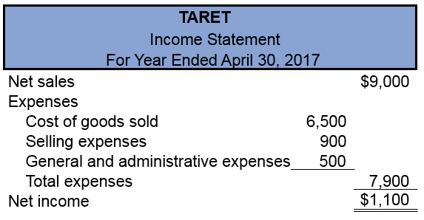
NEED-TO-KNOW 4-5 SOLUTION (2 of 2)
Learning Objective P4: Define and prepare multiple-step and single-step income statements.
Notes:
Now that we have the multiple-step income statement, it's easy to reformat into a single-step format. The single-step income statement simply lists revenues and subtracts the expenses. Revenues are the net sales, $9,000. Expenses include Cost of goods sold, Total selling expenses, and Total general and administrative expenses. Total expenses are $7,900. Net income is $1,100. Net income is identical, regardless of the format used.

Slide 85
Learning Objective A1: Compute the acid-test ratio and explain its use it to assess liquidity.

Slide 86
Acid-Test Ratio
Learning Objective A1: Compute the acid-test ratio and explain its use to assess liquidity.
A common rule of thumb is the acid-test ratio should have a value of at least 1.0 to conclude a company is unlikely to face liquidity problems in the near future.
Notes:
One measure of a merchandiser’s ability to pay its current liabilities (referred to as its liquidity) is the acid-test ratio. It differs from the current ratio by excluding less liquid current assets such as inventory and prepaid expenses that take longer to be converted to cash. The acid-test ratio, also called quick ratio, is defined as quick assets (cash, short-term investments, and current receivables) divided by current liabilities.

Slide 87
Exhibit 4.17 Acid-Test Ratio JCPenney
Learning Objective A1: Compute the acid-test ratio and explain its use to assess liquidity.
$millions | 2015 | 2014 | 2013 | 2012 | 2011 | 2010
Total quick assets…………………………… | $1,318 | $1,519 | $987 | $1,920 | $2,956 | $3,406
Total current assets……………………….. | $4,331 | $4,833 | $3,683 | $5,081 | $6,370 | $6,652
Total current liabilities……………………. | $2,241 | $2,846 | $2,568 | $2,756 | $2,647 | $3,249
Acid-test ratio……………………… | 0.59 | 0.53 | 0.38 | 0.70 | 1.12 | 1.05
Current ratio………………………… | 1.93 | 1.70 | 1.43 | 1.84 | 2.41 | 2.05
Industry acid-test ratio………………….. | 0.55 | 0.50 | 0.51 | 0.54 | 0.61 | 0.59
Industry current ratio……………………. | 2.03 | 1.99 | 1.94 | 2.01 | 2.27 | 2.15
Notes:
Analysis of JCPenney shows some need for concern regarding its liquidity as its acid-test ratio is less than 1.0. However, retailers such as JCPenney pay many current liabilities from inventory sales; moreover, in all years except 2013, JCPenney’s acid-test ratios exceed the industry norm (and its inventory is fairly liquid).

Slide 88
Learning Objective A2: Compute the gross margin ratio and explain its use to assess profitability.

Slide 89
Exhibit 4.19 Gross Margin Ratio
Learning Objective A2: Compute the gross margin ratio and explain its use to assess profitability.
Percentage of dollar sales available to cover expenses and provide a profit.
$millions | 2015 | 2014 | 2013 | 2012 | 2011 | 2010
Gross margin…………….……… | $4,261 | $3,492 | $4,066 | $6,218 | $6,960 | $6,910
Net sales……….......…………… | $12,257 | $11,859 | $12,985 | $17,260 | $17,759 | $17,556
Gross margin ratio……… | 34.8% | 29.4% | 31.3% | 36.0% | 39.2% | 39.4%
Notes:
The cost of goods sold makes up much of a merchandiser’s expenses. Without sufficient gross profit, a merchandiser will likely fail. Users often compute the gross margin ratio to help understand this relation. It differs from the profit margin ratio in that it excludes all costs except cost of goods sold. The gross margin ratio (also called gross profit ratio) is defined as gross margin (net sales minus cost of goods sold) divided by net sales.
Exhibit 4.19 shows the gross margin ratio of JCPenney for fiscal years 2010 through 2015. For JCPenney, each $1 of sales in 2015 yielded about 34.8¢ in gross margin to cover all other expenses and still produce a net income. This 34.8¢ margin is up from 29.4¢ in 2014. This increase is a favorable development. Success for merchandisers such as JCPenney depends on adequate gross margin. For example, the 5.4¢ increase in the gross margin ratio, computed as 34.8¢ − 29.4¢, means that JCPenney has $662 million more in gross margin! (This is computed as net sales of $12,257 million multiplied by the 5.4% increase in gross margin.)

Slide 90
Learning Objective P5: Appendix 4A Record and compare merchandising transactions using both periodic and perpetual inventory system.

Slide 91
Periodic Inventory System – Purchases (1 of 3)
Learning Objective P5: Record and compare merchandising transactions using both periodic and perpetual inventory system.
Periodic inventory system updates inventory only at the end of a period to reflect the quantity and cost of goods available and goods sold.
Notes:
A periodic inventory system requires updating the inventory account only at the end of a period to reflect the quantity and cost of both the goods available and the goods sold. Thus, during the period, the Merchandise Inventory balance remains unchanged. During the period the cost of merchandise is recorded in a temporary Purchases account. When a company sells merchandise, it records revenue but not the cost of the goods sold. At the end of the period when a company prepares financial statements, it takes a physical count of inventory by counting the quantities and costs of merchandise available. The cost of goods sold is then computed by subtracting the ending inventory amount from the cost of merchandise available for sale.
Under a periodic system, purchases, purchase returns and allowances, purchase discounts, and transportation-in transactions are recorded in separate temporary accounts. At period-end, each of these temporary accounts is closed and the Merchandise Inventory account is updated. During the period, the Merchandise Inventory balance remains unchanged.
To illustrate, journal entries under the periodic inventory system are shown for the most common transactions (codes a through d link these transactions to those in the chapter, and we drop explanations for simplicity). For comparison, perpetual system journal entries are shown to the right of each periodic entry.
The periodic system uses a temporary Purchases account that accumulates the cost of all purchase transactions during each period. Z-Mart’s November 2 entry to record the purchase of merchandise for $500 on credit with terms of 2/10, n/30 is illustrated in entry a.
The periodic system uses a temporary Purchase Discounts account that accumulates discounts taken on purchase transactions during the period.
If Z-Mart pays the supplier for the previous purchase in (a) within the discount period, the required payment is $490 ($500 x 98%) and is recorded as illustrated in entry b1.
If payment in (a) is delayed until after the discount period expires, the entry is to debit Accounts Payable and credit Cash for $50 each as shown in entry b2.
Z-Mart returned merchandise purchased on November 2 because of defects. In the periodic system, the temporary Purchase Returns and Allowances account accumulates the cost of all returns and allowances during a period. The recorded cost (including discounts) of the defective merchandise is $30, and Z-Mart records the return with entry c1.
Z-Mart returns $50 of merchandise within the discount period with the entry shown in c2.
Z-Mart paid a $75 freight charge to transport merchandise to its store. In the periodic system, this cost is charged to a temporary Transportation-In account as illustrated in entry d.

Slide 92
Periodic Inventory System – Purchases (2 of 3)
Learning Objective P5: Record and compare merchandising transactions using both periodic and perpetual inventory system.

Slide 93
Periodic Inventory System – Purchases (3 of 3)
Learning Objective P5: Record and compare merchandising transactions using both periodic and perpetual inventory system.

Slide 94
Periodic Inventory System – Sales (1 of 2)
Learning Objective P5: Record and compare merchandising transactions using both periodic and perpetual inventory system.
Periodic inventory system updates inventory only at the end of a period to reflect the quantity and cost of goods available and goods sold.
Notes:
Both the periodic and perpetual systems record sales entries similarly, using the gross method. The same holds for entries related to payment of receivables from sales both within and after the discount period. However, under the periodic system, the cost of goods sold is not recorded at the time of each sale (whereas it is under the perpetual system)—we show later in this appendix how to compute cost of goods sold at period-end under the periodic system. The entries to record $1,000 in credit sales (costing $300) is a debit to Accounts Receivable and a credit to Sales. Under the periodic system, the cost of goods sold is not recorded at the time of each sale.
A customer returned part of the merchandise, where the returned items sell for $15 and cost $9. Z-Mart restores the merchandise to inventory and records the November 6 return as illustrated in entry e1 and e2.
A customer received an allowance in transaction f of $10 cash; only the revenue side is impacted as no inventory was returned and cost stays the same. The entry is identical under the periodic and perpetual systems. The seller records this allowance as shown in entry f.

Slide 95
Periodic Inventory System – Sales (2 of 2)
Learning Objective P5: Record and compare merchandising transactions using both periodic and perpetual inventory system.
Notes:
Both the periodic and perpetual systems record sales entries similarly, using the gross method. The same holds for entries related to payment of receivables from sales both within and after the discount period. However, under the periodic system, the cost of goods sold is not recorded at the time of each sale (whereas it is under the perpetual system)—we show later in this appendix how to compute cost of goods sold at period-end under the periodic system. The entries to record $1,000 in credit sales (costing $300) is a debit to Accounts Receivable and a credit to Sales. Under the periodic system, the cost of goods sold is not recorded at the time of each sale.
A customer returned part of the merchandise, where the returned items sell for $15 and cost $9. Z-Mart restores the merchandise to inventory and records the November 6 return as illustrated in entry e1 and e2.
A customer received an allowance in transaction f of $10 cash; only the revenue side is impacted as no inventory was returned and cost stays the same. The entry is identical under the periodic and perpetual systems. The seller records this allowance as shown in entry f.

Slide 96
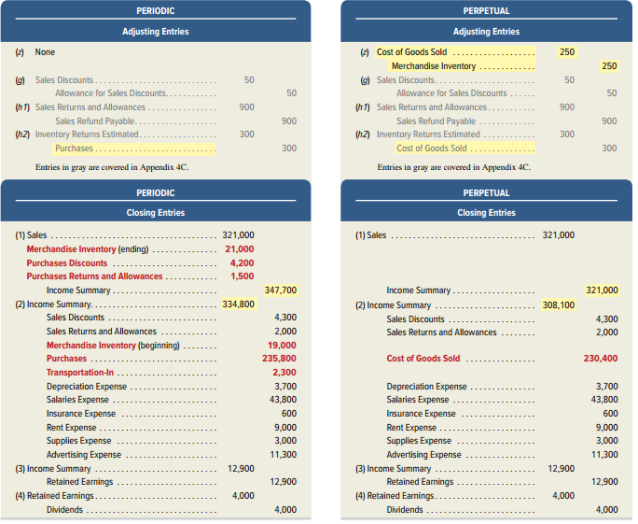
Exhibit 4A.1 Periodic Inventory – Adjusting & Closing Entries
Learning Objective P5: Record and compare merchandising transactions using both periodic and perpetual inventory system.
Notes:
The periodic and perpetual inventory systems have slight differences in closing entries. The period-end Merchandise Inventory balance (unadjusted) is $19,000 under the periodic system. Since the periodic system does not update the Merchandise Inventory balance during the period, the $19,000 amount is the beginning inventory. A physical count of inventory taken at the end of the period reveals $21,000 of merchandise available. The adjusting and closing entries for the two systems are shown in Exhibit 4A.1.
Recording the periodic inventory balance is a two-step process. The ending inventory balance of $21,000 (which includes shrinkage) is entered by debiting the inventory account in the first closing entry. The beginning inventory balance of $19,000 is deleted by crediting the inventory account in the second closing entry 2.

Slide 97
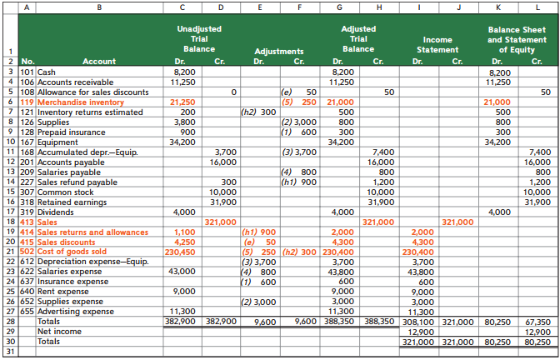
Exhibit 4B.1 Appendix 4B: Work Sheet—Perpetual System
Learning Objective P5: Record and compare merchandising transactions using both periodic and perpetual inventory system.
Notes:
This slide shows the work sheet for preparing financial statements of a merchandiser. It differs slightly from the work sheet layout in the prior chapter—the differences are in red boldface. The adjustments in the work sheet reflect the following: (1) expiration of $600 of prepaid insurance, (2) use of $3,000 of supplies, (3) depreciation of $3,700 for equipment, (4) accrual of $800 of unpaid salaries, and (5) inventory shrinkage of $250. Once the adjusted amounts are extended into the financial statement columns, the information is used to develop financial statements.

Slide 98
Learning Objective P6: Appendix 4C – Prepare adjustments for discounts, returns and allowances per revenue recognition rules.

Slide 99
Adjusting Entries under New Revenue Recognition Rules (1 of 7)
Learning Objective P6: Prepare adjustments for discounts, returns and allowances per revenue recognition rules.
Expected Sales Discounts
Adjusting entries required to estimate sales discounts for current-period’s sales expected to be taken in future periods.
Z-Mart has unadjusted Accounts Receivable of $11,250 and Allowance for Sales Discounts of $0.
$2,500 of receivables are within 2% discount period.
Expect buyers to take $50 in future period discounts ($2,500 x 2%).
Notes:
Sales are to be reported at the net amount expected which follows new revenue recognition rules. This means that a period-end adjusting entry is commonly made to estimate sales discounts for current-period’s sales that are expected to be taken in future periods.
To illustrate, assume Z-Mart has the following unadjusted balances: Accounts Receivable, $11,250; and Allowance for Sales Discounts, $0. Of the $11,250 of receivables, $2,500 of them are within the 2% discount period, and we expect buyers to take $50 in future-period discounts (computed as $2,500 × 2%) arising from this period’s sales. The adjusting entry for the $50 update to the allowance for sales discounts is shown in entry g.
Allowance for Sales Discounts is a contra asset account and is reported on the balance sheet as a reduction to the Accounts Receivable asset account. The Allowance for Sales Discounts account has a normal credit balance because it reduces Accounts Receivable, which has a normal debit balance.

Slide 100
Adjusting Entries under New Revenue Recognition Rules (2 of 7)
Learning Objective P6: Prepare adjustments for discounts, returns and allowances per revenue recognition rules.

Slide 101
Adjusting Entries under New Revenue Recognition Rules (3 of 7)
Learning Objective P6: Prepare adjustments for discounts, returns and allowances per revenue recognition rules.
Expected Sales Discounts:
Adjusting entries result in Accounts receivable and sales being reported at their net expected amounts:
Notes:
The adjusting entry for sales discounts results in both accounts receivable and sales being reported at their net expected
amounts.

Slide 102
Adjusting Entries under New Revenue Recognition Rules (4 of 7)
Learning Objective P6: Prepare adjustments for discounts, returns and allowances per revenue recognition rules.
Revenue side for Expected R&A:
Seller sets up a Sales Refund Payable, current liability reflecting amount expected to be refunded to customers.
Company estimates future sales refunds to be $1,200.
Unadjusted balance in Sales Refund Payable is $300 credit.
Adjusting entry for $900 update to Sales Refund Payable
Notes:
To avoid overstatement of sales and cost of sales, sellers estimate sales returns and allowances in the period of the sale. Estimating returns and allowances requires companies to maintain the following two balance sheet accounts that are set up with adjusting entries: inventory returns estimated, a current asset, and sales refund payable, a current liability.
The Sales Refund Payable account is updated only during the adjusting entry process. Its balance remains unchanged during the period when actual returns and allowances are recorded.

Slide 103
Adjusting Entries under New Revenue Recognition Rules (5 of 7)
Learning Objective P6: Prepare adjustments for discounts, returns and allowances per revenue recognition rules.

Slide 104
Adjusting Entries under New Revenue Recognition Rules (6 of 7)
Learning Objective P6: Prepare adjustments for discounts, returns and allowances per revenue recognition rules.
Cost side for Expected R&A:
Seller sets up an Inventory Returns Estimated account, current asset reflecting the inventory estimated to be returned.
Company estimates future inventory returns to be $500.
Unadjusted balance in Inventory Returns Estimated is $200 debit.
Adjusting entry for $300 update to Inventory Returns Est.
Notes:
On the cost side, the expected returns and allowances implies that some inventory is expected to be returned, which means that cost of goods sold recorded at the time of sale is overstated due to expected returns. A seller sets up an Inventory Returns Estimated account, which is a current asset reflecting the inventory estimated to be returned.
Extending the example above, assume that the company estimates future inventory returns to be $500 (which is the cost side of the $1,200 expected returns and allowances above). Assume also that the (beginning) unadjusted balance in Inventory Returns Estimated is a $200 debit. The adjusting entry for the $300 update to expected returns is shown in entry h2.
The Inventory Returns Estimated account is updated only during the adjusting entry process. Its balance remains unchanged during the period when actual returns and allowances are recorded.

Slide 105
Adjusting Entries under New Revenue Recognition Rules (7 of 7)
Learning Objective P6: Prepare adjustments for discounts, returns and allowances per revenue recognition rules.

Slide 106
NEED-TO-KNOW 4-8 (1 of 2)
Learning Objective P6: Prepare adjustments for discounts, returns and allowances per revenue recognition rules.
At the current year-end, a company shows the following unadjusted balances for selected accounts:
Allowance for Sales Discounts | $75 credit
Sales Refund Payable | 800 credit
Inventory Returns Estimated | 450 debit
Sales Discounts | $1,850 debit
Sales Returns and Allowances | 4,825 debit
Cost of Goods Sold | 9,875 debit
Notes:
Need-to-Know 4.8

Slide 107
NEED-TO-KNOW 4-8 (2 of 2)
Learning Objective P6: Prepare adjustments for discounts, returns and allowances per revenue recognition rules.
After an analysis of future sales discounts, the company estimates that the Allowance for Sales Discounts account should have a $275 credit balance. Prepare the current year-end adjusting journal entry for future sales discounts.
After an analysis of future sales returns and allowances, the company estimates that the Sales Refund Payable account should have a $870 credit balance (revenue side).
After an analysis of future inventory returns, the company estimates that the Inventory Returns Estimated account should have a $500 debit balance (cost side).

Slide 108
NEED-TO-KNOW 4-8 SOLUTION (1 of 7)
Learning Objective P6: Prepare adjustments for discounts, returns and allowances per revenue recognition rules.
At the current year-end, a company shows the following unadjusted balances for selected accounts:
Allowance for Sales Discounts | $75 credit
Sales Refund Payable | 800 credit
Inventory Returns Estimated | 450 debit
Sales Discounts | $1,850 debit
Sales Returns and Allowances | 4,825 debit
Cost of Goods Sold | 9,875 debit
Notes:
Need-to-Know 4.8

Slide 109
NEED-TO-KNOW 4-8 SOLUTION (2 of 7)
Learning Objective P6: Prepare adjustments for discounts, returns and allowances per revenue recognition rules.
After an analysis of future sales discounts, the company estimates that the Allowance for Sales Discounts account should have a $275 credit balance. Prepare the current year-end adjusting journal entry for future sales discounts.
Step 1: Determine what the current account balance equals. $75 credit
Step 2: Determine what the current account balance should equal. $275 credit
Notes:
Need-to-Know 4.8

Slide 110
NEED-TO-KNOW 4-8 SOLUTION (3 of 7)
Learning Objective P6: Prepare adjustments for discounts, returns and allowances per revenue recognition rules.
Step 3: Record an adjusting entry to get from step 1 to step 2.

Slide 111
NEED-TO-KNOW 4-8 SOLUTION (4 of 7)
Learning Objective P6: Prepare adjustments for discounts, returns and allowances per revenue recognition rules.
After an analysis of future sales returns and allowances, the company estimates that the Sales Refund Payable account should have a $870 credit balance (revenue side).
Step 1: Determine what the current account balance equals. $800 credit
Step 2: Determine what the current account balance should equal. $870 credit
Notes:
Need-to-Know 4.8

Slide 112
NEED-TO-KNOW 4-8 SOLUTION (5 of 7)
Learning Objective P6: Prepare adjustments for discounts, returns and allowances per revenue recognition rules.
Step 3: Record an adjusting entry to get from step 1 to step 2.

Slide 113
NEED-TO-KNOW 4-8 SOLUTION (6 of 7)
Learning Objective P6: Prepare adjustments for discounts, returns and allowances per revenue recognition rules.
After an analysis of future inventory returns, the company estimates that the Inventory Returns Estimated account should have a $500 debit balance (cost side).
Step 1: Determine what the current account balance equals. $450 debit
Step 2: Determine what the current account balance should equal. $500 debit
Notes:
Need-to-Know 4.8

Slide 114
NEED-TO-KNOW 4-8 SOLUTION (7 of 7)
Learning Objective P6: Prepare adjustments for discounts, returns and allowances per revenue recognition rules.
Step 3: Record an adjusting entry to get from step 1 to step 2.

Slide 115
Learning Objective P7: Appendix 4D – Record and compare merchandising transactions using the gross method and net method.

Slide 116
Perpetual System – Net versus Gross Method Purchases
Learning Objective P7: Record and compare merchandising transactions using the gross method and net method.
Net method records invoice at its amount net of any discounts.
Notes:
The net method is another means of recording invoices, which initially records the invoice at its net amount (net of any cash discount). This appendix records merchandising transactions using the net method, where key differences with the gross method are highlighted. When invoices are recorded at net amounts, any cash discounts are deducted from the balance of the Merchandise Inventory account when initially recorded. This assumes that all cash discounts will be taken. If any discounts are later lost, they are recorded in a Discounts Lost expense account reported on the income statement.
A company purchases merchandise on November 2 at a $500 invoice price ($490 net) with terms of 2∕10, n∕30. Its November 2 entries under the gross and net methods are shown in the first entries.
If the invoice is paid on (or before) November 12 within the discount period, it records as shown in the second entries.
If, instead, the invoice is not paid within the discount period, but is later paid on December 2 (the n∕30 due date), after the discount period, it records the third entries shown.

Slide 117
Perpetual System – Net versus Gross Method Sales (1 of 2)
Learning Objective P7: Record and compare merchandising transactions using the gross method and net method.
Net method records invoice at its amount net of any discounts.
Notes:
To illustrate, a company sells merchandise on November 2 at a $500 invoice price ($490 net) with terms of 2∕10, n∕30. The goods cost $200. Its November 2 entries under the gross and net methods are shown in the first two entries.
If cash is received on (or before) November 12 within the discount period, company will record the third entries shown.
If, instead, cash is not received within the discount period, but it is later received on December 2 (the n∕30 due date), after the discount period, it records the last entries shown.

Slide 118
Perpetual System – Net versus Gross Method Sales (2 of 2)
Learning Objective P7: Record and compare merchandising transactions using the gross method and net method.
Notes:
To illustrate, a company sells merchandise on November 2 at a $500 invoice price ($490 net) with terms of 2∕10, n∕30. The goods cost $200. Its November 2 entries under the gross and net methods are shown in the first two entries.
If cash is received on (or before) November 12 within the discount period, company will record the third entries shown.
If, instead, cash is not received within the discount period, but it is later received on December 2 (the n∕30 due date), after the discount period, it records the last entries shown.

Slide 119
Periodic System – Net versus Gross Method Purchases
Learning Objective P7: Record and compare merchandising transactions using the gross method and net method.
Net method records invoice at its amount net of any discounts.
Notes:
Under the periodic system, the balance of the Merchandise Inventory account remains
unchanged during the period and is updated at period-end as part of the adjusting process. During the
period, three accounts are used to record purchases of inventory: Purchases; Purchases Discounts; and
Purchases Returns and Allowances. It is helpful to see that the entries below are identical to the perpetual system except that Merchandise Inventory is substituted for each of the three purchases accounts.
To illustrate, we apply the periodic system to purchases transactions. On November 2, a buyer purchases goods ($500 gross; $490 net) with terms of 2∕10, n∕30. Its November 2 entries under the gross and net methods are shown in the first entries.
The second entries shown illustrate if the invoice is paid on (or before) November 12 within the discount period.
The third entries shown illustrate If the invoice is not paid within the discount period, but it is later paid on December 2 (the n∕30 due date), after the discount period.
SALES—Periodic For the above sales transactions, the perpetual and periodic entries are identical except that under the periodic system the cost-side entries are not made at the time of each sale nor for any subsequent returns. Instead, the cost of goods sold is computed at period-end based on a physical count of inventory. This entry is illustrated in Exhibit 5A.1.

Slide 120
End of Presentation

