Slide 1

Financial & Managerial Accounting
Information for Decisions
Seventh Edition
Chapter 7
Accounting for Receivables
© McGraw-Hill Education. All rights reserved. Authorized only for instructor use in the classroom. No reproduction or further distribution permitted without the prior written consent of McGraw-Hill Education.

Slide 2
Learning Objectives (1 of 2)
CONCEPTUAL
C1 Describe accounts receivable and how they occur and are recorded.
C2 Describe a note receivable, the computation of its maturity date, and the recording of its existence.
C3 Explain how receivables can be converted to cash before maturity.
ANALYTICAL
A1 Compute accounts receivable turnover and use it to help assess financial condition.

Slide 3
Learning Objectives (2 of 2)
PROCEDURAL
P1 Apply the direct write-off method to accounts receivable.
P2 Apply the allowance method to accounts receivable.
P3 Estimate uncollectibles based on sales and accounts receivable.
P4 Record the honoring and dishonoring of a note and adjustments for interest

Slide 4
Learning Objective C1: Describe accounts receivable and how they occur and are recorded.

Slide 5
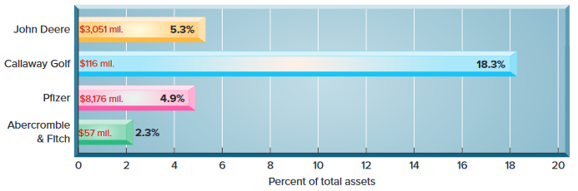
Exhibit 7.1 Valuing Accounts Receivable (1 of 2)
Learning Objective C1: Describe accounts receivable and how they occur and are recorded.
This graph shows recent dollar amounts of receivables and their percent of total assets for four well-known companies.
Notes:
A receivable is an amount due from another party. The two most common receivables are accounts receivable and notes receivable. Other receivables include interest receivable, rent receivable, tax refund receivable, and receivables from employees. Accounts receivable are amounts due from customers for credit sales. This section begins by describing how accounts receivable occur. It includes receivables that occur when customers use credit cards and when a company gives credit directly to customers.
The graph on this slide shows recent dollar amounts of receivables and their percent of total assets for four well-known companies.
Credit sales are recorded by increasing (debiting) Accounts Receivable. A company must maintains a separate account for each customer that tracks how much that customer purchases, has already paid, and still owes.
The general ledger continues to have a single Accounts Receivable account (called a control account). A supplementary record maintains a separate account for each customer called the accounts receivable ledger (or accounts receivable subsidiary ledger).

Slide 6
Exhibit 7.1 Valuing Accounts Receivable (2 of 2)
Learning Objective C1: Describe accounts receivable and how they occur and are recorded.
A company must also maintain a separate account for each customer that tracks how much that customer purchases, has already paid, and still owes.

Slide 7
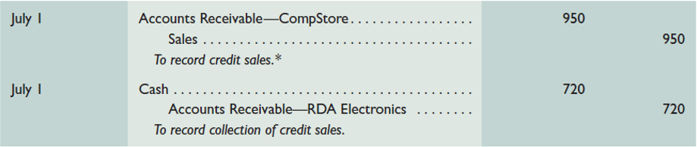
Sales on Credit (1 of 2)
Learning Objective C1: Describe accounts receivable and how they occur and are recorded.
On July 1, TechCom had a credit sale of $950 to CompStore and a collection of $720 from RDA Electronics from a prior credit sale.
We omit the entry to Dr. Cost of Sales and Cr. Merchandise Inventory to focus on sales and receivables.
Notes:
To see how accounts receivable from credit sales are recognized in the accounting records, we look at two transactions on July 1 between TechCom and its credit customer.
The first is a credit sale of $950 to CompStore.
The second transaction is a collection of $720 from RDA Electronics from a prior credit sale.

Slide 8
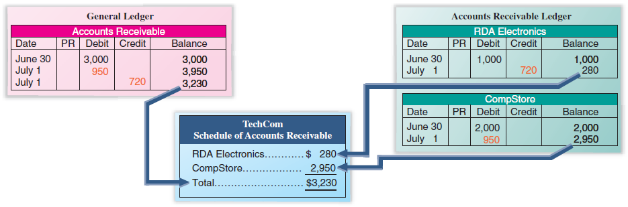
Sales on Credit (2 of 2)
Learning Objective C1: Describe accounts receivable and how they occur and are recorded.
Exhibit 7.4
Notes:
This slide shows the general ledger and the accounts receivable ledger after recording the two July 1 transactions. The general ledger shows the effects of the sale, the collection, and the resulting balance of $3,230. These events are also reflected in the individual customer accounts: RDA Electronics has an ending balance of $280, and CompStore’s ending balance is $2,950. The $3,230 sum of the individual accounts equals the debit balance of the Accounts Receivable account in the general ledger.

Slide 9
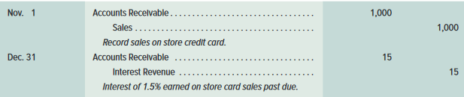
Sales on Store Credit Card
Learning Objective C1: Describe accounts receivable and how they occur and are recorded.
On November 1, TechCom recorded sales on their own credit card in the amount of $1,000.
On December 31, TechCom recorded an adjusting entry for the interest earned at the rate of 1.5% per month on seller credit card.
Notes:
Many large retailers such as Home Depot sell on credit and maintain their own credit cards to grant credit to approved customers and to earn interest on any balance past due. The entries are the same as those described for Tech-Com except for added interest revenue.
On November 1, TechCom recorded sales on their own credit card in the amount of $1,000.
On December 31, TechCom recorded an adjusting entry for the interest earned at the rate of 1.5% per month on seller credit card.

Slide 10
Sales on Bank Credit Card
Learning Objective C1: Describe accounts receivable and how they occur and are recorded.
On July 15, TechCom has $100 of credit card sales with a 4% fee, and its $96 cash is received immediately on deposit.
We omit the entry to Dr. Cost of Sales and Cr. Merchandise Inventory to focus on credit card expense.
Notes:
Most companies allow customers to pay for products and services using bank or third-party credit cards such as Visa, MasterCard, or American Express, and debit cards. Sellers allow customers to use credit cards and debit cards instead of granting credit directly for several reasons. First, the seller does not have to who gets credit and how much. Second, the seller avoids the risk of customers not paying. This risk is transferred to the card company. Third, the seller typically receives cash from the card company sooner than had it granted credit directly to customers. Fourth, more credit options for customers can lead to more sales.
To illustrate, if TechCom has $100 of credit card sales with a 4% fee, and its $96 cash is received immediately on deposit, the entry is a credit to Sales for the entire amount of the sale of $100. However, TechCom will debit Cash for $96, which represents how much cash they will collect from the bank. The difference of $4 is the 4% fee that TechCom must pay for allowing customers to use the third-party credit card. The $4 will be debited to Credit Card Expense.

Slide 11
Sales on Installment
Learning Objective C1: Describe accounts receivable and how they occur and are recorded.
Amounts owed by customers from credit sales for which payment is required in periodic amounts over an extended time period. The customer is usually charged interest.
Notes:
Many companies allow their credit customers to make periodic payments over several months. For example, Harley-Davidson reports more than $2 billion in installment receivables. The seller refers to such assets as installment accounts (or finance) receivable, which are amounts owed by customers from credit sales for which payment is required in periodic amounts over an extended time period. Most of these receivables require interest payments, and they can be either current or noncurrent assets depending on the length of repayment.
Review what you have learned in the following NEED-TO-KNOW Slides.

Slide 12
NEED-TO-KNOW 7-1 (1 of 2)
Learning Objective C1: Describe accounts receivable and how they occur and are recorded.
A small retailer allows customers to use two different credit cards in charging purchases. The AA Bank Card assesses a 5% service charge for credit card sales.
The VIZA Card assesses a 3% charge on sales for using its card. This retailer also has its own store credit card. As of January 31 month-end, the retailer earned $75 in net interest revenue on its own card.
Notes:
A small retailer allows customers to use two different credit cards in charging purchases. With the AA Bank Card, the retailer receives an immediate credit to its account when it deposits sales receipts. AA Bank assesses a 5% service charge for credit card sales. The second credit card that the retailer accepts is the VIZA Card. The retailer sends its accumulated receipts to VIZA on a weekly basis and is paid by VIZA about a week later. VIZA assesses a 3% charge on sales for using its card. Prepare journal entries to record the following selected credit card transactions for the retailer. (The retailer uses the perpetual inventory system for recording sales.)

Slide 13
NEED-TO-KNOW 7-1 (2 of 2)
Learning Objective C1: Describe accounts receivable and how they occur and are recorded.
Prepare journal entries to record the following selected credit card transactions for the retailer. (The retailer uses the perpetual inventory system for recording sales.)
Jan. 2 | Sold merchandise for $1,000 (that had cost $600) and accepted the customer’s AA Bank Card.
Jan. 6 | Sold merchandise for $400 (that had cost $300) and accepted the customer’s VIZA Card.
Jan. 31 | Recognized the $75 interest revenue earned on its store credit card for January.

Slide 14
NEED-TO-KNOW 7-1 SOLUTION (1 of 4)
Learning Objective C1: Describe accounts receivable and how they occur and are recorded.
A small retailer allows customers to use two different credit cards in charging purchases. The AA Bank Card receives an immediate credit to its account when it deposits sales receipts. AA Bank assesses a 5% service charge for credit card sales. The second credit card that the retailer accepts is the VIZA Card. The retailer sends its accumulated receipts to VIZA on a weekly basis and is paid by VIZA about a week later. VIZA assesses a 3% charge on sales for using its card. Prepare journal entries to record the following selected credit card transactions for the retailer. (The retailer uses the perpetual inventory system for recording sales.)
Notes:
On Jan. 2 - Sold merchandise for $1,000 (that had cost $600) and accepted the customer’s AA Bank Card. The AA receipts are immediately deposited in the retailer’s bank account. We record the $1,000 sale by crediting Sales for $1,000. This revenue is immediately matched with an expense, Credit card expense, equal to 5% of the sales, $50. And because the amount is immediately deposited in the retailer's bank account, we debit Cash for the balance, $950. The retailer is using the perpetual inventory system, so cost of goods sold is calculated at the time of the sale; debit Cost of goods sold, $600, and credit Merchandise inventory.

Slide 15
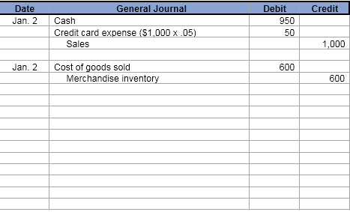
NEED-TO-KNOW 7-1 SOLUTION (2 of 4)
Learning Objective C1: Describe accounts receivable and how they occur and are recorded.
Jan. 2 | Sold merchandise for $1,000 (that had cost $600) and accepted the customer’s AA Bank Card. The AA receipts are immediately deposited in the retailer’s bank account.

Slide 16
NEED-TO-KNOW 7-1 SOLUTION (3 of 4)
Learning Objective C1: Describe accounts receivable and how they occur and are recorded.
A small retailer allows customers to use two different credit cards in charging purchases. The AA Bank Card receives an immediate credit to its account when it deposits sales receipts. AA Bank assesses a 5% service charge for credit card sales. The second credit card that the retailer accepts is the VIZA Card. The retailer sends its accumulated receipts to VIZA on a weekly basis and is paid by VIZA about a week later. VIZA assesses a 3% charge on sales for using its card. Prepare journal entries to record the following selected credit card transactions for the retailer. (The retailer uses the perpetual inventory system for recording sales.)
Notes:
On Jan. 6 - Merchandise was sold for $400 (that had cost $300) and accepted the customer's VIZA card. Again we credit Sales for the amount of the sale, $400. Credit card expense is recorded at the time of the sale, equal to the fee; 3% of sales; or $12. Because the amount is immediately deposited in the retailer's bank account, we debit Cash for the balance, $388. Cost of goods sold is recorded at the time of the sale, debiting Cost of goods sold, $300, and crediting Merchandise inventory.
On Jan. 31 – recognized $75 in interest revenue earned on its store credit card for January. The journal entry includes a debit to Accounts Receivable and a credit to Interest Revenue for $75.

Slide 17
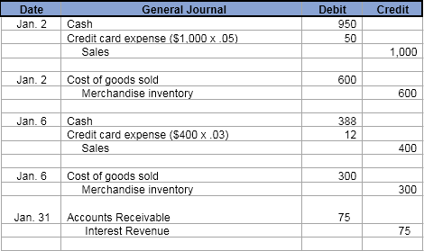
NEED-TO-KNOW 7-1 SOLUTION (4 of 4)
Learning Objective C1: Describe accounts receivable and how they occur and are recorded.
Jan. 6 | Sold merchandise for $400 (that had cost $300) and accepted the customer’s VIZA Card.
Jan. 31 | Recognized the $75 interest revenue earned on its store credit card for January.

Slide 18
Learning Objective P1: Apply the direct write-off method to accounts receivable.

Slide 19
Direct Write-Off Method
Learning Objective P1: Apply the direct write-off method to accounts receivable.
Some customers may not pay their account. Uncollectible amounts are referred to as bad debts.
There are two methods of accounting for bad debts:
  Direct Write-Off Method
  Allowance Method
Notes:
When a company directly grants credit to its customers, it expects that some customers will not pay what they promised. The accounts of these customers are uncollectible accounts, commonly called bad debts. The total amount of uncollectible accounts is an expense of selling on credit. Why do companies sell on credit if they expect some accounts to be uncollectible? The answer is that companies believe that granting credit will increase total sales and net income enough to offset bad debts. Companies use two methods to account for uncollectible accounts: (1) direct write-off method and (2) allowance method.

Slide 20

Direct Write-Off Method - Recording and Writing Off Bad Debts
Learning Objective P1: Apply the direct write-off method to accounts receivable.
TechCom determines on January 23 that it cannot collect $520 owed to it by its customer J. Kent.
Notice that the specific customer is noted in the transaction so we can make the proper entry in the customer’s Accounts Receivable subsidiary ledger.
Notes:
The direct write-off method of accounting for bad debts records the loss from an uncollectible account receivable when it is determined to be uncollectible. No attempt is made to predict bad debts expense. To illustrate, if TechCom determines on January 23 that it cannot collect $520 owed to it by its customer J. Kent, it recognizes the loss using the direct write-off method as shown in this slide.
The debit in this entry charges the uncollectible amount directly to the current period’s Bad Debts Expense account. The credit removes its balance from the Accounts Receivable account in the general ledger (and its subsidiary ledger).

Slide 21

Direct Write-Off Method – Recovering a Bad Debt
Learning Objective P1: Apply the direct write-off method to accounts receivable.
On March 11, J. Kent was able to make full payment to TechCom for the amount previously written-off.
Notes:
Sometimes an account written off is later collected. If the account of J. Kent that was written off directly to Bad Debts Expense is later collected in full, the two entries in this slide record this recovery.

Slide 22
Matching versus Materiality
Learning Objective P1: Apply the direct write-off method to accounts receivable.
Expense recognition principle requires expenses to be reported in the same accounting period as the sales they helped produce.
Materiality constraint states that an amount can be ignored if its effect on the financial statements is unimportant to users’ business decisions.
The direct write-off method usually does not best match sales and expenses.
Notes:
Expense Recognition applied to bad debts requires expenses to be reported in the same accounting period as the sales they helped produce. This means that if extending credit to customers helped produce sales, the bad debts expense linked to those sales is matched and reported in the same period. The direct write-off method usually does not best match sales and expenses because bad debts expense is not recorded until an account becomes uncollectible, which often occurs in a period after that of the credit sale. To match bad debts expense with the sales it produces therefore requires a company to estimate future uncollectibles.
Materiality applied to bad debts states that an amount can be ignored if its effect on the financial statements is unimportant to users’ business decisions. The materiality constraint permits the use of the direct write-off method when its results are similar to using the allowance method.
Review what you have learned in the following NEED-TO-KNOW Slide.

Slide 23
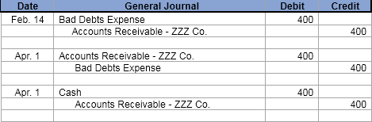
NEED-TO-KNOW 7-2
Learning Objective P1: Apply the direct write-off method to accounts receivable.
A retailer applies the direct write-off method in accounting for uncollectible accounts. Prepare journal entries to record the following selected transactions.
Feb. 14 | The retailer determines that it cannot collect $400 of its accounts receivable from a customer named ZZZ Company.
Apr. 1 | ZZZ Company unexpectedly pays its account in full to the retailer, which then records its recovery of this bad debt.
Notes:
A retailer applies the direct write-off method in accounting for uncollectible accounts. Prepare journal entries to record the following selected transactions.
Feb. 14 - The retailer determines that it cannot collect $400 of its accounts receivable from a customer named ZZZ Company. Under the direct write-off method, when an account is determined to be uncollectible, the journal entry debits the expense account, Bad debts expense, and credits Accounts receivable for the amount that's uncollectible; in this case, $400.
Apr. 1 - ZZZ Company unexpectedly pays its account in full to the retailer, which then records its recovery of this bad debt. On April 1, we reinstate the account receivable, reversing the write-off from February 14; debit Accounts receivable and credit Bad debts expense. Now that the account has been reestablished, we collect the account receivable, debiting Cash and crediting Accounts receivable. The advantage of the direct write-off method is simply that it's easy. If the amount of bad debts expense is material, Generally Accepted Accounting Principles do not allow the use of the direct write-off method.

Slide 24
Learning Objective P2: Apply the allowance method to accounts receivable.

Slide 25
Allowance Method
Learning Objective P2: Apply the allowance method to accounts receivable.
At the end of each period, estimate total bad debts expected to be realized from that period’s sales.
Two advantages to the allowance method:
It records estimated bad debts expense in the period when the related sales are recorded.
It reports accounts receivable on the balance sheet at the estimated amount of cash to be collected.
Notes:
The allowance method of accounting for bad debts matches the estimated loss from uncollectible accounts receivable against the sales they helped produce. We must use estimated losses because when sales occur, sellers do not know which customers will not pay their bills. This means that at the end of each period, the allowance method requires an estimate of the total bad debts expected from that period’s sales. This method has two advantages over the direct write-off method:
it records estimated bad debts expense in the period when the related sales are recorded and
it reports accounts receivable on the balance sheet at the estimated amount of cash to be collected.

Slide 26

Allowance Method - Recording Bad Debts Expense
Learning Objective P2: Apply the allowance method to accounts receivable.
TechCom had credit sales of $300,000 during its first year of operations. At the end of the first year, $20,000 of credit sales remained uncollected. Based on the experience of similar businesses, TechCom estimated that $1,500 of its accounts receivable would be uncollectible.
Notes:
The allowance method estimates bad debts expense at the end of each accounting period and records it with an adjusting entry. TechCom, for instance, had credit sales of $300,000 during its first year of operations. At the end of the first year, $20,000 of credit sales remained uncollected. Based on the experience of similar businesses, TechCom estimated that $1,500 of its accounts receivable would be uncollectible and made the adjusting entry shown in this slide.
The estimated bad debts expense of $1,500 is reported on the income statement (as either a selling expense or an administrative expense). The Allowance for Doubtful Accounts is a contra asset account. A contra account is used instead of reducing accounts receivable directly because at the time of the adjusting entry, the company does not know which customers will not pay. After the bad debts adjusting entry is posted, TechCom’s account balances (in T-account form) for Accounts Receivable and its Allowance for Doubtful Accounts are as shown at the bottom of this slide.

Slide 27

Exhibits 7.6 & 7.7 Balance Sheet Presentation
Learning Objective P2: Apply the allowance method to accounts receivable.
TechCom had credit sales of $300,000 during its first year of operations. At the end of the first year, $20,000 of credit sales remained uncollected. Based on the experience of similar businesses, TechCom estimated that $1,500 of its accounts receivable would be uncollectible.
Notes:
The Allowance for Doubtful Accounts credit balance of $1,500 has the effect of reducing accounts receivable to its realizable value. Although credit customers owe $20,000 to TechCom, only $18,500 is expected to be realized in cash collections from these customers. (TechCom continues to bill its customers a total of $20,000). In the balance sheet, the Allowance for Doubtful Accounts is subtracted from Accounts Receivable and is often reported as shown here.

Slide 28
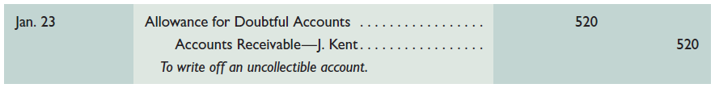
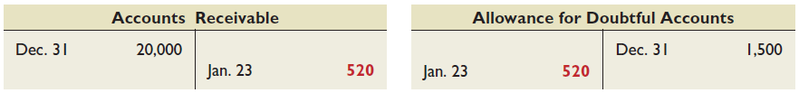
Allowance Method – Writing Off a Bad Debt
Learning Objective P2: Apply the allowance method to accounts receivable.
TechCom has determined that J. Kent’s $520 account is uncollectible.
Notes:
When specific accounts are identified as uncollectible, they are written off against the Allowance for Doubtful Accounts. To illustrate, TechCom decides that J. Kent’s $520 account is uncollectible and makes the above entry to write it off.
Posting this write-off entry to the Accounts Receivable account removes the amount of the bad debt from the general ledger (it is also posted to the accounts receivable subsidiary ledger). The general ledger accounts now appear as shown (assuming no other transactions affecting these accounts).

Slide 29
Exhibit 7.8 Writing Off a Bad Debt
Learning Objective P2: Apply the allowance method to accounts receivable.
The write-off does not affect the realizable value of accounts receivable.
 | Before Write-Off | After Write-Off
Accounts receivable…………………………………………… | $ 20,000 | $ 19,480
Less allowance for doubtful accounts………………. | 1,500 | 980
Realizable value of accounts receivable……………. | $ 18,500 | $ 18,500
Notes:
The write-off does not affect the realizable value of accounts receivable as shown in this slide. Neither total assets nor net income is affected by the write-off of a specific account. Instead, both assets and net income are affected in the period when bad debts expense is predicted and recorded with an adjusting entry.

Slide 30

Allowance Method - Recovering a Bad Debt
Learning Objective P2: Apply the allowance method to accounts receivable.
To help restore credit standing, a customer sometimes pays all or part of the amount owed on an account even after it has been written off.
On March 11, Kent pays in full his $520 account previously written off.
Notes:
When a customer fails to pay and the account is written off as uncollectible, his or her credit standing declines. To help restore credit standing, a customer sometimes volunteers to pay all or part of the amount owed. A company makes two entries when collecting an account previously written off by the allowance method. The first is to reverse the write-off and reinstate the customer’s account. The second is to record the collection of the reinstated account as illustrated here.
Review what you have learned in the following NEED-TO-KNOW Slides.

Slide 31
NEED-TO-KNOW 7-3
Learning Objective P2: Apply the allowance method to accounts receivable.
A retailer applies the allowance method in accounting for uncollectible accounts. Prepare journal entries to record its following selected transactions.
12/31/20X1 | The retailer estimates $3,000 of its accounts receivable are uncollectible.
2/14/20X2 | The retailer determines that it cannot collect $400 of its accounts receivable from a customer named ZZZ Company.
4/1/20X2 | ZZZ Company unexpectedly pays its account in full to the retailer, which then records its recovery of this bad debt.
Notes:
Need-to-Know 7.3

Slide 32
NEED-TO-KNOW 7-3 SOLUTION (1 of 2)
Learning Objective P2: Apply the allowance method to accounts receivable.
A retailer applies the allowance method in accounting for uncollectible accounts. Prepare journal entries to record its following selected transactions.
12/31/20X1 | The retailer estimates $3,000 of its accounts receivable are uncollectible.
2/14/20X2 | The retailer determines that it cannot collect $400 of its accounts receivable from a customer named ZZZ Company.
4/1/20X2 | ZZZ Company unexpectedly pays its account in full to the retailer, which then records its recovery of this bad debt.
Notes:
Need-to-Know 7.3

Slide 33
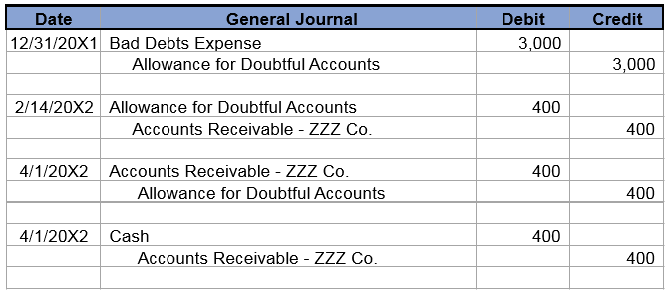
NEED-TO-KNOW 7-3 SOLUTION (2 of 2)
Learning Objective P2: Apply the allowance method to accounts receivable.

Slide 34
Learning Objective P3: Estimate uncollectibles based on sales and accounts receivable.

Slide 35
Estimating Bad Debts Expense
Learning Objective P3: Estimate uncollectibles based on sales and accounts receivable.
Two Methods
Percent of Sales Method
Accounts Receivable Methods
  Percent of Accounts Receivable
  Aging of Accounts Receivable
Notes:
Under the allowance method only do we require an estimate of bad debts expense to prepare an adjusting entry at the end of each accounting period. There are two common methods. One is based on the income statement relation between bad debts expense and sales. The second is based on the balance sheet relation between accounts receivable and the allowance for doubtful accounts.

Slide 36
Percent of Sales Method (1 of 3)
Learning Objective P3: Estimate uncollectibles based on sales and accounts receivable.
Bad debts expense is computed as follows:
Current Period Sales × Bad Debt % = Estimated Bad Debts Expense
Notes:
The percent of sales method, also called the income statement method, is based on the idea that a percent of a company’s credit sales for the period is uncollectible.
When using the Percent of Sales Method, the estimate at the end of the period is determined by taking current period sales and multiplying by an established bad debt percentage. The bad debt percentage is determined based on past history of the company and current economic trends. Also, the sales transactions included in this computation are typically only the credit sales. There are no collection issues to consider for cash sales transactions.

Slide 37
Percent of Sales Method (2 of 3)
Learning Objective P3: Estimate uncollectibles based on sales and accounts receivable.
Musicland has credit sales of $400,000 in 2017. It is estimated that 0.6% of credit sales will eventually prove uncollectible.
Let’s look at recording Bad Debts Expense for 2017.
Musicland’s accountant computes estimated Bad Debts Expense of $2,400.
Notes:
The percent of sales method, also referred to as the income statement method, is based on the idea that a given percent of a company’s credit sales for the period is uncollectible. To illustrate, assume that Musicland has credit sales of $400,000 in year 2016. Based on past experience, Musicland estimates 0.6% of credit sales to be uncollectible. This implies that Musicland expects $2,400 of bad debts expense from its sales (computed as $400,000 x 0.006). The adjusting entry to record this estimated expense is shown here.
The allowance account ending balance on the balance sheet for this method would rarely equal the bad debts expense on the income statement. This is because unless a company is in its first period of operations, its allowance account has a zero balance only if the prior amounts written off as uncollectible exactly equal the prior estimated bad debts expenses. (When computing bad debts expense as a percent of sales, managers monitor and adjust the percent so it is not too high or too low.)

Slide 38

Percent of Sales Method (3 of 3)
Learning Objective P3: Estimate uncollectibles based on sales and accounts receivable.

Slide 39
Percent of Receivables Method
Learning Objective P3: Estimate uncollectibles based on sales and accounts receivable.
Compute the estimate of the Allowance for Doubtful Accounts.
Year-end Accounts Receivable × Bad Debt %
Bad Debts Expense is computed as:
Total Estimated Bad Debts Expense – Previous Balance in Allowance Account = Current Bad Debts Expense
Notes:
The accounts receivable methods, also called balance sheet methods, use balance sheet relations to estimate bad debts—mainly the relation between accounts receivable and the allowance amount. The goal of the bad debts adjusting entry for these methods is to make the Allowance for Doubtful Accounts balance equal to the portion of accounts receivable that is estimated to be uncollectible. The estimated balance for the allowance account is obtained in one of two ways: (1) computing the percent uncollectible from the total accounts receivable or (2) aging accounts receivable.
The percent of accounts receivable method assumes that a percent of a company’s receivables is uncollectible. This percent is based on past experience and is impacted by current conditions such as economic trends and customer difficulties. The total dollar amount of all receivables is multiplied by this percent to get the estimated dollar amount of uncollectible accounts—reported in the balance sheet as the Allowance for Doubtful Accounts.

Slide 40
Exhibit 7.10 Percent of Receivables Method (1 of 2)
Learning Objective P3: Estimate uncollectibles based on sales and accounts receivable.
Musicland has $50,000 in accounts receivable and a $200 credit balance in Allowance for Doubtful Accounts on December 31, 2017. Past experience suggests that 5% of receivables are uncollectible.
Desired balance in Allowance for Doubtful Accounts.
Notes:
Musicland has $50,000 of accounts receivable on December 31, 2017. Experience suggests 5% of its receivables is uncollectible. This means that after the adjusting entry is posted, we want the Allowance for Doubtful Accounts to show a $2,500 credit balance (5% of $50,000). We are also told that its beginning balance is $2,200, which is 5% of the $44,000 accounts receivable on December 31, 2016.
During 2017, accounts of customers are written off on February 6, July 10, and November 20. Thus, the account has a $200 credit balance before the December 31, 2017, adjustment. The adjusting entry to give the allowance account the estimated $2,500 balance is shown on this slide.

Slide 41
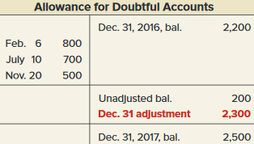

Exhibit 7.10 Percent of Receivables Method (2 of 2)
Learning Objective P3: Estimate uncollectibles based on sales and accounts receivable.

Slide 42
Aging of Receivables Method (1 of 6)
Learning Objective P3: Estimate uncollectibles based on sales and accounts receivable.
Classify each receivable by how long it is past due.
Each age group is multiplied by its estimated bad debts percentage.
Estimated bad debts for each group are totaled.
Notes:
This aging of accounts lists each customer’s individual balances assigned to one of five classes based on its days past due. The amounts in each class are totaled and multiplied by the estimated percent of uncollectible accounts for each class. The percents used are regularly reviewed to reflect changes in the company and economy.
Musicland has $3,700 in accounts receivable that are 31 to 60 days past due. Its management estimates 10% of the amounts in this age class are uncollectible, or a total of $370 ($3,700 x 10%). Similar analysis is done for each of the other four classes. The final total of $2,270 ($740 + $325 + 370 + $475 + $360) shown in the first column is the estimated balance for the Allowance for Doubtful Accounts.

Slide 43
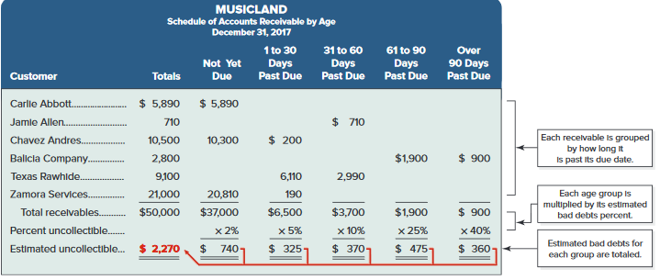
Aging of Accounts Receivable (2 of 6)
Learning Objective P3: Estimate uncollectibles based on sales and accounts receivable.
Exhibit 7.11
Notes:
This aging of accounts lists each customer’s individual balances assigned to one of five classes based on its days past due. The amounts in each class are totaled and multiplied by the estimated percent of uncollectible accounts for each class. The percents used are regularly reviewed to reflect changes in the company and economy.
Musicland has $3,700 in accounts receivable that are 31 to 60 days past due. Its management estimates 10% of the amounts in this age class are uncollectible, or a total of $370 ($3,700 x 10%). Similar analysis is done for each of the other four classes. The final total of $2,270 ($740 + $325 + 370 + $475 + $360) shown in the first column is the estimated balance for the Allowance for Doubtful Accounts.

Slide 44
Aging of Accounts Receivable (3 of 6)
Learning Objective P3: Estimate uncollectibles based on sales and accounts receivable.
Step 1: Determine what current balance equals: $200 credit.
Step 2: Determine what the account balance should be: $2,270.
Step 3: Make adjusting entry to get from step 1 to step 2: $2,270 - 200 = $2,070.
Notes:
Notice that the allowance account has an unadjusted credit balance of $200, the required adjustment to the Allowance for Doubtful Accounts is $2,070. (We could also use a T-account for this analysis as shown in the slide.) This yields the following end-of-period adjusting entry shown above.

Slide 45
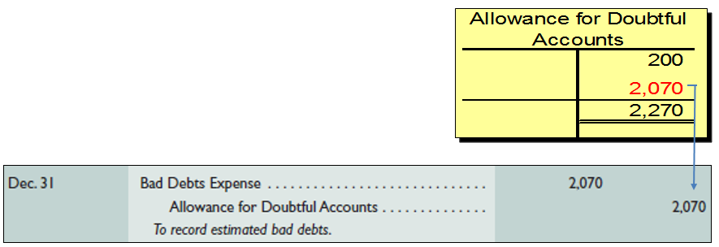
Aging of Accounts Receivable (4 of 6)
Learning Objective P3: Estimate uncollectibles based on sales and accounts receivable.

Slide 46
Aging of Accounts Receivable (5 of 6)
Learning Objective P3: Estimate uncollectibles based on sales and accounts receivable.
Step 1: Determine what current balance equals: $500 debit.
Step 2: Determine what the account balance should be: $2,270.
Step 3: Make adjusting entry to get from step 1 to step 2: $2,270 + 200 = $2,770.
Notes:
Notice that if the allowance account has an unadjusted debit balance of $500, the required adjustment to the Allowance for Doubtful Accounts is $2,770 because we need to add the $500 debit balance to the desired ending balance. (We could also use a T-account for this analysis as shown in the slide.) This yields the following end-of-period adjusting entry shown above.

Slide 47
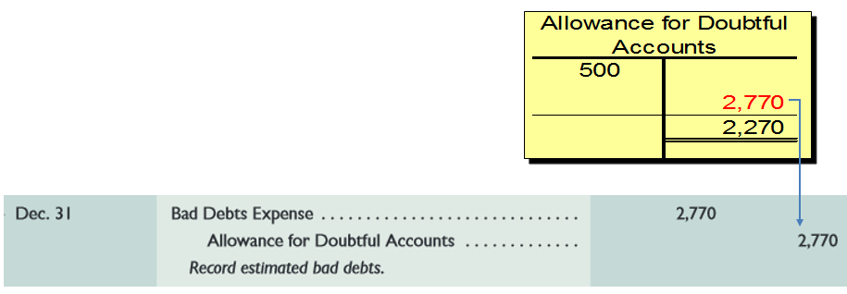
Aging of Accounts Receivable (6 of 6)
Learning Objective P3: Estimate uncollectibles based on sales and accounts receivable.
Notes:
Notice that if the allowance account has an unadjusted debit balance of $500, the required adjustment to the Allowance for Doubtful Accounts is $2,770 because we need to add the $500 debit balance to the desired ending balance. (We could also use a T-account for this analysis as shown in the slide.) This yields the following end-of-period adjusting entry shown above.

Slide 48
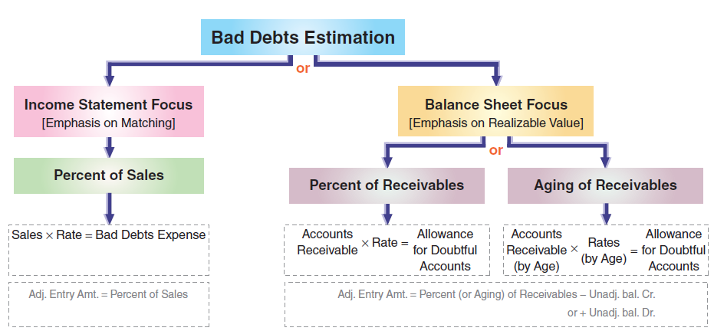
Exhibit 7.13 Summary of Methods
Learning Objective P3: Estimate uncollectibles based on sales and accounts receivable.
Notes:
This diagram summarizes the three estimation methods and their focus of analysis. Percent of sales, with its income statement focus, does a good job at matching bad debts expense with sales. The accounts receivable methods, with their balance sheet focus, do a better job at reporting accounts receivable at realizable value.
Review what you have learned in the following NEED-TO-KNOW Slides.

Slide 49
NEED-TO-KNOW 7-4 (1 of 3)
Learning Objective P3: Estimate uncollectibles based on sales and accounts receivable.
At its December 31 year-end, a company estimates uncollectible accounts using the allowance method. It prepared the following aging of receivables analysis.
 | Total | Days Past Due: 0 | Days Past Due: 1 to 30 | Days Past Due: 31 to 60 | Days Past Due: 61 to 90 | Days Past Due: Over 90
Accounts receivable | $2,600 | $2,000 | $300 | $80 | $100 | $120
Percent uncollectible |  | 1% | 2% | 5% | 7% | 10%
Notes:
At its December 31 year-end, a company estimates uncollectible accounts using the allowance method. It prepared the following aging of receivables analysis.
1. (a) Estimate the balance of the Allowance for Doubtful Accounts using the aging of accounts receivable method. (b) Prepare the adjusting entry to record Bad Debts Expense using the estimate from part (a). Assume the unadjusted balance in the Allowance for Doubtful Accounts is a $10 debit balance. This adjusting entry, like all adjusting entries, affects one income statement account and one balance sheet account.
The journal entry to estimate bad debts using the allowance method is always a debit to Bad debts expense, the income statement account, and a credit to Allowance for doubtful accounts, the balance sheet account.
Preparing adjusting entries is a three-step process:
Step 1: Determine what the account balance equals.
Step 2: Determine what the account balance SHOULD equal.
Step 3: Make an adjusting entry to get from step 1 to step 2.
The entry to estimate bad debts is always a debit to Bad debts expense and a credit to Allowance for doubtful accounts, regardless of the method used. In this case, the company is estimating their bad debts based on an aging of accounts receivable.

Slide 50
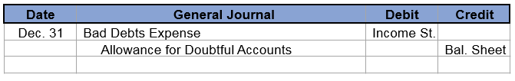
NEED-TO-KNOW 7-4 (2 of 3)
Learning Objective P3: Estimate uncollectibles based on sales and accounts receivable.
(a) Estimate the balance of the Allowance for Doubtful Accounts using the aging of accounts receivable method. (b) Prepare the adjusting entry to record Bad Debts Expense using the estimate from part a. Assume the unadjusted balance in the Allowance for Doubtful Accounts is a $10 debit.

Slide 51
NEED-TO-KNOW 7-4 (3 of 3)
Learning Objective P3: Estimate uncollectibles based on sales and accounts receivable.
Adjusting entries: 3-step process:
Step 1) Determine what the account balance equals.
Step 2) Determine what the account balance SHOULD equal.
Step 3) Make an adjusting entry to get from Step 1 to Step 2.

Slide 52
NEED-TO-KNOW 7-4 SOLUTION (1 of 8)
Learning Objective P3: Estimate uncollectibles based on sales and accounts receivable.
 | Total | Days Past Due: 0 | Days Past Due: 1 to 30 | Days Past Due: 31 to 60 | Days Past Due: 61 to 90 | Days Past Due: Over 90
Accounts receivable | $2,600 | $2,000 | $300 | $80 | $100 | $120
Percent uncollectible |  | 1% | 2% | 5% | 7% | 10%
Uncollectible amount | $49 | $20 | $6 | $4 | $7 | $12
Step 1: Determine what the current account balance equals.
When the estimate is based on receivables (Balance Sheet Approach) the account is the Balance sheet portion of the adjusting entry, Allowance for Doubtful Accounts. The existing balance is a debit of $10.
Notes:
Step 1: Determine what the current account balance equals. When the estimate is based on receivables, this is the balance sheet approach. The account is the balance sheet portion of the adjusting entry, Allowance for doubtful accounts. The existing balance is a debit of $10.
Step 2: Determine what the current account balance SHOULD BE. When a company uses an aging of accounts receivable, they look at the number of days past due and then multiply by the historical percentage of uncollectible items. For accounts that are current, not yet past due, 1% are uncollectible. 1% of $2,000 is $20. 2% of accounts that are 1 to 30 days past due are uncollectible; 2% of $300 is $6. 5% of the accounts that are 31 to 60 days past due are uncollectible; $80 multiplied by 5% is $4. 7% of the accounts that are 61 to 90 days past due are uncollectible; 7% of $100 is $7. And accounts that are over 90 days past due have a 10% chance of becoming uncollectible; 10% of $120 is $12. Total accounts receivable is $2,600. The total amount that's estimated to be uncollectible is $49. The balance in Allowance for doubtful accounts should equal the amount calculated, $49. Remember, Allowance for doubtful accounts is a contra asset account and has a normal credit balance.
Step 3: Make an adjusting entry to get from step 1 to step 2. In order to go from a debit balance of $10 to a credit balance of $49, we need to credit the Allowance account for the total, $59. The adjusting entry debits Bad debts expense and credits Allowance for doubtful accounts for $59.

Slide 53


NEED-TO-KNOW 7-4 SOLUTION (2 of 8)
Learning Objective P3: Estimate uncollectibles based on sales and accounts receivable.
Step 2: Determine what the current account balance SHOULD BE.
The balance should equal the amount calculated, $49.
Step 3: Make an adjusting entry to get from step 1 to step 2.

Slide 54
NEED-TO-KNOW 7-4 SOLUTION (3 of 8)
Learning Objective P3: Estimate uncollectibles based on sales and accounts receivable.
(a) Estimate the balance of the Allowance for Doubtful Accounts assuming the company uses 2% of total accounts receivable to estimate uncollectibles, instead of the aging of receivables method in number 1. (b) Prepare the adjusting entry to record Bad Debts Expense using the estimate from part a. Assume the unadjusted balance in the Allowance for Doubtful Accounts is a $4 credit.
Step 1: Determine what the current account balance equals.
Notes:
2. (a) Estimate the balance of the Allowance for Doubtful Accounts assuming the company uses 2% of total accounts receivable to estimate uncollectibles, instead of the aging of accounts receivables method in number 1. (b) Prepare the adjusting entry to record Bad Debts Expense using the estimate from part a. Assume the unadjusted balance in the Allowance for Doubtful Accounts is a $4 credit. The process stays the same. The adjusting entry to estimate Bad debts expense is always a debit to Bad debts expense and a credit to Allowance for doubtful accounts. The company is estimating that 2% of total accounts receivable are uncollectible.
When the estimate is based on receivables, we're using the balance sheet approach. The account is the balance sheet portion of the adjusting entry, Allowance for doubtful accounts. The existing balance is a credit of $4.
Step 2: Determine what the current account balance SHOULD BE. Total accounts receivable of $2,600 multiplied by 2% is $52. The allowance for doubtful accounts should have an ending credit balance of $52.
Step 3: Make an adjusting entry to get from step 1 to step 2. To go from a credit of $4 to a credit a $52, we need to credit Allowance for doubtful accounts for $48.

Slide 55

NEED-TO-KNOW 7-4 SOLUTION (4 of 8)
Learning Objective P3: Estimate uncollectibles based on sales and accounts receivable.
When the estimate is based on receivables, the Balance Sheet Approach, the account is the Balance sheet portion of the adjusting entry, Allowance for Doubtful Accounts. The existing balance is a credit of $4.

Slide 56

NEED-TO-KNOW 7-4 SOLUTION (5 of 8)
Learning Objective P3: Estimate uncollectibles based on sales and accounts receivable.
Step 2: Determine what the current account balance SHOULD BE.
The balance should be 2% of Accounts Receivable. $2,600 × .02 = $52.
Step 3: Make an adjusting entry to get from step 1 to step 2.

Slide 57
NEED-TO-KNOW 7-4 SOLUTION (6 of 8)
Learning Objective P3: Estimate uncollectibles based on sales and accounts receivable.
a) Estimate the balance of the uncollectibles assuming the company uses 0.5% of annual credit sales (annual credit sales were $10,000). (b) Prepare the adjusting entry to record Bad Debts Expense using the estimate from part a. Assume the unadjusted balance in the Allowance for Doubtful Accounts is a $2 credit.
Notes:
3. (a) Estimate the balance of the uncollectibles assuming the company uses 0.5% of annual credit sales (annual credit sales were $10,000). (b) Prepare the adjusting entry to record Bad Debts Expense using the estimate from part a. Assume the unadjusted balance in the Allowance for Doubtful Accounts is a $2 credit.
Step 1: Determine what the current account balance equals. The adjusting entry will be the same, debiting Bad debts expense and crediting Allowance for doubtful accounts. When the estimate is based on sales, we're using the income statement approach; the account is the income statement portion of the adjusting entry, Bad debts expense. The existing balance in the expense account is always $0, as it's closed every period.
Step 2: Determine what the current account balance SHOULD BE. The balance in bad debts expense should equal 0.5% of net credit sales. $10,000 multiplied by 0.005 equals $50. Remember, Bad debts expense has a normal debit balance, as expenses decrease equity.
Step 3: Make an adjusting entry to get from step 1 to step 2. To go from an unadjusted balance of $0 to an adjusted debit balance of $50, we need to debit Bad debts expense for $50. Notice that we did not need to consider the existing balance in Allowance for doubtful accounts to solve this question, because we were using the income statement approach, not a balance sheet approach, and Allowance for doubtful accounts is a balance sheet account.

Slide 58

NEED-TO-KNOW 7-4 SOLUTION (7 of 8)
Learning Objective P3: Estimate uncollectibles based on sales and accounts receivable.
Step 1: Determine what the current account balance equals.
When the estimate is based on sales, the Income Statement Approach, the account is the Income Statement portion of the adjusting entry, Bad Debts Expense. The existing balance in the expense account is always $0, as it is closed every period.

Slide 59

NEED-TO-KNOW 7-4 SOLUTION (8 of 8)
Learning Objective P3: Estimate uncollectibles based on sales and accounts receivable.
Step 2: Determine what the current account balance SHOULD BE.
The balance should be .5% of net credit sales. $10,000 × .005 = $50.
Step 3: Make an adjusting entry to get from step 1 to step 2.

Slide 60
Learning Objective C2: Describe a note receivable, the computation of its maturity date, and the recording of its existence.

Slide 61
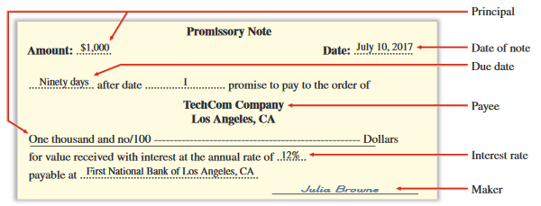
Exhibit 7.14 Notes Receivable
Learning Objective C2: Describe a note receivable, the computation of its maturity date, and the recording of its existence.
A promissory note is a written promise to pay a specified amount of money, usually with interest, either on demand or at a stated future date.
Notes:
A promissory note is a written promise to pay a specified amount of money, usually with interest, either on demand or at a stated future date. Promissory notes are used in many transactions, including paying for products and services, and lending and borrowing money. Sellers sometimes ask for a note to replace an account receivable when a customer requests additional time to pay a past-due account. For legal reasons, sellers generally prefer to receive notes when the credit period is long and when the receivable is for a large amount. If a lawsuit is needed to collect from a customer, a note is the buyer’s written acknowledgment of the debt, its amount, and its terms.
The note illustrated on this slide shows a promissory note dated July 10, 2017. For this note, Julia Browne promises to pay TechCom or to its order (according to TechCom’s instructions) a specified amount of money ($1,000), called the principal of a note, at a stated future date (October 8, 2017). As the one who signed the note and promised to pay it at maturity, Browne is the maker of the note. As the person to whom the note is payable, TechCom is the payee of the note. To Browne, the note is a liability called a note payable. To TechCom, the same note is an asset called a note receivable. This note bears interest at 12%, as written on the note. Interest is the charge for using the money until its due date. To a borrower, interest is an expense. To a lender, it is revenue.

Slide 62
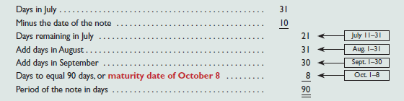
Exhibit 7.15 Computing Maturity and Interest
Learning Objective C2: Describe a note receivable, the computation of its maturity date, and the recording of its existence.
The maturity date of a note is the day the note (principal and interest) must be repaid.
On July 10, TechCom received a $1,000, 90-day, 12% promissory note as a result of a sale to Julia Browne.
The note is due and payable on October 8.
Notes:
The maturity date of a note is the day the note (principal and interest) must be repaid. The period of a note is the time from the note’s (contract) date to its maturity date. Many notes mature in less than a full year, and the period they cover is often expressed in days. When the time of a note is expressed in days, its maturity date is the stated number of days after the note’s date. As an example, a five-day note dated June 15 matures and is due on June 20. A 90-day note dated July 10 matures on October 8. This October 8 due date is computed as shown in this slide. The period of a note is sometimes expressed in months or years. When months are used, the note matures and is payable in the month of its maturity on the same day of the month as its original date. A nine-month note dated July 10, for instance, is payable on April 10. The same analysis applies when years are used.

Slide 63
Interest Computation
Learning Objective C2: Describe a note receivable, the computation of its maturity date, and the recording of its existence.
Principal of the note × Annual interest rate × Time expressed in fraction of year = Interest
Annual interest rate → Even for maturities less than one year, the rate is annualized.
Time expressed in fraction of year → If the note is expressed in days, base a year on 360 days using the “banker’s rule.”
Notes:
Interest is the cost of borrowing money for the borrower or, alternatively, the profit from lending money for the lender. Unless otherwise stated, the rate of interest on a note is the rate charged for the use of the principal for one year. The formula for computing interest on a note is shown in the slide. It is calculated as Principal times Rate times Time.
To simplify interest computations, a year is commonly treated as having 360 days (called the banker’s rule in the business world and widely used in commercial transactions). We treat a year as having 360 days for interest computations in the examples and assignments. Using the promissory note in the earlier slide where we have a 90-day, 12%, $1,000 note, the total interest is computed as $30.

Slide 64
Recording Notes Receivable (1 of 2)
Learning Objective C2: Describe a note receivable, the computation of its maturity date, and the recording of its existence.
Notes receivable are usually recorded in a single Notes Receivable account to simplify recordkeeping. The original notes are kept on file, including information on the maker, rate of interest, and due date.
To illustrate the recording for the receipt of a note, we use the $1,000, 90-day, 12% promissory note from Julia Browne to TechCom. TechCom received this note at the time of a product sale to Julia Browne.
Notes:
Notes receivable are usually recorded in a single Notes Receivable account to simplify record-keeping.
To illustrate the recording for the receipt of a note, we use the $1,000, 90-day, 12% promissory note we discussed in a prior slide. TechCom received this note at the time of a product sale to Julia Browne. This transaction is recorded as shown above.

Slide 65

Recording Notes Receivable (2 of 2)
Learning Objective C2: Describe a note receivable, the computation of its maturity date, and the recording of its existence.
*We omit the entry to Dr. Cost of sales and Cr. Merchandise Inventory to focus on sales and receivables.

Slide 66
Learning Objective P4: Record the honoring and dishonoring of a note and adjustments for interest.

Slide 67

Recording an Honored Note
Learning Objective P4: Record the honoring and dishonoring of a note and adjustments for interest.
The principal and interest of a note are due on its maturity date.
J. Cook has a $600, 15%, 60-day note receivable due to TechCom on December 4.
Notes:
The principal and interest of a note are due on its maturity date. The maker of the note usually honors the note and pays it in full. To illustrate, when J. Cook pays the note above on its due date, TechCom records the journal entry shown.
Interest revenue, also called interest earned, is reported on the income statement.

Slide 68
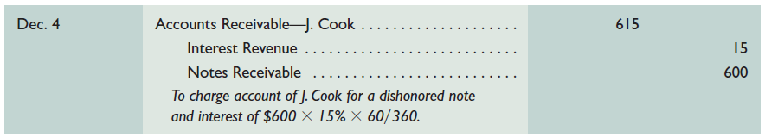
Recording a Dishonored Note
Learning Objective P4: Record the honoring and dishonoring of a note and adjustments for interest.
The act of dishonoring a note does not relieve the maker of the obligation to repay the principal and interest due.
J. Cook has a $600, 15%, 60-day note receivable due to TechCom on December 4.
Notes:
When a note’s maker does not pay at maturity, the note is dishonored. The act of dishonoring a note does not relieve the maker of the obligation to pay. The payee continues to attempt to collect. How do companies report this event? The balance of the Notes Receivable account should include only those notes that have not matured. Thus, when a note is dishonored, we remove the amount of this note from the Notes Receivable account and charge it back to an account receivable from its maker. To illustrate, assume that J. Cook dishonors the note above at maturity. The journal entry to record the dishonoring of the note is shown.

Slide 69
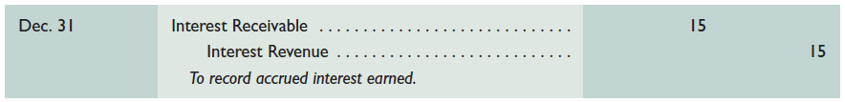
Recording End-of-Period Interest Adjustments (1 of 3)
Learning Objective P4: Record the honoring and dishonoring of a note and adjustments for interest.
On December 16, TechCom accepts a $3,000, 60-day, 12% note from a customer in granting an extension on a past-due account. When TechCom’s accounting period ends on December 31, $15 of interest has accrued on the note.
$3,000 × 12% × 15/360 = $15
Notes:
When notes receivable are outstanding at the end of a period, any accrued interest earned is recorded. To illustrate, on December 16, TechCom accepts a $3,000, 60-day, 12% note from a customer. When TechCom’s accounting period ends on December 31, $15 of interest has accrued on this note ($3,000 x 12% x 15/360). The adjusting entry shown records this revenue.

Slide 70
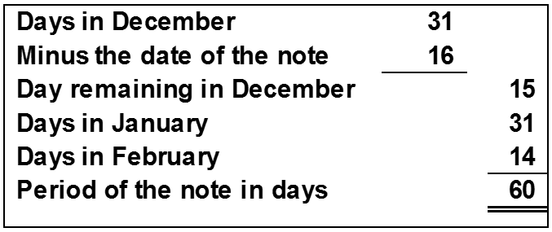
Recording End-of-Period Interest Adjustments (2 of 3)
Learning Objective P4: Record the honoring and dishonoring of a note and adjustments for interest.
Recording collection on note at maturity.

Slide 71

Recording End-of-Period Interest Adjustments (3 of 3)
Learning Objective P4: Record the honoring and dishonoring of a note and adjustments for interest.
$3,000 × 12% × 60/360 = $60

Slide 72
NEED-TO-KNOW 7-5 (1 of 3)
Learning Objective P4: Record the honoring and dishonoring of a note and adjustments for interest.
AA Company purchases $1,400 of merchandise from ZZ on December 16, 20X1. ZZ accepts AA’s $1,400, 90-day, 12% note as payment. ZZ’s accounting period ends on December 31, and it does not make reversing entries. Prepare entries for ZZ on December 16, 20X1, and December 31, 20X1.
Using the information in part a, prepare ZZ’s March 16, 20X2, entry if AA dishonors the note.
Instead of the facts in part b, prepare ZZ’s March 16, 20X2, entry if AA honors the note
Notes:
Need-to-Know 7.5

Slide 73
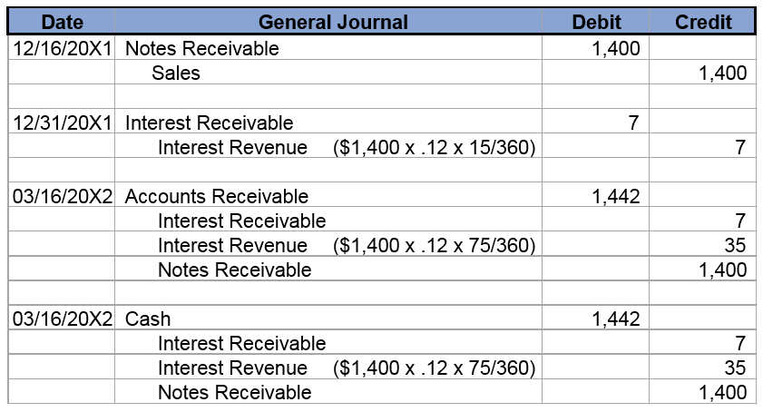
NEED-TO-KNOW 7-5 (2 of 3)
Learning Objective P4: Record the honoring and dishonoring of a note and adjustments for interest.

Slide 74
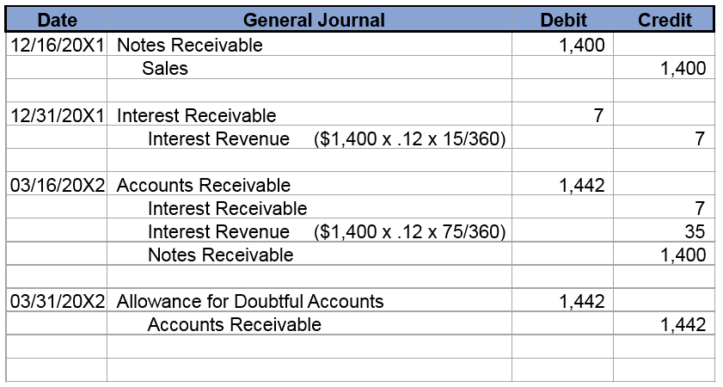
NEED-TO-KNOW 7-5 (3 of 3)
Learning Objective P4: Record the honoring and dishonoring of a note and adjustments for interest.
Assume the facts in part b above (AA dishonors the note). Then, on March 31, ZZ decides to write off the receivable from AA Company. Prepare that write-off entry assuming that ZZ uses the allowance method.

Slide 75
Learning Objective C3: Explain how receivables can be converted to cash before maturity.

Slide 76
Disposal of Receivables
Learning Objective C3: Explain how receivables can be converted to cash before maturity.
Companies can convert receivables to cash before they are due.
Selling Receivables
Pledging Receivables
Notes:
Companies can convert receivables to cash before they are due if they need cash or do not want to be involved in collection activities. Converting receivables is usually done by (1) selling them or (2) using them as security for a loan.
A company can sell its receivables to a finance company or bank. The buyer, called a factor, charges the seller a factoring fee and then the buyer takes ownership of the receivables and receives cash when they come due. By incurring a factoring fee, the seller receives cash earlier and can pass the risk of bad debts to the factor. The seller also avoids costs of billing and accounting for the receivables.
A company can raise cash by borrowing money and pledging its receivables as security for the loan. Pledging receivables does not transfer the risk of bad debts to the lender because the borrower retains ownership of the receivables. If the borrower defaults on the loan, the lender has a right to be paid from the cash receipts of the receivable when collected.
Since pledged receivables are committed as security for a specific loan, the borrower’s financial statements disclose the pledging of them. Inventory and accounts receivable are two assets commonly demanded by bankers as collateral when making business loans.

Slide 77
Learning Objective A1: Compute accounts receivable turnover and use it to help assess financial condition.

Slide 78
Accounts Receivable Turnover (1 of 2)
Learning Objective A1: Compute accounts receivable turnover and use it to help assess financial condition.
This ratio provides useful information for evaluating how efficient management has been in granting credit to produce revenue.
Notes:
Accounts receivable turnover is a measure of both the quality and liquidity of accounts receivable. It indicates how often, on average, receivables are received and collected during the period. The formula for this ratio is shown above.
Accounts receivable turnover also reflects how well management is doing in granting credit to customers in a desire to increase sales. A high turnover in comparison with competitors suggests that management should consider using more liberal credit terms to increase sales. A low turnover suggests management should consider stricter credit terms and more aggressive collection efforts to avoid having its resources tied up in accounts receivable.
IBM’s 2015 turnover is 9.4, computed as $81,741/$8,712 ($ millions). This means that IBM’s average accounts receivable balance was converted into cash 9.4 times in 2015. Its turnover slightly decreased in 2015 (9.4) compared with 2014 (9.5). However, IBM’s turnover exceeds that for Oracle in each of the four years shown here. Both IBM and Oracle seem to be doing an adequate job of managing receivables.

Slide 79
Accounts Receivable Turnover (2 of 2)
Learning Objective A1: Compute accounts receivable turnover and use it to help assess financial condition.
Exhibit 7.19
Company | Figure ($ millions) | 2015 | 2014 | 2013 | 2012
IBM | Net sales…………………………………………. | $81,741 | $92,793 | $98,367 | $102,874
 | Average accounts receivable, net…… | $8,712 | $9,778 | $10,566 | $10,923
 | Accounts receivable turnover….. | 9.4 | 9.5 | 9.3 | 9.4
Oracle | Net sales…………………………………………. | $38,226 | $38,275 | $37,180 | $37,121
 | Average accounts receivable, net…… | $5,618 | $6,068 | $6,213 | $6,503
 | Accounts receivable turnover….. | 6.8 | 6.3 | 6.0 | 5.7

Slide 80
End of Presentation

