Slide 1
Cost Behavior and Cost-Volume-Profit Analysis
Chapter 18
Wild, Shaw, and Chiappetta
Financial and Managerial Accounting
7th Edition
©McGraw-Hill Education. All rights reserved. Authorized only for instructor use in the classroom. No reproduction or further distribution permitted without the prior written consent of McGraw-Hill Education.

Slide 2
Chapter 18 Learning Objectives
CONCEPTUAL
C1 Describe different types of cost behavior in relation to production and sales volume.
C2 Describe several applications of cost-volume-profit analysis.
ANALYTICAL
A1 Compute the contribution margin and describe what it reveals about a company’s cost structure.
A2 Analyze changes in sales using the degree of operating leverage.
PROCEDURAL
P1 Determine cost estimates using the scatter diagram, high-low, and regression methods of estimating costs.
P2 Compute the break-even point for a single product company.
P3 Graph costs and sales for a single product company.
P4 Compute the break-even point for a multiproduct company.
P5 Compute unit cost and income under both absorption and variable costing (Appendix 18B).
© McGraw-Hill Education

Slide 3
C1: Describe different types of cost behavior in relation to production and sales volume.
Learning Objective
© McGraw-Hill Education

Slide 4
Identifying Cost Behavior
Managers use cost-volume-profit analysis to make predictions such as:
How many units must we sell to break-even?
How much does income increase if we install a new machine to reduce labor costs?
What is the change in income if selling prices decline and sales volume increases?
How will income change if we change the sales mix of our products or services?
What sales volume is needed to earn a target income?
© McGraw-Hill Education
Learning Objective C1: Describe different types of cost behavior in relation to production and sales volume.
Notes:
Planning a company’s future activities is crucial to successful management. Managers use cost-volume-profit (CVP) analysis, to predict how changes in costs and sales levels affect profit. In its basic form, CVP analysis involves computing the sales level at which a company neither earns an income nor incurs a loss, called the break-even point. For this reason, this basic form of cost-volume-profit analysis is often called break-even analysis.
Managers use CVP analysis to make predictions such as:
How many units must we sell to break-even?
How much does income increase if we install a new machine to reduce labor costs?
What is the change in income if selling prices decline and sales volume increases?
How will income change if we change the sales mix of our products or services?
What sales volume is needed to earn a target income?
We describe in this chapter how to apply CVP analysis. We first review cost classifications like fixed and variable costs, and then we show several methods for measuring these types of costs. The concept of relevant range is important to classifying costs for CVP analysis. The relevant range of operations is the normal operating range for a business.

Slide 5
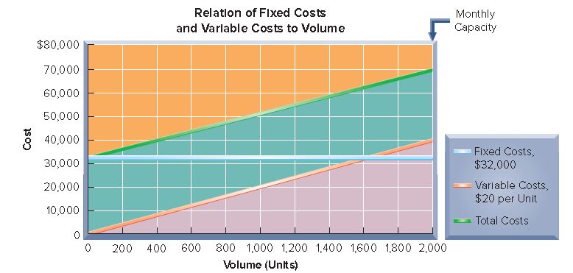
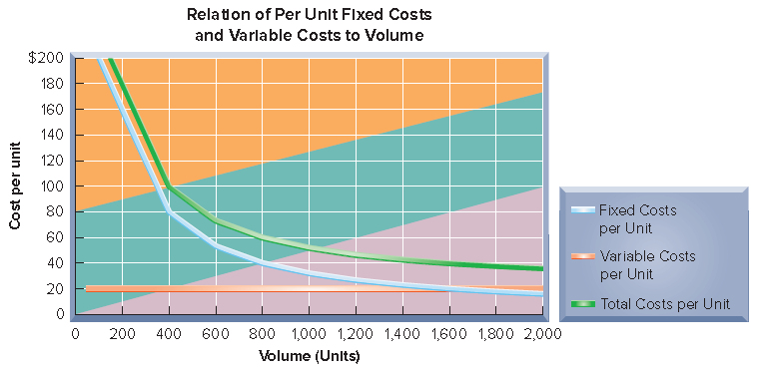
Fixed Costs
Exhibit 18.2
© McGraw-Hill Education
Learning Objective C1: Describe different types of cost behavior in relation to production and sales volume.
Notes:
Fixed costs remain unchanged despite variations in the volume of activity within a relevant range. For example, $32,000 in monthly rent paid for a factory building remains the same whether the factory operates with a single eight-hour shift or around the clock with three shifts. This means that rent cost is the same each month at any level of output from zero to the plant’s full productive capacity.
When production volume and costs are graphed, units of product are usually plotted on the horizontal axis and dollars of cost are plotted on the vertical axis.
Though the total amount of fixed cost does not change as volume changes, fixed cost per unit of output decreases as volume increases. For instance, if 200 units are produced when monthly rent is $32,000, the average rent cost per unit is $160 (computed as $32,000/200 units). When production increases to 1,000 units per month, the average rent cost per unit decreases to $32 (computed as $32,000/1,000 units).
The upper graph in Exhibit 18.2 shows the relation between total fixed costs and volume, and the relation between total variable cost and volume. We see that total fixed costs of $32,000 remains the same at all production levels up to the company’s monthly capacity of 2,000 units. We also see that total variable costs increase by $20 per unit for each additional unit produced. When variable costs are plotted on a graph of cost and volume, they appear as a straight line starting at the zero cost level.
The lower graph in Exhibit 18.2 shows that fixed costs per unit decrease as production increases. This drop in per unit costs as production increases is known as economies of scale. This lower graph also shows that variable costs per unit remain constant as production levels change.

Slide 6
Variable Costs
Exhibit 18.2
© McGraw-Hill Education
Learning Objective C1: Describe different types of cost behavior in relation to production and sales volume.
Notes:
Variable costs change in proportion to changes in volume of activity. The direct materials cost of a product is one example of a variable cost. If one unit of product requires materials costing $20, total materials costs are $200 when ten units of product are manufactured, $400 for 20 units and so on.
While the total amount of variable cost changes with the level of production, variable cost per unit remains constant as volume changes.

Slide 7
Mixed Costs
Exhibit 18.2
© McGraw-Hill Education
Learning Objective C1: Describe different types of cost behavior in relation to production and sales volume.
Notes:
Are all costs only either fixed or variable? No—another category, mixed costs, includes both fixed and variable cost components. For example, compensation for sales representatives often includes a fixed monthly salary and a variable commission based on sales. Utilities can also be considered a mixed cost; even if no units are produced, it is not likely a manufacturing plant will use no electricity or water. Like a fixed cost, a mixed cost is greater than zero when volume is zero; but unlike a fixed cost, it increases steadily in proportion to increases in volume.
The total cost line in the top graph in this slide starts on the vertical axis at the $32,000 fixed cost point. Thus, at the zero volume level, total cost equals the fixed costs. As the volume of activity increases, the total cost line increases at an amount equal to the variable cost per unit. This total cost line is a “mixed cost”—and it is highest when the volume of activity is at 2,000 units (the end point of the relevant range). In CVP analysis, mixed costs should be separated into fixed and variable components. The fixed component is added to other fixed costs, and the variable component is added to other variable costs.
We show how to separate costs later in this chapter.

Slide 8
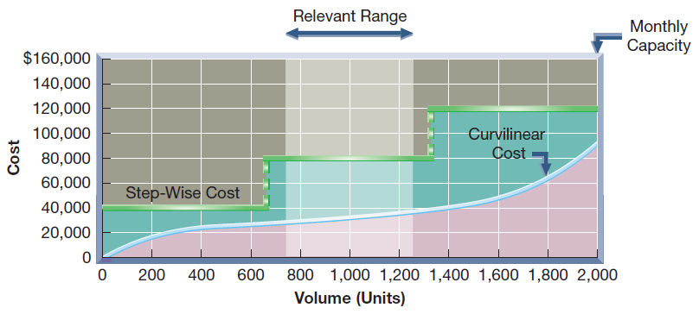
Step-Wise Costs
Exhibit 18.3
Total cost increases to a new higher cost for the next higher range of activity, but remains constant within a range of activity.
© McGraw-Hill Education
Learning Objective C1: Describe different types of cost behavior in relation to production and sales volume.
Notes:
A step-wise cost (or stair-step cost) reflects a step pattern in costs. Salaries of production supervisors are fixed within a relevant range of the current production volume. However, if production volume expands significantly (for example, with the addition of another shift), additional supervisors must be hired. This means that the total cost for supervisory salaries steps up by a lump-sum amount. Similarly, if production volume takes another significant step up, supervisory salaries will increase by another lump sum. This behavior is graphed in this slide. See how the step-wise cost line is flat within ranges, called the relevant range. Then, when volume significantly changes, the cost steps up to another level for that range.

Slide 9
Curvilinear Costs
Exhibit 18.3
Costs that increase when activity increases, but in a nonlinear manner.
Learning Objective C1: Describe different types of cost behavior in relation to production and sales volume.
© McGraw-Hill Education
Notes:
Curvilinear costs also increase as volume increases, but at a nonconstant rate. The curved line in this slide shows a curvilinear cost beginning at zero (when production is zero) and increasing at different rates as volume increases.
One example of a curvilinear cost is total direct labor cost. At low levels of production, employees can specialize in certain tasks. This efficiency results in a flatter slope in the curvilinear cost graph at lower levels of production in Exhibit 18.3. At some point, adding more employees creates inefficiencies (they get in each other’s way or do not have special skills). This inefficiency is reflected in a steeper slope at higher levels of production in the curvilinear cost graph in Exhibit 18.3.
In CVP analysis, step-wise costs are usually treated as either fixed or variable costs. Likewise, curvilinear costs are typically treated as variable costs, and thus constant per unit. These treatments involve manager judgment and depend on the width of the relevant range and the expected volume.
Review what you have learned in the following NEED-TO-KNOW Slides.

Slide 10
NEED-TO-KNOW 18-1
Determine whether each of the following is best described as a fixed, variable, mixed, step-wise, or curvilinear
cost as the number of product units changes.
Rubber used to manufacture tennis balls
$0.50 per tennis ball
Variable cost
Depreciation (straight-line method)
Electricity cost
Supervisory salaries
A salesperson’s commission is 7% for sales of up to $100,000, and
10% of sales for sales above $100,000
$0.50 per tennis ball
-
Variable
$6,000
$5,000
$4,000
Total Cost
$3,000
$2,000
$1,000
$0
0
2,000
4,000
6,000
8,000
10,000
Units Produced
© McGraw-Hill Education
Learning Objective C1: Describe different types of cost behavior in relation to production and sales volume.
Notes:
Determine whether each of the following is best described as a fixed, variable, mixed, step-wise, or curvilinear cost with respect to product units. For each of these items, we'll chart the cost, and we're going to pay careful attention to where the line begins, and how the line behaves as production increases.
Rubber used to manufacture tennis balls: Let's assume the cost is $0.50 per tennis ball. If zero units are produced, the cost is $0. If 2,000 units are produced, the cost is $1,000; 4,000 units, the total cost is $2,000; and so on. This is a variable cost. The variable cost line always starts at the origin and increases at a constant slope, in this case, $0.50 per unit.

Slide 11
NEED-TO-KNOW 18-1
Determine whether each of the following is best described as a fixed, variable, mixed, step-wise, or curvilinear
cost with respect to product units.
Rubber used to manufacture tennis balls
$0.50 per ball
Variable cost
Depreciation (straight-line method)
$2,000 per month
Fixed cost
Electricity cost
Supervisory salaries
A salesperson’s commission is 7% for sales of up to $100,000, and
10% of sales for sales above $100,000
$2,000 per month
-
Fixed
$2,500
$2,000
Total Cost
$1,500
$1,000
$500
$0
0
2,000
4,000
6,000
8,000
10,000
Units Produced
© McGraw-Hill Education
Learning Objective C1: Describe different types of cost behavior in relation to production and sales volume.
Notes:
Depreciation (straight-line method): Let's assume that depreciation is $2,000 per month. Even if zero units are produced, the cost is $2,000. The cost remains at $2,000, regardless of the number of units produced. This is a fixed cost. Fixed costs remain constant, regardless of changes in production. The total amount of fixed cost is always equal to the y-intercept.

Slide 12
NEED-TO-KNOW 18-1
Determine whether each of the following is best described as a fixed, variable, mixed, step-wise, or curvilinear
cost with respect to product units.
Rubber used to manufacture tennis balls
$0.50 per ball
Variable cost
Depreciation (straight-line method)
$2,000 per month
Fixed cost
Electricity cost
$500 + $0.10 per ball
Mixed cost
Supervisory salaries
A salesperson’s commission is 7% for sales of up to $100,000, and
10% of sales for sales above $100,000
$500 + $0.10 per unit
-
Mixed
$1,600
$1,400
$1,200
$1,000
Total Cost
$800
$600
$400
$200
$0
0
2,000
4,000
6,000
8,000
10,000
Units Produced
© McGraw-Hill Education
Learning Objective C1: Describe different types of cost behavior in relation to production and sales volume.
Notes:
The electricity cost: Let's assume that the cost is $500 plus $0.10 per tennis ball. Even if zero units are produced, the electricity bill will be $500. The total cost increases by $0.10 for each unit produced. If 2,000 units are produced, the cost is $700; 4,000 units produced, the cost is $900, and so on. This is a mixed cost. A mixed cost has a fixed component, the y-intercept, and then increases at a constant rate, in this case $0.10 per unit.

Slide 13
NEED-TO-KNOW 18-1
Determine whether each of the following is best described as a fixed, variable, mixed, step-wise, or curvilinear
cost with respect to product units.
Rubber used to manufacture tennis balls
$0.50 per ball
Variable cost
Depreciation (straight-line method)
$2,000 per month
Fixed cost
Electricity cost
$500 + $0.10 per ball
Mixed cost
Supervisory salaries 4,000 units per shift
$5,000 per mo. per supervisor
Fixed *
A salesperson’s commission is 7% for sales of up to $100,000, and
10% of sales for sales above $100,000
$5,000 per supervisor per month
-
Step
-
wise
$16,000
$14,000
$12,000
$10,000
$8,000
Total Cost
$6,000
$4,000
$2,000
$0
0
2,000
4,000
6,000
8,000
10,000
Units Produced
* If more shifts are added, then supervisory salaries behave like a step-wise cost with respect to the number of shifts.
© McGraw-Hill Education
Learning Objective C1: Describe different types of cost behavior in relation to production and sales volume.
Notes:
Supervisory salaries: Let's assume that 4,000 units can be produced per shift, and each supervisor earns $5,000 per month. The company will require one supervisor for production volumes up to 4,000 units. As soon as the production volume increases beyond 4,000 units, they need to add a second supervisor. The cost increases to $10,000. The cost will remain at $10,000 up until the production volume is 8,000 units, at which point, they'll need to add a third shift, increasing the cost to $15,000. This is an example of a step-wise cost.

Slide 14
NEED-TO-KNOW 18-1
Determine whether each of the following is best described as a fixed, variable, mixed, step-wise, or curvilinear
cost with respect to product units.
Rubber used to manufacture tennis balls
$0.50 per ball
Variable cost
Depreciation (straight-line method)
$2,000 per month
Fixed cost
Electricity cost
$500 + $0.10 per ball
Mixed cost
Supervisory salaries 4,000 units per shift
$5,000 per mo. per supervisor
Step-wise cost
A salesperson’s commission is 7% for sales of up to $100,000, and
Curvilinear cost
10% of sales for sales above $100,000
Sales Commissions
-
Curvilinear
$30,000
$25,000
$20,000
Total Cost
$15,000
$10,000
$5,000
$0
$0
$50,000
$100,000
$150,000
$200,000
$250,000
$300,000
Sales $
© McGraw-Hill Education
Learning Objective C1: Describe different types of cost behavior in relation to production and sales volume.
Notes:
Salesperson’s commission: A salesperson's commission is 7% for sales up to $100,000, and 10% of sales for sales above $100,000. If sales are $0, sales commissions are also $0. Total commissions increase at a rate of 7% of sales, up until sales equal $100,000. Total commissions are $7,000 when sales are $100,000. Once sales exceed the $100,000 threshold, the commission rate increases to 10%. The total commission cost increases, as does the slope of the total cost line. This is a curvilinear cost.

Slide 15
P1: Determine cost estimates using the scatter diagram, high-low, and regression methods of estimating costs.
Learning Objective
© McGraw-Hill Education

Slide 16
Measuring Cost Behavior
The objective is to classify all costs as either fixed or variable. We will look at three methods:
Scatter diagram
High-low method
Regression
© McGraw-Hill Education
Learning Objective P1: Determine cost estimates using the scatter diagram, high-low, and regression methods of estimating costs.
Notes:
Identifying and measuring cost behavior requires careful analysis and judgment. An important part of this process is to identify costs that can be classified as either fixed or variable, which often requires analysis of past cost behavior. A goal of classifying costs is to develop a cost equation. The cost equation expresses total costs as a function of fixed costs plus variable cost per unit. Three methods are commonly used to analyze past costs:
scatter diagram
high-low method
regression

Slide 17
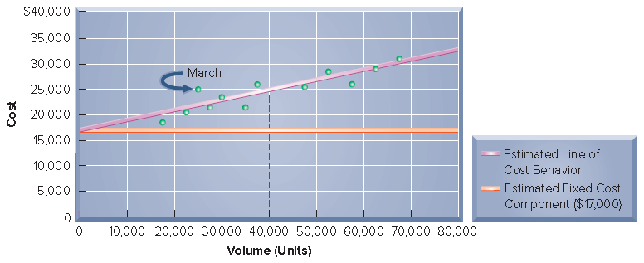
Scatter Diagrams
Exhibit 18.5a
Exhibit 18.5b
© McGraw-Hill Education
Learning Objective P1: Determine cost estimates using the scatter diagram, high-low, and regression methods of estimating costs.
Notes:
Scatter diagrams are graphs of unit volume and cost data. Units are plotted on the horizontal axis and costs are plotted on the vertical axis. Each point on a scatter diagram reflects the cost and number of units for a prior period.
In this graph, the prior 12 months’ costs and numbers of units are graphed. Each point reflects total costs incurred and units produced in that month. For instance, the point labeled March had units produced of 25,000 and costs of $25,000.
The estimated line of cost behavior is drawn on a scatter diagram to reflect the relation between cost and unit volume. This line best visually “fits” the points in a scatter diagram. Fitting this line demands judgment, or can be done with spreadsheet software.
The line drawn in the graph intersects the vertical axis at approximately $17,000, which reflects fixed cost.
To compute variable cost per unit, we perform three steps.
Step 1: Select any two levels of units produced, say 0 and 40,000.
Step 2: Identify total costs at each of those production levels (at zero units of output, total costs equal fixed costs of $17,000, and at 40,000 units of output, total costs equal $25,000).
Step 3: Compute the slope of the line, which is the change in cost divided by the change in units.
The equation on this slide shows this computation. Variable cost is $0.32 per unit. Thus, the cost equation that management will use to estimate costs for different unit levels is $17,000 plus $0.32 per unit produced.

Slide 18
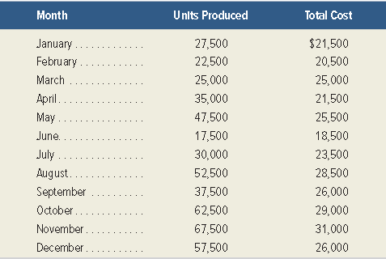
The High-Low Method
Exhibit 18.4
The following relationships between units produced and total cost are observed:
Using these two levels of volume, compute:
the variable cost per unit.
the total fixed cost.
© McGraw-Hill Education
Learning Objective P1: Determine cost estimates using the scatter diagram, high-low, and regression methods of estimating costs.
Notes:
The high-low method is a way to estimate the cost equation using just two points: the highest and lowest volume levels. The high-low method follows these steps:
Step 1: Identify the highest and lowest volume levels. These might not be the highest or lowest levels of costs.
Step 2: Compute the slope (variable cost per unit) using the high and low volume levels.
Step 3: Compute the total fixed costs by computing the total variable cost at either the high or low volume level, and then subtracting that amount from the total cost at that volume level.

Slide 19
The High-Low Method
Exhibit 18.6
Exhibit 18.7
Total cost = $14,125 + $0.25 per unit produced
© McGraw-Hill Education
Learning Objective P1: Determine cost estimates using the scatter diagram, high-low, and regression methods of estimating costs.
Notes:
We illustrate the high-low method here.
Step 1: In our case, the lowest number of units is 17,500, and the highest is 67,500. The costs corresponding to these unit volumes are $18,500 and $31,000, respectively (see the data in Exhibit 18.4).
Step 2: The variable cost per unit is calculated using a simple formula: change in cost divided by the change in units. Using the data from the high and low unit volumes, this results in a slope, or variable cost per unit, of $0.25 as computed in Exhibit 18.6.
Step 3: To estimate the fixed cost for the high-low method, we use the knowledge that total cost equals fixed cost plus variable cost per unit times the number of units. Then we pick either the high or low point (based on volume) to determine the fixed cost. This computation is shown in Exhibit 18.7— where we use the high point (67,500 units) in determining the fixed cost of $14,125. (Use of the low point yields the same fixed cost estimate.)
Thus, the cost equation from the high-low method is $14,125 plus $0.25 per unit produced. This cost equation differs from that determined from the scatter diagram method. A weakness of the high-low method is that it ignores all data points except the highest and lowest volume levels.

Slide 20
Regression
Regression is usually covered in advanced cost accounting courses. It is commonly used with spreadsheet programs or calculators.
The objective of the cost analysis remains the same: determination of total fixed cost and the variable unit cost.
© McGraw-Hill Education
Learning Objective P1: Determine cost estimates using the scatter diagram, high-low, and regression methods of estimating costs.
Notes:
Least-squares regression is a statistical method for identifying cost behavior. For our purposes, we use the cost equation estimated from this method but leave the computational details for more advanced courses. Such computations for least-squares regression are readily done using most spreadsheet programs or calculators. We illustrate this using Excel in this chapter’s Appendix. Using least-squares regression, the cost equation for the data presented in Exhibit 21.3 is $16,688 plus $0.20 per unit produced; that is, the fixed cost is estimated as $16,688 and the variable cost at $0.19 per unit.

Slide 21
Comparison of Cost Estimation Methods
Exhibit 18.8
© McGraw-Hill Education
Learning Objective P1: Determine cost estimates using the scatter diagram, high-low, and regression methods of estimating costs.
Notes:
The three cost estimation methods result in different estimates of fixed and variable costs as summarized in this slide. Estimates from the scatter diagram, unless done with spreadsheet software, are based on a visual fit of the cost line and are subject to interpretation. Estimates from the high-low method use only two sets of values corresponding to the lowest and highest unit volumes. Sometimes these two extreme activity levels do not reflect the more usual conditions likely to recur. Estimates from least-squares regression use a statistical technique and all available data points.
We must remember that all three methods use past data. Thus, cost estimates resulting from these methods are only as good as the data used for estimation. Managers must establish that the data are reliable in deriving cost estimates for the future. If the data are reliable, the use of more data points, as in the regression or scatter diagram methods, should yield more accurate estimates than the high-low method. However, the high-low method is easier to apply and thus might be useful for obtaining a quick cost equation estimate.
Review what you have learned in the following NEED-TO-KNOW Slides.

Slide 22
NEED-TO-KNOW 18-2
Using the information below, use the high-low method to determine the cost equation
(total fixed costs plus variable costs per unit).
Volume
Units
Total Cost
Level
Produced
Lowest
1,600
$9,800
Highest
4,000
17,000
Variable Cost =
Cost at high point - Cost at low point
($17,000 - $9,800)
$7,200
Units at high point - Units at low point
(4,000 - 1,600)
2,400
$3
per unit produced
Fixed Costs (at high point)
Total cost = Fixed costs + $3 per unit
$17,000 = Fixed costs + ($3 x 4,000)
$5,000 = Fixed costs
Fixed Costs (at low point)
Total cost = Fixed costs + $3 per unit
$9,800 = Fixed costs + ($3 x 1,600)
$5,000 = Fixed costs
Total costs = $5,000 + $3 per unit
© McGraw-Hill Education
Learning Objective P1: Determine cost estimates using the scatter diagram, high-low, and regression methods of estimating costs.
Notes:
Using the information below, use the high-low method to determine the cost equation (total fixed costs plus variable costs per unit).
We begin by calculating the variable cost per unit. The formula for variable cost takes the cost at the high point minus the cost at the low point and divides by the units at the high point minus the units at the low point. ($17,000 - $9,800) divided by (4,000 units - 1,600 units). The change in cost, $7,200, as a result of the change in volume, an increase of 2,400 units, equals a variable cost of $3 per unit produced. Now that we have the variable cost per unit, we calculate the total fixed costs at either the high point or the low point.

Slide 23
NEED-TO-KNOW 18-2 SOLUTION
Slope = Variable Cost $3 per unit
y-intercept = Fixed Costs $5,000
Total Cost
= $5,000 + $3 per unit
$18,000
$16,000
(4,000 units, $17,000)
$14,000
$12,000
Total Cost
$10,000
(1,600 units, $9,800)
$8,000
$6,000
$4,000
(0 units, $5,000)
$2,000
$0
0
500
1,000
1,500
2,000
2,500
3,000
3,500
4,000
4,500
Units Produced
© McGraw-Hill Education
Learning Objective P1: Determine cost estimates using the scatter diagram, high-low, and regression methods of estimating costs.
Notes:
To calculate fixed costs at the high point: Total cost equals fixed cost plus $3 per unit. We know that total costs at the high point are $17,000. Variable costs at the high point are $12,000; $3 per unit for each of the 4,000 units produced. Fixed costs at the high point are $5,000. Fixed costs remain constant at all levels of production, and we can prove this by using our cost formula at the low point. Total cost equals fixed cost plus $3 per unit. We know that the total cost at the low point is $9,800. Variable costs at the low point, $3 per unit for each of the 1,600 units produced, are $4,800; fixed costs are $5,000.
Total costs equal $5,000 plus $3 per unit. The cost equation is the formula for the line that connects the low point (1,600 units and $9,800) with the high point (4,000 units and $17,000). The slope of the line is the variable cost, $3 per unit. When we connect the two points and extend the line back to production volume of zero, we see that total fixed costs are $5,000; the y-intercept represents the fixed costs.

Slide 24
A1: Compute the contribution margin and describe what it reveals about a company’s cost structure.
Learning Objective
© McGraw-Hill Education

Slide 25
Contribution Margin and Its Measures
Exhibit 18.9
Exhibit 18.10
© McGraw-Hill Education
Learning Objective A1: Compute the contribution margin and describe what it reveals about a company’s cost structure.
Notes:
After we classify costs as fixed or variable we can compute the contribution margin, which equals total sales minus total variable costs. The contribution margin contributes to covering fixed costs and generating profits. Contribution margin per unit, or unit contribution margin, is the amount by which a product’s unit selling price exceeds its variable cost per unit. The top graphic shows the formula to calculate contribution margin per unit.
The contribution margin ratio is the percent of a unit’s selling price that exceeds total unit variable cost. It can be interpreted as the percent of each sales dollar that remains after deducting the unit variable cost. The second graphic shows the formula for the contribution margin ratio.
To illustrate the use of contribution margin, let’s consider Rydell, which sells footballs for $100 each and incurs variable costs of $70 per football sold. Its fixed costs are $24,000 per month with monthly capacity of 1,800 units (footballs). Rydell’s contribution margin per unit is $30, which is computed as shown.
Thus, at a selling price of $100 per unit, Rydell covers its per unit variable costs and makes $30 per football to contribute to fixed costs and profit. Rydell’s contribution margin ratio is 30%, computed as $30/$100. A contribution margin ratio of 30% implies that for each $1 in sales, Rydell has $0.30 that contributes to fixed cost and profit.

Slide 26
P2: Compute the break-even point for a single product company.
Learning Objective
© McGraw-Hill Education

Slide 27
Break-Even Point
Sales level at which total sales equal total costs.
Company neither earns a profit nor incurs a loss.
Can be expressed in units or dollars of sales.
Three methods to find break-even point:
Formula
Contribution margin income statement
Cost-volume-profit chart
Learning Objective P2: Compute the break-even point for a single product company.
© McGraw-Hill Education
Notes:
The break-even point is the sales level at which total sales equal total costs and a company neither earns a profit nor incurs a loss. Break-even applies to nearly all organizations, activities, and events. A key concern when launching a project is whether it will break even—that is, whether sales will at least cover total costs. The break-even point can be expressed in either units or dollars of sales.
To illustrate break-even analysis, let’s again look at Rydell, which sells footballs for $100 per unit and incurs $70 of variable costs per unit sold. Its fixed costs are $24,000 per month. Three different methods are used to find the break-even point.
Formula
Contribution margin income statement
Cost-volume-profit chart

Slide 28
Formula Method
Exhibit 18.11
Exhibit 18.12
Learning Objective P2: Compute the break-even point for a single product company.
© McGraw-Hill Education
Notes:
We compute the break-even point using the formula in this slide. This formula uses the contribution margin per unit (calculated above), which for Rydell is $30 ($100 - $70). The break-even sales volume in units is $24,000 / $30 = 800 units per month.
If Rydell sells 800 units, its profit will be zero. Profit increases or decreases by $30 for every unit sold above or below that break-even point; if Rydell sells 801 units, profit will equal $30. We also can calculate the break-even point in dollars. Also called break-even sales dollars, it uses the contribution margin ratio to determine the required sales dollars needed for the company to break even.
The second graphic shows the formula and Rydell’s break-even point in dollars.

Slide 29
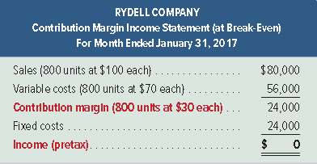
Contribution margin income statement method
Exhibit 18.13
© McGraw-Hill Education
Learning Objective P2: Compute the break-even point for a single product company.
Notes:
The left-side of this Exhibit shows the general format of a contribution margin income statement. It differs in format from a traditional income statement in two ways. First, it separately classifies costs and expenses as variable or fixed. Second, it reports contribution margin (sales – variable costs).
We can use this statement as another way to find the break-even point. For Rydell to break even, its contribution margin must exactly equal its fixed costs of $24,000. For Rydell’s contribution margin to equal $24,000, it must sell 800 units ($24,000/$30). The resulting contribution margin income statement shows that the $80,000 revenue from sales of 800 units exactly equals the sum of variable and fixed costs.
Review what you have learned in the following NEED-TO-KNOW Slides.

Slide 30
NEED-TO-KNOW 18-3
Hudson Co. predicts fixed costs of $400,000 for 2017. Its one product sells for $170 per unit, and it incurs
variable costs of $150 per unit. The company predicts total sales of 25,000 units for the next year.
1. Compute the contribution margin per unit.
$20 per unit
2. Compute the break-even point (in units).
3. Prepare a contribution margin income statement at the break-even point.
Contribution margin per unit, or unit contribution margin, is the amount by which a product’s unit selling price exceeds its total variable cost per unit.
Sales $170 per unit
Variable costs 150 per unit
Contribution margin $ 20 per unit
Learning Objective P2: Compute the break-even point for a single product company.
© McGraw-Hill Education
Notes:
A manufacturer predicts fixed costs of $400,000 for the next year. Its one product sells for $170 per unit, and it incurs variable costs of $150 per unit. The company predicts total sales of 25,000 units for the next year.
1. Compute the contribution margin per unit. Contribution margin per unit, or unit contribution margin, is the amount by which a product’s unit selling price exceeds its total variable cost per unit. Sales of $170 per unit, minus variable costs of $150 per unit is a contribution margin of $20 per unit. Each unit increases sales by $170, but simultaneously increases the variable costs. Each unit sold contributes $20 toward first meeting the fixed costs, and then contributing toward profit.

Slide 31
NEED-TO-KNOW 18-3
Hudson Co. predicts fixed costs of $400,000 for 2017. Its one product sells for $170 per unit, and it incurs
variable costs of $150 per unit. The company predicts total sales of 25,000 units for the next year.
1. Compute the contribution margin per unit.
$20 per unit
2. Compute the break-even point (in units).
20,000 units
3. Prepare a contribution margin income statement at the break-even point.
Break-even point in units = Fixed costs
Contribution margin per unit
$400,000
$20 per unit
20,000 units to break-even
Units
per unit
Total
Sales
20,000
$170
$3,400,000
Variable costs
20,000
$150
3,000,000
Contribution margin
$20
400,000
Fixed costs
400,000
Net income
$0
© McGraw-Hill Education
Learning Objective P2: Compute the break-even point for a single product company.
Notes:
2. Compute the break-even point (in units). The formula for the break-even point takes the fixed costs and divides by the contribution margin per unit. Fixed costs of $400,000 divided by $20 per unit is break-even units of 20,000. If the company sells exactly 20,000 units, their net income is $0. We can prove this by preparing a contribution margin income statement. The sales of 20,000 units, each unit selling for $170, is a total sales of $3,400,000. Variable costs; 20,000 units multiplied by $150 per unit is total variable costs of $3,000,000. The contribution margin is $20 per unit, or $400,000 in total. When we subtract the fixed costs of $400,000, net income is $0. 20,000 units is the break-even point.

Slide 32
P3: Graph costs and sales for a single product company.
Learning Objective
© McGraw-Hill Education

Slide 33
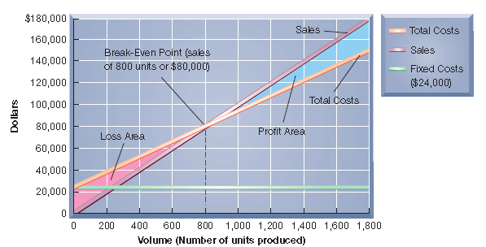
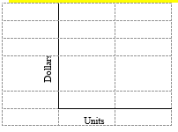
Graphing – Cost-volume-profit Chart
Exhibit 18.14
© McGraw-Hill Education
Learning Objective P2: Compute the break-even point for a single product company.
Notes:
A third way to find the break-even point is by graphing using a cost-volume-profit (CVP) chart (break-even chart). Exhibit 18.14 shows Rydell’s CVP chart. In a CVP chart, the horizontal axis is the number of units produced and sold, and the vertical axis is dollars of sales and costs. The lines in the chart show both sales and costs at different output levels.
1. Plot fixed costs on the vertical axis ($24,000 for Rydell). Draw a horizontal line at this level to show that fixed costs remain unchanged regardless of output volume (drawing this fixed cost line is not essential to the chart).
2. Draw the total (variable plus fixed) cost line for a relevant range of volume levels. This line starts at the fixed costs level on the vertical axis because total costs equal fixed costs at zero volume. The slope of the total cost line equals the variable cost per unit ($70). To draw the line, compute the total costs for any volume level, and connect this point with the vertical axis intercept ($24,000).
3. Draw the sales line. Start at the origin (zero units and zero dollars of sales) and make the slope of this line equal to the selling price per unit ($100). To draw the line, compute dollar sales for any volume level and connect this point with the origin. Do not extend this line beyond the productive capacity. Total sales will be highest at maximum capacity.
The total cost line and the sales line intersect at 800 units in Exhibit 21.14, which is the breakeven point—the point where total dollar sales of $80,000 equals the sum of both fixed and variable costs ($80,000).

Slide 34
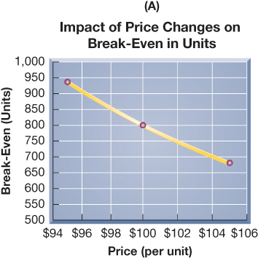
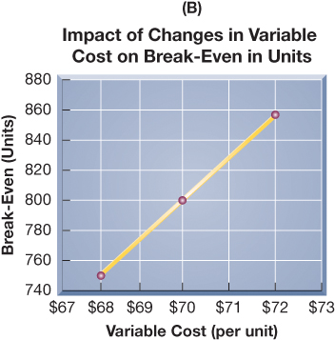
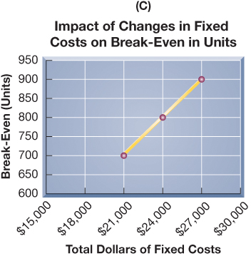
Changes in Estimates
Exhibit 18.15
Exhibit 18.16
Exhibit 18.17
© McGraw-Hill Education
Learning Objective P3: Graph costs and sales for a single product company.
Notes:
Because CVP analysis uses estimates, knowing how changes in those estimates impact break-even is useful. For example, a manager might form three estimates for each of the components of break-even: optimistic, most likely, and pessimistic. Then ranges of break-even points in units can be computed, using any of the three methods shown. To illustrate, assume Rydell’s managers provide the set of estimates in this slide.
If, for example, Rydell’s managers believe they can raise the selling price of a football to $105, without any change in unit variable or total fixed costs, then the revised contribution margin per football is $35 ($105 - $70), and the revised break-even in units is shown in the middle graphic.
Repeating this calculation using each of the other eight separate estimates above (and keeping other estimates unchanged from their original amounts), and graphing the results, yields the three graphs as shown.
These graphs show how changes in selling prices, variable costs, and fixed costs impact break-even. When selling prices can be increased without impacting unit variable costs or total fixed costs, break-even decreases (graph A). When competition reduces selling prices, and the company cannot reduce costs, break-even increases (graph A). Increases in either variable (graph B) or fixed costs (graph C), if they cannot be passed on to customers via higher selling prices, will increase break-even. If costs can be reduced and selling prices held constant, the break-even point decreases.

Slide 35
C2: Describe several applications of cost-volume-profit analysis.
Learning Objective
© McGraw-Hill Education

Slide 36
Computing the Margin of Safety
© McGraw-Hill Education
Learning Objective P2: Compute the break-even point for a single product company.
Notes:
All companies wish to sell more than the break-even number of units. The excess of expected sales over the break-even sales level is called a company’s margin of safety, the amount that sales can drop before the company incurs a loss. It is often expressed in dollars or as a percent of the expected sales level.
To illustrate, recall that Rydell’s break-even point in dollars is $80,000. If its expected sales are $100,000, the margin of safety is $20,000 ($100,000 - $80,000). As a percent, the margin of safety is 20% of expected sales as shown in this slide.
Management must assess whether the margin of safety is adequate in light of factors such as sales variability, competition, consumer tastes, and economic conditions.
Review what you have learned in the following NEED-TO-KNOW Slides.

Slide 37
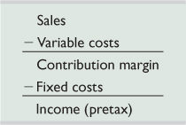
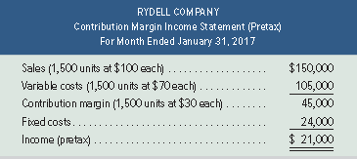
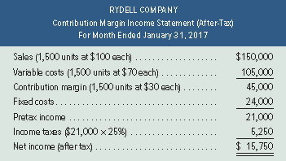
Computing Income from Sales and Costs
Exhibit 18.19
Exhibit 18.20
Exhibit 18.21
© McGraw-Hill Education
Learning Objective C2: Describe several applications of cost-volume-profit analysis.
Notes:
Managers often use contribution margin income statements to forecast future sales or income. Exhibit 18.19 shows the key variables in CVP analysis—sales, variable costs, contribution margin, and fixed costs, and their relations to income (pretax). To answer the question “What is the predicted income from a predicted level of sales?” we work our way down this income statement to compute income.
To illustrate, let’s assume that Rydell’s management expects to sell 1,500 units in January 2017. What is the amount of income if this sales level is achieved? Using the calculation format in the top graphic we compute Rydell’s expected income in the middle graphic.
To find the amount of after-tax income from selling 1,500 units, management must apply the proper tax rate. Assume that the tax rate is 25%. Then we can prepare a projected after-tax income statement, shown in the bottom graphic. After-tax income can also be computed as pre-tax income x (1-tax rate).
Management then assesses whether this income is an adequate return on assets invested. Management should also consider whether sales and income can be increased by raising or lowering prices. CVP analysis is a good tool for addressing these kinds of “what-if” questions.

Slide 38
Computing Sales for a Target Income
Exhibit 18.22
© McGraw-Hill Education
Learning Objective C2: Describe several applications of cost-volume-profit analysis.
Notes:
Many companies’ annual plans are based on certain income targets (sometimes called budgets). Rydell’s goal for this year is to increase income by 10% over the prior year. CVP analysis helps to determine the sales level needed to achieve the target income. Planning for the year is then based on this level.
We use the formula shown in Exhibit 18.22 to compute sales for a target income (pretax). To illustrate, Rydell has monthly fixed costs of $24,000 and a 30% contribution margin ratio. Assume that it sets a target monthly income of $12,000. Using the formula in Exhibit 18.22, we find that Rydell needs $120,000 of sales to produce a $12,000 pretax target income.

Slide 39
Computing Sales for a Target Income
Exhibit 18.23
Learning Objective C2: Describe several applications of cost-volume-profit analysis.
© McGraw-Hill Education
Notes:
Alternatively, we can compute unit sales instead of dollar sales. To do this, we substitute contribution margin per unit for the contribution margin ratio in the denominator. This gives the number of units to sell to reach the target income. Exhibit 18.23 illustrates this for Rydell. The two computations in Exhibits 18.22 and 18.23 are equivalent because sales of 1,200 units at $100 per unit equal $120,000 of sales.

Slide 40
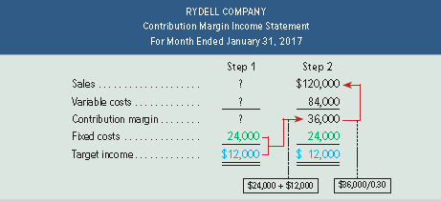
Computing Sales for a Target Income
Exhibit 18.24
© McGraw-Hill Education
Learning Objective C2: Describe several applications of cost-volume-profit analysis.
Notes:
We can also use the contribution margin income statement approach to compute sales for a target income, in two steps:
Step 1: Insert the fixed costs ($24,000) and the target profit level ($12,000) into a contribution margin income statement, as shown in Exhibit 18.24. To cover its fixed costs of $24,000 and yield target income of $12,000, Rydell must generate a contribution margin of $36,000 (computed as $24,000 plus $12,000).
Step 2: Enter $36,000 in the contribution margin row as Step 2. With a contribution margin ratio of 30%, sales must be $120,000, computed as $36,000 / 0.30, to yield a contribution margin of $36,000. We enter $120,000 in the sales row of the contribution margin income statement and solve for variable costs of $84,000 (computed as $120,000 - $36,000). At a selling price of $100 per unit, Rydell must sell 1,200 units ($120,000 / $100) to earn a target income of $12,000.
Review what you have learned in the following NEED-TO-KNOW Slides.

Slide 41
NEED-TO-KNOW 18-4
A manufacturer predicts fixed costs of $502,000 for the next year. Its one product sells for $180 per unit,
and it incurs variable costs of $126 per unit. Its target income (pretax) is $200,000.
1. Compute the contribution margin ratio.
30%
2. Compute the dollar sales needed to yield the target income.
3. Compute the unit sales needed to yield the target income.
The contribution margin ratio is the percent of a unit’s selling price that exceeds total unit variable cost.
Contribution margin ratio = Contribution margin per unit
Selling price per unit
$180 - $126 $54
$180 $180
30%
per unit
Ratio
Sales
$180
100%
Variable costs
126
70%
Contribution margin
$54
30%
© McGraw-Hill Education
Learning Objective C2: Describe several applications of cost-volume-profit analysis.
Notes:
A manufacturer predicts fixed costs of $502,000 for the next year. Its one product sells for $180 per unit, and it incurs variable costs of $126 per unit. Its target income (pretax) is $200,000.
1. Compute the contribution margin ratio. The contribution margin ratio is the percent of a unit's selling price that exceeds total unit variable cost. It's calculated by taking the contribution margin per unit and dividing by the selling price per unit. The contribution margin for this product is $54, the $180 selling price minus the $126 in variable costs. We divide by the selling price of $180 per unit to calculate the contribution margin ratio of 30% ($54 / $180). In other words, $0.30 of every sales dollar contributes to covering the fixed costs and/or profit.

Slide 42
NEED-TO-KNOW 18-4
A manufacturer predicts fixed costs of $502,000 for the next year. Its one product sells for $180 per unit,
and it incurs variable costs of $126 per unit. Its target income (pretax) is $200,000.
1. Compute the contribution margin ratio.
30%
2. Compute the dollar sales needed to yield the target income.
$2,340,000
3. Compute the unit sales needed to yield the target income.
Dollar sales to achieve target income = Fixed costs + Pretax Income
Contribution margin ratio
$502,000 + $200,000
.30
$2,340,000
per unit
Ratio
Total
Sales
$180
100%
$2,340,000
Variable costs
$126
70%
1,638,000
Contribution margin
$54
30%
702,000
Fixed costs
502,000
Net income
$200,000
© McGraw-Hill Education
Learning Objective C2: Describe several applications of cost-volume-profit analysis.
Notes:
2. Compute the dollar sales needed to yield the target income. Dollars sales to achieve the target income are calculated by taking the fixed costs plus the targeted pretax income and dividing by the contribution margin ratio. $502,000 plus $200,000 ($702,000) divided by 30% (0.30) is $2,340,000 of sales. We can prove the accuracy by completing a contribution margin income statement. Sales of $2,340,000 minus variable costs, 70% of sales. 70% of $2,340,000 is $1,638,000. Contribution margin, 30% of sales. 30% of $2,340,000 is $702,000. When we subtract the fixed costs of $502,000, net income is $200,000.

Slide 43
NEED-TO-KNOW 18-4
A manufacturer predicts fixed costs of $502,000 for the next year. Its one product sells for $180 per unit,
and it incurs variable costs of $126 per unit. Its target income (pretax) is $200,000.
1. Compute the contribution margin ratio.
30%
2. Compute the dollar sales needed to yield the target income.
$2,340,000
3. Compute the unit sales needed to yield the target income.
13,000 units (or $2,340,000 / $180)
Units to yield target income = Fixed costs + target (pretax) income
Contribution margin per unit
$502,000 + $200,000 $702,000
$180 - $126 $54
13,000 units
Break-even point in units = Fixed costs
Contribution margin per unit
Units
per unit
Total
Sales
13,000
$180
$2,340,000
Variable costs
13,000
$126
1,638,000
Contribution margin
$54
702,000
Fixed costs
502,000
Net income
$200,000
© McGraw-Hill Education
Learning Objective C2: Describe several applications of cost-volume-profit analysis.
Notes:
3. Compute the unit sales needed to yield the target income. Previously, we calculated the break-even point in units by taking the fixed costs and dividing by the contribution margin per unit. To compute the unit sales needed to yield the target income, the denominator stays the same, contribution margin per unit. But we modify the numerator, adding the targeted pretax income to the fixed costs. $502,000 plus $200,000 divided by $54 per unit is 13,000 units. If the company sells 13,000 units for $180 per unit, sales are $2,340,000. Variable costs: 13,000 units multiplied by $126 per unit is $1,638,000. The contribution margin is $54 per unit, or a total of $702,000. We subtract the fixed costs of $502,000 to calculate net income of $200,000. If the company sells 13,000 units, net income is $200,000.
Another way to calculate the unit sales would have been to take the $2,340,000 in sales needed to yield the targeted income and divide by the $180 per unit selling price. $2,340,000 divided by $180 is 13,000 units.

Slide 44
NEED-TO-KNOW 18-4
A manufacturer predicts fixed costs of $502,000 for the next year. Its one product sells for $180 per unit,
and it incurs variable costs of $126 per unit. Its target income (pretax) is $200,000.
1. Compute the contribution margin ratio.
30%
2. Compute the dollar sales needed to yield the target income.
$2,340,000
3. Compute the unit sales needed to yield the target income.
13,000 units (or $2,340,000 / $180)
4. Assume break-even sales of 9,296 units. Compute the margin of safety (in dollars) if the company
expects to sell 10,000 units.
$126,720
The excess of expected sales over the break-even sales level is called a company’s margin of safety
Units
per unit
Total
Expected sales
10,000
$180
$1,800,000
Break-even sales
9,296
$180
1,673,280
Margin of safety
$126,720
© McGraw-Hill Education
Learning Objective C2: Describe several applications of cost-volume-profit analysis.
Notes:
Need-to-Know 18-4 Part 4

Slide 45
Evaluating Strategies
Exhibit 18.25
© McGraw-Hill Education
Learning Objective C2: Describe several applications of cost-volume-profit analysis.
Notes:
Earlier we showed how changing one of the estimates in a CVP analysis impacts break-even. We can also examine strategies that impact several estimates in the CVP analysis. For instance, we might want to know what happens to income if we automate a currently manual process. We can use sensitivity analysis to predict income if we can describe how these changes affect a company’s fixed costs, variable costs, selling price, and volume. CVP analyses based on different estimates can be useful to management in planning business strategy.
Assume Rydell is considering buying a new machine that would increase monthly fixed costs from $24,000 to $30,000 and would decrease variable costs by $10 per unit (from $70 per unit to $60 per unit). Rydell’s break-even point in dollars is currently $80,000. Management needs to know how the new machine would affect Rydell’s break-even point in dollars. If Rydell maintains its selling price of $100 per unit, its contribution margin per unit will increase to $40—computed as the sales price of $100 per unit minus the (new) variable costs of $60 per unit. With this new machine, the revised contribution margin ratio per unit is 40% (computed as $40 / $100). Rydell’s revised break-even point in dollars would be $75,000, as computed in the first graphic. The new machine would lower Rydell’s break-even point by $5,000, or 50 units, per month. The revised margin of safety increases to 25%, computed as ($100,000 - $75,000) / $100,000.

Slide 46
P4: Compute the break-even point for a multiproduct company.
Learning Objective
© McGraw-Hill Education

Slide 47
Sales Mix and Break-Even
The CVP formulas can be modified for use when a company sells more than one product.
The unit contribution margin is replaced with the contribution margin for a composite unit.
A composite unit is composed of specific numbers of each product in proportion to the product sales mix.
Sales mix is the ratio of the volumes of the various products.
© McGraw-Hill Education
Learning Objective P4: Compute the break-even point for a multiproduct company.
Notes:
So far we have looked only at cases where the company sells a single product or service. However, many companies sell multiple products or services, and we can modify the CVP analysis for use in these cases. An important assumption in a multiproduct setting is that the sales mix of different products is known and remains constant during the planning period. Sales mix is the ratio (proportion) of the sales volumes for the various products.

Slide 48
Sales Mix and Break-Even
The resulting break-even formula for composite unit sales is:
Break-even point in composite units
Fixed costs Contribution margin per composite unit
=
Continue
© McGraw-Hill Education
Learning Objective P4: Compute the break-even point for a multiproduct company.
Notes:
When companies sell more than one product or service, we estimate the break-even point by using a composite unit, which summarizes the sales mix and contribution margins of each product. Multiproduct CVP analysis treats this composite unit as a single product.

Slide 49
Sales Mix and Break-Even
Hair-Today offers three cuts as shown below. Annual fixed costs are $192,000. Compute the break-even point in composite units and in number of units for each haircut at the given sales mix.
Learning Objective P4: Compute the break-even point for a multiproduct company.
© McGraw-Hill Education
Notes:
To illustrate, let’s look at Hair-Today, a styling salon that offers three cuts: basic, ultra, and budget in the ratio of four basic units to two ultra units to one budget unit (expressed as 4:2:1). Management wants to estimate its break-even point for next year. Unit selling prices for these three cuts are basic, $20; ultra, $32; and budget, $16. Unit variable costs for these three cuts are basic $13; ultra, $18; and budget, $8. Using the 4:2:1 sales mix, the selling price and variable cost of a composite unit of the three products is computed as shown.

Slide 50
Sales Mix and Break-Even
Learning Objective P4: Compute the break-even point for a multiproduct company.
© McGraw-Hill Education
Notes:
Using the 4:2:1 sales mix, the selling price of a composite unit of the three products is computed as shown.

Slide 51
Sales Mix and Break-Even
Exhibit 18.28
© McGraw-Hill Education
Learning Objective P4: Compute the break-even point for a multiproduct company.
Notes:
Hair-Today’s fixed costs are $192,000 per year, and its unit variable costs of the three products are basic, $13; ultra, $18; and budget, $8. Variable costs for a composite unit of these products is shown.

Slide 52
Computing a Multiproduct Break-Even Point
Exhibit 18.29
Break-even point in composite units
Fixed costs Contribution margin per composite unit
=
Break-even point in composite units
$192,000 $64.00 per composite unit
=
Break-even point in composite units
= 3,000 composite units
© McGraw-Hill Education
Learning Objective P4: Compute the break-even point for a multiproduct company.
Notes:
We compute the contribution margin for a composite unit using essentially the same formula used earlier. Assuming Hair-Today’s fixed costs are $192,000 per year, we compute Hair-Today’s break-even point in composite units as shown here.

Slide 53
Computing a Multiproduct Break-Even Point
Learning Objective P4: Compute the break-even point for a multiproduct company.
© McGraw-Hill Education
Notes:
This computation implies that Hair-Today breaks even when it sells 3,000 composite units. Each composite unit represents seven haircuts. To determine how many units of each product it must sell to break even, we use the expected sales mix of 4:2:1 and multiply the number of units of each product in the composite by 3,000 as follows.

Slide 54
Multiproduct Break-Even Income Statement
Exhibit 18.30
Learning Objective P4: Compute the break-even point for a multiproduct company.
© McGraw-Hill Education
Notes:
This slide verifies the results for composite units by showing Hair-Today’s sales and costs at this break-even point using a forecasted contribution margin income statement.
If the sales mix changes, it is likely that the break-even point will change also. For example, if Hair-Today sells more ultra cuts and fewer basic cuts, its break-even point will decrease. We can vary the sales mix to see what happens under alternative strategies.
For companies that sell many different products, multiproduct break-even computations can become unwieldy. Amazon, for example, sells over 200 million different products. In such cases, managers can group these products into departments (such as clothing, sporting goods, music) and compute department contribution margins. The department contribution margins and the sales mix can be used as we illustrate in this section.
Review what you have learned in the following NEED-TO-KNOW Slides.

Slide 55
NEED-TO-KNOW 18-5
The sales mix of a company’s two products, X and Y, is 2:1. Unit variable costs for both products
are $2, and unit selling prices are $5 for X and $4 for Y. The company has $640,000 of fixed costs.
1. What is the contribution margin per composite unit?
$8
2. What is the break-even point in composite units?
3. How many units of X and how many units of Y will be sold at the break-even point?
Selling price per composite unit
Units
per unit
Total
Product X
2
$5
$10
Product Y
1
$4
4
Total
3
$14
Variable cost per composite unit
Units
per unit
Total
Product X
2
$2
$4
Product Y
1
$2
2
Total
3
$6
Contribution margin per composite unit ($14 - $6)
$8
© McGraw-Hill Education
Learning Objective P4: Compute the break-even point for a multiproduct company.
Notes:
The sales mix of a company’s two products, X and Y, is 2:1. Unit variable costs for both products are $2, and unit selling prices are $5 for X and $4 for Y. The company has $640,000 of fixed costs.
1. What is the contribution margin per composite unit? First we calculate the selling price per composite unit. Every composite unit includes two units of Product X and one unit of Product Y; Product X sells for $5 per unit. Each composite unit sold represents $10 of sales for Product X. Product Y sells for $4; total sales of $4. The selling price per composite unit is $14. The variable cost per composite unit: two units of Product X with a cost per unit of $2 is $4 in variable costs for Product X. One unit of Product Y with a variable cost per unit of $2 is $2 in variable costs for Product Y. The total variable cost per composite unit is $6. The contribution margin per composite unit: sales of $14 minus variable costs of $6, is $8 per composite unit.

Slide 56
NEED-TO-KNOW 18-5
The sales mix of a company’s two products, X and Y, is 2:1. Unit variable costs for both products
are $2, and unit selling prices are $5 for X and $4 for Y. The company has $640,000 of fixed costs.
1. What is the contribution margin per composite unit?
$8
2. What is the break-even point in composite units?
80,000 composite units
3. How many units of X and how many units of Y will be sold at the break-even point?
Break-even point in composite units = Fixed costs
Contribution margin per composite unit
$640,000
$8 per composite unit
80,000 composite units to break even
Learning Objective P4: Compute the break-even point for a multiproduct company.
© McGraw-Hill Education
Notes:
2. What is the break-even point in composite units? The break-even point is calculated by taking the fixed costs and dividing by the contribution margin per composite unit. $640,000 divided by $8 per composite unit is 80,000 composite units to break even.

Slide 57
NEED-TO-KNOW 18-5
The sales mix of a company’s two products, X and Y, is 2:1. Unit variable costs for both products
are $2, and unit selling prices are $5 for X and $4 for Y. The company has $640,000 of fixed costs.
1. What is the contribution margin per composite unit?
$8
2. What is the break-even point in composite units?
80,000 composite units
3. How many units of X and how many units of Y will be sold at the break-even point?
Units of each product at break-even
Total
Product X
80,000 composite units x 2 units per composite unit
160,000
Product Y
80,000 composite units x 1 unit per composite unit
80,000
240,000
Total Sales
Units
per unit
Total
Product X
160,000
$5
$800,000
Product Y
80,000
$4
320,000
Total
240,000
$1,120,000
Total Variable Costs
Units
per unit
Total
Product X
160,000
$2
$320,000
Product Y
80,000
$2
160,000
Total
240,000
$480,000
Composite units
per unit
Total
Sales
80,000
$14
$1,120,000
Variable costs
80,000
$6
480,000
Contribution margin
$8
640,000
Fixed costs
640,000
Net income
$0
© McGraw-Hill Education
Learning Objective P4: Compute the break-even point for a multiproduct company.
Notes:
3. How many units of X and how many units of Y will be sold at the break-even point? 80,000 composite units with two units of Product X in each composite unit is a total of 160,000 units of Product X. 80,000 composite units with one unit of Product Y per composite unit is 80,000 units of Product Y; a total of 240,000 units. We can check the accuracy of our answer by calculating total sales, 160,000 units selling for $5 per unit, $800,000 of sales of Product X; and 80,000 units of Product Y, each selling for $4 per unit, $320,000 of sales of Product Y at the break-even point. The total sales at the break-even point are $1,120,000. Total variable costs: 160,000 units of Product X at $2 per unit, $320,000; and 80,000 units of Product Y at $2 per unit, $160,000. The total variable costs at the break-even point are $480,000. Sales of $1,120,000 agrees with our calculation, 80,000 composite units with a selling price per composite unit of $14; 80,000 multiplied by $14 equals $1,120,000. Variable costs of $480,000, 80,000 units at $6 per composite unit. Contribution margin: $8 per composite unit multiplied by the 80,000 composite units is $640,000 of contribution margin. We subtract the fixed costs of $640,000. When the company breaks even, net income is $0, at 80,000 composite units.

Slide 58
Assumptions in Cost-Volume-Profit Analysis
CVP analysis relies on several assumptions:
Costs can be classified as variable or fixed
Costs are linear within the relevant range
All units produced are sold
Sales mix is constant
Learning Objective A2: Analyze changes in sales using the degree of operating leverage.
© McGraw-Hill Education
Notes:
CVP analysis relies on several assumptions:
Costs can be classified as variable or fixed
Costs are linear within the relevant range
All units produced are sold
Sales mix is constant
If costs and sales differ from these assumptions, the results of CVP analysis can be limited. Managers understand that CVP analysis gives approximate answers to questions and enables them to make rough estimates about the future.

Slide 59
A2: Analyze changes in sales using the degree of operating leverage.
Learning Objective
© McGraw-Hill Education

Slide 60
Degree of Operating Leverage
A measure of the extent to which fixed costs are being used in an organization.
A measure of how a percentage change in sales will affect profits.
Exhibit 18.32
Learning Objective A2: Analyze changes in sales using the degree of operating leverage.
© McGraw-Hill Education
Notes:
One goal of all managers is to get maximum benefits from their fixed costs. Managers would like to use 100% of their output capacity so that fixed costs are spread over the largest number of units. This would decrease fixed cost per unit and increase income. The extent, or relative size, of fixed costs in the total cost structure is known as operating leverage. Companies having a higher proportion of fixed costs in their total cost structure are said to have higher operating leverage. An example of this is a company that chooses to automate its processes instead of using direct labor, increasing its fixed costs and lowering its variable costs.
A useful managerial measure to help assess the effect of changes in the level of sales on income is the degree of operating leverage (DOL), calculated as shown in this slide.

Slide 61
Operating Leverage
Exhibit 18.32
If Rydell increases sales by 10 percent, what will the percentage increase in income be?
Exhibit 18.33
Learning Objective A2: Analyze changes in sales using the degree of operating leverage.
© McGraw-Hill Education
Notes:
To illustrate, let’s return to Rydell Company and assume it sells 1,200 footballs. At this sales level, its contribution margin (in dollars) and pretax income are computed as shown.
Rydell’s degree of operating leverage (DOL) is then computed as shown. We then can use DOL to measure the effect of changes in the level of sales on pretax income. For example, if Rydell expects sales can either increase or decrease by 10%, and these changes would be within Rydell’s relevant range, we can compute the change in pretax income using DOL as shown in the bottom graphic.

Slide 62
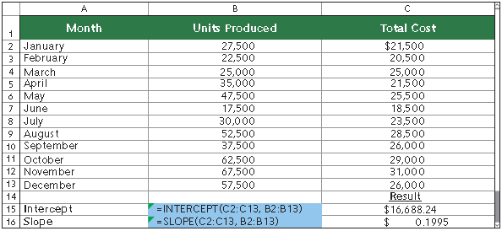
Appendix 18A: Using Excel to Estimate Least-Squares Regression
© McGraw-Hill Education
Notes:
Microsoft Excel® and other spreadsheet software can be used to perform least-squares regressions to identify cost behavior. In Excel, the INTERCEPT and SLOPE functions are used. The following screen shot reports the data from earlier in the presentation in cells Al through C13 and shows the cell contents to find the intercept (cell B15) and slope (cell B16). Cell B15 uses Excel to find the intercept from a least-squares regression of total cost (shown as C2:C13 in cell B15) on units produced (shown as B2:B13 in cell B15). Spreadsheet software is useful in understanding cost behavior when many data points (such as monthly total costs and units produced) are available.

Slide 63
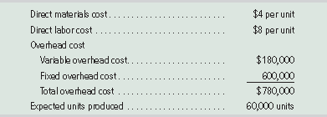
Appendix 18B: Variable Costing and Performance Reporting
Contribution margin income statement also known as variable costing income statement.
Variable costing – only costs that change in total with changes in production levels are included in product costs.
Includes: direct materials, direct labor, and variable overhead.
Fixed overhead costs excluded from product costs.
GAAP requires absorption costing – includes direct materials, direct labor, and all overhead (variable and fixed.
Exhibit 18B.1
© McGraw-Hill Education
Notes:
The contribution margin income statement introduced in this chapter is also known as a variable costing income statement. In variable costing, only costs that change in total with changes in production levels are included in product costs. These costs include direct materials, direct labor, and variable overhead costs. Thus, under variable costing, fixed overhead costs are excluded from product costs. As we showed in this chapter, a variable costing approach can be useful in many managerial analyses and decisions.
The variable costing method is not allowed, however, for external financial reporting. Instead, GAAP requires absorption costing. Under absorption costing, product costs include direct materials, direct labor, and all overhead, both variable and fixed. Managers can use variable costing information for internal decision making, but they must use absorption costing for external reporting purposes.
Using the product cost data for IceAge, a skate manufacturer, Exhibit 18B.2 shows the product cost per unit computations for both absorption and variable costing. These computations are shown both in a tabular format (left side of exhibit) and a visual format (right side of exhibit). For absorption costing, the product cost per unit is $25, which consists of $4 in direct materials, $8 in direct labor, $3 in variable overhead ($180,000∕60,000 units), and $10 in fixed overhead ($600,000∕60,000 units).
For variable costing, the product cost per unit is $15, which consists of $4 in direct materials, $8 in direct labor, and $3 in variable overhead. Fixed overhead costs of $600,000 are treated as a period cost and are recorded as expense in the period incurred. The difference between the two costing methods is the exclusion of fixed overhead from product costs for variable costing.

Slide 64
End of Chapter 18
© McGraw-Hill Education

