Slide 1
Financial & Managerial Accounting Information for Decisions
Seventh Edition
Chapter 20
Master Budgets and Performance Planning
© McGraw-Hill Education. All rights reserved. Authorized only for instructor use in the classroom. No reproduction or further distribution permitted without the prior written consent of McGraw-Hill Education.

Slide 2
Learning Objectives (1 of 2)
CONCEPTUAL
C1 Describe the benefits of budgeting and the process of budget administration.
C2 Describe a master budget and the process of preparing it.
ANALYTICAL
A1 Analyze expense planning using activity-based budgeting.

Slide 3
Learning Objectives (2 of 2)
PROCEDURAL
P1 Prepare the operating budget components of a master budget -- for a manufacturing company.
P2 Prepare a cash budget.
P3 Prepare budgeted financial statements.
P4 Prepare each component of a master budget and link each to the budgeting process—for a merchandising company. (Appendix 20A)

Slide 4
Learning Objective C1: Describe the benefits of budgeting and the process of budget administration.

Slide 5
Benefits of Budgeting
Learning Objective C1: Describe the benefits of budgeting and the process of budget administration.
Benefits of Budgeting
Coordination: activities of all units contribute to meeting the company’s overall goals.
Communication: management plans throughout the organization.
Motivation: through participation in the budgeting process and establishment of attainable goals.
Planning: focuses on future opportunities.
Control: provides a benchmark for evaluating performance.
Notes:
Managers must ensure that activities of employees and departments contribute to meeting the company’s overall goals. Budgeting is the process of planning future business actions and expressing them as formal plans to help achieve coordination. A budget is a formal statement of a company’s plans, expressed in monetary terms. Unlike long-term strategic plans, budgets typically cover shorter periods such as a month, quarter, or year. Budgets are useful in controlling operations.
Budgets help fulfill key managerial functions of planning and control. Benefits to having a written budget include:
Planning: a budget focuses on the future opportunities and threats to the organization. This focus on the future is important, because the daily pressures of operating an organization can divert management’s attention from planning.
Control: the control function requires management to evaluate (benchmark) operations against some norm. Budgeted performance considers important company, industry, and economic factors, a comparison of actual to budgeted performance provide an effective monitoring and control system.
Coordination: helps to coordinate activities so all employees and departments understand and work towards the company’s overall goals.
Communication: written budgets communicate management’s specific action plans to all employees.
Motivativation: employees through participation in the budgeting process and the establishment of attainable goals.

Slide 6
Negative Outcomes of Budgeting (1 of 2)
Learning Objective C1: Describe the benefits of budgeting and the process of budget administration.
Budgets can be a positive motivating force when:
Affected employees are consulted
Goals are challenging but attainable
Actual and budgeted differences carefully analyzed.
Notes:
Budgeting process has three important guidelines:
Employees affected by a budget should be consulted when it is prepared (participatory budgeting).
Goals reflected in a budget should be challenging but attainable.
Evaluations should be made carefully with opportunities to explain differences between actual and budgeted amounts.
Under participatory budgeting, potential negative outcomes of budgeted include:
1. Employees may understate sales and overstate expenses to allow cushion called budgetary slack.
2. Pressure to meet results may lead to employees engaging in unethical behavior or fraud.
3. Employees may purchase might always spend their budgeted amounts, even on unnecessary items to ensure their budget is not reduced next period.

Slide 7
Negative Outcomes of Budgeting (2 of 2)
Learning Objective C1: Describe the benefits of budgeting and the process of budget administration.
Potential negative outcomes of budgeted include:
Employees may understate sales and overstate expenses to allow cushion.
Pressure to meet results may lead to unethical behavior or fraud.
Employees may purchase unnecessary items to ensure budget is not reduced next period.

Slide 8
Budget Reporting and Timing (1 of 2)
Learning Objective C1: Describe the benefits of budgeting and the process of budget administration.
Continuous budgeting applied by preparing rolling budgets over a twelve-month period that rolls forward one month as the current month is completed.
Notes:
We need to choose a budgeting period. The budget period usually coincides with the company’s fiscal year. To provide specific guidance to help control operations, the annual budget usually is separated into quarterly or monthly budgets. These short-term budgets allow management to periodically evaluate performance and take corrective action.
Many companies apply continuous budgeting by preparing rolling budgets. In continuous budgeting, a company continually revises its budgets as time passes. A company would revise its entire set of budgets by adding a new quarterly budget to replace the quarter that just elapsed.
Review what you have learned in the following NEED-TO-KNOW Slides.

Slide 9
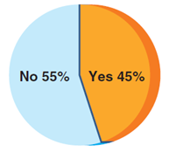
Budget Reporting and Timing (2 of 2)
Learning Objective C1: Describe the benefits of budgeting and the process of budget administration.
Companies Using Rolling Budgets

Slide 10
NEED-TO-KNOW 20-1 (1 of 2)
Learning Objective C1: Describe the benefits of budgeting and the process of budget administration.
Label each item below with yes if it describes a benefit of budgeting or no if it describes a potential negative outcome of budgeting.
Budgets provide goals for employees to work toward. Yes
Written budgets help communicate plans to all employees. Yes
Notes:
Need-to-Know 20.1

Slide 11
NEED-TO-KNOW 20-1 (2 of 2)
Learning Objective C1: Describe the benefits of budgeting and the process of budget administration.
Some employees might understate sales targets in budgets. No
A budget forces managers to spend time planning for the future. Yes
Some employees might always spend budgeted amounts. No
With rolling budgets, managers can continuously plan ahead. Yes

Slide 12
Learning Objective C2: Describe a master budget and the process of preparing it.

Slide 13
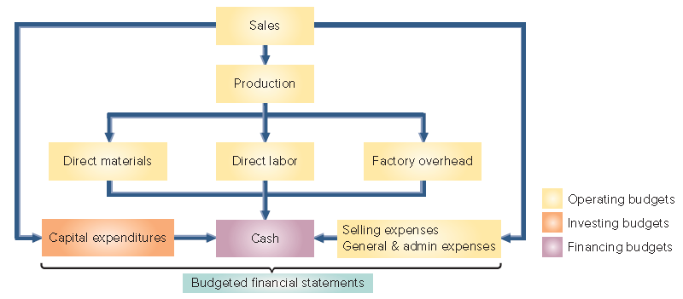
Master Budget Components
Learning Objective C2: Describe a master budget and the process of preparing it.
Exhibit 20.2
Notes:
This slide summarizes the master budgeting process for a company that manufacturers a product. The master budgeting process typically begins with the sales budget and ends with a cash budget and budgeted financial statements. The master budget includes individual budgets for sales, production (or purchases), various expenses, capital expenditures, and cash.
The number and types of budgets included in a master budget depend on the company’s size and complexity. A manufacturer’s master budget should include, at a minimum, several operating budgets (shown in yellow in Exhibit 20.2), a capital expenditures budget, and a cash budget. The capital expenditures budget summarizes the effects of investing activities on cash and helps determine the company’s need for financing. Managers also often express the expected financial results of these planned activities with a budgeted balance sheet and a budgeted income statement. Some budgets require the input of other budgets.

Slide 14
Learning Objective P1: Prepare the operating budget components of a master budget -- for a manufacturing company.

Slide 15
Sales Budget (1 of 3)
Learning Objective P1: Prepare the operating budget components of a master budget -- for a manufacturing company.
The first step in preparing the master budget is the sales budget, which shows the planned sales units and the expected dollars from these sales.
Analysis of economic and market conditions + Business capacity and advertising plans
Estimated Unit Sales
Estimated Unit Price
Sales Budget
Notes:
The first step in preparing the master budget is the sales budget, which shows the planned sales units and the expected dollars from these sales. The sales budget is the starting point in the budgeting process because plans for most departments are linked to sales.
The sales budget comes from a careful analysis of forecasted economic and market conditions, business capacity and advertising plans. To develop the sales budget, companies must estimate both unit sales and the selling price per unit.

Slide 16
Sales Budget (2 of 3)
Learning Objective P1: Prepare the operating budget components of a master budget -- for a manufacturing company.
Example: In September 2017, Toronto Sticks Company sold 700 hockey sticks at $60 each. Toronto Sticks prepared the following sales budget for the next three months:
Notes:
To illustrate the budgeting process, we are going to prepare a detailed budget for Toronto Sticks Company, a manufacturer of youth hockey sticks. We will begin with the sales budget. TSC sold 700 hockey sticks at $60 per unit. After considering sales predictions and market conditions, TSC prepares its sales budget for the next three months. Let’s take a look…

Slide 17
Sales Budget (3 of 3)
Learning Objective P1: Prepare the operating budget components of a master budget -- for a manufacturing company.
Example: TSC sold 700 hockey sticks at $60 per unit. After considering sales predictions and market conditions, TSC prepares its sales budget for the next three months.
Exhibit 20.4
Notes:
To illustrate the budgeting process, we are going to prepare a detailed budget for Toronto Sticks Company, a manufacturer of youth hockey sticks. We will begin with the sales budget. TSC sold 700 hockey sticks at $60 per unit. After considering sales predictions and market conditions, TSC prepares its sales budget for the next three months. Let’s take a look…

Slide 18
Production Budget (1 of 3)
Learning Objective P1: Prepare the operating budget components of a master budget -- for a manufacturing company.
A manufacturer prepares a production budget, which shows the number of units to be produced in a period.
Exhibit 20.5
The production budget is based on the unit sales projected in the sales budget, along with inventory considerations.
Total units to be produced in the period = Budgeted ending inventory (units of safety stock) + Budgeted sales units for the period (from the sales budget) − Number of units In beginning inventory
Notes:
A manufacturer prepares a production budget, which shows the number of units to be produced in a period. The production budget is based on the budgeted unit sales from the sales budget, along with inventory considerations.
This slide depicts the general computation for the production required for a period. We start with budgeted ending inventory. Then, we add the budgeted sales units for the period which came from the Sales budget. This will give us the required units needed for the period. Then, we subtract the number of units in beginning inventory and we are left with the total units to be produced in the period.
A production budget does not show costs; it is always expressed in units of product.

Slide 19
Production Budget (2 of 3)
Learning Objective P1: Prepare the operating budget components of a master budget -- for a manufacturing company.
Budgeted ending inventory (units of safety stock) + Budgeted sales units for the period (from the sales budget) are the Required units for the period
Note: A production budget does not show costs; it is always expressed in units of product.

Slide 20
Production Budget (3 of 3)
Learning Objective P1: Prepare the operating budget components of a master budget -- for a manufacturing company.
The production budget is based on the unit sales projected in the sales budget, along with inventory considerations.
Exhibit 20.6
Notes:
The production budget for Toronto Sticks Company (TSC) is prepared next. Manufacturing companies, like TSC, prepare a production budget, which shows the number of units to be produced in a period. The production budget is based on the unit sales projected in the sales budget, along with inventory considerations.
Use these three steps to complete the production budget:
1. Compute budgeted ending inventory, based on the company’s inventory policy.
2. Add budgeted sales, from the sales budget.
3. Subtract beginning inventory.
The result is the required units to be produced for the period.
Review what you have learned in the following NEED-TO-KNOW Slides.

Slide 21
NEED-TO-KNOW 20-2
Learning Objective P1: Prepare the operating budget components of a master budget -- for a manufacturing company.
A manufacturing company predicts sales of 220 units for May and 250 units for June. The company wants each month’s ending inventory to equal 30% of next month’s predicted unit sales. Beginning inventory for May is 66 units.
Compute the company’s budgeted production in units for May.
Budgeted ending inventory for May | 75 | 30% of 250 (June’s expected sales)
Plus: Budgeted sales for May | 220
Required units of available production | 295
Less: Beginning inventory (units) | (66)
Total units to be produced during May | 229
Notes:
A manufacturing company predicts sales of 220 units for May and 250 units for June. The company wants each month’s ending inventory to equal 30% of next month’s predicted unit sales. Beginning inventory for May is 66 units. Compute the company’s budgeted production in units for May.
The budgeted ending inventory for May equals 30% of 250 units, June's expected sales. 75 units need to be on hand as of May 31.
They also need to produce enough units to cover the budgeted sales for May, 220 units. The total required units of available production is 295.
We subtract the number of units that are already on hand in beginning inventory, 66, to calculate the total number of units to be produced, 229.

Slide 22
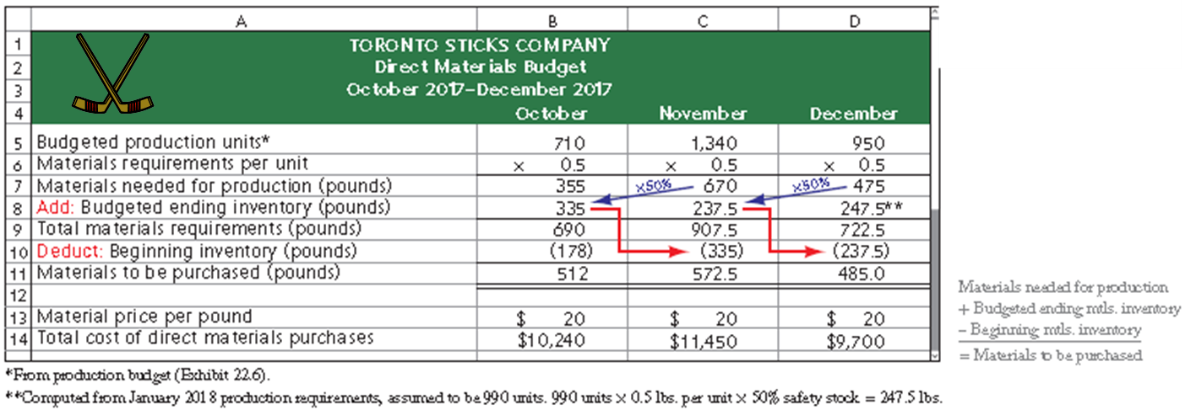
Direct Materials Budget
Learning Objective P1: Prepare the operating budget components of a master budget -- for a manufacturing company.
The direct materials budget shows the budgeted costs for the direct materials that will need to be purchased to satisfy the estimated production for the period
Exhibit 20.7
Notes:
The direct materials budget shows the budgeted costs for the direct materials that will need to be purchased to satisfy the estimated production for the period. Whereas the production budget shows units to be produced, the direct materials budget translates the units to be produced into budgeted costs.
A direct materials budget requires:
Number of units to produce from the production budget
Materials requirements per unit
Budgeted ending inventory in units of direct materials
Beginning inventory in units of direct materials
Cost per unit of direct materials
It is based on the budgeted production volume from the production budget. The direct materials budget for Toronto Sticks company is shown on your screen. The direct materials budget is driven by the budgeted materials needed to satisfy each month’s production requirement.
This budget begins with the budgeted production from the production budget.
Next, TSC needs to know the amount of direct materials needed for each of the units to be produced—in this case, half a pound (.5) of wood. With these two inputs we can now compute the amount of direct materials needed for production. For example, to produce 710 hockey sticks in October, TSC will need 355 pounds of wood (710 units x 0.5 lbs. = 355 lbs.).
TSC wants to have a safety stock of direct materials on hand at the end of each month to complete 50% of the budgeted units to be produced in the next month. Since TSC expects to produce 1,340 units in November, requiring 670 pounds of materials, it needs ending inventory of direct materials of 335 pounds (50% x 670) in inventory at the end of October. TSC’s total direct materials requirement for October is therefore 690 pounds (355 + 335).
Since TSC already has 178 pounds of direct materials in its beginning inventory it deducts this amount from the total materials requirements for the month. For October, the calculation is 690 pounds - 178 pounds, = 512 pounds of direct materials to be purchased in October.
The direct materials budget next translates the pounds of direct materials to be purchased into budgeted costs. TSC estimates that the cost of direct materials will be $20 per pound over the quarter. At $20 per pound, purchasing 512 pounds of direct materials for October production will cost $10,240.

Slide 23
Direct Labor Budget
Learning Objective P1: Prepare the operating budget components of a master budget -- for a manufacturing company.
The direct labor budget shows the budgeted costs for the direct labor that will be needed to satisfy the estimated production for the period.
Exhibit 20.8
Notes:
The direct labor budget shows the budgeted costs for the direct labor that will be needed to satisfy the estimated production for the period.
To develop a direct labor budget, companies need the following inputs:
1. Number of units to produce (from production budget).
2. Labor requirements per unit—direct labor hours for each unit of finished product.
3. Cost per direct labor hour.
15 minutes (one-fourth of an hour) of labor time is required to produce one unit. Labor is paid at the rate of $12 per hour.
Include the number of units to be produced from the production budget. For October, 710 units are planned to be produced.
Compute budgeted direct labor hours by multiplying the budgeted production level for each month by one-quarter (0.25) of an hour.
Compute total cost of direct labor by multiplying budgeted labor hours by the labor rate of $12 per hour.
Review what you have learned in the following NEED-TO-KNOW Slides.

Slide 24
NEED-TO-KNOW 20-3 (1 of 3)
Learning Objective P1: Prepare the operating budget components of a master budget -- for a manufacturing company.
A manufacturing company budgets production of 800 units during June and 900 units during July. Each unit of finished goods requires 2 pounds of direct materials, at a cost of $8 per pound. The company maintains an inventory of direct materials equal to 10% of next month’s budgeted production. Beginning direct materials inventory for June is 160 pounds. Each finished unit requires 1 hour of direct labor at the rate of $14 per hour.
Notes:
A manufacturing company budgets production of 800 units during June and 900 units during July. Each unit of finished goods requires 2 pounds of direct materials, at a cost of $8 per pound. The company maintains an inventory of direct materials equal to 10% of next month’s budgeted production. Beginning direct materials inventory for June is 160 pounds. Each finished unit requires 1 hour of direct labor at the rate of $14 per hour.
Compute the budgeted (a) cost of direct materials purchases for June and (b) direct labor cost for June.
The company requires 800 units to be produced during June. Each unit will require 2 pounds of direct materials.
The company requires a total of 1,600 pounds of direct materials for the current month's production.
They also require an ending inventory equal to 10% of next month's budgeted production.
July's production of 900 units multiplied by 2 pounds per unit, 1,800 pounds, multiplied by 10% is 180 pounds in ending inventory.
Total materials requirements, 1,780 pounds.
We subtract the number of pounds in beginning inventory, 160, to calculate the number of pounds to be purchased, 1,620.
Each pound of direct materials costs $8.
The total cost of direct materials purchases, 1,620 pounds at $8 per pound, is a total cost of $12,960.
Budgeting the direct labor cost is simpler, as there is no beginning or ending inventory of labor hours to consider.
The budgeted production in units is 800. Each of the 800 units requires 1 hour of direct labor, a total of 800 direct labor hours are required.
We multiply by the labor rate, $14 per hour, to calculate the total cost of direct labor, $11,200.

Slide 25
NEED-TO-KNOW 20-3 (2 of 3)
Learning Objective P1: Prepare the operating budget components of a master budget -- for a manufacturing company.
Compute the budgeted (a) cost of direct materials purchases for June and (b) direct labor cost for June.
Budgeted production (units) | 800
Materials requirements per unit (lbs.) | 2
Materials needed for production (lbs.) | 1,600
Add: Budgeted ending inventory (lbs.) | 180 (July production of 900 units × 2 lbs. per unit × 10%)
Total materials requirements (lbs.) | 1,780
Less: Beginning inventory (lbs.) | (160)
Materials to be purchased (lbs.) | 1,620
Material price per pound | $ 8
Total cost of direct materials purchases | $ 12,960

Slide 26
NEED-TO-KNOW 20-3 (3 of 3)
Learning Objective P1: Prepare the operating budget components of a master budget -- for a manufacturing company.
Budgeted production (units) | 800
Labor requirements per unit (hrs.) | 1
Total direct labor hours needed | 800
Labor rate (per hour) | $14
Total cost of direct labor | $11,200

Slide 27
Factory Overhead Budget (1 of 2)
Learning Objective P1: Prepare the operating budget components of a master budget -- for a manufacturing company.
The factory overhead budget shows the budgeted costs for factory overhead that are needed to complete the estimated production for the period.
Exhibit 20.9
Notes:
The factory overhead budget shows the budgeted costs for factory overhead that will be needed to complete the estimated production for the period. TSC’s factory overhead budget is shown on your screen. TSC separates variable and fixed overhead costs in its overhead budget, as do many companies. The variable portion of factory overhead using the predetermined overhead rate of $2.50 per unit of production. The fixed overhead stays constant at $1,500 per month.
Other common overhead budget costs include supervisor salaries, indirect materials, indirect labor, utilities, and maintenance of manufacturing equipment and are discussed in chapter 21.

Slide 28
Factory Overhead Budget (2 of 2)
Learning Objective P1: Prepare the operating budget components of a master budget -- for a manufacturing company.
The variable portion of factory overhead is assigned at the rate of $2.50 per unit of production. The fixed overhead is $1,500 per month.

Slide 29
Product Cost Per Unit (1 of 2)
Learning Objective P1: Prepare the operating budget components of a master budget -- for a manufacturing company.
TSC’s can compute product cost per unit from the three manufacturing budgets (direct materials, direct labor, and factory overhead).
For budgeting purposes, TSC assumes it will normally produce 3,000 units of product each quarter, yielding fixed overhead of $1.50 per unit. TSC’s other product costs are all variable.
Notes:
With the information from the three manufacturing budgets (direct materials, direct labor, and factory overhead), we can compute TSC’s product cost per unit. This amount is useful in computing cost of goods sold and preparing a budgeted income statement, as we show later. For budgeting purposes, TSC assumes it will normally produce 3,000 units of product each quarter, yielding fixed overhead of $1.50 per unit (computed as $4,500 / 3,000). TSC’s other product costs are all variable. This slide summarizes the product cost per unit calculation.

Slide 30
Product Cost Per Unit (2 of 2)
Learning Objective P1: Prepare the operating budget components of a master budget -- for a manufacturing company.
Exhibit 20.10
Product Cost | Per Unit
Direct materials: 1/2 pound of materials × $20 per pound of materials……………………….. | $10.00
Direct labor: 0.25 hours of direct labor × $12 per hour of direct labor……………………….…. | 3.00
Variable overhead (from predetermined overhead rate)…………………………………………….…… | 2.50
Fixed overhead ($4,500 total fixed overhead per quarter/3,000 units of expected production per quarter)………………………………………………………………………………………………. | 1.50
Total product cost per unit*……………………………………………………………………………………….……… | $17.00
*At the normal production level of 3,000 units per quarter

Slide 31
Selling Expense Budget (1 of 3)
Learning Objective P1: Prepare the operating budget components of a master budget -- for a manufacturing company.
The selling expense budget is an estimate of the types and amounts of selling expenses expected during the budget period.
TSC pays sales commissions equal to 10% of total sales.
TSC pays a monthly salary of $ 2,000 to its sales manager.
Let’s prepare the selling expense budget for Toronto Sticks Company.
Notes:
The selling expense budget is an estimate of the types and amounts of selling expenses expected during the budget period. It is usually prepared by the vice president of marketing or sales manager. Budgeted selling expenses are based on the sales budget, plus a fixed amount of sales manager salaries.
We use the sales budget to prepare a selling expense budget for TSC. Sales commissions are variable, based on 10% of sales revenue. The sales manager’s salary is a fixed expense. Other common selling expenses include advertising, delivery expenses, and marketing expenses.

Slide 32
Selling Expense Budget (2 of 3)
Learning Objective P1: Prepare the operating budget components of a master budget -- for a manufacturing company.
Exhibit 20.11
Notes:
We begin the selling expense budget with sales revenues amounts taken from the sales budget. Next, we compute sales commissions for each month by multiplying sales revenue for each month times 10%. The sales manager’s salary of $2,000 per month is then added to sales commissions to get the total selling expense for each month.

Slide 33
Selling Expense Budget (3 of 3)
Learning Objective P1: Prepare the operating budget components of a master budget -- for a manufacturing company.
From TSC’s sales budget
TSC pays sales commissions equal to 10 percent of total sales.
TSC pays a monthly salary of $2,000 to its sales manager: Salary for sales manager is 2,000 for October, November, December.

Slide 34
General and Administrative Expense Budget (1 of 3)
Learning Objective P1: Prepare the operating budget components of a master budget -- for a manufacturing company.
The general and administrative expense budget plans the predicted operating expenses not included in the selling expenses or manufacturing budgets.
Toronto Sticks Company has general and administrative salaries of $54,000 per year or $4,500 per month.
Notes:
The general and administrative expense budget plans the predicted operating expenses not included in the selling expenses or manufacturing budgets. These expenses may be either variable or fixed with respect to sales volume. The office manager responsible for general administration often is responsible for preparing the general and administrative expense budget.
Toronto Sticks Company’s general and administrative expense budget includes salaries of $54,000 per year, or $4,500 per month. Let’s see what their general and administrative expense budget looks like.

Slide 35
General and Administrative Expense Budget (2 of 3)
Learning Objective P1: Prepare the operating budget components of a master budget -- for a manufacturing company.
Let’s prepare the general and administrative expense budget for TSC.
Notes:
The general and administrative expense budget for each month is the administrative salaries of $4,500. The total amount is the same each month since the amount is a fixed expense.
Review what you have learned in the following NEED-TO-KNOW Slides.

Slide 36
General and Administrative Expense Budget (3 of 3)
Learning Objective P1: Prepare the operating budget components of a master budget -- for a manufacturing company.
Toronto Sticks Company has general and administrative salaries of $54,000 per year or $4,500 per month.
Exhibit 20.12
Notes:
The general and administrative expense budget for each month is the administrative salaries of $4,500. The total amount is the same each month since the amount is a fixed expense.
Review what you have learned in the following NEED-TO-KNOW Slides.

Slide 37
NEED-TO-KNOW 20-4 (1 of 2)
Learning Objective P1: Prepare the operating budget components of a master budget -- for a manufacturing company.
A manufacturing company budgets sales of $70,000 during July. It pays sales commissions of 5% of sales and also pays a sales manager a salary of $3,000 per month. Other monthly costs include depreciation on office equipment ($500), insurance expense ($200), advertising ($1,000), and an office manager salary of $2,500 per month. For the month of July, compute the total (a) budgeted selling expense and (b) budgeted general and administrative expense.
Notes:
A manufacturing company budgets sales of $70,000 during July. It pays sales commissions of 5% of sales and also pays a sales manager a salary of $3,000 per month. Other monthly costs include depreciation on office equipment ($500), insurance expense ($200), advertising ($1,000), and office manager salary of $2,500 per month. For the month of July, compute the total (a) budgeted selling expense and (b) budgeted general and administrative expense.
Selling expenses are costs that are targeting the customer, vs. general and administrative expenses which are non-customer related.
Sales commissions are selling expenses. 5% of $70,000 is $3,500.
The sales manager's salary is also a selling expense.
Depreciation on office equipment is non-customer related; it's considered a general and administrative expense.
Insurance expense is also considered general and administrative expense.
Advertising expense is customer related; it's included as part of the budgeted selling expense.
And the office manager's salary is a general and administrative expense.
Total budget selling expenses; $7,500.
Total budgeted general and administrative expense; $3,200.

Slide 38
NEED-TO-KNOW 20-4 (2 of 2)
Learning Objective P1: Prepare the operating budget components of a master budget -- for a manufacturing company.
Budgeted selling expense | Total
Sales commissions ($70,000 × 5%) | $3,500
Sales manager's salary | 3,000
Advertising expense | 1,000
Total budgeted selling expense | $7,500
Budgeted general and administrative expense | Total
Depreciation on office equipment | $500
Insurance expense | 200
Office manager's salary | 2,500
Total budgeted and administrative expense | $3,200

Slide 39
Capital Expenditures Budget
Learning Objective P1: Prepare the operating budget components of a master budget -- for a manufacturing company.
The capital expenditures budget shows dollar amounts estimated to be spent to purchase additional plant assets and amounts to be received from plant asset disposals.
TSC does not anticipate disposal of any plant assets through December 2017, but management is planning to acquire additional equipment for $25,000 cash in December 2017.
*Since this is the only budgeted capital expenditure for the quarter, no separate capital expenditures budget is shown.
Notes:
The capital expenditures budget lists dollar amounts to be received from plant asset disposals and spent on additional plant assets. It also shows cash expected to be received from plant asset disposals. This budget is usually prepared after the operating budgets.
Capital budgeting is the process of planning for capital (plant asset) expenditures.
Since TSC only plans one capital expenditure of $25,000 for additional equipment near the end of December, so this information will be incorporated into the cash budget.

Slide 40
Learning Objective P2: Prepare a cash budget.

Slide 41
Cash Budgets
Learning Objective P2: Prepare a cash budget.
The next step is to prepare the cash budget, which shows expected cash inflows and outflows during the budget period.
Exhibit 20.13
The general formula for a cash budget is:
Beginning cash balance + Budgeted cash receipts − Budgeted cash payments = Preliminary cash balance
Adequate
Loan activity: Repay loans, buy securities
Too low
Loan activity: Increase short-term loans
Notes:
The next step is to prepare the cash budget, which shows expected cash inflows and outflows during the budget period. Managing cash flows is vital for the firm’s success. Most companies set an amount of cash they require. The cash budget is important because it helps the company meet this cash balance goal. If the cash budget indicates a potential cash shortfall, the company can prearrange loans to meet its obligations. If the cash budget indicates a potential cash windfall
When preparing a cash budget, we add budgeted cash receipts to the beginning cash balance and deduct budgeted cash disbursements. If the preliminary cash balance is too low, additional cash requirements appear in the budget as planned increases from short-term loans. If the preliminary cash balance exceeds the balance the company wants to maintain, the excess is used to repay loans (if any) or to acquire short-term investments. Information for preparing the cash budget is mainly taken from the operating and capital expenditures budgets. Preparing the cash budget typically requires the preparation of other supporting schedules; we show the first of these, a schedule of cash receipts from sales, next., the company can plan to pay off prior loans or make other investments.

Slide 42
Cash Receipts from Sales
Learning Objective P2: Prepare a cash budget.
40% of TSC’s sales are for cash.
The remaining 60% are credit sales that are collected in full in the month following the sale.
Let’s prepare the cash receipts budget for TSC.
Notes:
Managers use the sales budget, combined with knowledge about how frequently customers pay on credit sales, to budget monthly cash receipts. Forty percent of TSC’s sales are for cash. The remaining 60 percent of sales are credit sales. None of the sales on account are collected in the month of sale. However they are expected to be collected in the month following the sale.

Slide 43
Budgeted Cash Receipts from Sales (1 of 2)
Learning Objective P2: Prepare a cash budget.
Exhibit 20.14
Notes:
We begin the cash receipts budget with sales revenues amounts taken from the sales budget. September sales revenue is included because 60 percent of September sales will be collected in October.
The accounts receivable balance at the end of each month is 60 percent of that month’s budgeted sales. Cash sales are 40 percent of each month’s sales.
The accounts receivable balance at the end of each month is collected in full during the next month. Cash sales are added to accounts receivable collections to get total cash receipts for the month.
We now can compute the budgeted cash receipts from customers, as shown in the table on this slide. October’s budgeted cash receipts consist of $24,000 from expected cash sales ($60,000 x 40%) plus the anticipated collection of $25,200 of accounts receivable from the end of September.

Slide 44
Budgeted Cash Receipts from Sales (2 of 2)
Learning Objective P2: Prepare a cash budget.
From TSC’ sales budget → Sales* September ($ 42,000)
Accounts receivable balance at the end of each month is 60% of that month’s budgeted sales. → Less: Ending accounts receivable (60%) September (25,200**)
Cash sales are 40% of each month’s sales → Cash sales (40% of sales) October (24,000)

Slide 45
Cash Payments for Materials (1 of 3)
Learning Objective P2: Prepare a cash budget.
Managers use the beginning balance sheet and the direct materials budget prepared earlier, to help prepare a schedule of cash payments for materials.
TSC’s purchases of materials are entirely on account.
Full payment is made in the month following the purchase.
Let’s look at the schedule of cash payments for materials for TSC.
Notes:
We’re now ready to prepare the cash payments for materials budget. Managers use the beginning balance sheet and the direct materials budget prepared earlier, to help prepare a schedule of cash payments for materials. Managers must also know how TSC purchases direct materials (pay cash or on account), and for credit purchases, how quickly TSC pays.
TSC’s materials purchases are entirely on account. It makes full payment during the month following its purchases. Using this information, the schedule of cash payments for materials can be prepared. Let’s take a look at it on the next slide.

Slide 46
Cash Payments for Materials (2 of 3)
Learning Objective P2: Prepare a cash budget.
Exhibit 20.15
From direct materials budget → $10,240
Notes:
Remember that TSC’s materials purchases are entirely on account. It makes full payment during the month following its purchases. We start with the direct materials budget and that budget told TSC to purchase $10,240 of materials in October. But none of these purchases will be paid for this month—instead those material costs end up in November’s column. We then add the balance owed from the previous month’s purchases (September) of $7,060. The total cash payments for direct materials in October, is $7,060.

Slide 47
Cash Payments for Materials (3 of 3)
Learning Objective P2: Prepare a cash budget.
TSC’s purchases of materials are entirely on account.
Full payment is made in the month following the purchase.

Slide 48
Preparing the Cash Budget
Learning Objective P2: Prepare a cash budget.
Beginning Cash Balance + Budgeted Cash Receipts − Budgeted Cash Payments = Preliminary Cash Balance
Preliminary Cash Balance
If adequate, repay loans or buy securities.
If inadequate, increase short-term loans.
Additional information for TSC’s cash budget:
Has a September 30 cash balance of $20,000.
Will pay a cash dividend of $3,000 in November.
Notes:
Now that we have completed the following budgets: cash receipts from sales budget, cash payments for direct materials, cash payments for direct labor, cash payments for variable overhead, cash payments for selling expenses and cash payments for general and administrative expenses, we are ready to complete the cash budget. The fixed overhead assigned to depreciation in the factory overhead budget does not require a cash payment, therefore, it is not included in the cash budget. Other types of fixed overhead such as payments for property taxes and insurance are included if they require cash payments.
When preparing a cash budget, we add expected cash receipts to the beginning cash balance and deduct expected cash payments. If the expected ending cash balance is inadequate, additional cash requirements appear in the budget as planned increases from short-term loans. If the expected ending cash balance exceeds the desired balance, the excess is used to repay loans or to acquire short-term investments.
Some additional events affecting TSC’s cash are displayed on your screen. You may need to make a few notes from this information to keep from referring back to this screen as we use this information. We will continue with the additional information on the next slide.

Slide 49
Cash Budget (1 of 2)
Learning Objective P2: Prepare a cash budget.
Toronto Sticks Company:
Has an income tax liability of $20,000 from the previous quarter that will be paid in October.
Will purchase $25,000 of equipment in December.
Has an agreement with its bank for loans at the end of each month to enable a minimum cash balance of $20,000.
Pays interest each month equal to one percent of the prior month’s ending loan balance.
Notes:
Here is the remainder of the information needed to complete TSC’s cash budget. Again, you my find it helpful to take a few notes summarizing this information.

Slide 50
Cash Budget (2 of 2)
Learning Objective P2: Prepare a cash budget.
Repays loans when the ending cash balance exceeds $20,000.
Owes $10,000 on this loan arrangement on September 30.
Has 40 percent income tax rate.
Will pay taxes for current quarter next year.
Notes:
Here is the remainder of the information needed to complete TSC’s cash budget. Again, you my find it helpful to take a few notes summarizing this information.

Slide 51
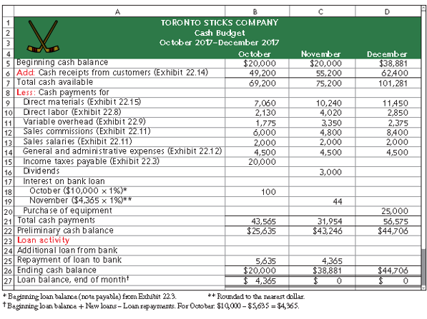
Exhibit 20.16 (1 of 4)
Learning Objective P2: Prepare a cash budget.
Notes:
We begin the cash budget with October. TSC’s cash balance at the beginning of October is $20,000. Budgeted cash receipts for October are $49,200, resulting in a total of $69,200 available for the month.
Now we are ready to look at TSC’s cash disbursements.

Slide 52
Exhibit 20.16 (2 of 4)
Learning Objective P2: Prepare a cash budget.
Add: Cash receipts from customers (Exhibit 22.14) (55,200) → From Cash Receipts Budget
Add: Cash receipts from customers (Exhibit 22.14) (49,200) → TSC’s cash balance at the beginning of October is $20,000. Budgeted cash receipts for October are $49,200, resulting in a total of $69,200 available for the month.
Now we are ready to look at TSC’s cash payments
Notes:
We next subtract expected cash payments for direct materials, direct labor, overhead, selling expenses, and general and administrative expenses. Income taxes of $20,000 were due as of the end of September 30, and payable in October.
Now we are ready to use some of the additional information affecting cash. Let’s take a look at the next slide.

Slide 53
Exhibit 20.16 (3 of 4)
Learning Objective P2: Prepare a cash budget.
Income taxes of $20,000 were due as of the end of September 30, and payable in October.
We next subtract expected cash payments for direct materials, direct labor, overhead, selling expenses, and general and administrative expenses.
TSC has a $10,000 loan and pays interest at the rate of one percent per month. October’s interest is $100.
TSC has a dividend payment of $3,000 that it plans to pay in November.
Notes:
We next subtract expected cash payments for direct materials, direct labor, overhead, selling expenses, and general and administrative expenses. Income taxes of $20,000 were due as of the end of September 30, and payable in October.
Now we are ready to use some of the additional information affecting cash. Let’s take a look at the next slide.
TSC has a $10,000 loan and pays interest at the rate of one percent per month. The preliminary cash balance for October is $25,635. TSC has a dividend payment of $3,000 that it plans to pay in November.

Slide 54
Exhibit 20.16 (4 of 4)
Learning Objective P2: Prepare a cash budget.
Repayment for loan to bank (5,635) → TSC has an agreement with its bank for loans at the end of each month to provide a minimum cash balance of $20,000. If the cash balance exceeds $20,000 at a month-end, as it does here, TSC uses the excess to repay loans.
Ending cash balance for October is the beginning November balance.
TSC interest on it’s outstanding loan amount in November is $44.
One last item, before our cash budget is complete…TSC plans to pay $25,000 in December to purchase new equipment.
Notes:
TSC has an agreement with its bank for loans at the end of each month to provide a minimum cash balance of $20,000. If the cash balance exceeds $20,000 at a month-end, TSC uses the excess to repay loans. If the cash balance is less than $20,000 at month-end, the bank loans TSC the difference. At the end of each month, TSC pays the bank interest on any outstanding loan amount, at the monthly rate of 1% of the beginning balance of these loans. For October, this payment is 1% of the $10,000 note payable amount reported on its balance sheet.
Based on our cash budget for the month of October, the preliminary cash balance increases to $25,635 (before any loan-related activity). This amount is more than the $20,000 minimum. Thus, TSC will pay off $5,635 of its outstanding loan.
The expected loan repayment of $5,635 is deducted from the preliminary cash balance in October. October’s ending cash balance of $20,000 becomes the beginning cash balance in November.
For November, TSC expects to pay interest of $44, computed as 1% of the $4,365 expected loan balance at October 31. No interest is budgeted for December because the company expects to repay the loans in full at the end of November.
The cash budget is completed with the December cash information. TSC plans to pay $25,000 in December to purchase new equipment. This large cash payment will reduce the December preliminary cash balance to $56,575 and leave an ending cash balance in December of $44,706.
Review what you have learned in the following NEED-TO-KNOW Slides.

Slide 55
NEED-TO-KNOW 20-5 (1 of 5)
Learning Objective P2: Prepare a cash budget.
Diaz Co. predicts sales of $80,000 for January and $90,000 for February. Seventy percent of Diaz’s sales are for cash, and the remaining 30% are credit sales. All credit sales are collected in the month after sale. January’s beginning accounts receivable balance is $20,000. Compute budgeted cash receipts for January and February.

Slide 56
NEED-TO-KNOW 20-5 (2 of 5)
Learning Objective P2: Prepare a cash budget.
Budgeted Cash Receipts | January | February
Sales | $80,000 | $90,000
Less: Ending accounts receivable (30%) | 24,000 | 27,000
Cash receipts from:
Cash sales (70% of sales) | 56,000 | 63,000
Collections of prior month's receivables | 20,000 | 24,000
Total cash receipts | $76,000 | $87,000
Notes:
Need-to-Know 20-5

Slide 57
NEED-TO-KNOW 20-5 (3 of 5)
Learning Objective P2: Prepare a cash budget.
Use the following information to prepare a cash budget for the month ended January 31 for Garcia Company. The company requires a minimum $30,000 cash balance at the end of each month. Any preliminary cash balance above $30,000 is used to repay loans (if any). Garcia has a $2,000 loan outstanding at the beginning of January.
Notes:
Need-to-Know 22.5

Slide 58
NEED-TO-KNOW 20-5 (4 of 5)
Learning Objective P2: Prepare a cash budget.
January 1 cash balance, $30,000
Cash receipts from sales, $132,000
Budgeted cash payments for materials, $63,500
Budgeted cash payments for labor, $33,400
Other budgeted cash expenses,* $8,200
Cash repayment of bank loan, $2,000
*Including loan interest for January.

Slide 59
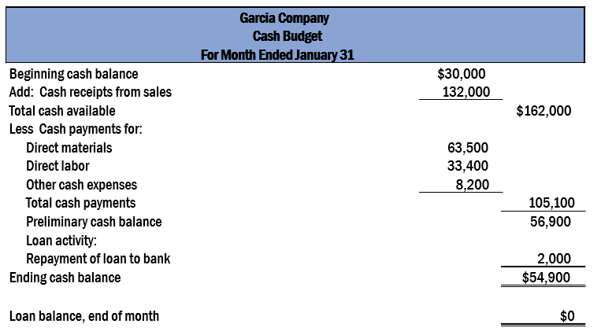
NEED-TO-KNOW 20-5 (5 of 5)
Learning Objective P2: Prepare a cash budget.

Slide 60
Learning Objective P3: Prepare budgeted financial statements.

Slide 61
Budgeted Income Statement (1 of 3)
Learning Objective P3: Prepare budgeted financial statements.
The budgeted income statement is a managerial accounting report showing predicted amounts of sales and expenses for the budget period.
Cash Budget: Completed → Budgeted Income Statement
Let’s prepare the budgeted income statement for Toronto Sticks Company.
Notes:
Now that we have completed the cash budget, we are ready to prepare a budgeted income statement for the quarter. The budgeted income statement is a managerial accounting report showing predicted amounts of sales and expenses for the budget period. It summarizes the predicted income effects of the budgeted activities. Information needed to prepare a budgeted income statement is primarily taken from already-prepared budgets. Let’s look at the budgeted income statement for Toronto Sticks Company.

Slide 62
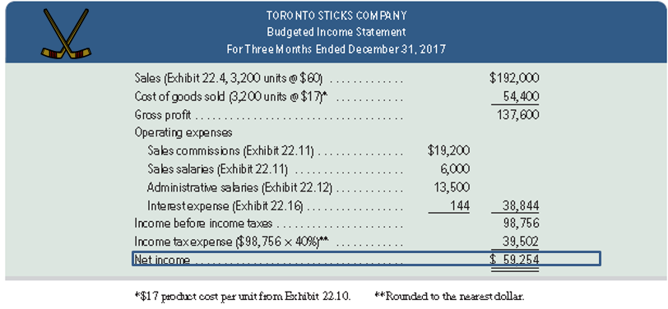
Budgeted Income Statement (2 of 3)
Learning Objective P3: Prepare budgeted financial statements.
Exhibit 20.17
Notes:
TSC’s condensed budgeted income statement is shown on this slide. All information in this statement is taken from the component budgets we’ve examined on previous slides. Also, we now can predict the amount of income tax expense for the quarter, computed as 40% of the budgeted pretax income. For TSC, these taxes are not payable until January 31, 2018. Thus, these taxes are not shown on the October–December 2017 cash budget. We can now move on to the budgeted balance sheet.

Slide 63
Budgeted Income Statement (3 of 3)
Learning Objective P3: Prepare budgeted financial statements.
All information in this budgeted income statement is taken from the component budgets we’ve examined on previous slides.
The predicted amount of income tax expense for the quarter, computed as 40% of the budgeted pretax income, is included.

Slide 64
Budgeted Balance Sheet (1 of 3)
Learning Objective P3: Prepare budgeted financial statements.
The budgeted balance sheet shows predicted amounts for the company’s assets, liabilities, and equity as of the end of the budget period.
Budgeted Income Statement: Completed → Budgeted Balance Sheet
Let’s prepare the budgeted balance sheet for Toronto Sticks Company.
Notes:
Now that we have completed the income statement for the quarter, we can prepare the balance sheet. The final step in preparing the master budget is summarizing the company’s predicted financial position. The budgeted balance sheet shows amounts for the company’s assets, liabilities, and equity as of the end of the budget period.

Slide 65
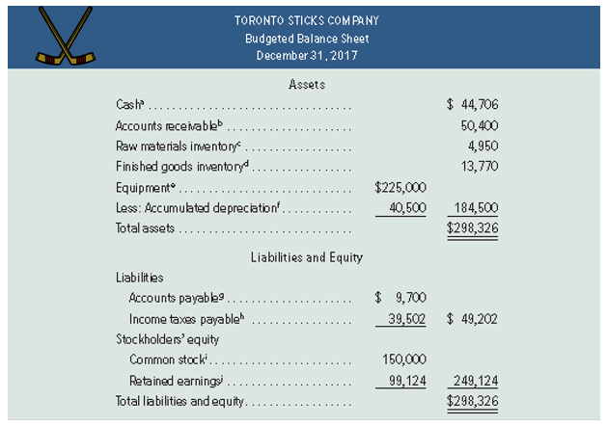
Budgeted Balance Sheet (2 of 3)
Learning Objective P3: Prepare budgeted financial statements.
Exhibit 20.18
Notes:
TSC’s budgeted balance sheet is shown on this slide. It is prepared using information from the other budgets.
a. Ending balance for December from the cash budget (in Exhibit 22.16).
b. 60% of $84,000 sales budgeted for December from the sales budget (in Exhibit 22.4).
c. 247.5 pounds of raw materials in budgeted ending inventory at the budgeted cost of $20 per pound (direct materials budget, Exhibit 22.7).
d. 810 units in budgeted finished goods inventory (Exhibit 22.6) at the budgeted cost of $17 per unit (Exhibit 22.10).
e. September 30 balance of $200,000 from the beginning balance sheet in Exhibit 22.3 plus $25,000 cost of new equipment from the cash budget in Exhibit 22.16.
f. September 30 balance of $36,000 from the beginning balance sheet in Exhibit 22.3 plus $4,500 depreciation expense from the factory overhead budget in Exhibit 22.9.
g. Budgeted cost of materials purchases for December from Exhibit 22.7, to be paid in January.
h. Income tax expense from the budgeted income statement for the fourth quarter in Exhibit 22.17, to be paid in January.
i. Unchanged from the beginning balance sheet in Exhibit 22.3.
j. September 30 balance of $42,870 from the beginning balance sheet in Exhibit 22.3 plus budgeted net income of $59,254 from the budgeted income statement in Exhibit 22.17 minus budgeted cash dividends of $3,000 from the cash budget in Exhibit 22.16.

Slide 66
Budgeted Balance Sheet (3 of 3)
Learning Objective P3: Prepare budgeted financial statements.
The budgeted balance sheet for TSC is prepared using information from the other budgets.

Slide 67
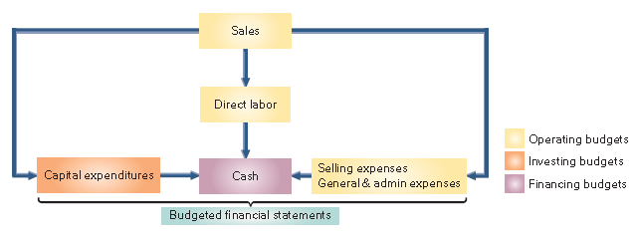
Budgeting for Service Companies
Learning Objective P3: Prepare budgeted financial statements.
Service providers also use master budgets but typically need fewer operating budgets than manufacturers.
Important budgets for a service companies include:
Exhibit 20.19
Notes:
Service providers also use master budgets. Since service providers do not manufacture goods and hold no inventory, they typically need fewer operating budgets than manufacturers do. Exhibit 20.19 shows the master budget process for a service provider.
From Exhibit 20.19, service providers do not prepare production or direct materials budgets. In addition, since many services such as accounting, banking, and landscaping are labor-intensive, the direct labor budget is important. If an accounting firm greatly underestimates the hours needed to complete an audit, it might charge too low a price. If the accounting firm greatly overestimates the hours needed, it might bid too high a price (and lose jobs) or incur excessive labor costs. Either way, the firm’s profits can suffer if its direct labor budget is unrealistic.

Slide 68
Learning Objective A1: Analyze expense planning using activity-based budgeting.

Slide 69
Activity-Based Budgeting (1 of 2)
Learning Objective A1: Analyze expense planning using activity-based budgeting.
Activity-based budgeting is based on activities rather than traditional items such as salaries, supplies, depreciation, and utilities.
Exhibit 20.21
Accounting Department Comparison of Activity-Based Budget with Traditional Budget
Traditional Budget
Salaries…………………… | $152,000
Supplies………………….. | 22,000
Depreciation…………… | 36,000
Utilities……………………. | 14,000
Total…………………….…. | $224,000
Activity-Based Budget
Auditing…………………… | $ 58,000
Tax reporting……….….. | 71,000
Financial reporting…… | 63,000
Cost accounting………. | 32,000
Total…………………….…. | $224,000
Notes:
Activity-based budgeting is based on expected activities instead of the traditional budget categories that we normally see. Activity-based budgets enable management to more easily plan resource consumption to match related changes in activity.
Traditional budgeting systems list items such as salaries, supplies, equipment, and utilities. With a traditional budget, management often makes across-the-board budget cuts or increases. For example, management might decide that each of the line items in the traditional budget must be cut by 5%. This might not be a good strategic decision.
In contrast, ABB requires management to list activities performed by, say, the accounting department such as auditing, tax reporting, financial reporting, and cost accounting. An understanding of the resources required to perform the activities, the costs associated with these resources, and the way resource use changes with changes in activity levels allows management to better assess how expenses will change to accommodate changes in activity levels.

Slide 70
Activity-Based Budgeting (2 of 2)
Learning Objective A1: Analyze expense planning using activity-based budgeting.
An understanding of the resources required to perform the activities, the costs associated with these resources, and the way resource use changes with changes in activity levels allows management to better assess how expenses will change to accommodate changes in activity levels.
Notes:
Activity-based budgeting is based on expected activities instead of the traditional budget categories that we normally see. Activity-based budgets enable management to more easily plan resource consumption to match related changes in activity.
Traditional budgeting systems list items such as salaries, supplies, equipment, and utilities. With a traditional budget, management often makes across-the-board budget cuts or increases. For example, management might decide that each of the line items in the traditional budget must be cut by 5%. This might not be a good strategic decision.
Review what you have learned in the following NEED-TO-KNOW Slides.
In contrast, ABB requires management to list activities performed by, say, the accounting department such as auditing, tax reporting, financial reporting, and cost accounting. An understanding of the resources required to perform the activities, the costs associated with these resources, and the way resource use changes with changes in activity levels allows management to better assess how expenses will change to accommodate changes in activity levels.

Slide 71
Learning Objective P4 (Appendix A): Prepare each component of a master budget and link each to the budgeting process—for a merchandising company.

Slide 72
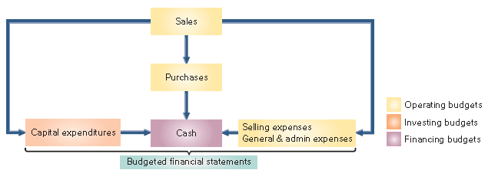
Merchandise Purchases Budget (1 of 6)
Learning Objective P4: Prepare each component of a master budget and link each to the budgeting process—for a merchandising company.
Unlike a manufacturing company, a merchandiser must prepare a merchandise purchases budget rather than a production budget.
Exhibit 20A.1
Notes:
Unlike a manufacturing company, a merchandiser must prepare a merchandise purchases budget rather than a production budget. In addition, a merchandiser does not prepare direct materials, direct labor, or factory overhead budgets. Let’s look at the merchandise purchases budget for Hockey Den (HD), a retailer of hockey sticks

Slide 73
Merchandise Purchases Budget (2 of 6)
Learning Objective P4: Prepare each component of a master budget and link each to the budgeting process—for a merchandising company.
Example: Let’s look at the merchandise purchases budget for Hockey Den (HD), a retailer of hockey sticks…

Slide 74
Merchandise Purchases Budget (3 of 6)
Learning Objective P4: Prepare each component of a master budget and link each to the budgeting process—for a merchandising company.
Example: Hockey Den buys hockey sticks for $60 each and maintains an ending inventory equal to 90 percent of the next month’s budgeted sales. On September 30, 1,010 hockey sticks are on hand.
Exhibit 20A.2
The general layout for the purchases budget in equation form is:
Merchandise Inventory to be purchased = Budgeted ending merchandise Inventory + Budgeted sales for the period − Budgeted beginning merchandise Inventory
Let’s prepare the purchases budget for Hockey Den.
Notes:
A merchandiser usually expresses a merchandise purchases budget in both units and dollars. The slide shows the general layout for this budget in equation form. If this formula is expressed in units and only one product is involved, we can compute the number of dollars of inventory to be purchased for the budget by multiplying the units to be purchased by the cost per unit.
To prepare a merchandise purchases budget, we need the following inputs:
1. Sales budget
2. Budgeted ending inventory
3. Cost per unit
Toronto Sticks Company is an exclusive supplier of hockey sticks to HD, meaning that the companies use the same budgeted sales figures in preparing budgets.
HD predicts unit sales of: October, 1,000; November, 800; December, 1,400; January, 900.
After considering the costs of keeping inventory and inventory shortages, HD set a policy that ending inventory (in units) should equal 90% of next month’s predicted sales. For example, inventory at the end of October should equal 90% of November’s budgeted sales.
Finally, HD expects the per unit purchase cost of $60 to remain unchanged through the budgeting period.

Slide 75
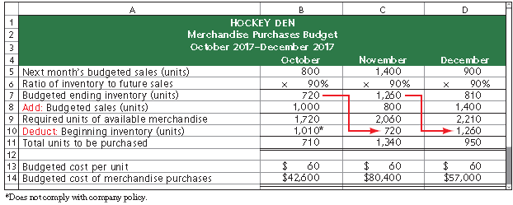
Merchandise Purchases Budget (4 of 6)
Learning Objective P4: Prepare each component of a master budget and link each to the budgeting process—for a merchandising company.
Exhibit 20A.3
Notes:
After considering the costs of keeping inventory and inventory shortages, HD set a policy that ending inventory (in units) should equal 90% of next month’s predicted sales. For example, inventory at the end of October should equal 90% of November’s budgeted sales. The unit sales figures are from the sales budget.

Slide 76
Merchandise Purchases Budget (5 of 6)
Learning Objective P4: Prepare each component of a master budget and link each to the budgeting process—for a merchandising company.
Next month budget sales (units) (800) → From the sales budget.
Budgeted ending inventory (units) (720) → Ending inventory for a month in units, should equal 90% of next month’s unit sales.
Add: Budgeted sales units (1000) → Next we add the unit sales for each month to the desired ending inventory to get the total needs for each month.

Slide 77
Merchandise Purchases Budget (6 of 6)
Learning Objective P4: Prepare each component of a master budget and link each to the budgeting process—for a merchandising company.
Required units of available merchandise. → 1,720
Deduct: beginning inventory (units) (1,010*) → Subtract beginning inventory to determine the budgeted number of units to be purchased.
Budgeted cost of the purchases, computed as: number of units × cost per unit.
Notes:
After we calculate the required units of available merchandise. We then subtract beginning inventory to determine the budgeted number of units to be purchased. The last line is the budgeted cost of the purchases, computed by multiplying the number of units to be purchased by the predicted cost per unit.
HD expects the per unit purchase cost of $60 to remain unchanged through the budgeting period. Here’s our completed merchandise purchases budget. Notice that the ending inventory for each month becomes the beginning inventory for the next month.
Review what you have learned in the following NEED-TO-KNOW Slides.

Slide 78
NEED-TO-KNOW 20-8
Learning Objective P4: Prepare each component of a master budget and link each to the budgeting process— for a merchandising company.
In preparing monthly budgets for the third quarter, a company budgeted sales of 120 units for July and 140 units for August. Management wants each month’s ending inventory to be 60% of next month’s sales. The June 30 inventory consists of 50 units, which does not comply with the company's inventory policy. How many units should be purchased in July?
Next month's budgeted sales (units) | 140
Ratio of inventory to future sales | 60%
Budgeted ending inventory (units) | 84
Add: Budgeted sales (units) | 120
Required units of available merchandise | 204
Deduct: Beginning inventory (units) | (72)
Units to be purchased | 132
Notes:
In preparing monthly budgets for the third quarter, a company budgeted sales of 120 units for July and 140 units for August. Management wants each month’s ending inventory to be 60% of next month’s sales.
The June 30 inventory consists of 50 units, which does not comply with the company's inventory policy. How many units should be purchased in July?
At the end of July, the company wants to have ending inventory equal to 60% of August sales.
140 units budgeted to be sold in August multiplied by 60% is an ending inventory of 84 units.
The company must also have enough units on hand for the current month's sales, 120 units.
The required units of available merchandise is 204.
Since the company already has 72 units in beginning inventory, they only need to purchase the difference, 132 units.

Slide 79
End of Presentation

