Slide 1

GO! with Microsoft 365 Excel 2021
Chapter 10
External Data, Side-by-Side Tables, and Workbook Distribution and Collaboration
Copyright © 2023 Pearson All Rights Reserved
Notes:
GO! with Microsoft 365 Excel 2021, Chapter 10
In this chapter, you will learn how to get external data into Excel and how to use database functions and side-by-side tables.

Slide 2
Learning Objectives
Get External Data into Excel
Clean Up and Manage Imported Data
Use Database Functions
Insert a Second Table into a Worksheet
Manage and Use Formulas in Conditional Formatting Rules
Create Custom Headers and Footers
Inspect a Workbook
Use Co-Authoring and Prepare a Final Workbook for Distribution
Notes:
The objectives are:
Get External Data into Excel
Clean Up and Manage Imported Data
Use Database Functions
Insert a Second Table into a Worksheet
Manage and Use Formulas in Conditional Formatting Rules
Create Custom Headers and Footers
Inspect a Workbook
Use Co-Authoring and Prepare a Final Workbook for Distribution

Slide 3
Get External Data into Excel (1 of 7)
Get & Transform Data commands—get data that reside outside of Excel into Excel
Data connection—link to external data so updates in the original data are automatically updated in Excel
Table—data stored in a format of rows and columns
Record—horizontal row that stores data about one database item
Field—vertical column that stores information describing a record
Notes:
The Get & Transform Data group commands enable you to bring data from an Access database, from the Web, from a text file, from an XML file, and from other sources such as a database on a SharePoint or SQL server, or an external data feed, into Excel without repeatedly copying the data.
A data connection is a link to external data that you can automatically update in an Excel workbook from the original data whenever the original data source gets new information.
An Access database is organized in a format of horizontal rows and vertical columns—like an Excel worksheet.
A table is data stored in a format of rows and columns.
A record is a horizontal row that stores all the data about one database item.
A field is a vertical column that stores information that describes a record.

Slide 4
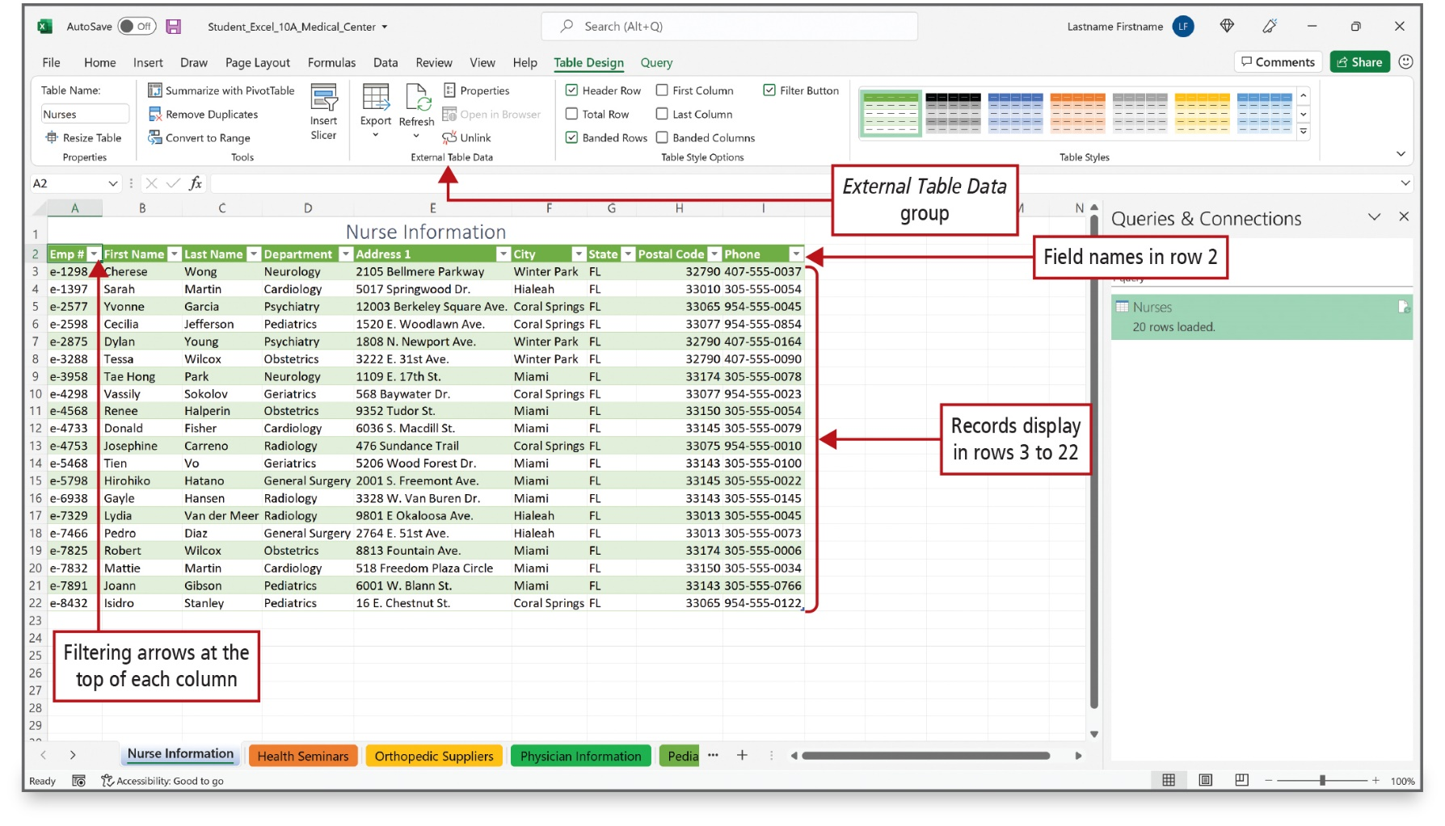
Get External Data into Excel (2 of 7)
Notes:
Get Data commands enable you to bring data from many different sources into your Excel worksheet in a manner that lets you transform the data. For example, you could remove a column of data. Such an action is referred to as a data transformation. Microsoft Access is a database program that manages database files. This slide displays an Access table of nurse information. Beside each column title, an arrow displays for easy sorting and filtering.
Alt Text: The external Table Data group is located in the ribbon. In the table, Filtering arrows are at the top of each column (row 2), Field names are in row 2, and Records are displayed in rows 3 to 22.

Slide 5
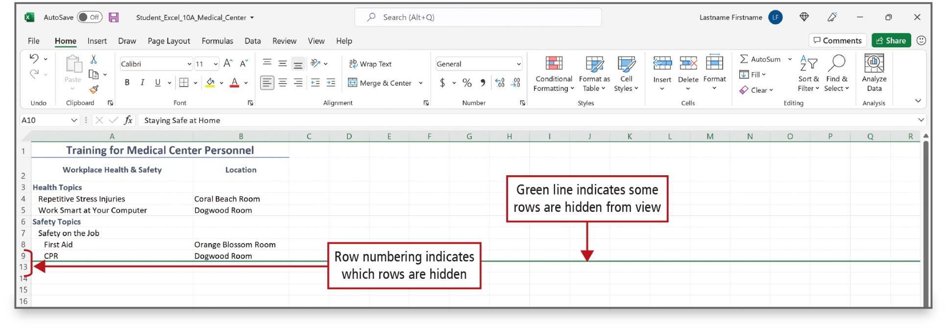
Get External Data into Excel (3 of 7)
Notes:
After Access data is brought into Excel, worksheets can be hidden, rows and columns can be hidden, and cell data can be indented or aligned. In this worksheet, a green line indicates that some rows are hidden from view, and the row numbers jump from row 9 to row 13 to show which row numbers are hidden.

Slide 6
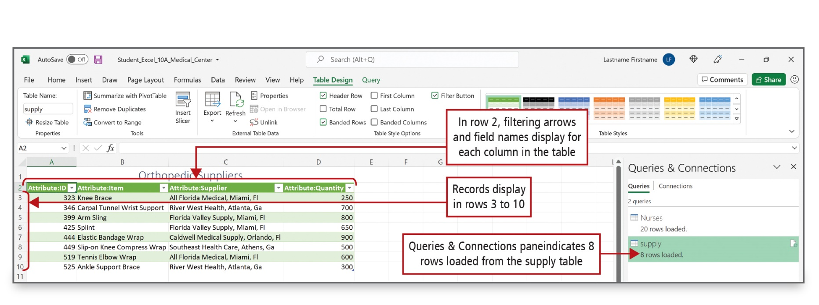
Get External Data into Excel (4 of 7)
Notes:
Extensible Markup Language (XML) is a language that structures data in text files so that it can be read by other systems, regardless of the hardware platform or operating system. Such portability is why XML has become a popular technology for exchanging data. The table on this slide was imported as an Excel table with filter arrows in the column titles. The Queries & Connections pane shows that 8 rows were loaded from the supply table.

Slide 7
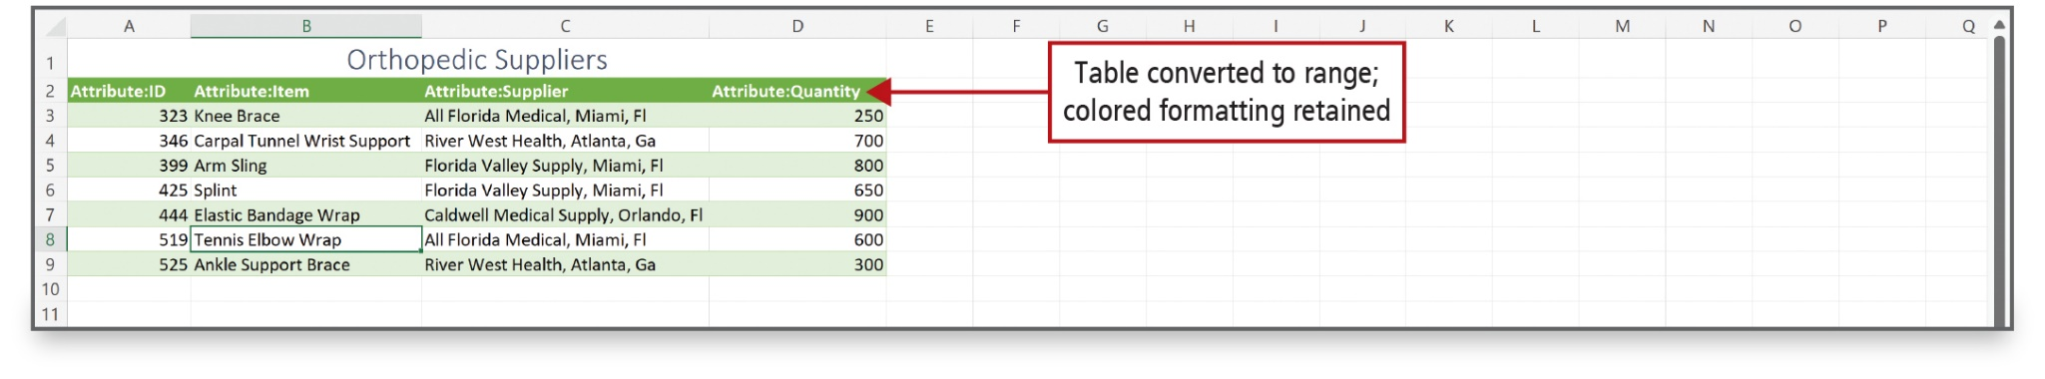
Get External Data into Excel (5 of 7)
Notes:
When you convert your table back to a range of cells, all the functionality of the table, such as filters, are moved, but the style, like colors and bold, will remain.

Slide 8
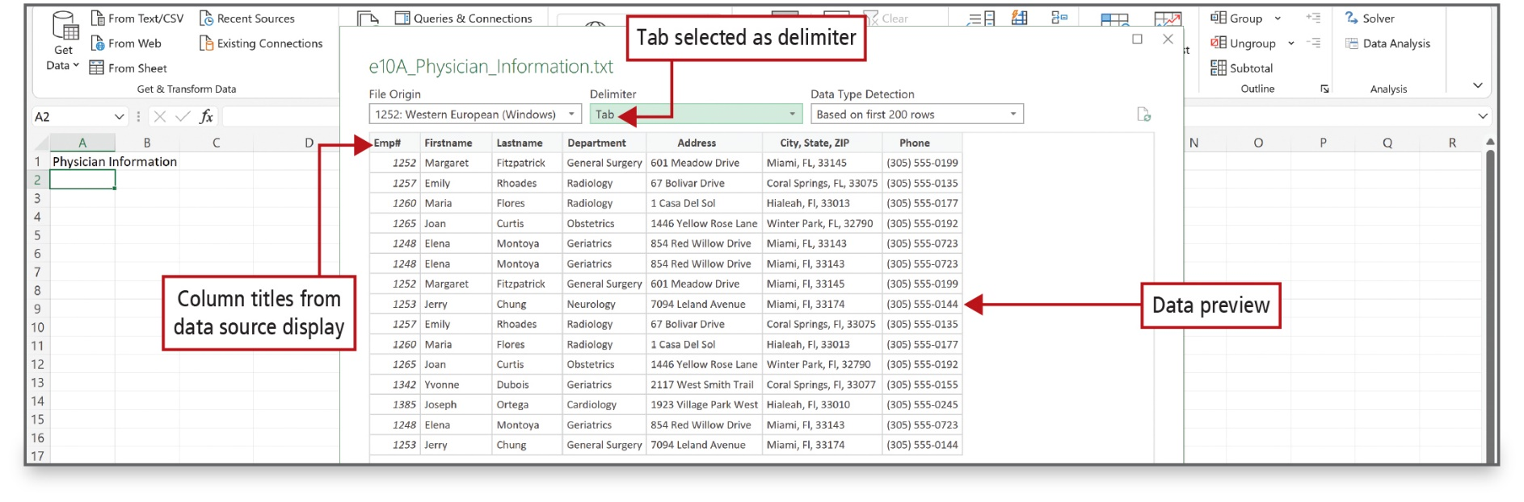
Get External Data into Excel (6 of 7)
Notes:
You can import information into Excel from a delimited text file. The Get & Transform command determines that the Physician Information file is delimited—separated by commas or tabs—and selects Delimited. At the bottom, a preview of the data displays.

Slide 9
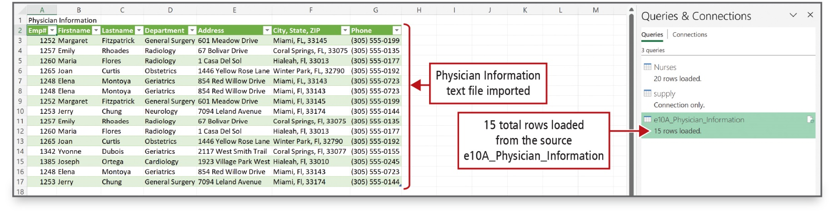
Get External Data into Excel (7 of 7)
Notes:
This slide shows the result of using the Get & Transform command to import a text file. The Queries & Connections pane shows that 15 rows were loaded from the file.

Slide 10
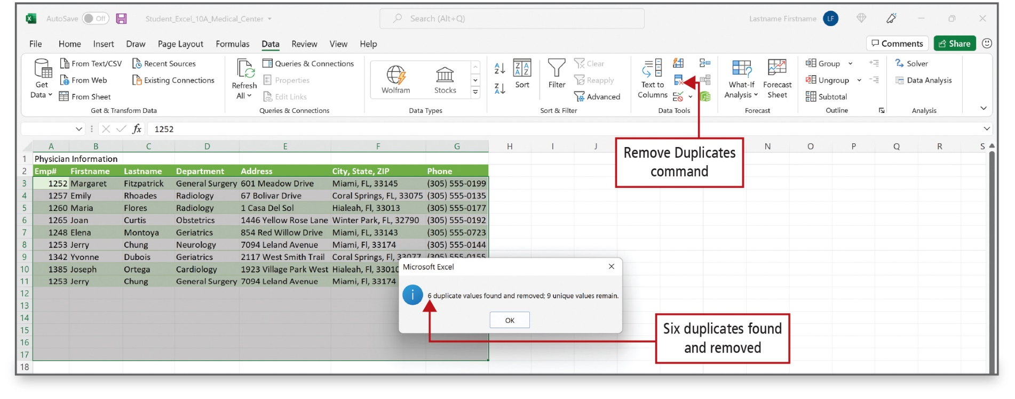
Clean Up and Manage Imported Data
(1 of 5)
Notes:
Data in a worksheet is not always formatted in a way you can use it. Excel includes several tools to help clean up data automatically, including text functions and ribbon commands. One tool is the Remove Duplicates button on the Data tab. By removing duplicate records, you ensure that an employee will only appear one time for each department, as shown here.
Alt Text: The Remove Duplicates command is located in the data tools group of the ribbon. The cells in range A3:G17 are selected. Message displayed in the popup window reads as “6 duplicated values found and removed: 9 unique values remain” and is labeled as “Six duplicates found and removed”.

Slide 11
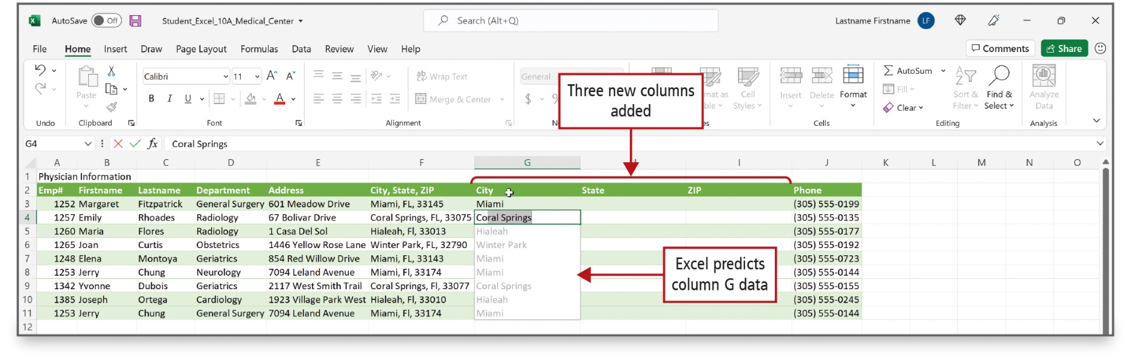
Clean Up and Manage Imported Data
(2 of 5)
Notes:
Excel can format text data. For example, to make sorting and filtering easier, you can separate data into separate fields using Flash Fill—an Excel feature that predicts how to alter data based on the pattern you enter in the cell at the beginning of the column. In this worksheet, based on your entries in cells G3 and G4, Flash Fill suggests entries for the remaining cells in the column.

Slide 12
Clean Up and Manage Imported Data
(3 of 5)
RIGHT—returns the specified number of characters from the end of a string
LEFT—returns the specified number of characters from the beginning of a string
MID—extracts a series of characters from a text string given the location of the beginning character
CONCAT—joins up to 255 strings of characters
TRIM—removes extra blank spaces from a string
UPPER/LOWER—change the case of the characters in a string to all uppercase/lowercase
PROPER—capitalizes the first letter of each word
Notes:
Excel’s Text functions can be used in formatting text. There are functions to combine or separate data, change case, and apply formatting to a string of characters.
The RIGHT function returns the specified number of characters from the end (right) of a string of characters.
The LEFT function returns the specified number of characters from the beginning (left) of a string.
The MID function extracts a series of characters from a text string given the location of the beginning character.
The CONCAT function joins up to 255 strings of characters.
The TRIM function removes extra blank spaces from a string.
The UPPER and LOWER functions change the case of the characters in a string, making all characters uppercase or lowercase.
The PROPER function capitalizes the first letter of each word.

Slide 13
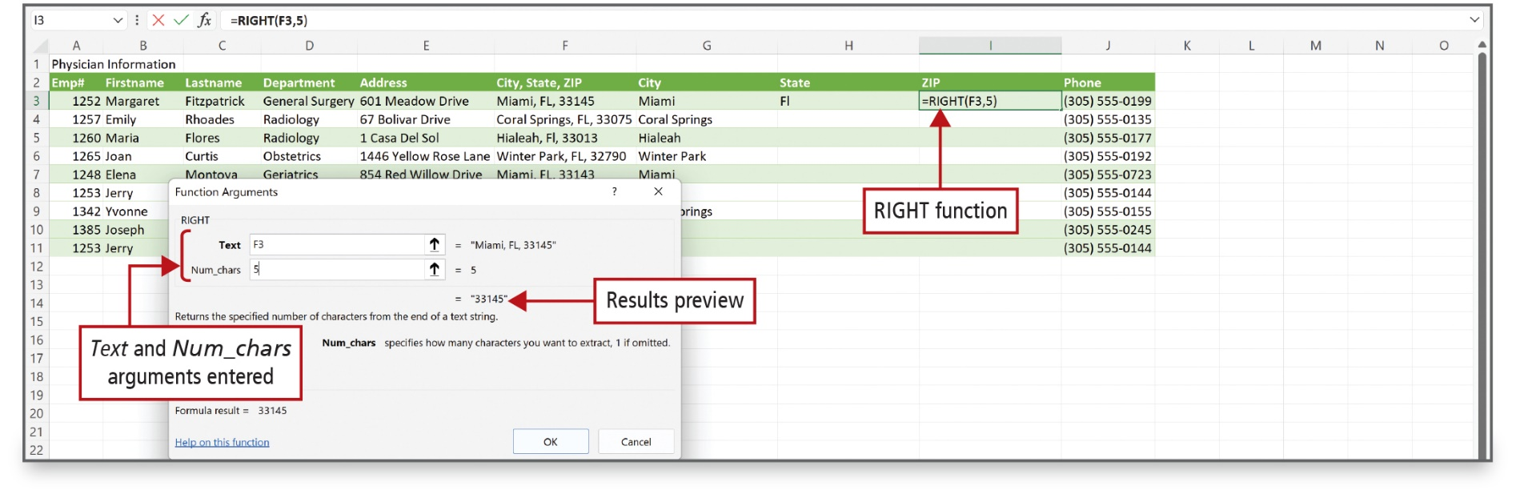
Clean Up and Manage Imported Data
(4 of 5)
Notes:
The text function RIGHT displays the last five characters of the text in column F.
Alt Text: In the dialog box, Text and Num_chars arguments are entered that reads as follows: Text: F3: Num_chars: 5. Results preview displayed below reads as 33145 inside double-quotes. In the Excel sheet, the RIGHT function displayed in cell I3 reads as “equal to RIGHT open parenthesis F3 comma 5 close parenthesis”.

Slide 14
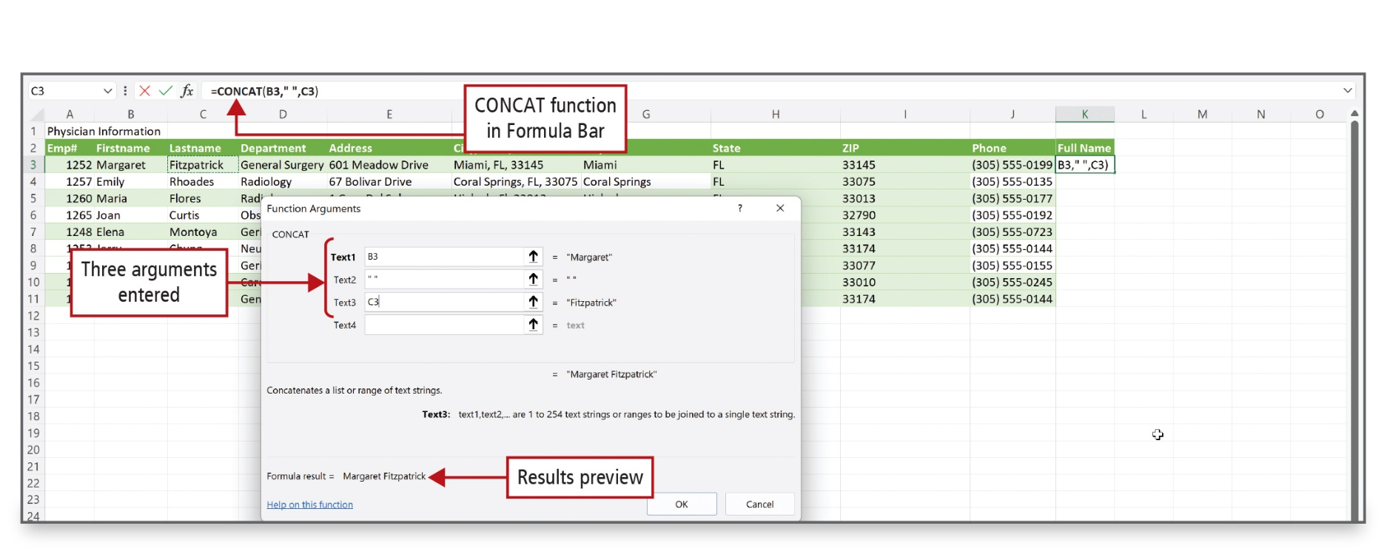
Clean Up and Manage Imported Data
(5 of 5)
Notes:
In this example, the CONCAT function joins three strings to create a string consisting of the person’s first name, a space, and last name.
Alt Text: In the dialog box, three arguments entered read as follows: Text1: B3, Text2: double quotes, Text3: C3. Results preview displayed at the bottom reads as “Formula result equals Margaret Fitzpatrick”. The CONCAT function in Formula Bar reads as “equals CONCAT open parenthesis B3 comma double-quotes comma C3 close parenthesis”.

Slide 15
Use Database Functions (1 of 6)
Database—collection of data related to a particular topic or purpose
Data—facts about people, events, things, or ideas
Information—data organized in a useful manner
Function—predefined formula that performs calculations using arguments
Notes:
A database is a collection of data related to a particular topic or purpose.
Data refers to facts about people, events, things, or ideas.
Information is data that is organized in a useful manner.
A function is a predefined formula that performs calculations by using specific values called arguments.

Slide 16
Use Database Functions (2 of 6)
D A V E R A G E—determines an average limited by criteria
D S U M—sums a column of values limited by criteria
D C O U N T—counts a column of values specified by criteria set for one or more cells
M A X I F S—returns the maximum value among cells specified by a set of conditions or criteria
M I N I F S—returns the minimum value among cells specified by a set of conditions or criteria
Notes:
Excel has several database functions:
The DAVERAGE function determines an average in a database that is limited by criteria set for one or more cells.
The DSUM function sums a column of values in a database that is limited by criteria set for one or more cells.
The DCOUNT function counts a column of values in a database specified by criteria set for one or more cells.
The MAXIFS function returns the maximum value among cells specified by a given set of conditions or criteria.
The MINIFS function returns the minimum value among cells specified by a given set of conditions or criteria.

Slide 17
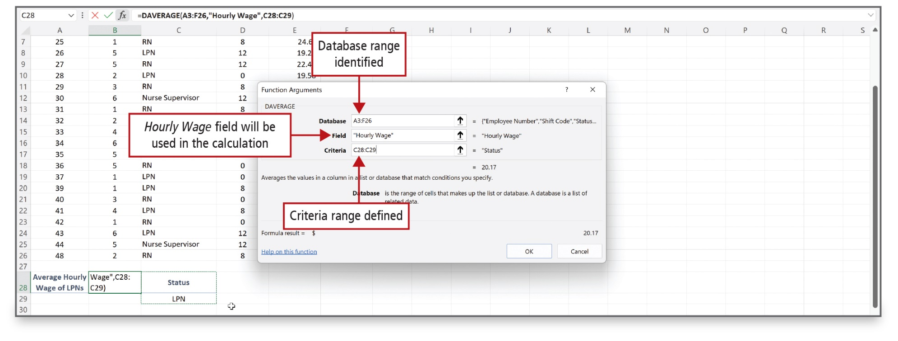
Use Database Functions (3 of 6)
Notes:
The DAVERAGE function determines an average in a database that is limited by criteria set for one or more cells. This slide shows the Function Arguments dialog box for DAVERAGE.

Slide 18
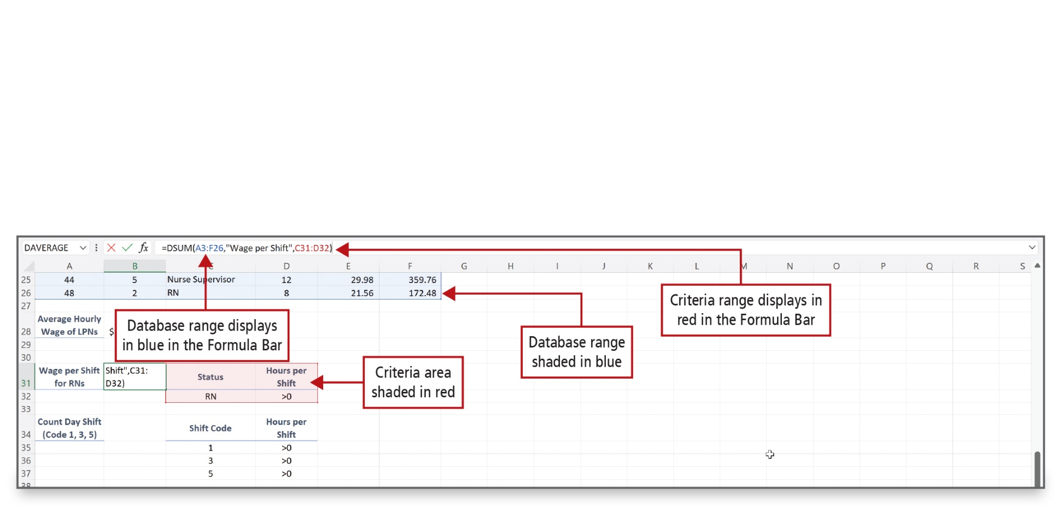
Use Database Functions (4 of 6)
Notes:
The DSUM function will sum a column of values in a database that is limited by criteria set for one or more cells. In this example, the Status will be limited to RN, and the Hours Worked will be limited to RNs who worked more than zero hours. This is a compound criteria, which is the use of two or more criteria on the same row in which all conditions must be met for the records to be included in the results.

Slide 19
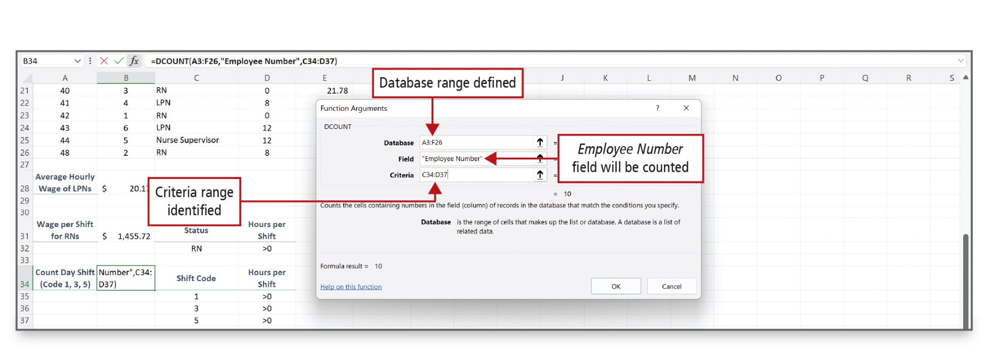
Use Database Functions (5 of 6)
Notes:
DCOUNT counts the cells containing numbers in the column of records that match the conditions you specify.

Slide 20
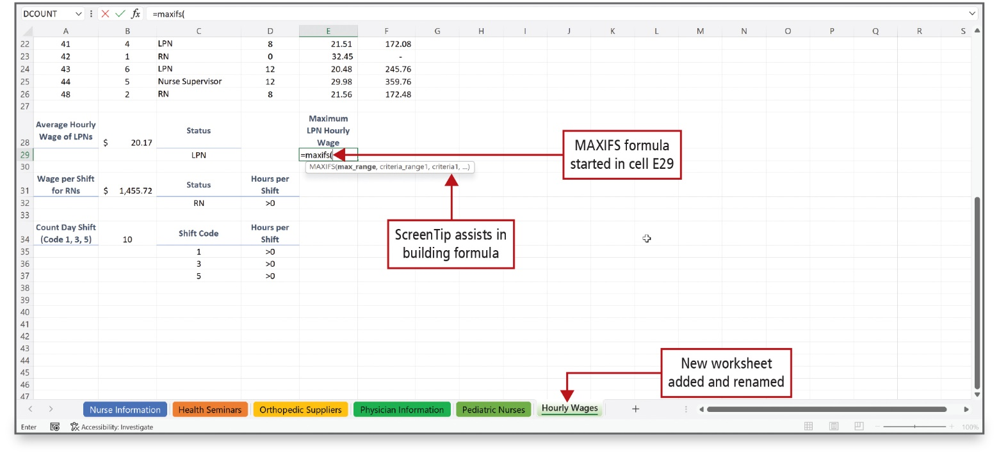
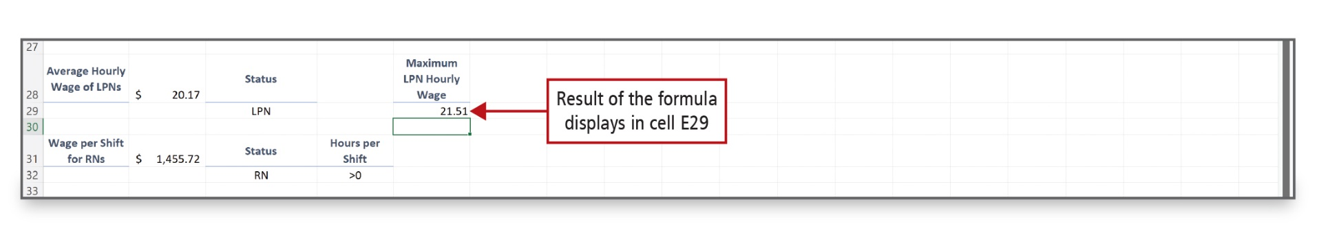
Use Database Functions (6 of 6)
Notes:
The MAXIFS function is used to determine the maximum wages.

Slide 21
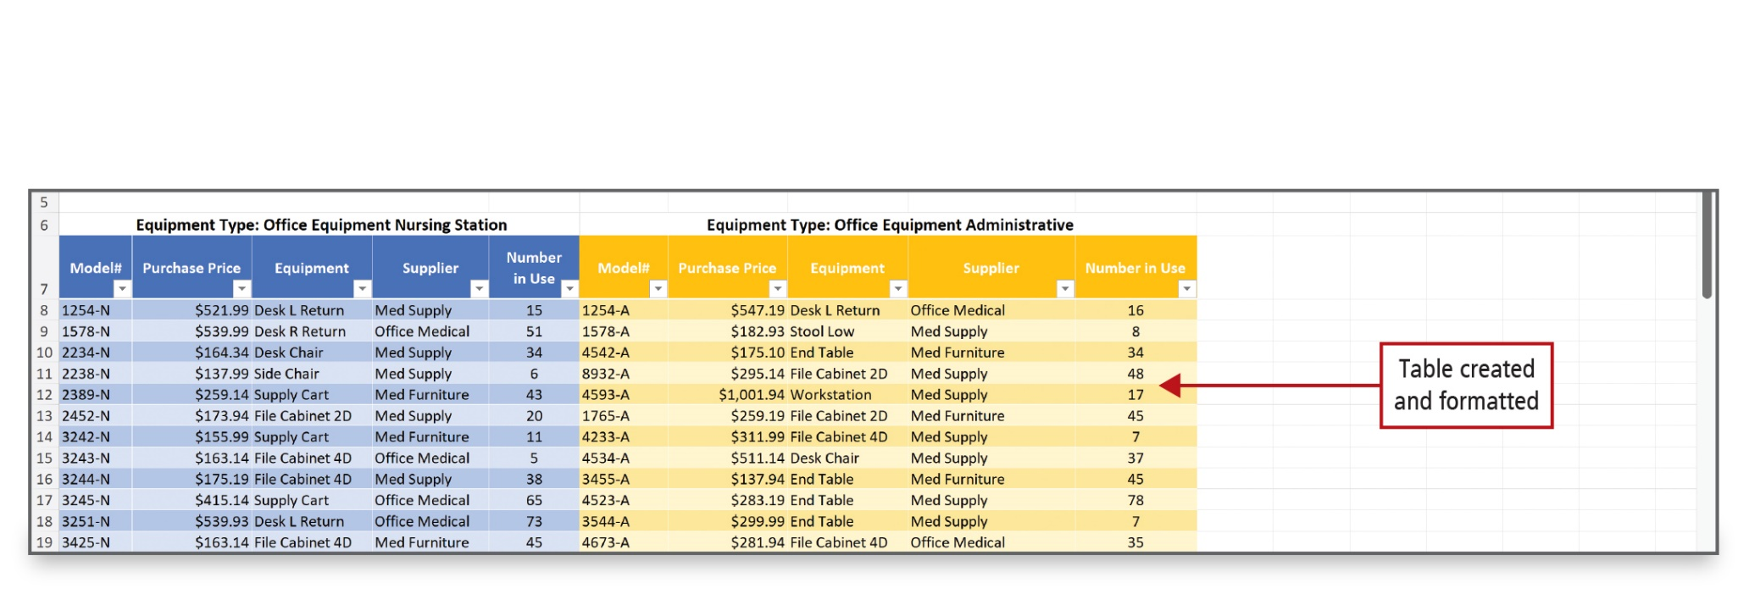
Insert a Second Table into a Worksheet (1 of 2)
Notes:
In Excel, you can insert a table beside another table in the same worksheet, and then work with the data in each table separately so you can view and compare similar sets of data. Here, the data regarding Office Equipment Administrative is added to the right of the Office Equipment Nursing Station table. A style is applied to the table on the right, and the headings display filtering controls.

Slide 22
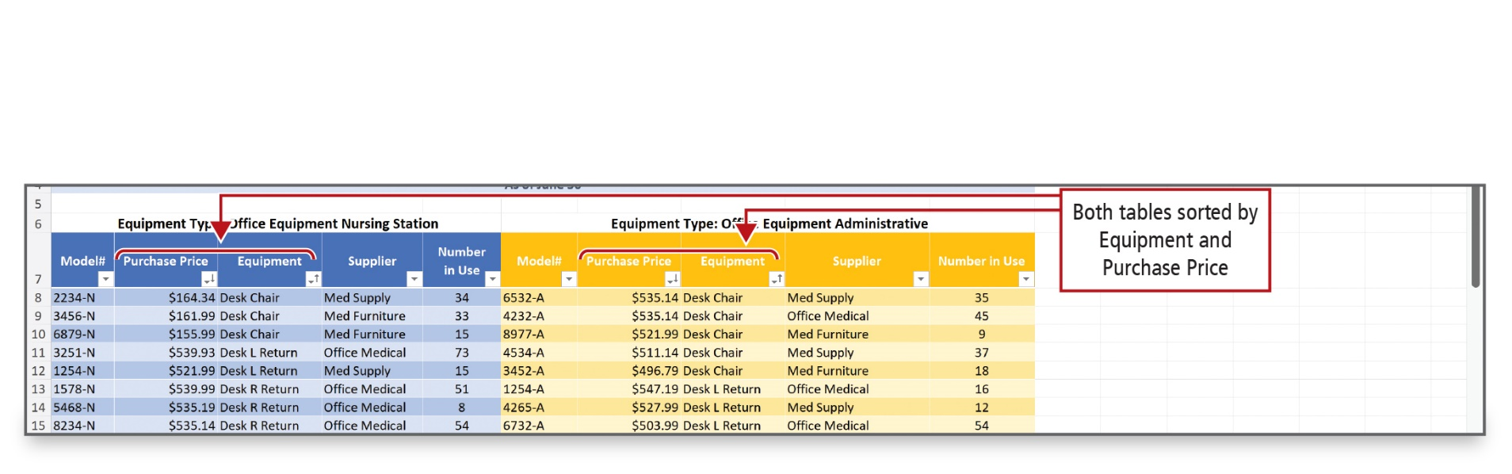
Insert a Second Table into a Worksheet (2 of 2)
Notes:
By having the two tables side-by-side in the same worksheet, you can sort similar sets of data to make comparisons. In this example, these two tables have been sorted by Equipment and Purchase Price.

Slide 23
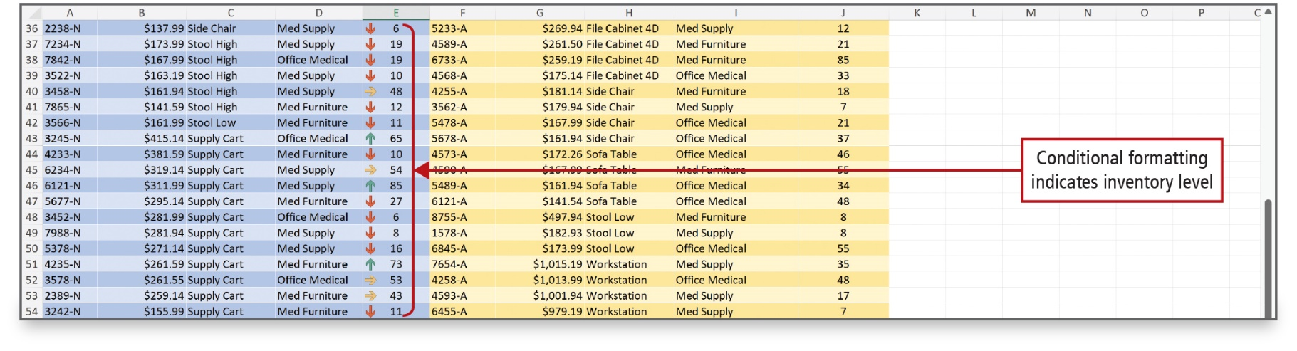
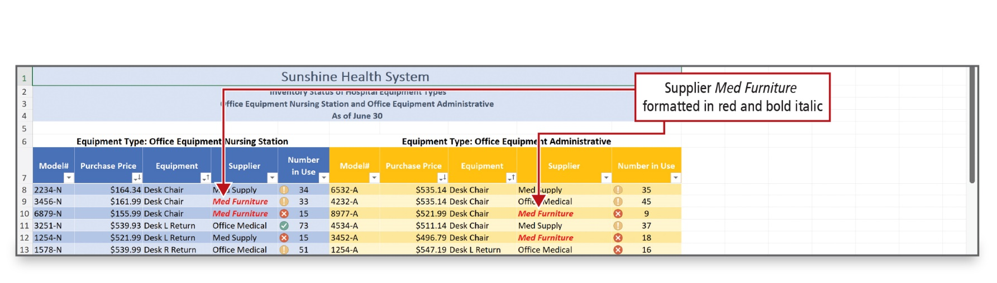
Manage and Use Formulas in Conditional Formatting Rules
Notes:
Conditional formatting makes your data easier to interpret by changing the appearance of your database on a condition; if the condition is true, the cell is formatted based on that condition, and if the condition is false, the cell is not formatted. Here, an icon set is used to identify inventory levels, and red and bold italic is used to identify a supplier.

Slide 24
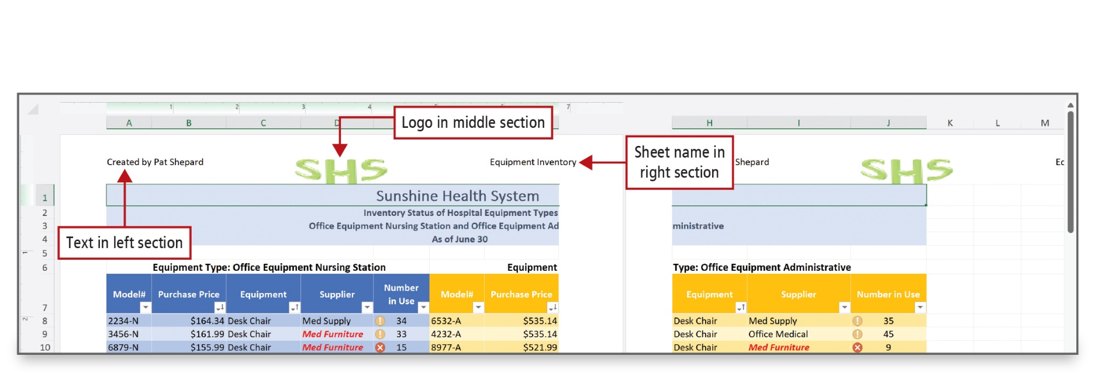
Create Custom Headers and Footers
(1 of 2)
Notes:
You can create custom headers and footers to provide useful information about your worksheet. You can type your own text or insert header and footer elements such as pictures, page numbers, and the date and time. Use Page Layout view to fine-tune your pages before printing.

Slide 25
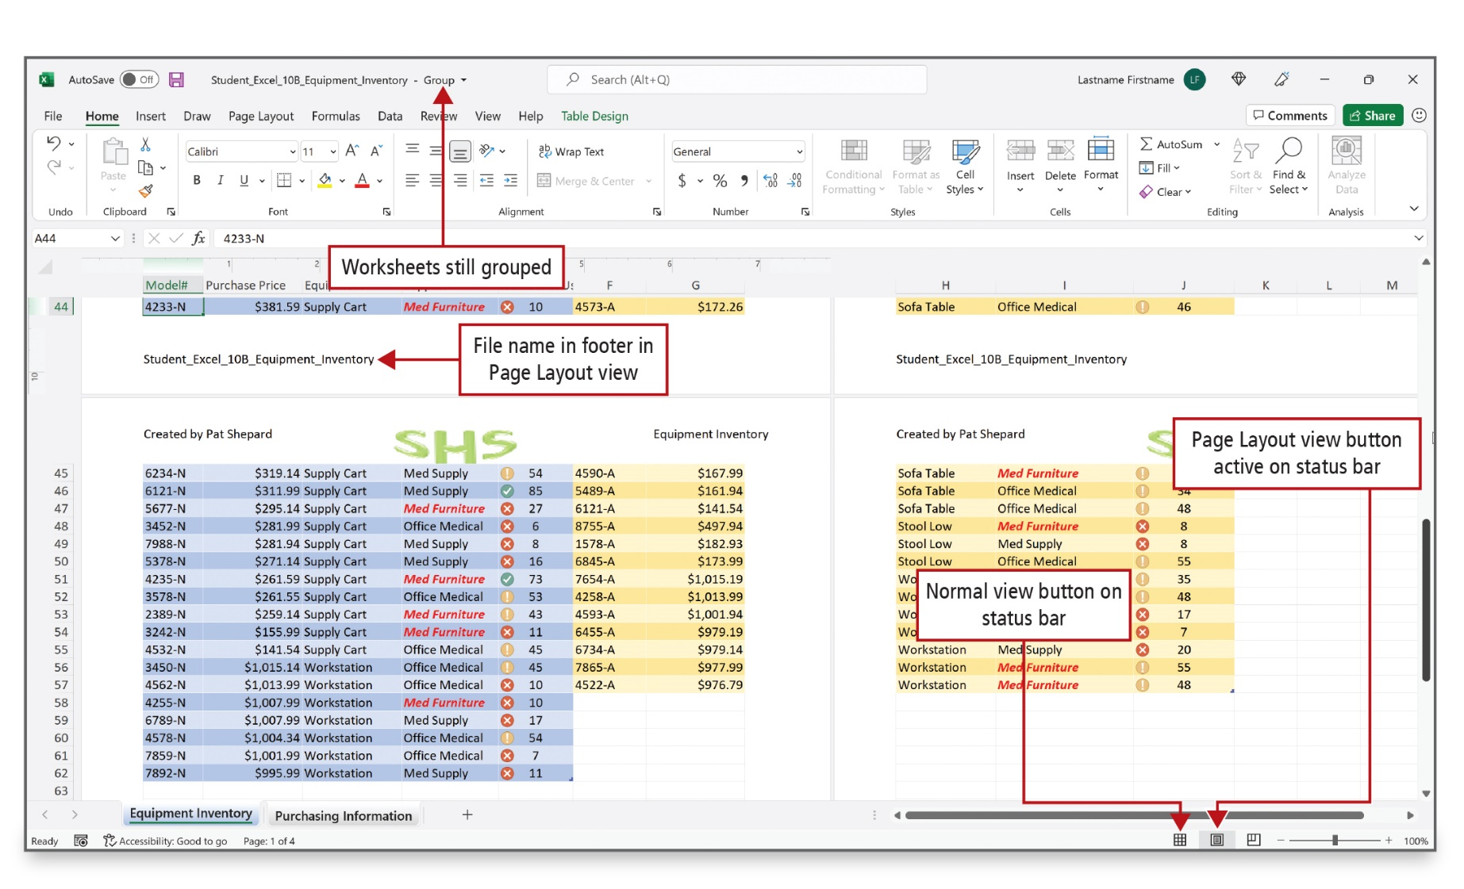
Create Custom Headers and Footers
(2 of 2)
Notes:
In the footer, the file name displays in the left section.
Alt Text: In this excel file, the name on the left sheet is labeled as file name in footer in page layout view. On the bottom right corner of the page, the button on the left is labeled as normal view button on status bar. The button to the right of this is labeled as page layout view button active on status bar.

Slide 26
Inspect a Workbook (1 of 4)
Finalizing a workbook
Accessibility Checker—finds any potential accessibility issues and creates a report
Compatibility Checker—finds any potential compatibility issues and creates a report
Document Inspector—finds and removes hidden properties and personal information
Notes:
When you finish editing a workbook, you may want to review its contents to ensure that it is accessible to individuals with disabilities, that it is compatible with earlier versions of Excel, and that it does not contain sensitive or personal information that you do not want to share with other people.
Accessibility Checker finds any potential accessibility issues and creates a report so that you can resolve the issues to make your file easier for those with disabilities to use.
Compatibility Checker finds any potential compatibility issues and creates a report so that you can resolve the issues.
Document Inspector finds and removes hidden properties and personal information in a workbook.

Slide 27
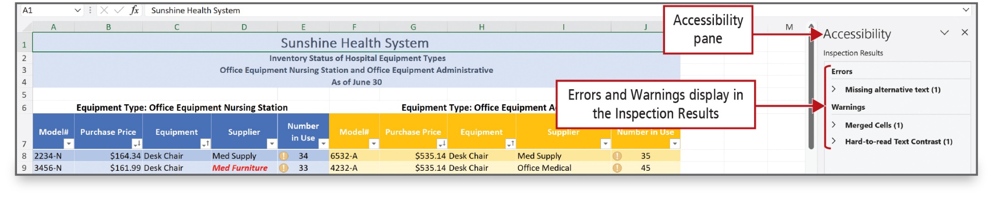
Inspect a Workbook (2 of 4)
Notes:
The Accessibility Checker pane displays, and the Inspection Results display an error and warnings. The Accessibility Checker also provides information on why and how you can fix the errors and warnings.

Slide 28
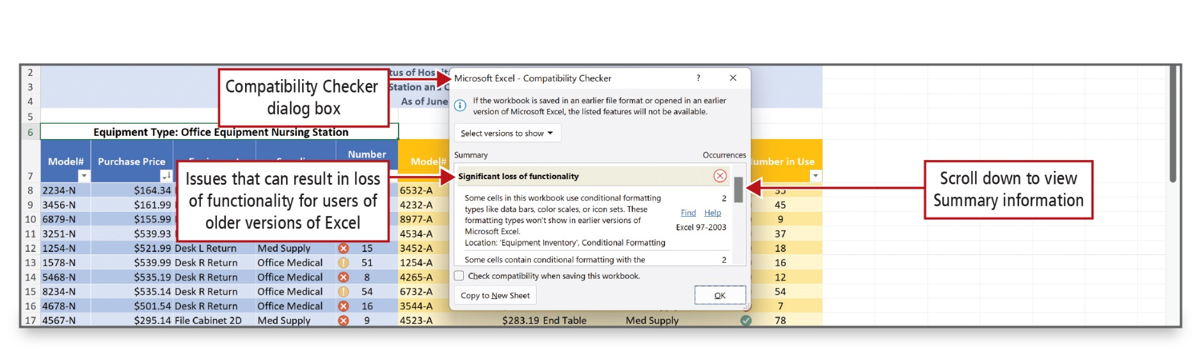
Inspect a Workbook (3 of 4)
Notes:
The Compatibility Checker dialog box displays issues that can result in loss of functionality if someone is using a version of Excel earlier than 2003.

Slide 29
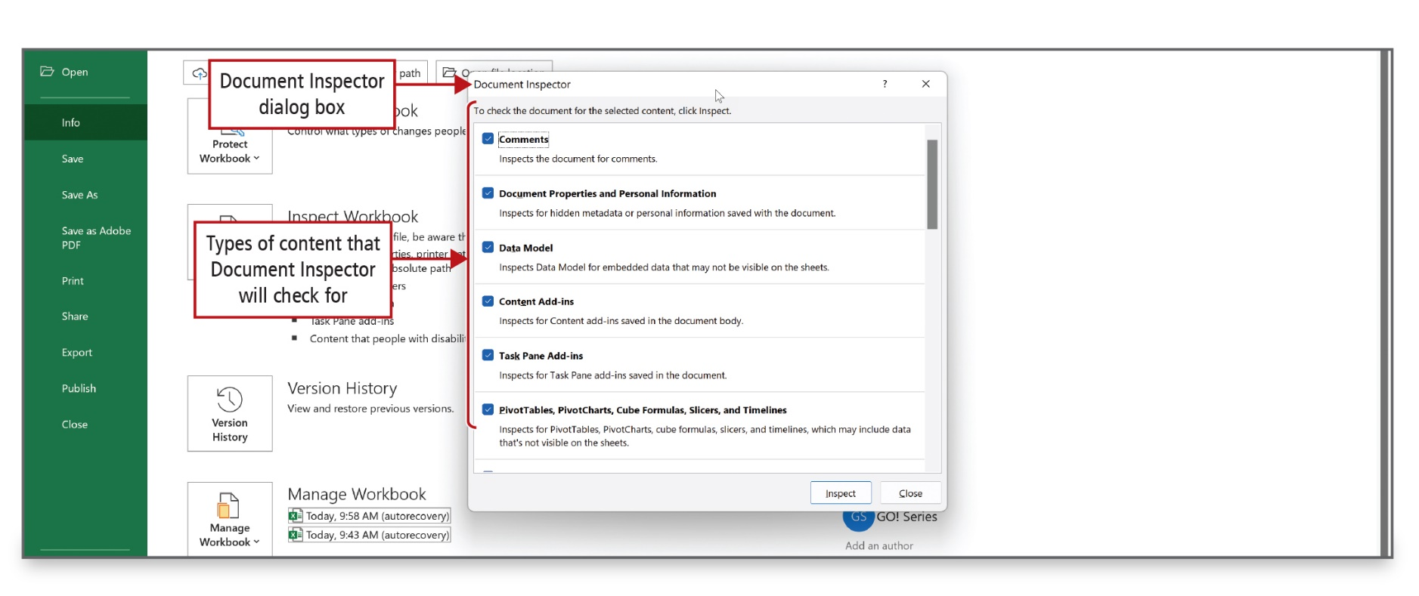
Inspect a Workbook (4 of 4)
Notes:
The Document Inspector indicates categories that contain personal information. In this workbook, the Document Inspector found document properties, author, and other information.

Slide 30
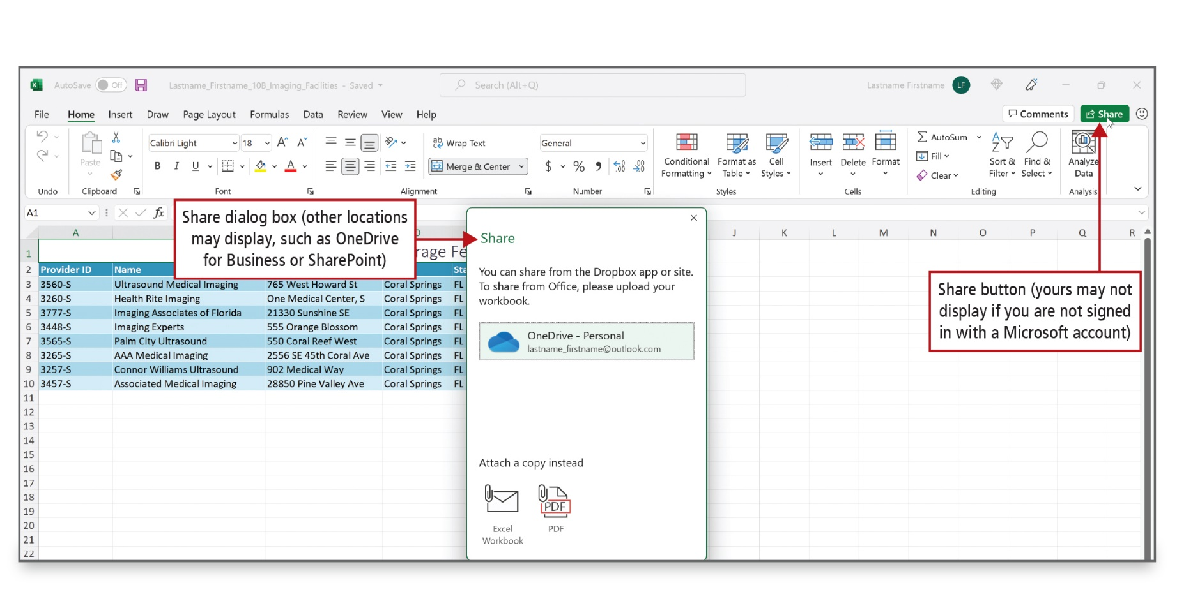
Use Co-Authoring and Prepare a Final Workbook for Distribution
Notes:
Co-authoring refers to the ability for you and your colleagues to open and work on the same Excel workbook and replaces the Track Changes features in earlier versions of Excel. To share a workbook, it must be stored in Microsoft OneDrive, Microsoft OneDrive for Business, or in a Microsoft SharePoint Online library.
You can provide a level of security for your workbook by adding encryption, which is the process by which a file is encoded so that it cannot be opened without the proper password.
Before you share a workbook, you can apply the Mark as Final command, which makes the document read-only. The Mark as Final command prevents additional changes to the document and disables typing and editing commands.
Alt Text: The share button is at the top right corner labeled as Share button (yours may not display if you are not signed in with a Microsoft account) and a share dialog box is labeled as other locations may display, such as OneDrive for Business or SharePoint.

Slide 31

Questions

Slide 32

Copyright
This work is protected by United States copyright laws and is provided solely for the use of instructors in teaching their courses and assessing student learning. Dissemination or sale of any part of this work (including on the World Wide Web) will destroy the integrity of the work and is not permitted. The work and materials from it should never be made available to students except by instructors using the accompanying text in their classes. All recipients of this work are expected to abide by these restrictions and to honor the intended pedagogical purposes and the needs of other instructors who rely on these materials.

