Slide 1

GO! with Microsoft 365: Excel 2021
Chapter 1
Creating a Worksheet and Charting Data
Copyright © 2023 Pearson All Rights Reserved.
Notes:
GO! with Microsoft 365 Excel 2021, Chapter 1
In this chapter, you will begin your study of Microsoft Excel, which is a tool to effectively communicate quantitative business information. Rather than just a tool for making calculations, Excel is also a tool for you to communicate and collaborate with others visually using tables and graphs.

Slide 2
Learning Objectives (1 of 2)
Create, Save, and Navigate an Excel Workbook
Enter Data in a Worksheet
Construct and Copy Formulas and Use the SUM Function
Format Cells with Merge & Center, Cell Styles, and Themes
Chart Data to Create a Column Chart and Insert Sparklines
Print a Worksheet, Display Formulas, and Close Excel
Notes:
The objectives of this chapter are:
Create, Save, and Navigate an Excel Workbook
Enter Data in a Worksheet
Construct and Copy Formulas and Use the SUM Function
Format Cells with Merge & Center, Cell Styles, and Themes
Chart Data to Create a Column Chart and Insert Sparklines
Print a Worksheet, Display Formulas, and Close Excel

Slide 3
Learning Objectives (2 of 2)
Check Spelling in a Worksheet
Enter Data by Range
Construct Formulas for Mathematical Operations
Edit Values in a Worksheet
Format a Worksheet
Notes:
Additional objectives of this chapter are:
Check Spelling in a Worksheet
Enter Data by Range
Construct Formulas for Mathematical Operations
Edit Values in a Worksheet
Format a Worksheet

Slide 4
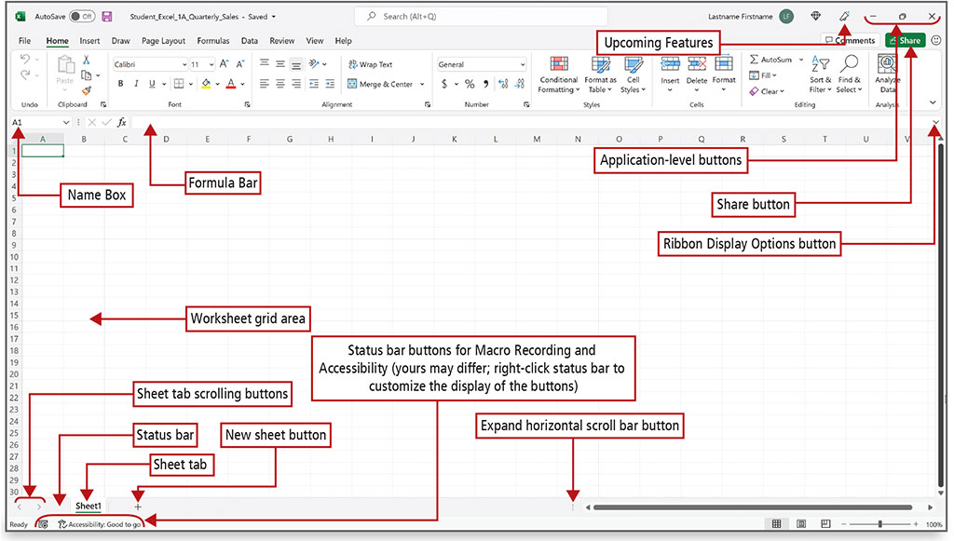
Create, Save, and Navigate an Excel Workbook (1 of 3)
Notes:
Alt text: On the top left on the sheet, below the Excel ribbon, is a box showing cell name A1. This box has a drop-down menu and is labeled as a “Name Box”. On the right side of the name box are formula bar buttons followed by a formula bar. On the top right corner of the sheet are minimize, maximize, and close buttons collectively labeled as “Application-Level Buttons”. To the left of these buttons is a ribbon display options button. Below this is a share button (top right corner of Excel ribbon). To the left of the application level buttons is the upcoming features button.
A green bar at the bottom of the sheet says “Ready” (bottom left corner) and is labeled as a “status bar”. Above the status bar (on the bottom left corner) are two arrows pointing to the left and right (labeled as sheet tab scrolling buttons). On the right of the scrolling buttons is a sheet 1 tab (labeled as sheet tab) followed by a circled plus icon (labeled as a new sheet button). On the bottom right corner is a horizontal scroll bar. To the left of this bar is an icon with three vertical dots (labeled as expand horizontal scroll bar button). The rectangular cells made by vertical and horizontal lines of the sheet are labeled as worksheet grid area. To the right of ready, the part is labeled as status bar buttons for macro recording and accessibility (yours may differ; right-click status bar to customize the display of the buttons).
When you start Excel, a new blank workbook—the Excel document that stores your data—displays. A workbook contains one or more pages called a worksheet (also known as a spreadsheet). Worksheets are stored in a workbook and formatted as a pattern of uniformly spaced horizontal rows and vertical columns, the intersection of which is referred to as a cell.

Slide 5
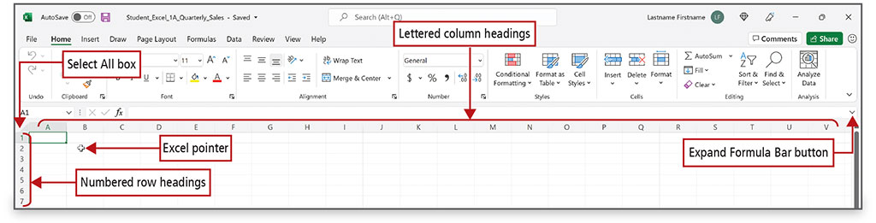
Create, Save, and Navigate an Excel Workbook (2 of 3)
Notes:
Alt Text: Below the name box is an arrow pointing to the bottom right corner labeled as “Select All box”. A column below this arrow shows numbering 1, 2, 3, and so on (labeled as numbered row headings), and columns to the right side show headings A, B, C, and so on (all capitalized, labeled as lettered column headings). On the right side of the sheet, above the vertical scroll bar, is a drop-down arrow labeled as “expand formula bar button”. A plus sign cursor on the Excel sheet is labeled as an Excel pointer.
A column is a vertical group of cells in a worksheet. Each column heading is designated in alphabetical order—A, B, C, etc. After column Z, columns start with AA, AB, and so on.
A row is a horizontal group of cells. Row headings are designated by a unique number—1, 2, 3, etc.

Slide 6
Create, Save, and Navigate an Excel Workbook (3 of 3)
Workbook Window Element | Description
Excel pointer | Display the location of the pointer.
Expand Formula Bar button | Increase the height of the Formula Bar to display lengthy cell content.
Lettered column headings | Indicate the column letter.
Numbered row headings | Indicate the row number.
Select All box | Selects all the cells in a worksheet.
Notes:
The table shows the elements of an Excel worksheet window.

Slide 7
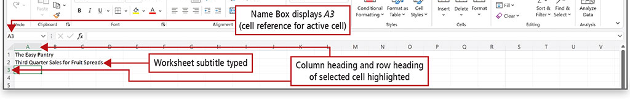
Enter Data in a Worksheet (1 of 6)
Notes:
Alt Text: Worksheet subtitle typed in cell A2 reads as “Third Quarter Sales for Fruit Spreads”. Cell A3 is selected and the cell name displayed by the name box is A3 (labeled as name box displays A3 (cell reference for active cell)). The column heading “A” and row heading “3” are highlighted and labeled as “column heading and row heading of the selected cell highlighted.”
Cell content, anything that you type in a cell, can be a constant value (referred to simply as a value) or a formula.
A formula is an equation that performs mathematical calculations on values in your worksheet.
The most commonly used values are text values and number values. A text value is also referred to as a label.
A cell reference, also called a cell address, is the intersection of the column letter and row number.

Slide 8
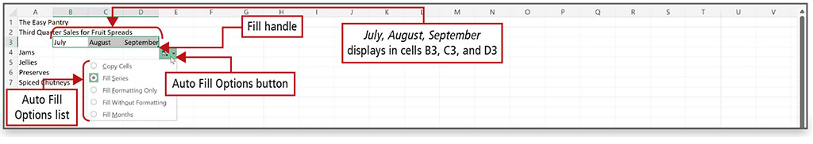
Enter Data in a Worksheet (2 of 6)
Notes:
Alt Text: The months July, August, and September are displayed in cells B3, C3, and D3 respectively. On selecting these cells and clicking on the fill handle (the dot at the bottom right corner of D3) an auto-fill options button displays. Clicking on this button displays a list of autofill options that include copy cells, fill series (selected), fill formatting only, fill without formatting, and fill months.
The fill handle is a small square in the lower right corner of a selected cell. You can drag the fill handle to adjacent cells to fill the cells with values based on the first cell.
Auto Fill generates and extends a series of values into adjacent cells based on the value of other cells. The Auto Fill Options button displays options to fill the data.

Slide 9
Enter Data in a Worksheet (3 of 6)
To Move the Location of the Active Cell | Windows PC
Up, down, right, or left one cell | Upwards Arrow , Downwards Arrow , Rightwards Arrow , Leftwards Arrow
Down one cell | Enter
Up one cell | Shift + Enter
Up one full screen | PgUp
Down one full screen | PgDn
To column A of the current row | Home
To the last cell on a worksheet, to the lowest used row of the rightmost used column | Ctrl + End
To cell A1 | Ctrl + Home
Right one cell | Tab
Left one cell | Shift + Tab
To one screen to the right in a worksheet | Alt + PgDn
To one screen to the left in a worksheet | Alt + PgUp
Notes:
Keyboard shortcuts can help you navigate a worksheet more efficiently. This table shows the Windows keys and key combinations.

Slide 10
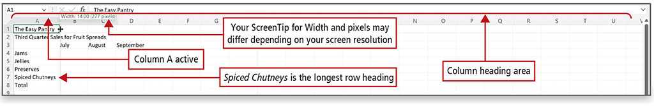
Enter Data in a Worksheet (4 of 6)
Notes:
Alt Text: The row below the formula bar is labeled as “column heading area”. The column heading “A” is highlighted and labeled as “Column A selected”. There is a pointer at the vertical line between columns A and B above which is a box that reads as width 14.00 (277 pixels). This box is labeled as “Your ScreenTip for Width and pixels may differ depending on your screen resolution”. Cell A7 (Spiced Chutneys) is labeled as “Spiced Chutneys is the longest row heading”. Column A is a little wider than the row containing Spiced Chutneys and other columns.
A ScreenTip displays information about the width of the column.
The default width of a column is 64 pixels.
A pixel, short for picture element, is a point of light measured in dots per square inch. Sixty-four pixels equal 8.43 characters, which is the average number of characters that will fit in a cell using the default font.
The default font in Excel is Calibri and the default font size is 11.

Slide 11
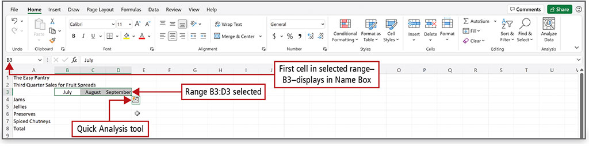
Enter Data in a Worksheet (5 of 6)
Notes:
Alt Text: The cell name (B3) is displayed in the name box (labeled as “first cell in the selected range–B3–displays in Name Box”). Cells B3 (July), C3 (August), and D3 (September) are selected (labeled as range B3:D3 selected). An icon at the lower right corner of D3 is labeled as the “Quick Analysis tool.”
A range is two or more cells on a worksheet that are adjacent or nonadjacent. When you see a colon between two cell references, the range includes all the cells between the two cell references.
The Quick Analysis tool displays in the lower right corner of the selected range, with which you can analyze your data by using Excel tools such as charts, color-coding, and formulas.

Slide 12
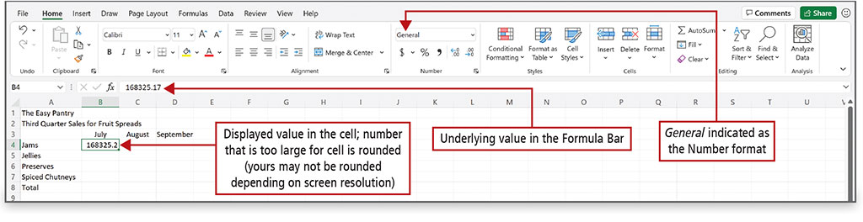
Enter Data in a Worksheet (6 of 6)
Notes:
Alt Text: In the number section of the Excel ribbon, the “General” option is selected and labeled as “general indicated as the Number format”. The formula bar displays number 168325.17 (labeled as Underlying value in the Formula Bar) and cell B4 displays number 168325.2 (labeled as the displayed value in the cell; number that is too large for the cell is rounded (yours may not be rounded depending on screen resolution).
Data that displays in a cell is the displayed value.
Data that displays in the Formula Bar is the underlying value. The number of digits or characters that display in a cell—the displayed value—depends on the width of the column. Calculations on numbers will always be based on the underlying value, not on the displayed value.

Slide 13
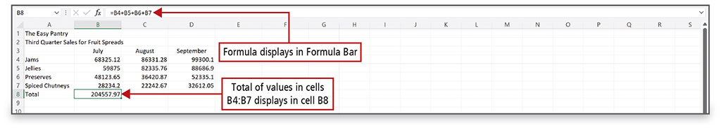
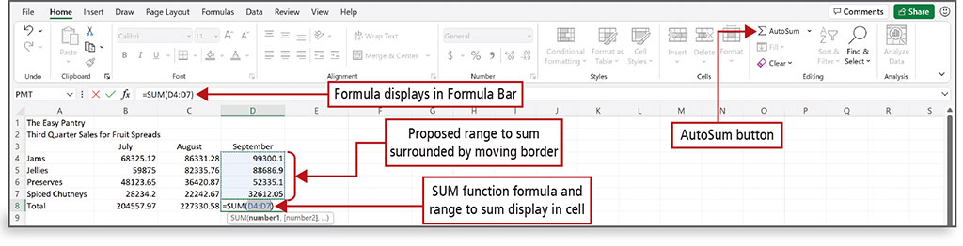
Construct and Copy Formulas and Use the SUM Function (1 of 3)
Notes:
A formula is an equation that performs mathematical calculations on values in other cells and then places the result in the cell containing the formula. The result displays in the cell and the underlying formula displays in the Formula Bar.
A function is a prewritten formula that looks at one or more values, performs an operation, and then returns a value.

Slide 14
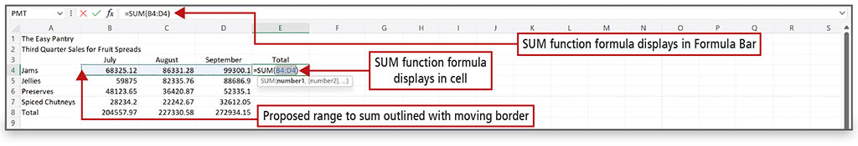
Construct and Copy Formulas and Use the SUM Function (2 of 3)
Notes:
Alt Text: The formula in the formula bar (labeled as SUM function formula displays in Formula Bar) is equal to capital s capital u capital m open parenthesis capital b 4 colon capital d 4 close parenthesis. The same formula is displayed in cell E4 and labeled as SUM function formula displays in cell. The sales for jams in July (68325.12; B4), August (86331.28; C4), and September (99300.1; D4) are surrounded by a dotted line and labeled as Proposed range to sum outlined with moving border.
The SUM function is an Excel function—a prewritten formula. In the SUM function shown above, the = sign signals the beginning of a formula or function, SUM indicates the type of calculation, and (D4:D7) indicates the range of cells on which the sum calculation will be performed.

Slide 15
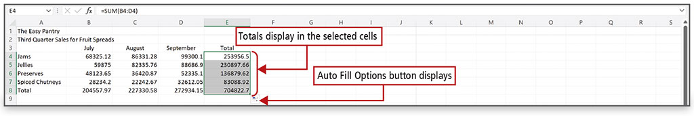
Construct and Copy Formulas and Use the SUM Function (3 of 3)
Notes:
Alt Text: Range E4:E9 is selected and the sales are as follows: E4: 253956.5, E5: 230897.66, E6: 136879.62, E7: 83088.92, E8: 704822.7.
When the fill handle is used to copy a cell containing a formula, the formula adjusts the cell references relative to the row number. This is called a relative cell reference—a cell reference based on the relative position of the cell that contains the formula and the cells referred to in the formula. The calculation is the same, but it is performed on the cells in that particular row.

Slide 16
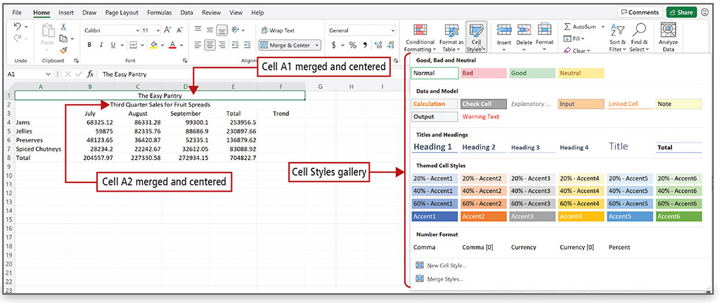
Format Cells with Merge & Center, Cell Styles, and Themes (1 of 4)
Notes:
Alt Text: Cells A1 to F1 are merged and display a heading “The Easy Pantry” at the center (labeled as Cell A1 merged and centered). Cells A2 to F2 are merged and display the subtitle “Third-quarter sales for fruit spreads” (labeled as Cell A2 merged and centered). In the Excel ribbon in the “styles group” is a button named “cell styles”. On clicking the button, a window showing the cell styles gallery opens.
The gallery displays options under the following headings:
Good, bad or neutral; Data and model; Titles and headings; Themed cell styles; Number format, new cell style and merge styles.
Format commands change the appearance of cells to make a worksheet attractive and easy to read.
A cell style is a defined set of formatting characteristics, such as font, font size, font color, cell borders, and cell shading.
The Merge & Center command joins selected cells into one larger cell and centers the contents in the merged cell.

Slide 17
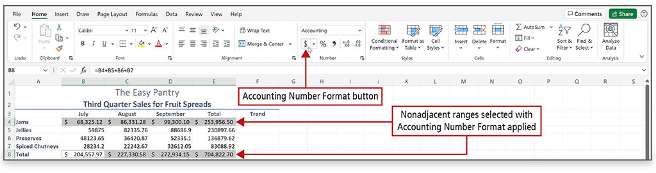
Format Cells with Merge & Center, Cell Styles, and Themes (2 of 4)
Notes:
When number values are typed into a cell, by default, they align at the right edge of the cell.
The default number format is the general format.
The Accounting Number Format, as shown on this slide, applies a thousand comma separator where appropriate, inserts a fixed U.S. dollar sign aligned at the left edge of the cell, applies two decimal places, and leaves a small amount of space at the right edge of the cell to accommodate a parenthesis when negative numbers are present.

Slide 18
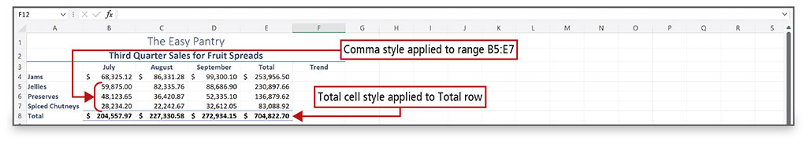
Format Cells with Merge & Center, Cell Styles, and Themes (3 of 4)
Notes:
The Comma Style inserts a thousand comma separator where appropriate and applies two decimal places.

Slide 19
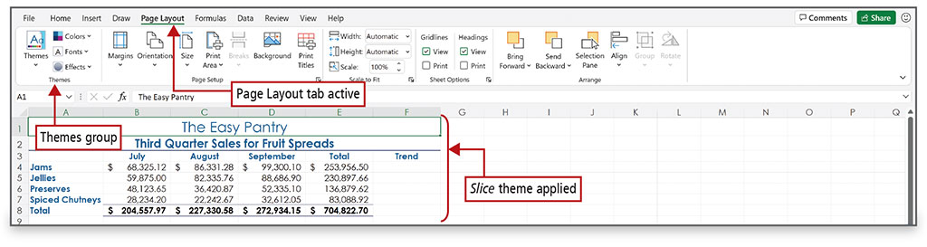
Format Cells with Merge & Center, Cell Styles, and Themes (4 of 4)
Notes:
Alt Text: The page layout tab is underlined and labeled as Page Layout tab active. In the Excel ribbon is a themes section (labeled as Themes group) consisting of themes, colors, fonts, and effects options. The title, subtitle, column titles (months), and row titles (names of spreads) appear blue. All the content is labeled as slice theme applied.
A theme is a predefined set of colors, fonts, lines, and fill effects that coordinate for an attractive look.

Slide 20
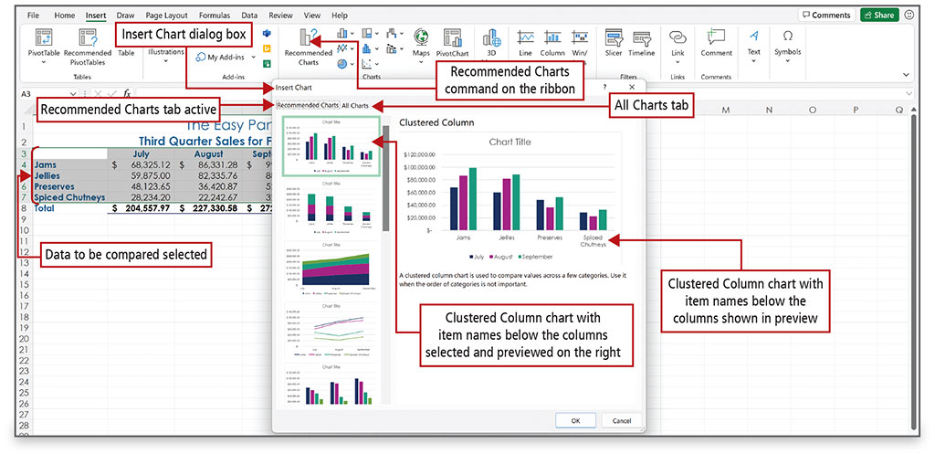
Chart Data to Create a Column Chart and Insert Sparklines (1 of 8)
Notes:
Alt Text: In the Excel sheet: In the charts group of the Excel ribbon is a recommended charts option (labeled as Recommended Charts command on the ribbon). The data in cell range A3:D7 is highlighted and surrounded by a line (labeled as Data to be compared selected).
In the dialog box:
Below the title are recommended charts (highlighted and labeled as Recommended Charts tab active) and All Charts tab. Below these tabs is a list of charts out of which the first one is selected and labeled as Clustered Column chart with item names below the columns selected and previewed on the right. The preview of the chart shows the names of the spreads on the x-axis (labeled as Clustered Column chart with item names below the columns shown in preview), sales on the Y-axis. There are color codes for each month.
A chart is a graphic representation of data in a worksheet. Data in a chart is easier to understand than a table of numbers.
Recommended Charts is an Excel feature that displays a customized set of charts that, according to Excel’s calculations, will best fit your data.
A column chart is useful for illustrating comparisons among related numbers.

Slide 21
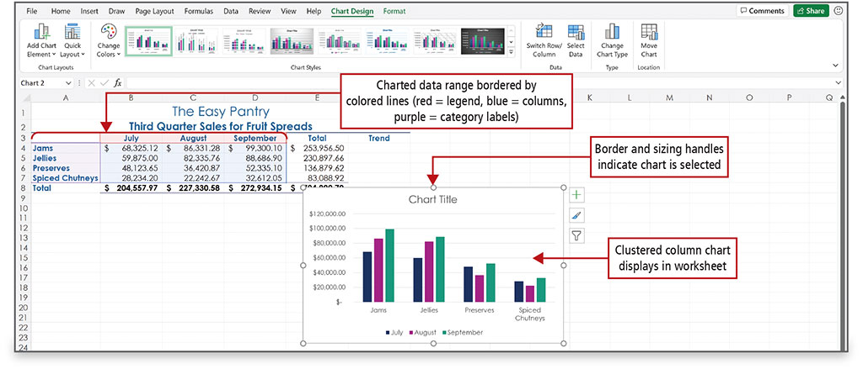
Chart Data to Create a Column Chart and Insert Sparklines (2 of 8)
Notes:
Alt Text: The cells in ranges A4 to A7, B3 to D3, and B4 to D7 are surrounded by purple, red, and blue colored lines and labeled as Charted data range bordered by colored lines (red = legend, blue = columns, purple = category labels). The chart is labeled as Clustered column chart displays in worksheet and chart border is labeled as Border and sizing handles indicate chart is selected. Sizing handles are circles at corners and center of the border.
When a chart has been created and inserted, and is selected, border and sizing handles display. The Chart Design and Format contextual tabs display next to the standard tabs on the ribbon. In this example, a clustered column chart has been inserted into the worksheet and is selected.

Slide 22
Chart Data to Create a Column Chart and Insert Sparklines (3 of 8)
Chart components:
Category labels—labels that display along the bottom of the chart
Category axis or x-axis—area along the chart’s bottom
  Identifies data categories
Value axis or y-axis—area along the left side of the chart
  Includes a numerical scale on which the charted data is based
Legend—identifies the patterns or colors that are assigned to the categories in the chart
Notes:
Chart components:
Category labels are the labels that display along the bottom of the chart to identify the category of data.
Category axis or the x-axis is the area along the chart’s bottom.
Value axis or the y-axis is the area along the left side of the chart.
Excel includes a numerical scale on which the charted data is based and appears along the lower edge of the chart.
A legend is a chart component that identifies the patterns or colors that are assigned to the categories in the chart.

Slide 23
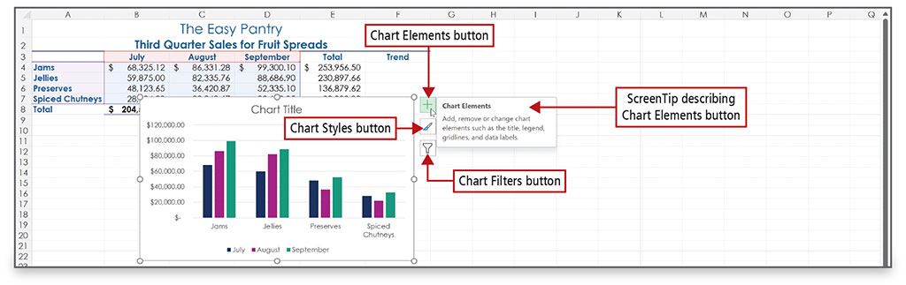
Chart Data to Create a Column Chart and Insert Sparklines (4 of 8)
Notes:
Alt Text: The buttons are the chart elements button (selected; plus icon), chart styles button (paintbrush icon), and chart filters button (funnel icon) followed by a window titled chart elements (labeled as ScreenTip describing Chart Elements button). The screen tip reads as add, remove or change chart elements such as the title, legend, gridlines, and data labels.
When a chart is selected, three buttons display to the right of the chart:
The Chart Elements button enables you to add, remove, or change chart elements such as the title, legend, gridlines, and data labels.
The Chart Styles button enables you to set a style or color scheme for your chart.
The Chart Filters button enables you to change which data displays in the chart.

Slide 24
Chart Data to Create a Column Chart and Insert Sparklines (5 of 8)
Data point—value that originates in a worksheet cell
Data marker—column, bar, area, dot, pie slice, or other symbol in a chart that represents a single data point
Data series—set of related data points
Chart layout—combination of chart elements including a title, legend, labels for the columns, and the table of charted cells
Notes:
A data point is a value that originates in a worksheet cell.
A data marker is a column, bar, area, dot, pie slice, or other symbol in a chart that represents a single data point.
A data series is a set of related data points.
A chart layout is a combination of chart elements, which can include a title, legend, labels for the columns, and the table of charted cells.

Slide 25
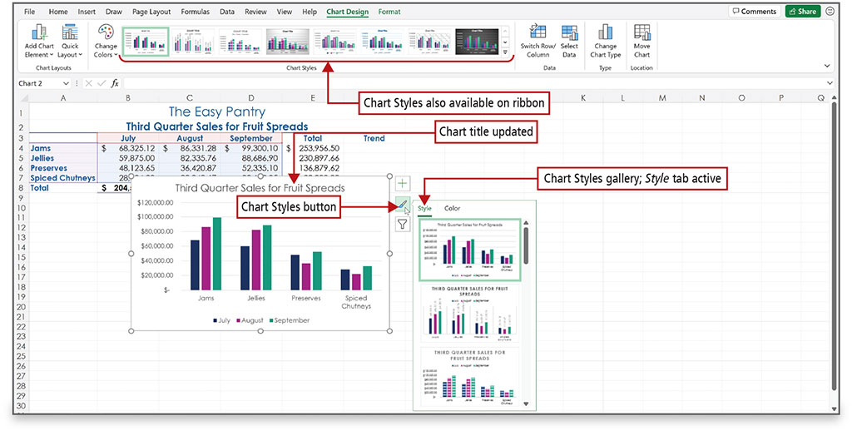
Chart Data to Create a Column Chart and Insert Sparklines (6 of 8)
Notes:
Alt Text: The chart styles section in the Excel ribbon shows list of charts (labeled as Chart Styles also available on ribbon). The chart title on the chart reads as “Third Quarter Sales for Fruit Spreads” (labeled as Chart title updated). The chart styles button on the right side of the chart is selected. On selecting this button a window with style (selected and labeled as Chart Styles gallery; Style tab active) and color tabs appear. Below these tabs is a list of chart styles.
The Chart Styles gallery displays an array of predefined chart styles—the overall visual look of a chart in terms of its colors, backgrounds, and graphic effects.

Slide 26
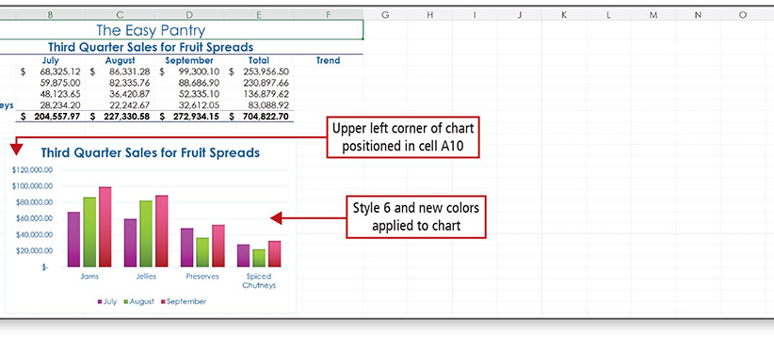
Chart Data to Create a Column Chart and Insert Sparklines (7 of 8)
Notes:
The Style gallery and the Color gallery are available by clicking the Chart Styles button.

Slide 27
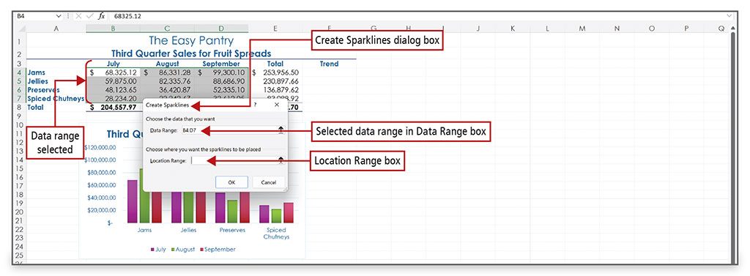
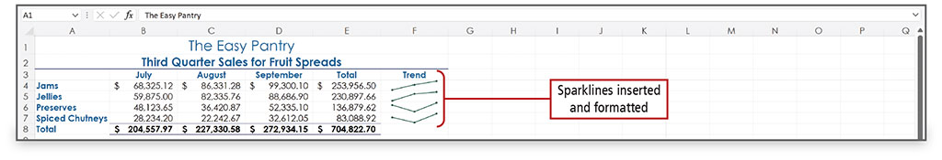
Chart Data to Create a Column Chart and Insert Sparklines (8 of 8)
Notes:
Alt Text, top image: In the Excel sheet:
The cells in range B4:D7 are highlighted and labeled as Data range selected.
In the dialog box:
Under the “choose the data that you want” instruction, the data range is B4:D7 (labeled as selected data range in Data Range box). Under the “choose where you want the sparklines to be placed” instruction is a location range box. The OK and Cancel buttons are at the bottom.
Sparklines are tiny charts embedded in a cell that give a visual trend summary alongside your data. A sparkline makes a pattern more obvious to the eye. By creating sparklines, you provide a context for your numbers. Your readers will be able to see the relationship between a sparkline and its underlying data quickly.

Slide 28
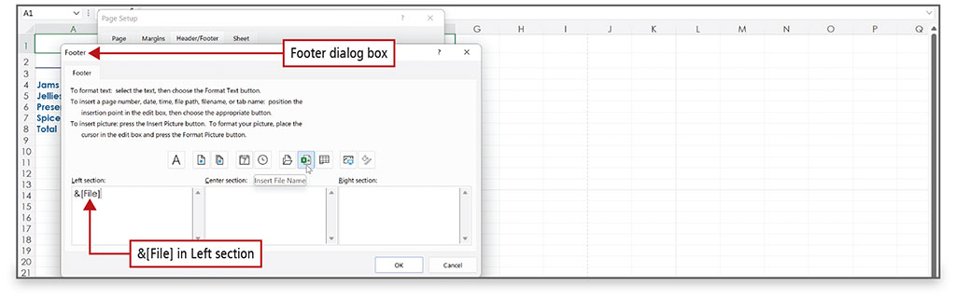
Print a Worksheet, Display Formulas, and Close Excel (1 of 4)
Notes:
Using the Header/Footer tab on the Page Setup dialog box, you can add headers or footers to a printed worksheet.

Slide 29
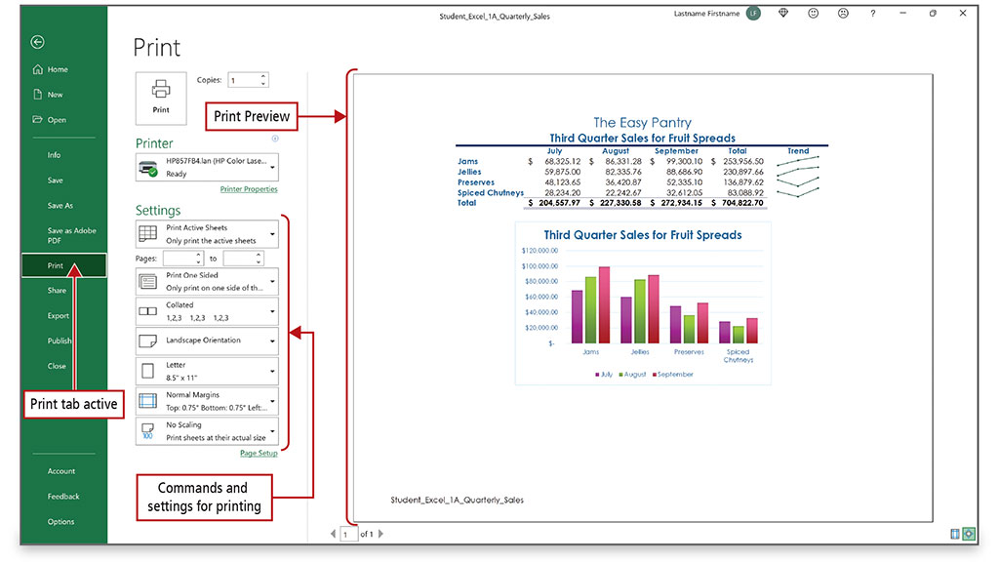
Print a Worksheet, Display Formulas, and Close Excel (2 of 4)
Notes:
Alt Text: On the left side, a print option is highlighted and labeled as Print tab active. On the right side is a print preview that shows the data table, chart, and file name. The center section is titled Print. In this section there is a print button, a button to select the number of copies, printer options, and settings options (labeled as Commands and settings for printing).
Always pay attention to the Print Preview of a worksheet so you know how your document will print prior to sending it to the printer.

Slide 30
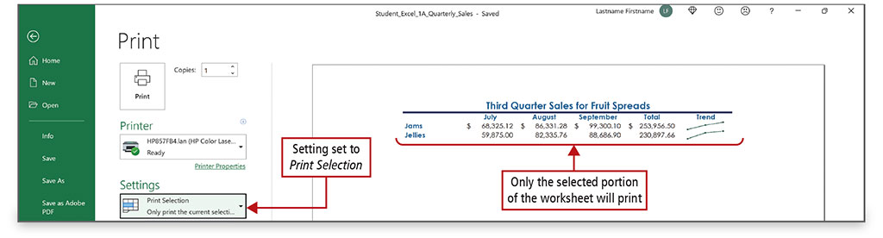
Print a Worksheet, Display Formulas, and Close Excel (3 of 4)
Notes:
Alt Text: The first settings option is selected (labeled as Setting set to Print Selection). This option reads as ”Only print the current selection”. In the print preview, the data up to sales of jellies is selected and labeled as “Only the selected portion of the worksheet will print”.
One of the printing options is to only print a section of a worksheet.

Slide 31
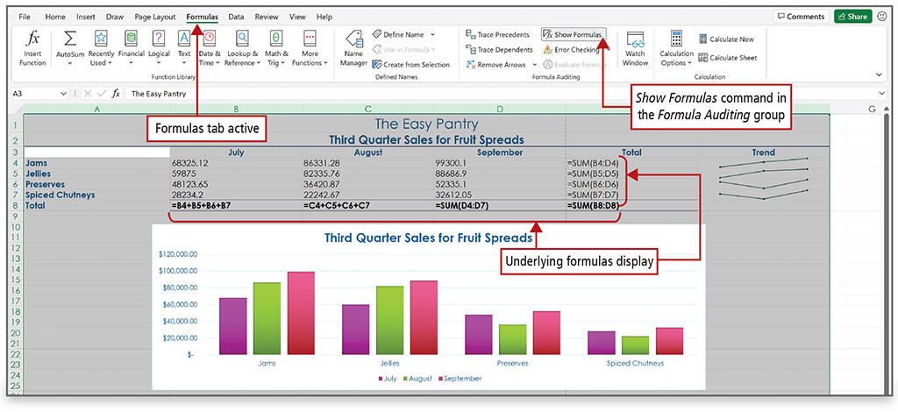
Print a Worksheet, Display Formulas, and Close Excel (4 of 4)
Notes:
Alt Text: The show formulas option in the formula auditing group of the ribbon is selected and labeled as “Show Formulas command in the Formula Auditing group”. The formula in cell B8 is equal to B4 plus B5 plus B6 plus B7, in C8 is equal to C4 plus C5 plus C6 plus C7, in D8 is equal to SUM open parenthesis D4 colon D7 close parenthesis, in E8 is equal to SUM open parenthesis B8 colon D8 close parenthesis, E4 is equal to SUM open parenthesis B4 colon D4 close parenthesis, E5 is equal to SUM open parenthesis B5 colon D5 close parenthesis, D6 is equal to SUM open parenthesis B6 colon D6 close parenthesis, and E7 is equal to SUM open parenthesis B7 colon D7 close parenthesis. All these formulas are labeled as Underlying formulas display. Formulas in row 8 are in bold.
The Show Formulas command is used to display the formula in each cell instead of the resulting value.

Slide 32
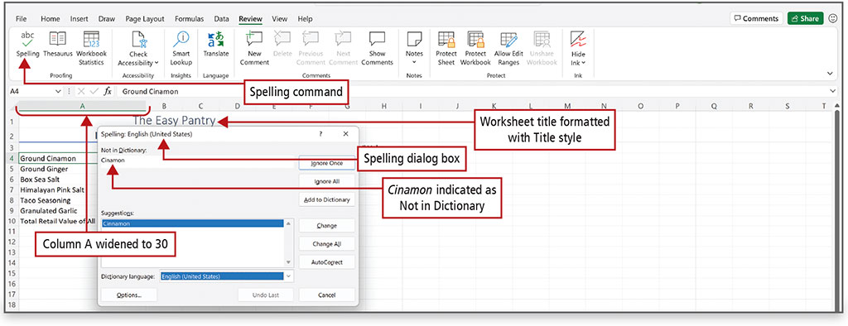
Check Spelling in a Worksheet
Notes:
Alt Text: In the Excel sheet, an abc spelling button in the proofing group of the Excel ribbon is labeled as a spelling command. Column A is widened to 30.
In the dialog box, there is a text box titled “not in dictionary” that displays cinamon (labeled as Cinamon indicated as Not in Dictionary). Ignore once (highlighted), ignore all, add to dictionary, change, change all, and autocorrect buttons are on the right. Options and cancel buttons are at the bottom.
In the spreadsheet, the title in row 1 is labeled “worksheet title formatted with Title style”.
In Excel, the spelling checker performs similarly to the other Microsoft 365 programs. Since the spelling checker searches from top to bottom, start in cell A1 and click Spelling on the Review tab, or press F7.

Slide 33
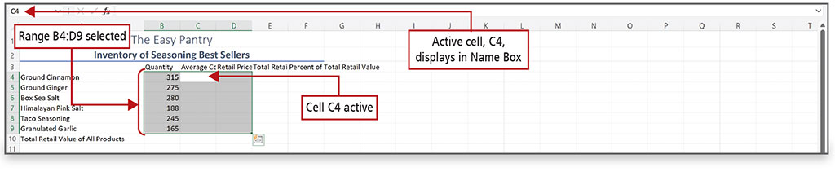
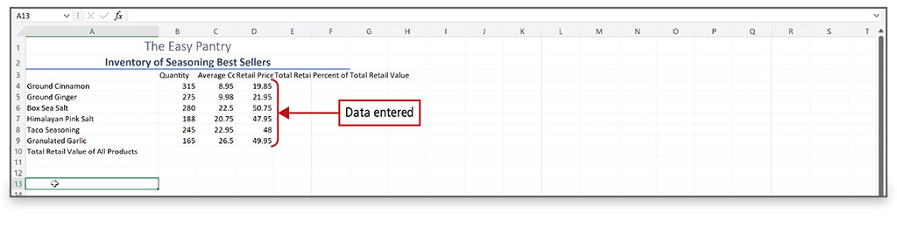
Enter Data by Range
Notes:
Alt Text for top image: The name box displays C4 (labeled as Active cell, C4, displays in Name Box). Cells in range B4:D9 (labeled as Range B4:D9 selected) except C4 (labeled as Cell C4 active) is shaded gray. Entries from cells B4 to B9 are as follows: 315, 275, 280, 188, 245, 165. There is a quick analysis button at the lower right corner of D9.
Data entry can be time consuming, but there is a time-saving technique in Excel. You first select the range of cells, and then you enter the data. After you enter the last value and press Enter, the active cell moves to the top of the next column within the selected range. Data entry in this manner is not required, but it can save you a lot of time because it confines the movement of the active cell to the selected range.

Slide 34
Construct Formulas for Mathematical Operations (1 of 3)
Operator Symbol | Operation
+ | Addition
- | Subtraction (also negative)
* | Multiplication
/ | Division
% | Percent
^ | Exponentiation
Notes:
Operators are symbols with which you can specify the type of calculation you want to perform in a formula.

Slide 35
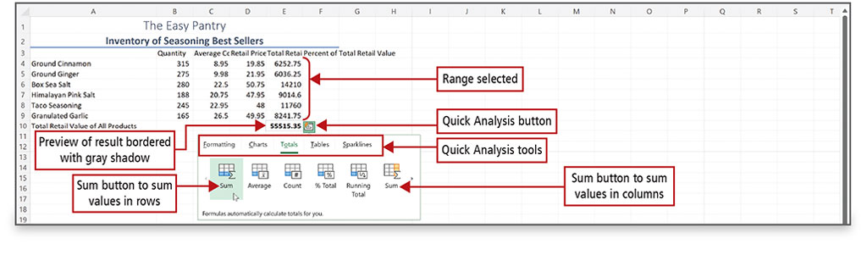
Construct Formulas for Mathematical Operations (2 of 3)
Notes:
Alt Text: Cells in range E4:E9 are selected. Cell E10 (55515.35) is labeled as Preview of result bordered with gray shadow. Quick Analysis button displays at the lower right corner of E9. Clicking on this button displays a gallery that shows Quick Analysis tools that include formatting, charts, totals (selected), tables, and sparklines. Selecting totals displays various buttons. The blue-colored sum button (first button) is labeled as the Sum button to sum values in rows and the other Sum button (last button) is labeled as Sum button to sum values in columns.
The Quick Analysis button displays when you select a range of data; it displays common commands. On this slide, the shaded cells on the button indicate what will be summed and where the result will display, and a preview of the result displays in the cell bordered with a gray shadow.

Slide 36
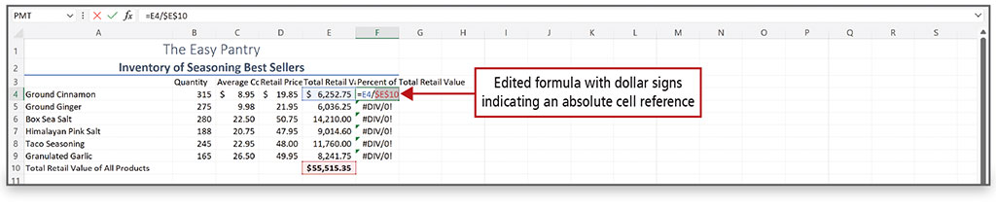
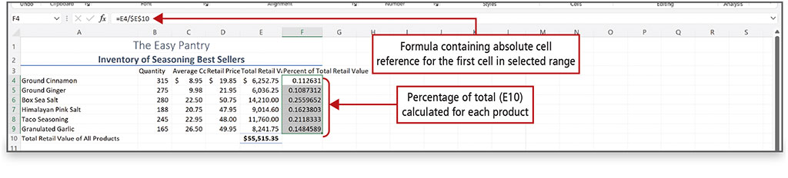
Construct Formulas for Mathematical Operations (3 of 3)
Notes:
Alt text for bottom image: The formula is labeled as “Formula containing absolute cell reference for the first cell in selected range”.
The data reads as follows:
F4: 0.112631; F5: 0.1087312; F6: 0.2559652; F7: 0.1623803; F8: 0.2118333; F9: 0.1484589.
A relative cell reference refers to a cell by its position relative to the cell that contains the formula. A relative cell reference automatically adjusts when a formula is copied, but in some calculations, you need a cell reference to remain fixed when copied.
An absolute cell reference, on the other hand, refers to a cell by its fixed position in the worksheet.
By changing the cell reference to an absolute reference in column F in the top figure, the error is eliminated in the results in the bottom figure.

Slide 37
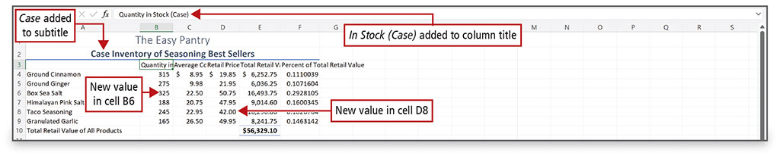
Edit Values in a Worksheet (1 of 2)
Notes:
Alt Text: The formula bar reads as Quantity in stock (Case) and is labeled as “In Stock (Case) added to column title” (case is in parentheses). The subtitle, Case inventory of seasoning best sellers, is labeled as “Case added to subtitle”. B6: 235 is labeled as New value in cell B6 and D8: 42.00 is labeled as New value in cell D8.
Excel formulas are recalculated if you change the value in a cell that is referenced in this formula. Simply start typing the new value and it will replace the old value, and the formula will recalculate automatically. If text is too long to fit in a cell and the cell to the right contains data, the text is truncated—cut off—but the entire value still exists as the underlying value.

Slide 38
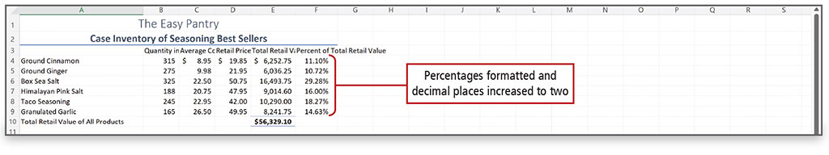
Edit Values in a Worksheet (2 of 2)
Notes:
A percentage is part of a whole expressed in hundredths. Percent Style may not offer a percentage precise enough to analyze important financial information—adding additional decimal places to a percentage makes data more precise.

Slide 39
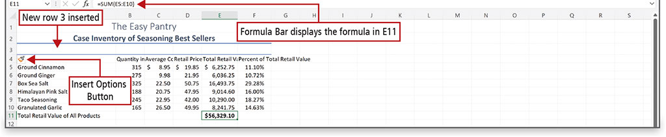
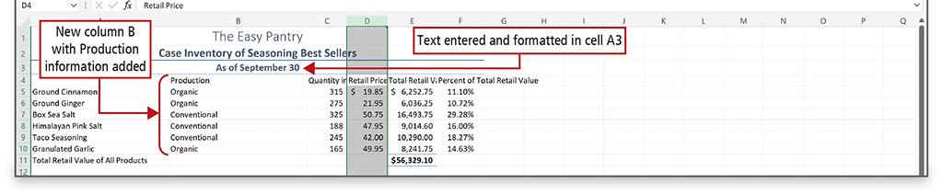
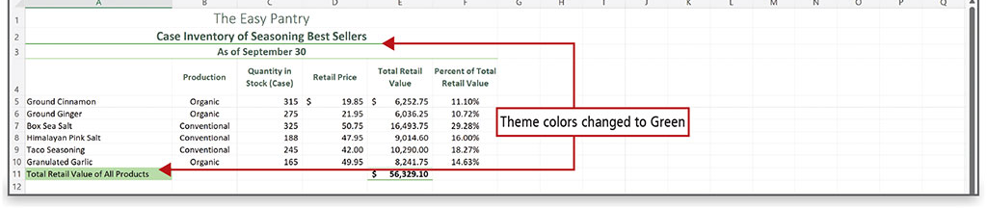
Format a Worksheet (1 of 2)
Notes:
Formatting refers to the process of specifying the appearance of cells and the overall layout of your worksheet. Columns and rows can be added and/or deleted, column widths can be adjusted, headings can be wrapped in cells, alignment can be changed, colors and styles can be changed, and headers or footers can be added.

Slide 40
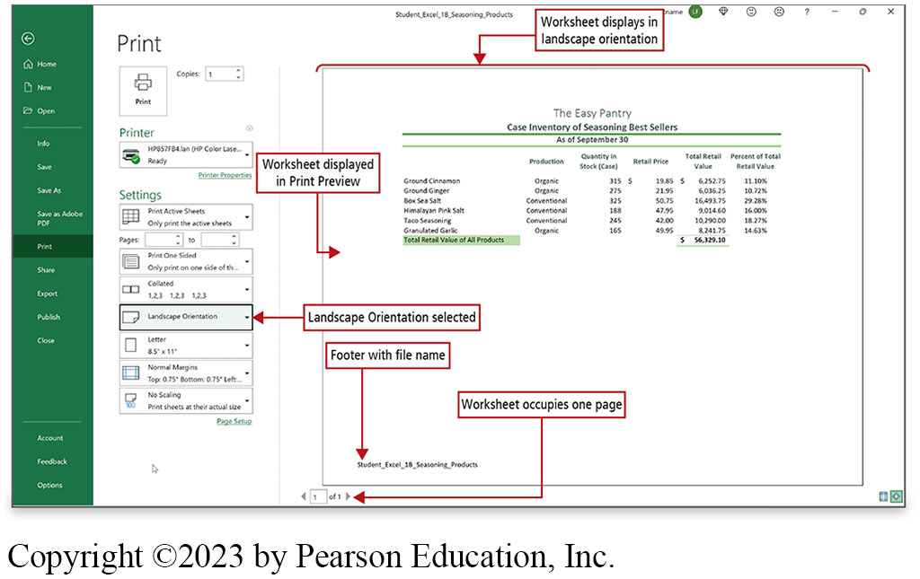
Format a Worksheet (2 of 2)
Notes:
Alt Text: The Landscape Orientation setting is selected. The print preview on the right side of this section is labeled as “worksheet displays in landscape orientation” and “workprint tab is selected. In the print section, the sheet displayed in Print Preview”. The bottom left corner of the preview reads as Student_Excel_1B_Seasoning_Products (labeled as a footer with file name). Below the preview are two arrows (right and left) that read as 1 of 1 (labeled as worksheet occupies one page).
You can change the orientation on the Page Layout tab or here, in Print Preview. Because it is in the Print Preview that you will often see adjustments that need to be made, commonly used settings display on the Print tab in Backstage view.

Slide 41

Questions

Slide 42

Copyright
This work is protected by United States copyright laws and is provided solely for the use of instructors in teaching their courses and assessing student learning. Dissemination or sale of any part of this work (including on the World Wide Web) will destroy the integrity of the work and is not permitted. The work and materials from it should never be made available to students except by instructors using the accompanying text in their classes. All recipients of this work are expected to abide by these restrictions and to honor the intended pedagogical purposes and the needs of other instructors who rely on these materials.

