Slide 1

GO! with Microsoft 365: Excel 2021
Chapter 2
Using Functions, Creating Tables, and Managing Large Workbooks
Copyright © 2023 Pearson All Rights Reserved.
Notes:
GO! with Microsoft 365 Excel 2021, Chapter 2
In this chapter, you will learn how to apply Excel functions, create and modify tables, and how to manage a workbook with multiple worksheets.

Slide 2
Learning Objectives (1 of 2)
Use Flash Fill and the SUM, AVERAGE, MEDIAN, MIN, and MAX Functions
Move Data, Resolve Error Messages, and Rotate Text
Use COUNTIF and IF Functions and Apply Conditional Formatting
Use Date & Time Functions and Freeze Panes
Create, Sort, and Filter an Excel Table
View, Format, and Print a Large Worksheet
Notes:
The objectives of this chapter are:
Use Flash Fill and the SUM, AVERAGE, MEDIAN, MIN, and MAX Functions
Move Data, Resolve Error Messages, and Rotate Text
Use COUNTIF and IF Functions and Apply Conditional Formatting
Use Date & Time Functions and Freeze Panes
Create, Sort, and Filter an Excel Table
View, Format, and Print a Large Worksheet

Slide 3
Learning Objectives (2 of 2)
Navigate a Workbook and Rename Worksheets
Enter Dates, Clear Contents, and Clear Formats
Copy and Paste by Using the Paste Options Gallery
Edit and Format Multiple Worksheets at the Same Time
Create a Summary Sheet with Column Sparklines
Format and Print Multiple Worksheets in a Workbook
Notes:
Additional objectives of this chapter are:
Navigate a Workbook and Rename Worksheets
Enter Dates, Clear Contents, and Clear Formats
Copy and Paste by Using the Paste Options Gallery
Edit and Format Multiple Worksheets at the Same Time
Create a Summary Sheet with Column Sparklines
Format and Print Multiple Worksheets in a Workbook

Slide 4
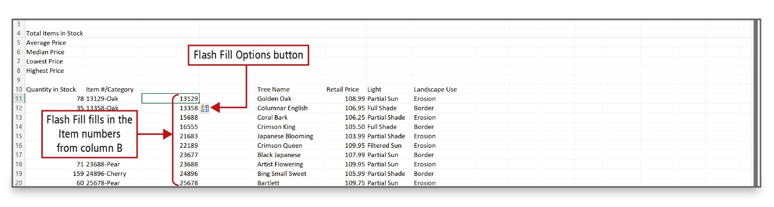
Use Flash Fill and the Sum, Average, Median, Min, and Max Functions (1 of 6)
Notes:
Alt Text: At the lower right corner of cell C11 is an icon labeled as the “Flash Fill Options button”. The item numbers from column B (except category) get filled in column C and are collectively labeled as “Flash Fill fills in the Item numbers from column B”.
Flash Fill recognizes a pattern in your data, and then automatically fills in values when you enter examples of the output that you want.
A function is a predefined formula.
Statistical functions include AVERAGE, MEDIAN, MIN, and MAX functions.

Slide 5
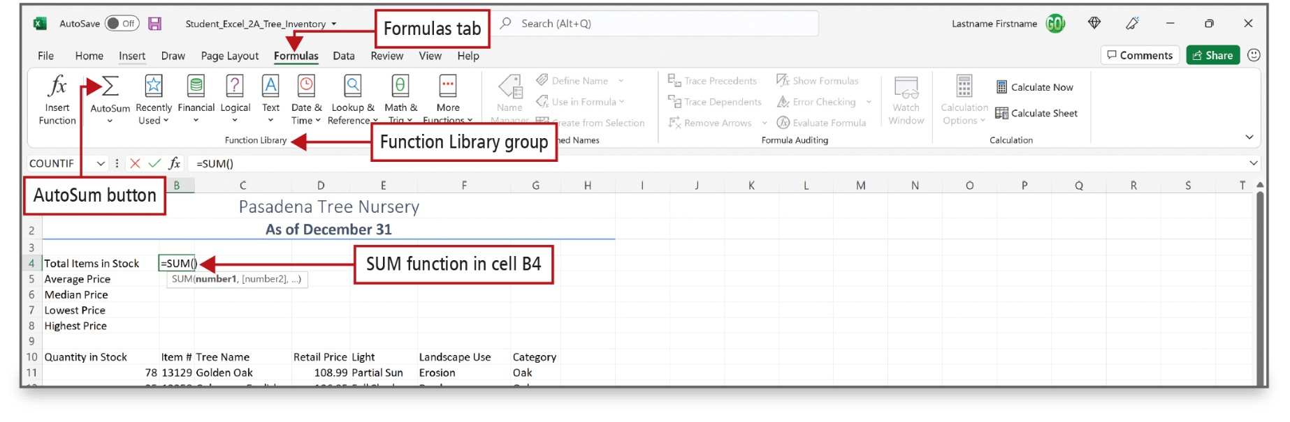
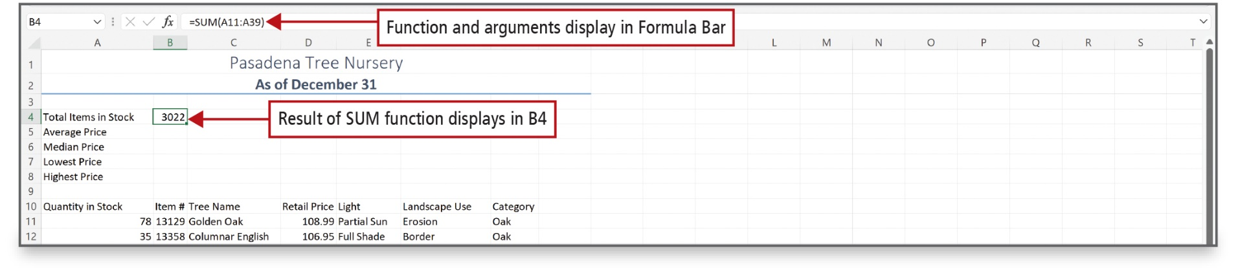
Use Flash Fill and the Sum, Average, Median, Min, and Max Functions (2 of 6)
Notes:
The SUM function is a predefined formula that adds all the numbers in a selected range of cells. You can insert the SUM function from the Home tab, from the Formulas tab, or by using the keyboard shortcut, Alt + =.

Slide 6
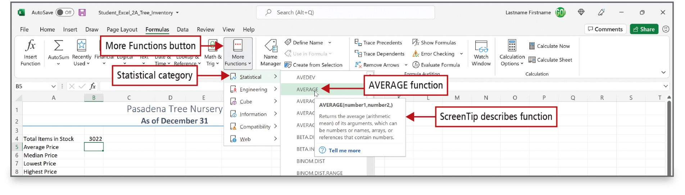
Use Flash Fill and the Sum, Average, Median, Min, and Max Functions (3 of 6)
Notes:
Alt Text: On clicking the “more functions” option from the “function library” section of the excel ribbon, a drop-down list opens. On selecting the “statistical category” from this list, another list opens. On selecting the “average function” from this list, a screen tip titled (Average (number1,number2,)) opens. The tip reads as, “returns the average (arithmetic mean) of its arguments, which can be the number of names, arrays, or references that contains numbers”. Below the screen tip is a question mark symbol that reads as “Tell me more”.
The More Functions button on the Formulas tab offers many function options, including the AVERAGE function, as shown here.
The AVERAGE function adds a group of values, and then divides the result by the number of values in the group.

Slide 7
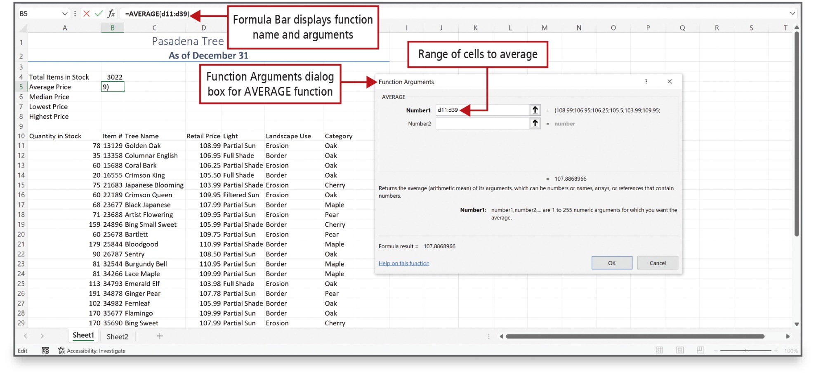
Use Flash Fill and the Sum, Average, Median, Min, and Max Functions (4 of 6)
Notes:
Alt Text: The formula displayed in the formula bar reads as “equal to AVERAGE (all capitalized) open parentheses d11 is to d39 close parentheses” and is labeled as “Formula Bar displays function name and arguments”.
In the dialog box, the heading “AVERAGE” is labeled as “Function Arguments dialog box for AVERAGE function”. Below the heading is a text box for “number 1” that reads as d11 is to d39 (labeled as Range of cells to average).
The Function Arguments dialog box allows you to enter the arguments for the function. The AVERAGE function, as shown here, requires a range of cells.

Slide 8
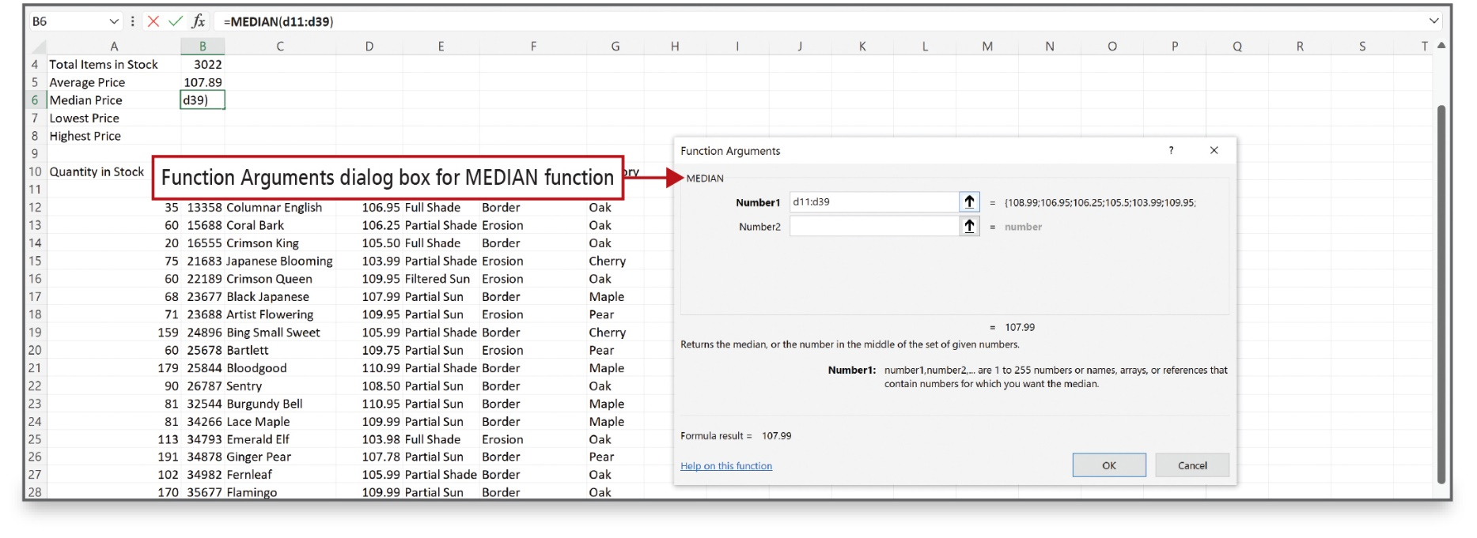
Use Flash Fill and the Sum, Average, Median, Min, and Max Functions (5 of 6)
Notes:
The MEDIAN function is a statistical function that describes a group of data; it finds the middle value that has as many values above it in the group as are below it.

Slide 9
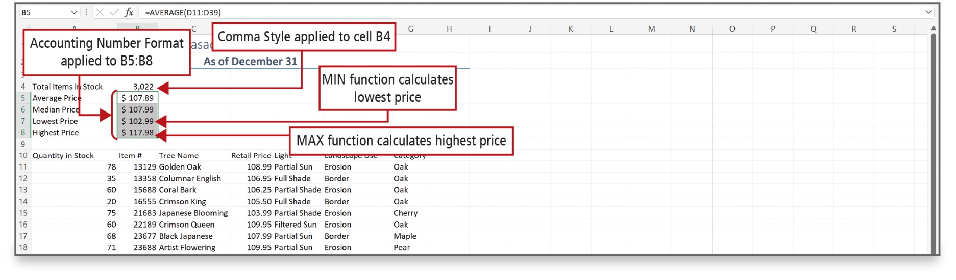
Use Flash Fill and the Sum, Average, Median, Min, and Max Functions (6 of 6)
Notes:
Alt Text: Entries in range B5:B8 are selected and labeled as Accounting Number Format applied to B5:B8. Cell B4 (3 commas 022) is labeled as Comma Style applied to cell B4. Cell B7 ($102 point 99) and B8 ($117 point 98) are labeled as “MIN function calculates the lowest price” and “MAX function calculates the highest price” respectively.
The MIN function determines the smallest value in a selected range of values.
The MAX function determines the largest value in a selected range of values.

Slide 10
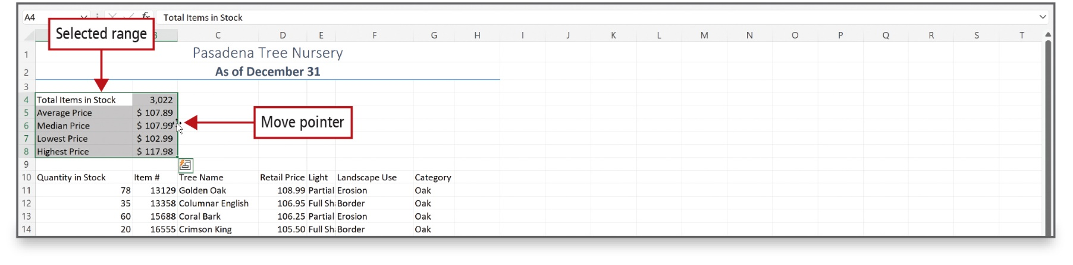
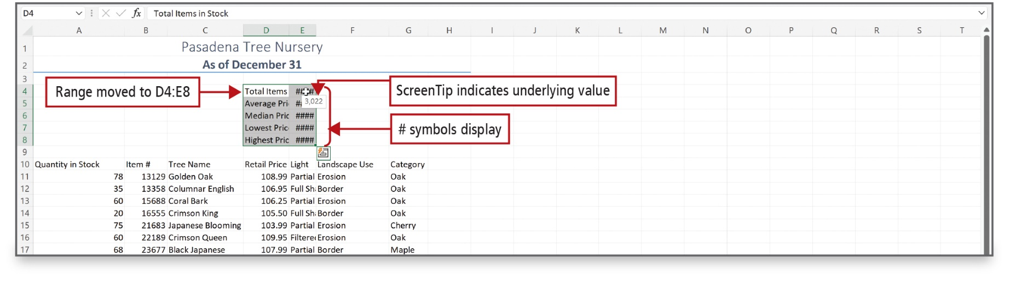
Move Data, Resolve Error Messages, and Rotate Text (1 of 2)
Notes:
When you move a formula, the cell references within the formula do not change, no matter what type of cell reference you use. An easy way to move a range of cells is to use drag and drop.
If you move cells that are not wide enough to display number values, a message is displayed so you can adjust as necessary.
If a cell width is too narrow to display the entire number, Excel displays the #### message.

Slide 11
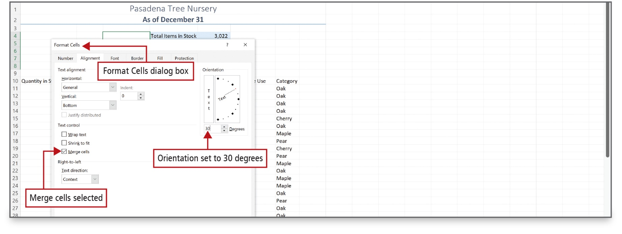
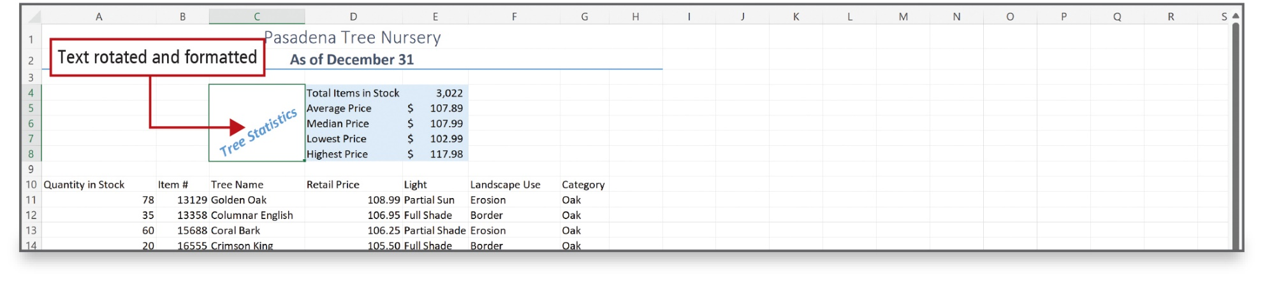
Move Data, Resolve Error Messages, and Rotate Text (2 of 2)
Notes:
Text can be rotated in a worksheet. In this example, in cell c6, the font size and color were changed and bold and italic were added. Range C4:C8 was merged and then rotated in the Format Cells dialog box, which is accessed from the shortcut menu.

Slide 12
Use COUNTIF and IF Functions and Apply Conditional Formatting (1 of 7)
Logical function—tests for specific conditions
Criteria—specific conditions that are true or false.
COUNT function—counts the number of cells in a range containing numbers
COUNTIF function—counts the number of cells within a range that meet the given criteria
Notes:
A logical function tests for specific conditions.
Criteria refers to the specific conditions that are true or false.
The COUNT function counts the number of cells in a range that contain numbers.
The COUNTIF function is a statistical function that counts the number of cells within a range that meet the given criteria.

Slide 13
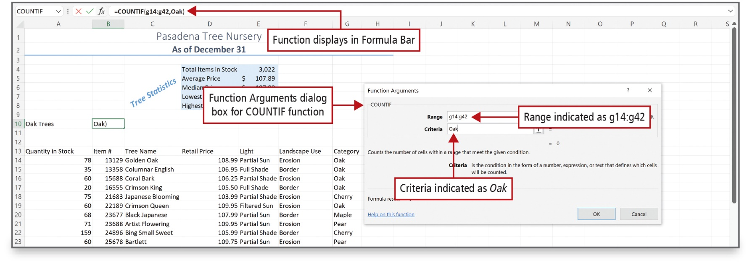
Use COUNTIF and IF Functions and Apply Conditional Formatting (2 of 7)
Notes:
Alt Text: The formula in the formula bar reads as “equal to COUNTIF (all capitalized) open parenthesis g14 is to g42 comma Oak close parenthesis.
In the dialog box, the range is indicated as g14 is to g42, and the criteria is indicated as Oak.
The slide shows the Function Arguments dialog box for the COUNTIF function.

Slide 14
Use COUNTIF and IF Functions and Apply Conditional Formatting (3 of 7)
Logical test—any value or expression evaluated as true or false
IF function—uses a logical test to check whether a condition is met
  Returns one value if true
  Another value if false
Notes:
A logical test is any value or expression that is evaluated as being true or false.
The IF function uses a logical test to check whether a condition is met, and then returns one value if the condition is true, and another value if false.

Slide 15
Use COUNTIF and IF Functions and Apply Conditional Formatting (4 of 7)
Comparison Operators | Symbol Definition
= | Equal to
> | Greater than
< | Less than
<= | Greater than or equal to
>= | Less than or equal to
<> | Not equal to
Notes:
When forming a logical text, comparison operators can be used.

Slide 16
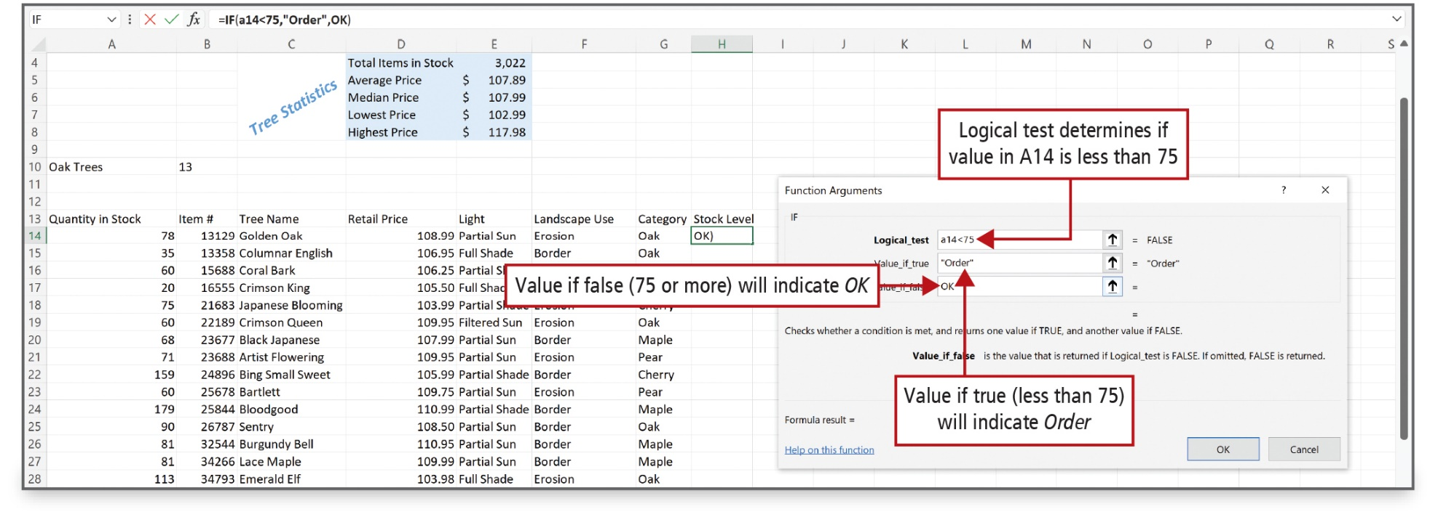
Use COUNTIF and IF Functions and Apply Conditional Formatting (5 of 7)
Notes:
Alt Text: The textbox for logical text reads as a14 less than 75 (labeled as Logical test determines if the value in A14 is less than 75), for value_if_true reads as Order in double quotes (labeled as Value if true (less than 75) will indicate Order) and for value if false reads as OK capitalized (labeled as Value if false (75 or more) will indicate OK).
The Function Arguments dialog box is used to create the IF function.

Slide 17
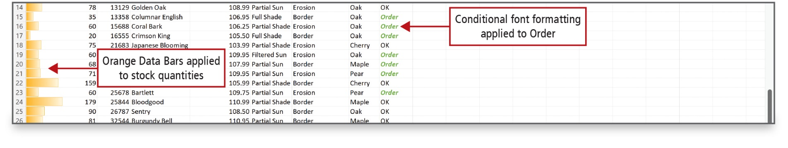
Use COUNTIF and IF Functions and Apply Conditional Formatting (6 of 7)
Notes:
A conditional format changes the appearance of a cell based on a condition—a criteria. If the condition is true, the cell is formatted based on that condition; if the condition is false, the cell is not formatted.
A data bar provides a visual cue to the reader about the value of a cell relative to other cells. The length of the data bar represents the value in the cell.

Slide 18
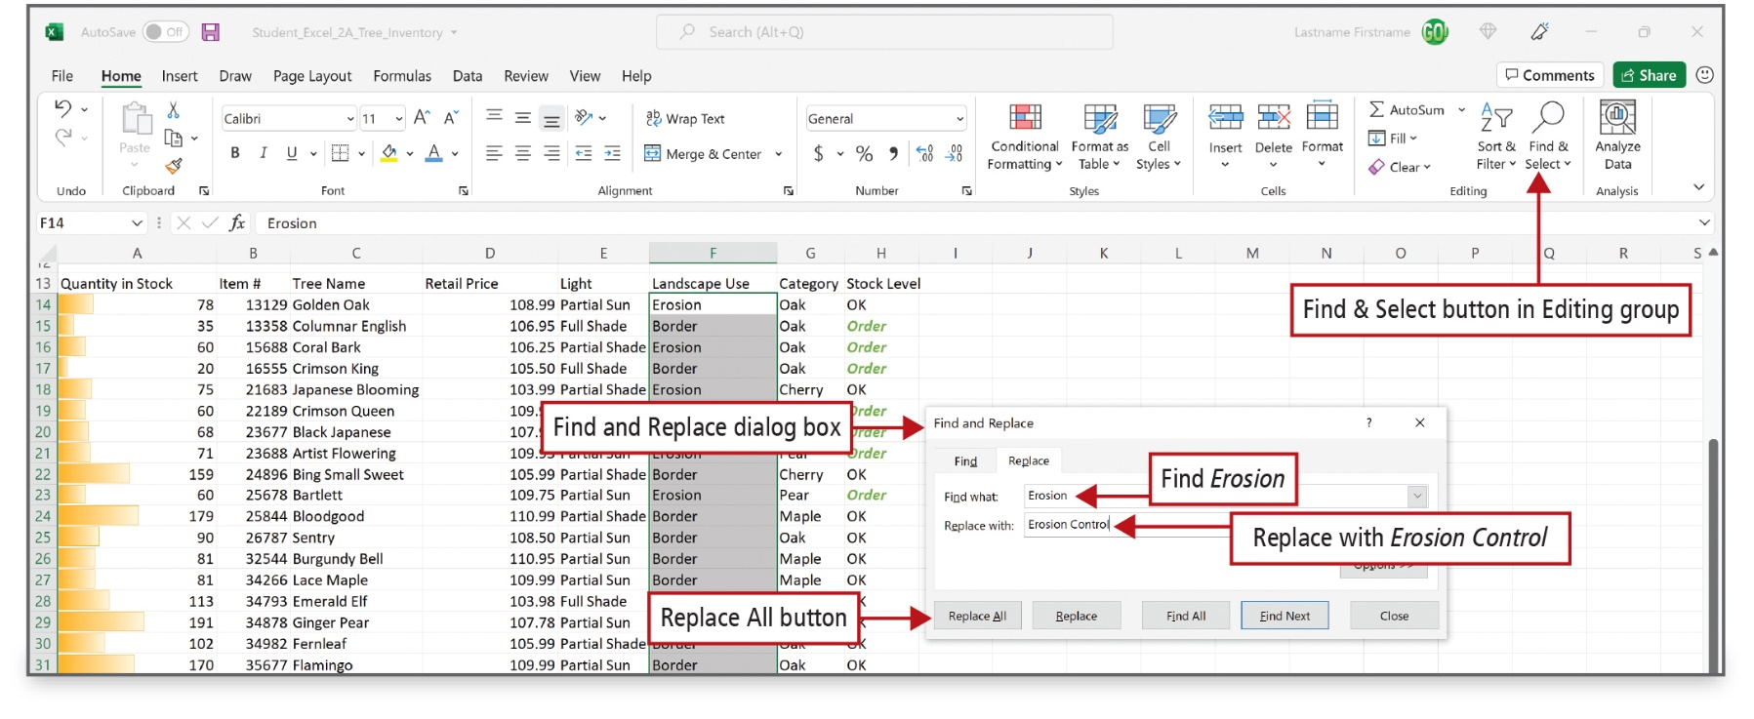
Use COUNTIF and IF Functions and Apply Conditional Formatting (7 of 7)
Notes:
Alt Text: In the editing group of the Excel ribbon is the find and select button.
In the dialog box, the replace tab is active. In the Find what textbox, erosion is entered, and in the replacing with a textbox, erosion control is entered. Replace all, replace, find next and close buttons are at the bottom.
The Find and Replace feature searches the cells in a worksheet—or in a selected range—for matches, and then replaces each match with a replacement value of your choice.

Slide 19
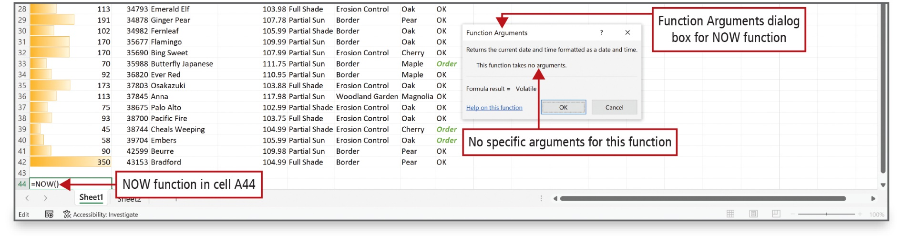
Use Date & Time Functions and Freeze Panes (1 of 2)
Notes:
Alt Text: The NOW function in cell A44 reads as equal to NOW (all capitalized) open and close parentheses.
The function arguments dialog box for the NOW function reads as follows:
Returns the current date and time formatted as a date and time. This function takes no arguments (labeled as No specific arguments for this function). Formula result equal to volatile.
Excel can obtain the date and time from your computer’s calendar and clock and display this information on your worksheet.
The NOW function retrieves the date and time from your computer’s calendar and clock and inserts the information into the selected cell.

Slide 20
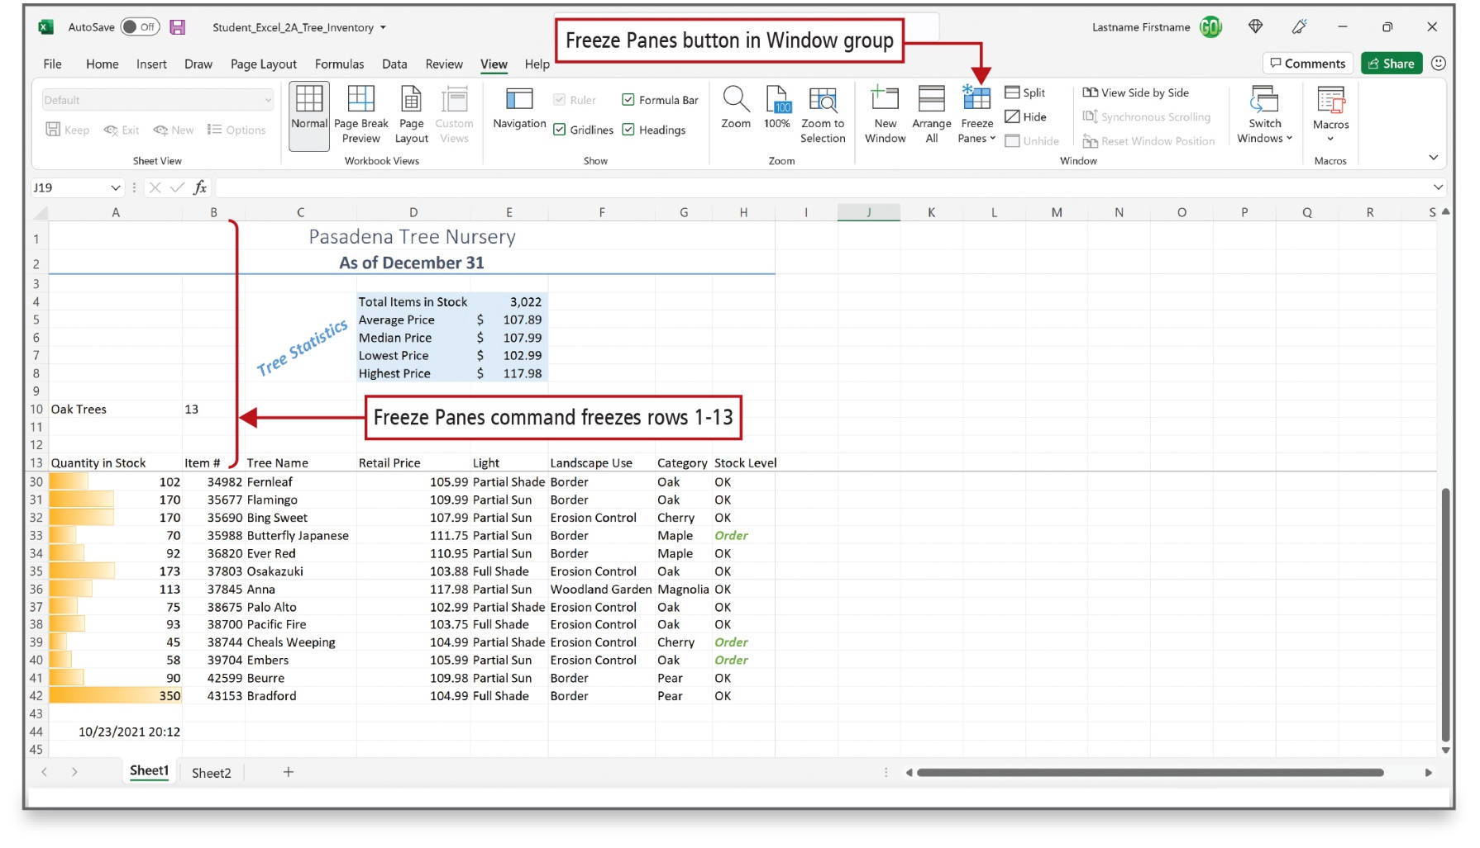
Use Date & Time Functions and Freeze Panes (2 of 2)
Notes:
The Freeze Panes command enables you to select one or more rows or columns and then freeze or lock them into place.
A pane is a portion of a worksheet window bounded by and separated from other portions by vertical or horizontal bars.

Slide 21
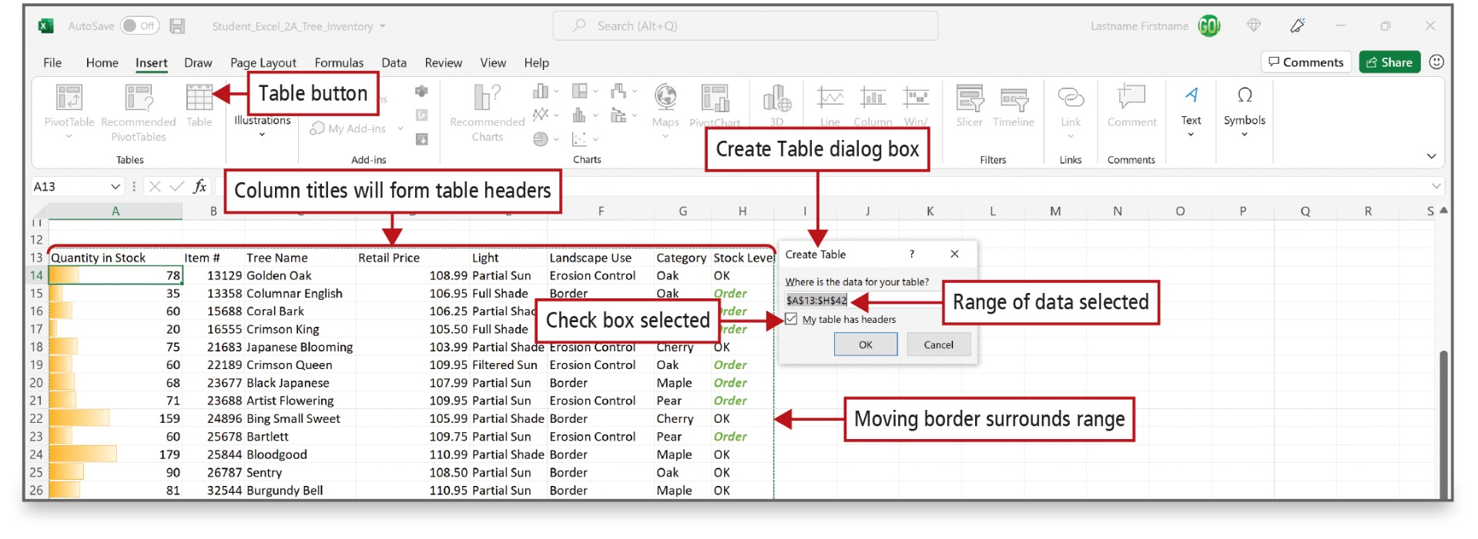
Create, Sort, and Filter an Excel Table
(1 of 3)
Notes:
Alt Text: In the Excel sheet:
The tables section of the Excel ribbon contains a table button. The columns titles in range A13:H13 are collectively labeled as Column titles will form table headers. There is a Moving border surrounding the range.
In the dialog box:
Under the command “where is the data for your table?”, the formula “equal to dollar A dollar 13 is to dollar H dollar 42” is entered (labeled as Range of data selected). The option, “my table has headers” is check marked. The OK and Cancel buttons are at the bottom.
In order to analyze a group of related data, you convert a range of cells to an Excel table, by selecting the range of cells that make up the table, including the header row, and clicking Table to display the Create Table dialog box.
An Excel table has a series of rows and columns that contains related data that is managed independently from the data in other rows and columns in the worksheet.

Slide 22
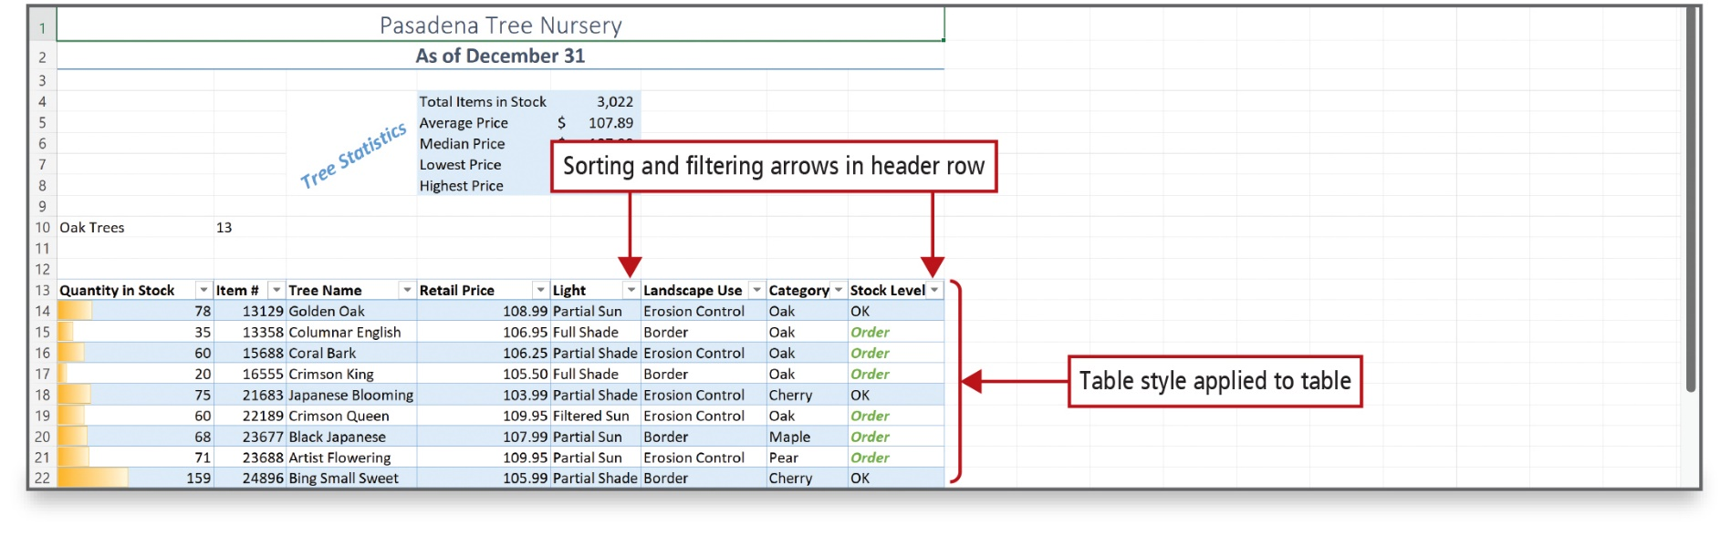
Create, Sort, and Filter an Excel Table
(2 of 3)
Notes:
You can sort tables—arrange all the data in a specific order—in ascending or descending order.
A table can have a style applied as shown in this worksheet.

Slide 23
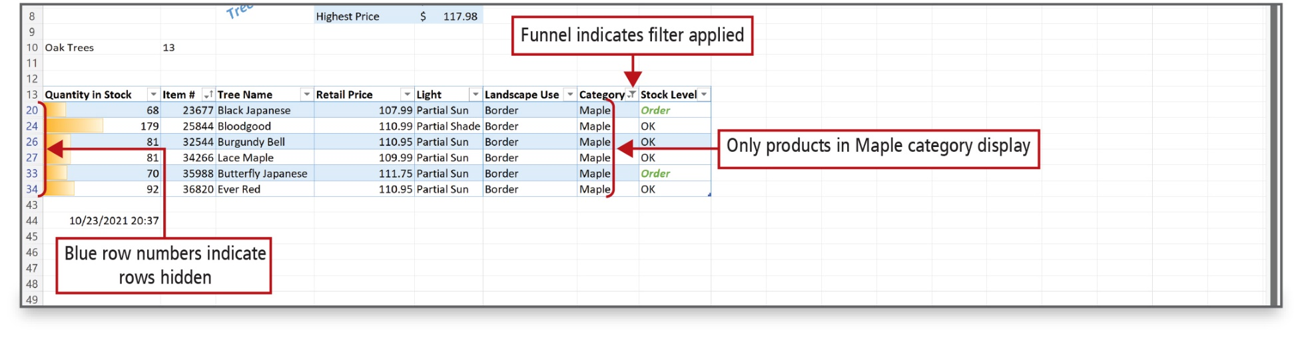
Create, Sort, and Filter an Excel Table
(3 of 3)
Notes:
Alt Text: The row numbers between 13 and 43 are in blue and are labeled as “Blue row numbers indicate rows hidden”. A symbol of a funnel to the right of the category column heading is labeled as “Funnel indicates filter applied”. The entries displayed in the category column are labeled as “Only products in Maple category display”.
You can filter tables—display only a portion of the data based on matching a specific value—to show only the data that meets the criteria that you specify. When you are finished answering questions about the data in a table, you can clear the filters.

Slide 24
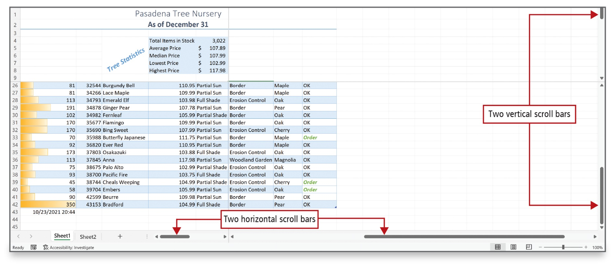
View, Format, and Print a Large Worksheet (1 of 2)
Notes:
You can magnify or shrink the view of a worksheet on your screen to either zoom in or zoom out. You can also split a worksheet window into panes. If a worksheet is too wide, too long, or both, to print on one page, Excel’s Print Titles and Scale to Fit commands can help you create pages that are attractive and easy to read. As you can see above, vertical and horizontal split bars display when you split a window.

Slide 25
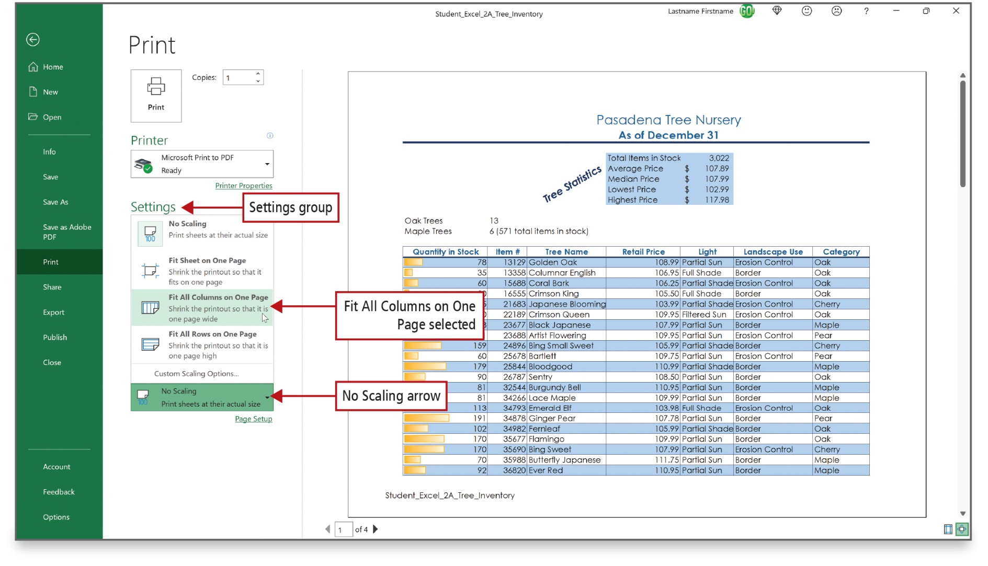
View, Format, and Print a Large Worksheet (2 of 2)
Notes:
Alt Text: In the print settings Fit All Columns on One Page (3rd option) and No Scaling arrow (last option) options are selected. The former reads as “shrink the printout so that it is one page wide” and the latter reads as “print sheets at their actual size”.
Print settings that help you print a professional-looking large worksheet include:
Center on page command
Landscape orientation
Fit All Columns on One Page command
Print Titles command

Slide 26
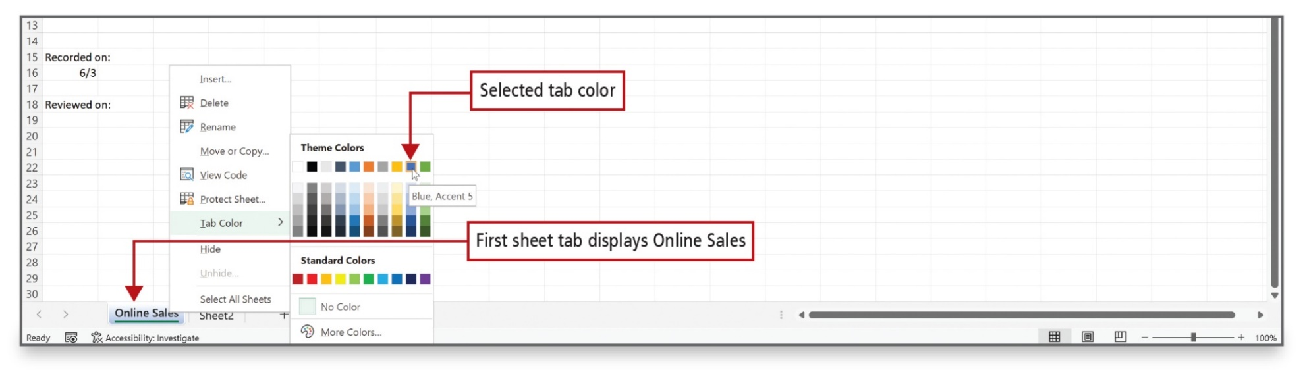
Navigate a Workbook and Rename Worksheets
Notes:
Alt Text: On right-clicking this tab, a window opens. On selecting the Tab color option from this window, the gallery labeled Theme colors opens. From this gallery, the 9th color (blue) from the first row is selected. Below are the no color and more colors options.
Use multiple worksheets in a workbook to organize data in a logical arrangement. When there is more than one worksheet in a workbook, you can navigate (move) among worksheets by clicking the sheet tabs.
Sheet tabs identify each worksheet in a workbook and display along the lower left edge of the workbook window. Sheet tab colors can also be changed. You can either double-click the sheet name or right-click the sheet name and use the shortcut menu to rename a sheet tab.

Slide 27
Enter Dates, Clear Contents, and Clear Formats (1 of 4)
Value Typed | Example
m/d/yy | 7/4/2022
d-mmm | 4-Jul
d-mmm-yy | 4-Jul-22
mmm-yy | Jul-22
Notes:
Dates represent a type of value that you can enter in a cell. When you enter a date, Excel assigns a serial value—a number—to the date. This makes it possible to treat dates like other numbers and use them in calculations. The table shows date formats recognized by Excel.

Slide 28
Enter Dates, Clear Contents, and Clear Formats (2 of 4)
Date Typed As | Completed by Excel As:
7/4/22 | 7/4/2022
7/4/98 | 7/4/1998
7/4 | 4-Jul (current year assumed)
7-4 | 4-Jul (current year assumed)
Jul 4 | 4-Jul (current year assumed)
Jul 4 | 4-Jul (current year assumed)
Jul/4 | 4-Jul (current year assumed)
Jul-4 | 4-Jul (current year assumed)
July 4,1998 | 4-Jul-98
July 2022 | Jul-12 (first day of month assumed)
July 1998 | Jul-98 (first day of month assumed)
Notes:
The table shows how Excel interprets dates.

Slide 29
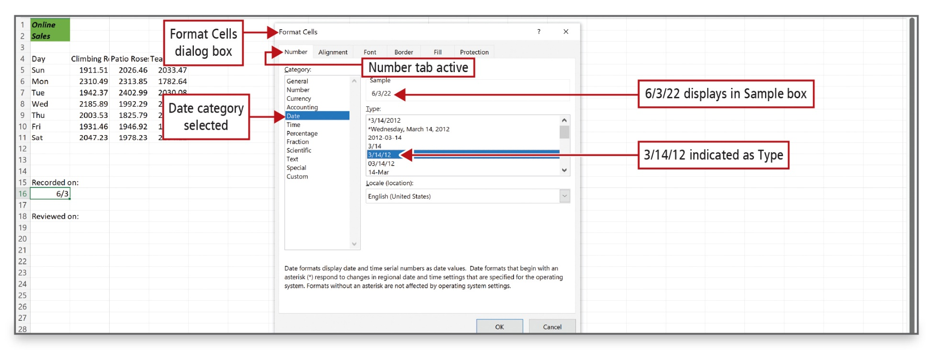
Enter Dates, Clear Contents, and Clear Formats (3 of 4)
Notes:
Alt Text: In the dialog box, the number tab is active. From the list of categories displayed on the left pane, the data category is selected. To the right, 6/3/22 displays in a Sample box, and 3/14/12 (selected) indicates as Type. The OK and Cancel buttons are at the bottom.
Dates represent a type of value that you can enter in a cell. When you enter a date, Excel assigns a serial value—a number—to the date. This makes it possible to treat dates like other numbers and use them in calculations.

Slide 30
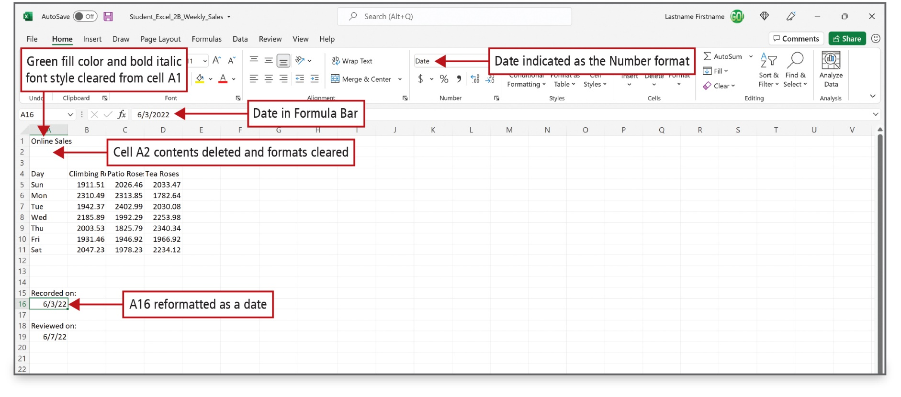
Enter Dates, Clear Contents, and Clear Formats (4 of 4)
Notes:
Alt Text: In the number section of the Excel ribbon, the Date is selected and labeled as Date indicated as the Number format. Cell A1 (Online Sales) is labeled as Green fill color and bold italic font style cleared from cell A1, cell A2 (blank) is labeled as Cell A2 contents deleted and formats cleared, cell A16 (6/3/22) is labeled as A16 reformatted as a date. Formula bar displays the date as 6 slash 3 slash 2022.
A cell has contents—a value or a formula—and a cell may also have one or more formats applied, for example, bold and italic font styles, fill color, font color, and so on.
You can choose to clear—delete—the contents of a cell, the formatting of a cell, or both.
Clearing the contents of a cell deletes the value or formula typed there, but it does not clear formatting applied to a cell.

Slide 31
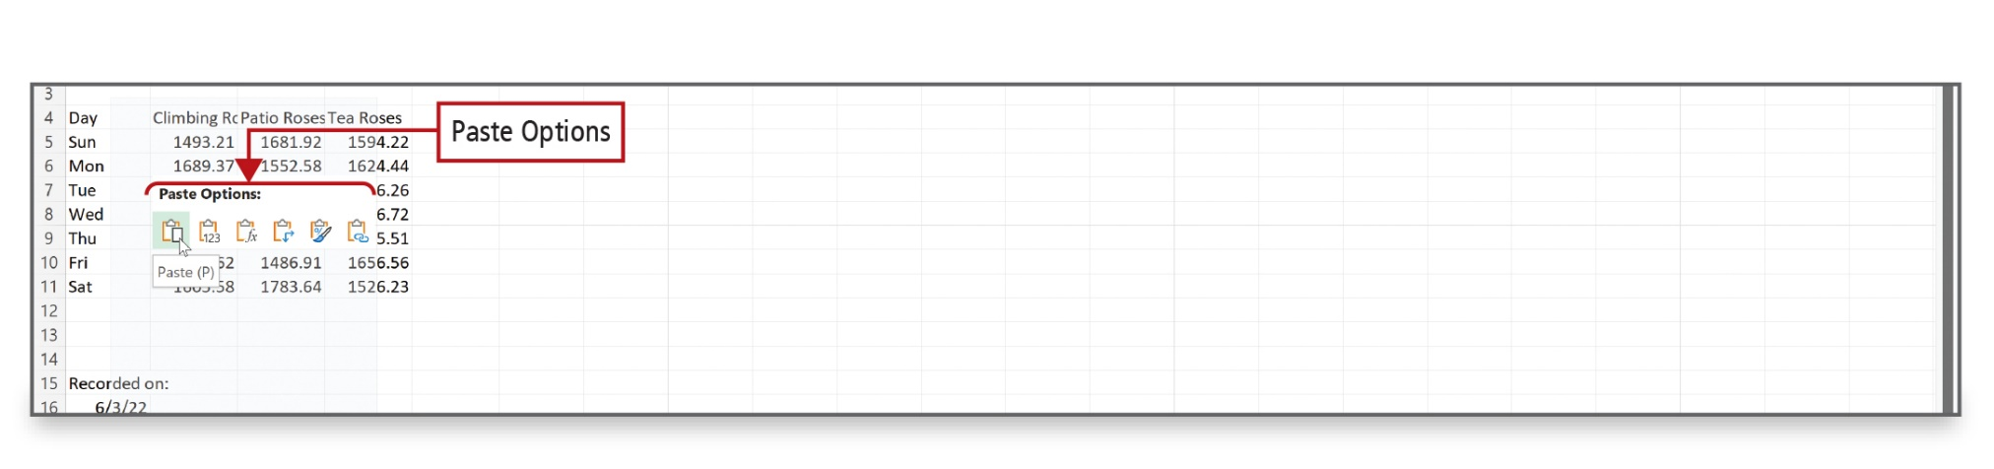
Copy and Paste by Using the Paste Options Gallery
Notes:
Data in cells can be copied to other cells. When you paste data to another cell, the Paste Options gallery displays, which includes Live Preview to preview the Paste formatting that you want.

Slide 32
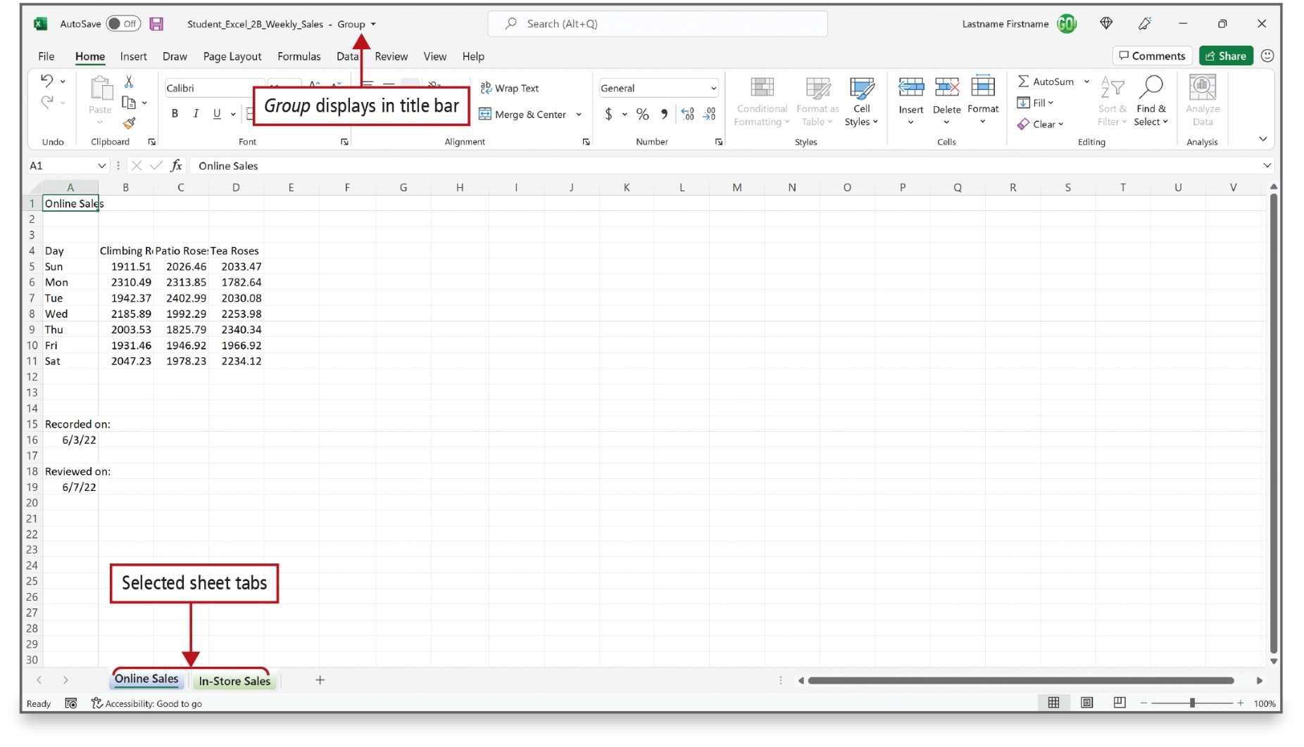
Edit and Format Multiple Worksheets at the Same Time (1 of 2)
Notes:
Alt Text: The tabs named Online sales (green) and In-store sales (black) are collectively labeled as Selected sheet tabs. The title bar reads as Student_Excel_2B_Weekly_Sales – Group (labeled as Group displays in the title bar).
You can enter or edit data on several worksheets at the same time. Use the Ctrl key to select more than one worksheet tab. If the sheet tab displays with a solid background color, you know the sheet is not selected. If you see [Group] in the title bar and tab names are underlined, those sheets have been grouped.

Slide 33
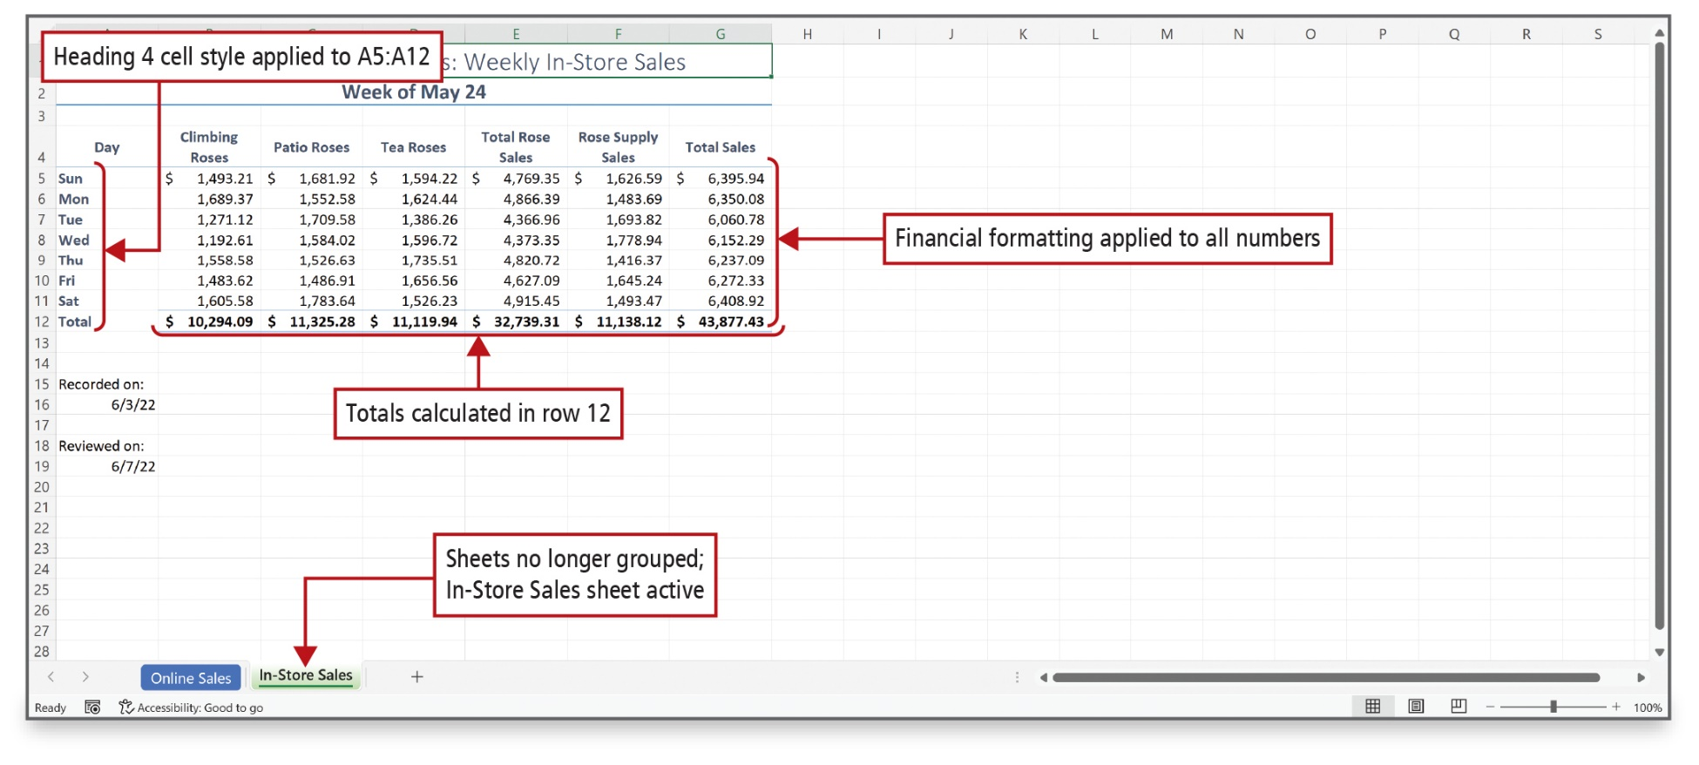
Edit and Format Multiple Worksheets at the Same Time (2 of 2)
Notes:
Alt Text: The tab of Online sales is highlighted in blue while that of In-store sales is highlighted in green. This indicates that Sheets are no longer grouped, and the In-Store Sales sheet is active. The days in column A, from cell A5 to A12 are bold and dark blue (labeled as Heading 4 cell style applied to A5:A12). The total sales in row 12 from cell B12 to G12 (bold) are labeled as Totals calculated in row 12. The total sales in column G from cells G5 to G12 are labeled as Financial formatting applied to all numbers. All the values are displayed with a thousands separator (comma).
Formulas, formatting, and styles in this workbook were applied to several worksheets at the same time by grouping the sheets. When you are finished, right-click a sheet tab, and on the shortcut menu, click Ungroup Sheets.

Slide 34
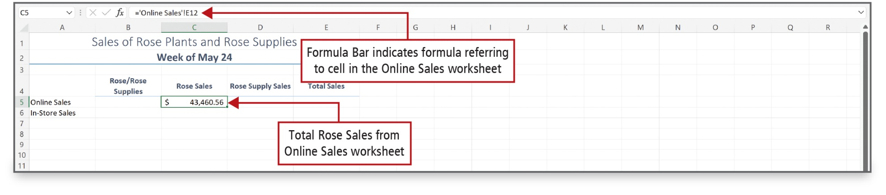
Create a Summary Sheet with Column Sparklines (1 of 5)
Notes:
Alt Text: The formula in the formula bar reads as equal to Online Sales (in the single quote) exclamation mark capital E12 (labeled as Formula Bar indicates formula referring to cell in the Online Sales worksheet). Cell C5 ($43,460.56, selected) is labeled as Total Rose Sales from the Online Sales worksheet.
A summary sheet is a worksheet where totals from other worksheets are displayed and summarized. This summary sheet uses formulas constructed from other sheets in the workbook, known as the detail sheets. The figure shows the data from the detail sheet named Online Sales being used in a summary sheet. Notice that the worksheet name is surrounded by apostrophes followed by an exclamation point.

Slide 35
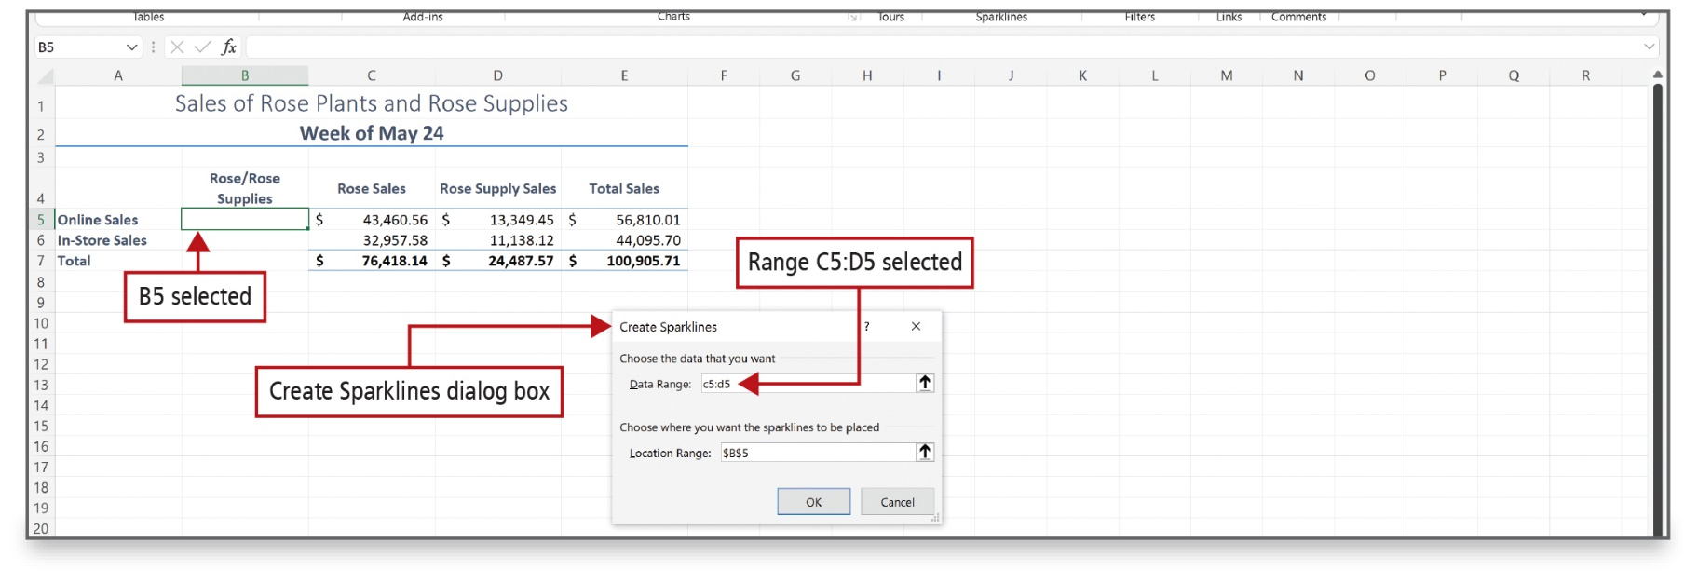
Create a Summary Sheet with Column Sparklines (2 of 5)
Notes:
Sparklines are tiny charts within a single cell that show a data trend. Sparklines are created using the Create Sparklines dialog box.

Slide 36
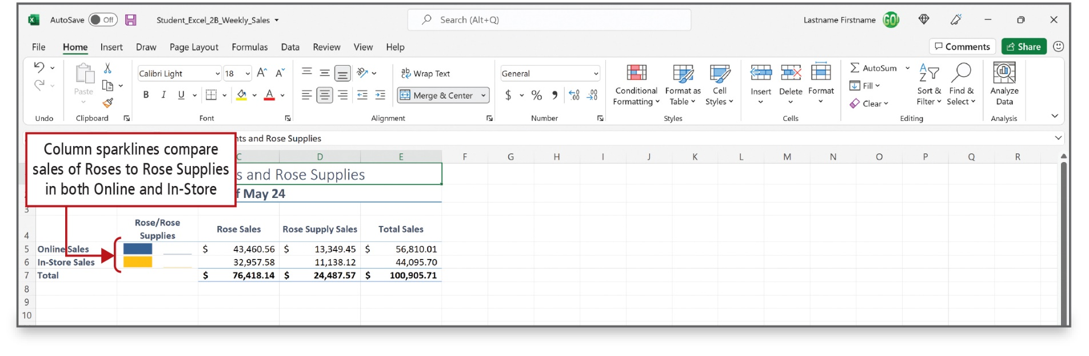
Create a Summary Sheet with Column Sparklines (3 of 5)
Notes:
The summary sheet now contains sparklines.

Slide 37
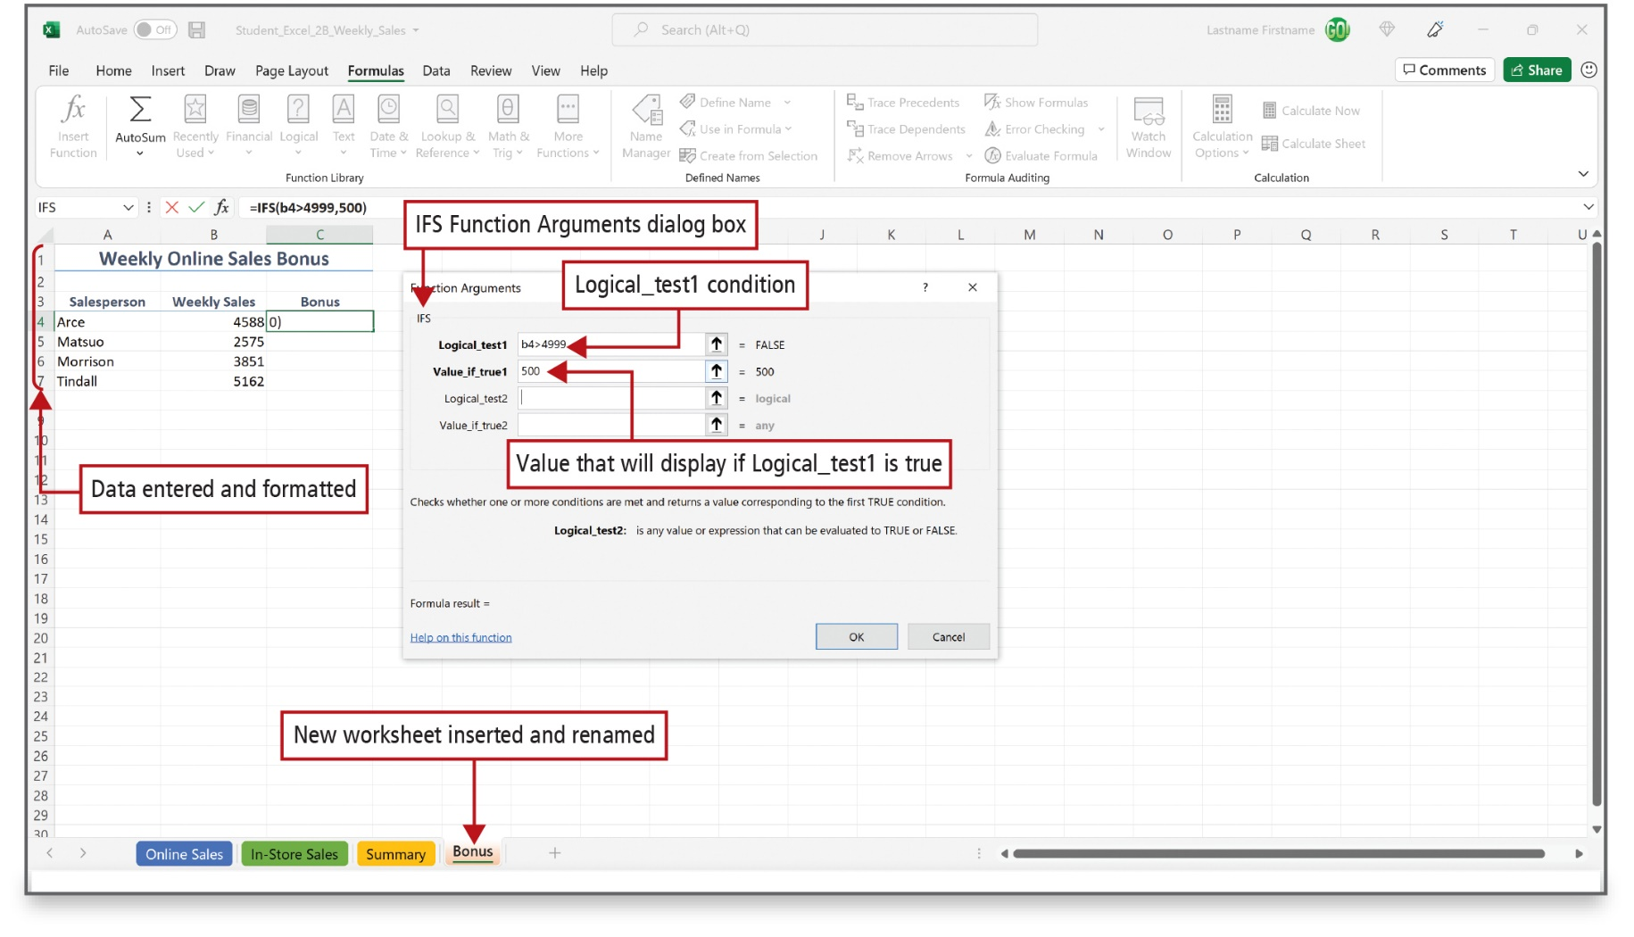
Create a Summary Sheet with Column Sparklines (4 of 5)
Notes:
Alt Text: The data of salesperson and weekly sales for weekly online sales bonus in cell range A1:B7 is labeled as Data entered and formatted. The bonus tab at the bottom is labeled as New worksheet inserted and renamed.
In the dialog box, the Logical_test1 condition entered is b4 greater than 4999. Value_if_true1 is 500 (labeled as Value that will display if Logical_test1 is true).
The IFS function checks whether one or more conditions—logical tests—are met, and then returns a value corresponding to the first TRUE condition.

Slide 38
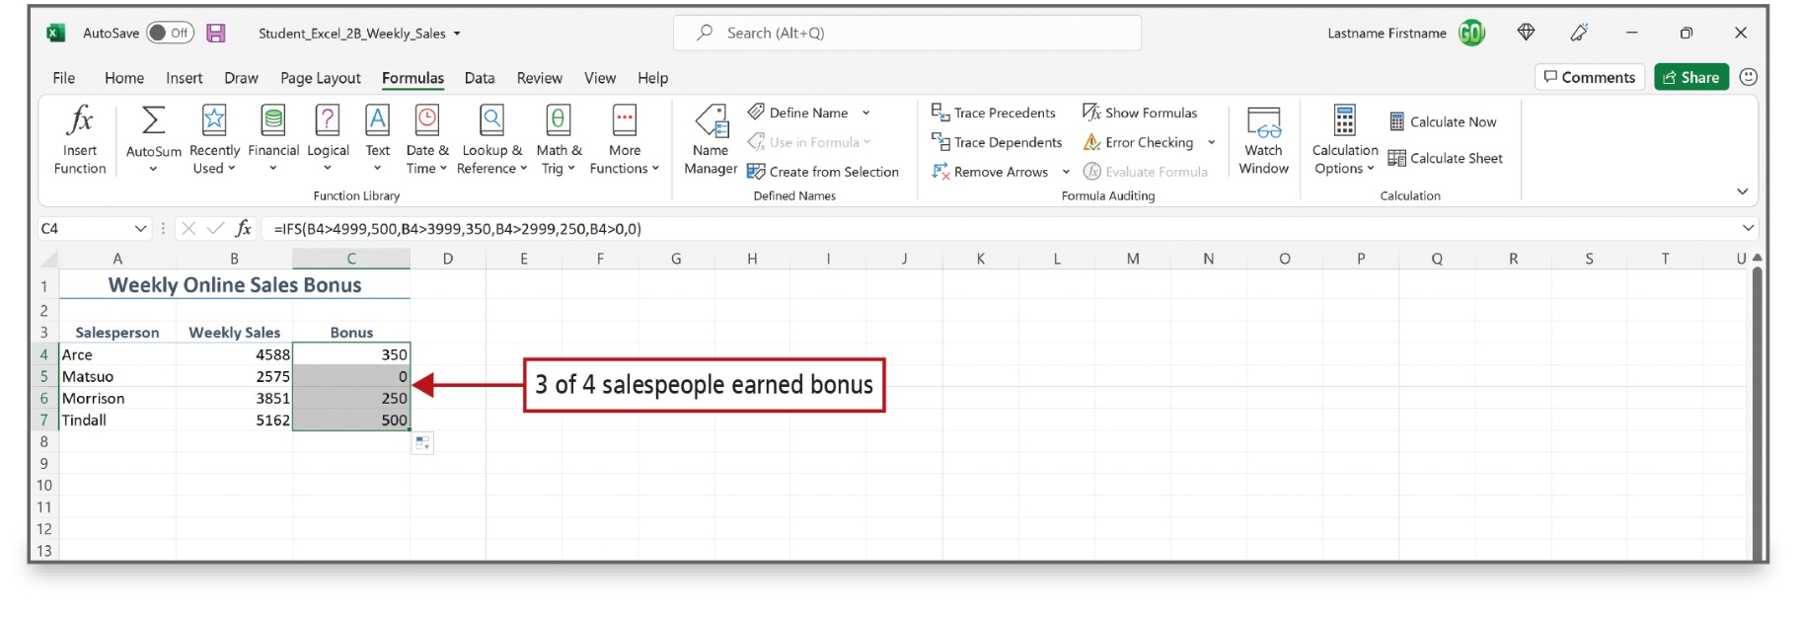
Create a Summary Sheet with Column Sparklines (5 of 5)
Notes:
This example of the IFS function contains four logical tests. It is important to include a default value that displays if none of the conditions are met. When no default value is included, an error message displays if no TRUE conditions are found. In this case, the default value is 0.

Slide 39
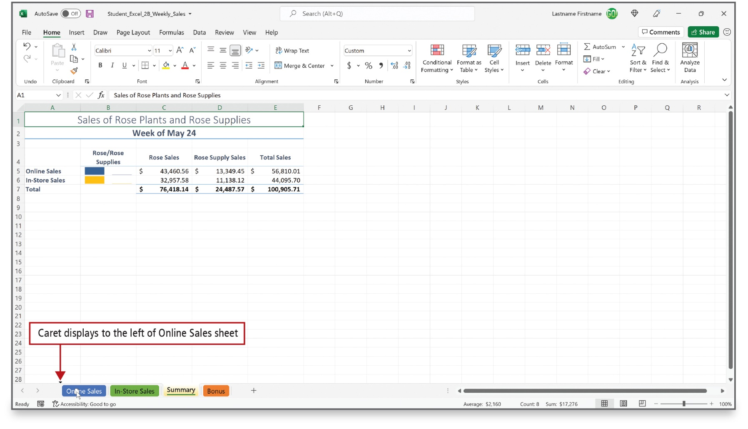
Format and Print Multiple Worksheets in a Workbook (1 of 2)
Notes:
You can drag a worksheet to a new location. The summary sheet will be moved to be the first worksheet in the workbook.

Slide 40
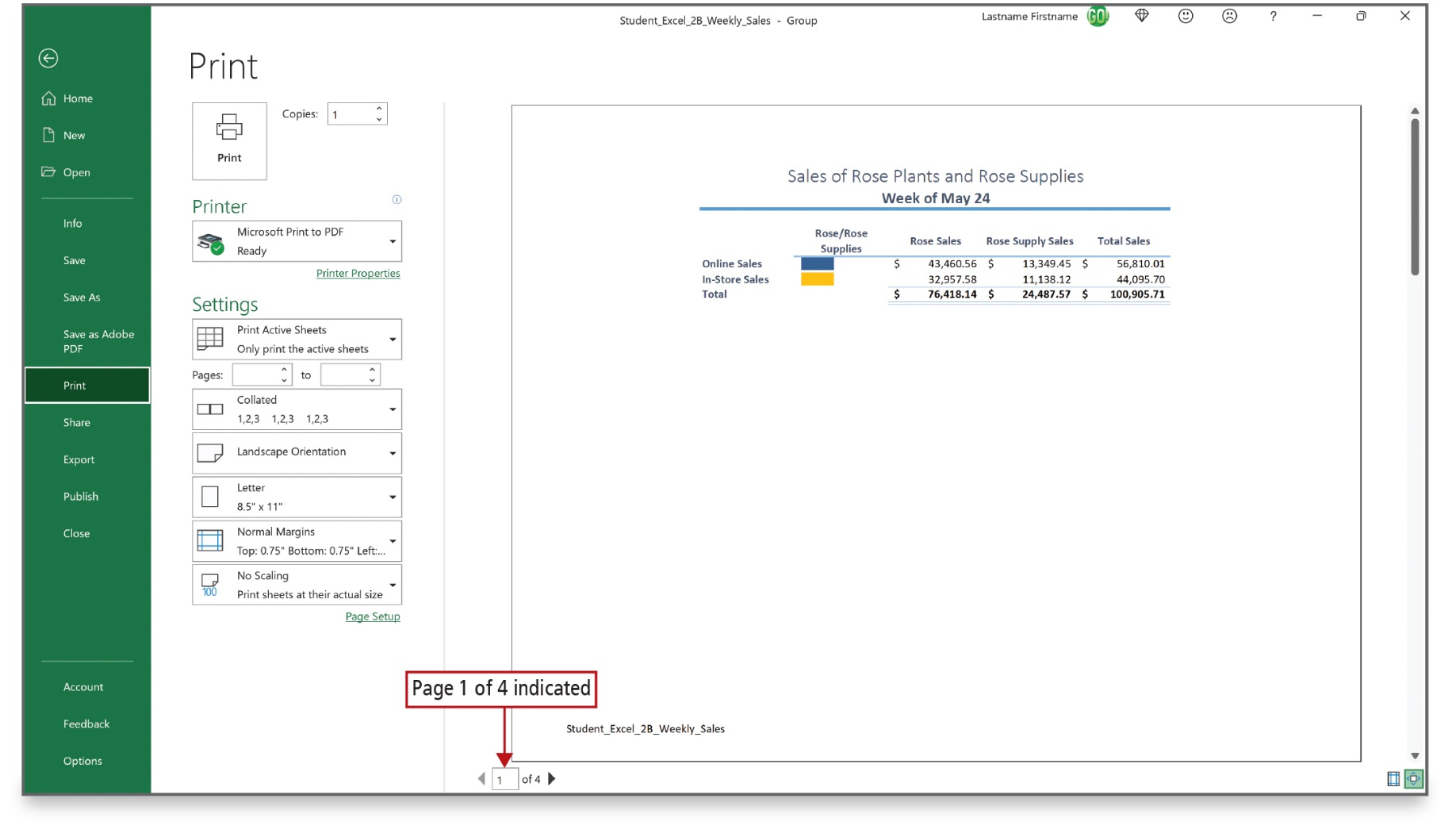
Format and Print Multiple Worksheets in a Workbook (2 of 2)
Notes:
By selecting more than one worksheet, you can apply the same formatting to all the worksheets at the same time; for example, to repeat headers or footers. You can also group worksheets in order to print several sheets at one time. In Print Preview, the number of pages that will print is indicated at the bottom of the window, as shown here.

Slide 41

Questions

Slide 42

Copyright
This work is protected by United States copyright laws and is provided solely for the use of instructors in teaching their courses and assessing student learning. Dissemination or sale of any part of this work (including on the World Wide Web) will destroy the integrity of the work and is not permitted. The work and materials from it should never be made available to students except by instructors using the accompanying text in their classes. All recipients of this work are expected to abide by these restrictions and to honor the intended pedagogical purposes and the needs of other instructors who rely on these materials.

