Slide 1

GO! with Microsoft 365: Excel 2021
Chapter 3
Analyzing Data with Pie Charts, Line Charts, and What-If Analysis Tools
Copyright © 2023 Pearson All Rights Reserved.
Notes:
GO! with Microsoft 365 Excel 2021, Chapter 3
In this chapter, you will learn how to analyze data with pie and line charts and What-If analysis tools.

Slide 2
Learning Objectives
Chart Data with a Pie Chart
Format a Pie Chart
Edit a Workbook and Update a Chart
Use Goal Seek to Perform What-If Analysis
Design a Worksheet for What-If Analysis
Answer What-If Questions by Changing Values in a Worksheet
Chart Data with a Line Chart
Create a Map Chart and a Funnel Chart
Notes:
The objectives of this chapter are:
Chart Data with a Pie Chart
Format a Pie Chart
Edit a Workbook and Update a Chart
Use Goal Seek to Perform What-If Analysis
Design a Worksheet for What-If Analysis
Answer What-If Questions by Changing Values in a Worksheet
Chart Data with a Line Chart
Create a Map Chart and a Funnel Chart

Slide 3
Chart Data with a Pie Chart (1 of 4)
Pie chart
  Shows the relationship of each part to a whole
Fund—sum of money set aside for a specific purpose
  General fund—money set aside for the normal operating activities of the municipality
  Enterprise fund—reports income and expenditures related to municipal services
Data point
  Value that originates in a worksheet cell
Notes:
A pie chart shows the relationship of each part to a whole, where the size of each pie slice is equal to its value compared to the total value of all the slices.
A fund is a sum of money set aside for a specific purpose.
In a municipal government, the general fund is money set aside for the normal operating activities of the city, such as police, fire, and administering the everyday functions of the city.
Municipal governments also commonly establish an enterprise fund to report income and expenditures related to municipal services for which a fee is charged in exchange for goods or services.
A data point is a value that originates in a worksheet cell.

Slide 4
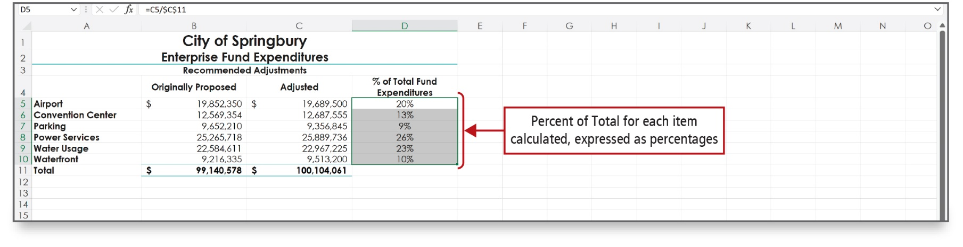
Chart Data with a Pie Chart (2 of 4)
Notes:
The data points for the pie chart will be the contents of Column A and Column D.

Slide 5
Chart Data with a Pie Chart (3 of 4)
Data marker
  Represents a data point on a chart
  In a pie chart, each pie slice is a data marker
Data series
  Related data points represented by data markers
  Determine the size of each pie slice
Legend
  Identifies patterns or colors assigned to categories
  Identifies the pie slices
Notes:
Data marker
Represents a data point on a chart
In a pie chart, each pie slice is a data marker
Data series
Related data points represented by data markers
Determine the size of each pie slice
Legend
Chart element that identifies the patterns or colors assigned to the categories in the chart
Identifies the pie slices

Slide 6
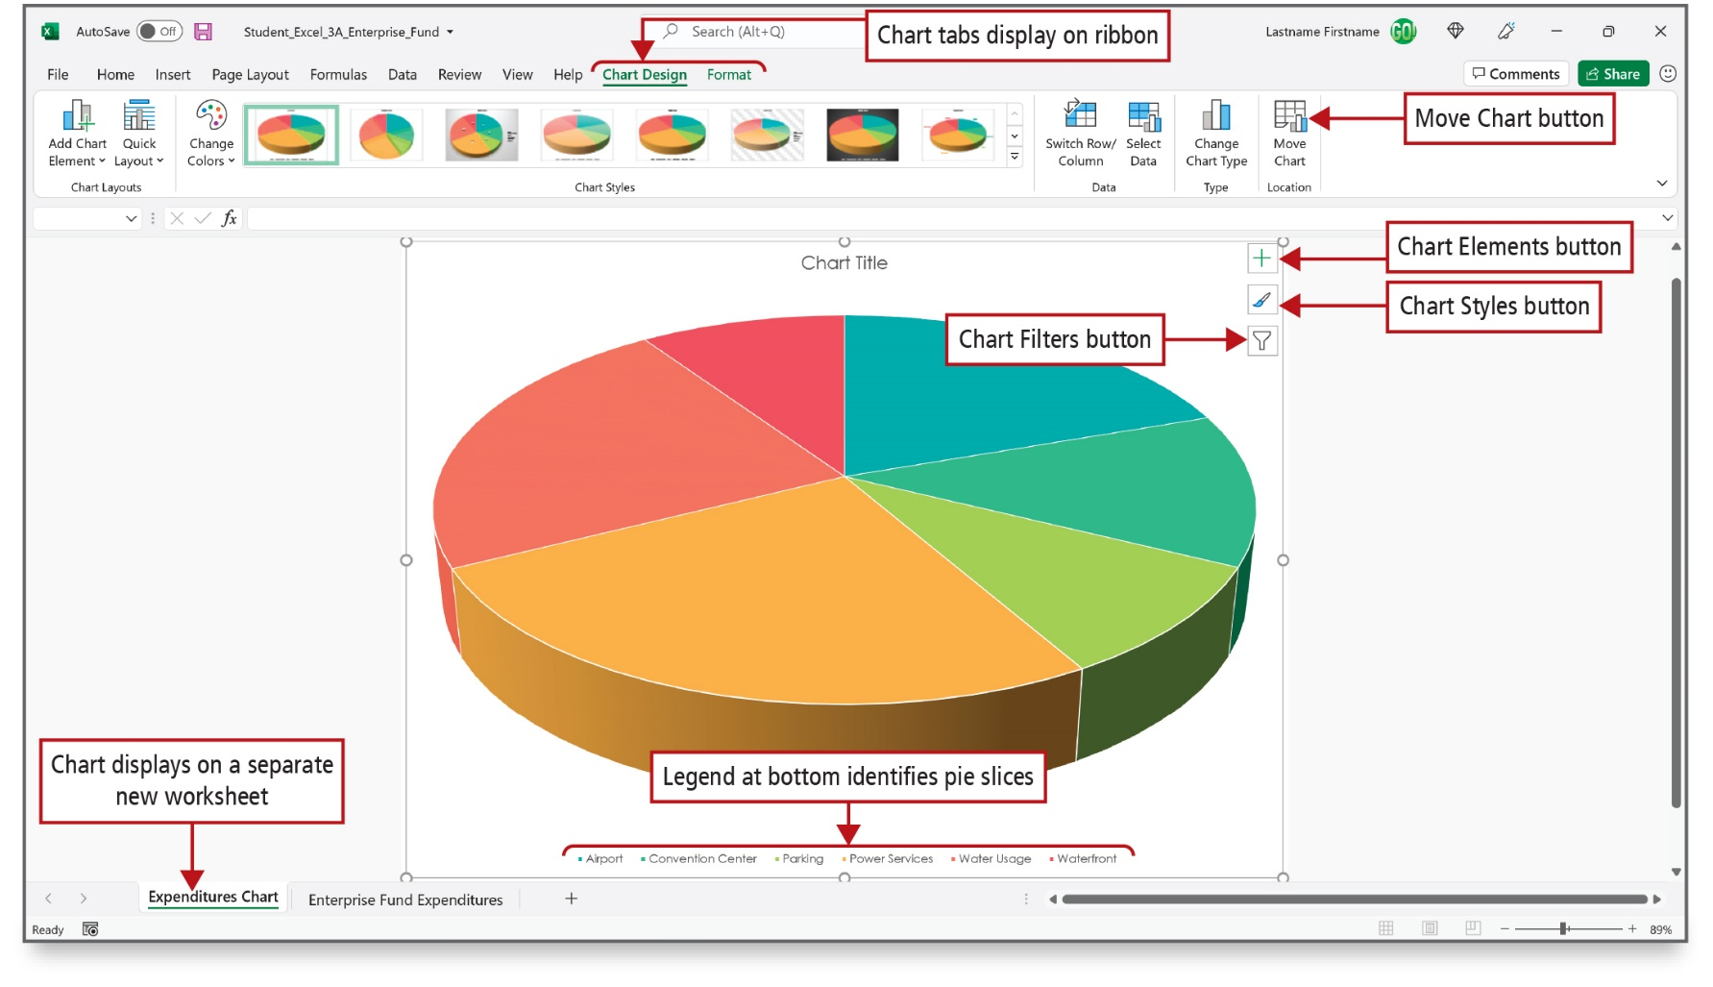
Chart Data with a Pie Chart (4 of 4)
Notes:
Alt Text: The Excel ribbon displays chart tabs (chart design and format). The first chart style option is selected. In the location section of the Excel ribbon is a Move Chart button. The tab named “Expenditures Chart” at the bottom is labeled as Chart displays on a separate new worksheet. On the top right corner of the pie chart are chart elements (plus icon), chart styles (paintbrush icon), and chart filters (funnel icon) buttons. Bullets of different colors representing airport, convention center, parking, power services, water usage, and waterfront are displayed at the bottom of the pie chart and are labeled as Legend at bottom identifies pie slices.
This pie chart was created from ranges A5:A10 and C5:C10 in the previous worksheet. A pie chart requires just two ranges. One range contains the labels for each slide; the other range contains the values that add up to a total. It’s placed on a chart sheet—a workbook sheet that contains only a chart.

Slide 7
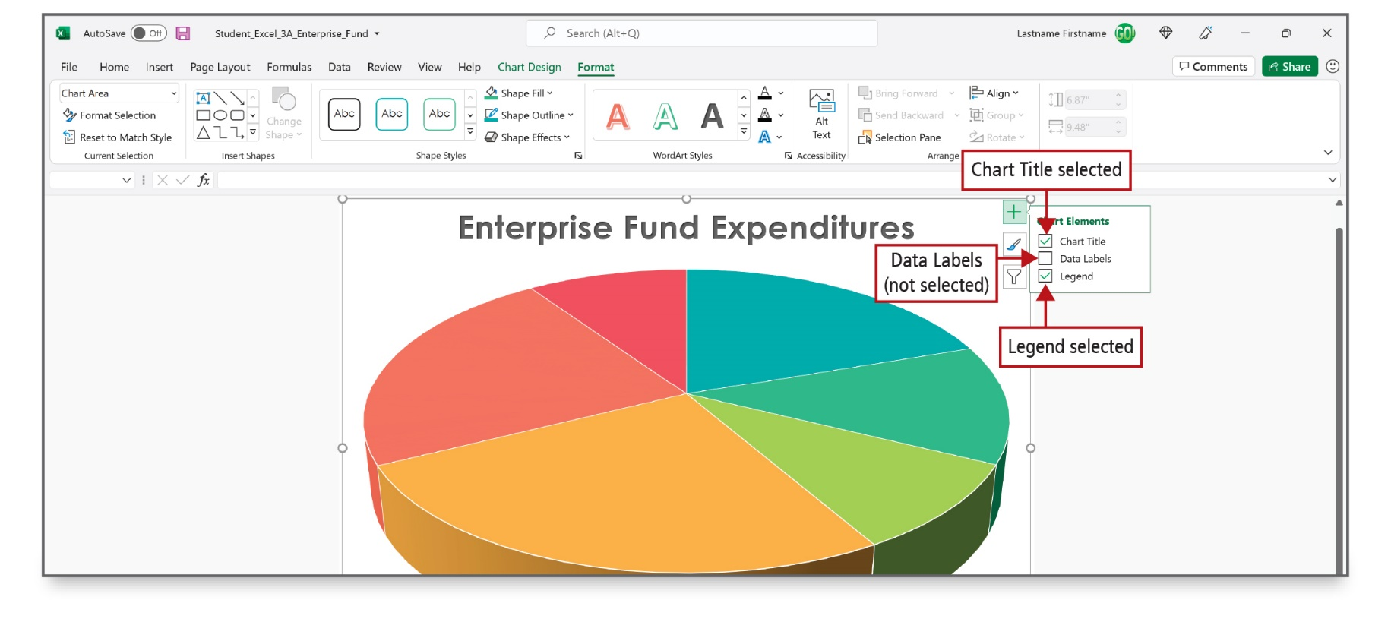
Format a Pie Chart (1 of 4)
Notes:
The Chart Elements button allows you to add, remove, or change chart elements such as the chart title, the legend, and the data labels. In the figure, a title and legend are selected to be added to the chart.

Slide 8
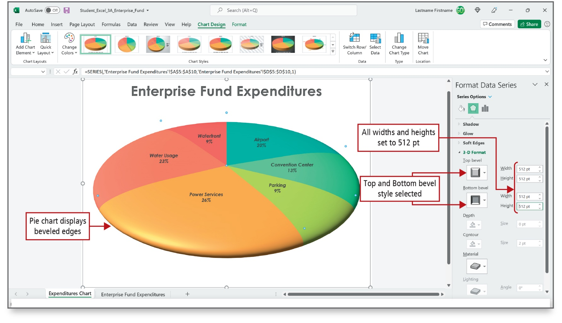
Format a Pie Chart (2 of 4)
Notes:
3-D or three-dimensional, refers to an image that appears to have all three spatial dimensions—length, width, and depth.
Bevel is a shape effect that uses shading and shadows to make the edges of a shape appear to be curved or angled. The chart on this figure has 3-D and bevel enhancements added to it.

Slide 9
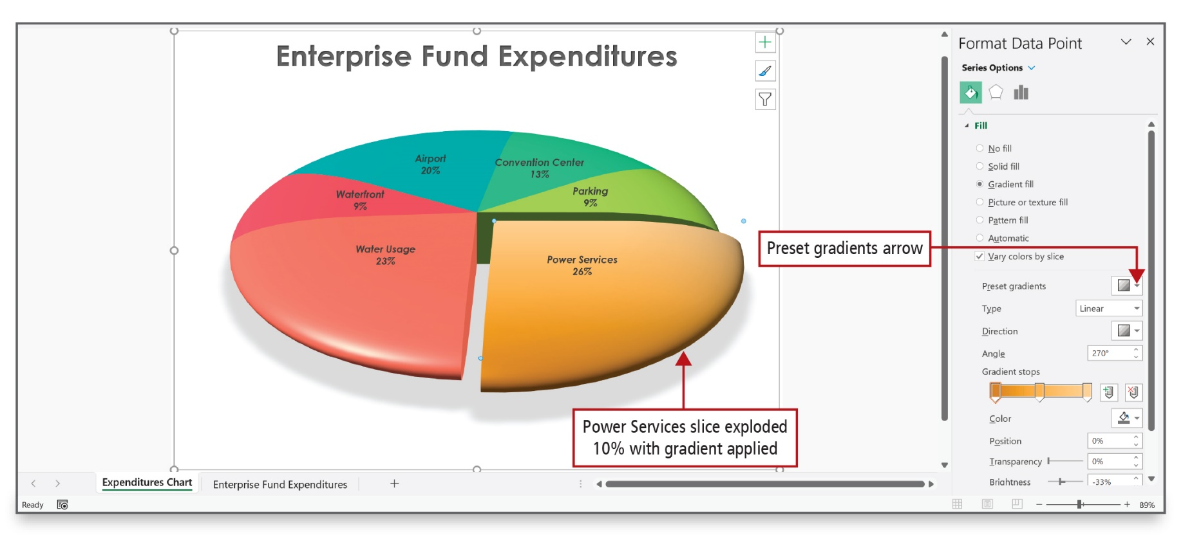
Format a Pie Chart (3 of 4)
Notes:
The pie chart on this slide has one piece of the pie exploded—pulled out from the rest—for emphasis. It also has a shadow emphasis added and is rotated. The order in which the data series in pie charts are plotted is determined by the order of the data on the worksheet. To gain a different view of the data, you can rotate the chart with the 360 degrees of the circle, which is what was done here.

Slide 10
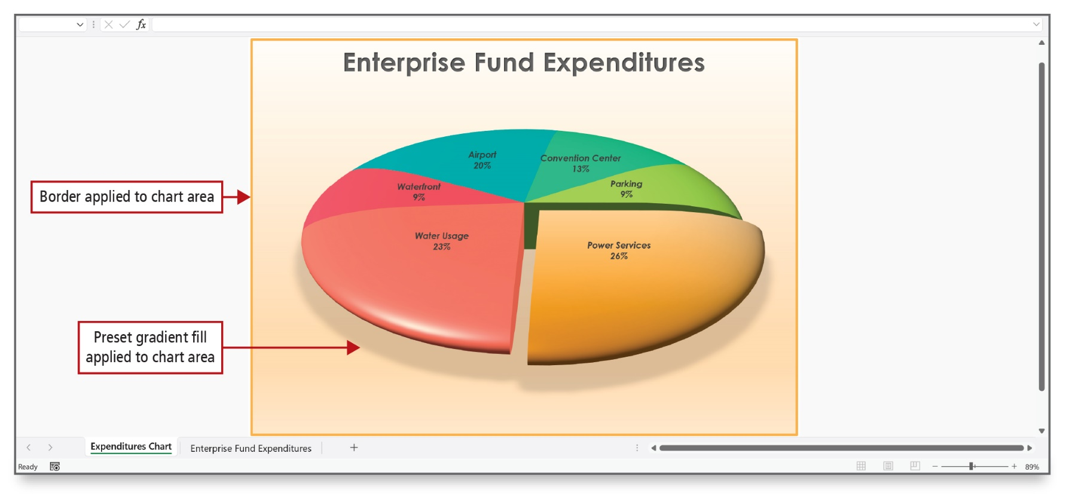
Format a Pie Chart (4 of 4)
Notes:
The entire chart and all of its elements comprise the chart area, and its components can be formatted.

Slide 11
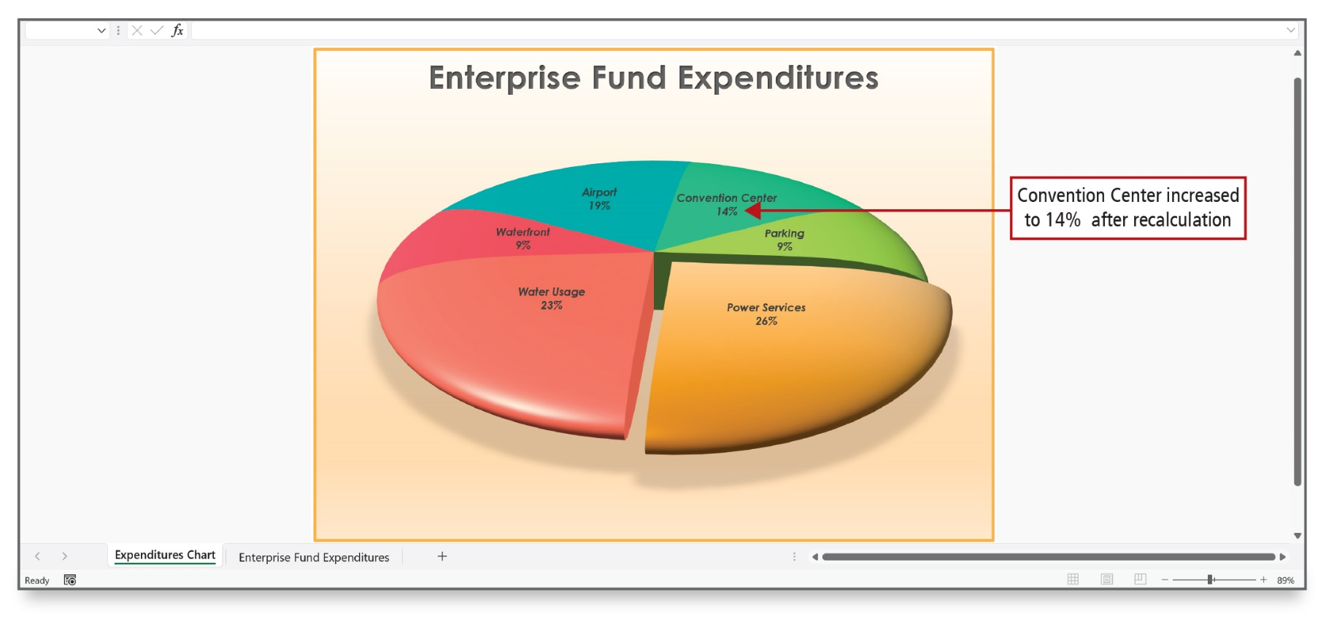
Edit a Workbook and Update a Chart
Notes:
If you edit the data in your worksheet, the chart data markers—in this instance, the pie slices—will adjust automatically to accurately represent the new values. A quick way to edit cell data is to double-click the cell to position the insertion point in the cell and edit the data.

Slide 12
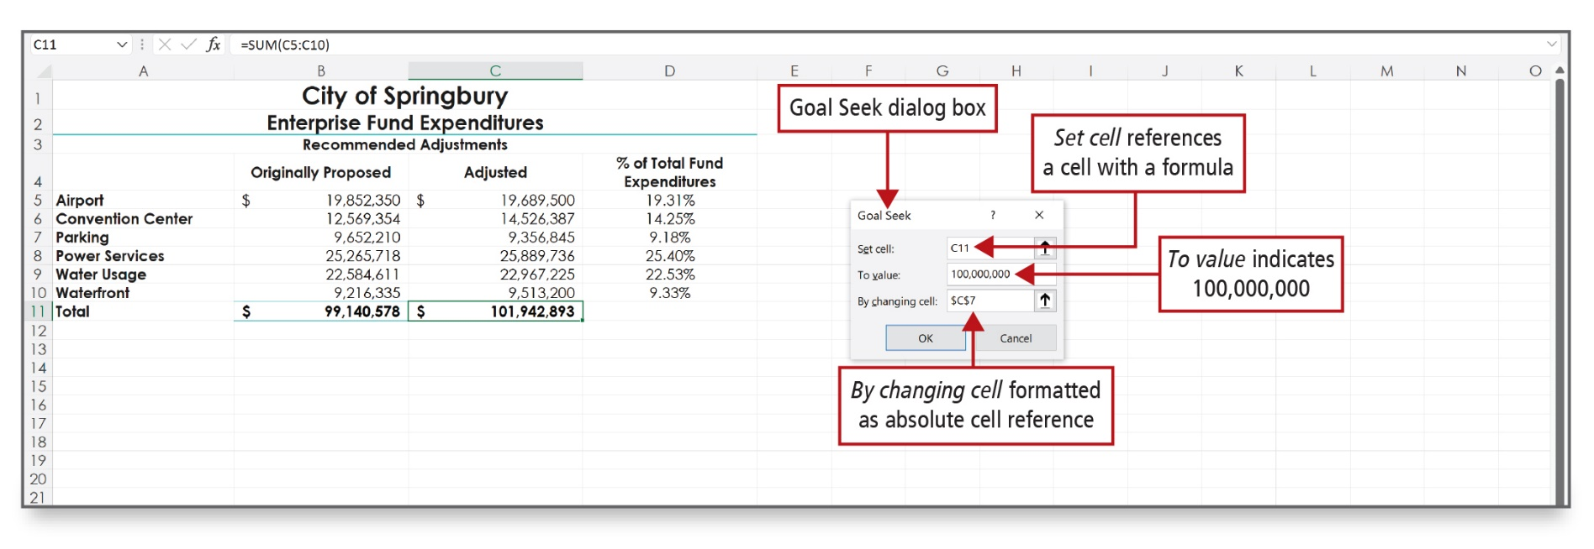
Use Goal Seek to Perform What-If Analysis (1 of 2)
Notes:
Alt Text: C11 is entered in a set cell box (labeled as Set cell references a cell with a formula). The To value indicates 100,000,000. $ capital C $ 7 is entered in By changing cell box and labeled as By changing cell formatted as absolute cell reference.
The process of changing the values in cells to see how those changes affect the outcome of formulas in your worksheet is referred to as what-if analysis.
One what-if analysis tool in Excel is Goal Seek, which finds the input needed in one cell to arrive at the desired result in another cell. In this example, C11 is the cell in which you want to set a specific value.

Slide 13
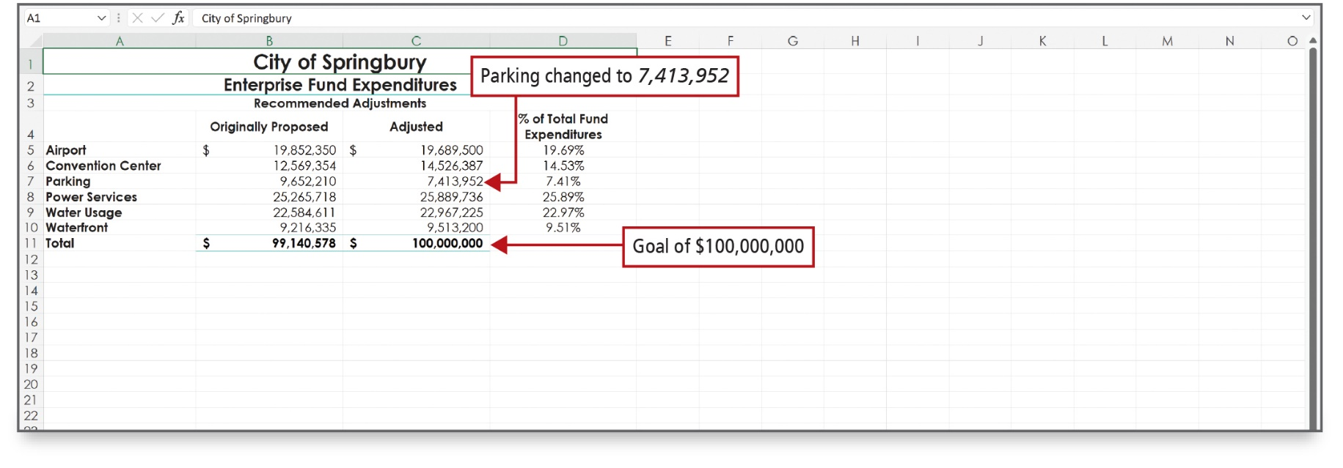
Use Goal Seek to Perform What-If Analysis (2 of 2)
Notes:
The result is shown here. Excel calculates that the city must budget for $9,794,189 in Waterfront expenditures in order to maintain a total Enterprise Fund Expenditure budget of $100,000,000.

Slide 14
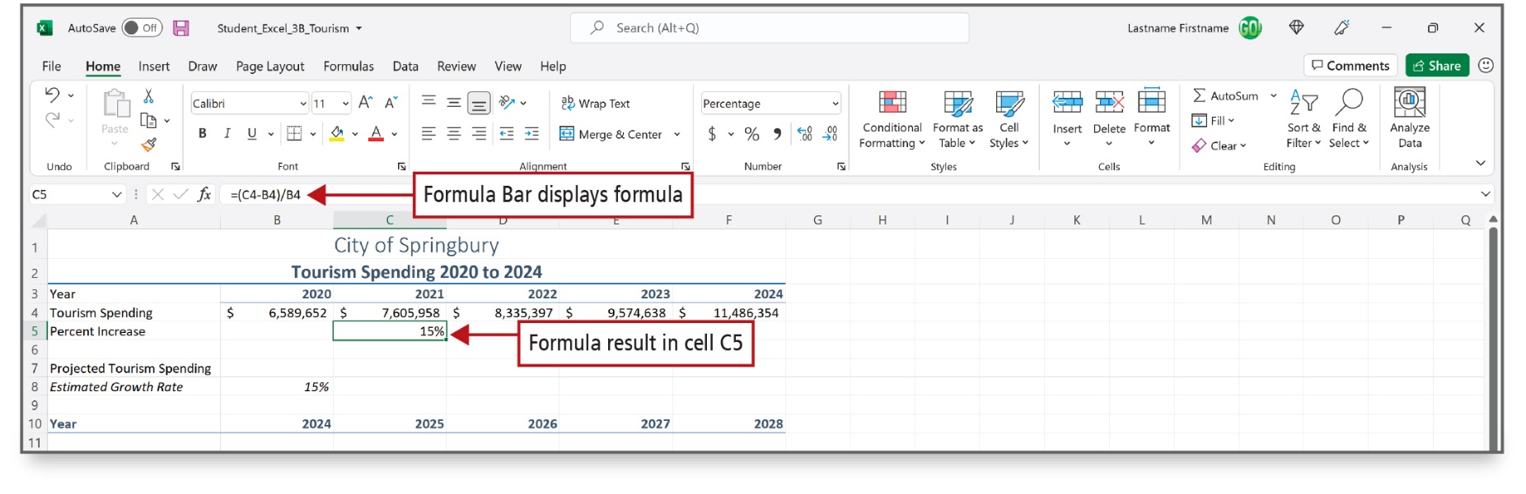
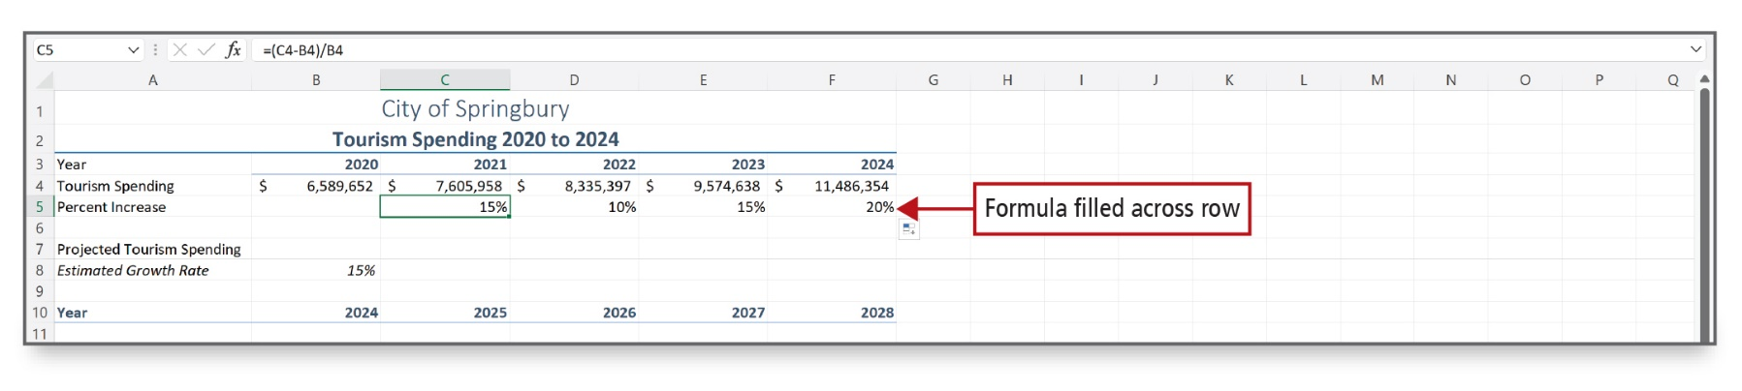
Design a Worksheet for What-If Analysis (1 of 2)
Notes:
In this Activity, you will construct a formula to calculate the percentage rate of increase—the percent by which one number increases over another number—for each year since 2019. From this information, future tourism spending growth can be estimated.
In this worksheet, the AutoFill feature was used to fill the pattern of years. Next, the formula based on rate = amount of increase/base was inserted in cell C6, and the fill handle was used to fill cells D6:F6.
It is important to recall the order of operations: parentheses, exponentiation, multiplication, division, addition, and subtraction.

Slide 15
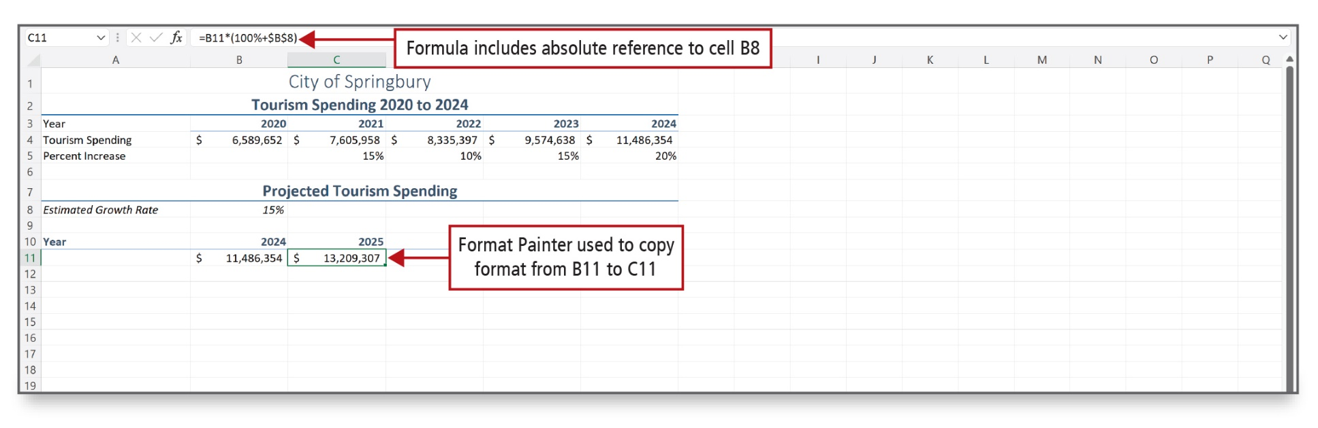
Design a Worksheet for What-If Analysis (2 of 2)
Notes:
Alt Text: The formula in the formula bar (equal to capital B11 asterisk open parenthesis 100% plus $ capital B $8 close parenthesis) labeled as Formula includes absolute reference to cell B8 and C11 ($13,209,307) labeled as Format Painter used to copy format from B11 to C11.
Use the Format Painter—easily accessible from the mini toolbar—to copy formats from a cell or a range to another cell or range.

Slide 16
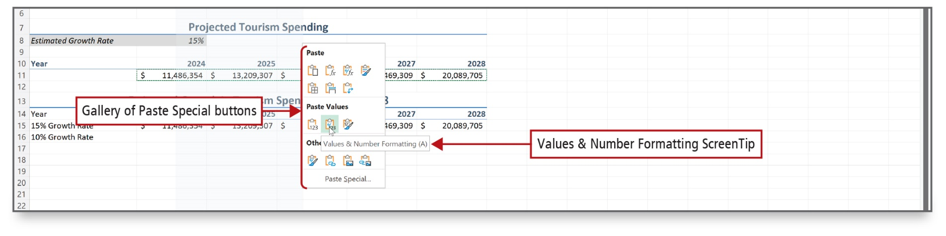
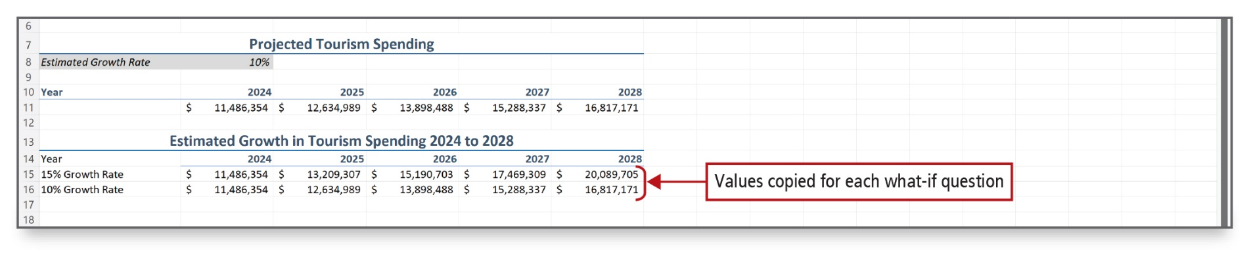
Answer What-If Questions by Changing Values in a Worksheet (1 of 2)
Notes:
If a formula depends on the value in a cell, you can see what effect it will have if you change the value in that cell. Then, you can copy the value computed by the formula and paste it into another part of the worksheet where you can compare it to other values. You may want to keep the results of a calculation so it can be compared, as shown here.
In the top figure, the Values & Number Formatting ScreenTip indicates that you can paste the calculated values that result from the calculation of formulas along with the formatting applied to the copied cells.
With this information, what-if questions about the projected increase in tourism spending based on the rates of increase over the past five years can be answered. Don’t underestimate the power of using what-if analysis.

Slide 17
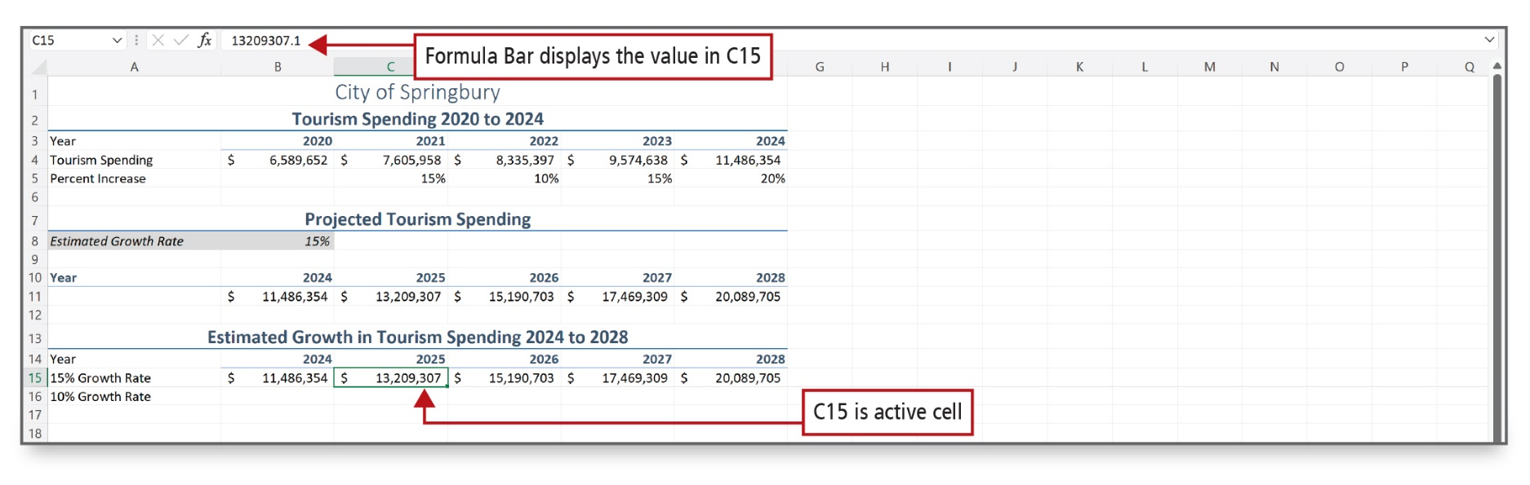
Answer What-If Questions by Changing Values in a Worksheet (2 of 2)
Notes:
Here, the calculated estimates based on a 15% growth rate are pasted along with the formatting.

Slide 18
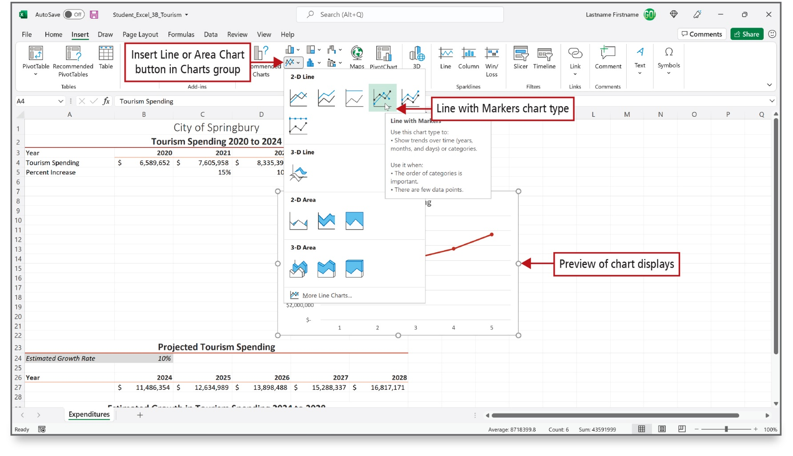
Chart Data with a Line Chart (1 of 6)
Notes:
Alt Text: The charts section of the Excel ribbon contains an Insert Line or Area Chart button (the first button in the second row). A gallery opens by clicking this button. The gallery displays various options of 2-D, 3-D line charts and 2-D, 3-D area charts. The fourth option in the 2-D line chart is selected and labeled as Line with Markers chart type. On selecting this option, a screen tip (line with markers) pops up. The preview of the chart is displayed on the excel sheet.
A line chart displays trends over time. Time is displayed along the bottom axis and the data point values connect with a line. The gallery of line charts, as shown here, display a ScreenTip for each line chart type that helps describe the type of chart.

Slide 19
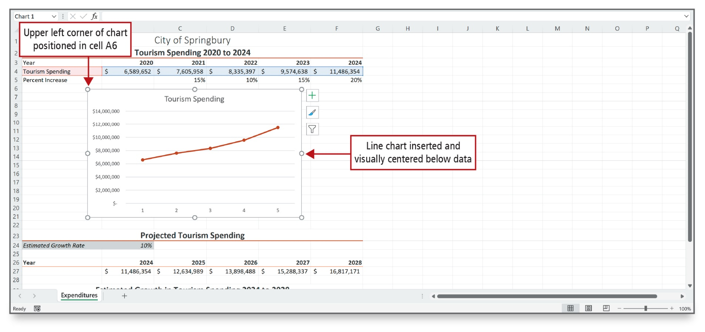
Chart Data with a Line Chart (2 of 6)
Notes:
Three chart elements are included in a line chart by default—the axes, the chart title, and the gridlines. Additional elements can be added through the Chart Elements button that displays on the right side of a selected chart.

Slide 20
Chart Data with a Line Chart (3 of 6)
Axis
  Line that serves as a frame of reference for measurement
  Borders the chart plot area
Plot area
  Area bounded by the axes, including all the data series
Category axis or x-axis
  Area along the bottom of a chart that identifies the categories of data
Value axis or y-axis
  Area along the left side of a chart that shows the range of numbers for the data points
Notes:
The Axis is a line that serves as a frame of reference for measurement, and it borders the chart plot area.
The Plot area is the area bounded by the axes, including all the data series.
The Category axis or the x-axis is the area along the bottom of a chart that identifies the categories of data.
Value axis or the y-axis is the area along the left side of a chart that shows the range of numbers for the data points.

Slide 21
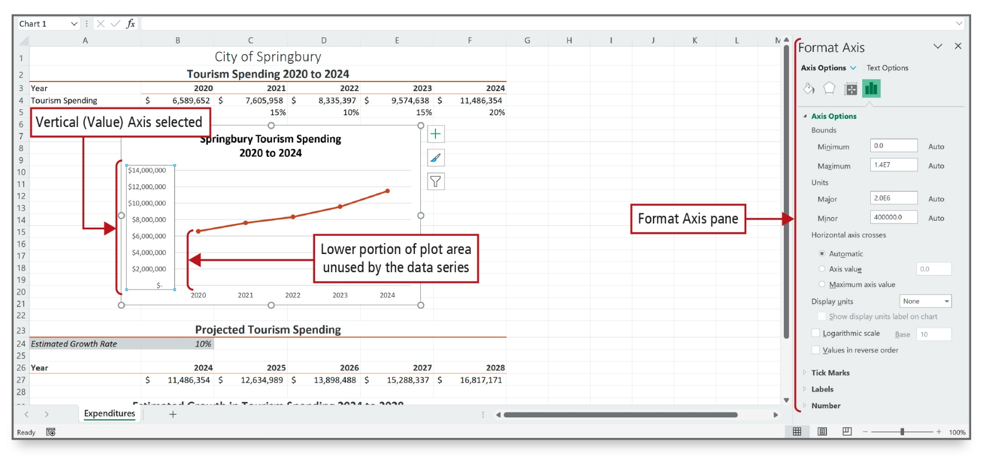
Chart Data with a Line Chart (4 of 6)
Notes:
Alt Text: The pane displays various axis options. The values on the y-axis of the line chart are surrounded by a line and labeled as Vertical (Value) Axis selected. The portion below the first plotted point on the graph is labeled as the Lower portion of the chart plot area unused by the data series.
The Format Axis pane can be displayed by clicking Format Axis on the shortcut menu when a chart is selected. Bounds—minimum and maximum numbers on a y-axis and unit spacing between those—can be set in the Format Axis pane. Thereby, unused portions of the chart can be deleted.

Slide 22
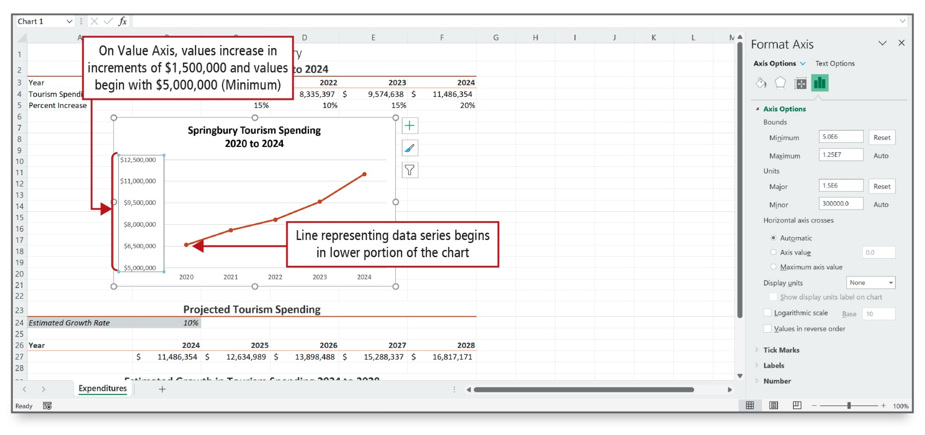
Chart Data with a Line Chart (5 of 6)
Notes:
Alt Text: The vertical values in the line chart are selected and labeled as On Value axis, values increase in increments of $1,500,000 and values begin with $5,000,000 (Minimum). The portion below the first plotted point on the graph is labeled as Line representing data series that begins in lower portion of the chart.
The Major unit value determines the spacing between the gridlines in the plot area. By default, Excel started the values at zero and increased in increments of $1,500,000. Bounds have been changed in the chart making it more visually appealing and more representational of the data it is trying to portray.

Slide 23
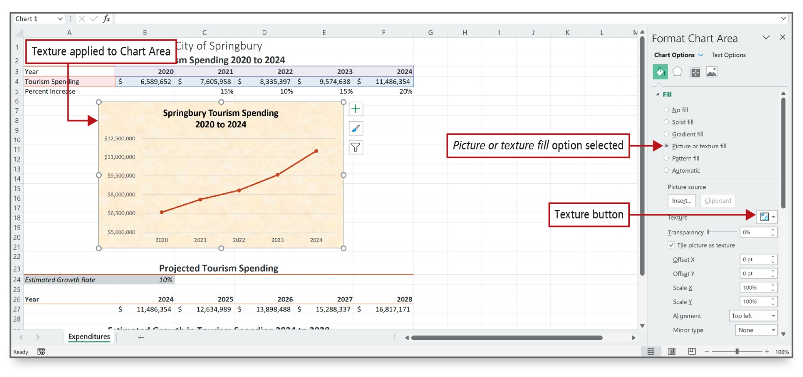
Chart Data with a Line Chart (6 of 6)
Notes:
Alt Text: The parchment (blurry faint pink background) texture is applied to Chart Area. There is a format chart area pane to the right. The chart options in the pane displays fill options (Picture or texture fill option selected), texture button (below print source), transparency settings, and so on.
A chart has two background elements—the plot area and the chart area—which by default display a single fill color. This chart has a graphic texture added as the chart area background.

Slide 24
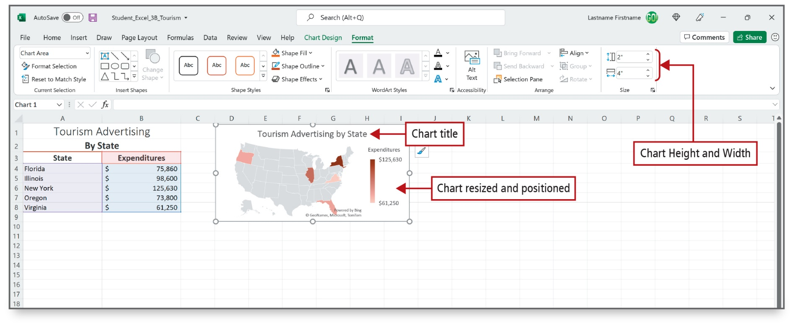
Create a Map Chart and a Funnel Chart
(1 of 2)
Notes:
Alt Text: The lower portion of the scale of the expenditure is labeled as Chart resized and positioned. In the size section of the Excel ribbon, chart height and width are set to 2 inches and 4 inches, respectively.
A map chart compares values and shows categories across geographical regions; for example, across countries, states, counties, and regions. The charted regions display in map form, and each region displays shading to indicate the values in the data series. A map of the United States displays to the right of the data. The five states display varying shades of red. Virginia—the state in which the fewest advertising dollars are spent—is the lightest shade of red. New York—the state in which the most advertising dollars are spent—is the darkest shade of red. The legend displays the Expenditures scale from highest to lowest.

Slide 25
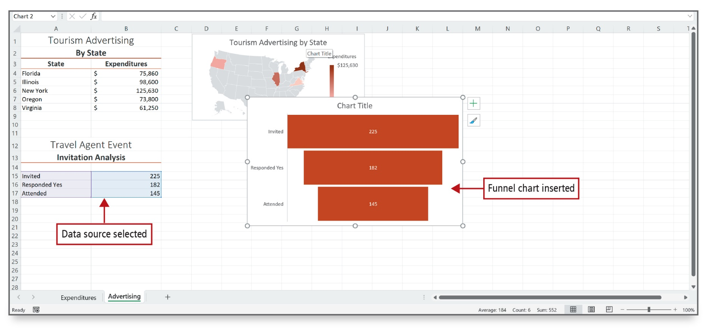
Create a Map Chart and a Funnel Chart
(2 of 2)
Notes:
Funnel charts show values across the stages in a process. Typically, the values decrease gradually, allowing the bars to resemble a funnel. The funnel chart displays to the right of the data and slightly overlaps the map chart. Each rectangle in the funnel chart indicates a corresponding value from the data series. The invited guests represent the largest number, and the attending guests represent the smallest number.

Slide 26

Questions

Slide 27

Copyright

