Slide 1

GO! with Microsoft 365: Excel 2021
Chapter 4
Creating PivotTables and PivotCharts
Copyright © 2023 Pearson All Rights Reserved.
Notes:
GO! with Microsoft 365 Excel 2021, Chapter 4
In this chapter, you will learn how to create PivotTables and PivotCharts.

Slide 2
Learning Objectives
Create a PivotTable Report
Use Slicers and Search Filters
Modify a PivotTable
Create a PivotChart
Create a PivotTable from a Data Model
Create and Format a 3-D Pie PivotChart
Notes:
The objectives are:
Create a PivotTable Report
Use Slicers and Search Filters
Modify a PivotTable
Create a PivotChart
Create a PivotTable from a Data Model
Create and Format a 3-D Pie PivotChart

Slide 3
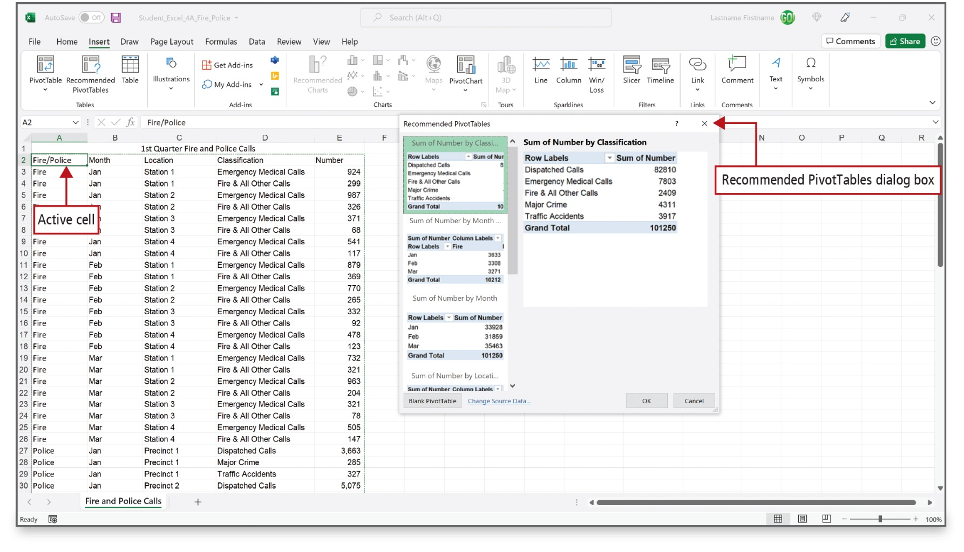
Create a PivotTable Report (1 of 5)
Notes:
A list is a series of rows that contains related data with column titles in the first row. To combine and compare large amounts of data (often structured as a list), use a PivotTable, which is an interactive Excel report that summarizes and helps you to analyze large amounts of data.
The source data for a PivotTable must be formatted in columns and rows and can be in an Excel worksheet or can be imported from an external source.
Excel uses the Recommended PivotTable dialog box to suggest PivotTables based on the organization of the data.

Slide 4
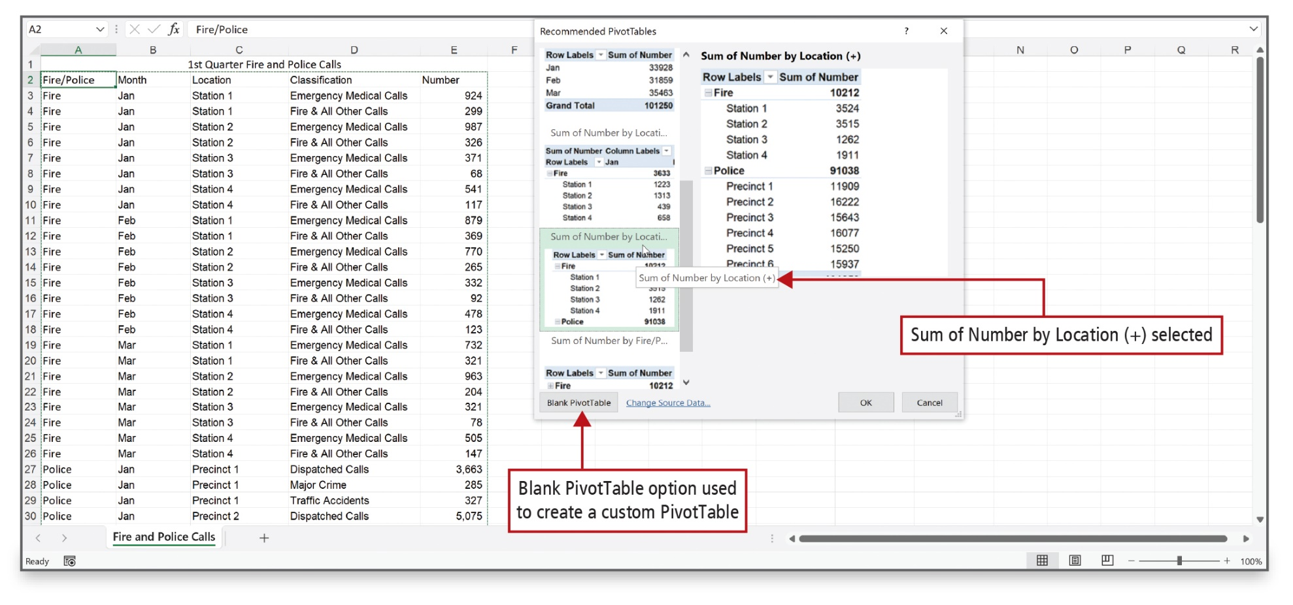
Create a PivotTable Report (2 of 5)
Notes:
This slide shows the selection of the PivotTable—Sum of Number by Location (+).

Slide 5
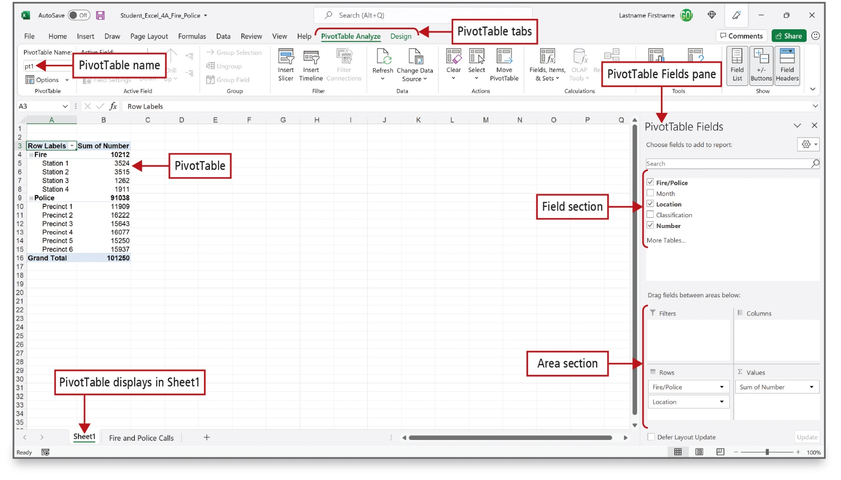
Create a PivotTable Report (3 of 5)
Notes:
Alt Text: The Pivot Table Analyze (active) and Design tabs are labeled as PivotTable tabs. The PivotTable section in the Excel ribbon displays the PivotTable name as pt1. The Excel sheet displays the pivot table in range A3:B16. On the right side of the excel sheet is a PivotTable Fields pane that contains a field section (selectable options) and an area section. The main instruction for former reads as “choose fields to add to report” and for latter reads as “drag fields between areas below”.
When you create a PivotTable, Excel adds a new sheet—Sheet1—to the workbook. On the left side of the new worksheet, Excel generates a PivotTable report. On the right side is the PivotTable Fields pane—a window in which you can arrange the fields in the PivotTable. The upper portion is the field section (lists of field names) with the lower portion as the layout section.
The lower portion, referred to as the Area section, displays four areas where you can build the PivotTable by rearranging and repositioning fields.

Slide 6
Create a PivotTable Report (4 of 5)
Screen Element | Description
PivotTable Fields pane | A window lists, at the top, all of the fields--column titles--from the source data for use in the PivotTable and at the bottom, an area in which you can arrange the fields in the PivotTable.
Filters area | An area to position fields that you want filter the PivotTable, enabling you display a subset of data in the PivotTable report.
Columns area | An area to position fields that you want to display as columns in the PivotTable. Fields names placed here become column titles, and the data is grouped in columns by these titles
Rows area | An area to position fields that you want to display as rows in the PivotTable report. Fields names placed here become row titles, and the data is grouped by these row titles.
Values area | An area to position fields that contain data that is summarized in a PivotTable or PivotChart. The data placed here is usually numeric or financial in nature and the data is summarized –summed. You can also perform other basic calculation such as finding the average, the minimum, or the maximum.
Layout section | The lower portion of the PivotTable Fields pane containing the four areas for layout; use this area to rearrange and reposition fields in the PivotTable.
Field section | The upper portion of the PivotTable Fields pane containing the fields--column titles--from your source data; use this area to add fields to and remove fields to from the PivotTable
Notes:
PivotTable screen elements are listed in this table.

Slide 7
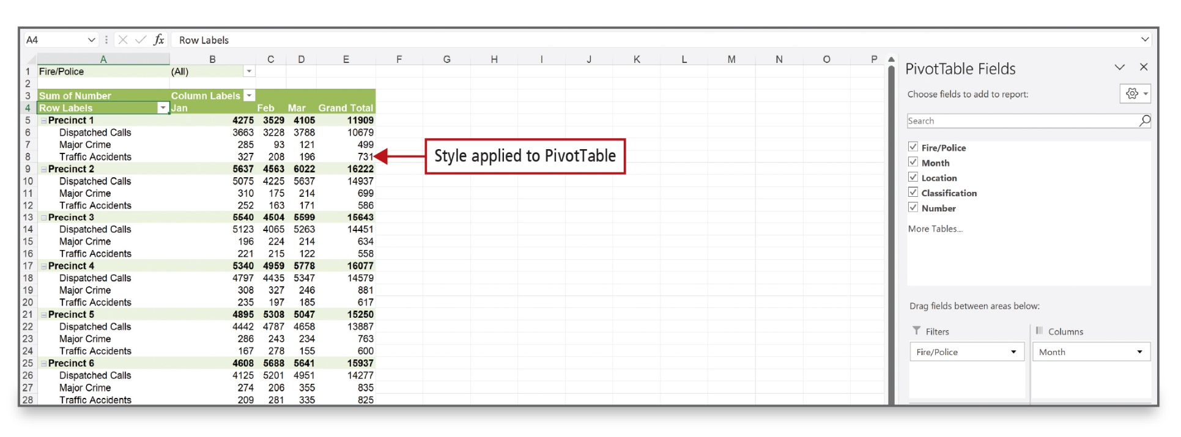
Create a PivotTable Report (5 of 5)
Notes:
This PivotTable report is complete; the result is a group of related totals. Formatting also has been applied. Data is organized and the number of calls calculated; you can easily view and compare various facts about the data.

Slide 8
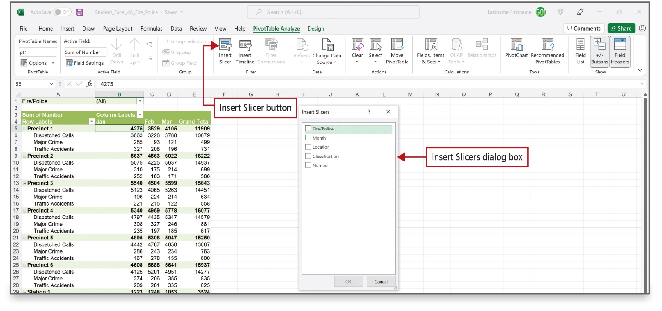
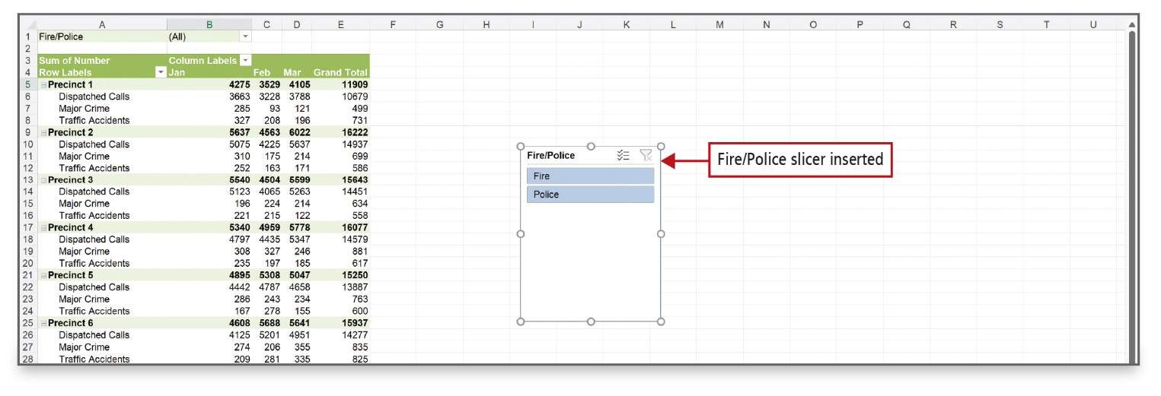
Use Slicers and Search Filters (1 of 3)
Notes:
You can filter a PivotTable by using a search filter or by using slicers, which are filtering controls with buttons that enable you to drill down through large amounts of data. Slicers display as movable objects on your worksheet in the same manner as charts and shapes and make it easy to see what filters are currently applied.

Slide 9
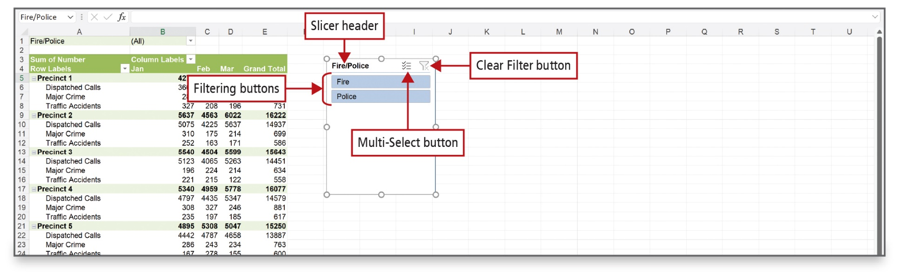
Use Slicers and Search Filters (2 of 3)
Notes:
Alt Text: The two icons beside the slicer header (Fire/Police) are labeled as Multi-Select button and (funnel) and Clear Filter button. Two tabs named Fire and Police below slicer headers are labeled as Filtering buttons.
A slicer includes a slicer header that indicates the category of the slicer items, filtering buttons to select the item by which to filter, a Multi-Select button, and a Clear Filter button. Clear Filter removes a filter.
You can apply various styles to slicers to make them easier to differentiate or to match the PivotTable report.

Slide 10
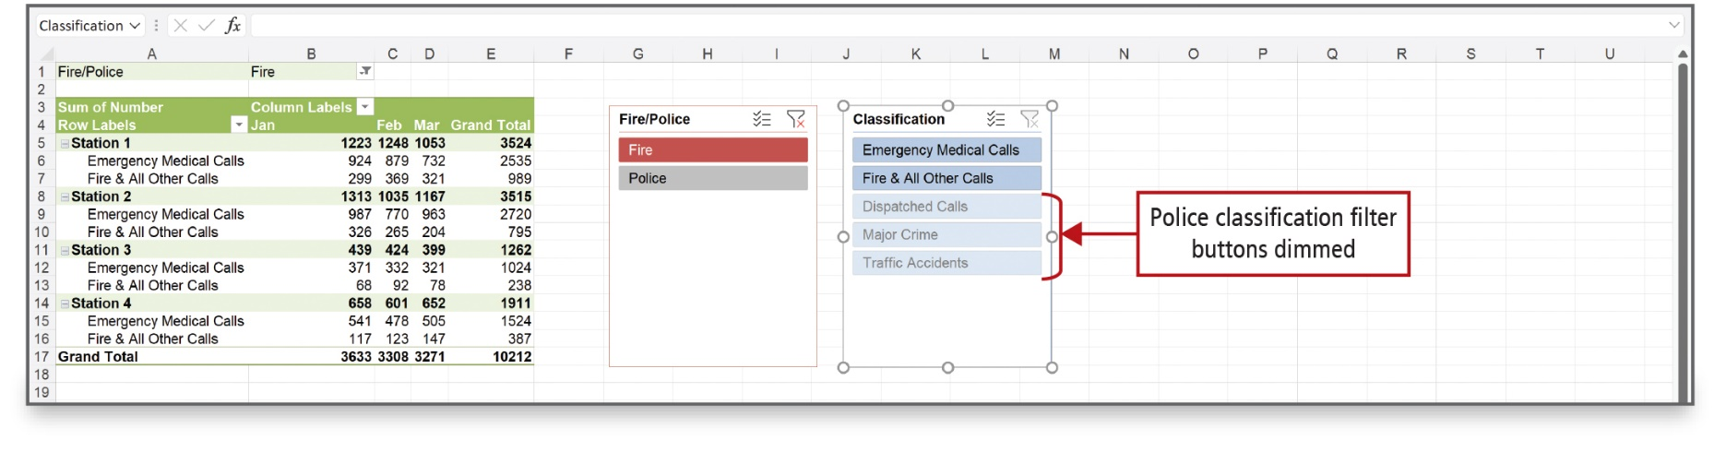
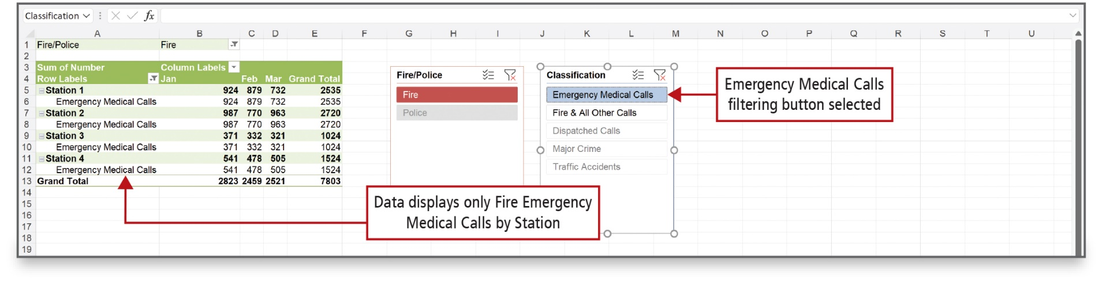
Use Slicers and Search Filters (3 of 3)
Notes:
The top figure shows the PivotTable filtered to show only the Fire data using the slicer. The bottom figure applies another slicer filter to display only the Emergency Medical Calls for the Fire data.

Slide 11
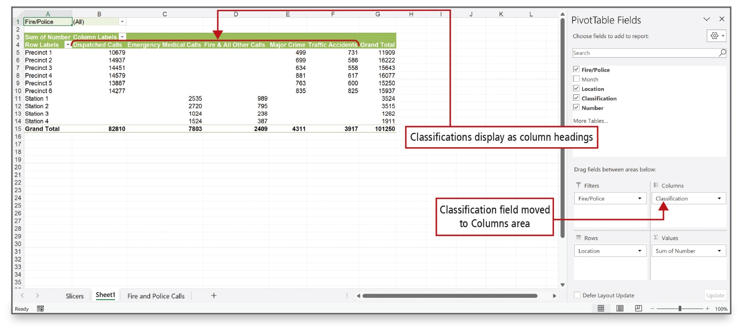
Modify a PivotTable (1 of 5)
Notes:
You can pivot (turn) worksheet information in various ways. You can also remove or rearrange fields to answer questions regarding your data. You can remove a field from the Field section; you can also move fields from the Rows area to the Columns area, or vice versa.

Slide 12
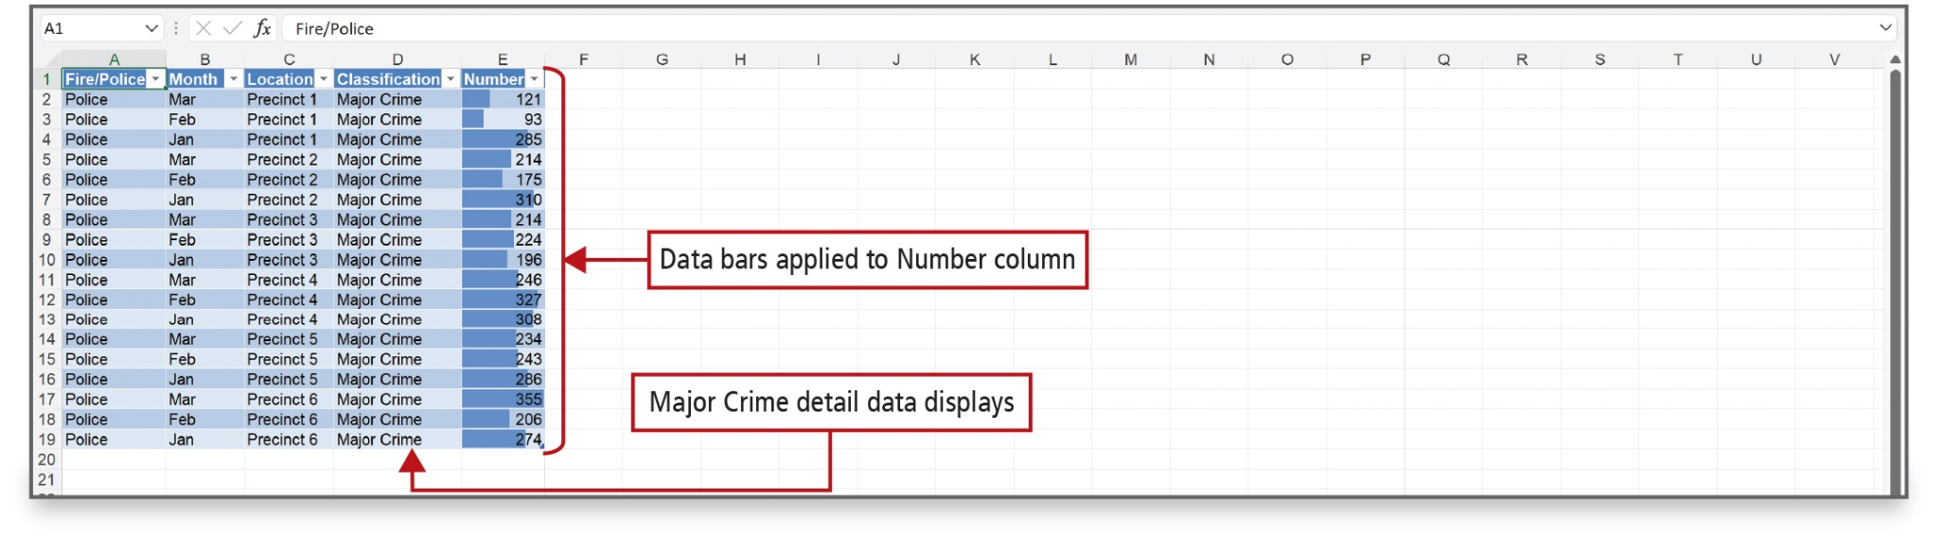
Modify a PivotTable (2 of 5)
Notes:
Conditional formatting can be applied to data as shown in the worksheet.

Slide 13
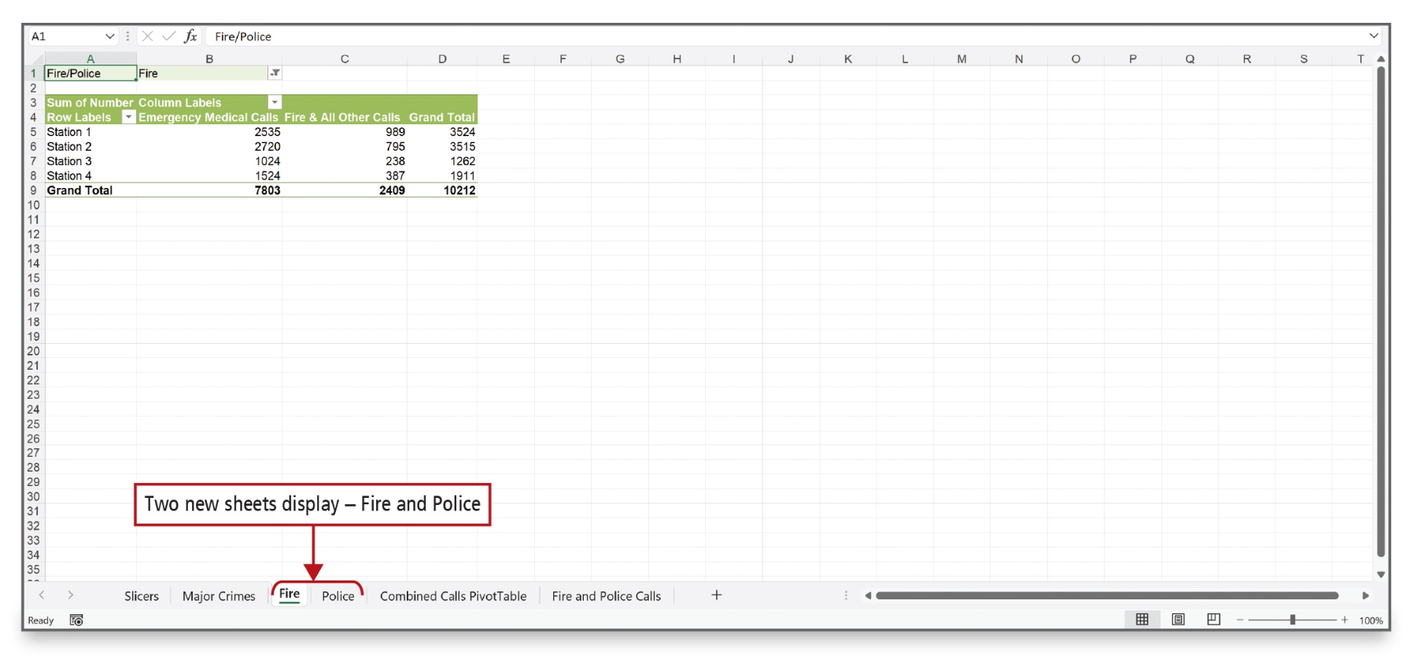
Modify a PivotTable (3 of 5)
Notes:
From a PivotTable report, you can display details for a particular category of information in a separate worksheet. Adding a field to the Filters area is optional but enables you to display multiple pages for your PivotTable data. As shown here, you can display the fire department calls on one page and the police department calls on another page.

Slide 14
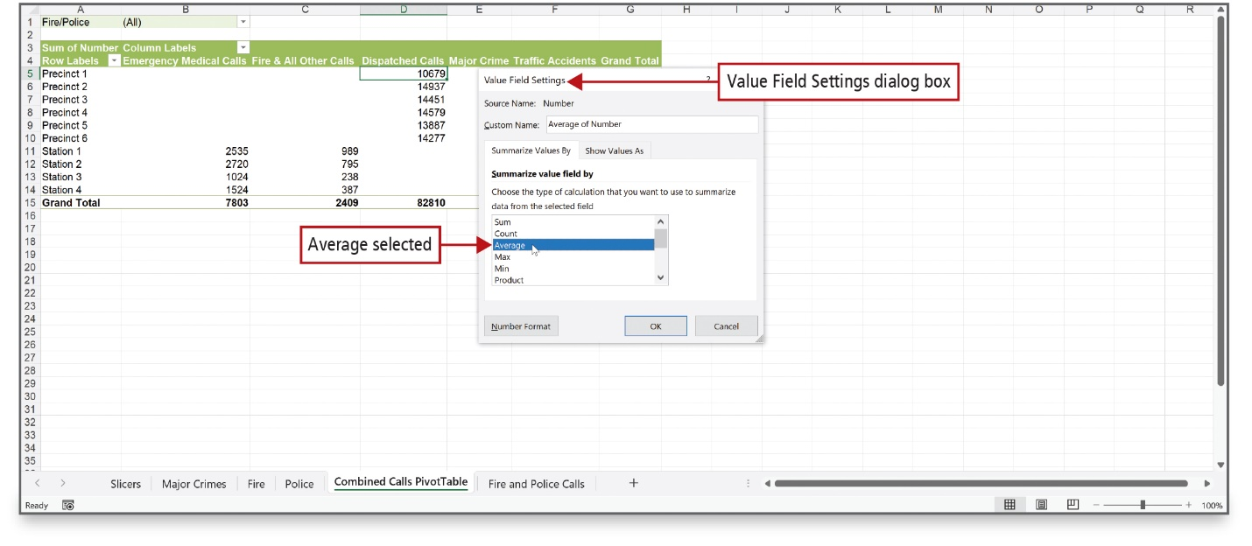
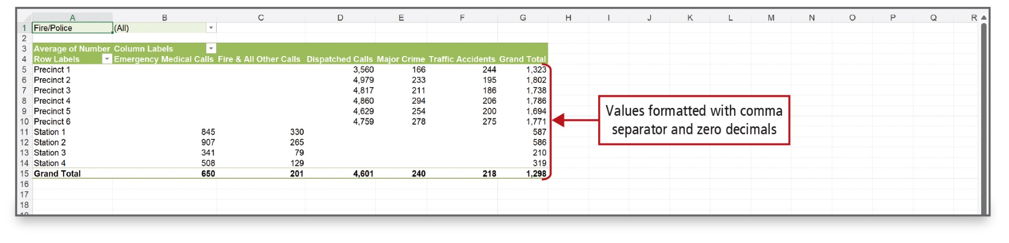
Modify a PivotTable (4 of 5)
Notes:
The default calculation in a PivotTable report is to sum the numeric data. You can modify the calculation to display an average, minimum, maximum, or some other calculation. Here, an average calculation is used, and the value cells are formatted.

Slide 15
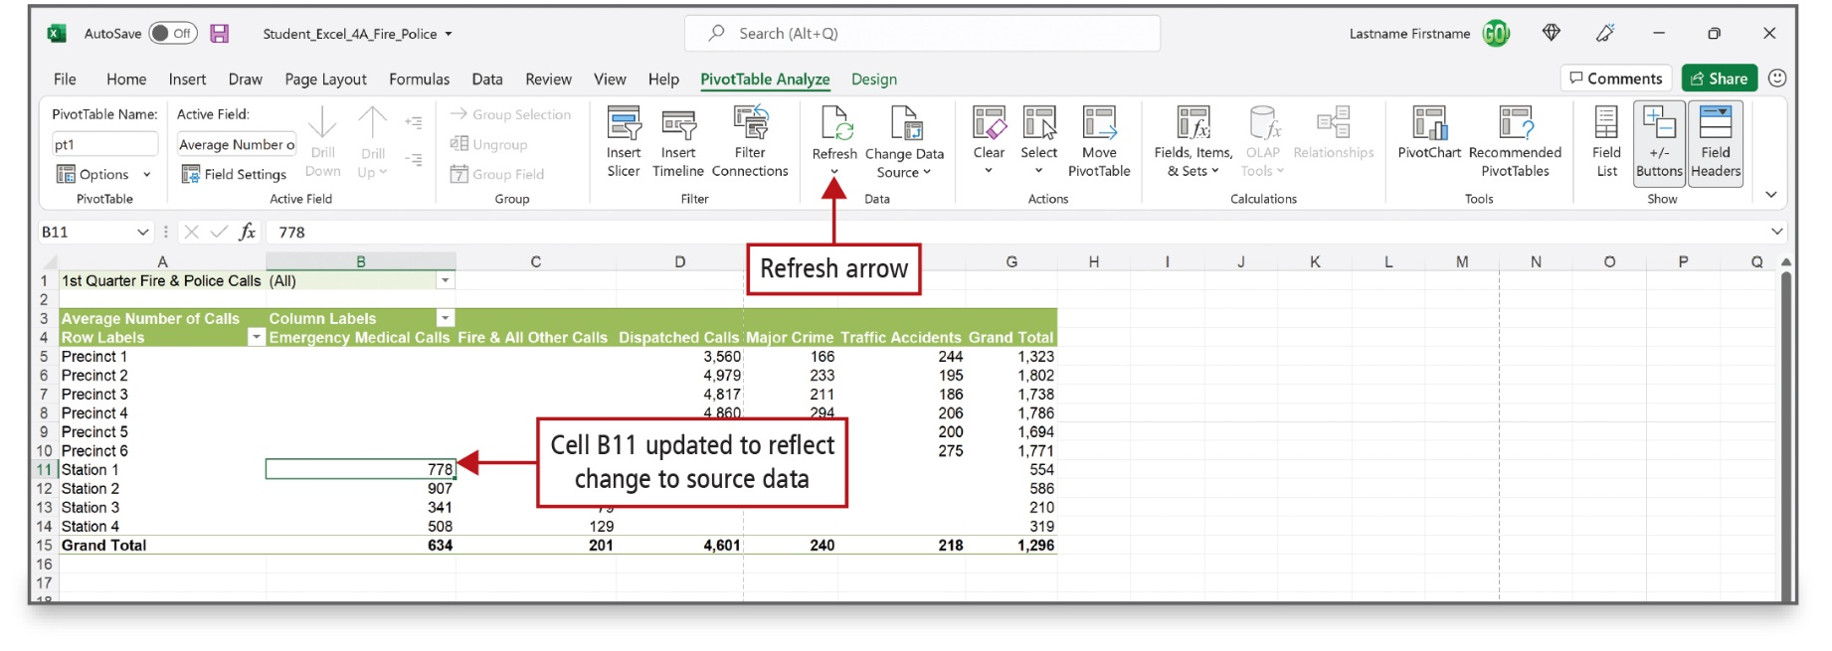
Modify a PivotTable (5 of 5)
Notes:
You can apply a PivotTable Style to the entire PivotTable report and change field names to make them easier to understand. In this worksheet, field names have been changed and a PivotTable Style has been applied. In addition, if you change the underlying data on which a PivotTable report is based, you must refresh—update—the PivotTable as has been done in this PivotTable report.

Slide 16
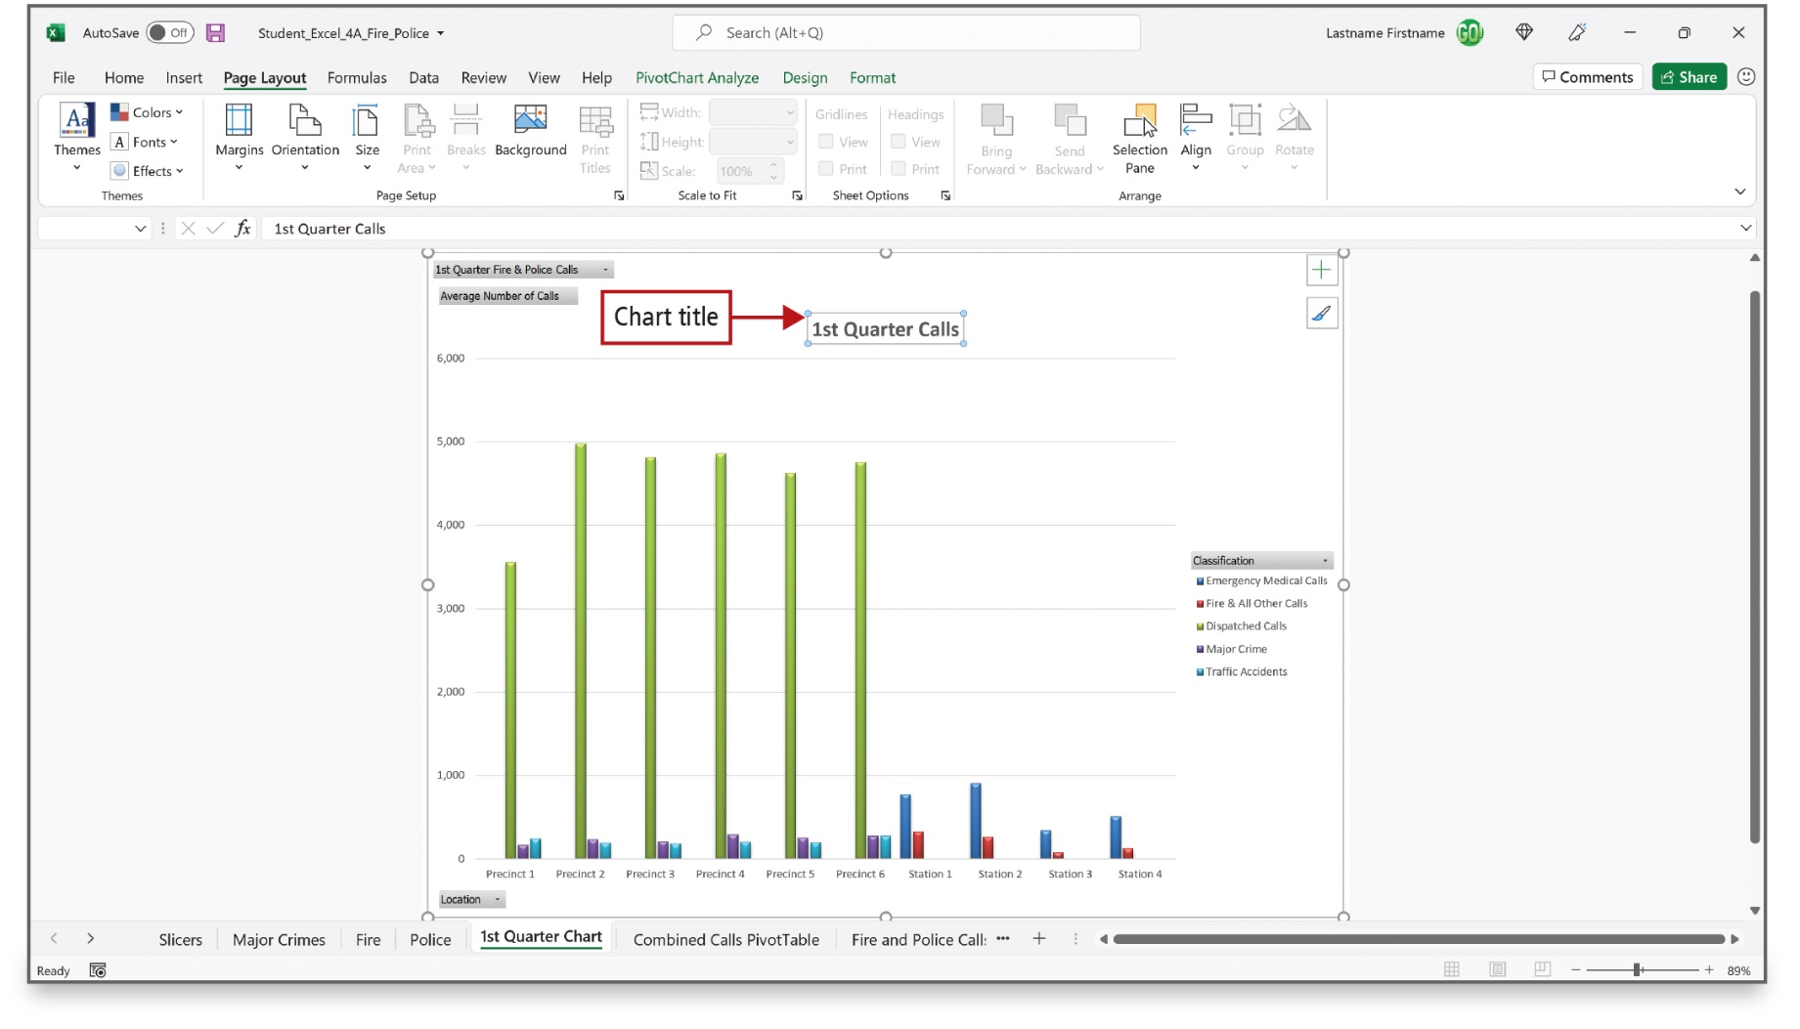
Create a PivotChart (1 of 3)
Notes:
A PivotChart is a graphical representation of the data in a PivotTable—referred to as the associated PivotTable report. A PivotChart displays field buttons. You can click on any button with an arrow to choose a filter and change the data that is displayed in the chart. In this PivotChart, the Classification field items form the legend, and the Location field items form the category axis.

Slide 17
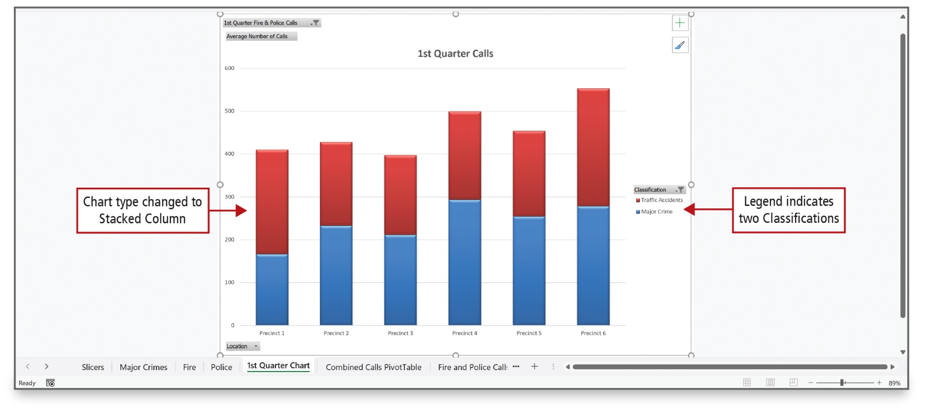
Create a PivotChart (2 of 3)
Notes:
Alt Text: The vertical bars in the chart are divided horizontally into two different sections (red and blue colored). These bars are labeled as Chart type changed to a stacked column. To the right are two color codes (red- traffic accidents and blue- major crime) labeled as Legend indicates two Classifications.
You can filter and change the values of the data in the PivotChart report by using the field buttons. The Dispatched Calls classification has been removed on this chart. Stacked columns display the two call classifications by location. Within each location, the stacked column shows the amount of activity as part of a whole.

Slide 18
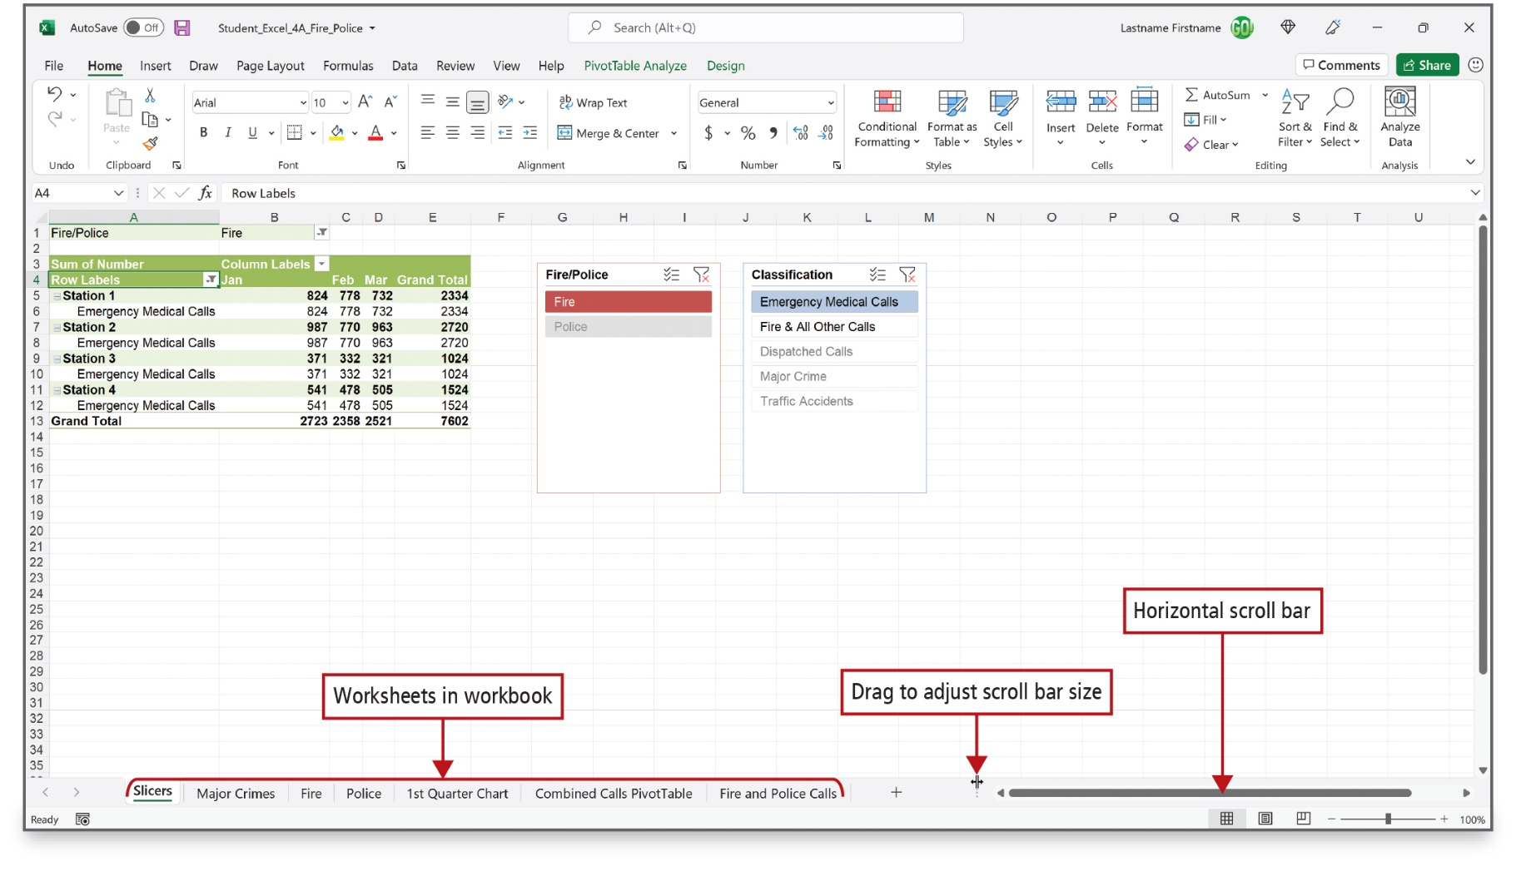
Create a PivotChart (3 of 3)
Notes:
Alt Text: The tabs named Slicers, Major Crimes, Fire, Police, 1st Quarter Chart, Combined Calls PivotTable, and Fire and Police Calls at the bottom of the Excel sheet are labeled as Worksheets in workbook. To the right of these tabs is a horizontal scroll bar. At the tip of the scroll bar is a pointer labeled as Drag to adjust scroll bar size. The pointer shows two vertical parallel lines between two arrows pointing to the left and right.
To the right of the sheet tabs, a horizontal scroll bar displays. At the left end of the scroll bar, the three vertical dots can be used to resize the width of the scroll bar and to display more worksheet tabs. By right-clicking on a tab and clicking Hide, worksheets can be hidden. This can help prevent users from altering data.

Slide 19
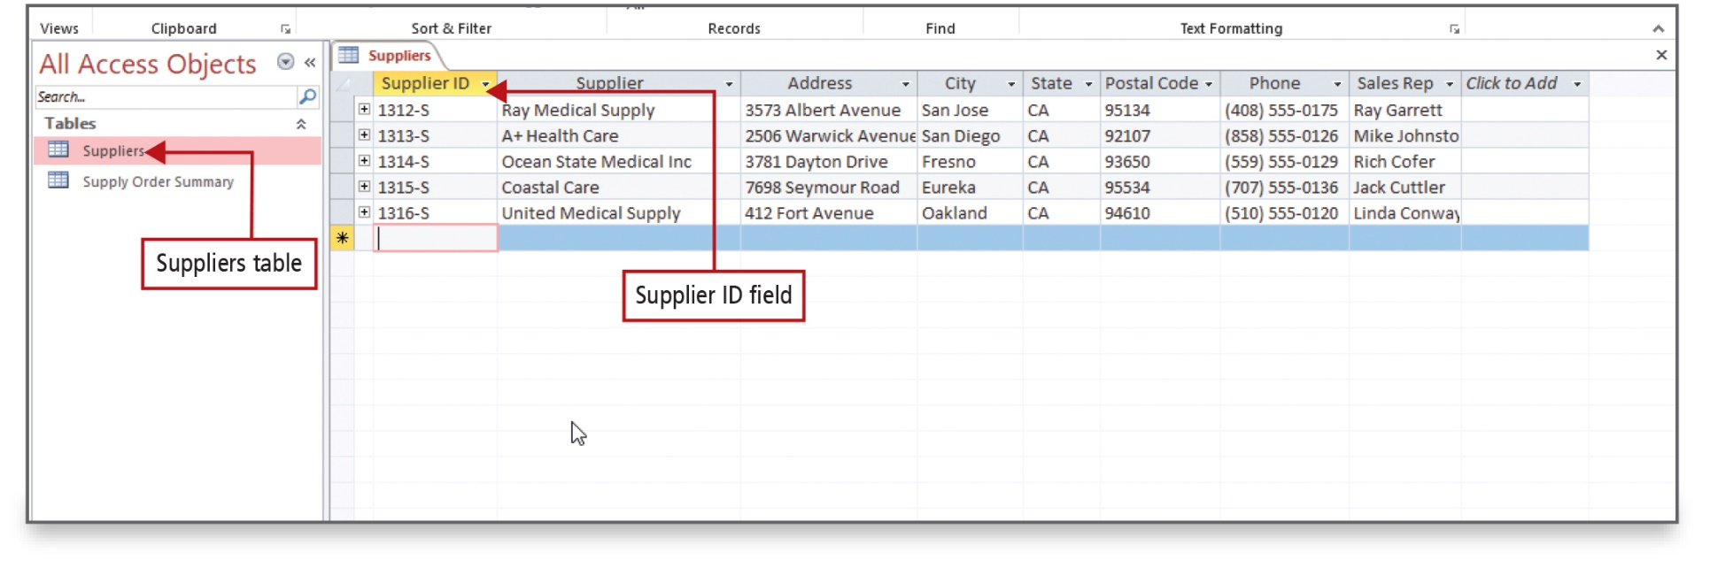
Create a PivotTable from a Data Model
(1 of 4)
Notes:
Alt Text: The first column heading in the table is supplier ID (labeled as supplier ID field). The pane displays a list of tables that include a supplier table and a supply order summary.
A data model is a method of incorporating data from multiple, related tables into an Excel worksheet. The data can be in an Excel workbook, imported from an Access database, or imported from an external source.
As shown here, a Microsoft Access table stores data in rows and columns. Each row is a record; each column is a field. In this database, Supplier ID is the primary key—a field used to uniquely identify a record.

Slide 20
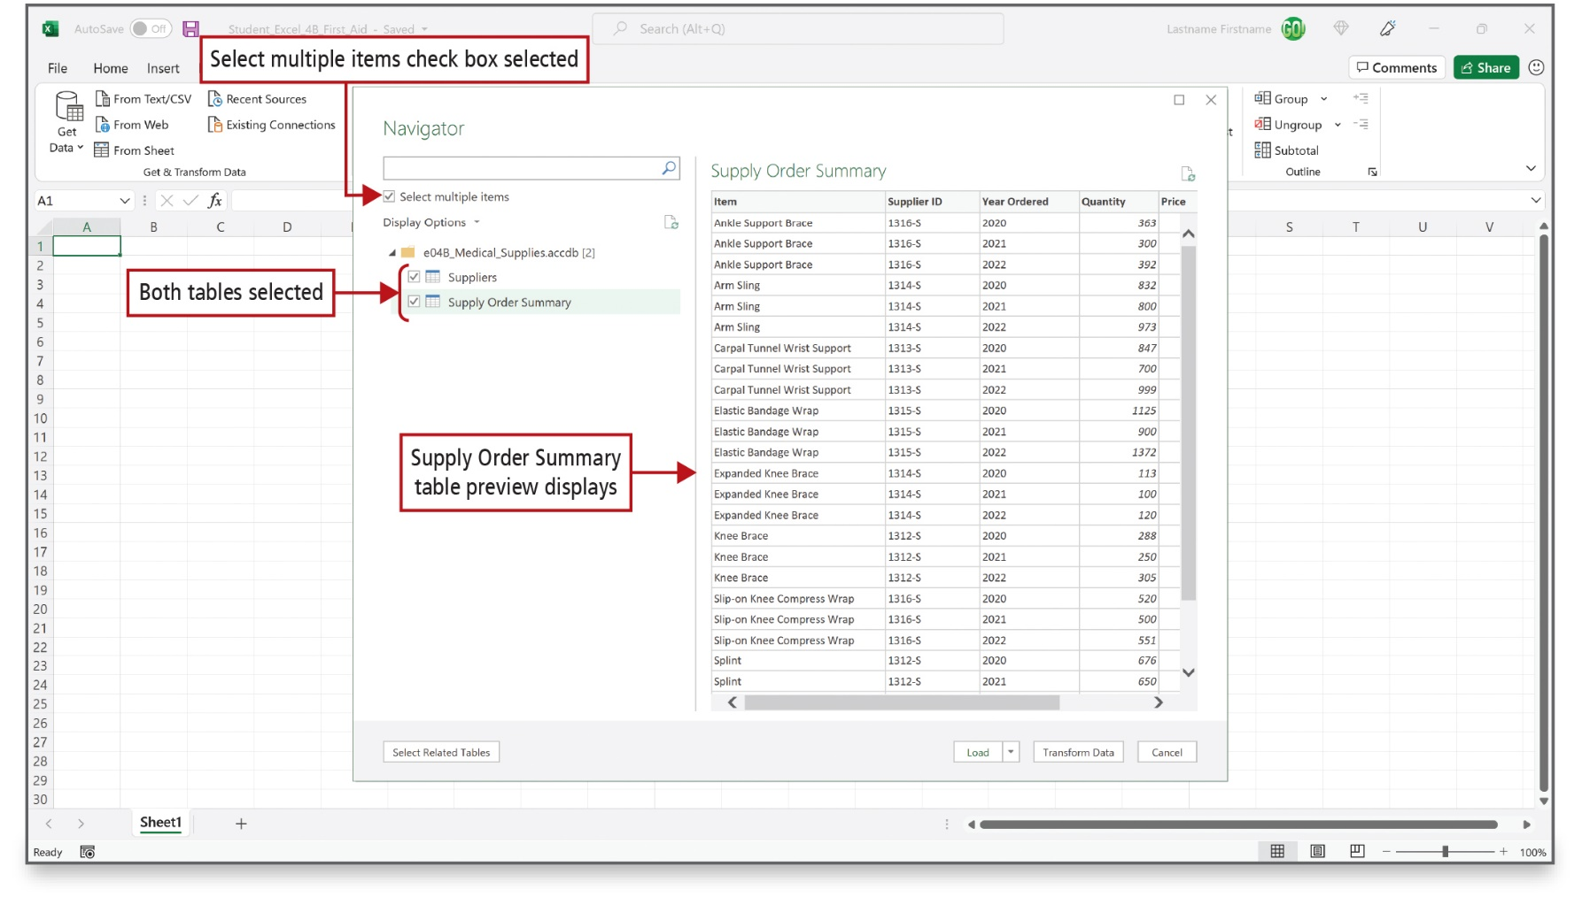
Create a PivotTable from a Data Model
(2 of 4)
Notes:
The database contains two tables—Suppliers and Supply Order Summary. Check the Name boxes for all tables to be included in the data model.

Slide 21
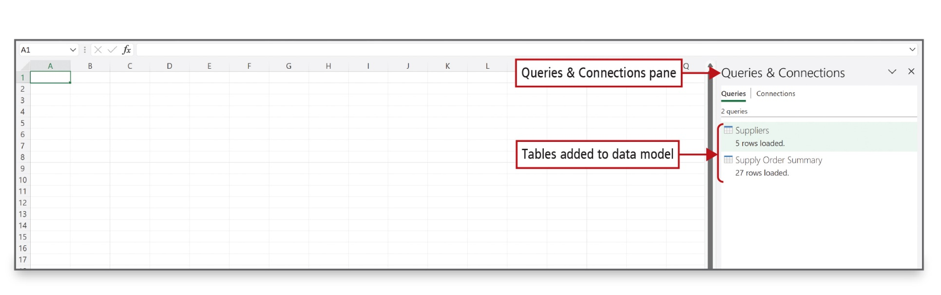
Create a PivotTable from a Data Model
(3 of 4)
Notes:
The two tables will not be added to the Excel workbook. Instead, a connection is created between the Excel PivotTable and the two Access tables. Both tables will be added to the Data Model.

Slide 22
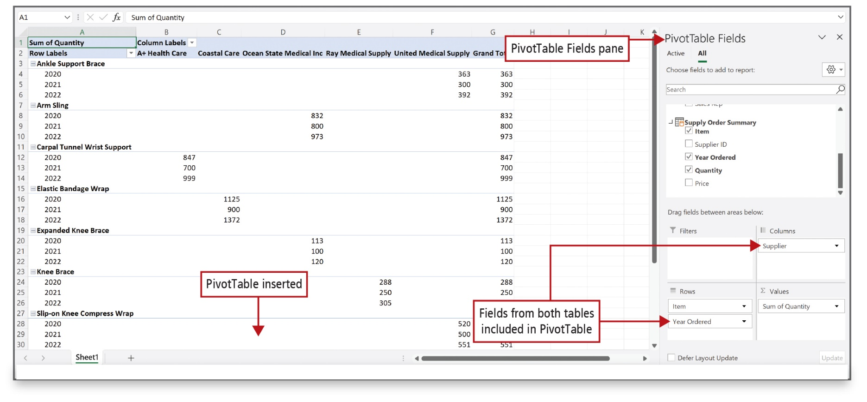
Create a PivotTable from a Data Model
(4 of 4)
Notes:
Alt Text: The pane displays “supplier” under the columns area and “item” and “year ordered” under the rows area. These are labeled as Fields from both tables included in PivotTable. The PivotTable is inserted into the sheet. The table displays item names followed by years in column A and supplier's names in row 2 (cells B2 to F2).
A PivotTable is created using data from two related tables. Although the common field—Supplier ID—is not used in the PivotTable, the relationship between the two tables that was created in the Access database enables Excel to use the common field to locate the data necessary from each table.

Slide 23
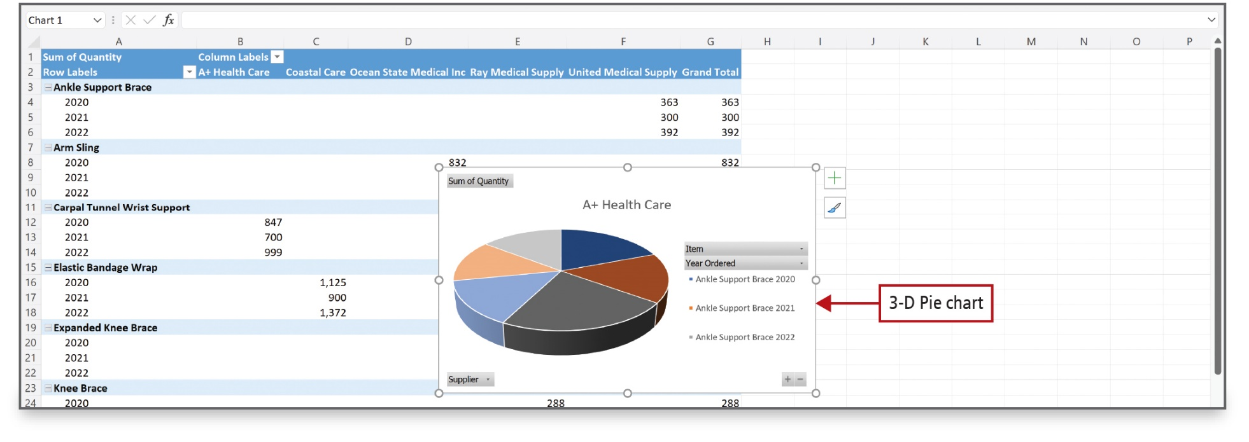
Create and Format a 3-D Pie PivotChart
(1 of 3)
Notes:
You can create a PivotChart from the data in a data model, and then filter the PivotChart to best represent your data. Here, a 3-D pie chart based on the PivotTable displays. The field buttons correspond to the fields used in the PivotTable.

Slide 24
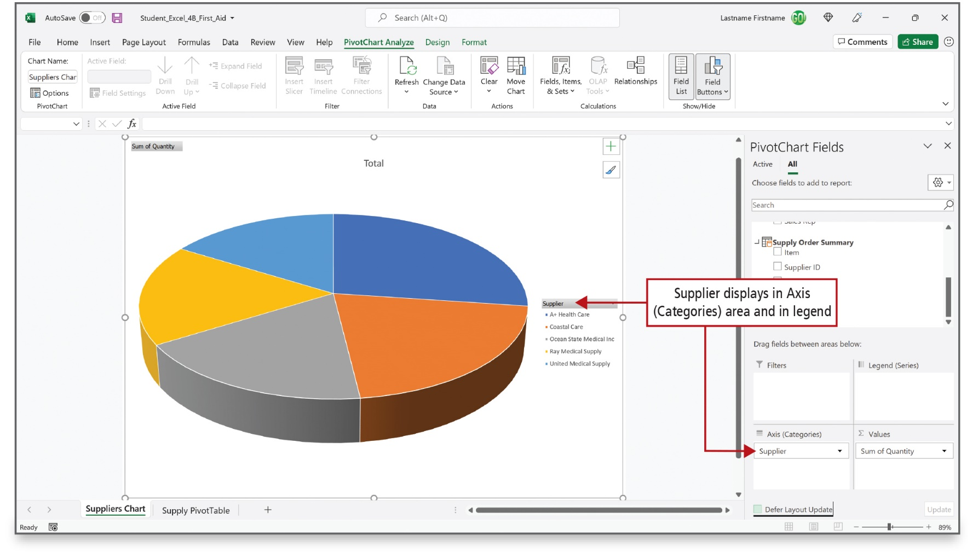
Create and Format a 3-D Pie PivotChart
(2 of 3)
Notes:
Alt Text: The list of suppliers with color codes displayed on the chart and supplier displayed by axis area in the pane are both collectively labeled as Supplier displays in Axis (Categories) area and in legend.
You can modify the data that displays in a PivotChart by dragging the fields between areas in the PivotChart Fields list. Here, the Axis (Category) area corresponds to the legend in the pie chart.

Slide 25
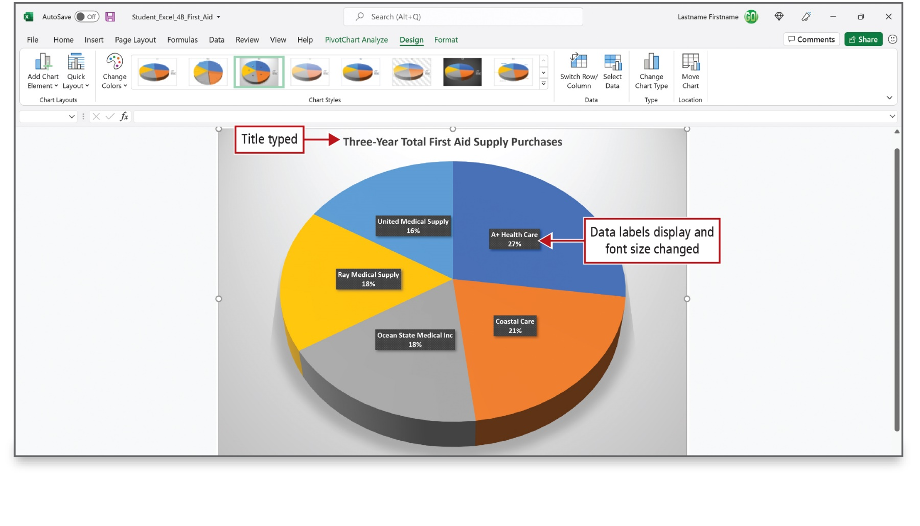
Create and Format a 3-D Pie PivotChart
(3 of 3)
Notes:
You can format a PivotChart using the same techniques that you use to format a chart.

Slide 26

Questions

Slide 27

Copyright
This work is protected by United States copyright laws and is provided solely for the use of instructors in teaching their courses and assessing student learning. Dissemination or sale of any part of this work (including on the World Wide Web) will destroy the integrity of the work and is not permitted. The work and materials from it should never be made available to students except by instructors using the accompanying text in their classes. All recipients of this work are expected to abide by these restrictions and to honor the intended pedagogical purposes and the needs of other instructors who rely on these materials.

