Slide 1

GO! with Microsoft 365: Excel 2021
Chapter 5
Managing Large Workbooks and Using Advanced Sorting and Filtering
Copyright © 2023 Pearson All Rights Reserved.
Notes:
GO! with Microsoft 365 Excel 2021, Chapter 5
In this chapter, you will learn how to manage large workbooks and use sorting and filtering.

Slide 2
Learning Objectives
Navigate and Manage Large Worksheets
Enhance Worksheets with Themes and Styles
Format a Worksheet to Share with Others
Save Excel Data in Other File Formats
Use Advanced Sort Techniques
Use Custom and Advanced Filters
Subtotal, Outline, and Group a List of Data
Notes:
The objectives are:
Navigate and Manage Large Worksheets
Enhance Worksheets with Themes and Styles
Format a Worksheet to Share with Others
Save Excel Data in Other File Formats
Use Advanced Sort Techniques
Use Custom and Advanced Filters
Subtotal, Outline, and Group a List of Data

Slide 3
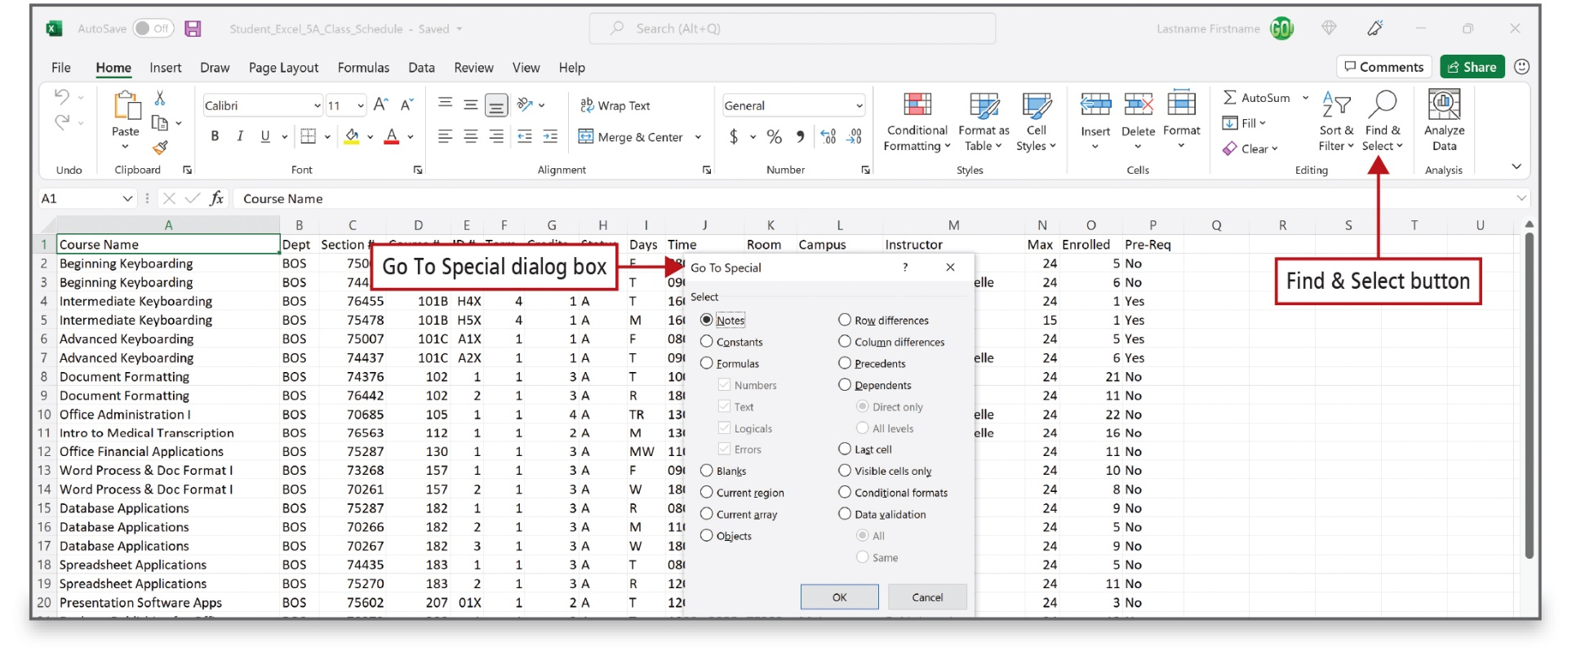
Navigate and Manage Large
Worksheets (1 of 3)
Notes:
The Find command is used to find and select specific text, formatting, or a type of information within the workbook. The Go To Special command moves to cells that have special characteristics, for example, to cells that are blank or to cells that contain constants as opposed to formulas.

Slide 4
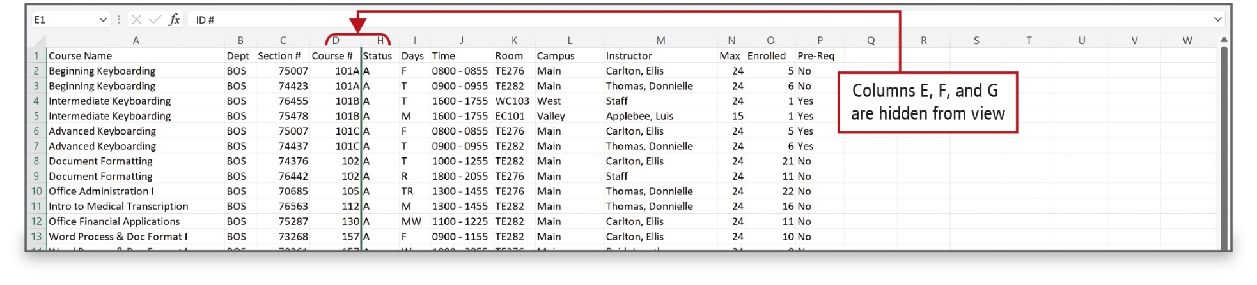
Navigate and Manage Large
Worksheets (2 of 3)
Notes:
In a large worksheet, it may be helpful to hide columns that are not necessary for the immediate task to make the worksheet more navigable and manageable. You can then unhide columns later. The worksheet on this slide has columns that are hidden as indicated by a dark line between columns D and H.

Slide 5
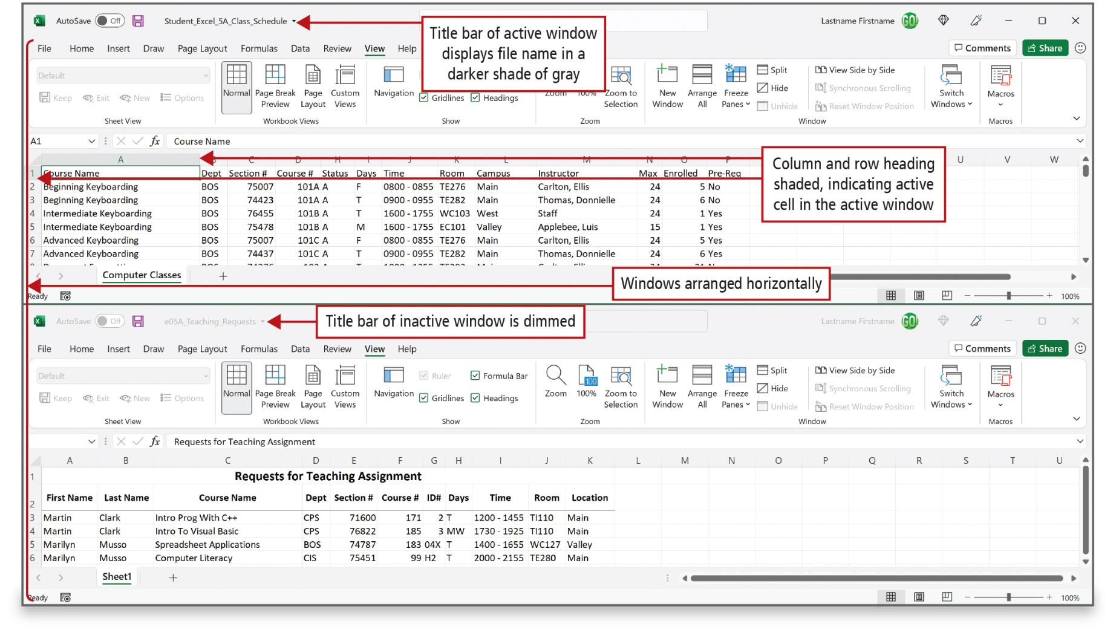
Navigate and Manage Large
Worksheets (3 of 3)
Notes:
Alt Text: The title bar of the top worksheet is labeled as Title bar of active window displays file name in a darker shade of gray while that of the bottom sheet is labeled as Title bar of the inactive window is dimmed. Column (A) and row heading (1) of the top worksheet are shaded gray and collectively labeled as Column and row heading shaded, indicating active cell in the active window. The screen is labeled as Windows arranged horizontally.
The Arrange All command tiles all open Excel windows on the screen. Additionally, you can view separate parts of the same worksheet on your screen by using the Split command, which splits the window into multiple resizable panes to view distant parts of your worksheet at once. This slide shows two worksheets arranged on the screen.

Slide 6
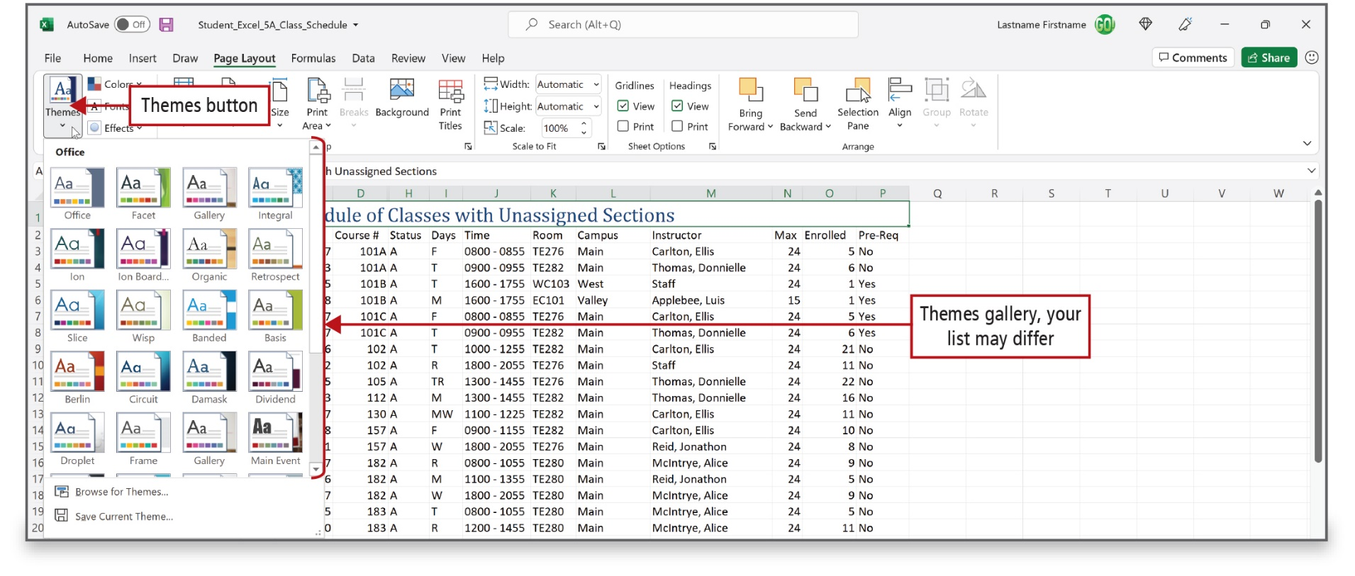
Enhance Worksheets with Themes and Styles (1 of 3)
Notes:
Applying a theme to a worksheet can enhance the appearance as well as the readability. A theme is a predesigned set of colors, fonts, lines, and fill effects. A theme combines two sets of fonts—one for text and one for headings. An applied theme has a set of complementary cell styles—a defined set of formatting characteristics, such as fonts, font sizes, font colors, cell borders, and cell shading.

Slide 7
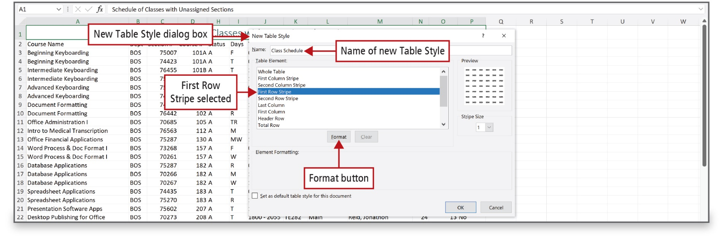
Enhance Worksheets with Themes and Styles (2 of 3)
Notes:
Alt Text: The name (Class Schedule) of the new table style is displayed in the name box. Below this box is a list of options for table elements. The first Row Stripe option is selected. At the bottom are format and clear (dimmed) buttons.
If the available table styles do not meet your needs, you can create and apply a custom table style of your own design.

Slide 8
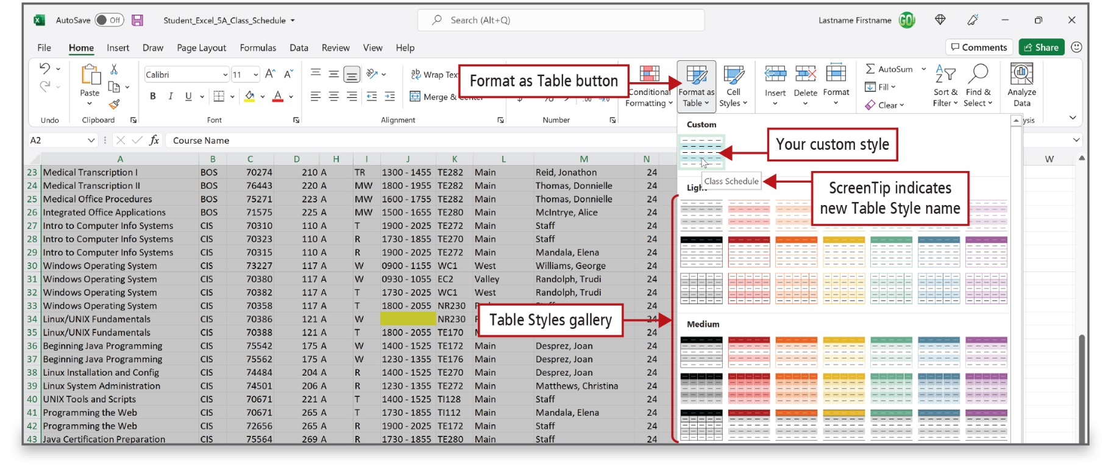
Enhance Worksheets with Themes and Styles (3 of 3)
Notes:
Alt Text: The gallery displays a preview of the custom style on the top followed by a list of light and medium styles. A ScreenTip (Class Schedule) near the custom style indicates a new table style name.
This slide shows the custom table style that was created and named Class Schedule as shown in the ScreenTip.

Slide 9
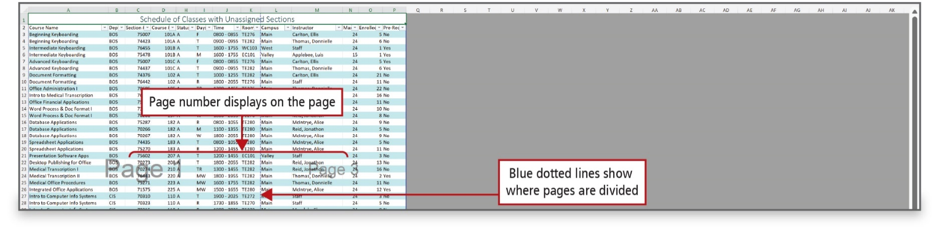
Format a Worksheet to Share with Others (1 of 3)
Notes:
Alt Text: On the spreadsheet, there is a vertical dotted line between the room and campus columns labeled as Blue dotted lines show where pages are divided. Page 1 and Page 3 (gray colored) are displayed on either side of the dotted line (labeled as Page number displays on the page).
Before you print or electronically distribute a large worksheet, preview it to see where the pages will break across columns and rows. You can move page breaks to a column or row that groups the data logically, and you can change page orientation. You can also apply scaling, which adjusts the horizontal and vertical size of printed data by a percentage or by the number of pages that you specify.

Slide 10
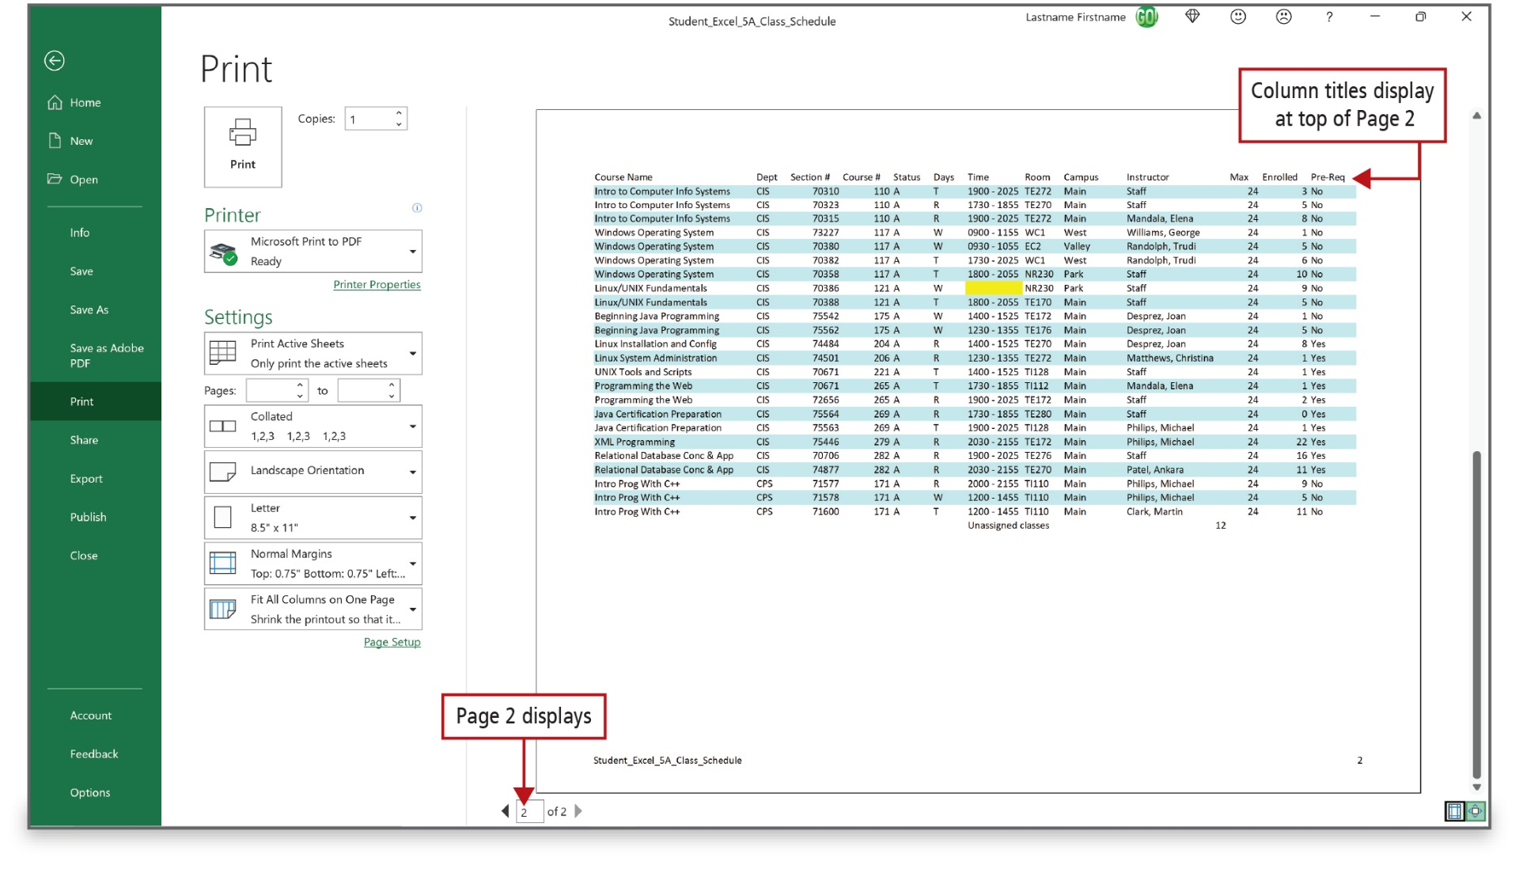
Format a Worksheet to Share with Others (2 of 3)
Notes:
As shown in Print Preview, column titles can also be made to appear on other pages.

Slide 11
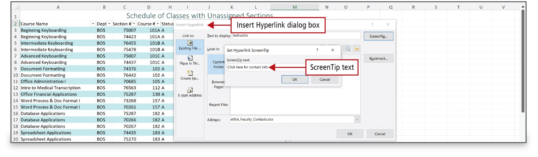
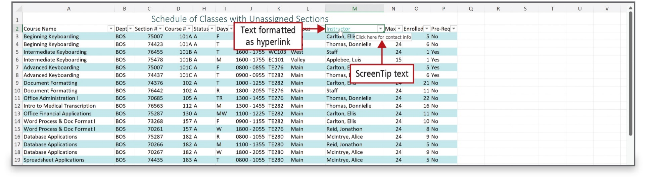
Format a Worksheet to Share with Others (3 of 3)
Notes:
You can share an Excel file electronically or post it to the web or to a shared workspace. If shared electronically, you can add a hyperlink to a worksheet. When clicked, the hyperlink moves to another location in the worksheet, to another file, or to a webpage on the Internet or on your organization’s intranet.

Slide 12
Save Excel Data in Other File Formats
(1 of 6)
Other Excel file formats:
  Excel 97-2003 Workbook
  Excel Template
  Single File Web Page
  Web Page
  Excel Macro-Enabled Workbook
Notes:
By default, Excel 2021 files are saved in the Excel Workbook file format with the .xlsx file extension. Using the Save As command, you can choose to save an Excel file in another file format such as:
Excel 97-2003 Workbook
Excel Template
Single File Web Page
Web Page
Excel Macro-Enabled Workbook

Slide 13
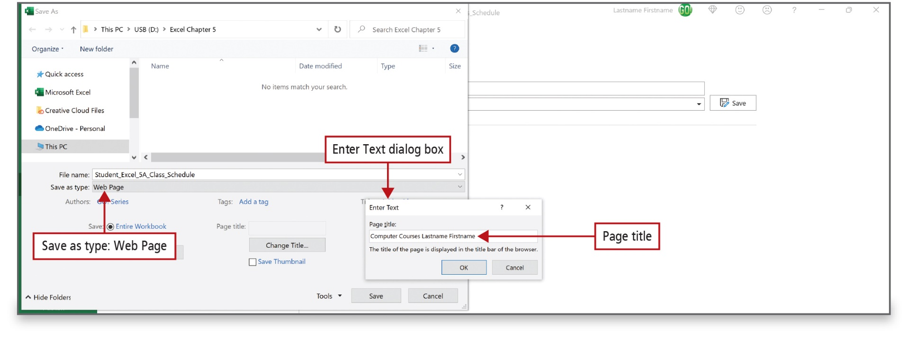
Save Excel Data in Other File Formats
(2 of 6)
Notes:
You can save a single worksheet as a webpage. Excel changes the contents of the worksheet into HTML (Hypertext Markup Language), which is a language web browsers can interpret, when you save a worksheet as a webpage.

Slide 14
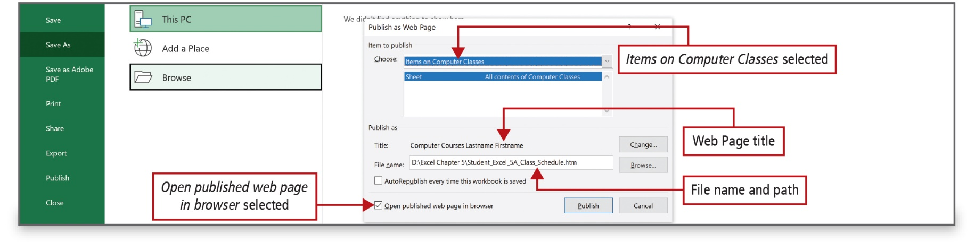
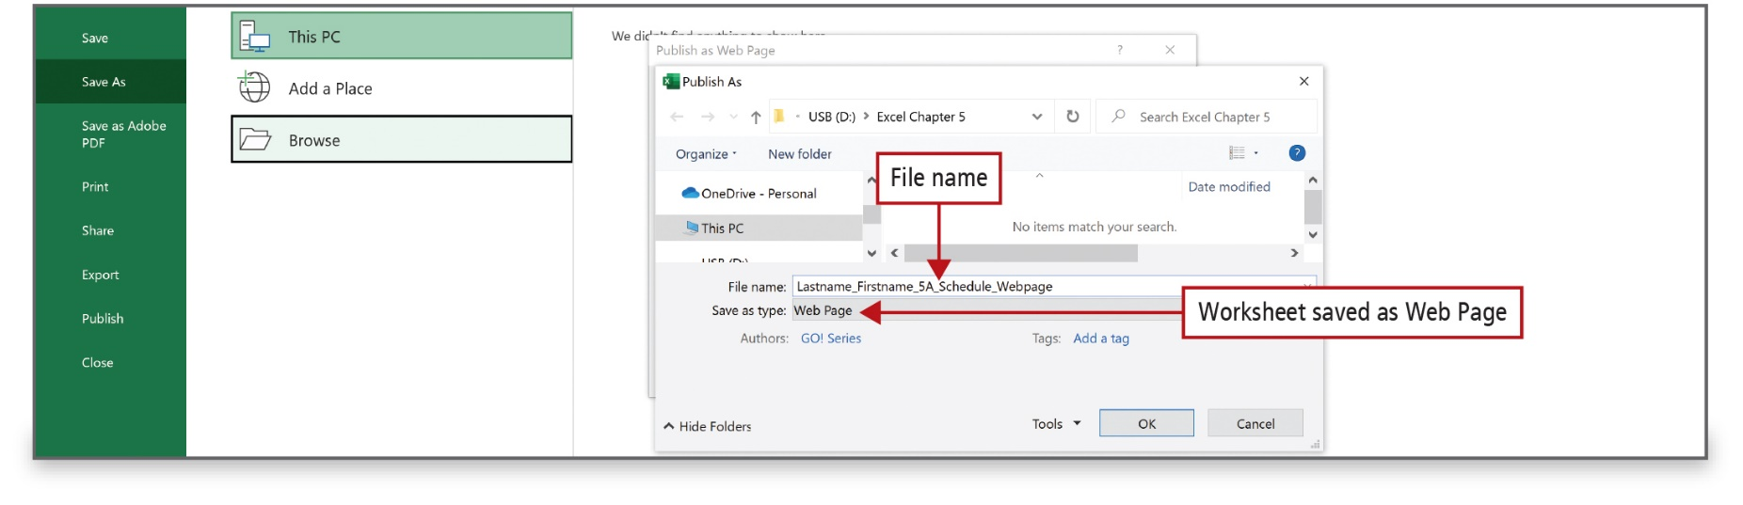
Save Excel Data in Other File Formats
(3 of 6)
Notes:
Alt Text: In the dialog box: Under choose, items on Computer Classes are selected. The webpage title reads as “computer courses Lastname firstname”. File name and path displayed below the title read as D:\Excel chapter 5\student_Excel_5A_Class_Schedule.htm. Open published webpage in browser option at the bottom is selected.
Alt Text: The window displays the file name that reads as lastname_firstname_Excel_5A_Schedule_Webpage. In the Save as type area, the webpage is selected (labeled as Worksheet saved as Web Page).
Under Item to publish, you can choose which elements to include. You can select the entire workbook, a specific worksheet in the workbook, a range of cells, or previously published items that you are modifying. Select the file name and the file type.

Slide 15
Save Excel Data in Other File Formats
(4 of 6)
Additional file formats:
  Text (Tab Delimited)
  CSV (Comma Delimited)
  PDF (Portable Document Format)
Notes:
Excel files can also be saved in these file formats:
Tab delimited text file, in which the cells of each row are separated by tab characters
CSV (comma separated values) file, in which the cells of each row are separated by commas
PDF file, a widely used format that lets you create a representation of electronic paper that displays data on the screen as it would look when printed

Slide 16
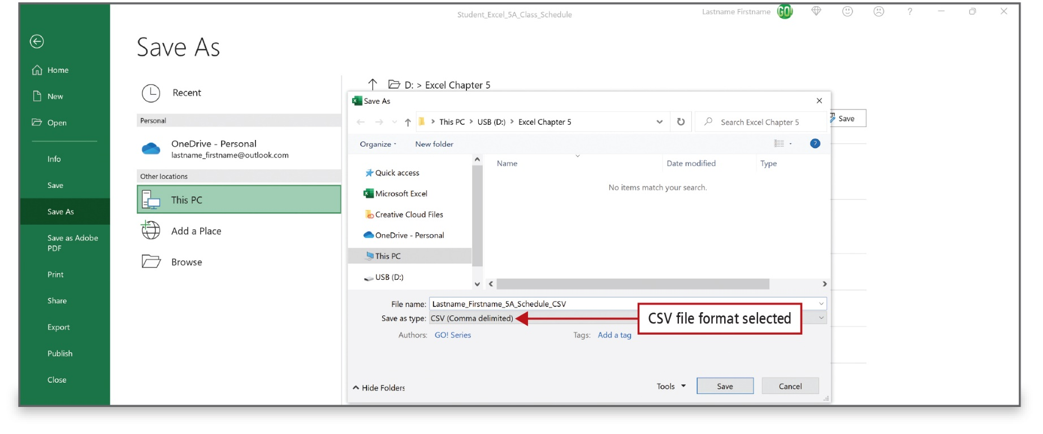
Save Excel Data in Other File Formats
(5 of 6)
Notes:
Saving an Excel worksheet as a comma-separated values (CSV) file saves the contents of the cells by placing commas between them and an end-of-paragraph mark at the end of each row.

Slide 17
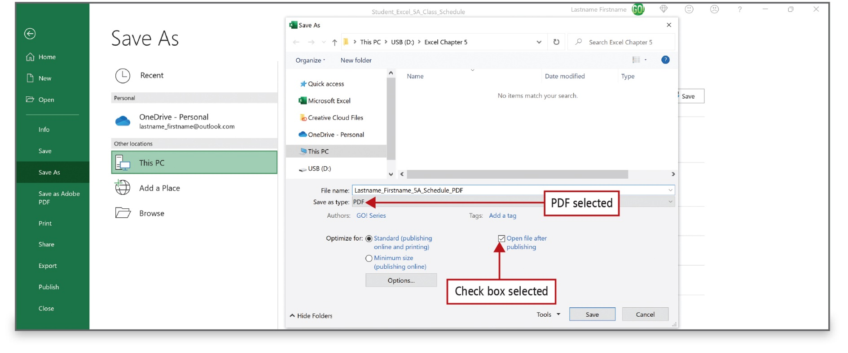
Save Excel Data in Other File Formats
(6 of 6)
Notes:
You can also create portable documents to share across applications and platforms with accurate visual representations. To publish a document and ensure that the appearance of the document is the same no matter what computer it is displayed on, save the document in PDF (Portable Document Format). PDF format can be used if you want someone to be able to view a document but not change it.

Slide 18
Use Advanced Sort Techniques (1 of 4)
Sort—organize data in a particular order
  Ascending sorts from low to high
  Descending sorts from high to low
Database—table organized as a collection of facts related to a specific topic.
  Record—row of categories of data
  Field—single piece of information
  Query—question about the data
Notes:
Sort means to organize data in a particular order; for example, alphabetizing a list of names. An ascending sort refers to text that is sorted alphabetically from A to Z, or numbers as lowest to highest, or dates and time sorted from earliest to latest. A descending sort refers to Z to A, numbers highest to lowest, or dates and times from latest to earliest.
A database is a table organized as a collection of facts related to a specific topic. Each table row forms a record—all of the categories of data pertaining to one person, place, thing, event, or idea. Each table column forms a field—a single piece of information that is stored in every record, such as a name or course number. When information is arranged as records in rows and fields in columns, then you can query—ask a question of—the data.

Slide 19
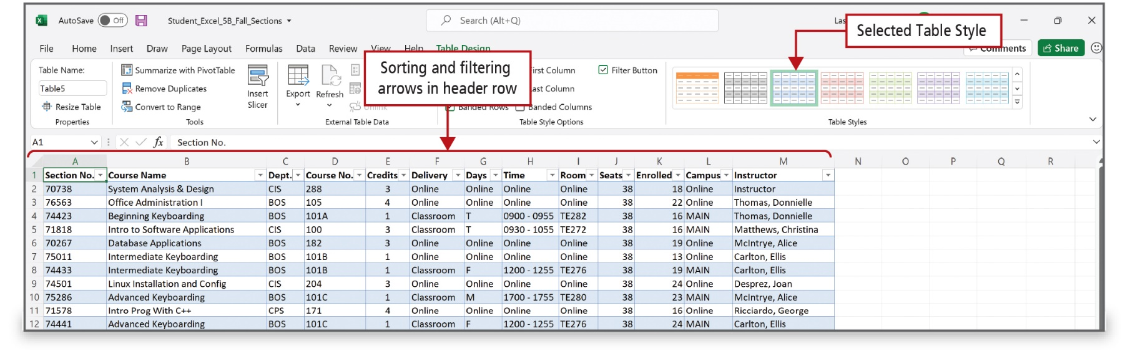
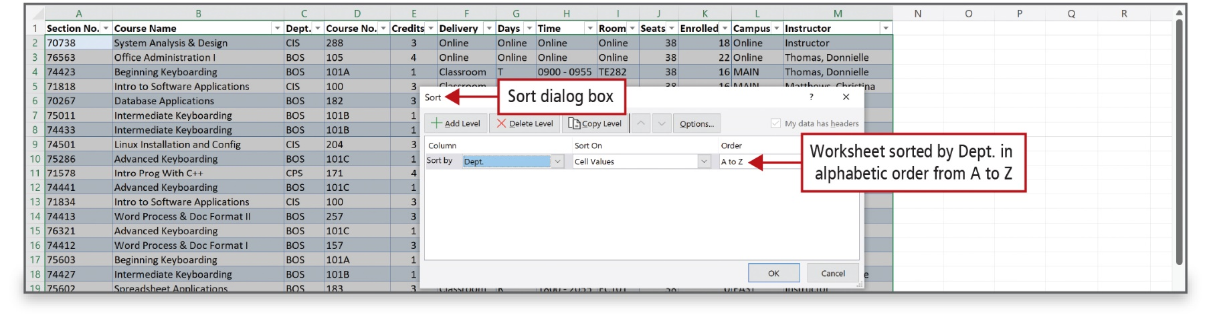
Use Advanced Sort Techniques (2 of 4)
Notes:
To sort data based on several criteria at once, you will convert the data into an Excel table, and then use the Sort dialog box to arrange the data.

Slide 20
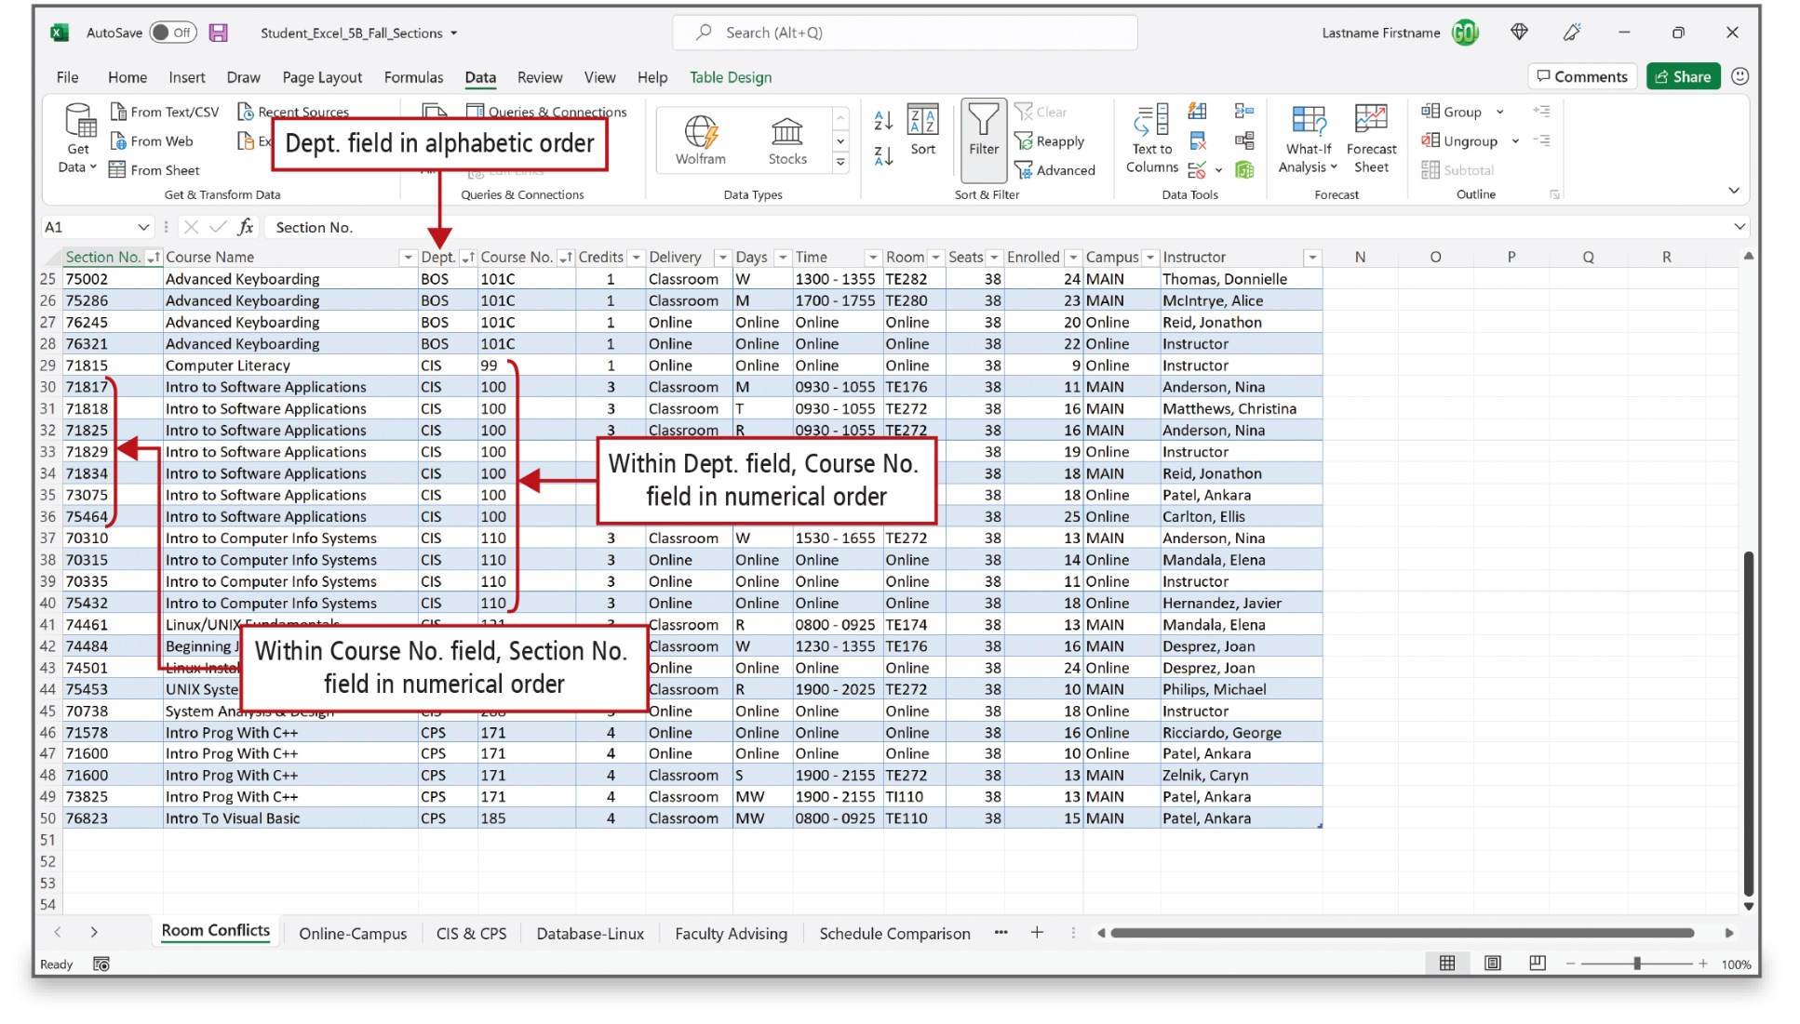
Use Advanced Sort Techniques (3 of 4)
Notes:
This worksheet shows a three-level sort. The first sort level, sometimes referred to as the major sort, is by the Dept. field in alphabetic order. The second sort level is by the Course No. field in ascending order. The third sort level is by the Section No. field in ascending order.

Slide 21
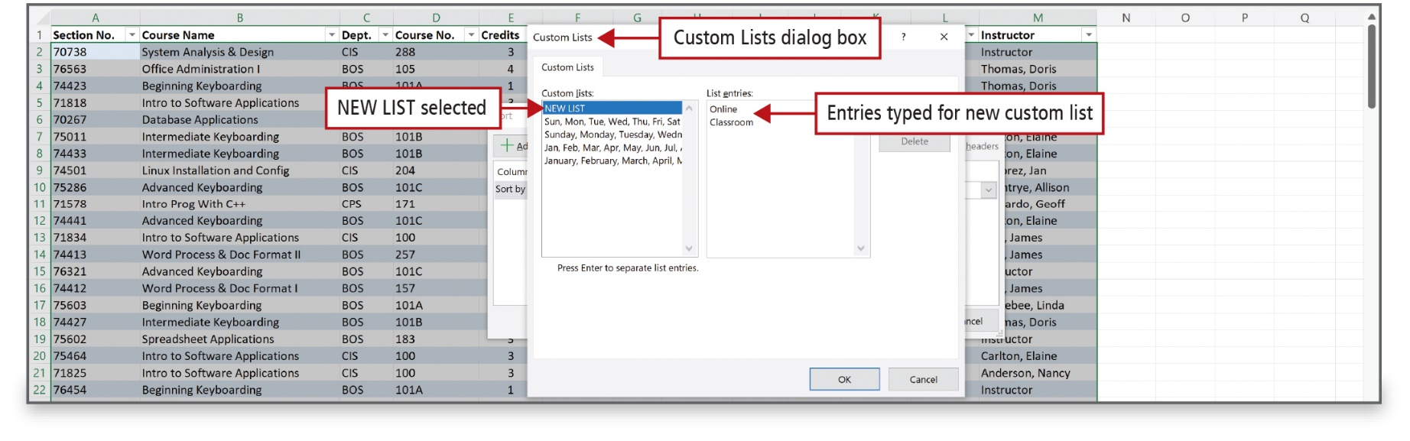
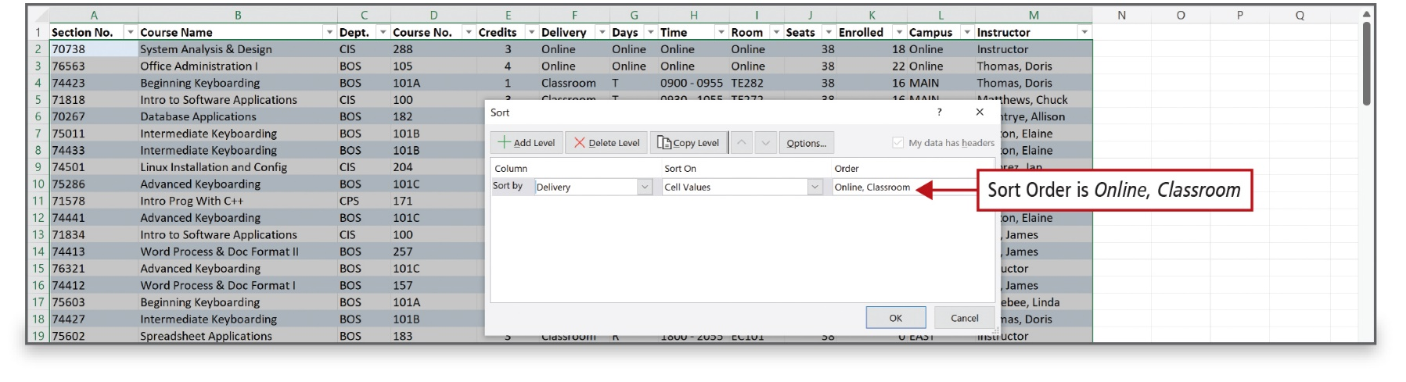
Use Advanced Sort Techniques (4 of 4)
Notes:
You can use a custom list to sort in an order that you define. Excel includes a day-of-the-week and month-of-the-year custom list, so that you can sort chronologically by the days of the week or by month. You can also create your own custom list by typing the values you want to sort by, in the order you want to sort them, from top to bottom. A custom list that you define must be based on a value—text, number, date, or time.

Slide 22
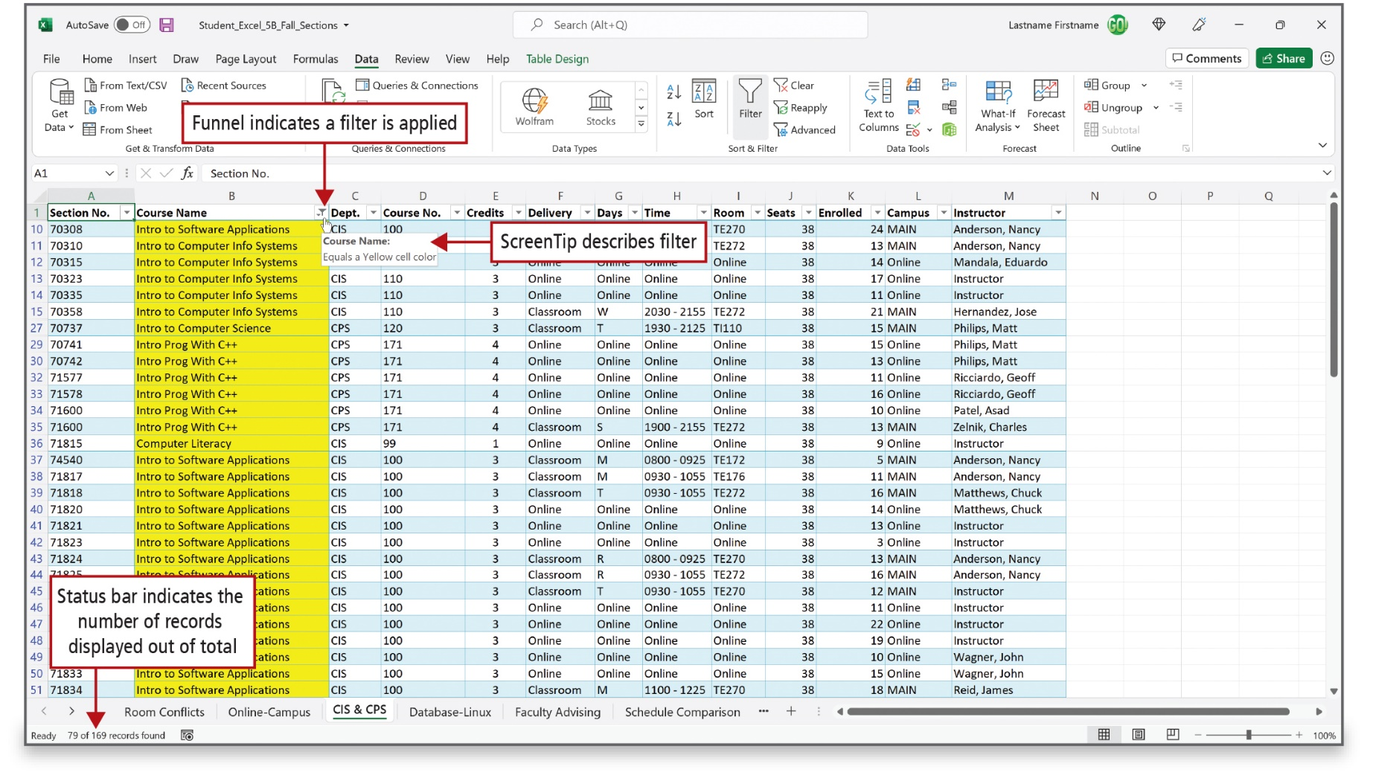
Use Custom and Advanced Filters (1 of 8)
Notes:
Alt Text: The funnel icon to the right of the heading “course name” (B1) indicates that a filter is applied. A screen tip below the icon describes the filter (reads as equals a yellow cell color). The status bar (green bar at bottom of sheet) reads as 79 of 169 records found and is labeled as Status bar indicates the number of records displayed out of total.
Filtering displays only the rows that meet the criteria—conditions that you specify to limit which records are included in the results—and hides the rows that do not meet your criteria. The AutoFilter menu is a drop-down menu from which you can filter a column by a list of values, by a format, or by criteria.

Slide 23
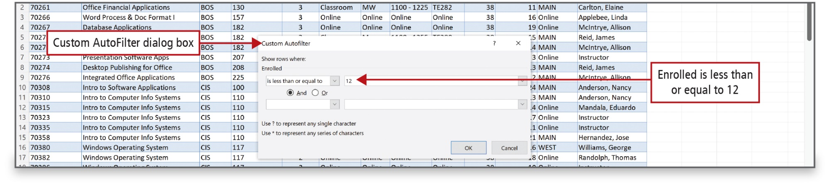
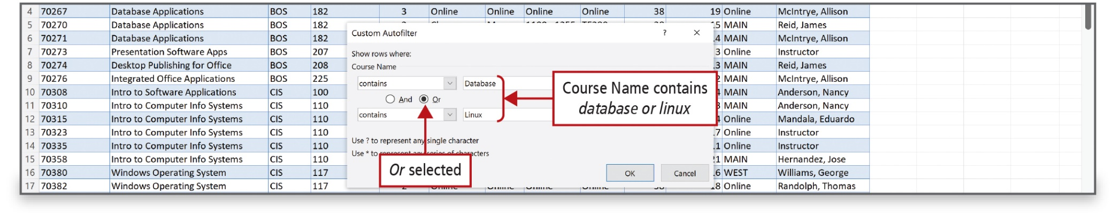
Use Custom and Advanced Filters (2 of 8)
Notes:
A custom filter is used to apply complex criteria to a single column. Use an advanced filter to specify three or more criteria for a particular column, to apply complex criteria to two or more columns, or to specify computed criteria. Comparison operators can be used to compare two values. For the Or comparison operator, only one of the two comparison criteria that you specify must be true. For the And comparison operator, every comparison criteria that you specify must be true. When you compare two values by using these operators, your result is a logical value that is either true or false.

Slide 24
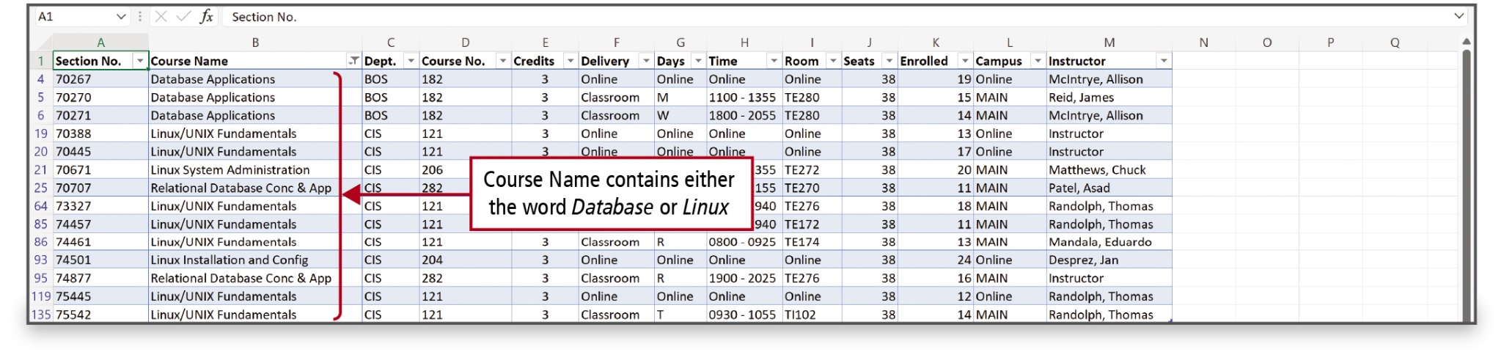
Use Custom and Advanced Filters (3 of 8)
Notes:
This filter answers the question, Which course sections relate to either databases or the Linux operating system?

Slide 25
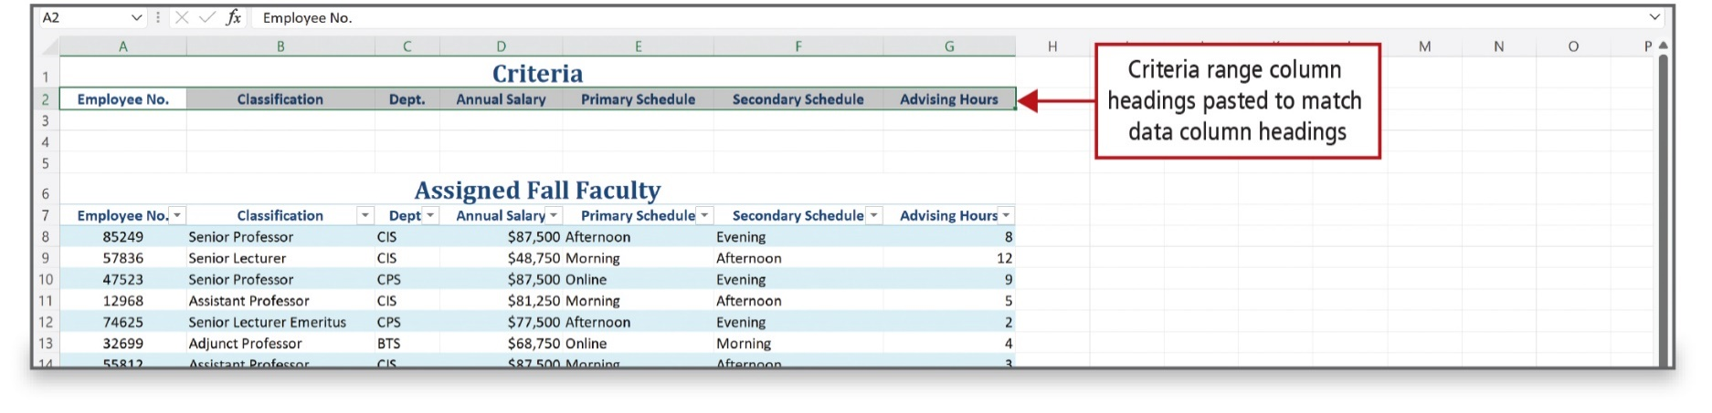
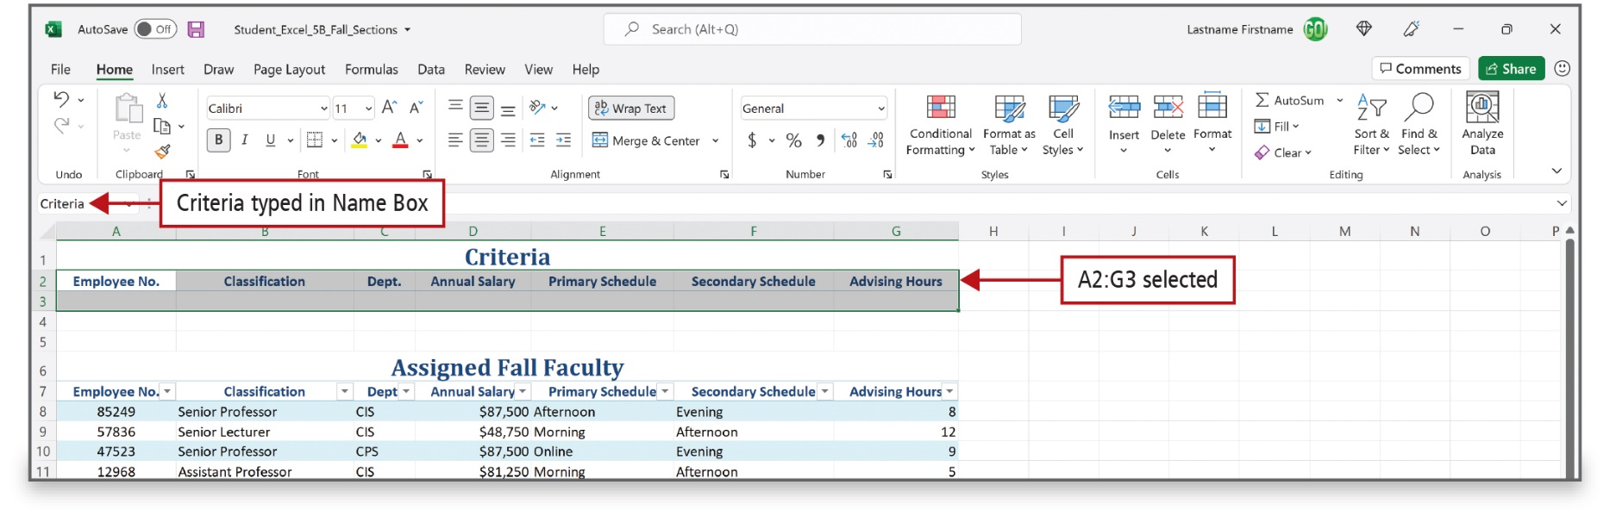
Use Custom and Advanced Filters (4 of 8)
Notes:
The first step in filtering by using advanced criteria is to create a criteria range—an area on your worksheet where you define the criteria for the filter. The criteria range indicates how the displayed records are filtered.
By naming the range Criteria, which is a predefined name recognized by Excel, the reference to this range will automatically display as the Criteria range in the Advanced Filter dialog box.

Slide 26
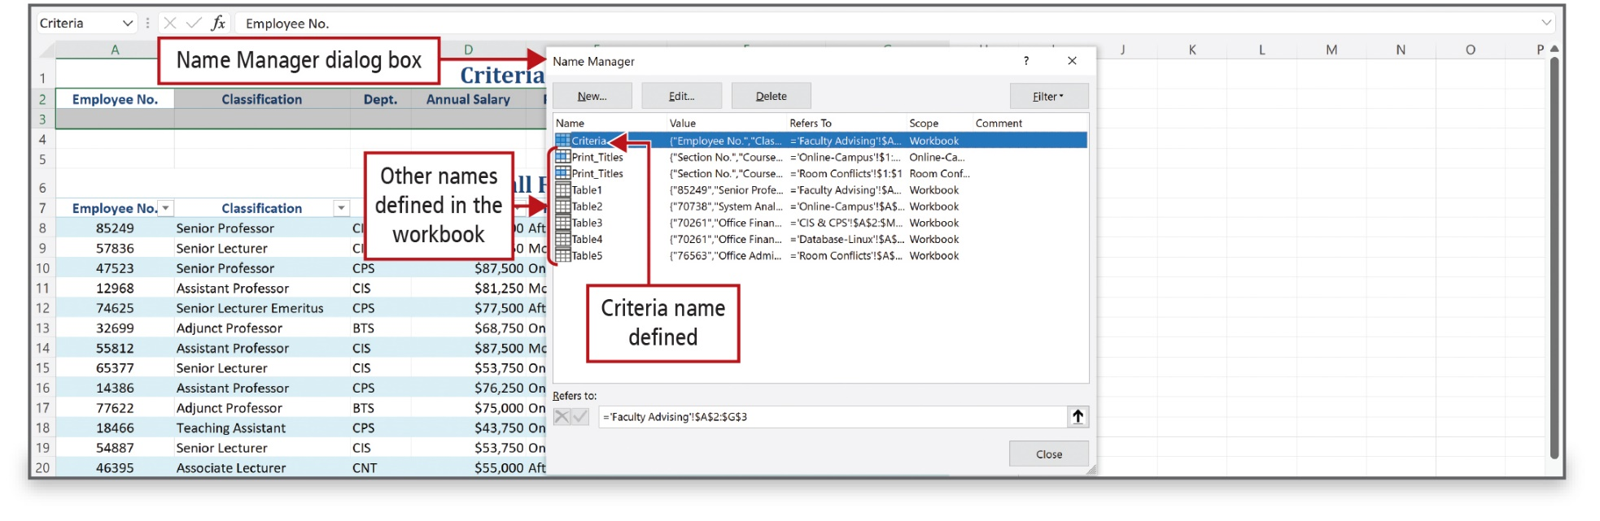
Use Custom and Advanced Filters (5 of 8)
Notes:
The Name Manager dialog box shows named tables and lists the Print titles ranges defined in previous worksheets.

Slide 27
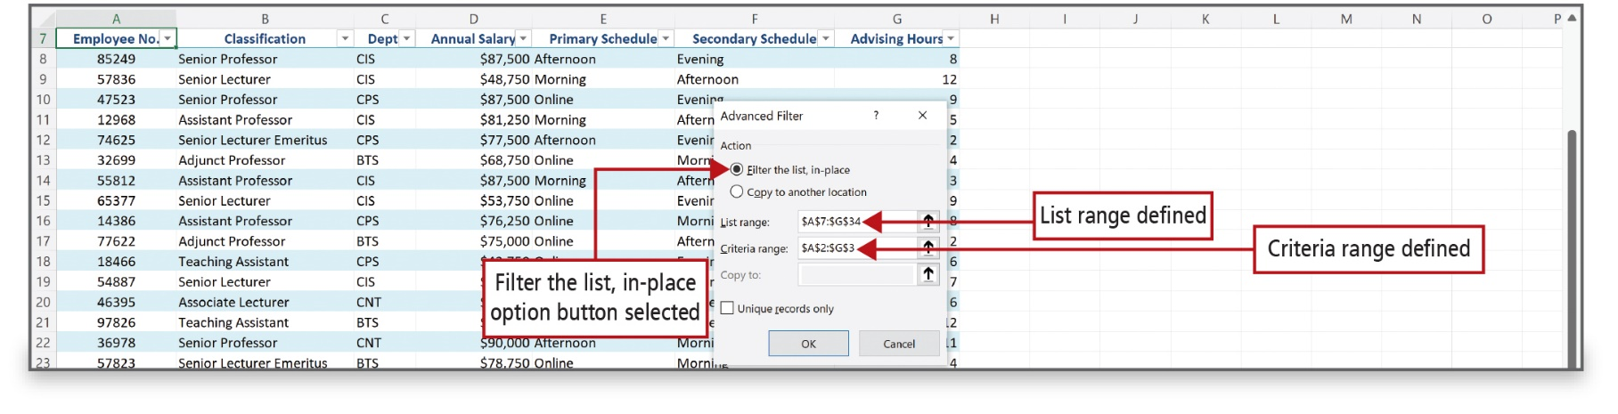
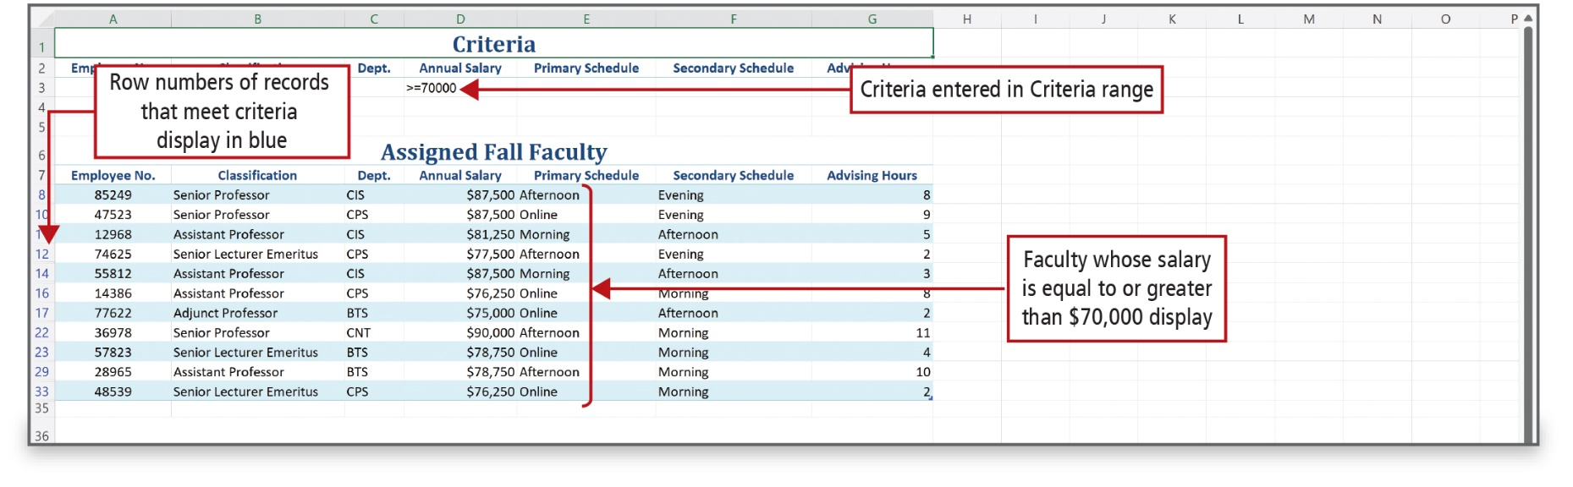
Use Custom and Advanced Filters (6 of 8)
Notes:
Alt Text: The row numbers of records that meet the criteria are displayed in blue (rows 8, 10, 12, and so on). Criteria entered in the criteria range reads as greater than or equal to 70000. The annual salary column in the table titled “assigned fall faculty” displays Faculty whose salary is equal to or greater than $70,000.
This worksheet displays only the records for faculty members whose salary is $70,000 or more. The row numbers for the records that meet the criteria display in blue. The Advanced command disables the AutoFilter command and removes the AutoFilter arrows from the column headings.

Slide 28
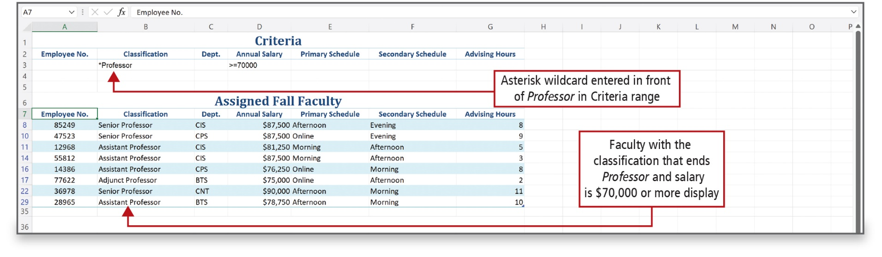
Use Custom and Advanced Filters (7 of 8)
Notes:
The asterisk (*) is a wildcard. Use a wildcard to search a field when you are uncertain of the exact value, or you want to widen the search to include more records.

Slide 29
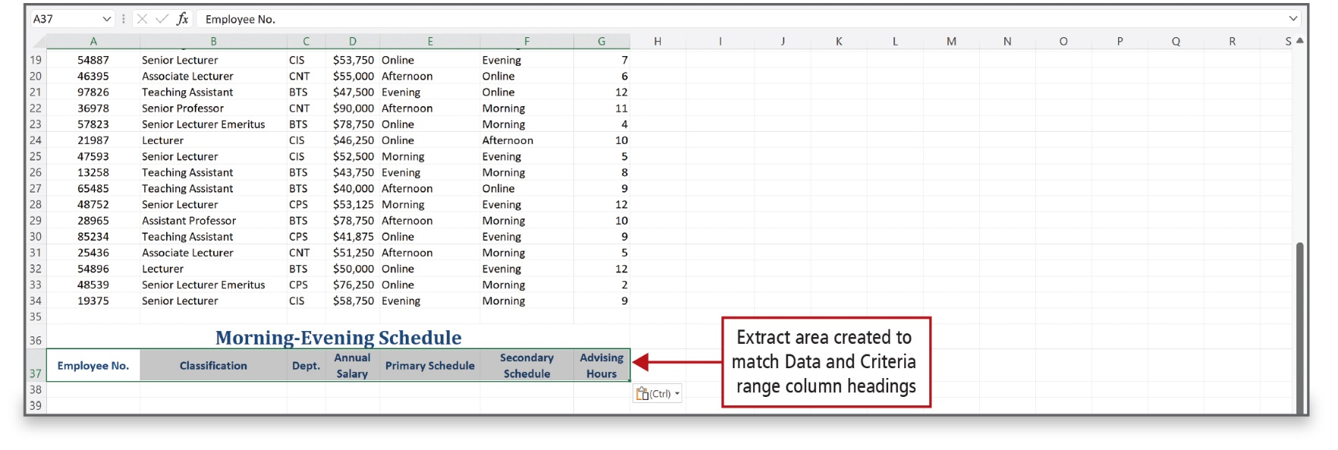
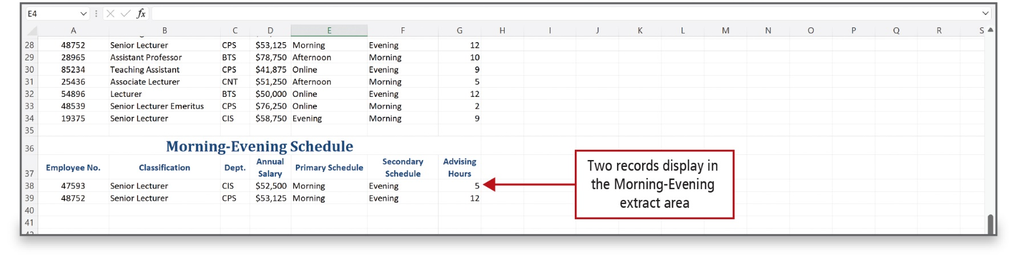
Use Custom and Advanced Filters (8 of 8)
Notes:
You can extract—pull out the results of a filter to another area of your worksheet—instead of displaying a filtered list. The location to which you copy the records is the Extract area and is commonly placed below the table of data.

Slide 30
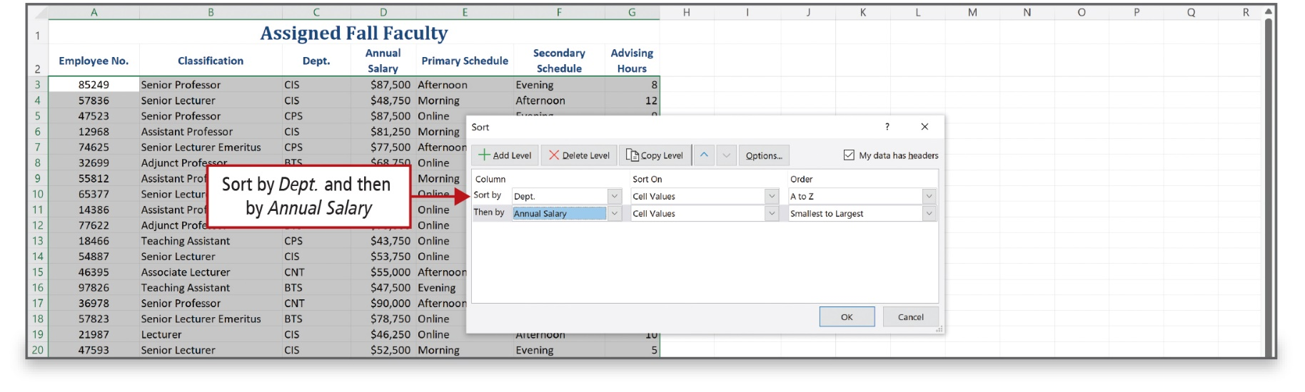
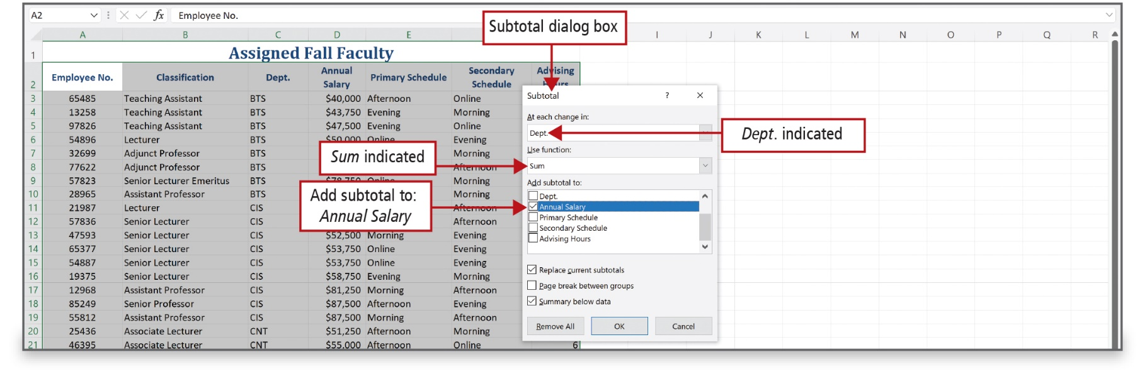
Subtotal, Outline, and Group a List of Data (1 of 3)
Notes:
Alt Text: In the “At each change in” box, Dept. is selected; in the “Use function” box, Sum is selected; and under “Add subtotal to” options, the annual salary is selected. Replace current subtotals and summary below data checkboxes are selected.
You can group and summarize a list—a series of rows that contains related data—by adding subtotals. The subtotal command totals several rows of related data together by automatically inserting subtotals and totals for the selected cells.

Slide 31
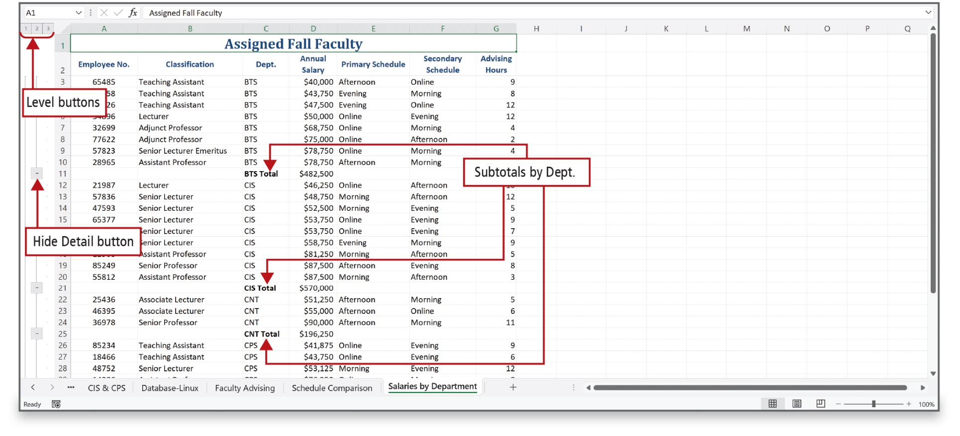
Subtotal, Outline, and Group a List of Data (2 of 3)
Notes:
In this example, the Dept. sort placed the data for each department together so that at each change in Dept., subtotals for the department salaries display.

Slide 32
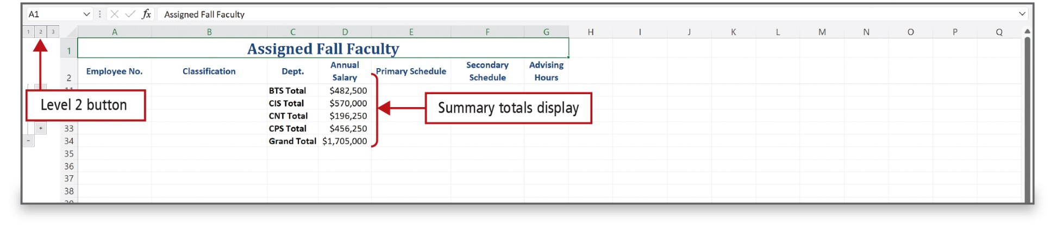
Subtotal, Outline, and Group a List of Data (3 of 3)
Notes:
When you add subtotals, Excel defines groups based on the rows used to calculate a subtotal. The outline bar along the left side of the worksheet enables you to show and hide levels of detail with a single mouse click. Detail data refers to the subtotaled rows that are totaled and summarized. Detail data is typically adjacent to and either above or to the left of the summary data. The Level buttons on the left of the window allow you to hide all levels of detail below the number clicked.

Slide 33

Questions

Slide 34

Copyright
This work is protected by United States copyright laws and is provided solely for the use of instructors in teaching their courses and assessing student learning. Dissemination or sale of any part of this work (including on the World Wide Web) will destroy the integrity of the work and is not permitted. The work and materials from it should never be made available to students except by instructors using the accompanying text in their classes. All recipients of this work are expected to abide by these restrictions and to honor the intended pedagogical purposes and the needs of other instructors who rely on these materials.

