Slide 1

GO! with Microsoft 365: Excel 2021
Chapter 7
Use Financial and Lookup Functions, Define Names, Validate Data, and Audit Worksheets
Copyright © 2023 Pearson All Rights Reserved
Notes:
GO! with Microsoft 365 Excel 2021, Chapter 7
In this chapter, you will learn how to use financial and lookup functions, define names, validate data, and audit worksheets.

Slide 2
Learning Objectives (1 of 2)
Use Financial Functions
Use Goal Seek
Create a Data Table
Use Defined Names in a Formula
Use Lookup Functions
Notes:
The objectives are:
Use Financial Functions
Use Goal Seek
Create a Data Table
Use Defined Names in a Formula
Use Lookup Functions

Slide 3
Learning Objectives (2 of 2)
Validate Data
Audit Worksheet Formulas
Use the Watch Window to Monitor Cell Values
Use the MATCH, INDEX, and XLOOKUP functions
Notes:
Additional objectives are:
Validate Data
Audit Worksheet Formulas
Use the Watch Window to Monitor Cell Values
Use the MATCH, INDEX, and XLOOKUP functions

Slide 4
Use Financial Functions (1 of 3)
Financial functions—prebuilt formulas that perform common business calculations
  Present value (Pv)—initial amount of a loan
  Nper—number of payments
  Future value (Fv)—value at the end of the time periods
  Interest—amount charged for use of money
  Rate—interest percentage
Notes:
Financial functions are prebuilt formulas that make common business calculations such as calculating a loan payment on a vehicle or calculating how much to save each month to buy something. Financial functions have several arguments.
The initial amount of the loan is called the Present value (Pv), which is the total amount that a series of future payments is worth now and is also known as the principal. When you borrow money, the loan amount is the present value to the lender. The number of time periods—number of payments—is abbreviated Nper. The value at the end of the time periods is the Future value (Fv)—the cash balance you want to attain after the last payment is made on is commonly involve a period of time such as months or years. The interest percentage is called the rate.

Slide 5
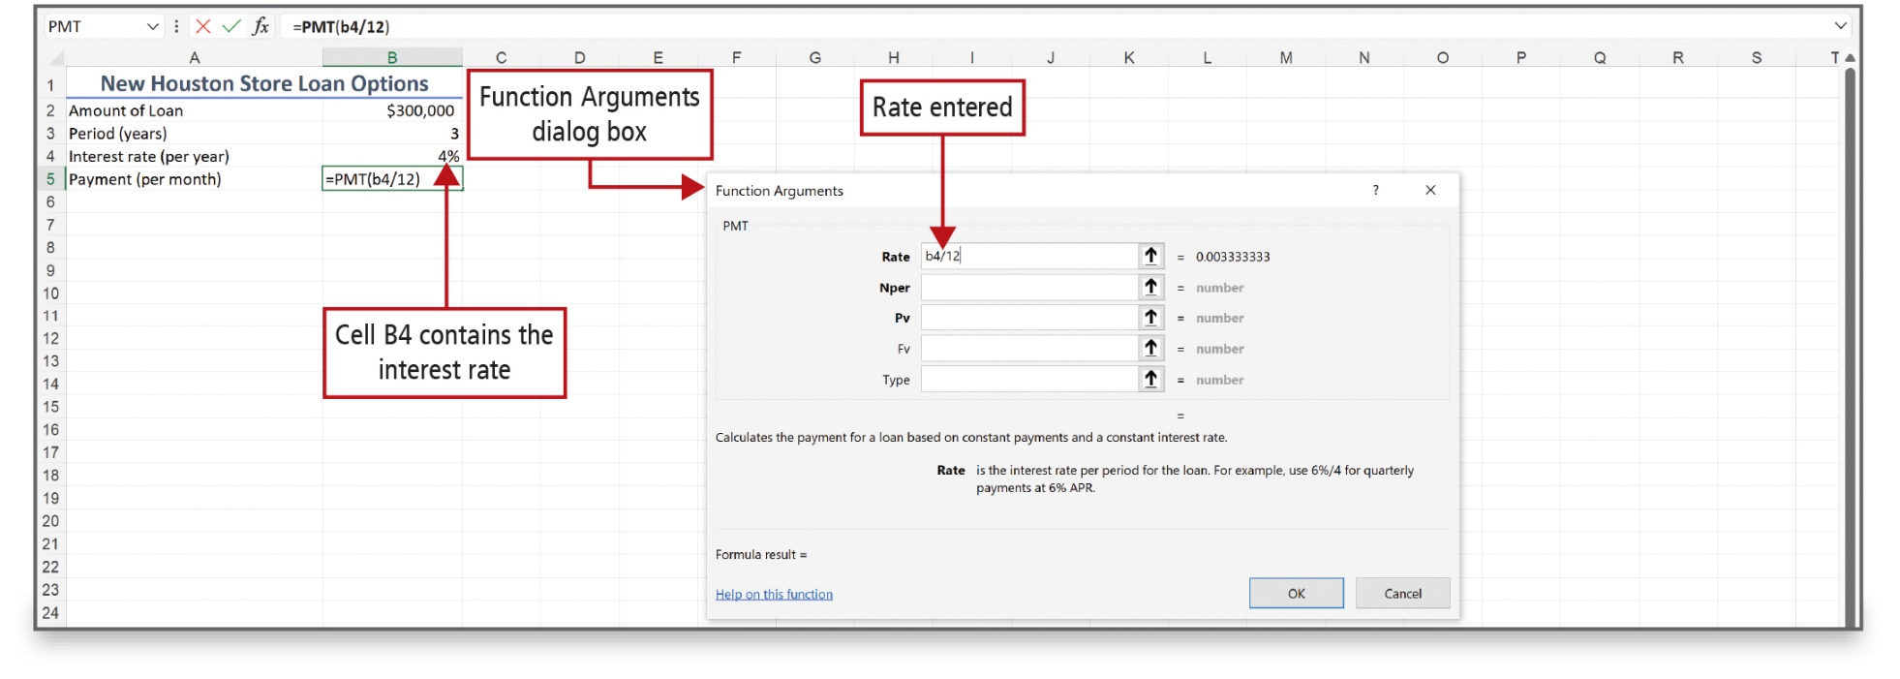
Use Financial Functions (2 of 3)
Notes:
The PMT function calculates the payment for a loan based on constant payments and at a constant interest rate.

Slide 6
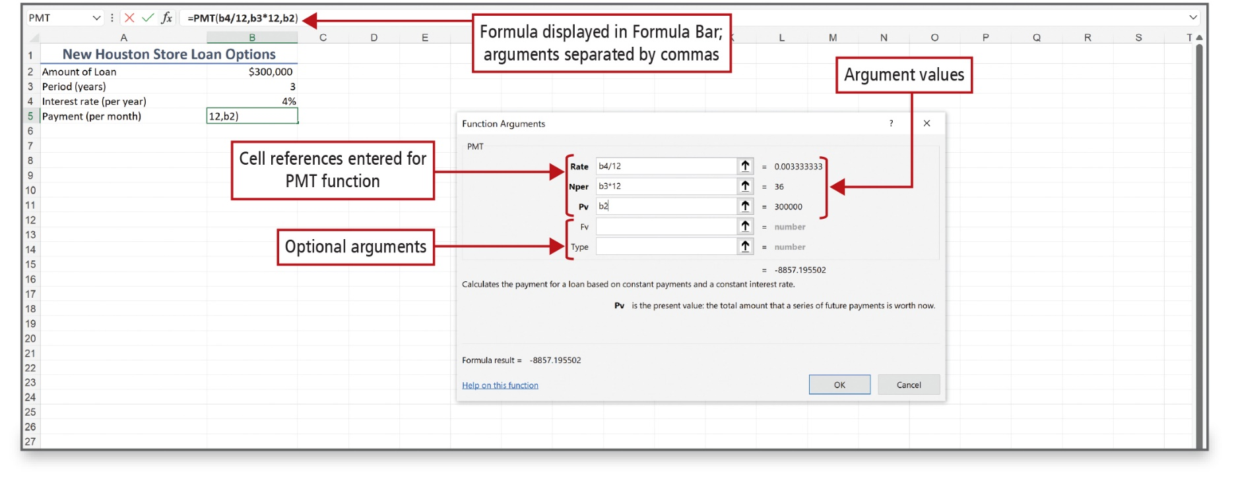
Use Financial Functions (3 of 3)
Notes:
The payment amount, using the PMT function, displays in cell B5 in this example.
Alt Text: In the dialog box, optional arguments; Fv and Type are blank and cell references entered for the PMT function are as follows:
• Rate: b4 forward slash 12; equals 0.003333333 (Argument value).
• Nper: b3 asterisk 12; equals 36 (Argument values).
• Pv: b2; equals 300000 (Argument values).
In the Excel sheet, the Formula displayed in Formula Bar shows arguments are separated by commas. The formula reads as equals capital P capital M capital T open parenthesis b4 forward slash 12 comma b3 asterisk 12 comma b2 close parenthesis.

Slide 7
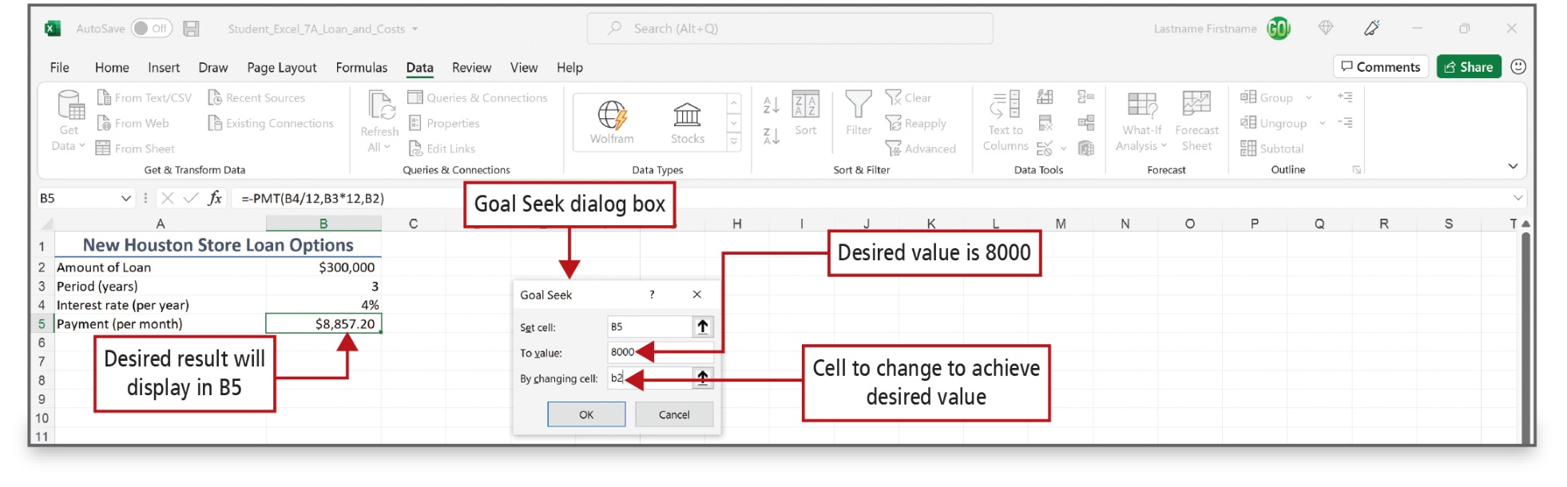
Use Goal Seek (1 of 2)
Notes:
What-If Analysis is a process of changing the values in cells to determine how those changes affect the outcome of formulas on the worksheet. Goal Seek, as shown on this slide, is a What-If Analysis data tool that seeks to find a specific value for a cell by adjusting the value of another cell.
Alt Text: In the Excel sheet, the desired result is displayed in B5 that reads as 8,857.20 dollars.
In the dialog box, the desired value is 8000 (entered in the “to value” box), and the cell to change to achieve desired value is b2 (entered in the “By changing cell” box).

Slide 8
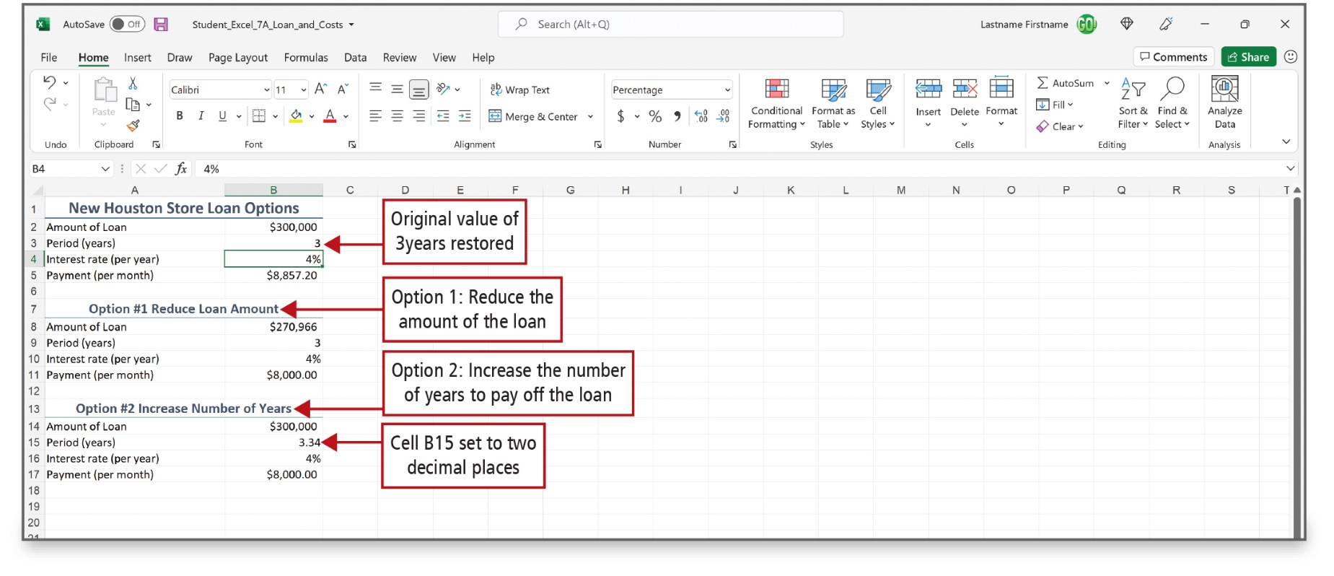
Use Goal Seek (2 of 2)
Notes:
Several Goal Seek scenarios have been created for the spreadsheet that shows on this slide. Additionally, the scenarios are formatted with cell styles and number formats.
Alt Text: The original value of 3years is restored in cell B3. The title “option number 1 reduces loan amount” (row 7) is labeled as Option 1: Reduce the amount of the loan. The title “option number 2 increase number of years” (row 13) is labeled as Option 2: Increase the number of years to pay off the loan. Cell B15 set to two decimal places (3 points 34).

Slide 9
Create a Data Table (1 of 4)
Data table—shows how changing values in formulas affects the results of those formulas
  One-variable—changes the value in one cell
  Two-variable—changes the values in two cells
Notes:
A data table is a range of cells that shows how changing certain values in your formulas affects the results of those formulas. Data tables make it easy to calculate multiple versions in one operation, and then to view and compare the results of all the different variations.
A one-variable data table changes the value in only one cell. For example, a one-variable data table is used to see how different interest rates affect a monthly payment.
A two-variable data table changes the values in two cells. For example, two-variable data table is used to see how different interest rates and different payment periods will affect a monthly payment.

Slide 10
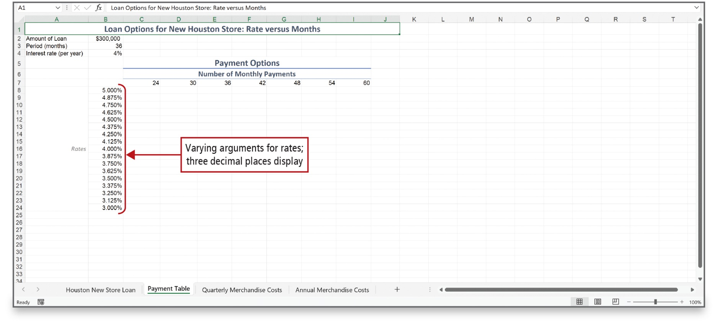
Create a Data Table (2 of 4)
Notes:
This spreadsheet shows the beginning of a one-variable data table. A row of the number of monthly payments is shown in row 7 with a range of possible annual interest rates shown in column B.

Slide 11
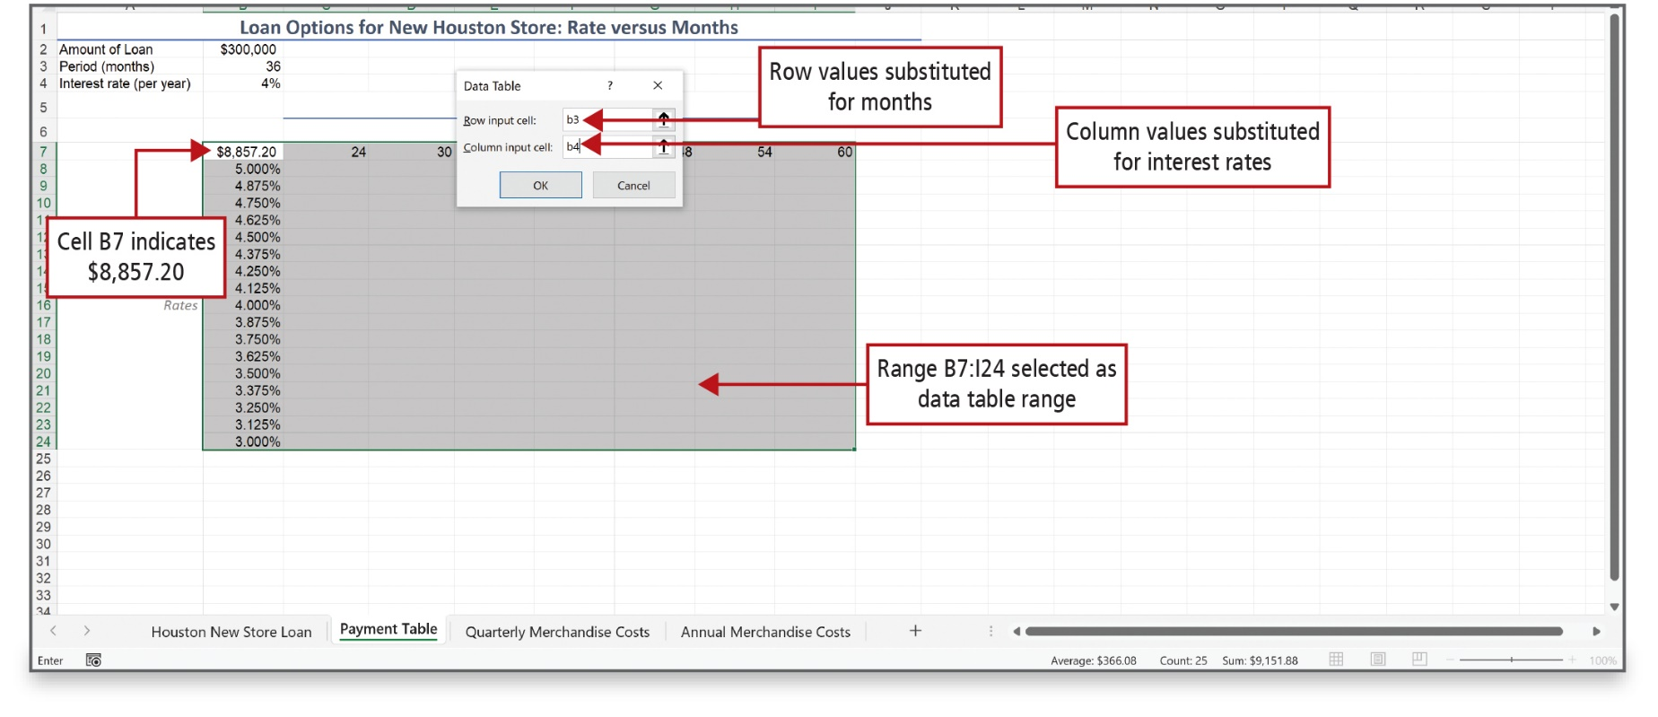
Create a Data Table (3 of 4)
Notes:
Here, the payment result displays in cell B7. After highlighting the range that encompasses all of the months and all of the rates, the Data Table tool is accessed from the Data tab and the What-If Analysis button. The Row input cell box uses cell B3, and the Column input cell box uses cell B4.
Alt Text: In the sheet, Cell B7 indicates 8,857.20 dollars. Range B7:I24 is selected as the data table range.
In the dialog box, value b3 in the “row input cell” box is labeled as row values substituted for months. Value b4 in the “column input cell” box is labeled as column values substituted for interest rates.

Slide 12
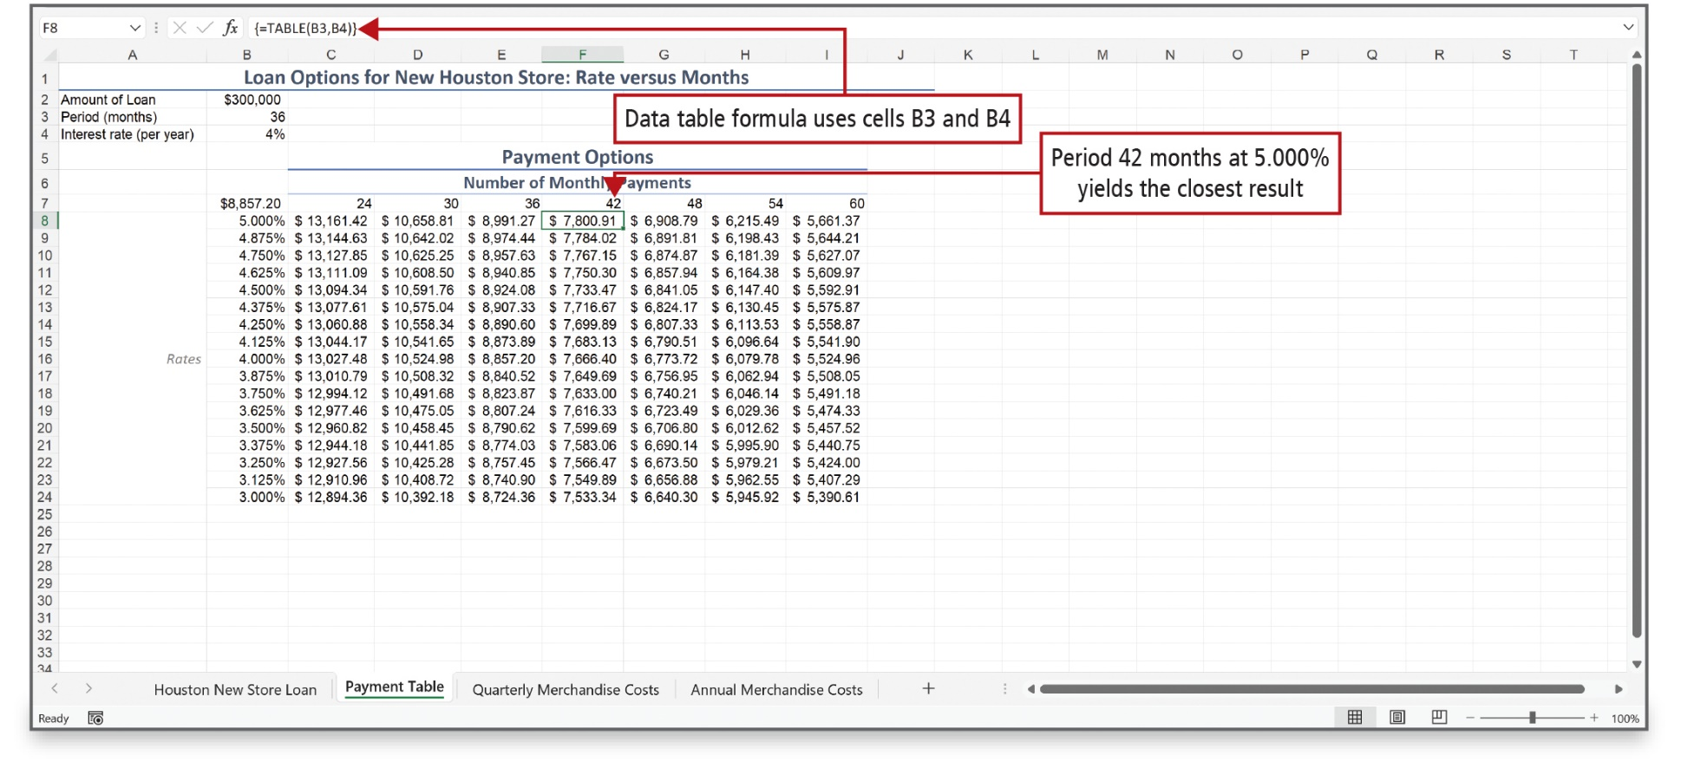
Create a Data Table (4 of 4)
Notes:
The table in this example is filled with payment options that use the month and interest rate corresponding to the position in the table. This data table offers a wide array of options to consider.

Slide 13
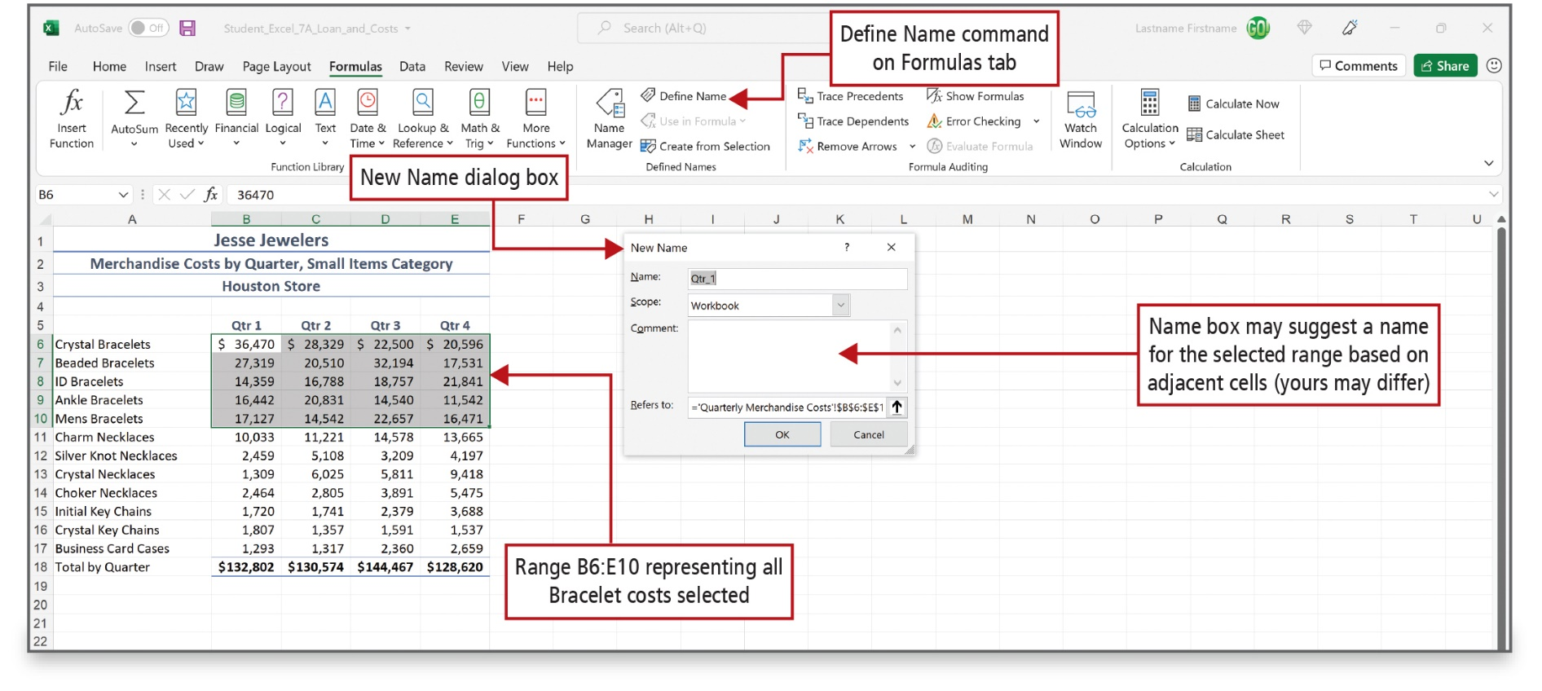
Use Defined Names in a Formula (1 of 7)
Notes:
A name, also referred to as a defined name, is a word or string of characters in Excel that represents a cell, a range of cells, a formula, or a constant value. Defined names may be used instead of a cell reference in a formula or function.
All names have a scope, the location within which the name is recognized without qualification. The name’s scope usually refers either to a specific worksheet or to an entire workbook.
Using the New Name dialog box is one way to name a cell or a range of cells.
Alt Text: In the Excel sheet, the define name command on the Formulas tab is located in the defined names section of the ribbon. Range B6:E10 representing all Bracelet costs is selected. In the dialog box comment box is dialogue box is labeled as “name box may suggest a name for the selected range based on adjacent cells (yours may differ)”.

Slide 14
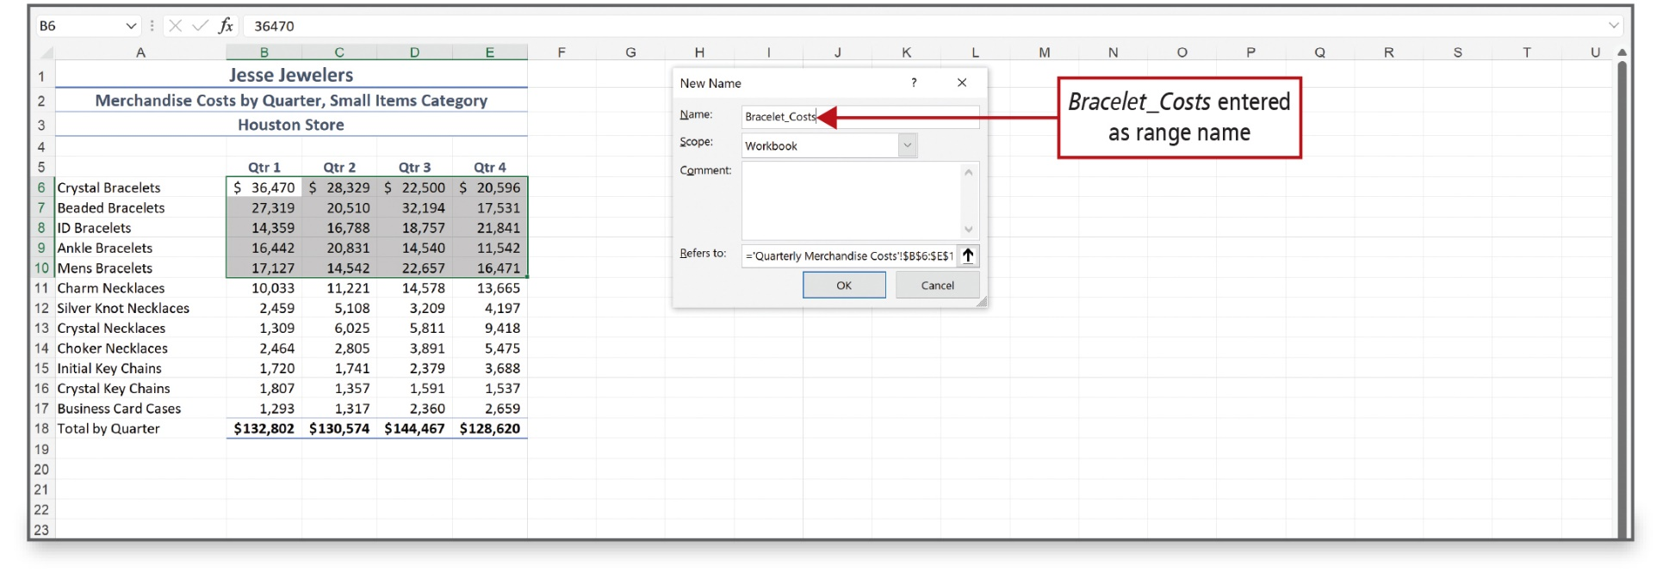
Use Defined Names in a Formula (2 of 7)
Notes:
Naming a range makes it easier to understand the meaning of a formula in a worksheet. Naming cells has no effect on the displayed or underlying values; it simply creates an easy-to-remember name to use in formulas and functions. A named range cannot contain spaces.

Slide 15
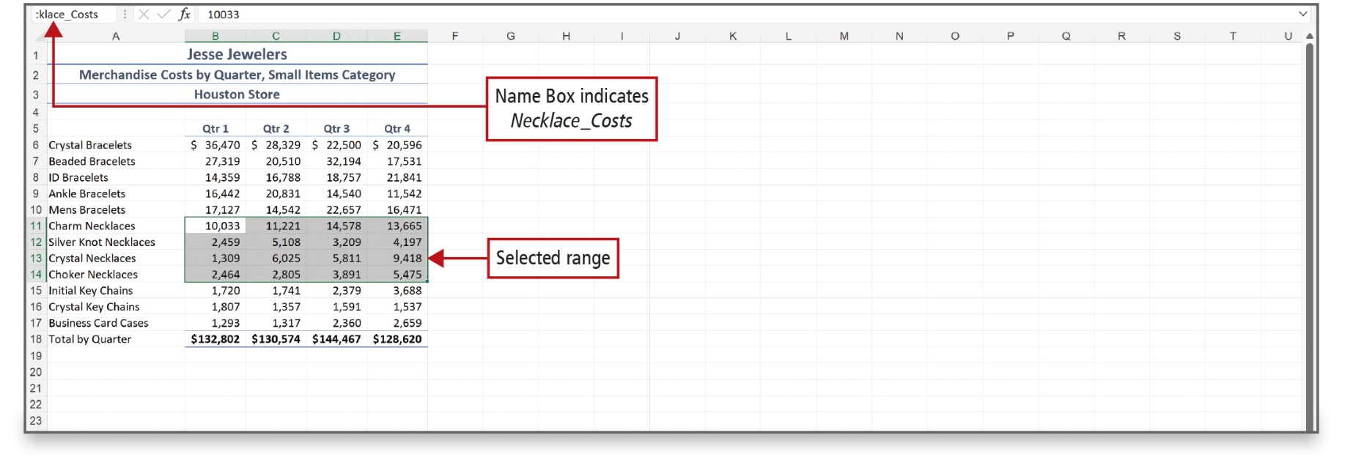
Use Defined Names in a Formula (3 of 7)
Notes:
After naming a range, click the Name box to display the named ranges that have been created in the workbook.

Slide 16
Use Defined Names in a Formula (4 of 7)
The first character of the defined name must be a letter, an underscore (_), or a backslash (\).
After the first character, the remaining characters can be letters, numbers, periods, and underscore characters.
Spaces are not valid in defined names.
The single letter C or R (uppercase or lowercase) cannot be defined as a name.
A defined name can be no longer than 255 characters.
Defined names cannot be the same as the cell reference.
Defined names can be uppercase or lowercase letters, but Excel does not distinguish between them.
Notes:
The rules for defining names are listed in this slide.

Slide 17
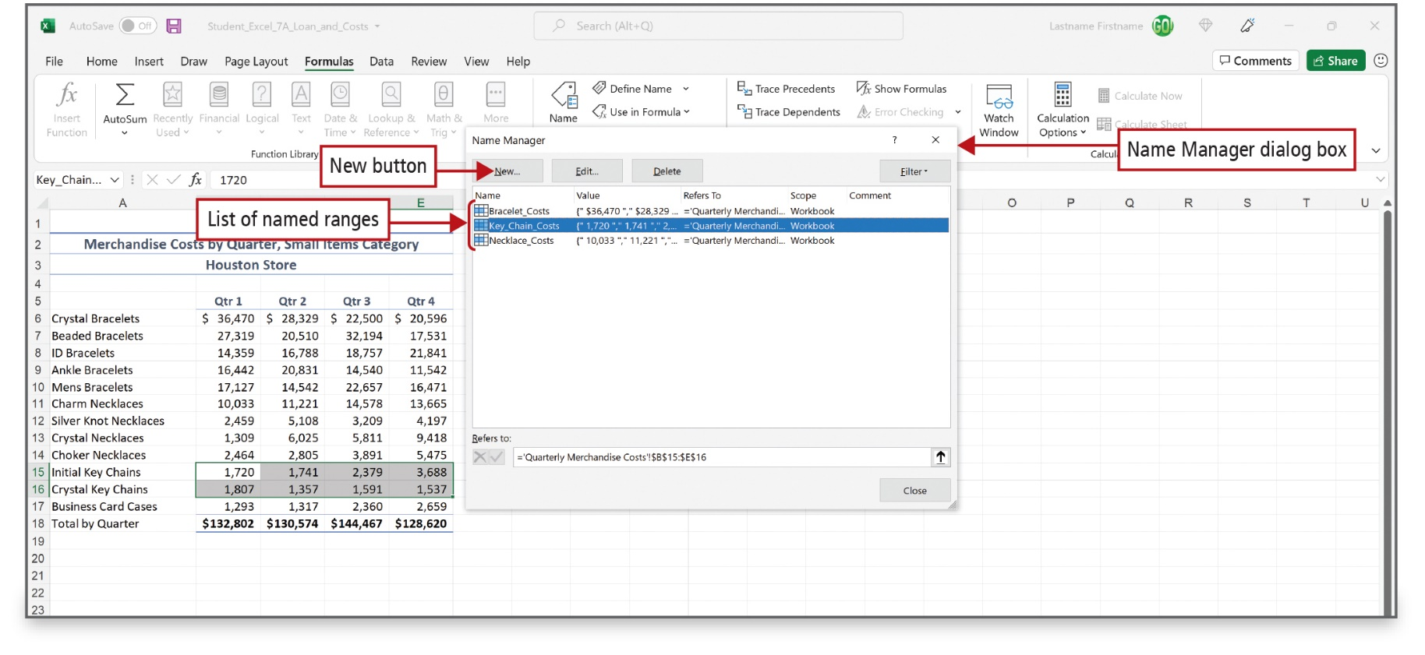
Use Defined Names in a Formula (5 of 7)
Notes:
You can also define range names in the Name Manager dialog box, accessed on the Formulas tab in the Defined Names group. The Name Manager dialog box can also be used to delete or edit a range that you have defined.

Slide 18
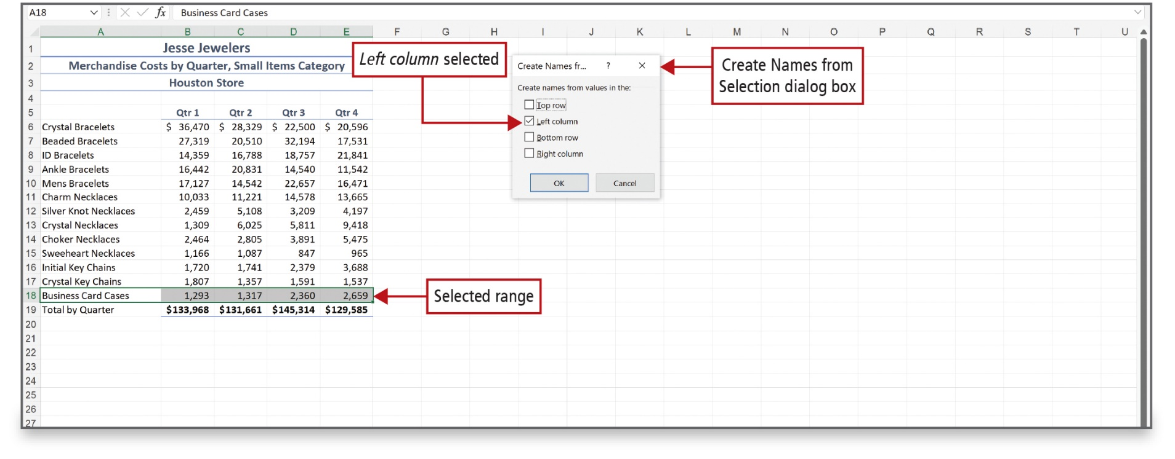
Use Defined Names in a Formula (6 of 7)
Notes:
You can use the Create from Selection command to name a range of cells based on existing row or column titles. With this method, Excel uses the text of the first cell to the left of the selected range as the range name and then formats the name properly.
Alt Text: In the dialog box, from the ‘create names from values in the options, the left column option is selected. In the excel sheet, under the table titled ‘Jesse jewelers’ “business card cases range” (row 18) is selected.

Slide 19
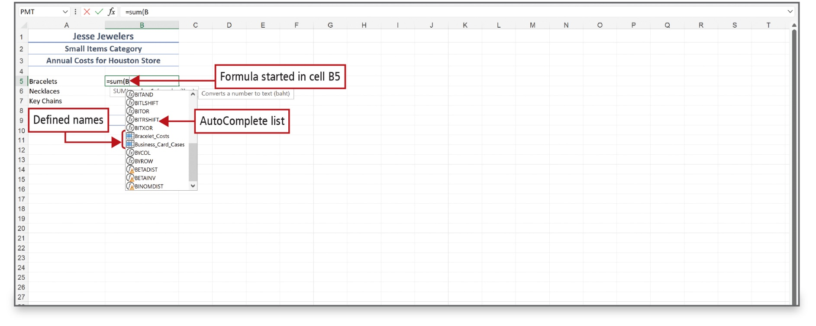
Use Defined Names in a Formula (7 of 7)
Notes:
When you start to type a formula in a cell, the Formula AutoComplete list displays. The Formula AutoComplete list contains all of Excel’s built-in functions that begin with the letter that you’ve typed as well as all named ranges that begin with that letter.
Alt Text: The text in cell B5 reads as “equals sum open parenthesis B” and is labeled as “Formula started in cell B5”. A pane of AutoComplete list is displayed below cell B5. Two components from the list named ‘bracelet underscore costs’ and ‘business underscore card underscore cases’ are labeled as “defined names”.

Slide 20
Use Lookup Functions (1 of 4)
VLOOKUP arguments
  —value to search in the first column
  of the table array
  —range that contains the data
  —column number in table array
  containing the result
Notes:
Lookup functions look up a value in a defined range of cells known as the table array.
The VLOOKUP function looks up values in a table array arranged as vertical columns. The function searches the first column of the table array for a corresponding value, and then returns a value from any cell on the same row.
The HLOOKUP function looks up values in a table array arranged in horizontal rows. The function searches the top row of the table array for a
corresponding value, and then returns a value from any cell in the same column.
For the VLOOKUP function, the values must be sorted on the first column in ascending order. For the HLOOKUP function, the values must be sorted on the first row in ascending order.
The arguments for the VLOOKUP function include:
Lookup_value, which is the value to search in the first column of the table array
Table_array, which is the range that contains the data
Col_index_num, which is the column number (1, 2, 3, and so on) in the table array that contains the result you want to retrieve from the table

Slide 21
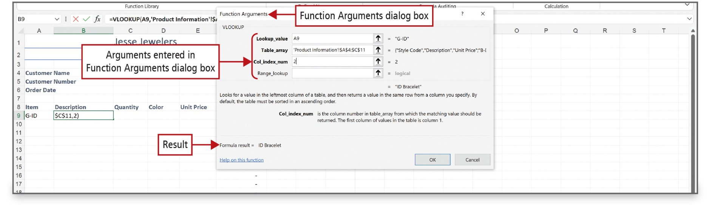
Use Lookup Functions (2 of 4)
Notes:
The Function Arguments dialog box is used to enter the lookup function arguments.
Alt Text: Arguments entered in the Function Arguments dialog box reads as follows: Lookup_value: A9; Table_array: ‘Product information Exclamation mark $A$4:$C$11; Col_index_num: 2; Range_lookup: blank. The result displayed at the bottom left corner reads as “formula result equals ID bracelet”.

Slide 22
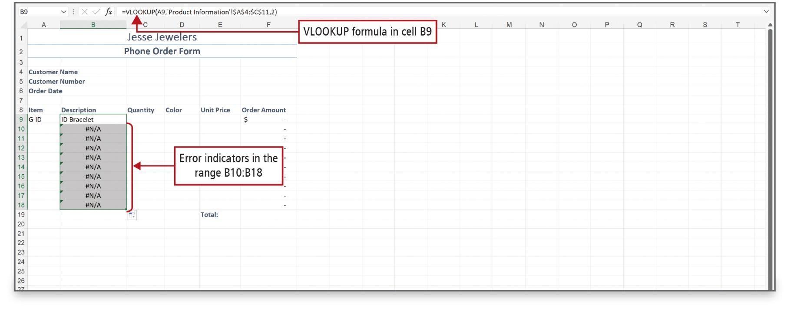
Use Lookup Functions (3 of 4)
Notes:
The VLOOKUP results show in row 9, but rows 10-18 show the #N/A error notation because no values have been entered in column A to perform calculations.
Alt Text: The formula reads as “equals VLOOKUP open parenthesis A9 comma single quote Product information single quote exclamation mark dollar A dollar 4 is to dollar C dollar 11 comma 2 close parenthesis”. Cell B9 reads as “ID Bracelet”. The error indicators read as ‘hashtag N forward-slash A’. A green-colored arrow is displayed at the top left corners of the cells B10 to B18.

Slide 23
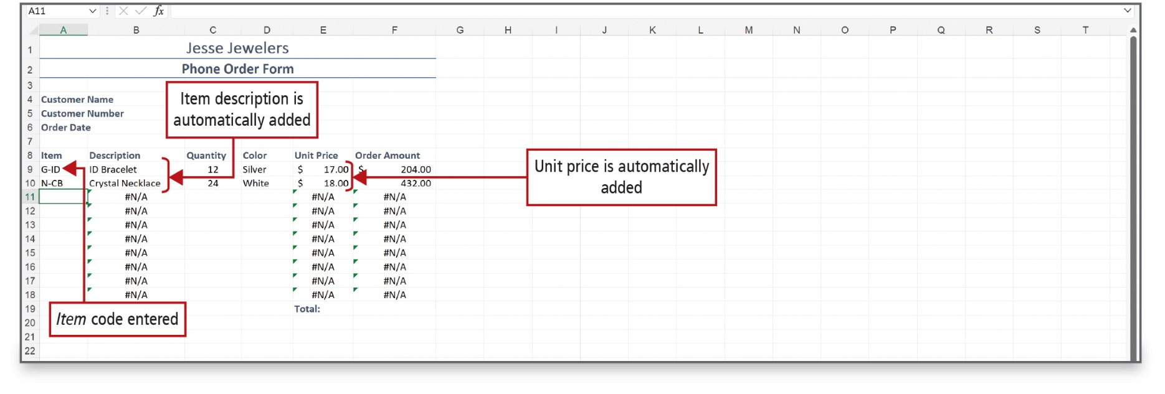
Use Lookup Functions (4 of 4)
Notes:
This example shows an entry in cell A10 and, therefore, the rest of the data in row 10 is filled in automatically.

Slide 24
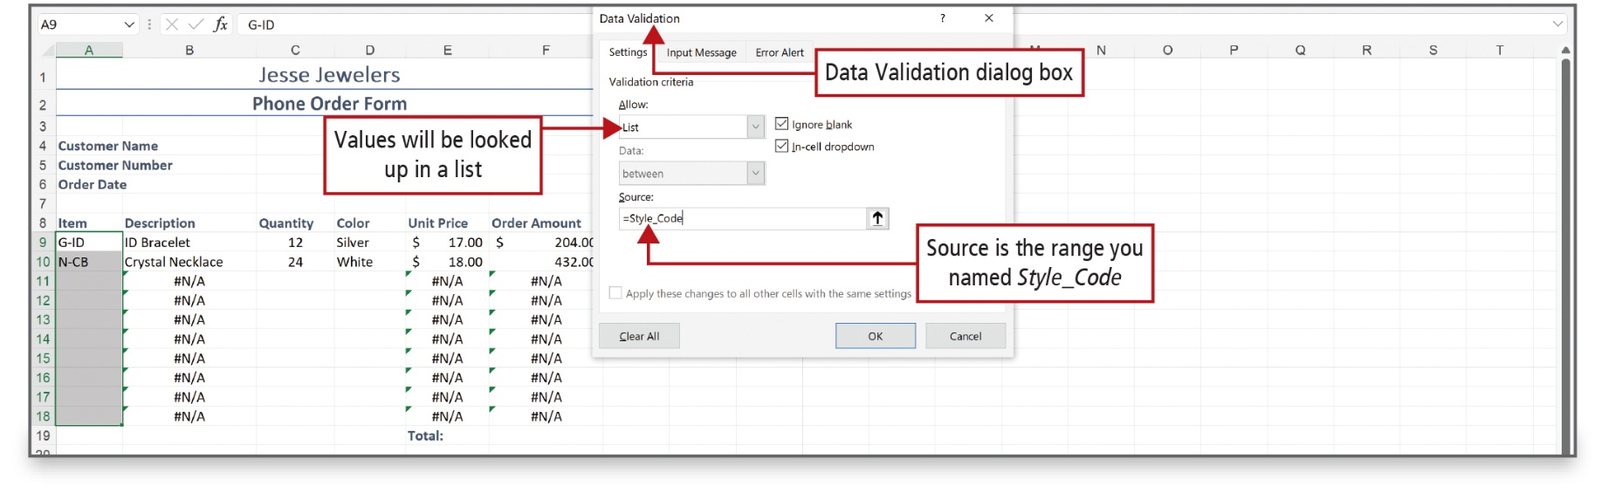
Validate Data (1 of 2)
Notes:
Data validation is technique to improve accuracy. Data validation is a technique in which you control the type of data or the values that are entered into a cell. A validation list—a list of values that are acceptable for a group of cells—is one way to control the type of data that is entered.
The Data Validation dialog box is used to enter the validation criteria.
Alt Text: The dialog box shows three tabs for settings (active), input message, and error alert. Under the “allow” validation criteria, ‘list’ is selected and labeled as ‘Values will be looked up in a list’ and under the “source” validation criteria ‘equal to style underscore code’ is entered and labeled as ‘Source is the range you named Style_Code’.

Slide 25
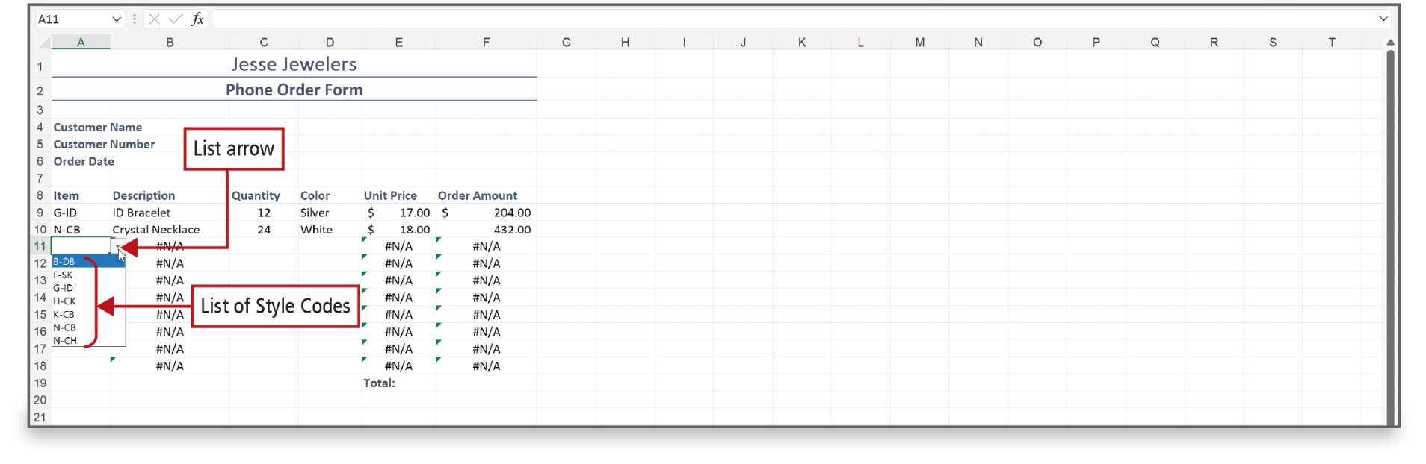
Validate Data (2 of 2)
Notes:
Clicking the List arrow displays the validation list that was entered in the Data Validation dialog box. An error message displays if a value is entered that is not valid.

Slide 26
Audit Worksheet Formulas (1 of 9)
Formula Auditing features—tools and commands that check for errors
  Precedent cells—cells referred to by a formula in another cell
  Trace Precedents—indicates cells that affect the values of the selected cell
  Dependent cells—cells that contain formulas that refer to other cells
  Trace Dependents—indicates what cells are affected by the value of the currently selected cell
Notes:
Auditing is the process of examining a worksheet for errors in formulas. Formulas are equations that perform calculations on values in your worksheet.
Formula Auditing features are tools and commands that help you check for errors.
Precedent cells are cells that are referred to by a formula in another cell.
The Trace Precedents command displays arrows that indicate what cells affect the values of the cell that is selected.
Dependent cells are cells that contain formulas that refer to other cells—they depend on the values of other cells to display a result.
The Trace Dependents command displays arrows that indicate what cells are affected by the value of the currently selected cell.

Slide 27
Audit Worksheet Formulas (2 of 9)
Cannot see data
Cannot divide by zero
Does not recognize a name used in a formula
Cannot use a text field in a formula
Cannot locate the reference
No value is available
Invalid argument in a worksheet function
No common cells
Notes:
This slide displays many of Excel’s common error values. An error value is the result of a formula that Excel cannot evaluate correctly.

Slide 28
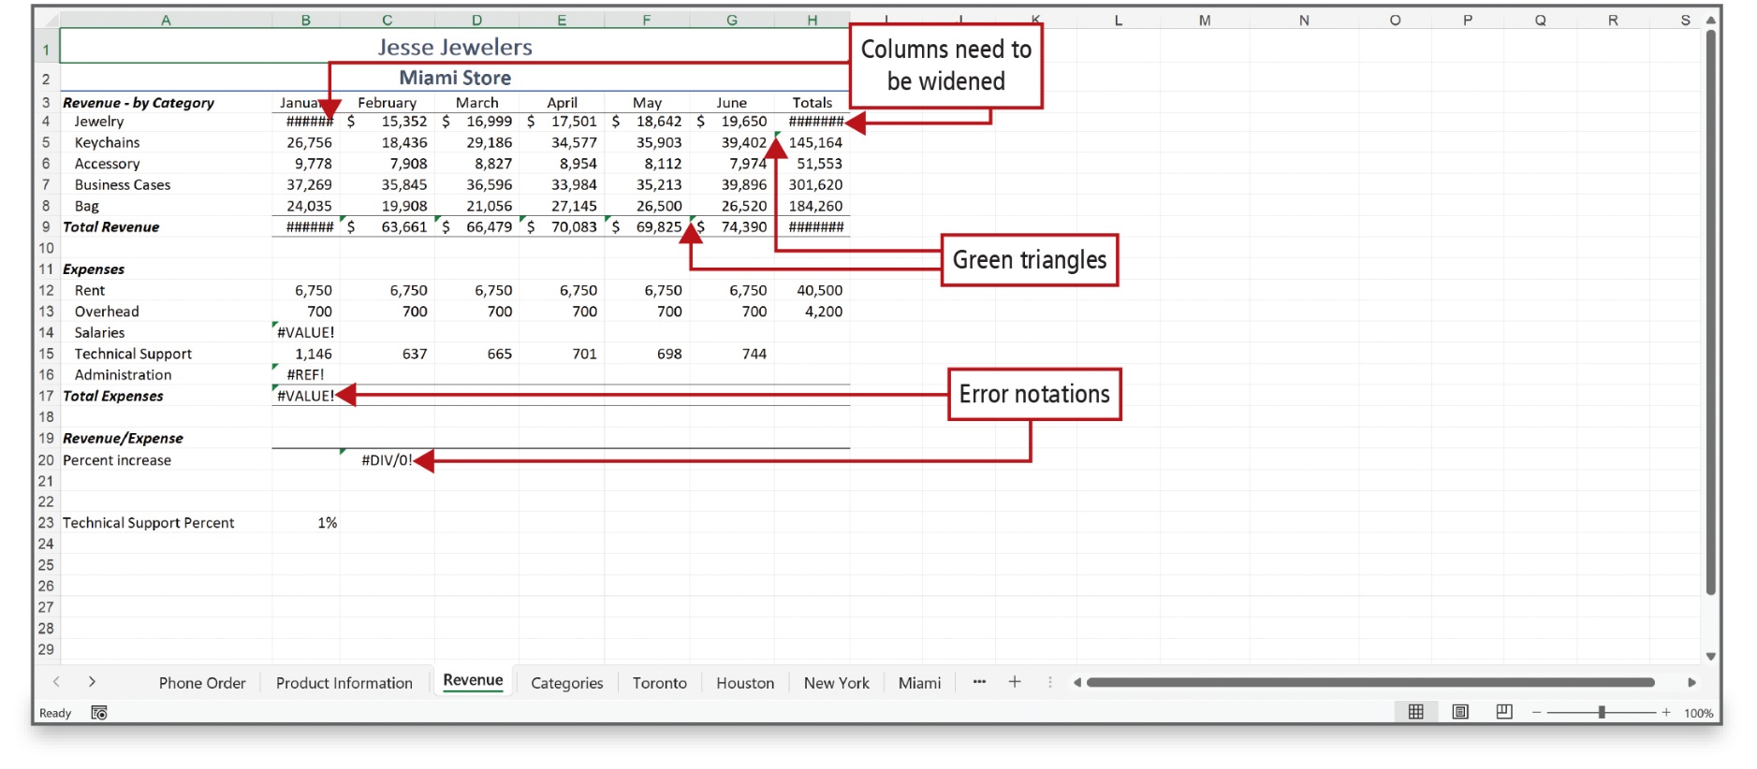
Audit Worksheet Formulas (3 of 9)
Notes:
In the worksheet, several error notations are present (hashtag VALUE exclamation mark, hashtag REF exclamatory mark, hashtag DIV/0 exclamatory mark), green triangles display in the top left corners of several cells indicating a potential error, and two columns are too narrow to fit the data, which Excel indicates by displaying pound signs—hashtag hashtag hashtag hashtag.
Alt Text: Row 1 and 2 of the sheet display the texts “Jesse Jewelers” and “Miami store” respectively. Column A shows titles such as ‘revenue by category, total revenue, expenses, and so on. The corresponding data is displayed in columns B to H in tabular format. The text corresponding to the ‘jewelry’ category for ‘January’ in cell B4 reads as ‘hashtag hashtag hashtag hashtag hashtag hashtag’ and is labeled as ‘Columns need to be widened’. Green triangles are displayed at the top left corners of the cells H5, F9, B14, B16, and B17. Error notations for total expenses in B17 read as “hashtag VALUE exclamatory mark” and that for percent increase in C 20 reads as “hashtag D I V forward slash 0 exclamatory mark”.

Slide 29
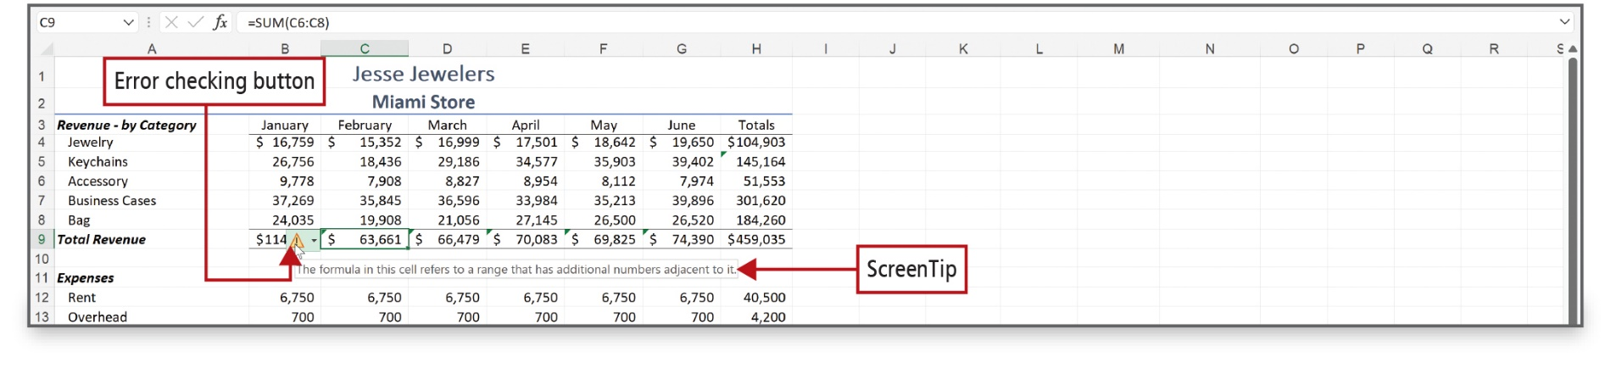
Audit Worksheet Formulas (4 of 9)
Notes:
Clicking the Error checking button displays a ScreenTip detailing the error.

Slide 30
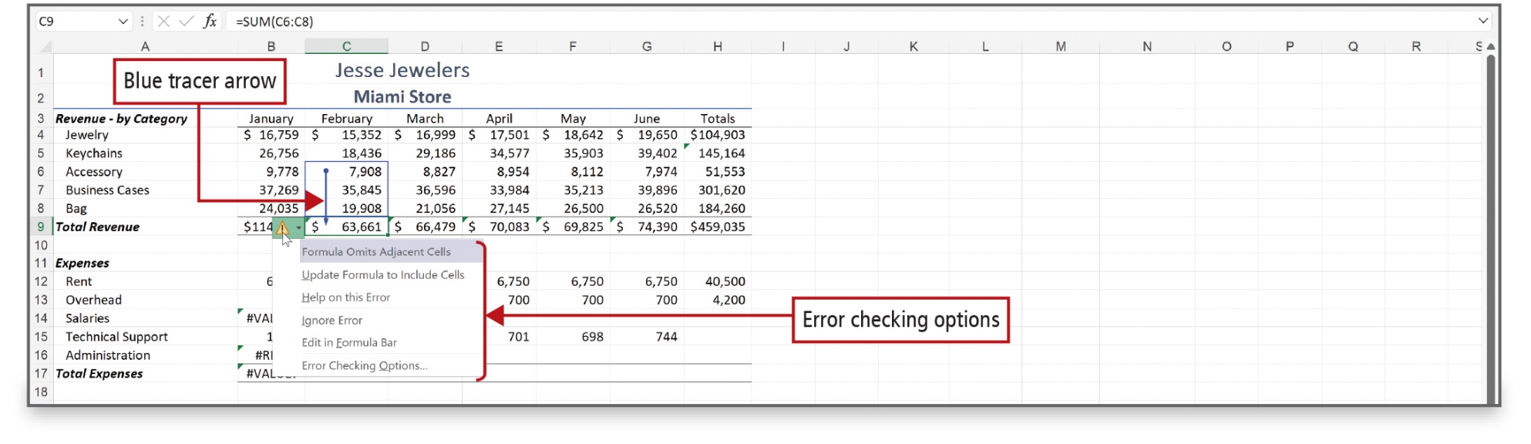
Audit Worksheet Formulas (5 of 9)
Notes:
This example shows the use of the Trace Precedents command, where a blue tracer arrow, displays from C6:C8, pointing to the selected cell C9. A tracer arrow shows the relationship between the active cell and its related cells. Tracer arrows are blue when pointing from a cell that provides data to another cell.

Slide 31
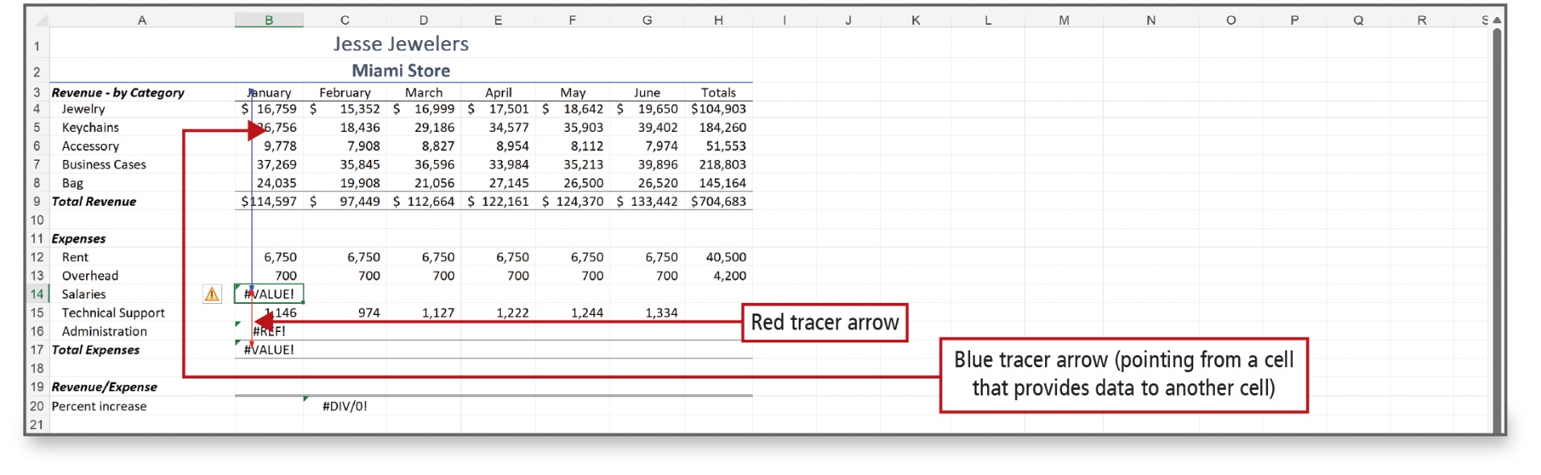
Audit Worksheet Formulas (6 of 9)
Notes:
This example shows the use of the Trace Dependents command, where a red tracer arrow displays, showing that the formula in cell B17 depends on the result of the formula in cell B17. Tracer arrows are red if a cell contains an error value, such as #VALUE!.

Slide 32
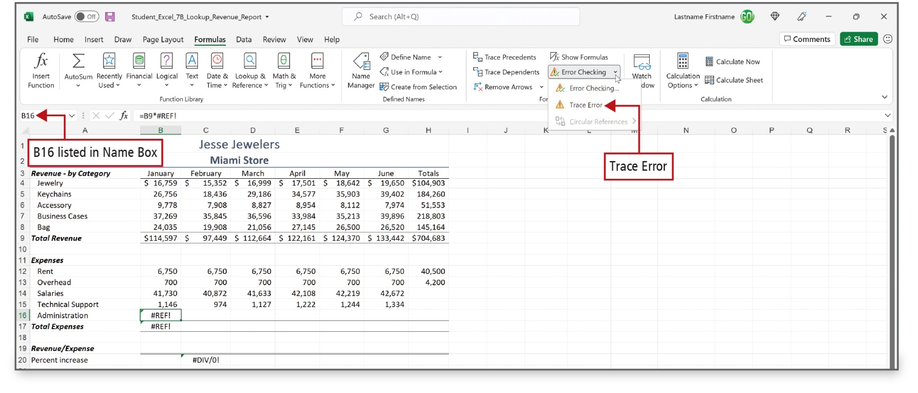
Audit Worksheet Formulas (7 of 9)
Notes:
The Trace Error command helps to locate and resolve errors in worksheets. This command can help trace a selected error values such as #VALUE, #REF, #NAME, and #DIV/0!.

Slide 33
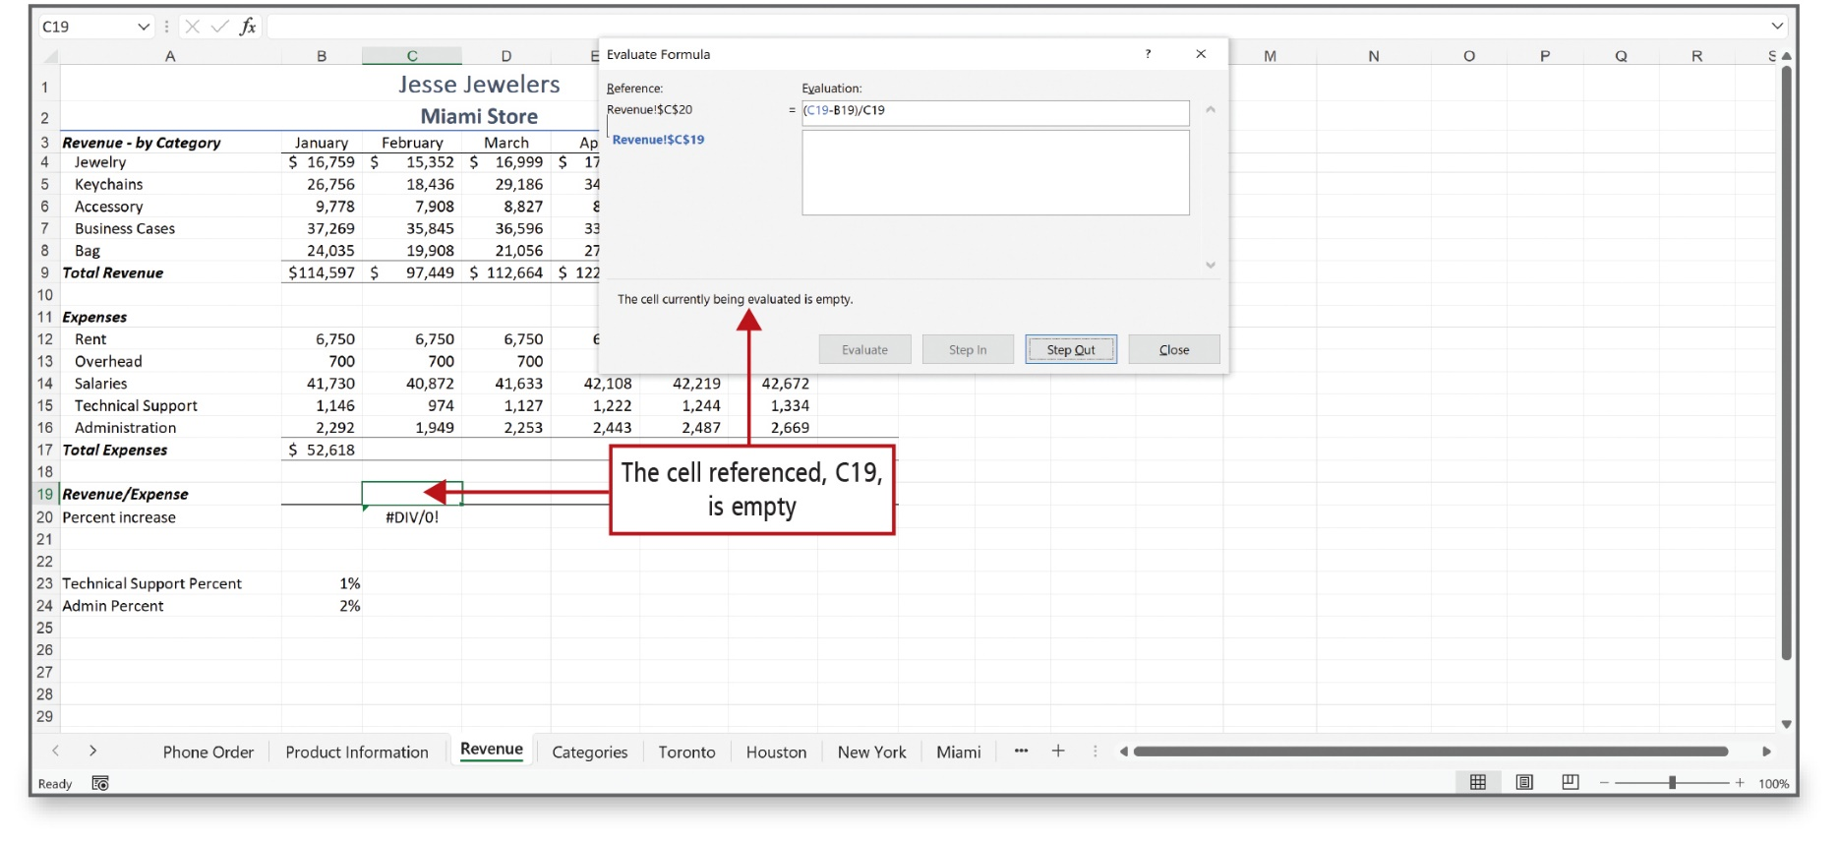
Audit Worksheet Formulas (8 of 9)
Notes:
The Error Checking command checks for common errors that occur in formulas. It is like checking for spelling; that is, the command uses a set of rules to check for errors in formulas.
Alt Text: Cell C19 is active. The text displayed at the end of the dialog box reads as “the cell currently being evaluated is empty”. This text and cell C19 are both labeled as ‘the cell referenced, C19, is empty’.

Slide 34
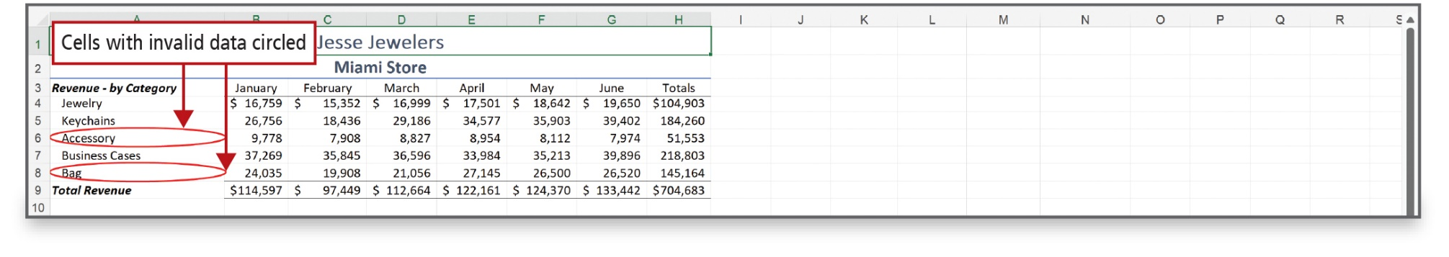
Audit Worksheet Formulas (9 of 9)
Notes:
If validation lists are used in a worksheet, then you can apply data validation and instruct Excel to circle invalid data.

Slide 35
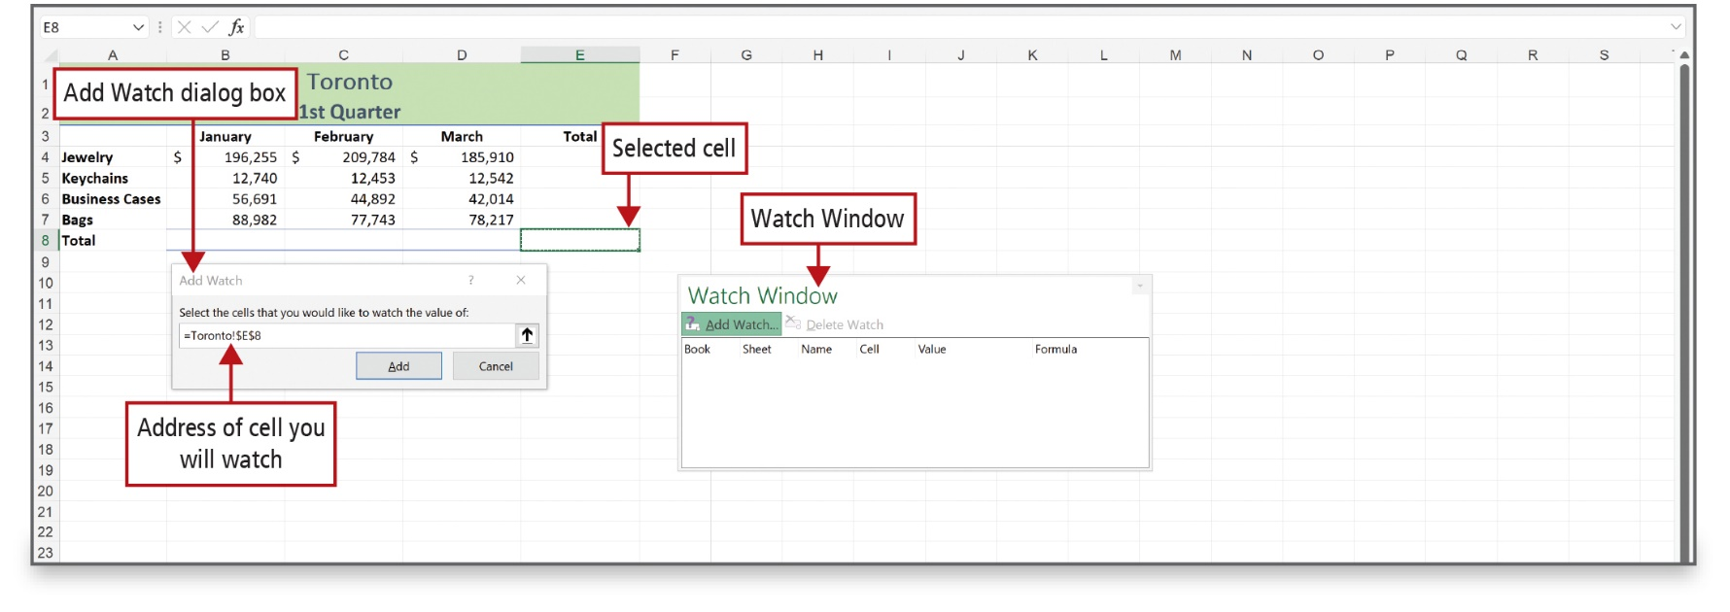
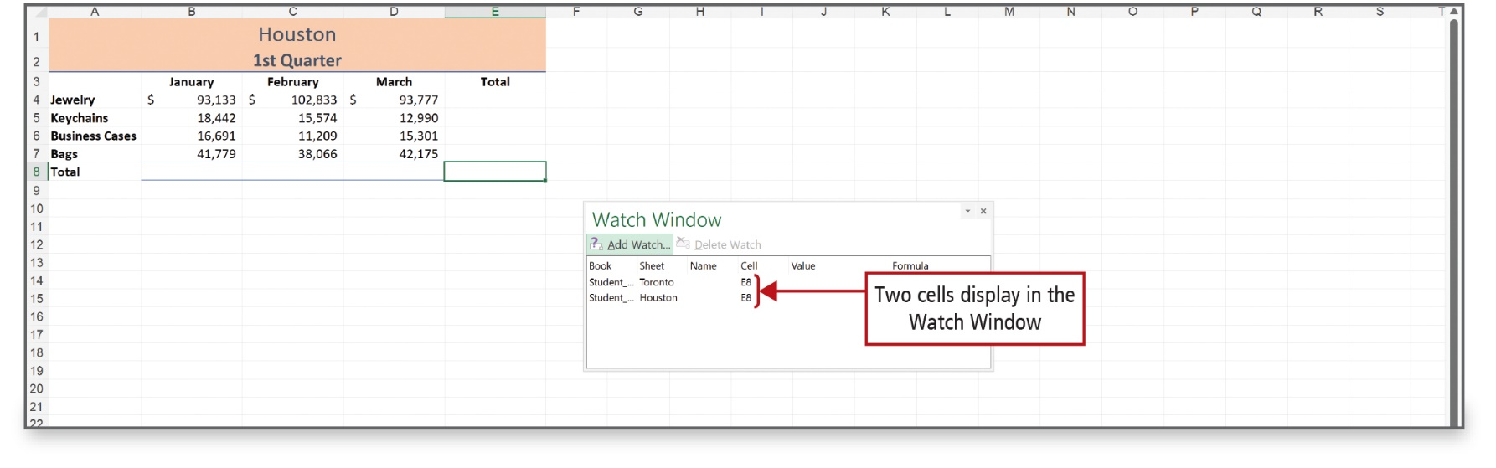
Use the Watch Window to Monitor Cell Values
Notes:
The Watch Window is a window that displays the results of specified cells. You can monitor cells in one part of a workbook while working on another part. The Watch Window can also be a helpful feature on large worksheets for which the total rows and columns are not visible on the screen with the details.
Alt Text: Cell E8 is selected. The formula in the dialog box reads as “equal to Toronto exclamatory mark dollar symbol E dollar symbol 8” and is labeled as ‘the address of the cell you will watch’. In the watch window, add watch tab is active which displays tabs for book, sheet, name, cell, value and formula.

Slide 36
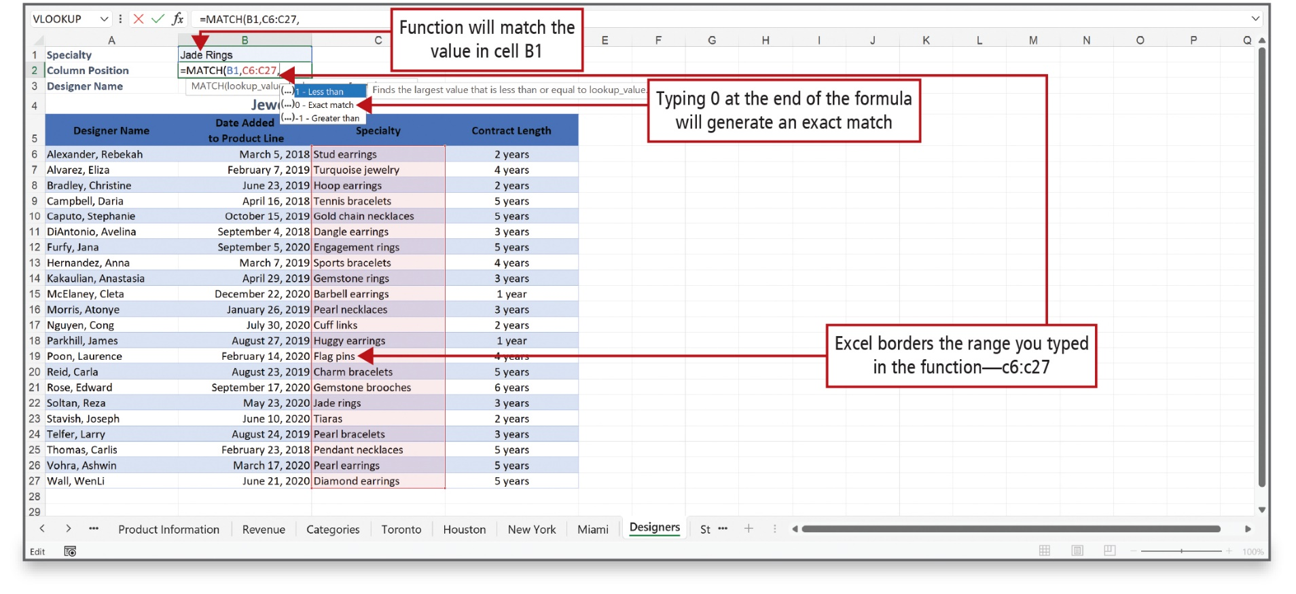
Use the MATCH, INDEX, and XLOOKUP Functions (1 of 3)
Notes:
The MATCH function is used instead of one of the LOOKUP functions when you need the position of an item in a range of cells instead of the item itself. By providing search parameters, the MATCH function indicates where in the list you can find what you are looking for.
Alt Text: The text ‘jade rings’ in cell B1 is labeled as ‘the function will match the value in cell B1’. The match function in cell B2 reads as “equal to MATCH (all capitalized) open parenthesis B1 (blue) comma C6 is to C27 (red)”. A small pane displaying a list of 1 less than, 0 exact matches, and minus 1 greater than is displayed below which is labeled as “Typing 0 at the end of the formula will generate an exact match”. Cells in range C6:C27 are surrounded by a red border and labeled as ‘Excel borders the range you typed in the function—C6:C27’.

Slide 37
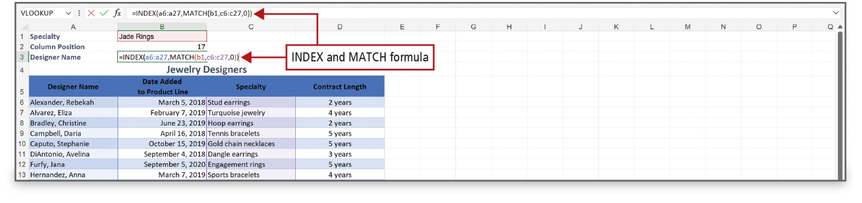
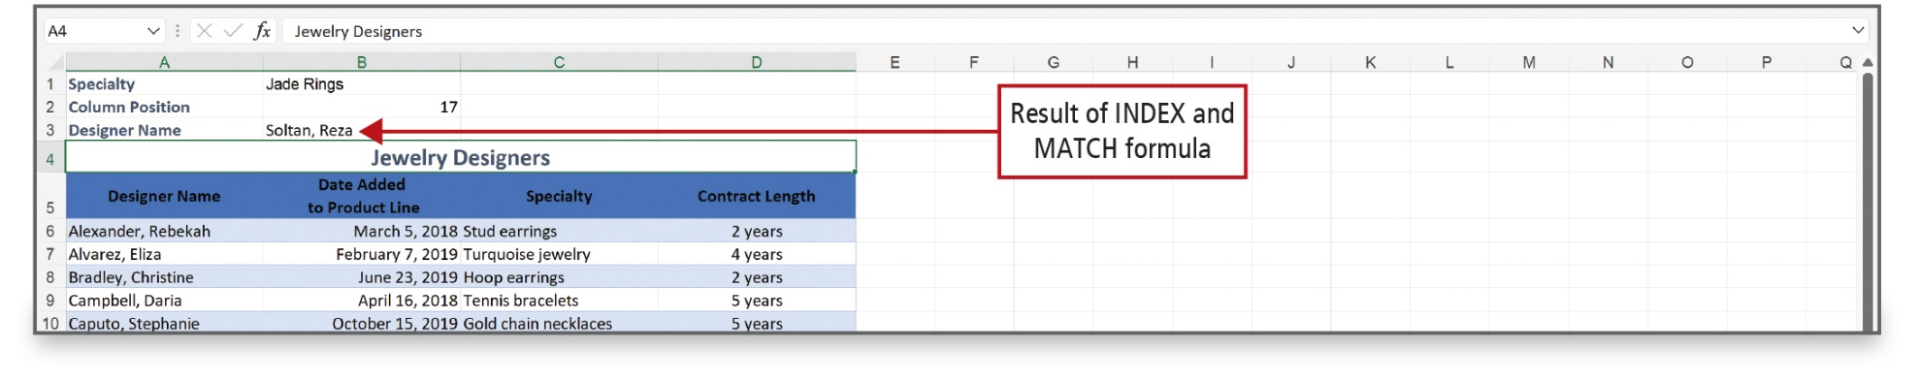
Use the MATCH, INDEX, and XLOOKUP Functions (2 of 3)
Notes:
The INDEX function is used to find a value within a table or range based on a relative row and column.
The MATCH function is commonly combined with the INDEX function. Combining the two functions enables you to find the row number and/or column number, and then use INDEX to display the value you are looking for.
Alt Text: The formula in the formula bar reads as follows: equal to INDEX (all capitalized) open parenthesis a6 is to a27 comma MATCH (all capitalized) open parenthesis b1 comma c6 is to c27 comma 0 close parentheses close parenthesis.
The formula in cell B3 reads as follows: equal to INDEX (all capitalized) open parenthesis a6 is to a27 (blue) comma MATCH (all capitalized) open parenthesis b1 (red) comma c6 is to c27 (purple) comma 0 close parenthesis (red) close parenthesis.

Slide 38
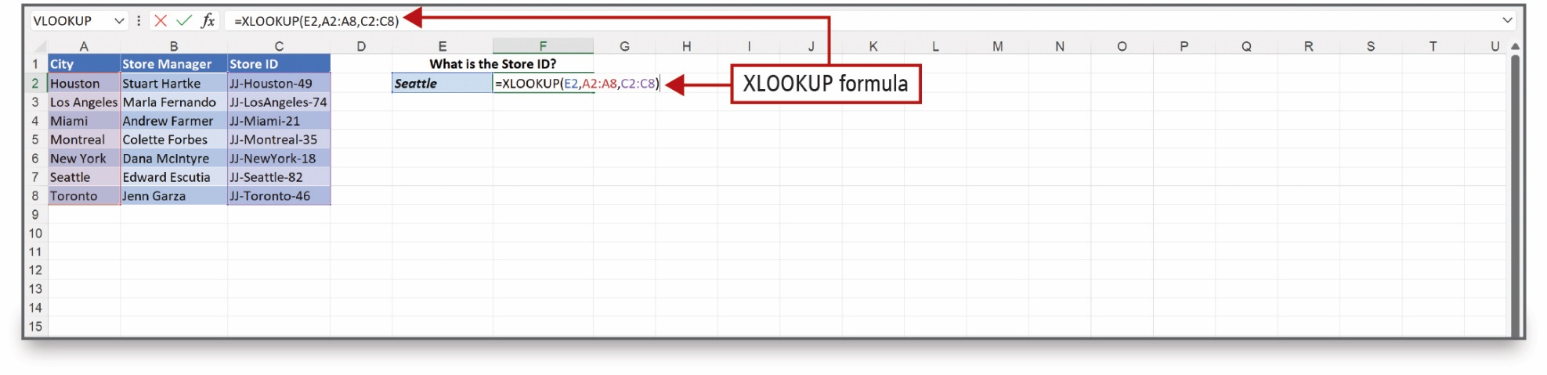
Use the MATCH, INDEX, and XLOOKUP Functions (3 of 3)
Notes:
Use the XLOOKUP function to look up information in a table by row. For example, you could look up a student name based on their student ID number. You can look in one column for a search term, and then return the result from the same row in another column. To conduct a search in a table of Excel data, you may find that, as compared to VLOOKUP and INDEX/MATCH, the XLOOKUP function is more versatile.
Alt Text: The formula in the formula bar reads as follows: equal to XLOOUP (all capitalized) open parenthesis E2 comma A2 is to A8 comma C2 is to C8 close parenthesis. The formula in cell F2 reads as follows: equal to XLOOUP (all capitalized) open parenthesis E2 (blue) comma A2 is to A8 (red) comma C2 is to C8 (purple) close parenthesis.

Slide 39

Questions

Slide 40

Copyright
This work is protected by United States copyright laws and is provided solely for the use of instructors in teaching their courses and assessing student learning. Dissemination or sale of any part of this work (including on the World Wide Web) will destroy the integrity of the work and is not permitted. The work and materials from it should never be made available to students except by instructors using the accompanying text in their classes. All recipients of this work are expected to abide by these restrictions and to honor the intended pedagogical purposes and the needs of other instructors who rely on these materials.

