Slide 1

GO! with Microsoft 365: Excel 2021
Chapter 8
Using the Data Analysis, Solver, and Scenario Features, and Building Complex Formulas
Copyright © 2023 Pearson All Rights Reserved.
Notes:
GO! with Microsoft 365 Excel 2021, Chapter 8
In this chapter, you will learn how to use the Data Analysis, Solver, and Scenario features and how to build complex formulas.

Slide 2
Learning Objectives
Calculate a Moving Average
Project Income and Expenses
Determine a Break-Even Point
Use Solver
Create Scenarios
Use Logical Functions
Create Complex Formulas
Notes:
The objectives are:
Calculate a Moving Average
Project Income and Expenses
Determine a Break-Even Point
Use Solver
Create Scenarios
Use Logical Functions
Create Complex Formulas

Slide 3
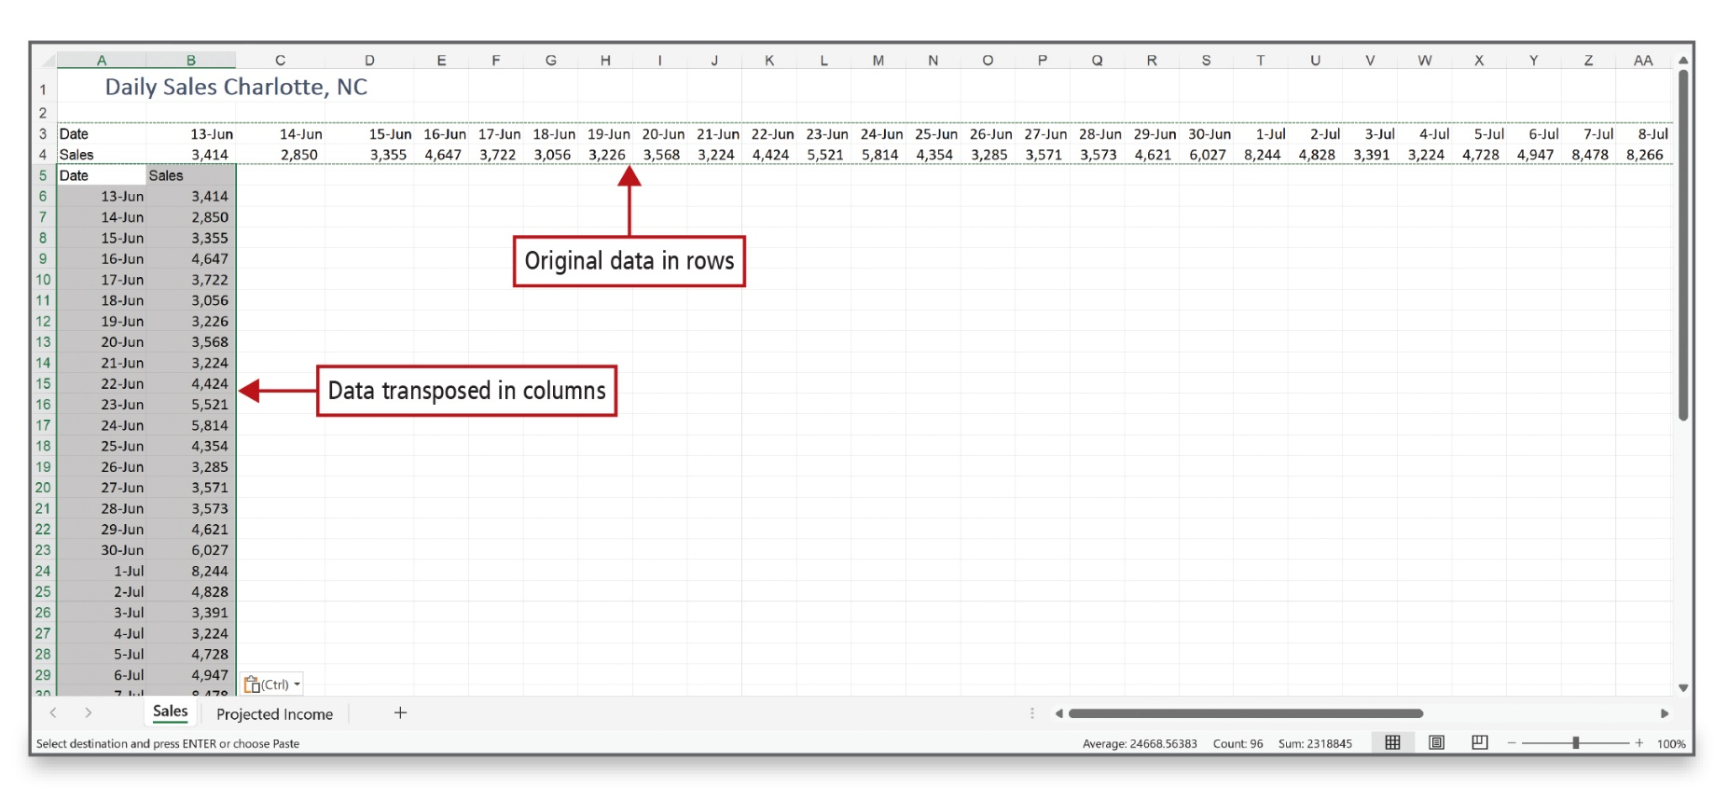
Calculate a Moving Average (1 of 6)
Notes:
Excel offers Data Analysis tools, which range from basic to very sophisticated, to help you project future results based on past performance. One of the basic tools is a moving average, which is a sequence of averages computed from parts of a data series. In a chart, a moving average evens out the fluctuations in data, showing a pattern or trend more clearly.
On occasion, data in a worksheet may not be arranged as you need it. You can transpose or switch the data from rows to columns or vice versa.

Slide 4
Calculate a Moving Average (2 of 6)
To Display | Use This Code
Months as 1–12 | m
Months as 01–12 | mm
Months as Jan–Dec | mmm
Months as January–December | mmmm
Months as the first letter of the month | mmmmm
Days as 1–31 | d
Days as 01–31 | dd
Days as Sun–Sat | ddd
Days as Sun–Sat | dddd
Years as 00–99 | yy
Years as 1900–9999 | yyyy
Notes:
You can customize numbers or dates when the available options do not match your needs. The table shows date codes for customizing dates.

Slide 5
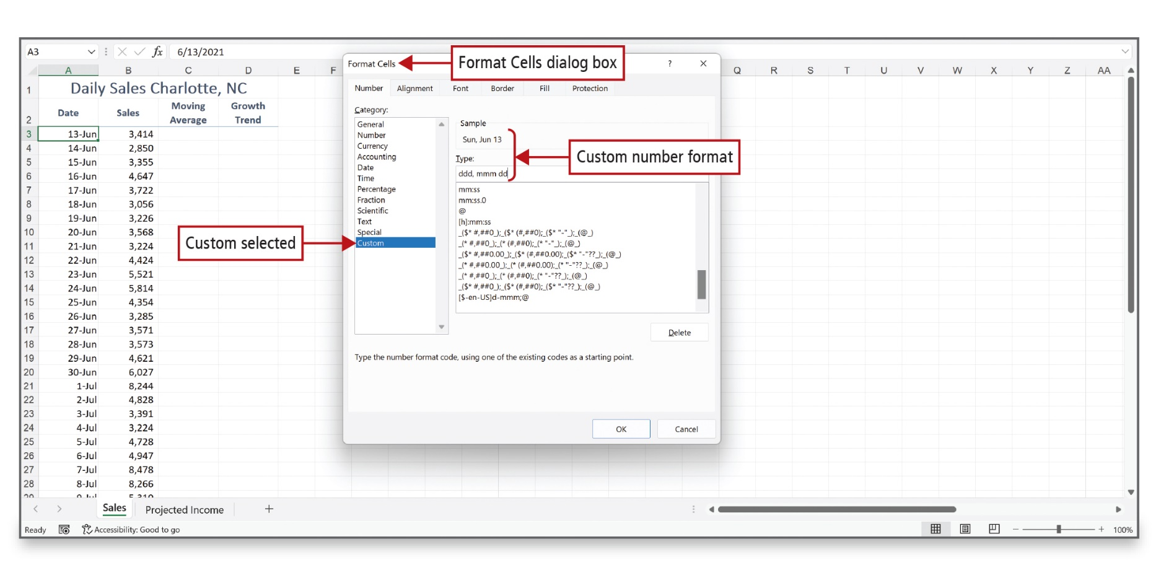
Calculate a Moving Average (3 of 6)
Notes:
The Format Cells dialog box is used to enter the custom number format.

Slide 6
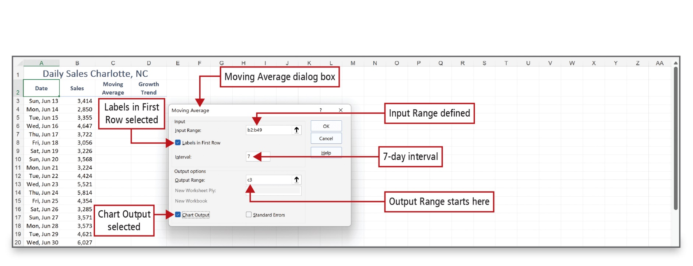
Calculate a Moving Average (4 of 6)
Notes:
When the Moving Average dialog box displays, you define the input range, the interval—the number of cells to include in the average—and the output range. The moving average will be a weekly (7 day) average of sales.
Alt Text: Input: Input Range is defined as b2 is to b49. The checkbox for ‘Labels in First Row’ is selected. 7-day interval is entered. Output: The option of ‘Chart Output’ is selected. Output Range starts here (at c3).

Slide 7
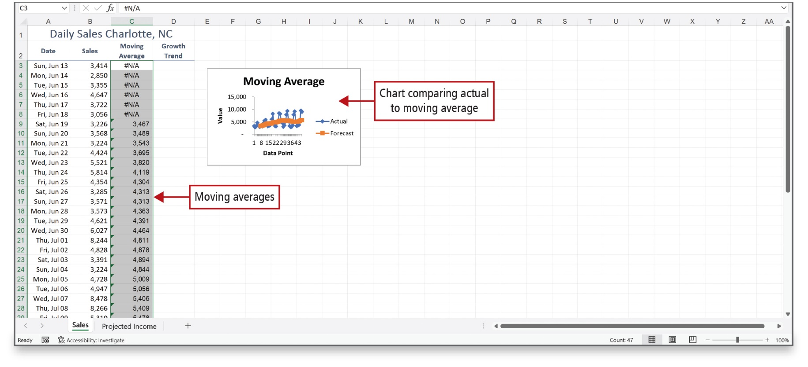
Calculate a Moving Average (5 of 6)
Notes:
The moving average displays and a chart is added to the worksheet. Note that the first six cells in column C display an error code because there were not seven numbers available to use in the average.
Alt Text: Data of moving averages in column C is selected and a chart comparing actual to moving average is displayed next to it. The x and y-axis represent value and data points respectively. The nature of the graph for actual is scattered as compared to forecast which is quite uniform.

Slide 8
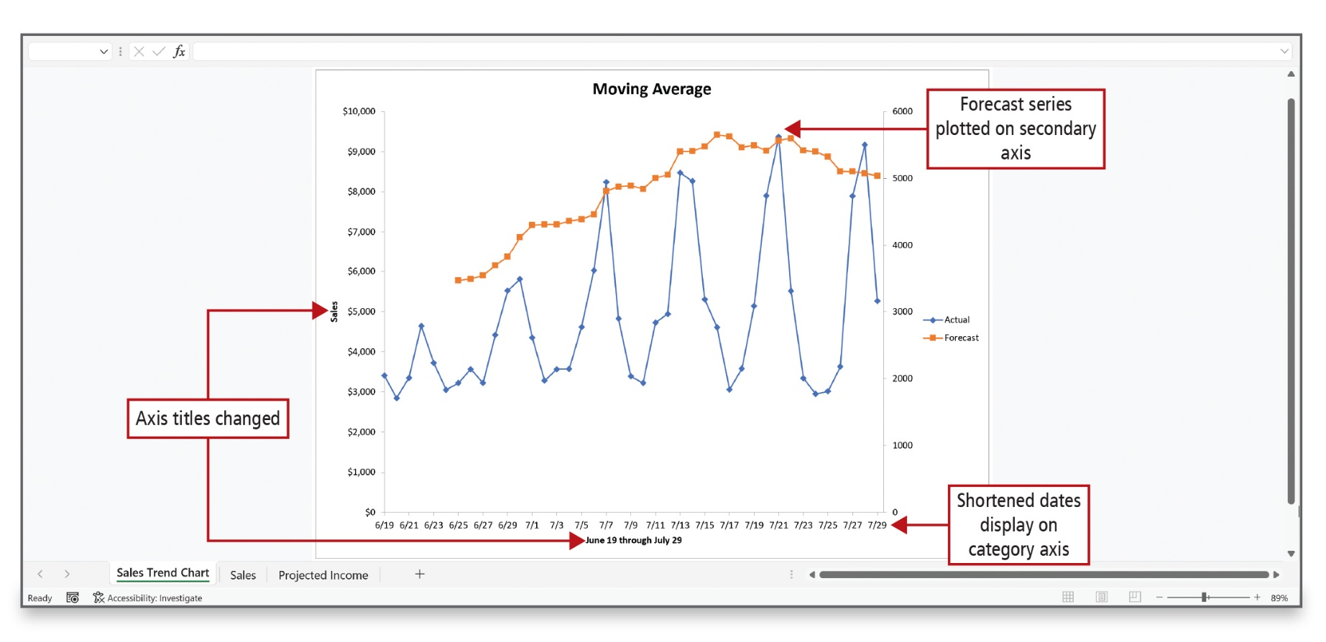
Calculate a Moving Average (6 of 6)
Notes:
A forecast is a prediction of the future, often based on past performances. To gain a clearer image of a trend—or forecast—you can modify the moving average chart, as shown here. The selected range is changed, the Horizontal Axis and Vertical Axis titles are changed and formatted, and numbers are changed to Currency with 0 decimal places. This is known as a dual-axis chart.
Alt Text: The left x-axis represents sales from 0 to 10,000 dollars an increment of 1000, the right x-axis represents values from 0 to 6000 in increment of 1000 (for 2 units) and the y-axis represents dates June 19 through July 29 from 6/19 to 7/29 with an increment of 2 years (labeled as Shortened dates display on category axis). X and y-axis are labeled as ‘Axis titles changed’. The legends to the right show blue dots represent ‘actual ‘and orange represent ‘forecast’. In the chart, the orange plot (top) shows broad peaks (wave-like) and the blue plot (bottom) shows sharp peaks. The orange plot is labeled as ‘Forecast series plotted on secondary axis’.

Slide 9
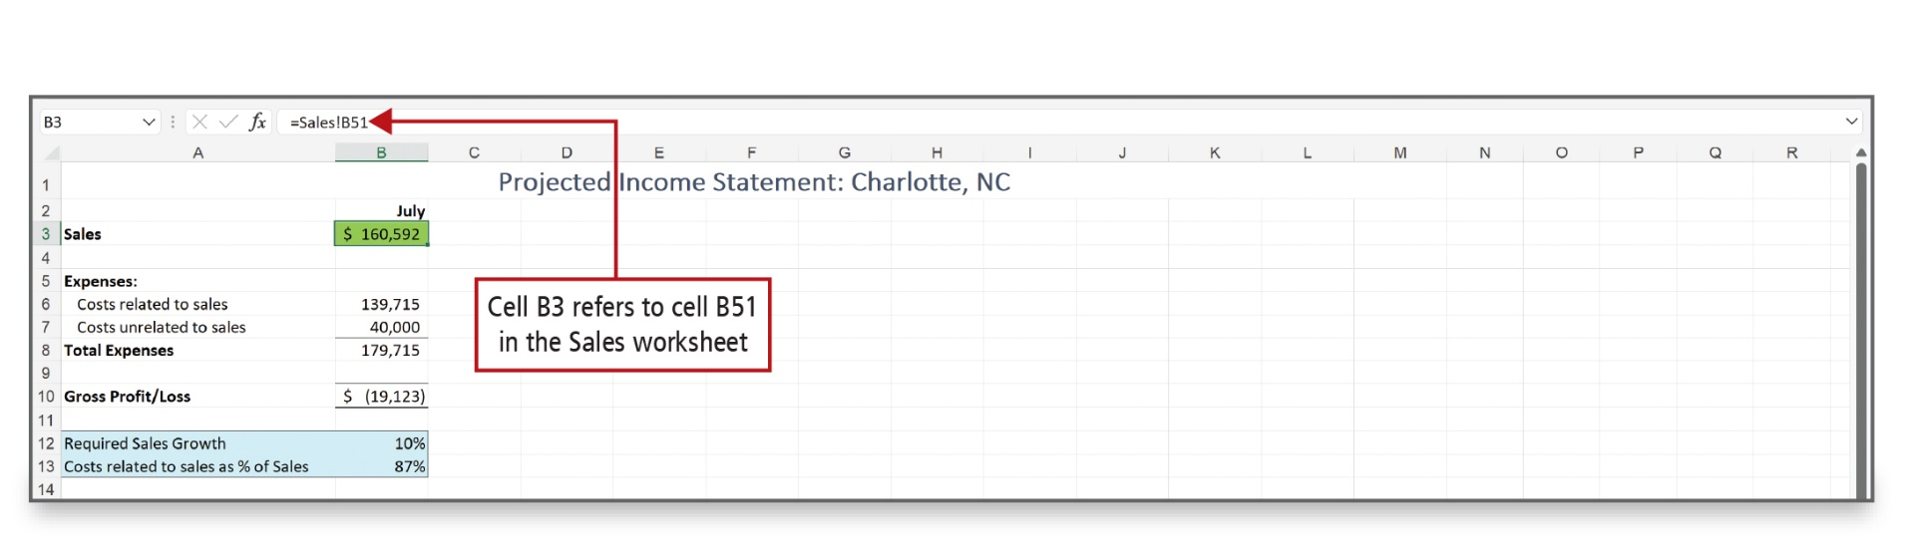
Project Income and Expenses (1 of 2)
Notes:
Expenses are classified as fixed expenses—expenses that remain the same each month—and variable expenses—expenses that change depending on the sales amount. The July total has been referenced on the Sales worksheet and this value will be used to project sales and expenses through June of next year.

Slide 10
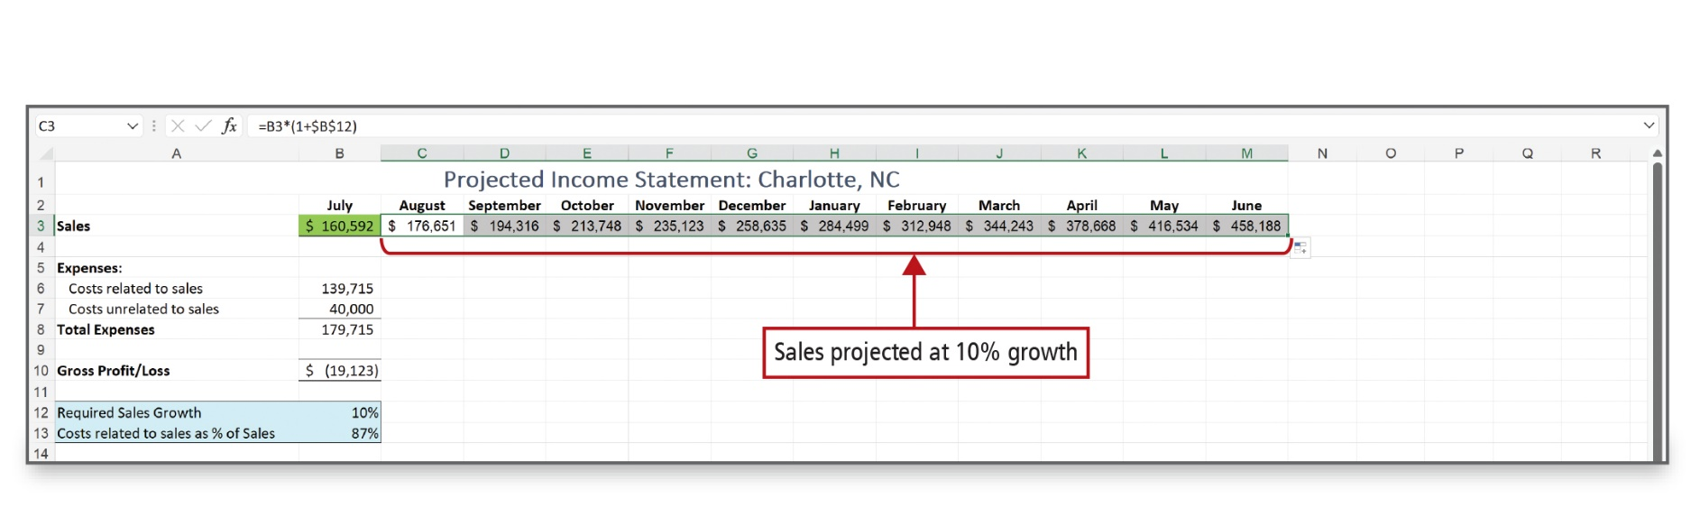
Project Income and Expenses (2 of 2)
Notes:
To make the prediction, =b3*(1+$b$12) is entered in cell C3 and then copied across to column M.
This formula takes the previous month’s sales in cell B3 and multiplies it by 110% to determine a growth rate of 10 percent (in cell B12) over the previous month—$176,651. Cell B12 indicates the Required Sales Growth rate of 10%, and the absolute cell reference is used so this formula can be copied across the row.

Slide 11
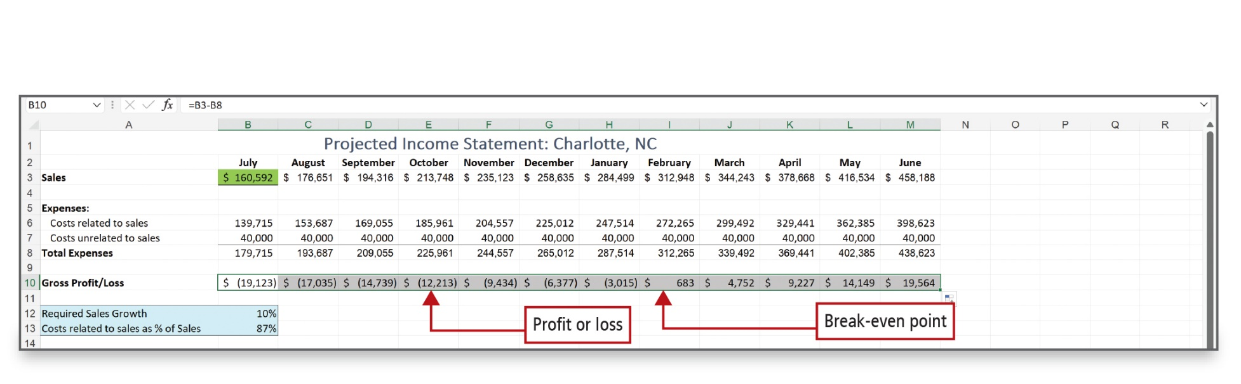
Determine a Break-Even Point (1 of 3)
Notes:
The goal of a business is to make a profit. The point at which a company starts to make a profit is known as the break-even point. A break-even point can be calculated for a product, an office, a division, or an entire company. You can chart the results of the estimated income statement to create a visual image of the income and expenses and the projected break-even point.

Slide 12
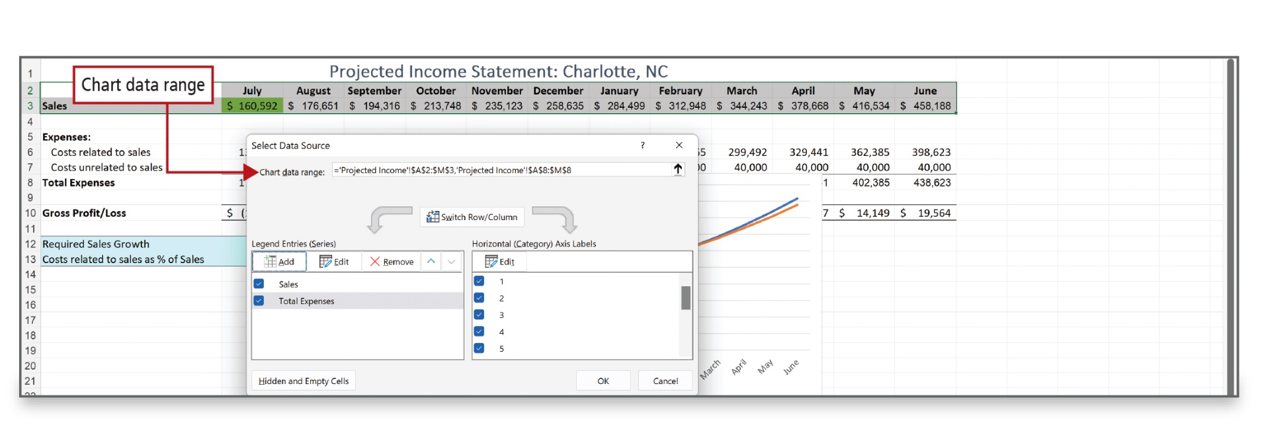
Determine a Break-Even Point (2 of 3)
Notes:
The results of the estimated income statement can be charted to create a visual image of the income and expenses and the projected break-even point. The Select Data Source dialog box is used to select chart attributes.
Alt Text: Chart data range in dialog box reads as “equal to single quote Projected Income single quote exclamatory mark dollar symbol A dollar symbol 2 is to dollar symbol M dollar symbol 3 comma single quote Projected Income single quote exclamatory mark dollar symbol A dollar symbol 8 is to dollar symbol M dollar symbol 8”.

Slide 13
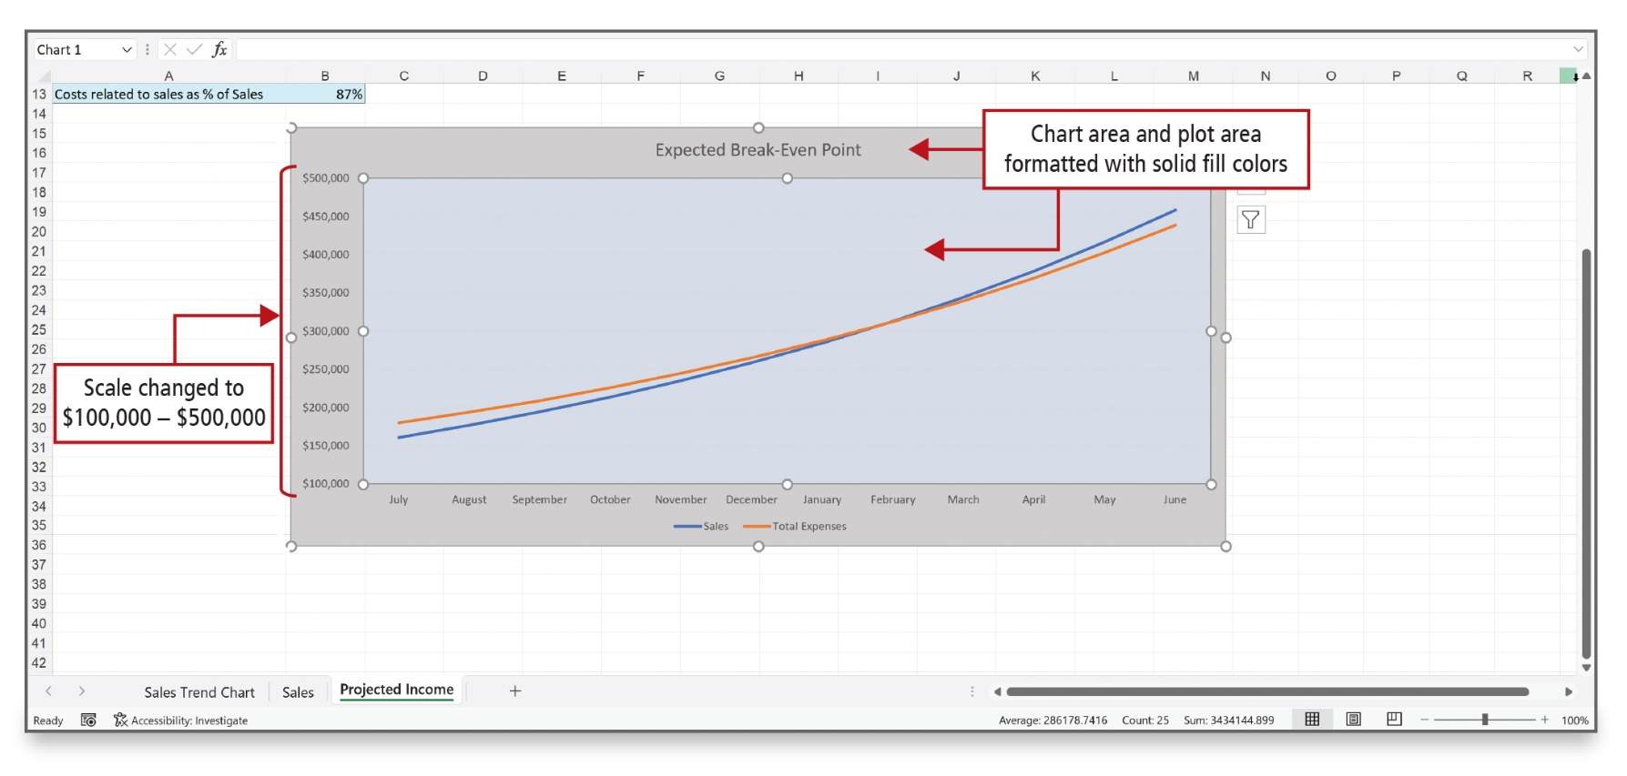
Determine a Break-Even Point (3 of 3)
Notes:
This is the visual result of the break-even analysis after the chart has been formatted and adjusted.

Slide 14
Use Solver (1 of 7)
Solver
  Excel what-if analysis tool
  Solver is an add-in
  Must install and/or activate
  Can find an optimal value for a formula in one cell subject to constraints
Notes:
Solver is an Excel What-If Analysis tool with which you can find an optimal (maximum or minimum) value for a formula in one cell subject to constraints, or limits, on the values of other formula cells on a worksheet. If Solver is not already installed on a computer, it must be downloaded and installed.

Slide 15
Use Solver (2 of 7)
Objective cell—contains formula for the results you are trying to determine
Decision variables/variable cells—where the values will change to achieve desired results
Constraint cells—contain values that limit or restrict the outcome
Notes:
The objective cell is the cell that contains a formula for the results you are trying to determine, such as minimum weekly payroll expense. Decision variables or variable cells are cells in which the values will change to achieve the desired results. Constraint cells are cells that contain values that limit or restrict the outcome.

Slide 16
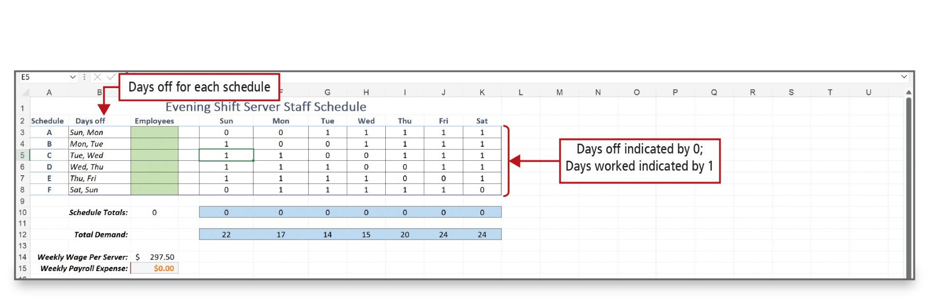
Use Solver (3 of 7)
Notes:
This worksheet sets the basis for the Solver analysis. Six possible schedules are labeled—A through F. Column B lists the consecutive days off for each schedule. The cells for columns E through K indicate a 0 for days off and a 1 for days worked.
Alt Text: The column heading ‘Days off’ (B2) is labeled as “Days off for each schedule”. The data in the table for Sunday to Saturday is entered in 1 and 0 and labeled as “Days off indicated by 0; Days worked indicated by 1”.

Slide 17
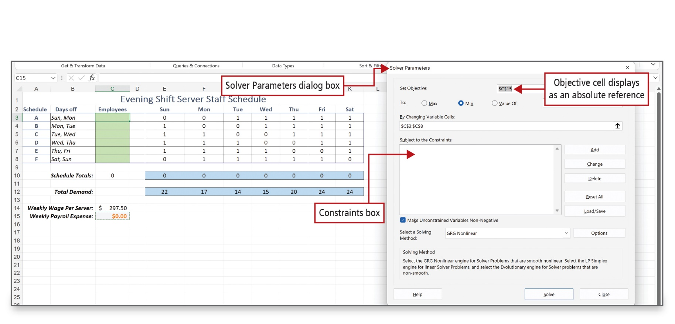
Use Solver (4 of 7)
Notes:
Solver is used to determine the minimum payroll expense; that is, the minimum number of servers that can be on duty and still meet expected customer demand. This process involves identifying the objective cell, the decision variable cells, and the constraint cells. Cell C15 displays as an absolute reference in the Set Objective box of the Solver Parameters dialog box.
Alt Text: The set objective entered is dollar symbol C dollar symbol 15 and is labeled as ‘Objective cell displays as an absolute reference’. Below is the Constraints box (blank with scroll bar to the right) titled ‘subject to the constraints’.

Slide 18
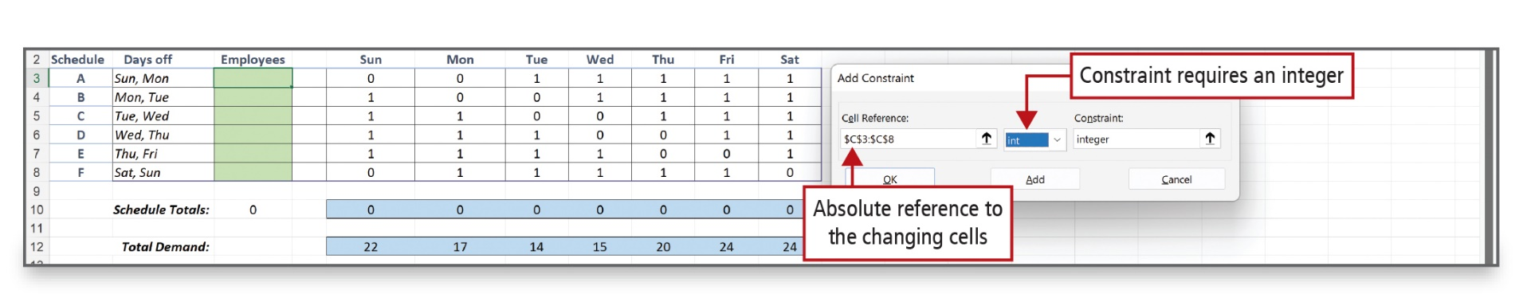
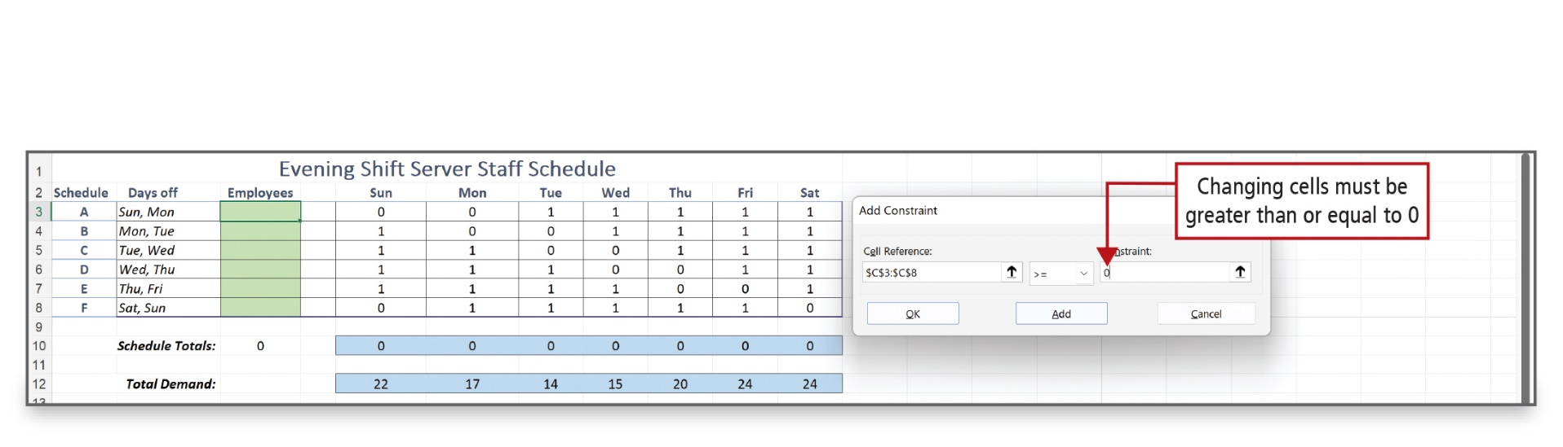
Use Solver (5 of 7)
Notes:
For this problem, the Add Constraint box requires that only an integer—a whole number—be used, because you cannot assign part of a person as a server.
The Limitation constraint requires that the number of servers assigned to each schedule be a positive number—a negative number of servers cannot be assigned. The number must be equal to or greater than zero.
Alt Text: Entered cell reference reads as ‘dollar symbol C dollar symbol 3 is to dollar symbol C dollar symbol 8’ and is labeled as ‘Absolute reference to the changing cells’. The ‘int’ option is selected and labeled as Constraint requires an integer.

Slide 19
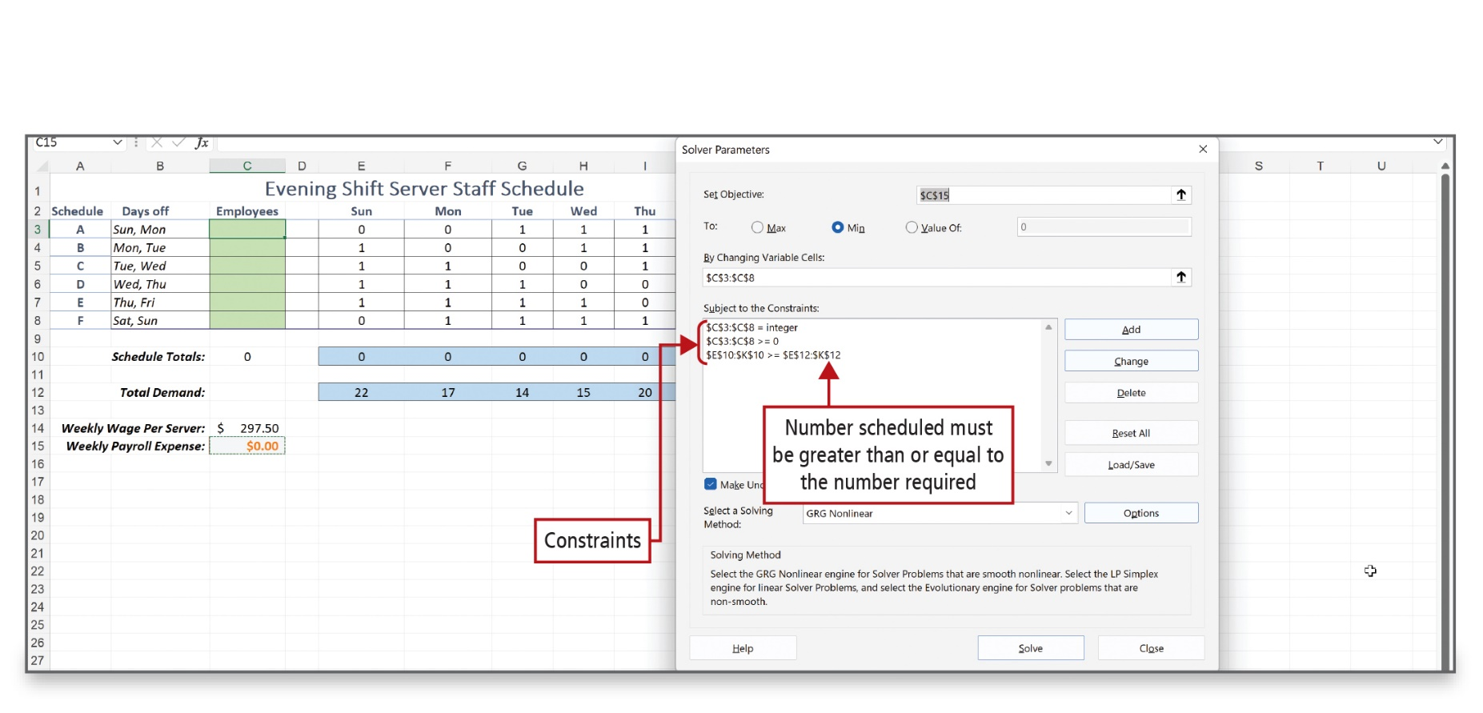
Use Solver (6 of 7)
Notes:
The constraints are displayed here in the Solver Parameters dialog box. With the constraints established, you can solve for, or calculate, the minimum payroll expense.
Alt Text: The constraints in the constraint box read as follows:
• Dollar symbol C dollar symbol 3 is to dollar symbol C dollar symbol 8 equals an integer.
• Dollar symbol C dollar symbol 3 is to dollar symbol C dollar symbol 8 greater than equal to 0.
• Dollar symbol E dollar symbol 10 is to dollar symbol K dollar symbol 10 greater than equal to dollar symbol E dollar symbol 12 is to dollar symbol K dollar symbol 12 (labeled as Number scheduled must be greater than or equal to the number required).

Slide 20
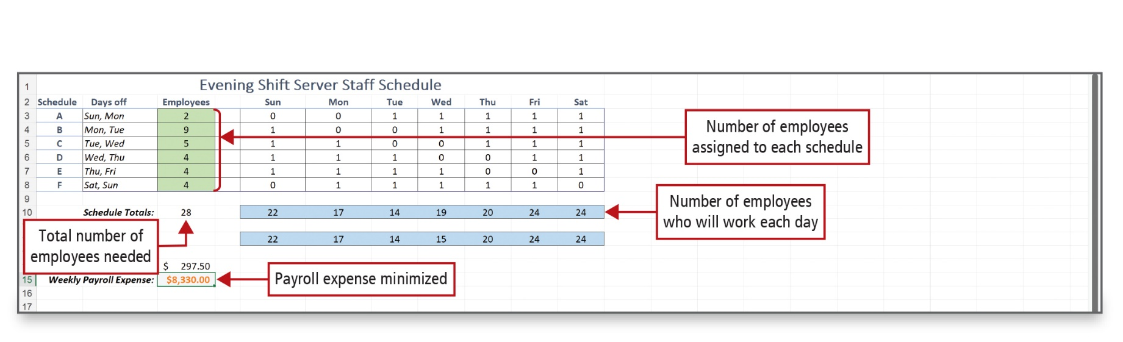
Use Solver (7 of 7)
Notes:
The decision variables—the cell range C3:C8—displays the number of servers that should be assigned to each Schedule to meet the demand while minimizing payroll. Cell C15—the objective cell—shows the Weekly Payroll Expense as $8,330.00, and the number of servers who will work each schedule displays in cells E10:K10.
Alt Text: The data (C3:C8) under the column heading ‘employees’ is shaded in green and labeled as “Number of employees assigned to each schedule”. The data (D10:J10) next to the row title ‘schedule totals’ is shaded in blue and labeled as “Number of employees who will work each day” and that in cell C10 (28) is labeled as ‘Total number of employees needed’. The weekly payroll expense entered in cell C15 is 833.00 dollars and is labeled as ‘Payroll expense minimized’.

Slide 21
Create Scenarios (1 of 3)
Scenario Manager—What-If Analysis tool to compare alternatives
Scenario—Set of values substituted automatically in a worksheet
Notes:
Scenario Manager is a What-If Analysis tool to compare the alternatives. A scenario is a set of values that Excel saves and can substitute automatically in a worksheet.

Slide 22
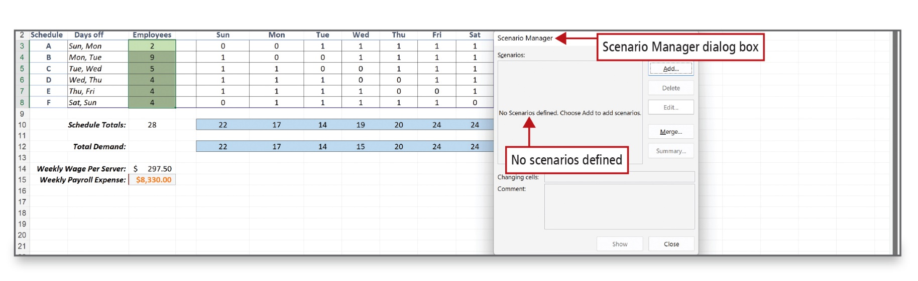
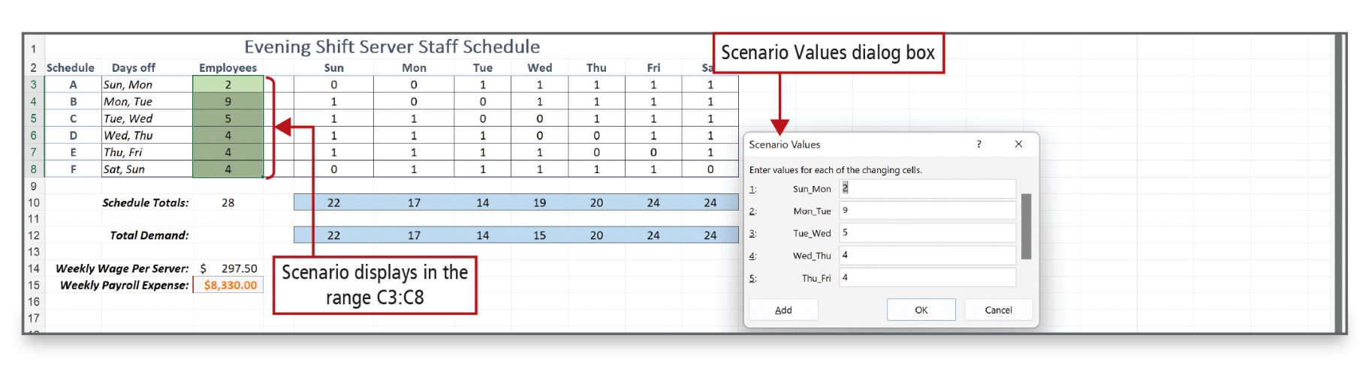
Create Scenarios (2 of 3)
Notes:
Initially, the Scenario Manager dialog box shows that no scenarios are defined. After clicking the Add button, naming the scenario, and verifying the C3:C8 range was selected and displays as the Changing cells, the current value in each of the decision variable cells displays. The values generated can then be accepted. You can also create a scenario using the Solver Parameters dialog box.

Slide 23
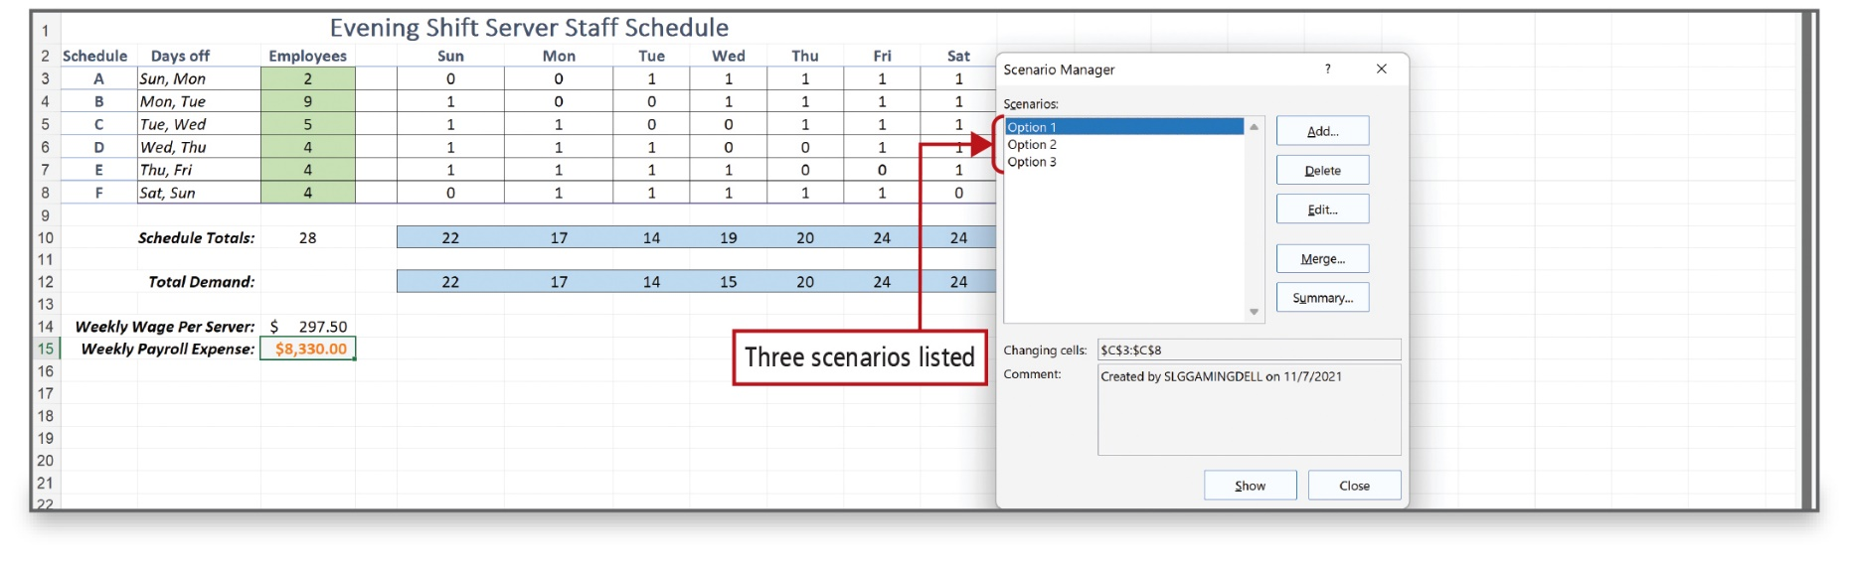
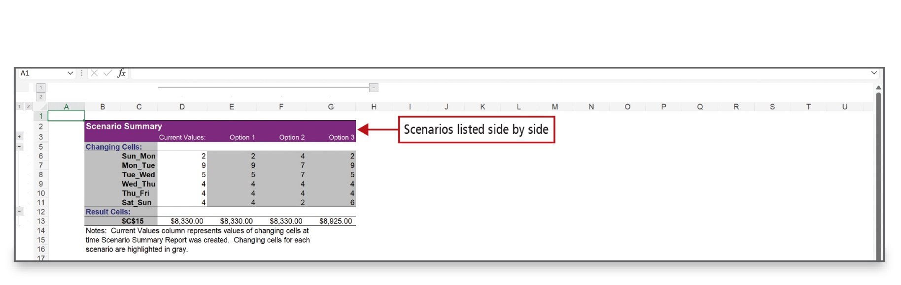
Create Scenarios (3 of 3)
Notes:
Because you can create several scenarios, it is helpful to be able to view a summary of the results of all alternatives. A scenario summary can be generated from the Scenario Summary dialog box. A scenario summary can display in a table or a Scenario PivotTable report. The bottom figure shows a scenario summary with three options.

Slide 24
Use Logical Functions (1 of 4)
Logical function—tests for specific conditions
  SUMIF function—adds values in a specified range that meet a certain condition or criteria
  SUMIFS function—allows specification of multiple ranges and multiple criteria
  COUNTIF function—counts all cells that meet specific criteria in a range
  COUNTIFS function—counts all cells in multiple ranges and multiple criteria
Notes:
Excel provides a number of logical functions that are used to test for specific conditions. The results of a logical test are either TRUE or FALSE.
The SUMIF function contains a logic test, and it will add values in a specified range that meet a certain condition or criteria.
The SUMIFS function is similar to the SUMIF function but allows you to specify multiple ranges and multiple criteria to test.
The COUNTIF function and COUNTIFS function work in the same way, counting cells that meet specific criteria in specified ranges.

Slide 25
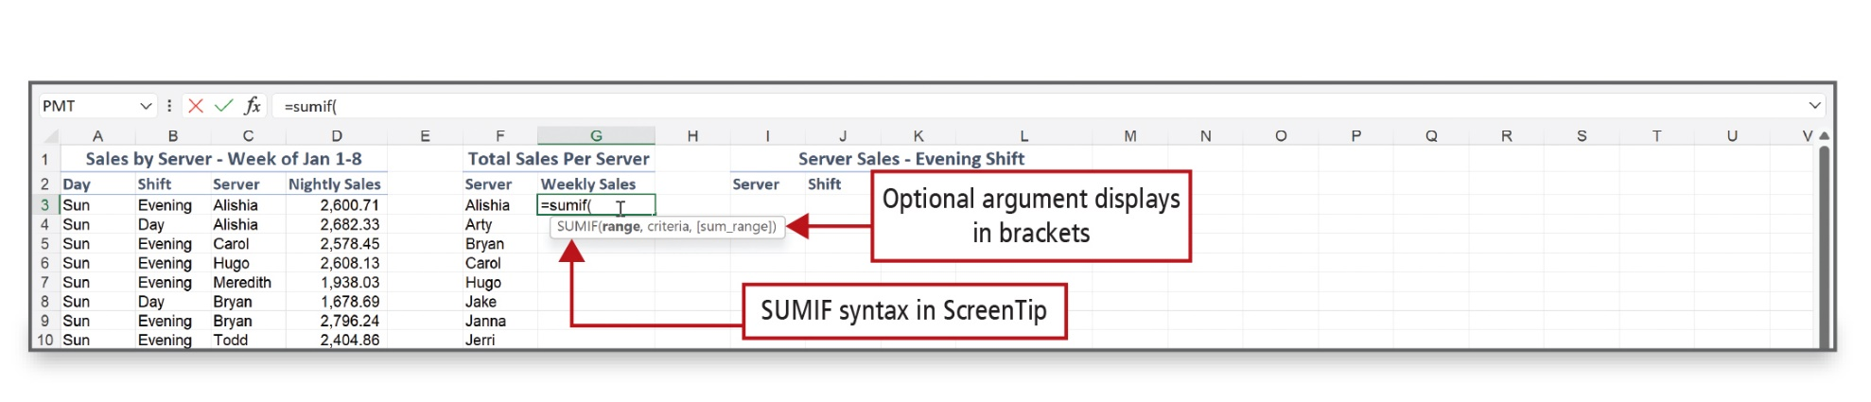
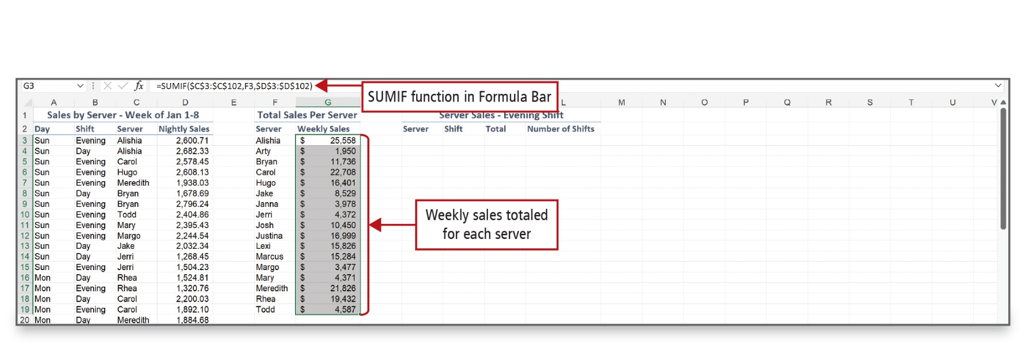
Use Logical Functions (2 of 4)
Notes:
The syntax for the SUMIF function requires two arguments—range and criteria—and an optional argument—sum_range. The results are shown in the bottom figure.
Alt Text: Weekly sales are totaled for each server (column G) and the SUMIF function in Formula Bar reads as follows: “equals SUMIF open parenthesis dollar C dollar 3 is to dollar C dollar 102 comma F3 comma dollar D dollar 3 is to dollar D dollar 102 close parenthesis”.

Slide 26
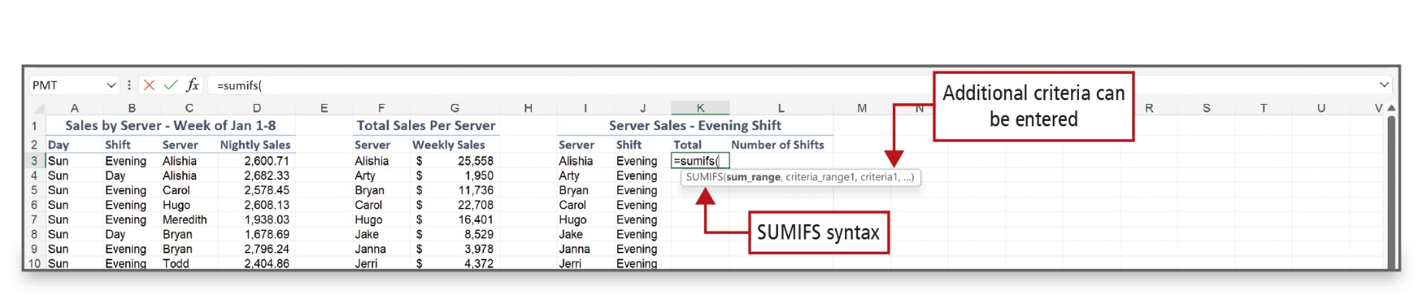
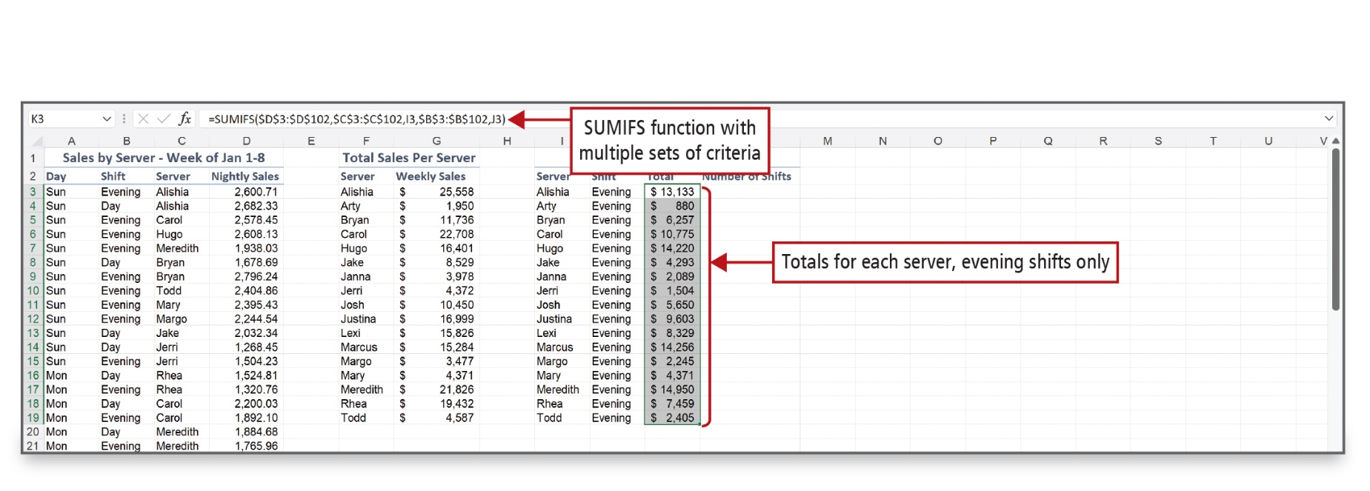
Use Logical Functions (3 of 4)
Notes:
The optional arguments in this SUMIFS function display in the ScreenTip. The multiple sets of criteria show in the Formula bar. As shown in the bottom figure, the results are generated in the highlighted column, column K.
Alt Text: The screen tip reads as SUMIFs open parenthesis sum underscore range comma criteria underscore range1 comma criteria1 comma ellipses. It is labeled as “Additional criteria can be entered (ellipses)” and “SUMIFS syntax”.
Alt Text: Totals for each server, evening shifts only is displayed in column K. The formula reads as follows: “equals SUMIFS open parenthesis dollar D dollar 3 is to dollar D dollar 102 comma dollar C dollar 3 is to dollar C dollar 102 comma I3 comma dollar B dollar 3 is to dollar B dollar 102 comma J3 close parenthesis.”

Slide 27
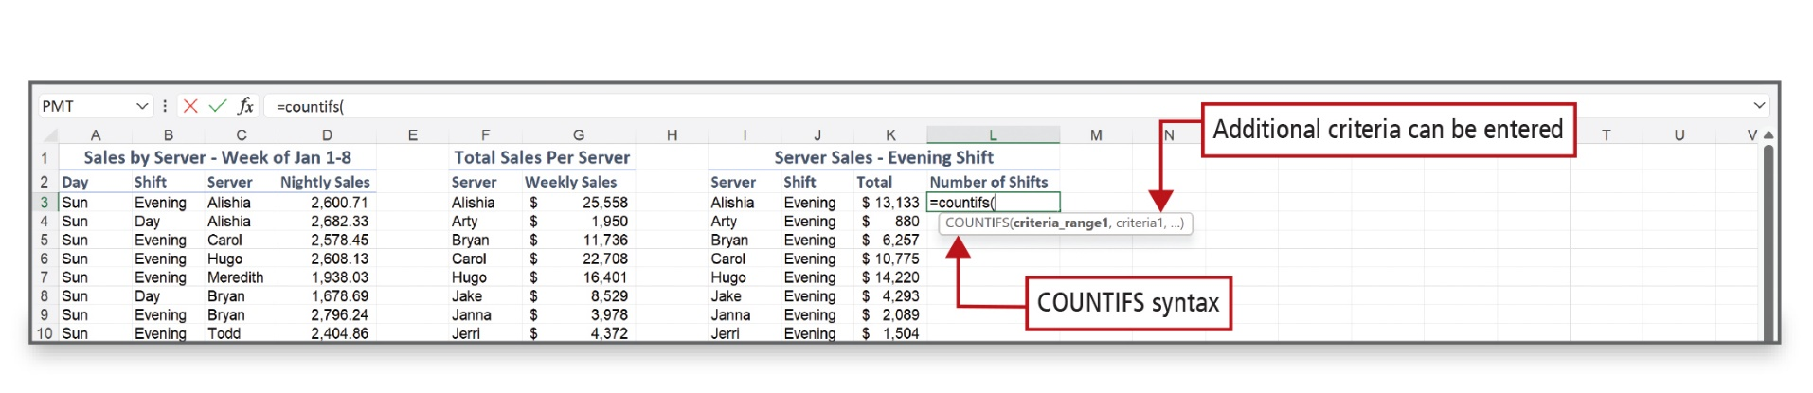
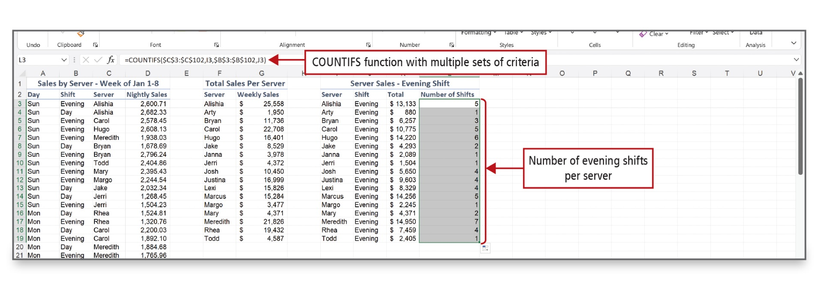
Use Logical Functions (4 of 4)
Notes:
Use the COUNTIFS function to count items that meet multiple conditions—in this example, the server and the shift worked.
Alt Text: The screen tip reads as “COUNTIFS open parenthesis criteria underscore range1 comma crieteria1 comma ellipses close parenthesis”. It is labeled as “Additional criteria can be entered)” and “COUNTIFS syntax”.
Alt Text: The number of evening shifts per server is displayed in column L. The formula reads as follows: “equals COUNTIFS open parenthesis dollar C dollar 3 is to dollar C dollar 102 comma I3 comma dollar B dollar 3 is to dollar B dollar 102 comma J3 close parenthesis.”

Slide 28
Create Complex Formulas (1 of 5)
Logical functions AND and OR are used to develop compound logical tests
  AND—returns a result of TRUE if all conditions are met
  OR—returns a value of TRUE if any conditions are met
  NOT—takes only one argument and tests one condition returning the logical opposite
Notes:
Use the logical functions AND and OR to develop compound logical tests using up to 255 arguments.
The AND function returns a result of TRUE if ALL of the conditions are met.
The OR function returns a value of TRUE if ANY of the conditions are met.
The NOT function takes only one argument and tests one condition. If the condition is true, NOT returns the logical opposite FALSE. If the condition is false, then TRUE is returned.

Slide 29
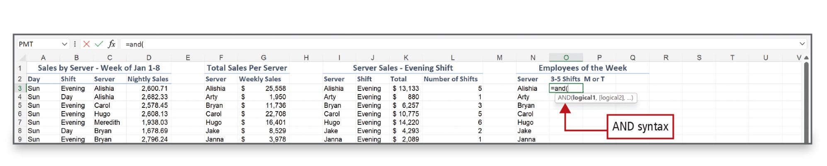
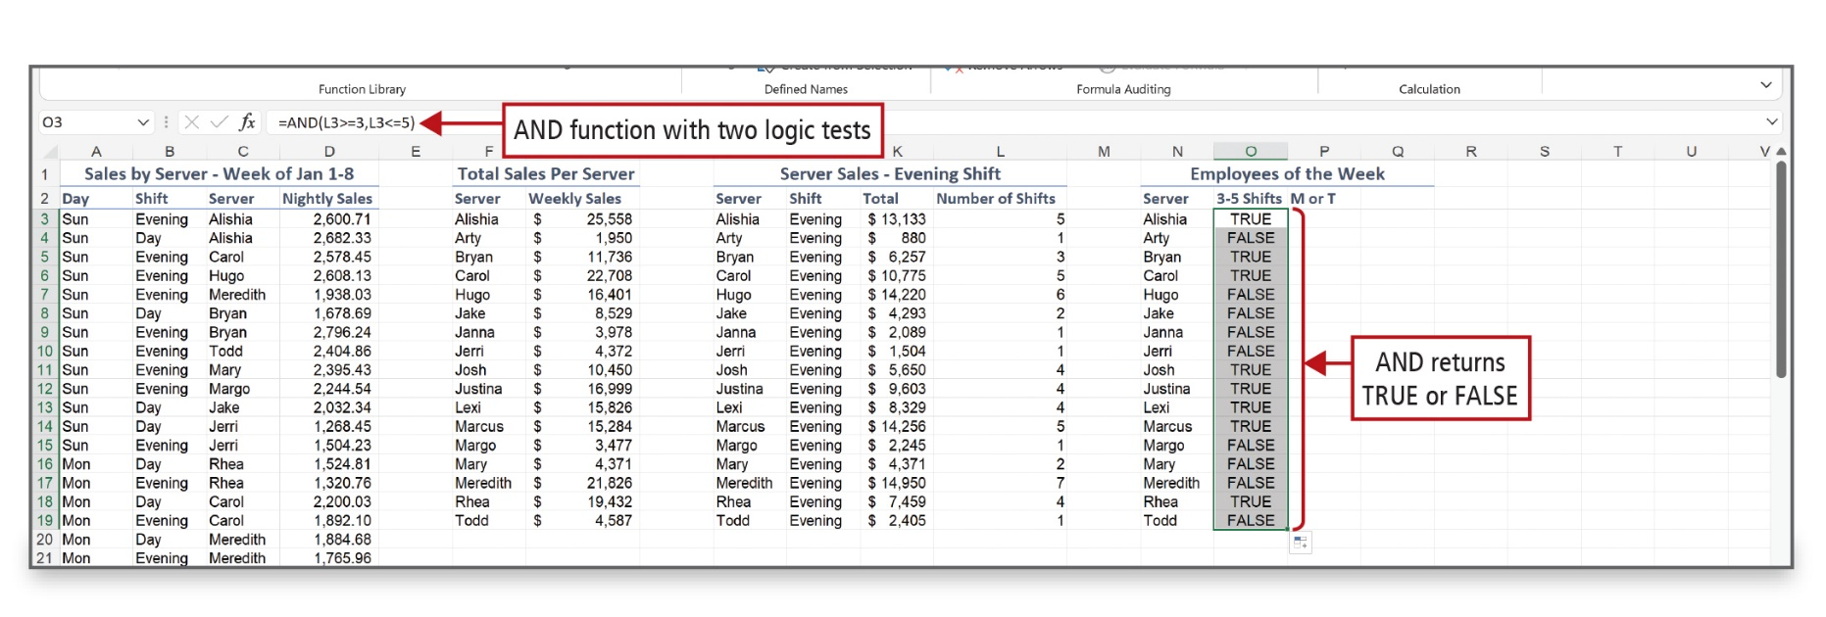
Create Complex Formulas (2 of 5)
Notes:
The AND function takes the argument logical1, followed by optional additional logical tests. This AND function performs two logical tests L3<=3 and L3<=5. Both must be true for the function to return TRUE. If either or both tests fail, the function returns the result FALSE.
Alt Text: The formula reads as “equals AND open parenthesis L3 greater than equal to 3 comma L3 less than equal to 5 close parentheses”. AND returns TRUE or FALSE are displayed in column O for 3 to 5 shifts.

Slide 30
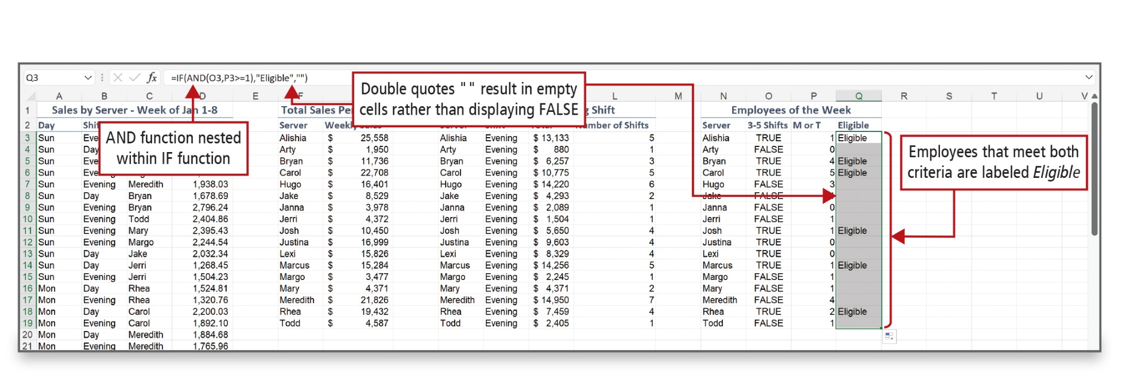
Create Complex Formulas (3 of 5)
Notes:
You can build complex formulas by using a nested function—a function contained inside another function. The inner, nested function is evaluated first, and the result becomes the argument for the outer function. In this example, there are six servers that meet both criteria—and are listed as “Eligible.”
Alt Text: The formula in the formula bar reads as follows: “equals IF open parenthesis AND open parenthesis O3 comma P3 greater than equal to 1 close parenthesis comma double quote Eligible double quote comma two double quotes close parenthesis.” The formula is labeled as “AND function nested within IF function”. Data in column Q is labeled as “Employees that meet both criteria are labeled Eligible”. The blank cells in column Q and formula in the formula bar are both labeled as “Double quotes "" result in empty cells rather than displaying FALSE”.

Slide 31
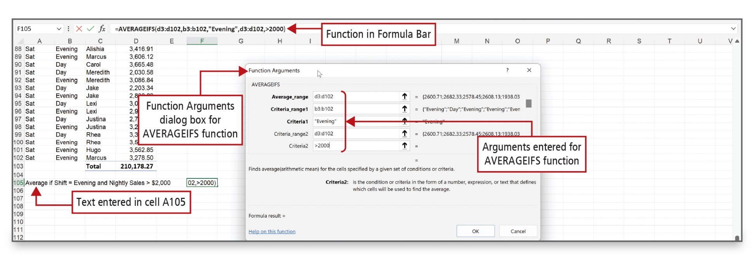
Create Complex Formulas (4 of 5)
Notes:
Excel’s AVERAGEIFS function enables you to specify multiple criteria when computing an average. This example shows the average nightly sales for servers working the evening shift who have sales over $2,000.
Alt Text: In the dialog box, Arguments entered for the AVERAGEIFS function are as follows:
• Average_range: d3 is to d102.
• Criteria_range1: b3 is to b102.
• Criteria1: “Evening”.
• Criteria_range2: d3 is to d102.
• Criteria2: greater than 2000.
In the Excel sheet: the text entered in cell A105 reads as Average if shift equals Evening and nightly sales greater than 2000 dollars. The Function in Formula Bar reads as equals AVERAGEIFS open parenthesis d3 is to d102 comma b3 is to b102 comma double quote Evening double quote comma d3 is to d102 comma greater than 2000 close parenthesis.

Slide 32
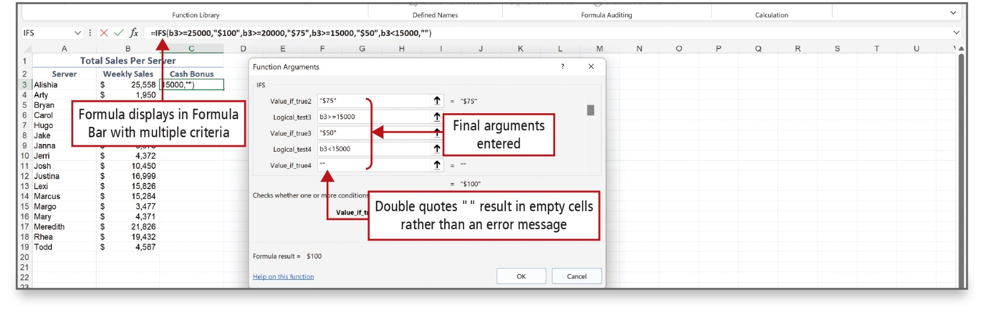
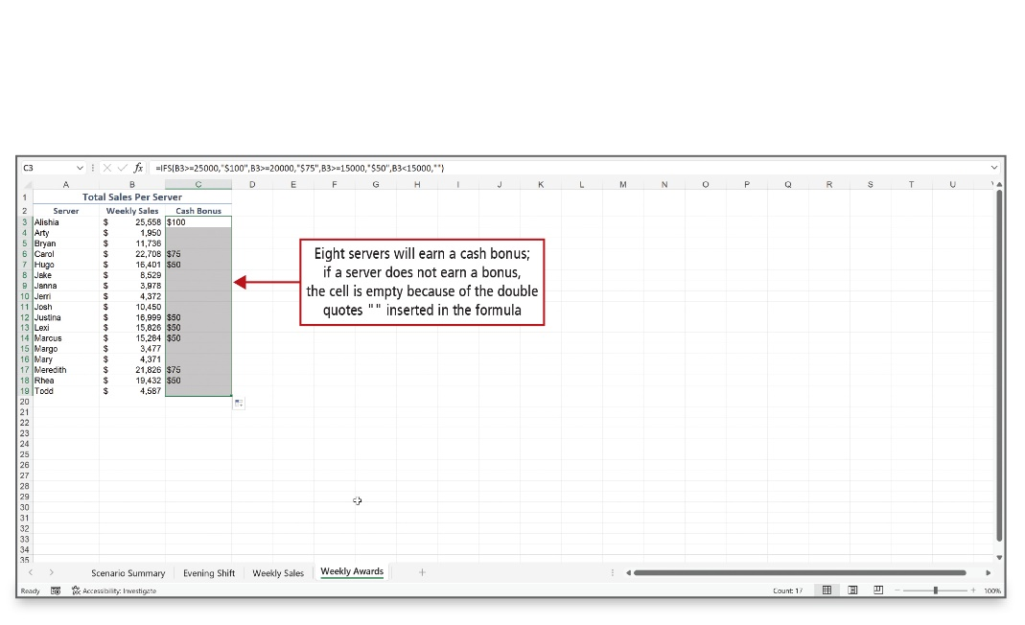
Create Complex Formulas (5 of 5)
Notes:
The IFS function checks whether one or more conditions are met and then returns a value that corresponds to the first TRUE condition. The benefit of using the IFS function is that it can take the place of multiple nested IF statements, which can be confusing to construct and read.
Using the fact that each week, servers can earn an extra cash bonus based on their weekly sales. Weekly sales of $25,000 or more earns a cash bonus of $100. Weekly sales of $20,000 or more—but under $25,000—earns a cash bonus of $75. And weekly sales of $15,000 or more—but under $20,000—earns a cash bonus of $50. The IFS function determines the bonus shown in the bottom figure.
Alt Text: In the dialog box, the Final arguments entered are as follows:
• Value_if_true2: double-quote dollar symbol 75 double quote.
• Logical_test3: b3 greater than equal to 15000.
• Value_if_true3: double-quote dollar symbol 50 double quote.
• Logical_test4: b3 less than 15000.
• Value_if_true4: double quotes (labeled as Double quotes "" result in empty cells rather than an error message)
In the excel sheet, Formula displays in Formula Bar with multiple criteria that read as follows: “equal to IFS open parenthesis b3 greater than equal to 25000 comma double quote dollar symbol 100 double quote comma b3 greater than equal to 20000 comma double quote dollar symbol 75 double quote comma b3 greater than equal to 15000 comma double quote dollar symbol 50 double quote comma b3 less than 15000 comma double quotes close parenthesis.”

Slide 33

Questions

Slide 34

Copyright
This work is protected by United States copyright laws and is provided solely for the use of instructors in teaching their courses and assessing student learning. Dissemination or sale of any part of this work (including on the World Wide Web) will destroy the integrity of the work and is not permitted. The work and materials from it should never be made available to students except by instructors using the accompanying text in their classes. All recipients of this work are expected to abide by these restrictions and to honor the intended pedagogical purposes and the needs of other instructors who rely on these materials.

