Slide 1

GO! with Microsoft 365 Excel 2021
Chapter 9
Using Macros and Visual Basic for Applications
Copyright © 2023 Pearson All Rights Reserved.
Notes:
GO! with Microsoft 365 Excel 2021, Chapter 9
In this chapter, you will learn how to use macros and Visual Basic for Applications.

Slide 2
Learning Objectives
Record a Macro
Modify a Macro
Write a VBA Procedure to Use an ActiveX Control
Restore Initial Settings
Notes:
The objectives are:
Record a Macro
Modify a Macro
Write a VBA Procedure to Use an ActiveX Control
Restore Initial Settings

Slide 3
Record a Macro (1 of 5)
Macro—an action or a set of actions to automate tasks by grouping series of commands into a single command
Command is performed with a mouse click, a keyboard shortcut, or when a workbook opens
Visual Basic for Applications (VBA)—a programming language used to write computer programs
Notes:
A macro is an action or a set of actions with which you can automate tasks by grouping a series of commands into a single command. You can perform the command with a single mouse click, a keyboard shortcut, or when a workbook opens.
Visual Basic for Applications (VBA) is a programming language that is used to write computer programs within the Microsoft Windows environment.

Slide 4
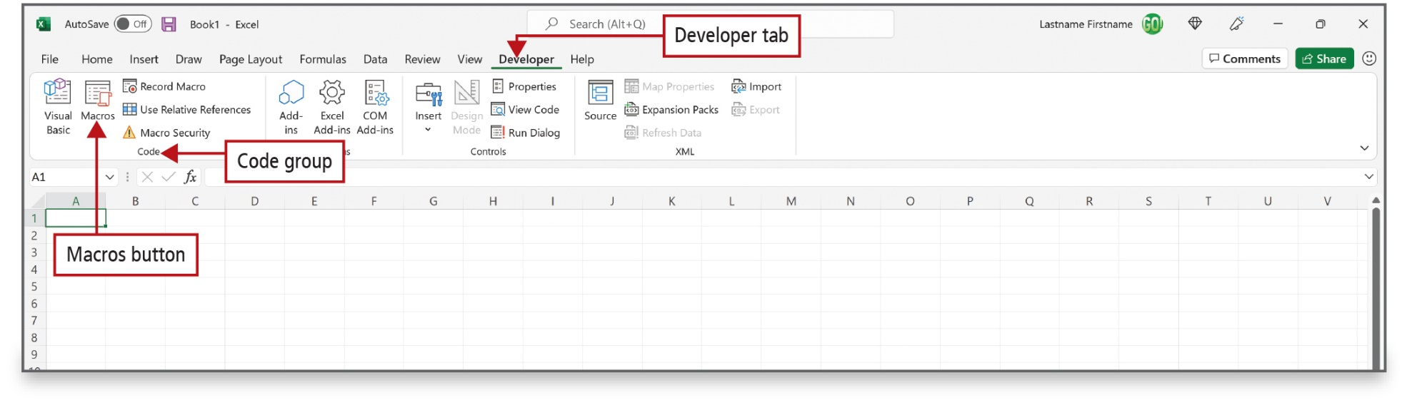
Record a Macro (2 of 5)
Notes:
The macro commands are located on the Developer tab, which, by default, does not display in Excel. You must enable the Developer tab from the Excel Options dialog box.

Slide 5
Record a Macro (3 of 5)
Macro Settings | Description
Disable VBA macros without notification | This setting disables all macros and security alerts unless the Excel workbook is in the trusted location.
Disable VBA macros with notification | This setting is enabled by default. You are alerted if macros are present in the workbook. This setting enables you to choose each time you can open a workbook whether to run the macros that are contained in the workbook.
Disable VBA macros except digitally signed macros | This setting enables macros from trusted publishers to run; otherwise, this setting is the same as the Disable VBA macros with notification setting.
Enable VBA macros (not recommended; potentially dangerous code can run) | Use this setting when you want to enable all macros to run on a temporary basis. It is not recommended as a permanent setting because it makes your computer vulnerable to potential malicious code.
Notes:
Macro settings and their effects are shown in this table.

Slide 6
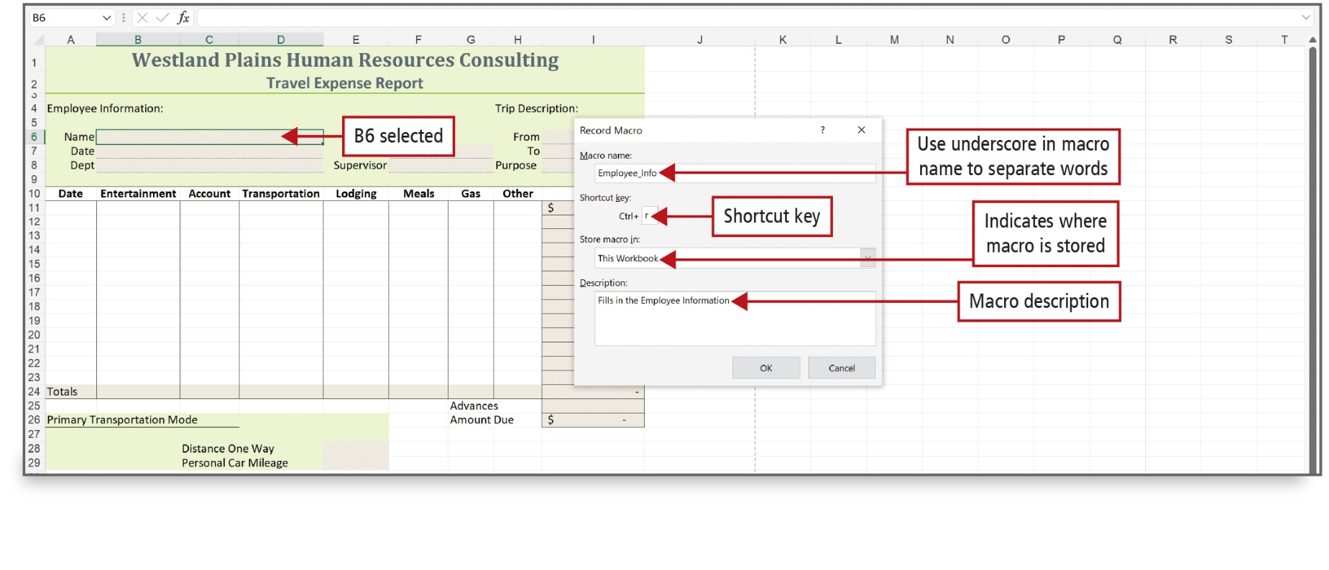
Record a Macro (4 of 5)
Notes:
The macro recorder records all the steps (keystrokes and mouse clicks) that you require to complete the actions you want your macro to perform—except for navigation on the ribbon. The Record Macro command records your actions in VBA. The Record Macro dialog box is used to enter the macro attributes.
Alt Text: In the Excel sheet, cell B6 (name box of the report) is selected. In the dialog box, the macro name reads as “employee underscore info” (labeled as Use underscore in macro name to separate words), the shortcut key is Ctrl plus r, store macro in entered is “this workbook” (labeled as Indicates where macro is stored) and Macro description reads as “fills in the employee information”.

Slide 7
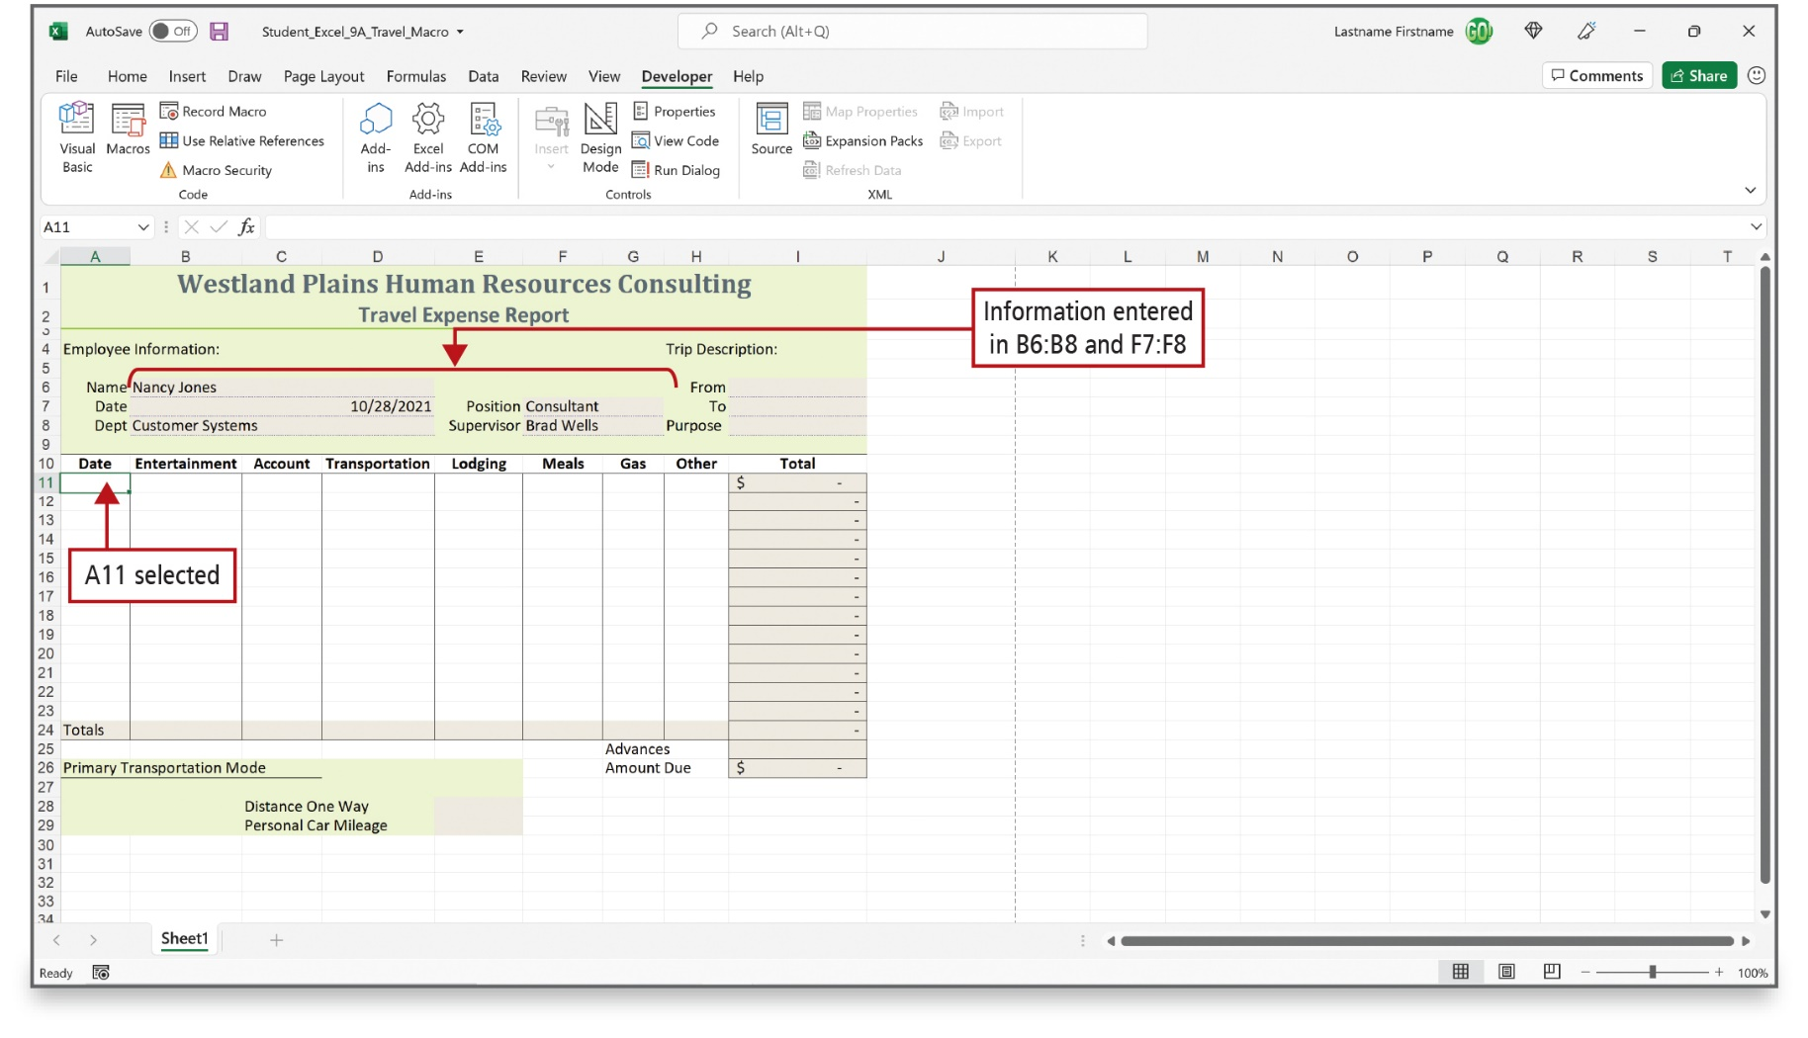
Record a Macro (5 of 5)
Notes:
Once the macro recorder is turned on, every action you take will be recorded as part of the macro. Be assured that the amount of time you take between actions is not being recorded, so there is no need to rush. If you make an error, take the appropriate steps to correct it; the corrective steps will simply become part of the macro, and you can edit the mistakes out of the macro later.

Slide 8
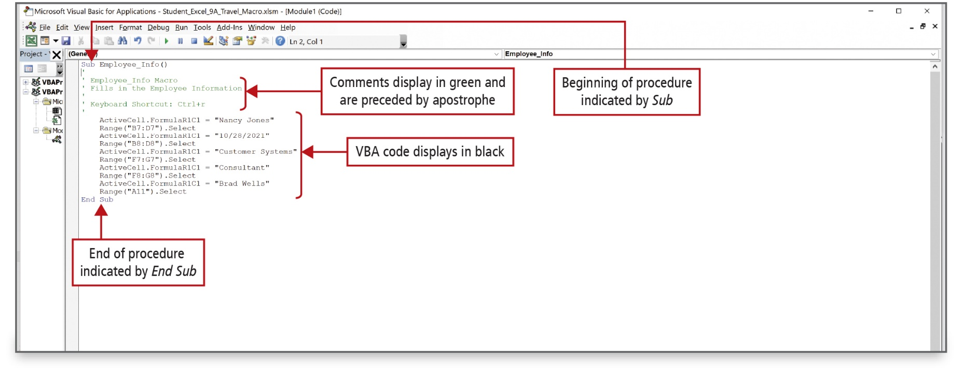
Modify a Macro (1 of 3)
Notes:
When you record a macro, the VBA programming code is stored in a module. A module consists of one or more procedures—a unit of computer code that performs an action. Procedures are commonly referred to as sub procedures, or simply subs. If you want to modify the way your macro performs, you can modify the actual code that was created by the macro.
Alt Text: Text in the code window reads as follows:
• Sub Employee_info () (labeled as Beginning of procedure indicated by Sub).
• Apostrophe
• Apostrophe Employee_Info Macro (labeled as Comments display in green and are preceded by an apostrophe).
• Aphostrphoe Fills in the employee information (labeled as Comments display in green and are preceded by an apostrophe).
• Apostrophe
• Apostrophe keyboard shortcut: Ctrl plus r (labeled as Comments display in green and are preceded by an apostrophe).
The VBA code below is displayed in black.
• End sub (labeled as End of procedure indicated by End Sub).

Slide 9
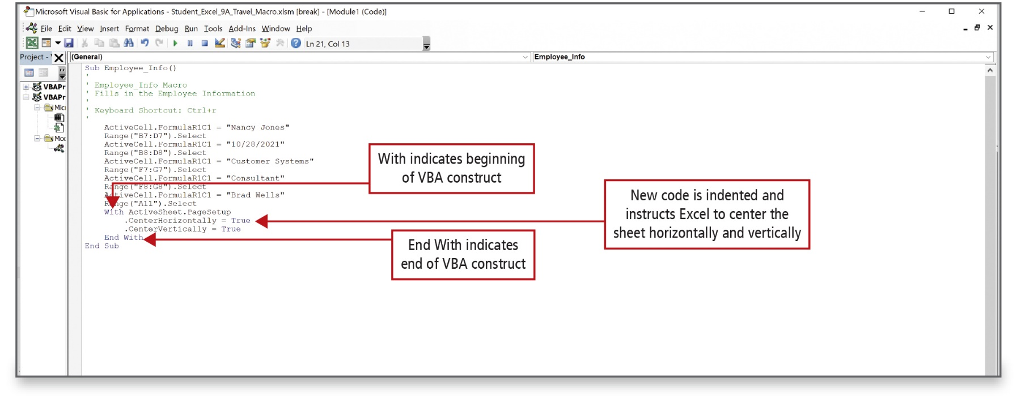
Modify a Macro (2 of 3)
Notes:
The VBA code is being edited in the figure on this slide.
Alt Text: In the code window, the eighteenth line reads as “With ActiveSheet. PageSetup” (labeled as “With indicates the beginning of V B A constructs”). The nineteenth line reads as “CenterHorizontally equals True” labeled as (“New code is indented and instructs Excel to center the sheet horizontally and vertically”). The twenty-first line reads as “End With” labeled as (“End With indicates the end of V B A constructs”).

Slide 10
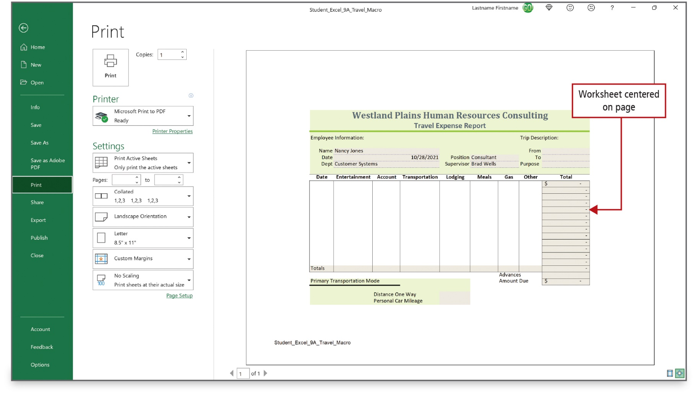
Modify a Macro (3 of 3)
Notes:
The result of the VBA editing is a worksheet that is centered horizontally and vertically on the page, as shown here.

Slide 11
Write a V B A Procedure to Use an ActiveX Control (1 of 12)
Buttons | ScreenTip | Description
 | Command Button | Inserts a command button control to which code can be attached, initiating an action when clicked.
 | Combo Box | Inserts a combo box control, which displays a list of choices from another source; the user can either select a choice from the list or type his or her own entry in the box.
 | Check Box | Inserts a check box control that can be turned on (selected) or turned off (cleared).
 | Image | Inserts an image control to embed a picture.
 | Label | Inserts a text label to provide information about a control.
 | List Box | Inserts a list box control, which displays a list of choices.
Notes:
Within VBA, you can write a procedure—a named sequence of statements in a computer program that performs an action or task. A procedure can include an ActiveX control—a graphic object such as a check box or a button that can be placed on a worksheet or form to display or enter data, to perform an action, or to make the form easier to read. This table shows some of the ActiveX controls.

Slide 12
Write a V B A Procedure to Use an ActiveX Control (2 of 12)
Buttons | ScreenTip | Description
 | More Controls | Displays a list of additional controls.
 | Option Button | Inserts an option button control to indicate an on/off choice.
 | Scroll Bar | Inserts a scroll bar control, which scrolls through a range of values.
 | Spin Button | Inserts a spin button control, which displays a range of numbers from which the user can increase or decrease a value.
 | Text Box | Inserts a text box control in which the user can type text.
 | Toggle Button | Inserts a toggle button control, which remains pressed in when clicked, and then releases when clicked again.
Notes:
This table shows the remaining ActiveX controls.

Slide 13
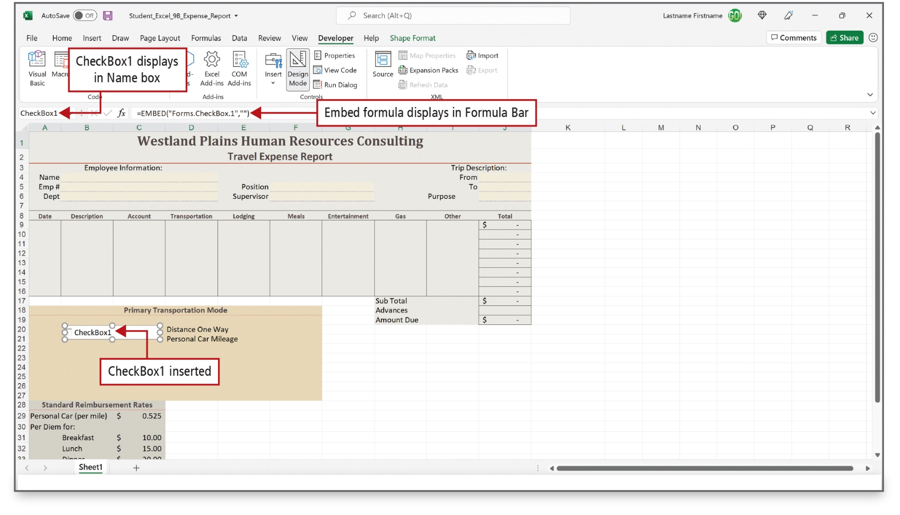
Write a V B A Procedure to Use an ActiveX Control (3 of 12)
Notes:
CheckBox1—the object name—displays in the check box and displays in the Name Box. An EMBED formula displays on the Formula Bar. The formula defines the object as an embedded object and includes the name of the object source. To embed means to insert something created in one program into another program.
Alt Text: CheckBox1 displays in the Name box, Embed formula (equals EMBED open parenthesis double quote Forms dot CheckBox1 double quote comma double-quotes close parenthesis) displays in Formula Bar and CheckBox1 inserted in cell B20.

Slide 14
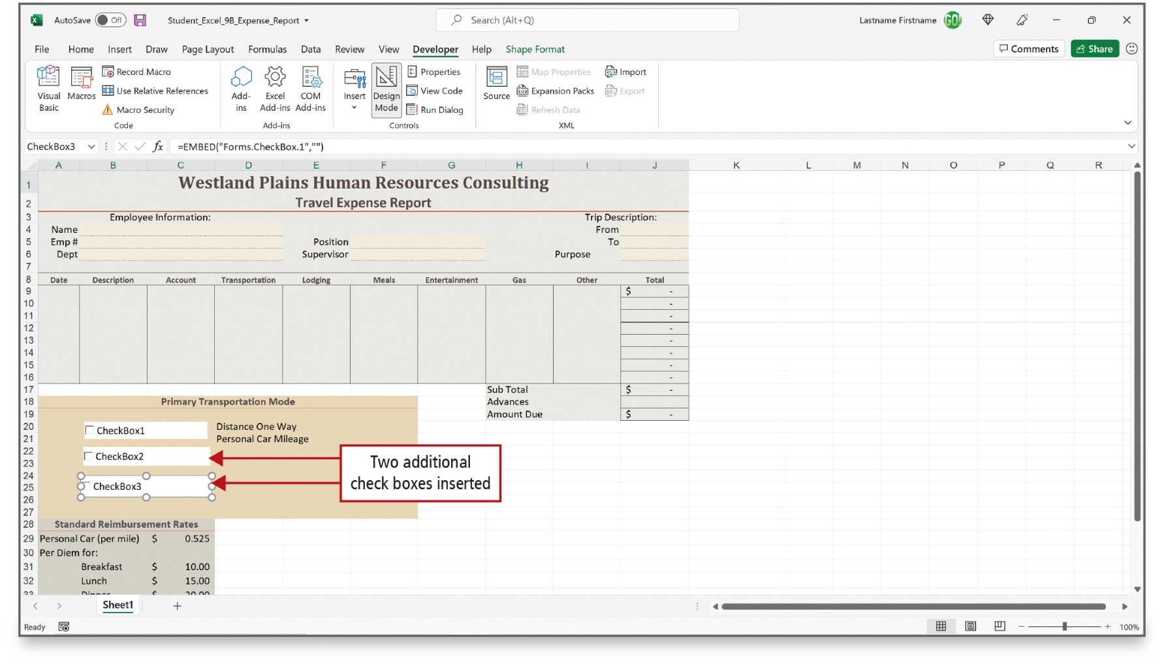
Write a V B A Procedure to Use an ActiveX Control (4 of 12)
Notes:
ActiveX controls are not attached to cells—rather, they float on the worksheet like inserted Shapes or SmartArt.

Slide 15
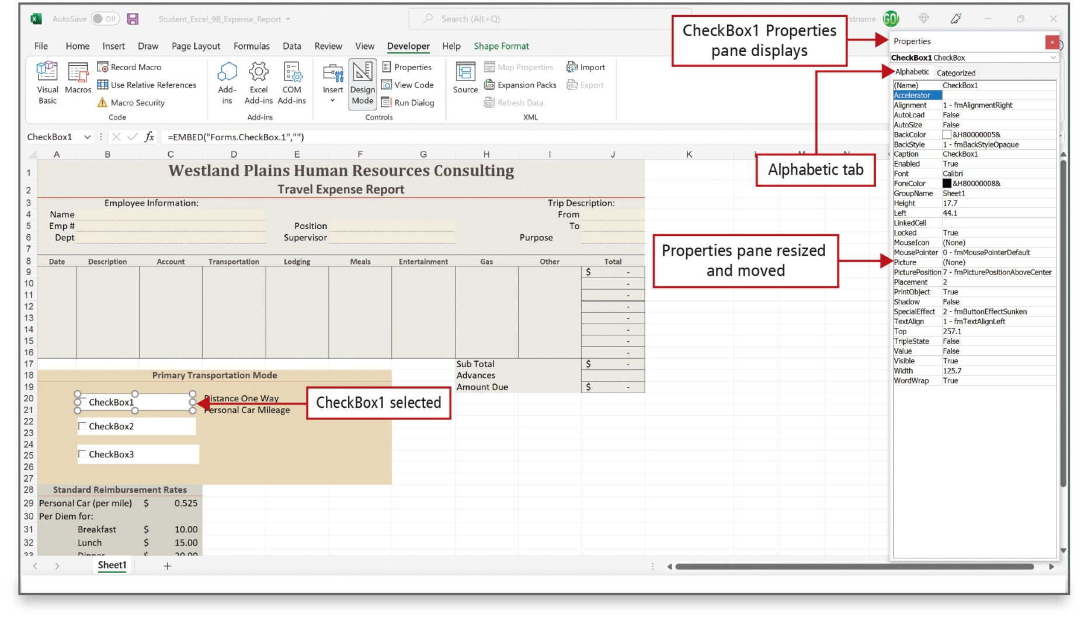
Write a V B A Procedure to Use an ActiveX Control (5 of 12)
Notes:
Each ActiveX control has a set of properties—characteristics—that you can change. The properties are organized in alphabetical order on the Alphabetic tab, the same properties are listed on the Categorized tab, but they are organized by logical groups. You can click the arrow at the top of the Properties pane to display a list from which you can select the object whose properties you want to modify.

Slide 16
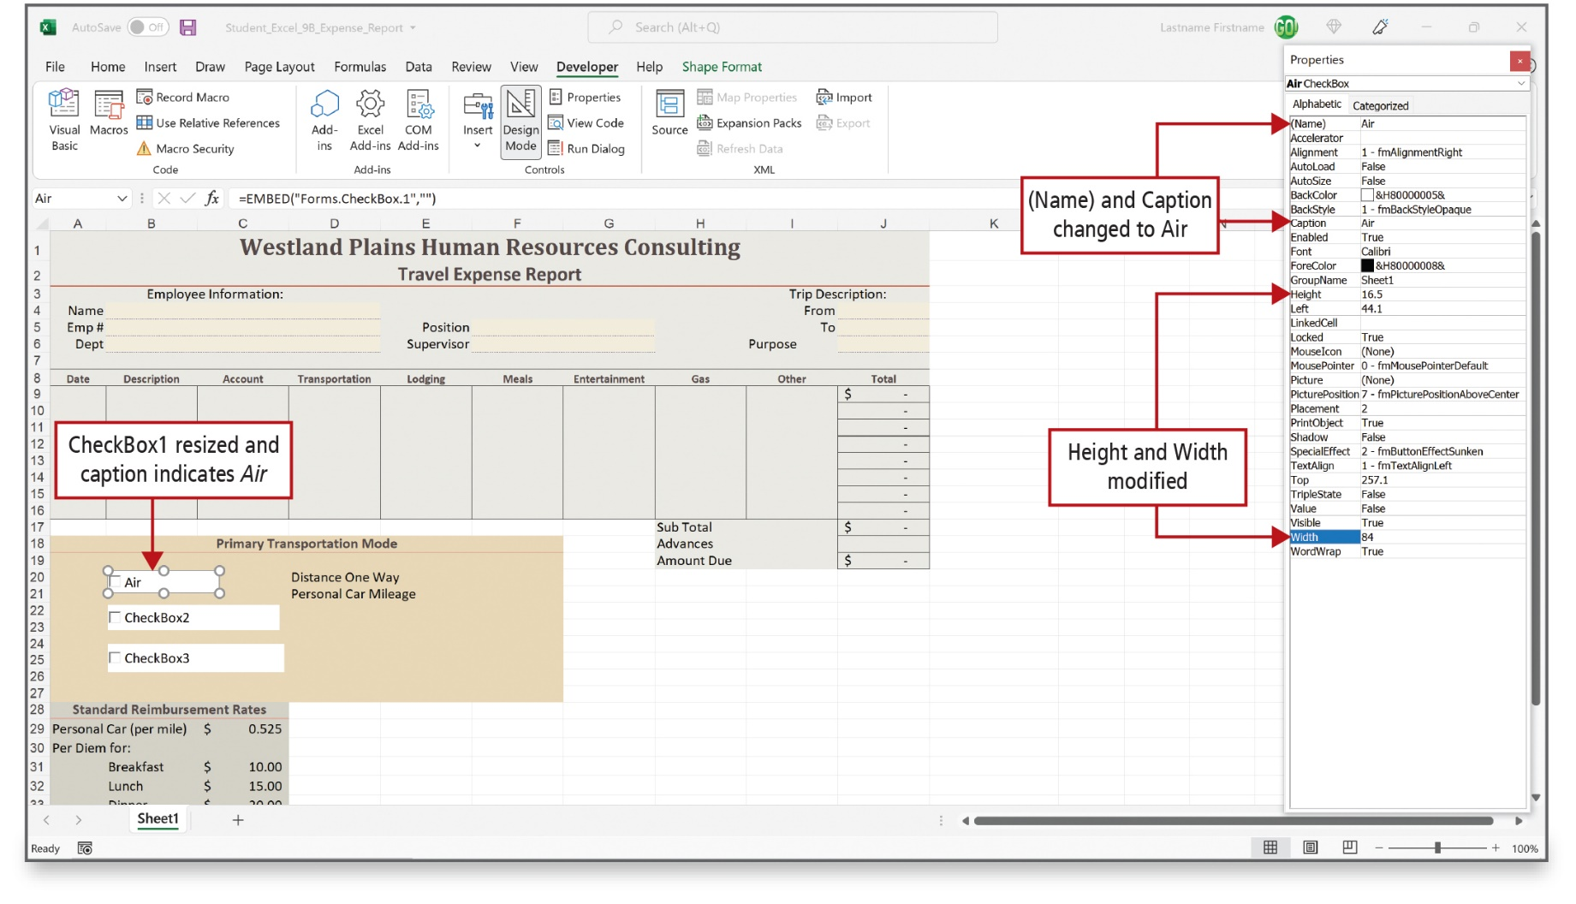
Write a V B A Procedure to Use an ActiveX Control (6 of 12)
Notes:
Use the (Name) field when you need to refer to an object in a program. The naming convention is the same for naming cells in Excel; that is, the name cannot include spaces or punctuation marks. This slide shows the check box properties Height and Width properties have been changed.

Slide 17
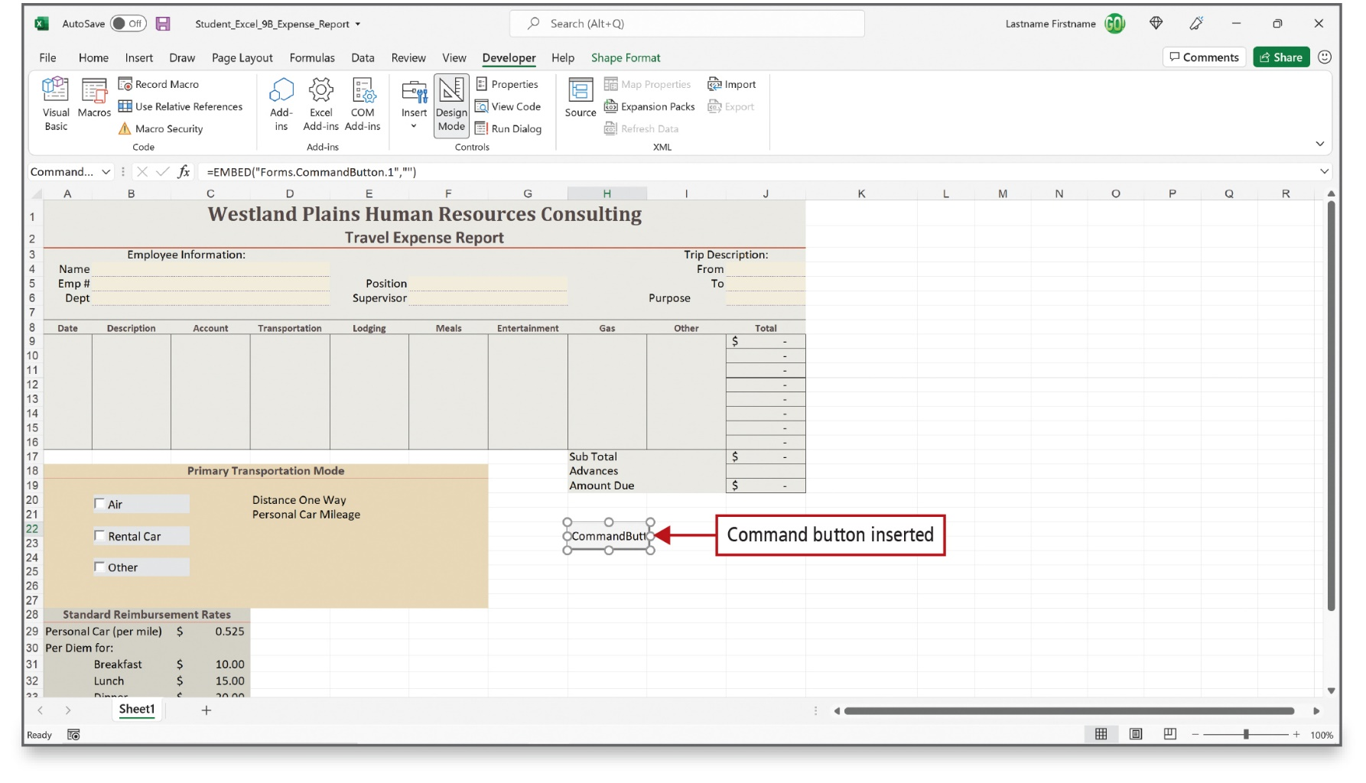
Write a V B A Procedure to Use an ActiveX Control (7 of 12)
Notes:
A Command button has been added to this worksheet and a portion of the text CommandButton1 displays as the caption on the button. By selecting cell H22, you have a visual cue as to where to place the Command Button. Recall, however, that ActiveX objects are not actually attached to a cell.

Slide 18
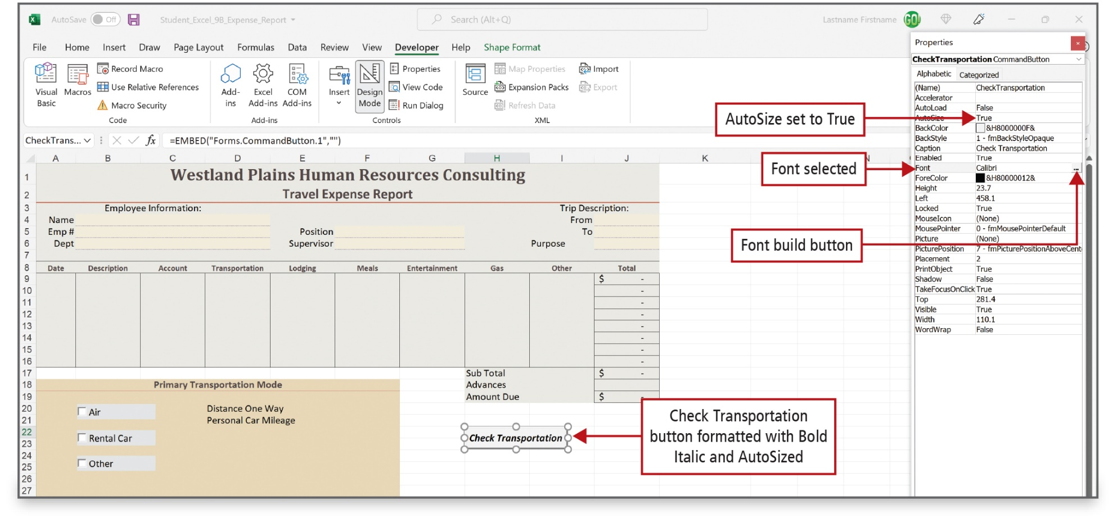
Write a V B A Procedure to Use an ActiveX Control (8 of 12)
Notes:
AutoSize is set to True; the button is resized to accommodate the new caption. The font has also been formatted with Bold Italic.

Slide 19
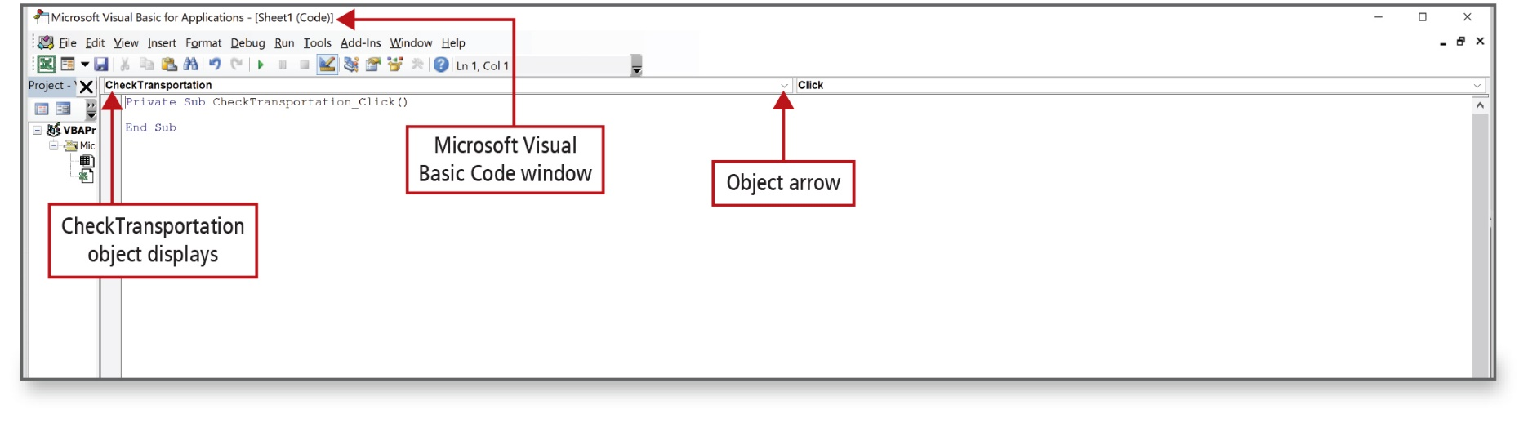
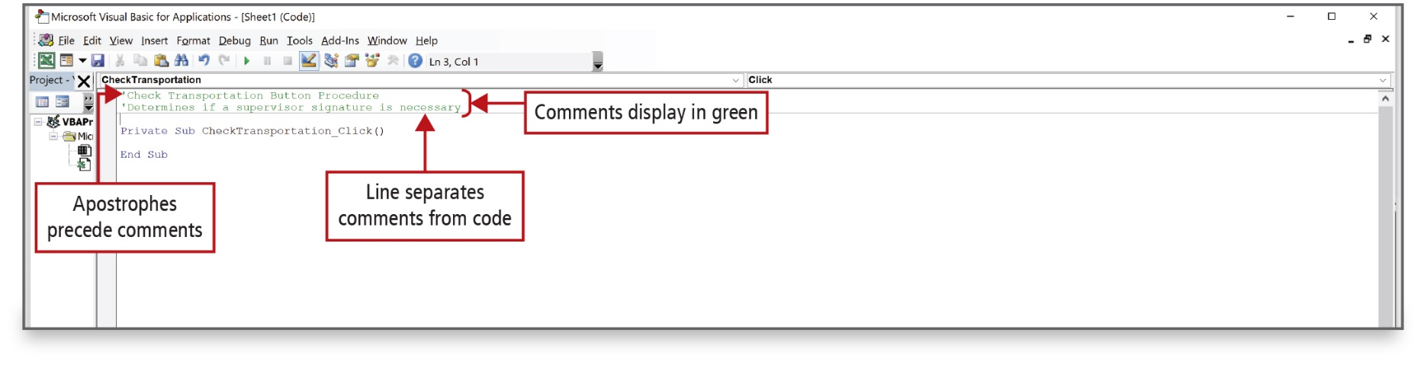
Write a V B A Procedure to Use an ActiveX Control (9 of 12)
Notes:
The Microsoft Visual Basic Code window displays here. CheckTransportation is the name of the selected ActiveX control. A comment displays in green and is preceded by an apostrophe (‘). A line separates the comments from the VBA code. Comments help document the procedure and do not affect the running of a procedure.
Alt Text: The first two lines start with apostrophes and are labeled as “Apostrophes precede comments” and “Comments display in green”. Next is a horizontal line labeled as “Line separates comments from code”.

Slide 20
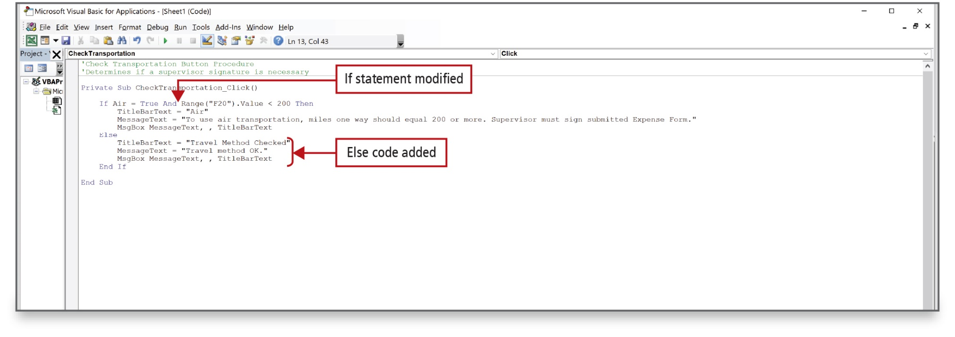
Write a V B A Procedure to Use an ActiveX Control (10 of 12)
Notes:
You can modify a VBA procedure in the same manner that you modified the VBA code that was created when you used a macro. A second condition and a second message box regarding the supervisor signature is added here.
Alt Text: The IF code reads as IF Air – True And (in blue) Range (“F20”). A value less than 200 Then (labeled as If statement modified). The Else code is added below the IF code.

Slide 21
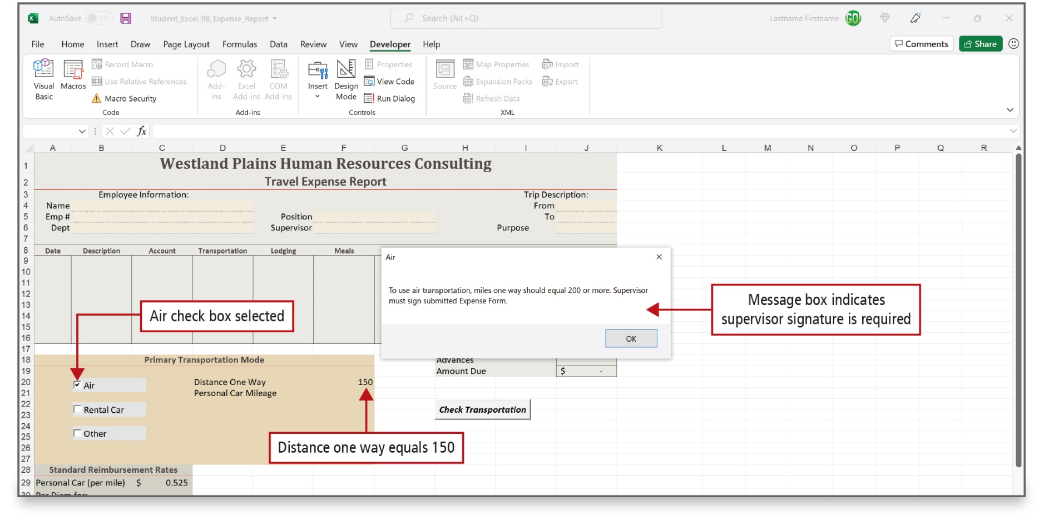
Write a V B A Procedure to Use an ActiveX Control (11 of 12)
Notes:
After you create a VBA procedure, you should always test it to verify that it works as intended.
Alt Text: The message in the dialog box reads as follows: to use air transportation, miles one way should equal 200 or more. Supervisor must sign submitted expense form (labeled as Message box indicates supervisor signature is required). The Air check box is selected and Distance one way equals 150 (F20).

Slide 22
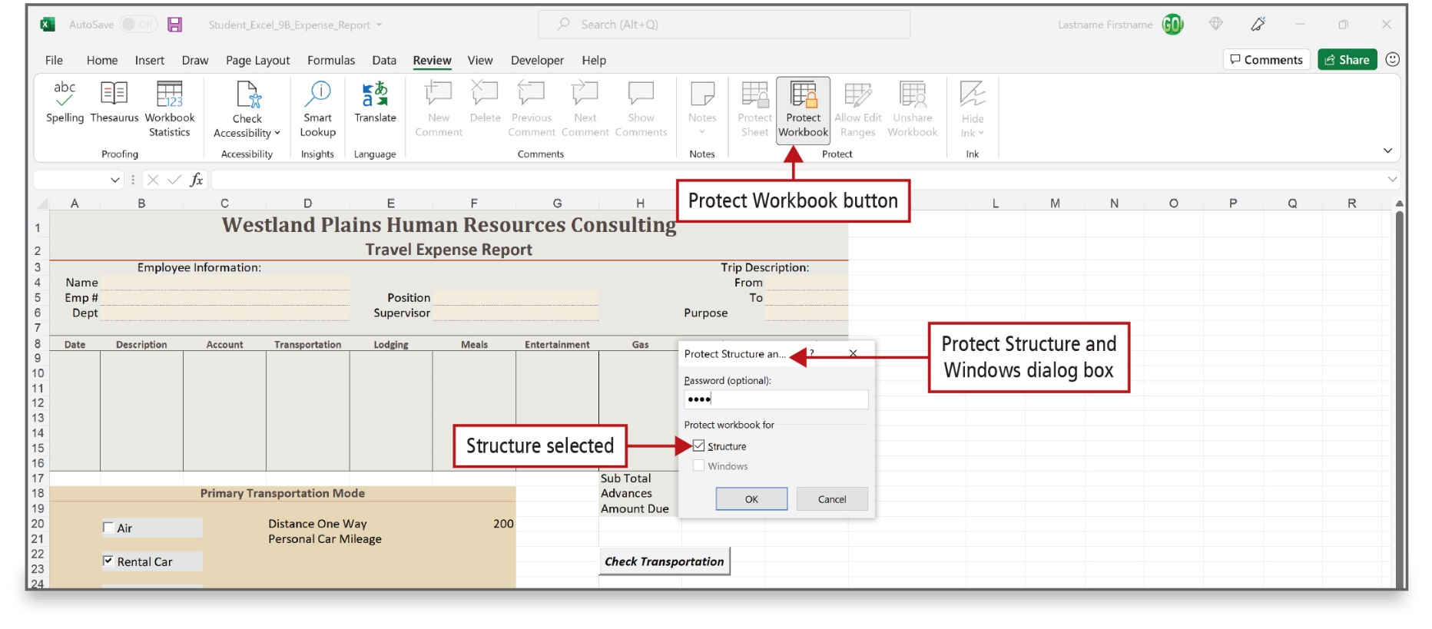
Write a V B A Procedure to Use an ActiveX Control (12 of 12)
Notes:
After a macro has been sufficiently tested, it is good practice to protect the workbook. In this case, the workbook that contains a form is protected so that users do not modify ActiveX controls.

Slide 23
Restore Initial Settings
Public location
  When you make changes to a public computer, it is proper etiquette to return it to the condition in which you found it
Delete macros
  On the Developer tab, click Macros
Remove the Developer tab
  Right-click the Developer tab, click Customize the Ribbon, and deselect Developer in the right pane
Notes:
It is good practice to return a public computer to the state in which you found it by following the steps shown on the slide.

Slide 24

Questions

Slide 25

Copyright
This work is protected by United States copyright laws and is provided solely for the use of instructors in teaching their courses and assessing student learning. Dissemination or sale of any part of this work (including on the World Wide Web) will destroy the integrity of the work and is not permitted. The work and materials from it should never be made available to students except by instructors using the accompanying text in their classes. All recipients of this work are expected to abide by these restrictions and to honor the intended pedagogical purposes and the needs of other instructors who rely on these materials.

