Slide 1
Chapter 1
Systems Analysis and Design in a Changing World, 7th Edition - Chapter 1 ©2016. Cengage Learning. All rights reserved.

Slide 2
From Beginning to End: An Overview of Systems Analysis and Design
Chapter 1
Systems Analysis and Design in a Changing World 7th Ed
Satzinger, Jackson & Burd

Slide 3
Chapter 1: Outline
Software Development and Systems Analysis and Design
Systems Development Lifecycle (S D L C)
Iterative Development
Introduction to Ridgeline Mountain Outfitters (R M O)
Developing R M O’s Tradeshow Systems
Where You are Headed—The Rest of the Book

Slide 4
Learning Objectives (1 of 2)
After reading this chapter, you should be able to:
  Describe the purpose of systems analysis and design when developing information systems
  Explain the purpose of the system development life cycle and identify its six core processes
  Explain how information system methodologies provide guidelines for completing the six core processes
  Describe the characteristics of Agile methodologies and iterative system development

Slide 5
Learning Objectives (2 of 2)
  Based on the Ridgeline Mountain Outfitters Tradeshow System example:
    Describe how the six core processes of the S D L C are used in each iteration
    Identify key documents used in planning a project
    Identify key diagrams used in systems analysis and systems design

Slide 6
Overview
This text is about developing information systems that solve an organization need.
Chapter 1 takes you through the process of developing one rather small information system
The rest of the textbook elaborates on the basic processes shown in chapter 1

Slide 7
Software Development (1 of 3)
Computer application (app) – a computer software program that executes on a computing device to carry out a specific set of functions
  Modest scope
Information system – a set of interrelated components that collects, processes, stores, and provides as output the information needed to complete business tasks
  Broader in scope than “app”
  Includes database and related manual processes

Slide 8
Software Development (2 of 3)
Systems analysis – those activities that enable a person to understand and specify what an information system should accomplish
Systems design – those activities that enable a person to define and describe in detail the system that solves the need

Slide 9
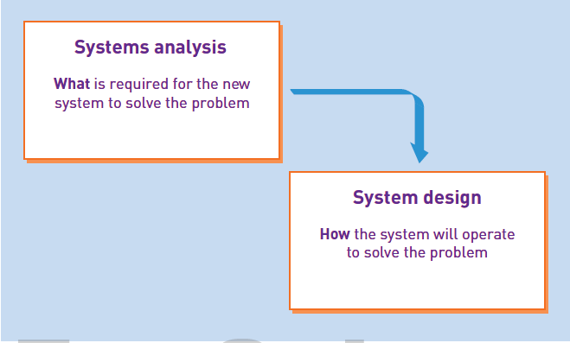

Slide 10
Software Development (3 of 3)
Understand the need (business need)
Capture the vision
Define a solution
Communicate the vision and solution
Build the solution
Confirm that the solution meets the need
Launch the solution system

Slide 11
System Development Life Cycle (S D L C) (1 of 3)
The process consisting of all activities required to build, launch, and maintain an information system. Six core processes are:
  Identify the problem or need and obtain approval
  Plan and monitor the project
  Discover and understand the details of the problem or need
  Design the system components that solve the problem
  Build, test, and integrate system components
  Complete system tests and then deploy the solution

Slide 12
System Development Life Cycle (S D L C) (2 of 3)
Project – a planned undertaking that has a beginning and end and that produces some definite result
  Used to develop an information system
  Requires knowledge of systems analysis and systems design tools and techniques

Slide 13
System Development Life Cycle (S D L C) (3 of 3)
System development process – the actual approach used to develop a particular information system (aka: methodology)
  Unified process (U P)
  Extreme programming (X P)
  Scrum
Most processes/methodologies now use Agile and Iterative development

Slide 14
Iterative Development
Agile development – an information system development process that emphasizes flexibility to anticipate new requirements during development
  Fast on feet; responsive to change
Iterative development -- an approach to system development in which the system is “grown” piece by piece through multiple iterations
  Complete small part of system (mini-project), then repeat processes to refine and add more, then repeat to refine and add more, until done

Slide 15
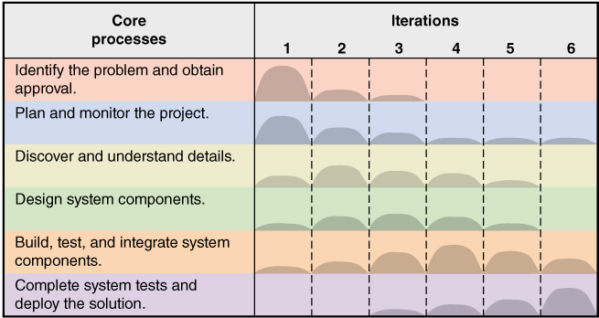
Iterative and Agile Systems Development Lifecycle (S D L C)

Slide 16
Ridgeline Mountain Outfitters (R M O) (1 of 2)
Large Retail Company
  Outdoor and sporting clothing and accessories
  Skiing, mountain biking, water sports
  Hiking, camping, mountain climbing
Rocky Mountain and Western States
  Started mail order and phone order
  Added retail stores
  Added extensive E-business component

Slide 17


Slide 18
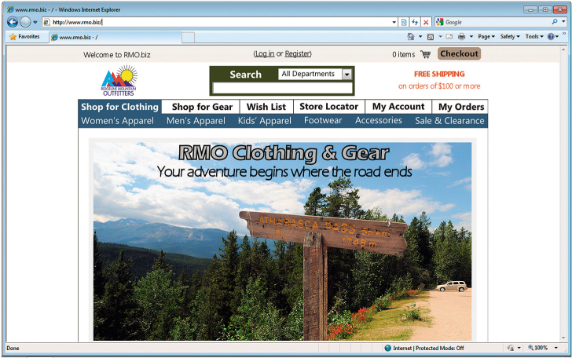
Ridgeline Mountain Outfitters (R M O) (2 of 2)

Slide 19
R M O Tradeshow System (1 of 2)
Sample project for chapter
Small information system (app)
Being added to larger supply chain management system
Demonstrates one iteration of the small project – assumes more iterations in total project
Goes through all six core processes of S D L C
The plan for this chapter is to complete iteration in six days

Slide 20
R M O Tradeshow System (2 of 2)
Problem-- purchasing agents attend apparel and fabric trade shows around the world to order new products from suppliers
Need– information system (app) to collect and track information about suppliers and new products while at tradeshows
Tradeshow Project– is proposed
  Supplier information subsystem
  Product information subsystem

Slide 21
Initial Activities – pre-project
Identify the problem and document the objective of the system (core process 1)
  Preliminary investigation
  System Vision Document
Obtain approval to commence the project (core process 1)
  Meet with key stakeholders, including executive management
  Decision reached, approve plan and budget

Slide 22
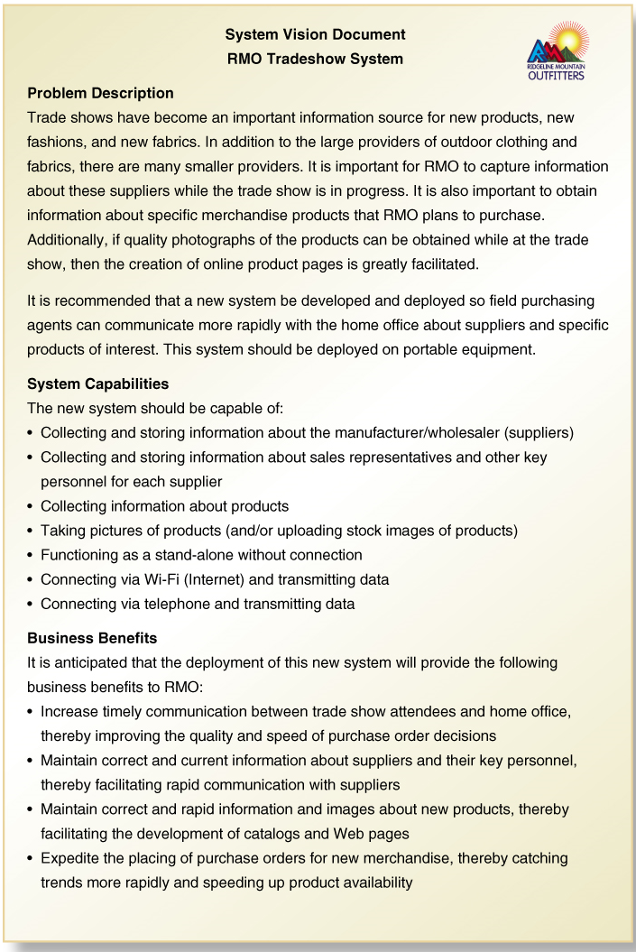
System Vision Document
Problem description
System capabilities
Business benefits

Slide 23
Problem Description
Trade shows have become an important information source for new products, new fashions, and new fabrics. In addition to the large providers of outdoor clothing and fabrics, there are many smaller providers. It is important for R M O to capture information about these suppliers while the trade show is in progress. It is also important to obtain information about specific merchandise products that R M O plans to purchase. Additionally, if quality photographs of the products can be obtained while at the trade show, then the creation of online product pages is greatly facilitated.
It is recommended that a new system be developed and deployed so field purchasing agents can communicate more rapidly with the home office about suppliers and specific products of interest. This system should be deployed on portable equipment.

Slide 24
System Capabilities
The new system should be capable of:
Collecting and storing information about the manufacture/wholesaler (suppliers)
Collecting and storing information about sales representatives and other key personnel for each supplier
Collecting information about products
Taking pictures of products (and/or uploading stock images of products)
Functioning as a stand-alone without connection
Connecting via Wi-Fi (Internet) and transmitting data
Connecting via telephone and transmitting data

Slide 25
Business Benefits
It is anticipated that the deployment of this new system will provide the following business benefits to R M O:
Increase timely communication between trade show attendees and home office, thereby improving the quality and speed of purchase order decisions
Maintain correct and current information about suppliers and their key personnel, thereby facilitating rapid communication with suppliers
Maintain correct and rapid information and images about new products, thereby facilitating the development of catalogs and Web pages
Expedite the placing of purchase orders for new merchandise, thereby catching trends more rapidly and speeding up product availability

Slide 26
Day 1: Activities
Core Process 2: Plan the Project
  Determine the major components (functional areas) that are needed
    Supplier information subsystem
    Product information subsystem
  Define the iterations and assign each function to an iteration
    Decide to do Supplier subsystem first
    Plan one iteration as it is small and straight forward
  Determine team members and responsibilities

Slide 27
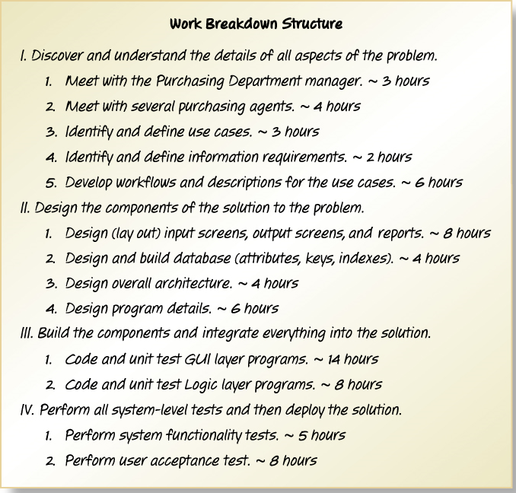
Work Breakdown Structure for Iteration
Describes the work and covers Core Processes 3, 4, 5, and 6

Slide 28
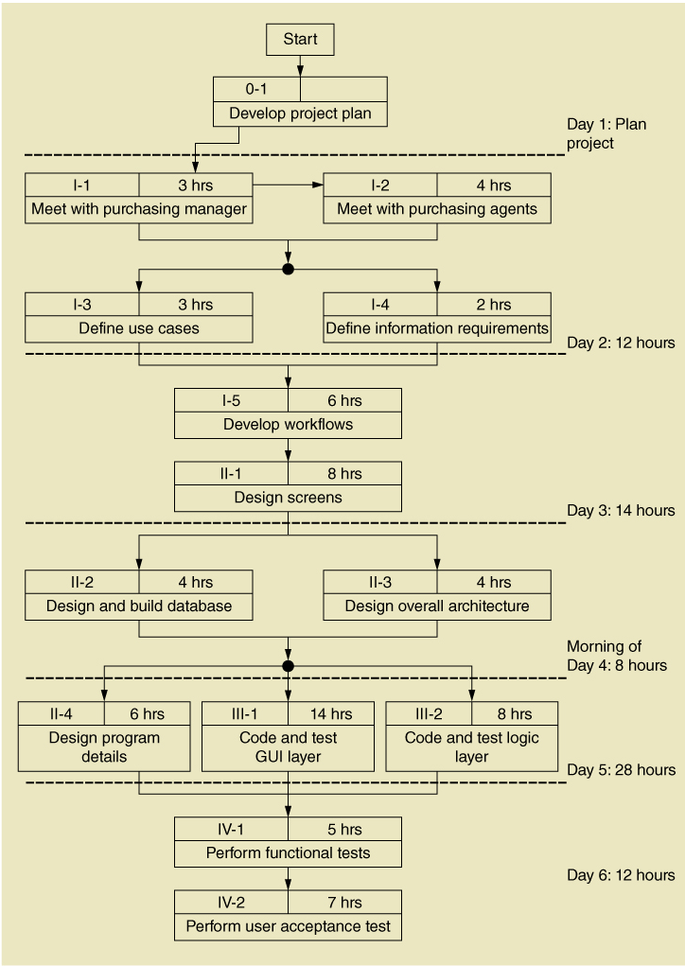
Work Sequence Draft for Iteration
Elaborates the Work Breakdown Structure

Slide 29
Day 2: Activities
Core Process 3: Discover and Understand Details
  Do preliminary fact-finding to understand requirements
  Develop a preliminary list of use cases and a use case diagram
  Develop a preliminary list of classes and a class diagram

Slide 30
Identify Use Cases: Both subsystems
Use Case | Description
Look up supplier | Using supplier name, find supplier information and contacts
Enter/update supplier information | Enter (new) or update (existing) supplier information
Look up contact | Using contact name, find contact information
Enter/update contact information | Enter (new) or update (existing) contact information
Look up product information | Using description or supplier name, look up product information
Enter/update contact information | Enter (new) or update (existing) product information
Upload product image | Upload images of the merchandise product

Slide 31
Identify Object Classes: Both subsystems
Object Classes | Attributes
Supplier | Supplier name, address, description, comments
Contact | name, address, phone(s), e-mail address(es), position, comments
Product | Category, name, description, gender, comments
ProductPicture | I D, image

Slide 32
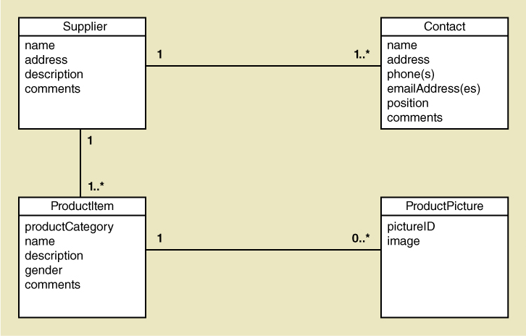
Preliminary Class Diagram: Both subsystems

Slide 33
Day 3: Activities
Core Process 3: Discover and Understand Details
  Do in-depth fact-finding to understand requirements
  Understand and document the detailed workflow of each use case
Core Process 4: Design System Components
  Define the user experience with screens and report sketches

Slide 34
Supplier Information Subsystem
Use cases:
  Look up supplier
  Enter/update supplier information
  Lookup contact information
  Enter/update contract information

Slide 35
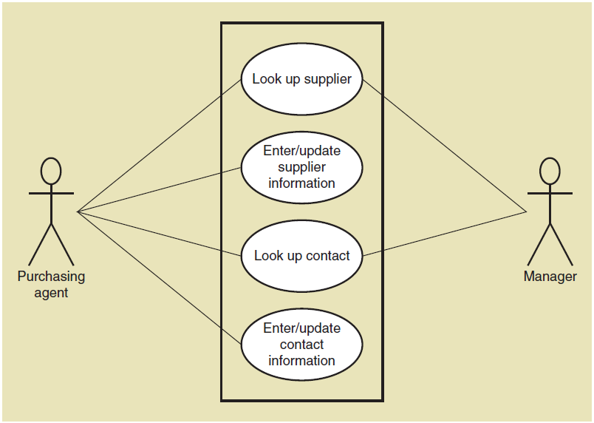
Use Case Diagram: Supplier information subsystem

Slide 36
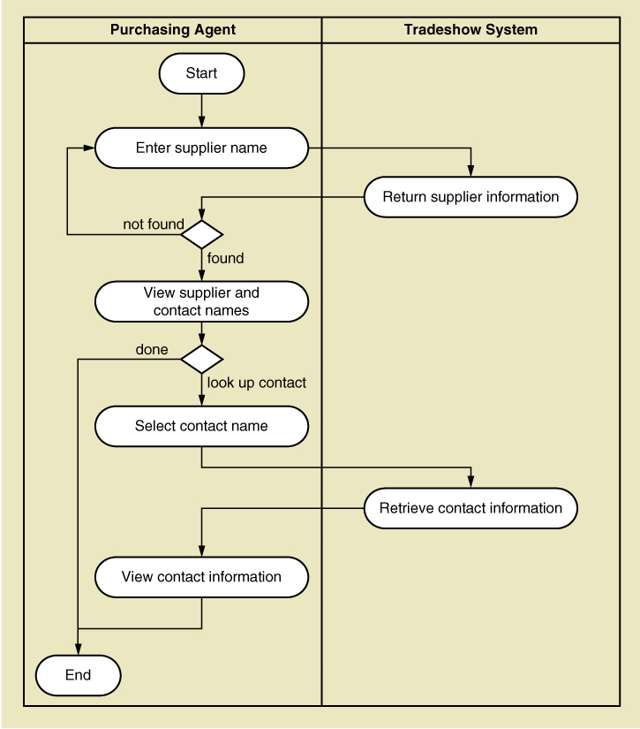
Activity Diagram (Workflow)
Look up supplier use case

Slide 37
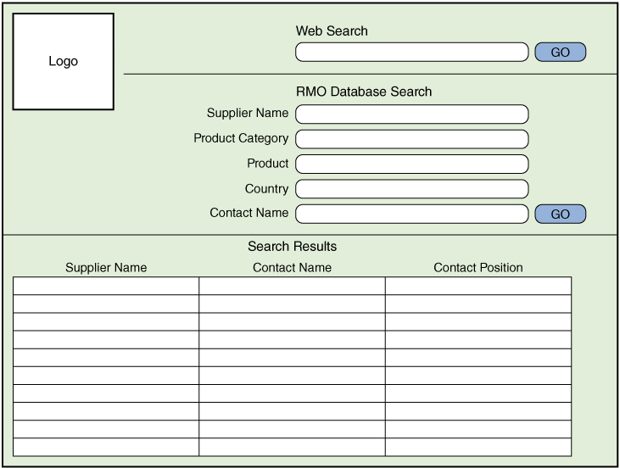
Draft Screen Layout: Look up supplier use case

Slide 38
Day 4: Activities
Core Process 4: Design System Components
  Design the database (schema)
  Design the system’s high level structure
    Browser, Windows, or Smart phone
    Architectural configuration (components)
    Design class diagram
    Subsystem architectural design

Slide 39
Database Schema (1 of 2)
Table name | Attributes
Supplier | SupplierID: integer {key} Name: string {index} Address1: string Address1: string City: string State-province: string Postal-code: string Country: string SupplierWebURL: string Comments: string

Slide 40
Database Schema (2 of 2)
Table name | Attributes
Contact | ContactID: integer {key} SupplierID: integer {foreign key} Name: string {index} Title: string WorkAddress1: string WorkAddress2: string WorkCity: string WorkState: string WorkPostal-code: string WorkCountry: string WorkPhone: string WorkPhone: string EmailAddress1: string EmailAddress2: string Comments: string

Slide 41
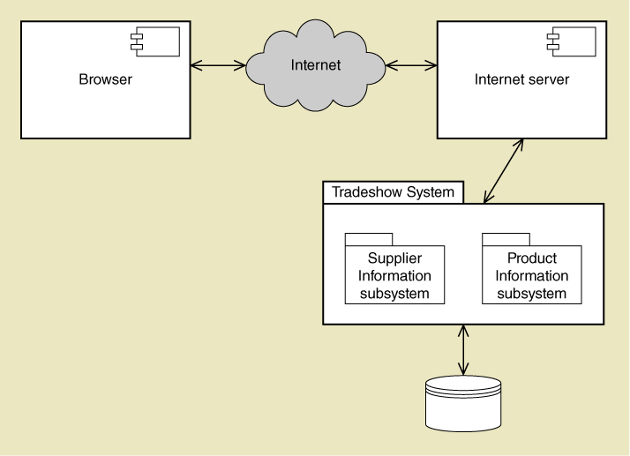
Architectural Configuration Diagram

Slide 42
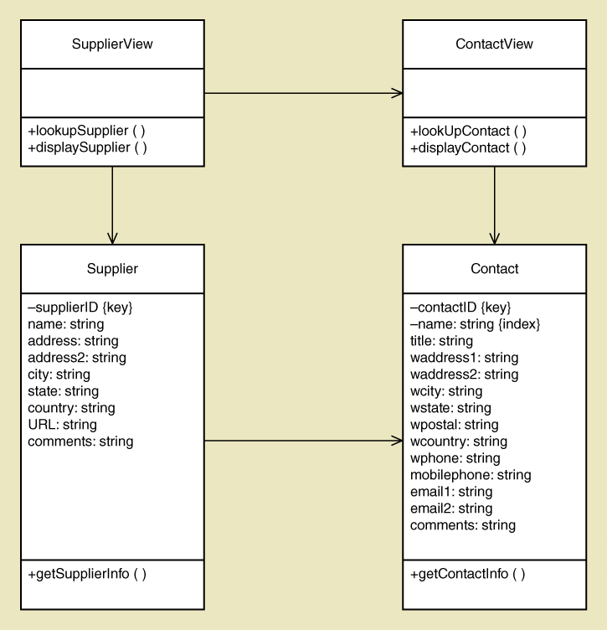
Preliminary Design Class Diagram
Includes View Layer Classes and Domain Layer Classes

Slide 43
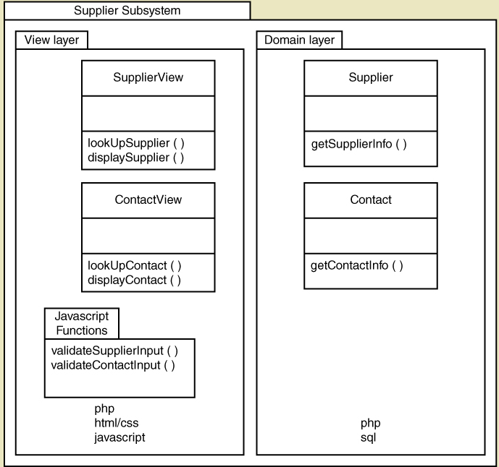
Subsystem Architectural Design Diagram

Slide 44
Notes on Managing the Project
Lots of design diagrams shown
  Design in a complex activity with multiple levels
  One diagram builds on/complements another
  Not everything is diagrammed, especially for a small project. Pick and choose.
Programming is also done concurrently
  You don’t design everything then code
  You do some design, some coding, some design, some coding

Slide 45
Day 5: Activities
Core Process 4: Design System Components
  Continue with design details
  Proceed use case by use case
Core Process 5: Build, Test, and Integrate System Components
  Continue programming (build)
  Build use case by use case
  Perform unit and integration tests

Slide 46
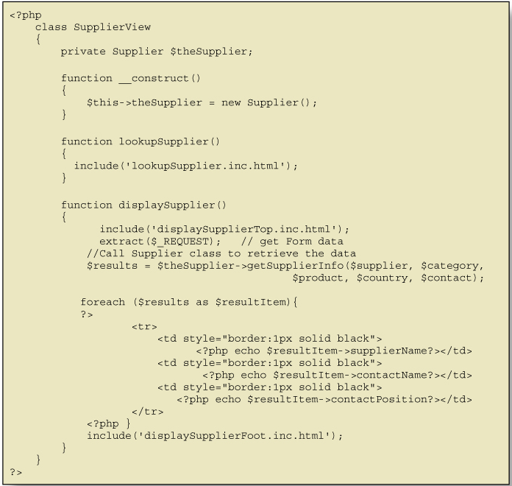
Code Example for One Class

Slide 47
Day 6: Activities
Core Process 6: Complete System Testing and Deploy the System
  Perform system functional testing
  Perform user acceptance testing
  Possibly deploy part of system

Slide 48
Workflow of Testing Tasks

Slide 49
First Iteration Recap
This was a 6 day iteration of small project
  Most iterations are longer (2 to 4 weeks)
  This project might be 2 iterations
  Most projects have many more iterations
End users need to be involved, particularly in day 1, 2, 3 and 6.
Days 4 and 5 involved design and programming concurrently.

Slide 50
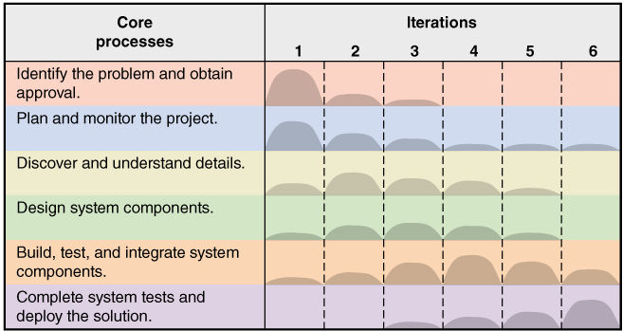
This Book is about Activities and Tasks in the S D L C

Slide 51
Where You Are Headed – The Rest of the Book (1 of 7)
Part I: An Introduction to Systems Development
  Chapter 1: From Beginning to End
    Small project overview emphasizing analysis and design and iterative development
  Online Chapter A: The Systems Analyst
    More about the role of the systems analyst in systems development, including system concepts and careers

Slide 52
Where You Are Headed – The Rest of the Book (2 of 7)
Part II. Systems Analysis Activities
  Chapter 2: Investigating System Requirements
    More about core process 3: Systems analysis activities
  Chapter 3: Identifying Use Cases
    Techniques for Identifying and modeling use cases for systems analysis

Slide 53
Where You Are Headed – The Rest of the Book (3 of 7)
Part II.
Chapter 4: Domain Modeling
    Techniques for identifying and modeling domain classes for systems analysis
  Chapter 5: Use Case Modeling
    Modeling more details about use cases
  Online Chapter B: The Traditional Approach to Requirements
    Modeling using Data Flow Diagrams

Slide 54
Where You Are Headed – The Rest of the Book (4 of 7)
Part III. Essentials of Systems Design
  Chapter 6: Foundations of Systems Design
    Design activities, Controls and Security
  Chapter 7: Defining the System Architecture
    Understanding the environment, configuring the application

Slide 55
Where You Are Headed – The Rest of the Book (5 of 7)
Part III.
  Chapter 8: Designing the User Interface
    Input and output design
  Chapter 9: Designing the Database
    Designing the schema – tables, data types, keys

Slide 56
Where You Are Headed – The Rest of the Book (6 of 7)
Part IV. Projects and Project Management
  Chapter 10: Approaches to Systems Development
    Predictive and adaptive approaches, S D L C, models
  Chapter 11: Project Planning and Project Management
    Core processes 1 and 2
  Online Chapter C: Project Management Techniques
    N P V, Pert charts, P M B O K knowledge areas

Slide 57
Where You Are Headed – The Rest of the Book (7 of 7)
Part V. Advanced Design and Deployment
  Chapter 12: Object-Oriented Design: Fundamentals
    Principles, Design Classes, C R C Cards
  Chapter 13: Object-Oriented Design: Use Case Realization
    Communication and Sequence Diagrams, three layer design
  Chapter 14: Deploying the New System
    Testing, deployment, support activities

Slide 58
Summary
This text is about developing information systems that solve an organization need
Chapter 1 takes you through the whole process for one small information system
System development involves 6 core processes, known as the S D L C
The rest of the text elaborates on the basic processes shown in chapter 1

Slide 59
Summary – Terms (1 of 3)
Terms to review and know include:
  Computer application
  Information system
  Project
  Systems analysis
  System design
  System development lifecycle (S D L C)
  Information system development process (methodology)

Slide 60
Summary – Terms (2 of 3)
  Agile development
  Iterative development
  System vision document
  Work breakdown structure
  Work sequence draft
  Use cases
  Use case diagram
  Object classes (domain classes)

Slide 61
Summary – Terms (3 of 3)
  Class diagram
  Design class diagram
  High level structural design (architectural design)
  Database schema
  Screen layout

