Slide 1
Chapter 8
Systems Analysis and Design in a Changing World, 7th Edition - Chapter 8 ©2016. Cengage Learning. All rights reserved.

Slide 2
Designing the User Interface
Chapter 8
Systems Analysis and Design in a Changing World 7th Ed Satzinger, Jackson & Burd

Slide 3
Chapter 8: Outline
Understanding the User Experience and the User Interface
Fundamental Principles of User-Interface Design
Transitioning from Analysis to User-Interface Design
User-Interface Design
Designing Reports, Statements, and Turnaround Documents

Slide 4
Learning Objectives (1 of 2)
Explain the concepts of user experience, user interface, and usability
Describe the metaphors that can be used to assist in user-interface design
Describe important characteristics of human interface objects that affect usability
Discuss the important principles of navigation through a software application

Slide 5
Learning Objectives (2 of 2)
Explain how a storyboard can be used to help with user-interface design
Describe important guidelines in user-interface design for desktop applications
Describe important guidelines in user-interface design for mobile devices
Design printed and on-screen reports appropriate to users’ needs

Slide 6
Overview
User interface design must consider the entire user experience
Good user interfaces are based on good design principles – visibility, affordance, feedback, etc.
Poorly designed user interface can make the information system unusable
Story boards are a powerful tool for UI design

Slide 7
User Experience
User Interface – inputs and outputs that directly involve a human user/actor
  A dialog goes on between actor and system
User interface design must focus on entire User Experience (Human Computer Interaction –H C I)
Called User-Centered Design
  Focus early on users and their work
  Evaluate designs to ensure usability
  Use iterative development
Usability is the objective

Slide 8
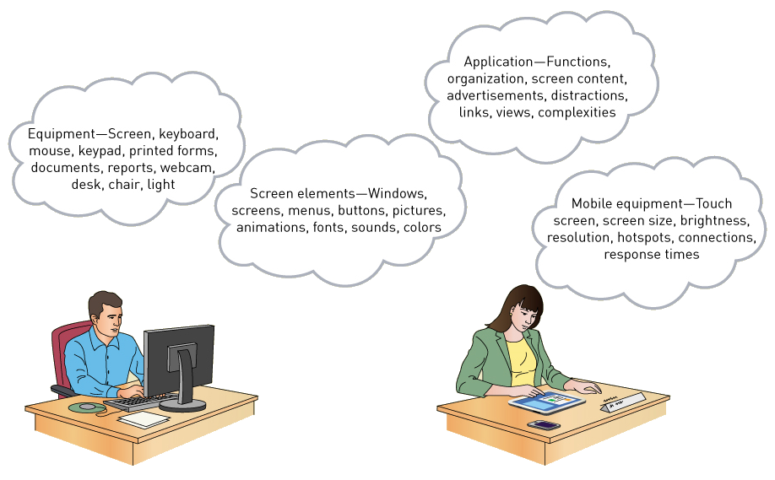
Components of the User Interface

Slide 9
Metaphors of Human Computer Interaction
Direct manipulation metaphor
  metaphor in which objects on a display are manipulated to look like physical objects (pictures) or graphic symbols that represent them (icons)
Desktop metaphor
  metaphor in which the visual display is organized into distinct regions, with a large empty workspace in the middle and a collection of tool icons around the perimeter
Document metaphor
  metaphor in which data is visually represented as paper pages or forms
Dialog metaphor
  metaphor in which user and computer accomplish a task by engaging in a conversation or dialog via text, voice, or tools such as labeled buttons

Slide 10
Metaphor Details
Metaphor | Description | Example
Direct manipulation | Manipulating objects on a display that look like physical objects (pictures) or that represent them (icons) | The user drags a folder icon to an image of a recycle bin or trash can to delete a collection of files.
Desktop | Organizing visual display into distinct regions, with a large empty workspace in the middle and a collection of tool icons around the perimeter | At computer startup, a Windows user sees a desktop, with icons for a clock, calendar, notepad, inbox and sticky notes (the computer interface version of a physical Post-It note).
Document | Visually representing the data in files as paper pages or forms: these pages can be linked together by references (hyperlinks) | The user fills in a form field for a product he or she owns, and the manufacturer’s Web site finds and displays the product’s manual as an Adobe Acrobat file, which contains a hyperlinked table of contents and embedded links to related documents.
Dialog | The user and computer accomplishing a task by engaging in a conversation or dialog by using text, voice, or tools. such as labeled buttons | The user clicks a button labeled "troubleshoot” because the printer isn't working. The computer prints questions on the display, and the user responds by typing answers or selecting responses from a printed list.

Slide 11
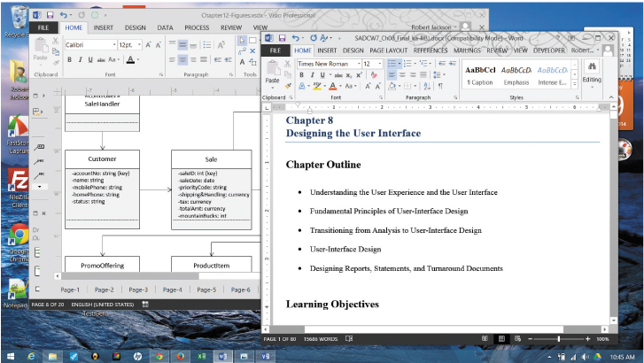
Direct Manipulation, Desktop, and Document Metaphors On One Screen

Slide 12
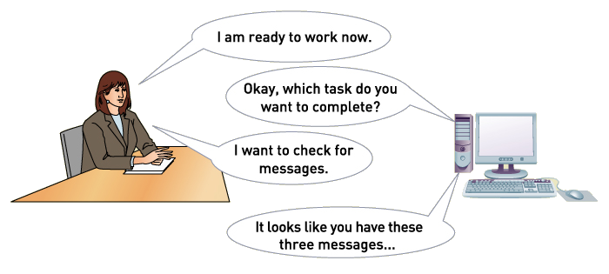
Dialog Metaphor

Slide 13
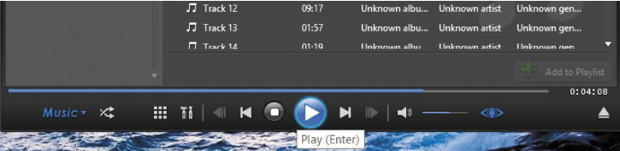
Principles of User-Interface Design (1 of 3)
Human-Interface Objects
  Affordance – the appearance of the object suggests its function

Slide 14
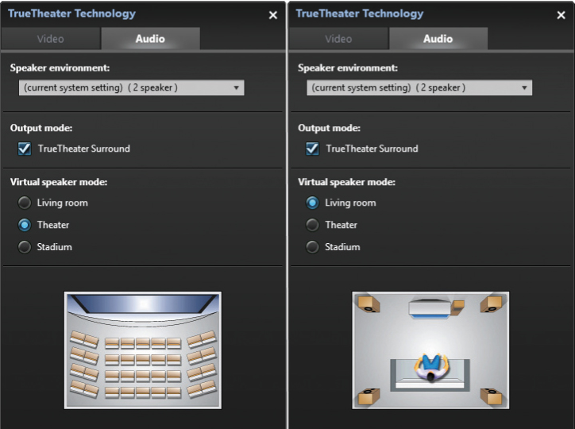
Principles of User-Interface Design (2 of 3)
Human-Interface Objects
  Visible with Feedback
  Both visible on the display and provides a response to a user action (feedback)
  Good examples – radio buttons and check boxes

Slide 15
Principles of User-Interface Design (3 of 3)
Consistency
  Across platforms
  Within a suite of applications
  Within a particular application
Continuity
  Consistency across releases over time

Slide 16
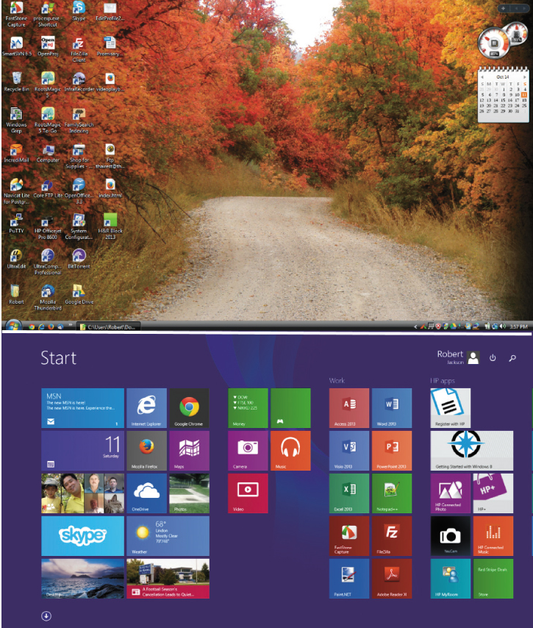
Windows Continuity
Windows 7
Windows 8

Slide 17
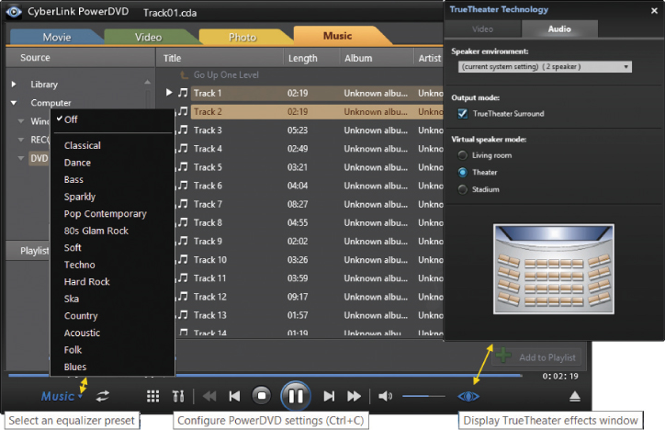
Principles of User-Interface Design (1 of 5)
Discoverability
  To help users discover “hidden” features or objects
  Active discovery – mouse hovers, pop-ups, tool tips

Slide 18
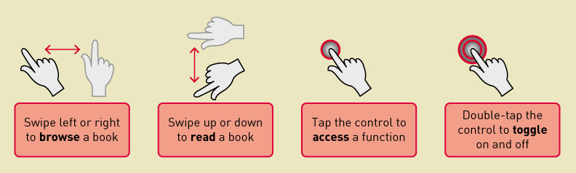
Principles of User-Interface Design (2 of 5)
Discoverability
  Visual Diagrams to guide users

Slide 19
Principles of User-Interface Design (3 of 5)
Closure
  Closure on Dialogues – End of a series of actions
  Protect user’s work – at end and for partially complete work
  Provide undo to reverse actions

Slide 20

Principles of User-Interface Design (4 of 5)
Readability and Navigation
  Readable text for all users (type, size, color)

Slide 21
Principles of User-Interface Design (5 of 5)
Readability and Navigation
  Clear navigation
  Reverse navigation – a way out – breadcrumbs navigation
Usability and Efficiency
  Shortcut keys for experienced users
  Meaningful error messages
  Simplicity – KISS

Slide 22
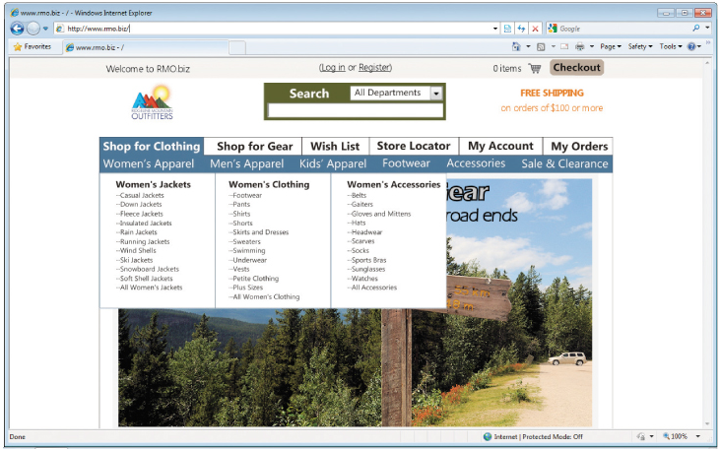
R M O Homepage – clean and simple

Slide 23
Transitioning from Analysis to U I Design
Use Cases and the Menu Hierarchy
  We design use case by use case
  Menus are a typical way to organize access to use case functionality
  Different types of users might have different menus
  Useful to design an overall menu hierarchy and then subsets for different users
  Once the hierarchy is established, menus can be implemented in a variety of ways

Slide 24
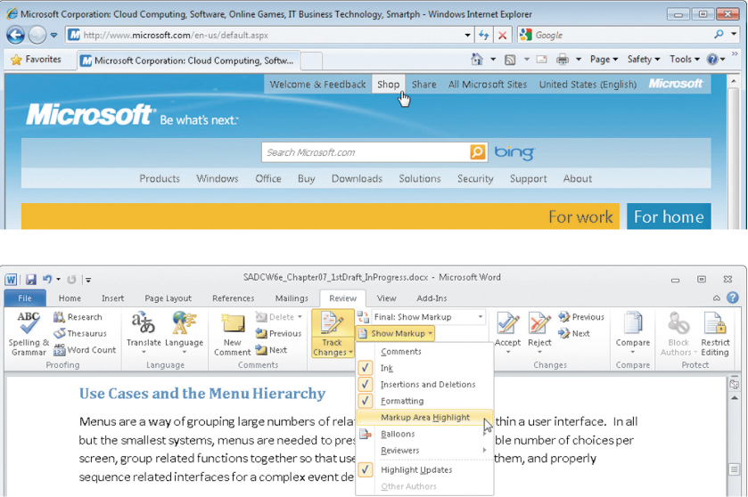
Two Different Menu Styles

Slide 25
Some R M O Use Cases (1 of 2)
Grouped by Actor and Subsystem
Subsystem | Use case | Users/actors
Sales | Search for item | Customer, customer service representative, store sales representative
Sales | View product comments and ratings | Customer, customer service representative, store sales representative
Sales | View accessory combinations | Customer, customer service representative, store sales representative
Sales | Fill shopping cart | Customer
Sales | Empty shopping cart | Customer
Sales | Check out shopping cart | Customer
Sales | Fill reserve cart | Customer
Sales | Empty reserve cart | Customer
Sales | Convert reserve cart | Customer
Sales | Create phone sale | Customer service representative
Sales | Create store sale | Store sales representative

Slide 26
Some R M O Use Cases (2 of 2)
Subsystem | Use case | Users/actors
Order fulfillment | Ship items | Shipping
Order fulfillment | Manage shippers | Shipping
Order fulfillment | Create backorder | Shipping
Order fulfillment | Create item return | Shipping, customer
Order fulfillment | Look up order status | Shipping, customer, management
Order fulfillment | Track shipment | Shipping, customer, marketing
Order fulfillment | Rate and comment on product | Customer
Order fulfillment | Provide suggestion | Customer

Slide 27
R M O Use Cases
Grouped into First Cut Menu Hierarchy
Menu description | Menu choices (use cases) | Intended user(s)
Shopping cart functions (primary or reserve) | Search for item View product comments and ratings View accessory combinations Switch carts (primary to reserve or vice versa) Fill shopping cart Empty shopping cart Check out shopping cart | Customer
Sale creation | Search for item View product comments and ratings View accessory combinations Create sale | Customer service and store sales representatives
Order shipment | Ship items Manage shippers Create backorder Create item return Look up order status Track shipment | Customer service and store sales representatives
Customer order control | Look up order status Track shipment Create item return Rate and comment on product Provide suggestion | Customer

Slide 28
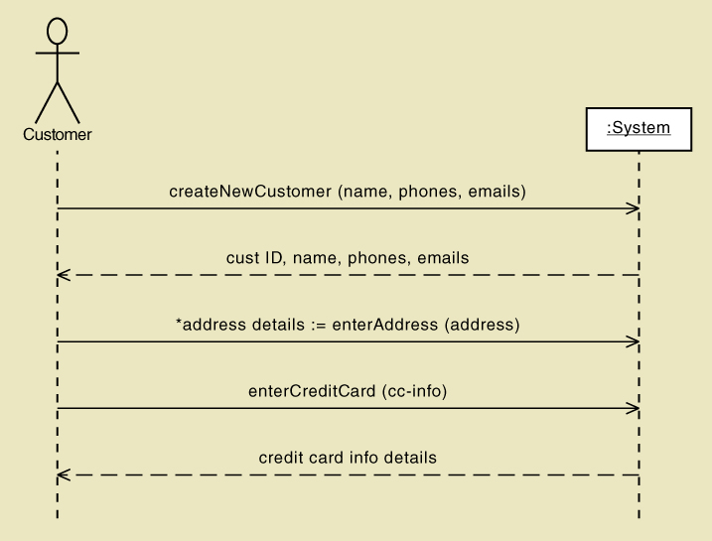
Analysis Models and Input Forms
S S D defines input messages, which indicates what forms

Slide 29
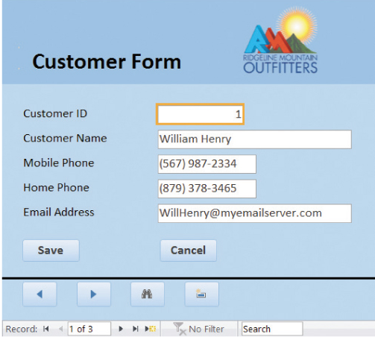
Sample Customer Form
First draft of R M O Customer Form from S S D information

Slide 30
Dialogs and Storyboards
For each use case, think of the natural flow of a dialog between user and computer
  Based on the flow of activities in use case description and/or the system sequence diagram
  Use natural language to emphasize feedback to user
  Create a storyboard of the dialog, showing the sequence of sketches of the screen each step of the dialog. (storyboarding)
  Review the storyboard with users

Slide 31
From Dialog to Storyboard (part 1)
Use case Check out shopping cart
SYSTEM: What would you like to do?
USER: I’d like to check out.
SYSTEM: Okay. What is your e-mail address or account number?
USER: My e-mail address is nwells22@gmail.com.
SYSTEM: Fine. You are Nancy Wells at 1122 Silicon Avenue. Correct?
USER: Yes.
SYSTEM: All items in your cart are in stock and can be shipped today. Because your order subtotal is over $100, you qualify for free UPS ground shipping (3 to 5 days). Other shipping options include next day ($35.00), two day ($20.00), and U S P S parcel post ($11.70, 5 to 7 days). How would you like your items to be shipped?

Slide 32
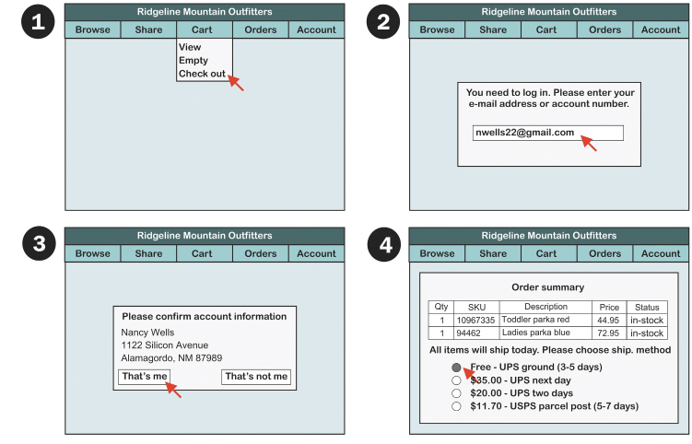
From Dialog to Storyboard (part 1)

Slide 33
From Dialog to Storyboard (part 2) (1 of 2)
USER: Free U P S ground shipping.
SYSTEM: We have a shipping address on file for you (1122 Silicon Avenue). Do you want your order shipped to that address?
USER: No.
SYSTEM: To what address would you like the order shipped?
USER: John Wells, 1612 Jefferson Street N E, Albuquerque, N M 87123.
SYSTEM: Okay, the total charge is $125.56 ($117.90 item subtotal plus $7.66 sales tax). Shall I charge that amount to your credit card on file (a Visa with an account number ending in 0899)?
USER: Yes.
SYSTEM: Your payment has been approved, and your order is being prepared for shipment. A confirmation e-mail has been sent to you, and another will be sent with a shipment tracking number when the order is shipped later today. Can I help you with anything else?
USER: No.

Slide 34
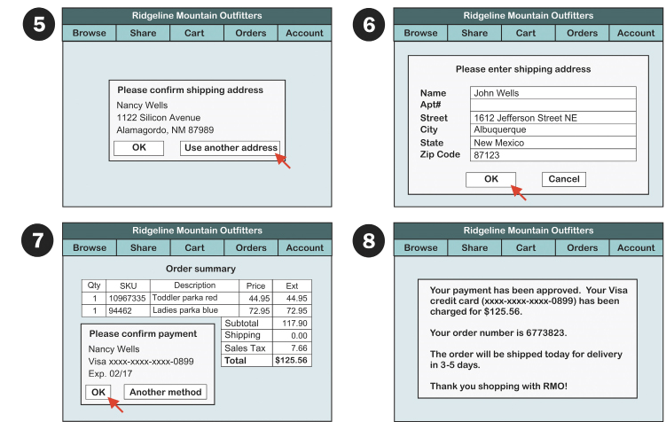
From Dialog to Storyboard (part 2) (2 of 2)

Slide 35
User-Interface Design (1 of 3)
Is the system a custom application or browser based?
What kinds of devices will the user-interface need to support?
What operating systems will the user-interface run on?

Slide 36
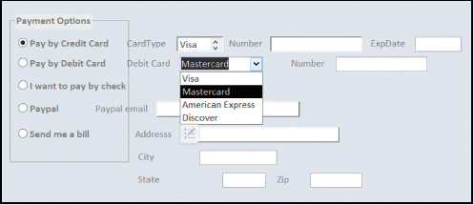
User-Interface Design (2 of 3)
Desktop and Laptop UIs
  Layout and Formatting
    Purposeful designs, location and grouping, no sloppiness or errors
  Poorly designed form –

Slide 37
User-Interface Design (3 of 3)
Data Entry
  Text box, list box, combo box, radio buttons, check boxes
  Include online editing to minimize errors
Navigation and Visibility
  Minimize, maximize, close, scroll bars, resize

Slide 38
R M O Windows Form

Slide 39
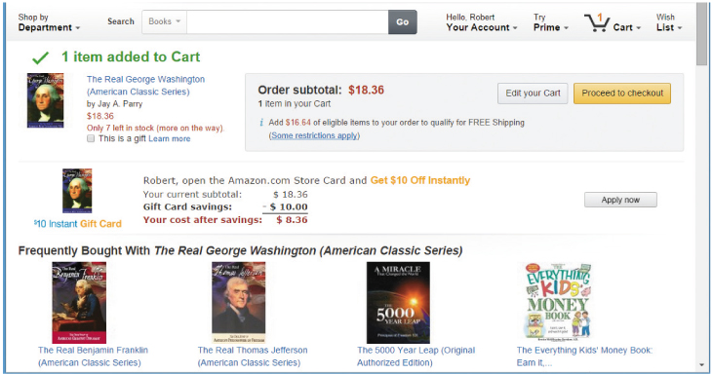
Sample Web page
More navigation controls would help

Slide 40
Considerations for Web-based Applications
Layout and formatting
  Various browser default settings
  Impact of online advertising
Data entry and user actions – client side programming
Navigation and visibility – complete yet simple

Slide 41
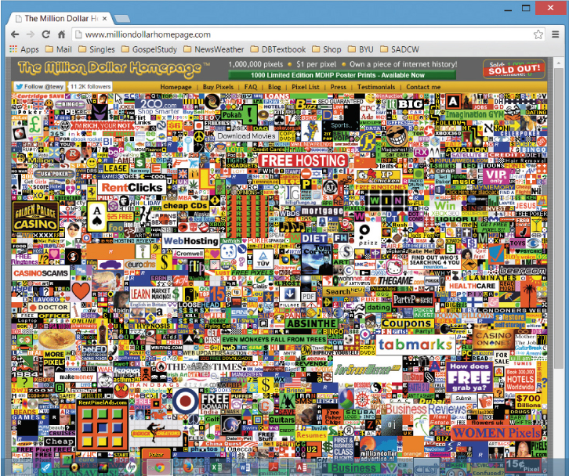
Extreme advertising
Only advertising on this page

Slide 42
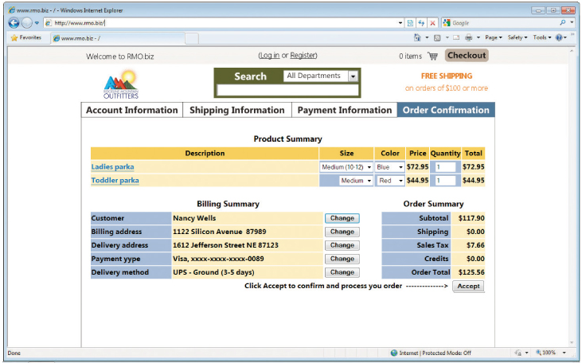
R M O Checkout Page
R M O shopping cart checkout
  Simple, easy to read

Slide 43
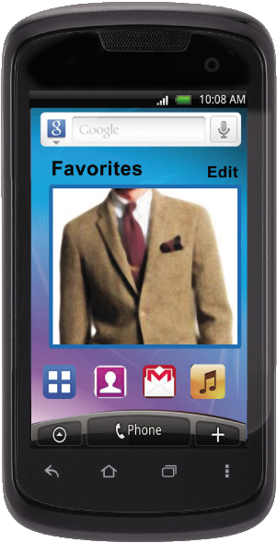
Smartphones and Small Mobile Devices (1 of 3)
Challenges
  Small screen size, small keyboards and touch screens, limited network capacity, app design guidelines and toolkits

Slide 44
Smartphones and Small Mobile Devices (2 of 3)
Layout and formatting
  Rotating view, resizing, visible navigation, scrolling
Data entry and user actions
  Fat finger and accidental touches
Navigation and visibility
  Show site map
  Use action bar
  Visual clues
  Back button

Slide 45
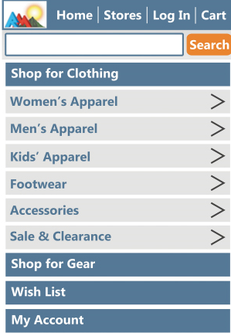
Smartphones and Small Mobile Devices (3 of 3)
Sample prototype for R M O home page display

Slide 46
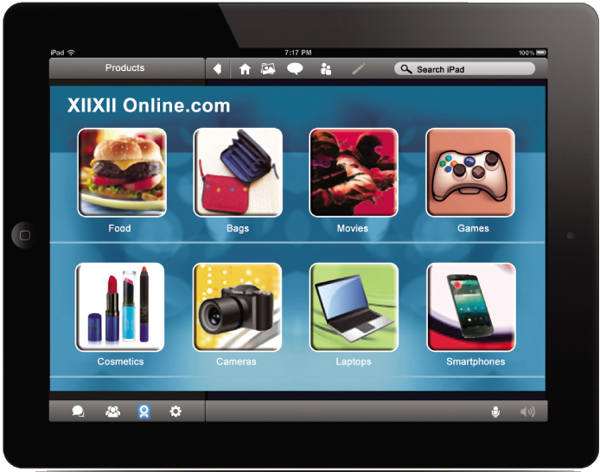
U I for Tablets
Similar to smartphones, except more real estate to display

Slide 47
Designing Reports, Statements, and Turnaround Documents (1 of 2)
Report Types
  Detailed reports -- reports that contain specific information on business transactions
  Summary reports -- reports that summarize detail or recap periodic activity
  Exception reports -- reports that provide details or summary information about transactions or operating results that fall outside a predefined normal range of values
  Executive reports -- reports used by high level managers to assess overall organizational health and performance

Slide 48
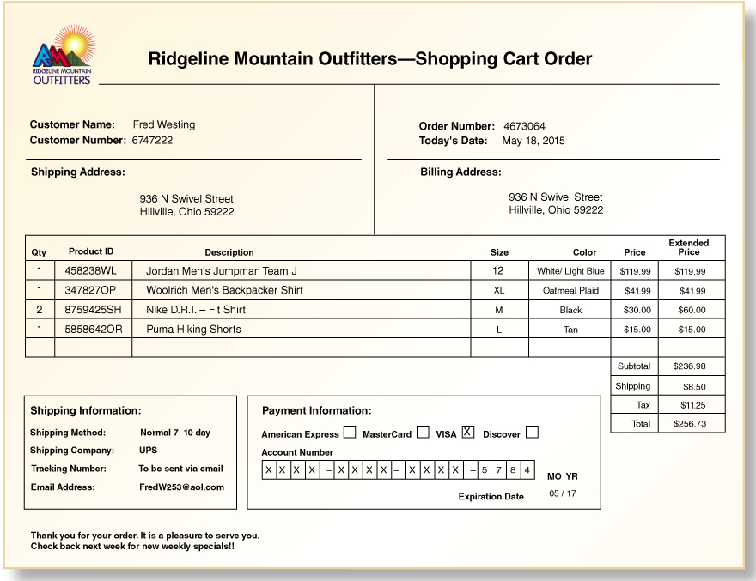
R M O Reports (1 of 5)
Shopping cart order report

Slide 49
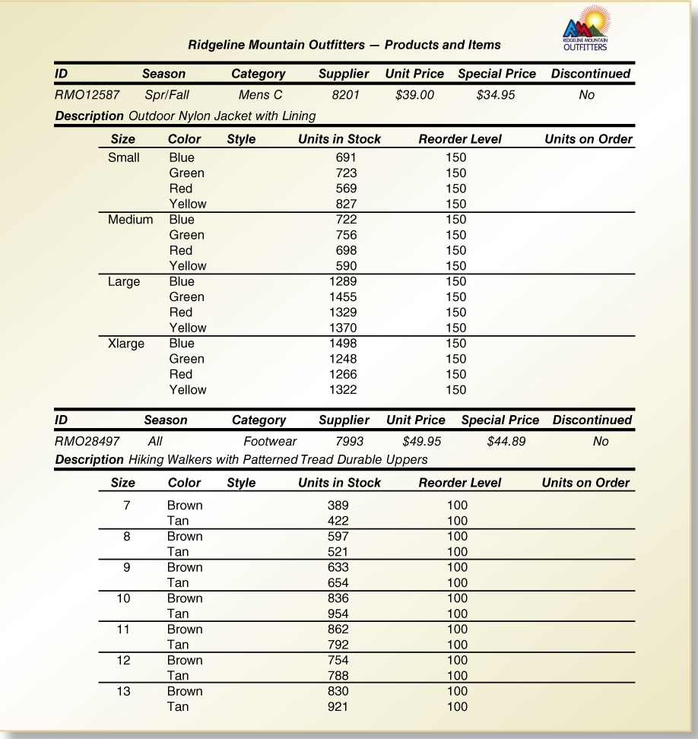
R M O Reports (2 of 5)
Inventory report

Slide 50
R M O Reports (3 of 5)
Employee benefit report
Survivor Protection
In the event of your death while working for a participating employer, your designated beneficiaries could receive:
Lump Sum Benefits
$50,000 | Basic Life Insurance
$230,000 | Supplemental Life Insurance
$148,677 | Thrift Plan
$31,686 | Tax Sheltered Annuity (T S A) Plan
$255 | Social Security for your eligible dependents
$460,618 | Total*

Slide 51
R M O Reports (4 of 5)
You have not elected Universal Life Insurance. If you would like more information on this plan, please call 1-800-555-7772.
*Refer to page 7 for additional information on the amount of coverage needed to provide ongoing replacement income.
Accidental Death Benefits
If your death is due to an accident, your designated beneficiaries will receive the above benefits plus:
$100,000 | 24-Hour Accidental Death and Dismemberment Insurance
$100,000 | Occupational Accidental Death and Dismemberment Insurance, if the accident is work related

Slide 52
R M O Reports (5 of 5)
Monthly Death Benefits
If you die before receiving the Master Retirement Plan benefits and you are vested and have a surviving spouse, your spouse may be eligible for a Qualified Pre-Retirement Survivor Annuity.
In addition, your family may be eligible for the following estimated monthly benefits from Social Security, not to exceed a maximum of $2,591 based on:
$1,110 | each child under age 18
$1,110 | a spouse with children under age 16; or
$1,058 | for a spouse age 60 or older

Slide 53
Designing Reports, Statements, and Turnaround Documents (2 of 2)
Electronic Reports
  Drill down – to view additional detail related to an item
  Linking reports to other reports
  View data grouped various categories
Graphical and Multimedia Reports
  Charting and graphing of data

Slide 54
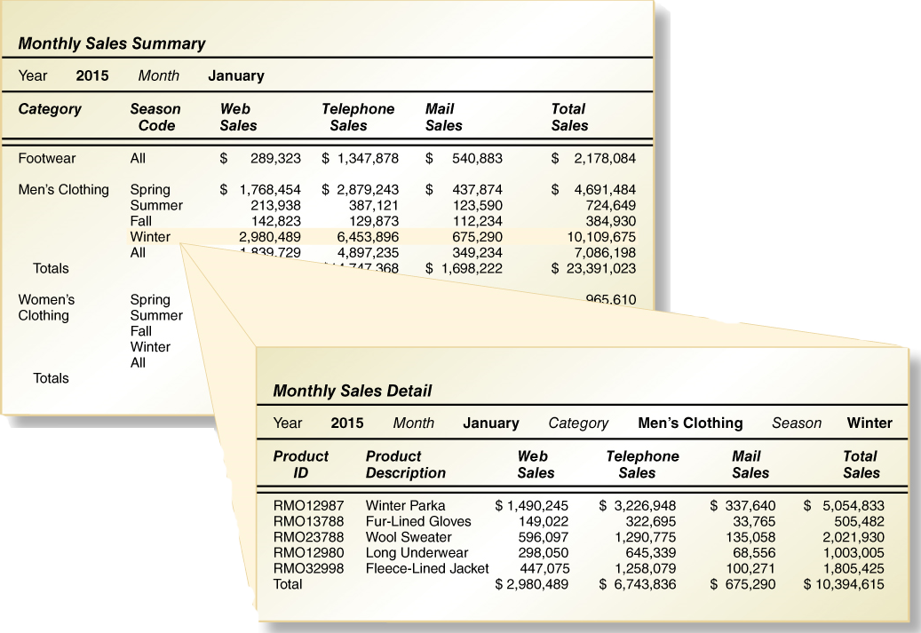
Electronic Reports (1 of 2)
Drill down

Slide 55
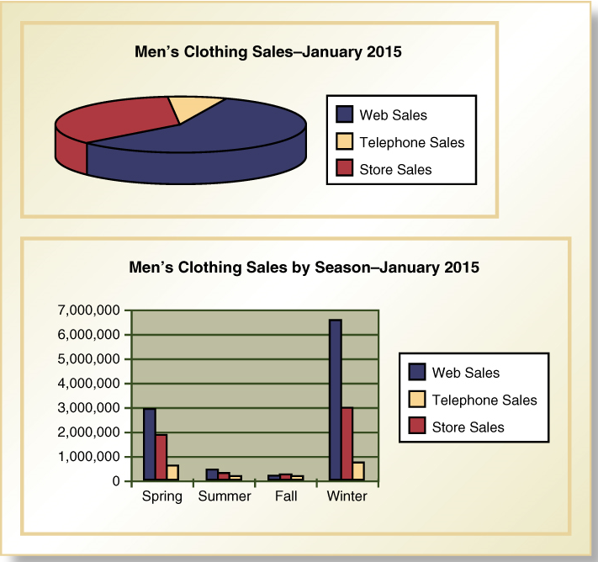
Electronic Reports (2 of 2)
Charts and graphs

Slide 56
Summary (1 of 3)
User interfaces involve direct user interaction with the system.
The design of the user interface has a long history as human computer interaction (H C I) and relies on user-centered design, which focuses early on users, evaluates designs to ensure usability, and uses iterative development
Metaphors are used to think about the nature of the user interface, and they include direct manipulation, desktop, document, and dialog metaphors.

Slide 57
Summary (2 of 3)
Key user interface concepts include affordance and visibility for controls
Other key principles include consistency, shortcuts, feedback, dialog closure, error handling, and reversal of actions
Use cases are organized into one or more menu hierarchies to arrange functionality for users
Dialogs and storyboards are used to design the interaction for each use case based on use case flow of activates and system sequence diagrams
Guidelines are available for designing for Windows, Web browsers, and Handheld devices

Slide 58
Summary (3 of 3)
Designing inputs involves identifying devices and mechanisms, identifying inputs and the data content, and determining the controls necessary
Designing outputs includes designing detailed reports, summary report, exception reports, and executive reports
Electronic reports and other outputs can include drill down, graphics, and multimedia

