Slide 1
Chapter 11
Systems Analysis and Design in a Changing World, 7th Edition - Chapter 11 ©2016. Cengage Learning. All rights reserved.

Slide 2
Project Planning and Project Management
Chapter 11
Systems Analysis and Design in a Changing World 6th Ed
Satzinger, Jackson & Burd

Slide 3
Chapter 11: Outline
Principles of Project Management
Activities of S D L C Core Process 1:
  Identify the Problem and Obtain Approval
Activities of S D L C Core Process 2:
  Plan and Monitor the Project

Slide 4
Learning Objectives
Describe the factors that cause a software development project to succeed or fail
Describe the responsibilities of a project manager
Describe the knowledge areas in the project management body of knowledge (P M B O K)
Describe the Agile approach to the project management knowledge areas
Explain the activities required to get a project approved (Core Process 1)
Explain the activities required to plan and monitor a project (Core Process 2)

Slide 5
Overview
Chapter 10 covered the various alternatives for the S D L C and approaches to development
You should be asking yourself:
  “How are all these activities coordinated?”
  “How do I know which tasks to do first?”
  “How is the work assigned to the different teams and team members?”
  “How do I know which parts of the new system should be developed first?”

Slide 6
Principles of Project Management: The Need for Project Management
Categories of project success
  Successful projects – on time, within budget, on scope
  Challenged projects – failure in one area
  Failed projects – cancelled or not used
Recent years have seen some improvement, but still 1/3 to 1/2 of projects are challenged or fail
Development paradigm | Successful | Challenged | Failed
Ad hoc | 50% | 35% | 15%
Traditional | 49% | 32% | 18%
Lean | 72% | 21% | 7%
Agile | 64% | 30% | 6%
Iterative | 65% | 28% | 7%

Slide 7
The Need for Project Management
Reasons for failure
  Undefined project management practices
  Poor I T management and poor I T procedures
  Inadequate executive support for the project
  Inexperienced project managers
  Unclear business needs and project objectives
  Inadequate user involvement

Slide 8
The Role of the Project Manager
Project Management
  Organizing and directing other people to achieve a planned result within a predetermined schedule and budget
  The processes used to plan the project and then to monitor and control it.
Project Manager
  Great need for effective project managers
  Internally managing people and resources
  Externally conducting public relations

Slide 9
Project Manager Responsibilities
Internal Responsibilities
  Developing the project schedule
  Recruiting and training team members
  Assigning work to teams and team members
  Assessing project risks
  Monitoring and controlling project deliverables and milestones
External Responsibilities
  Reporting the project’s status and progress
  Working directly with the client (the project’s sponsor) and other stakeholders
  Identifying resource needs and obtaining resources

Slide 10
Additional Project Stakeholders
Client
  the person or group that funds the project
Oversight Committee
  clients and key managers who review the progress and direct the project
Users
  the person or group of people who will use the new system

Slide 11
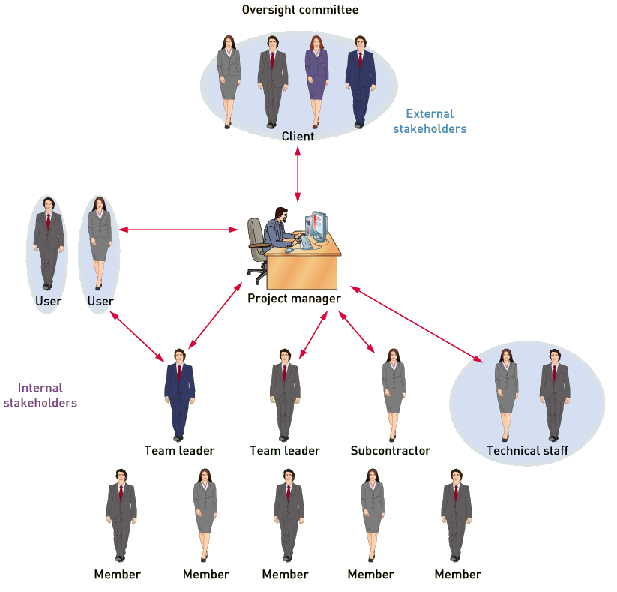
Project Manager & Project Stakeholders

Slide 12
Project Management and Ceremony
Ceremony
  The level of formality of a project; the rigor of holding meetings and producing documentation
High Ceremony
  Meetings are often held on a predefined schedule, with specific participants, agendas, minutes, and follow-through
  Specifications are formally documented with an abundance of diagrams and documentation and are frequently verified through formal review meetings between developers and users.
Low Ceremony
  Meetings occur in the hallway or around the water cooler.
  Written documentation, formal specifications, and detailed models are kept to a minimum
  Developers and users usually work closely together on a daily basis to define requirements and develop the system

Slide 13
Project Management Body of Knowledge (P M B O K) (1 of 2)
P M P O K is organized into 10 knowledge areas:
Project Integration Management—Integrating all the other knowledge areas into one seamless whole
Project Scope Management—Defining and controlling the functions that are to be included in the system as well as the scope of the work to be done by the project team
Project Time Management—Creating a detailed schedule of all project tasks and then monitoring the progress of the project against defined milestones
Project Cost Management—Calculating the initial cost/benefit analysis and its later updates and monitoring expenditures as the project progresses
Project Quality Management—Establishing a comprehensive plan for ensuring quality, which includes quality control activities for every phase of a project

Slide 14
Project Management Body of Knowledge (P M B O K) (2 of 2)
Project Human Resource Management—Recruiting and hiring project team members; training, motivating, and team building; and implementing related activities to ensure a happy, productive team
Project Communications Management—Identifying all stakeholders and the key communications to each; also establishing all communications mechanisms and schedules
Project Risk Management—Identifying and reviewing throughout the project all potential risks for failure and developing plans to reduce these risks
Project Procurement Management—Developing requests for proposals, evaluating bids, writing contracts, and then monitoring vendor performance
Project Stakeholder Management—Identifying and communicating with the stakeholders of the new system

Slide 15
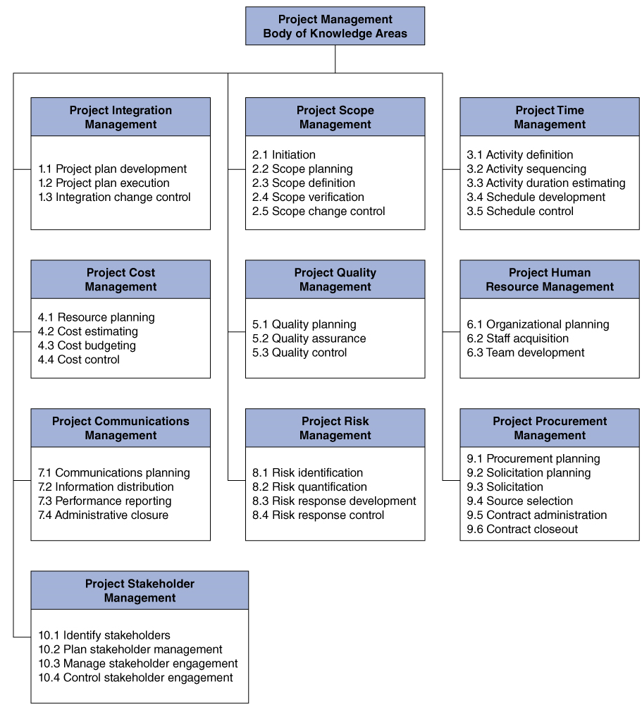
P M B O K

Slide 16
“Agile” Project Management
Agile Scope Management
  Scope is not well understood, but needs to be controlled
Agile Time Management
  Schedule must be flexible due to changes
Agile Cost Management
  Costs are more difficult to estimate
Agile Risk Management
  Higher risk aspects of project are completed first
Agile Quality Management
  Quality assessed after each iteration

Slide 17
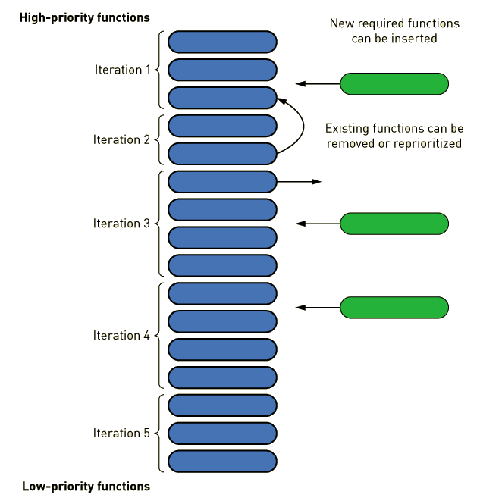
Agile Scope Management

Slide 18
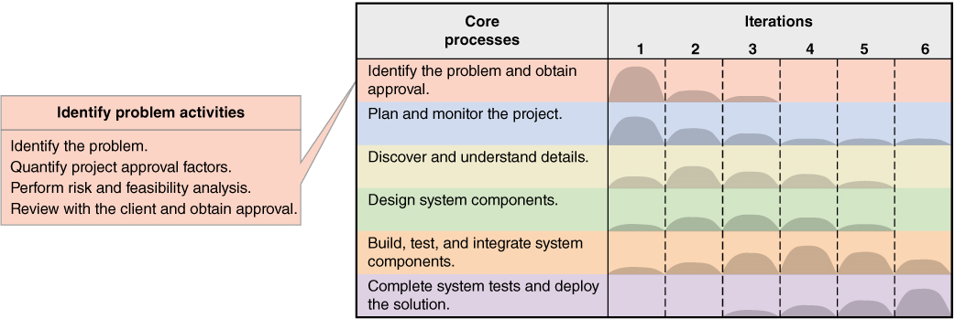
Activities of Core Process 1:
Identify the Problem and Obtain Approval

Slide 19
Identify the Problem (1 of 2)
I S Development Projects usually:
  Respond to an opportunity
    Strategic initiative
    Something that provides competitive advantage
  Resolve a problem
    Operational issues keep coming up
    User needs aren’t being met
  Respond to an external directive
    Legislation requires new form of reporting
    Changes in tax laws or regulations

Slide 20
Identify the Problem (2 of 2)
System Vision Document
  Problem Description
    What is the problem and idea for the solution?
  System Capabilities
    What are the capabilities the new system will have?
    Helps define the scope
  Business Benefits
    The benefits that accrue to the organization
    Tangible (in dollars) and intangible benefits

Slide 21
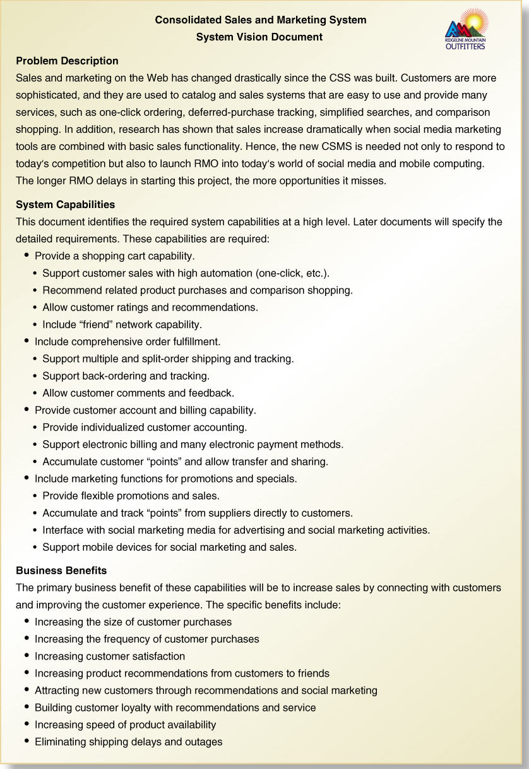
System Vision Document R M O C S M S

Slide 22
R M O C S M S Vision Document (1)
Consolidated Sales and Marketing System: System Vision Document
Problem Description
Sales and marketing on the Web has changed drastically since the CSS was built. Customers are more sophisticated, and they are used to catalog and sales systems that are easy to use and provide many services, such as one-click ordering, deferred-purchase tracking, simplified searches, and comparison shopping. In addition, research has shown that sales increase dramatically when social media marketing tools are combined with basic sales functionality. Hence, the new C S M S is needed not only to respond to today’s competition but also to launch R M O into today’s world of social media and mobile computing. The longer R M O delays in starting this project, the more opportunities it misses.

Slide 23
R M O C S M S Vision Document (2)
System Capabilities
This document identifies the required system capabilities at a high level. Later documents will specify the detailed requirements. These capabilities are required:
Provide a shopping cart capability.
  Support customer sales with high automation (one-click. etc.)
  Recommend related product purchases and comparison shopping.
  Allow customer ratings and recommendations.
  Include “friend” network capability.
Include comprehensive order fulfillment.
  Support multiple and split-order shipping and tracking.
  Support back-ordering and tracking.
  Allow customer comments and feedback.
Provide customer account and billing capability.
  Provide Individualized customer accounting.
  Support electronic billing area many electronic payment methods.
  Accumulate customer “points” and allow transfer and sharing.
Include marketing functions for promotions and specials.
  Provide flexible promotions and sales.
  Accumulate and track “points” from suppliers directly to customers.
  interface with social marketing media for advertising and social marketing activities.
  Support mobile devices for social marketing and sales.

Slide 24
R M O C S M S Vision Document (3)
Business Benefits
The primary business benefit of these capabilities will be to increase sales by connecting with customers and improving the customer experience. The specific benefits include.
Increasing the size of customer purchases
Increasing the frequency of customer purchases
Increasing customer satisfaction
Increasing product recommendations from customers to friends
Attracting new customers through recommendations and social marketing
Building customer loyalty with recommendations and service
Increasing speed of product availability
Eliminating shipping delays and outages

Slide 25
Quantify Project Approval Factors (1 of 5)
Estimated Time for Completion
Time Estimate for the New C S M S Project
Subsystem | Functional requirements | Iterations required | Estimated time
Sales subsystem* | 15 | 5 | 20 weeks
Order Fulfillment subsystems | 12 | 5 | 20 weeks
Customer Account subsystem** | 10 | 4 | 15 weeks
Marketing subsystem** | 6 | 3 | 13 weeks
Reporting subsystem** | 7 | 3 | 12 weeks
Total development time (2 teams) | Blank | Blank | 40 weeks
Final hardening and acceptance testing | Blank | 2 | 8 weeks
Total project time | Blank | Blank | 48 weeks
*Assigned to Tiger team
**Assigned to Cougar team

Slide 26
Quantify Project Approval Factors (2 of 5)
Estimated Cost for Development
Summary of Development Costs for C S M S
Expense category | Amount
Salaries/wages (includes benefits costs) (1 P M, 8 analysts, 1 support) | $936,000.00
Equipment/installation | $308,000.00
Training | $78,000.00
Facilities | $57,000.00
Utilities | $97,000.00
Travel/miscellaneous | $87,000.00
Licenses | $18,000.00
Total | $1,581,000.00

Slide 27
Quantify Project Approval Factors (3 of 5)
Estimated Cost for Support
Summary of Estimated Annual Operating Costs for C S M S
Recurring expense | Amount
Connectivity/hosting | $156,000.00
Programming | $75,000.00
Help desk | $90,000.00
Total | $321,000.00

Slide 28
Quantify Project Approval Factors (4 of 5)
Anticipated Benefits from New System
  Opening up new markets with new services, products, or locations
  Increasing market share in existing markets
  Enhancing cross-sales capabilities with existing customers
  Reducing staff by automating manual functions or increasing efficiency
  Decreasing operating expenses, such as shipping charges for “emergency shipments”
  Reducing error rates through automated editing or validation
  Reducing bad accounts or bad credit losses
  Reducing inventory or merchandise losses through tighter controls
  Collecting receivables (accounts receivable) more rapidly

Slide 29
Quantify Project Approval Factors (5 of 5)
Tangible “Dollar” Benefits
  Used for Cost/Benefit Analysis--process of comparing costs and benefits to see whether investing in a new system will be beneficial--
Estimated Annual Benefits for C S M S
Benefit or cost saving | Amount
Recapture/prevention of lost sales | $200,000.00
Increase sales to existing customers | $300,000.00
Sales to new customers | $350,000.00**
Increased efficiency in order processing | $50,000.00
Reduction of data center and equipment costs because of hosting | $146,000.00
Total | $1,046,000.00
**plus 8 % annual growth

Slide 30
Cost/Benefit Analysis (1 of 3)
Cost/benefit analysis
  comparing costs and benefits to see if the net result is plus or minus
Net Present Value (N P V)
  the present value of dollar benefits and dollar costs of a particular investment
Break-even Point
  point in time at which benefits and costs are equal
Payback Period
  the time period after which the dollar benefits have offset the dollar costs

Slide 31
Cost/Benefit Analysis (2 of 3)
Tangible Benefit
  a benefit that can be measured or estimated in terms of dollars
Intangible Benefit
  a benefit that accrues to an organization but that can’t be measured quantitatively or estimated accurately

Slide 32
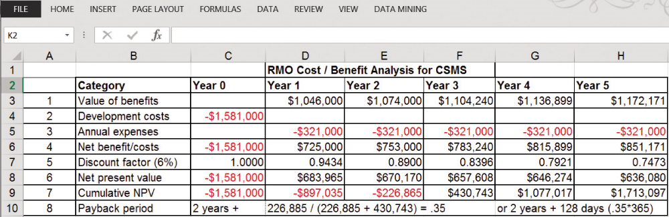
Cost/Benefit Analysis (3 of 3)
Use present value (after discount factor) for all dollar values
Estimate the useful life of the system
The N P V after 5 years is $1,713,097
Payback Period is 2 years amd 128 days

Slide 33
Examples of Intangible Benefits
Increased levels of service (in ways that can’t be measured in dollars)
Increased customer satisfaction (not measurable in dollars)
Survival—need to do it to compete
Need to develop in-house expertise (such as a pilot program with new technology)

Slide 34
Determine Project Risk and Feasibility
Determine the organizational risks and feasibility
  How well does the new system fit the organizational culture? Risk of negative impacts?
Evaluate the technological risks and feasibility
  Can the system be built by the team using technology needed? Training available?
Assess the resource risks and feasibility
  Are the needed resources available? Skilled people?
Identify the schedule risks and feasibility
  Can the system be built in the amount of time available? Fixed Deadline?

Slide 35
Review with Client and Obtain Approval
Executive committee reviews and approves
Board must review and approve for very large projects
Involved stakeholders need to understand what is expected of them
I S department needs to know what to do for staffing and support
Whole organization should be made aware of the project and its importance

Slide 36
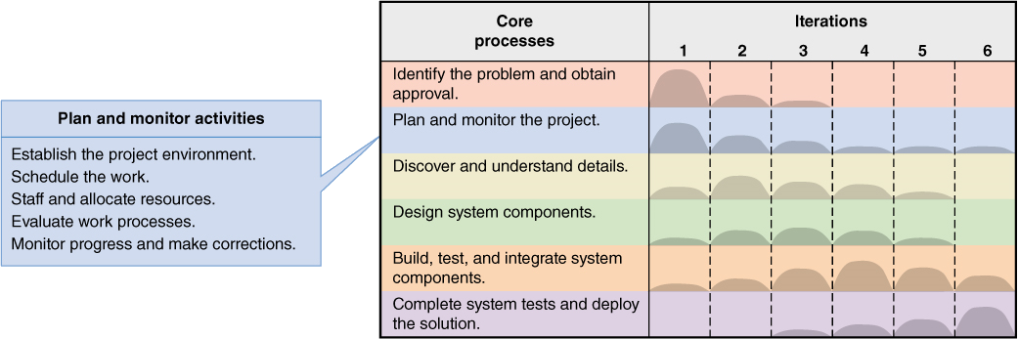
Activities of Core Process 2: Plan and Monitor the Project

Slide 37
Establish the Project Environment (1 of 6)
Project manager must establish project parameters and the work environment:
  Recording and communicating—internal and external
    Who, what, when, and how
  Work environment
    Workstations, software development tools (I D E), servers and repositories, office and meeting space, support staff
  Process and procedures followed
    Reporting and documentation, programming approach, testing, deliverables, code and version control
In other words, tailor and operationalize the methodology being used

Slide 38
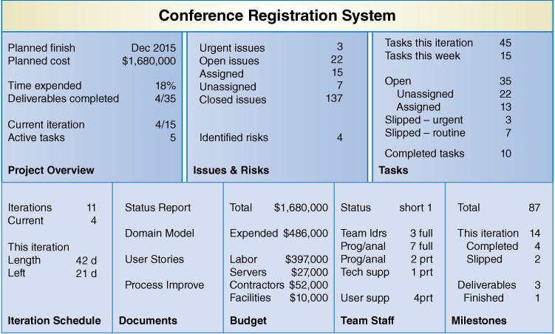
Establish the Project Environment (2 of 6)
Sample Dashboard showing project information and status

Slide 39
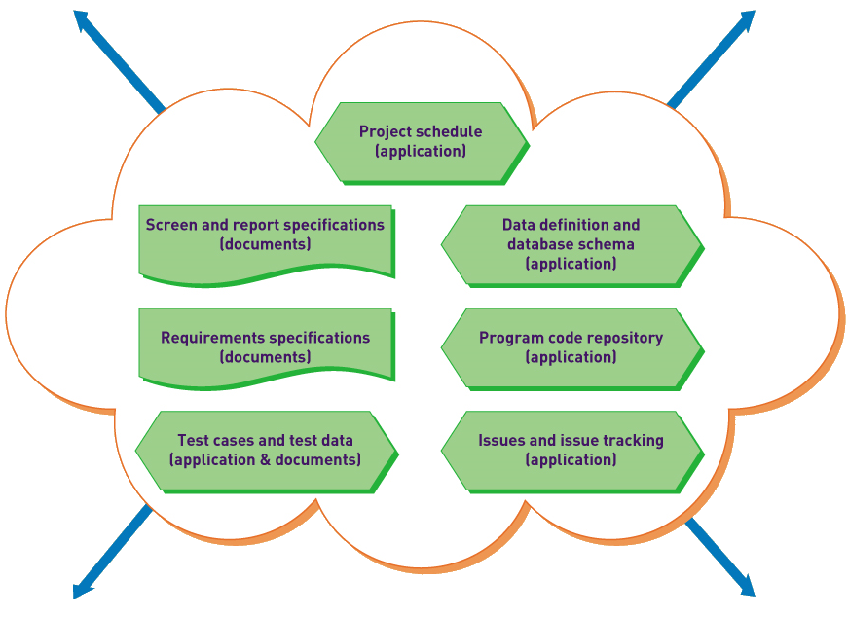
Establish the Project Environment (3 of 6)
Electronic digital repositories of information

Slide 40
Establish the Project Environment (4 of 6)
Information stored in repositories for team member use
Electronic Digital Repositories
Information captured | Electronic tools | Who can update/view
User definitions and functions User documents | Forum software Document server Scanners | Analysts, users/all
Screens and reports layouts | Web design tools Visio PowerPoint/Keynote | Analysts, users/all
Design specifications and diagrams | Wiki software Visio | Analysts/all
Issues and outstanding problems | Issue-tracking software | Analysts, users/all
Program code | Apache subversion (SVN) | Analysts
Project schedule | Microsoft project | Analysts/all
Project status and information | Forum software | Analysts, users/all
Daily team coordination meeting | Video laptop conferencing | Project team
Distributed team communication | I M chat with video | Project team
Project update newsletter | Blog software | Project manager/all

Slide 41
Establish the Project Environment (5 of 6)
Work Environment – Tools
  Personal computer(s) and/or workstation(s)
  Personal development software and tools
  Development server with repositories, sandboxes, and communication tools
  Office space, conference rooms, and equipment, including printers, scanners, and projectors
  Support staff

Slide 42
Establish the Project Environment (6 of 6)
Processes and Procedures
  Reporting and documentation—What is done? How is it done? Who does it?
  Programming—Single or pair programming? How is work assigned? By whom?
  Testing—Programmer tests or user tests? How do you mark items ready for testing?
  Deliverables—What are they? How and when are they handed over to users? How are they accepted?
  Code and version control—How is the code controlled to prevent conflicts? How do you coordinate bug fixing with new development? How and when are deliverables released?

Slide 43
Schedule the Work (1 of 5)
Project manager must establish initial project schedule and keep adjusting:
  Project Iteration Schedule
    The list of iterations and use cases or user stories assigned to each iteration
  Detailed Work Schedule
    Within an iteration, the schedule that lists, organizes, and describes the dependencies of the detailed work tasks
    As each iteration is finished, a detailed work schedule is prepared for the next iteration
    The next detailed work schedule takes into account the changes necessary based on feedback/progress

Slide 44
Schedule the Work (2 of 5)
Project Iteration Schedule for the C S M S Sales Subsystem
Iteration | Time estimate | Use cases assigned to iteration
1 | 4 weeks | Search for item. View detailed descriptions. View rotating (3-D) images. Compare item characteristics.
2 | 4 weeks | View comments and ratings. Search comments and ratings for friends. View accessory combinations (images). Save item + accessories as "combo."
3 | 5 weeks | Add item (or combo) to shopping cart. Remove item (or combo) from shopping cart. Add item (or combo) to “on reserve” cart. Remove item (or combo) from “on reserve” cart.
4 | 4 weeks | Check out active cart. Create and process store sale. Create and process phone sale.
5 | 3 weeks | Clean up, final test, harden site, tune database, etc.
Total | 20 weeks | blank

Slide 45
Schedule the Work (3 of 5)
Developing Detailed Work Schedule takes three steps:
  Develop a Work Breakdown Structure (W B S)
    The list or hierarchy of activities and tasks used to estimate the work to be done in a project or iteration
  Estimate effort and identify dependencies
    Task times
    Tasks that must be completed before another task begins
    Critical path--a sequence of tasks that can’t be delayed without causing the entire project to be delayed
  Create a schedule using a Gantt chart
    Bar chart that portrays the schedule by the length of horizontal bars superimposed on a calendar

Slide 46
Schedule the Work (4 of 5)
Tasks for the Work Breakdown Schedule
  There should be a way to recognize when the task is complete.
  The definition of the task should be clear enough so you can estimate the amount of effort required.
  As a general rule for software projects, the effort should take one to five working days.

Slide 47
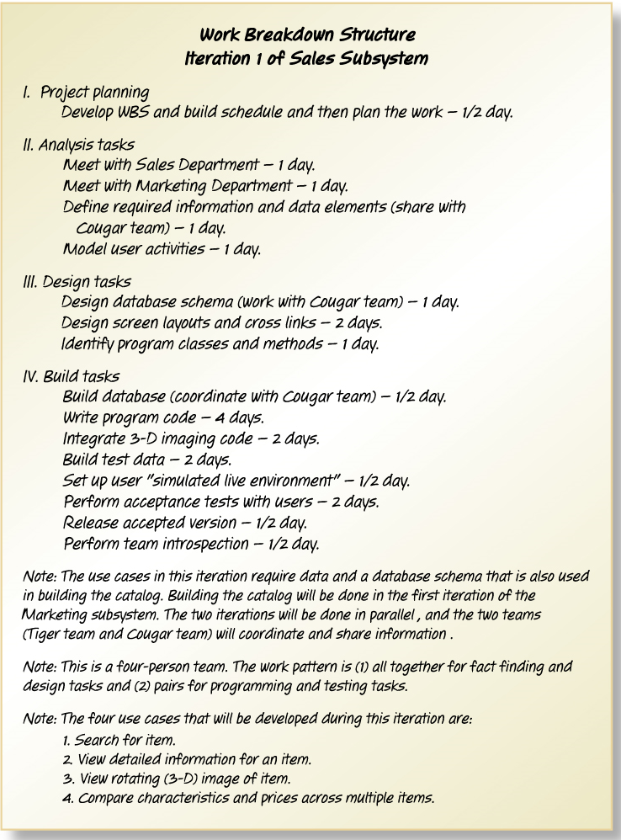
Schedule the Work: Work Breakdown Structure (W B S) with Time Estimates and Notes

Slide 48
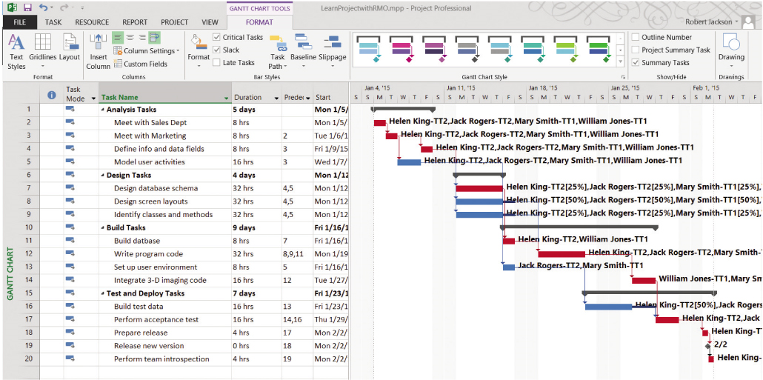
Schedule the Work (5 of 5)
Gantt Chart for first iteration
  Shows task, duration, start date, predecessors, and resources
  Generates chart graphically showing dates, predecessors, tasks, and critical path

Slide 49
Staff and Allocate Resources
Staffing activity tasks consists of 5 tasks:
  Developing a resource plan for the project
  Identifying and requesting specific technical staff
  Identifying and requesting specific user staff
  Organizing the project team into work groups
  Conducting preliminary training and team-building exercises

Slide 50
Evaluate Work Processes: Retrospective
Are our communication procedures adequate? How can they be improved?
Are our working relationships with the user effective?
Did we hit our deadlines? Why or why not?
Did we miss any major issues? How can we avoid this in the future?
What things went especially well? How can we ensure it continues?
What were the bottlenecks or problem areas? How can we eliminate them?

Slide 51
Monitor Project Progress and Make Corrections (1 of 2)
Process to monitor and control project execution

Slide 52
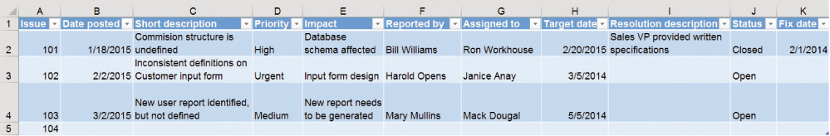
Monitor Project Progress and Make Corrections (2 of 2)
Sample Issues-Tracking Log

Slide 53
Summary (1 of 3)
Project management is an important and challenging career role. Information systems projects do not have a great success rate, and project management knowledge and skills are valued and needed to improve this record.
Project management is directing other people to achieve a planned result on schedule and on budget. Project managers have internal and external responsibilities.
Project managers work with clients, who fund the project, an oversight committee which approves and reviews progress, and users who will directly interact with the system.
The discipline of project management is organized into the Project Management Body of Knowledge (P M B O K) that includes nine knowledge areas. Project managers should study and digest this body of knowledge.

Slide 54
Summary (2 of 3)
Managing a project can be at a high or low level of ceremony, meaning the degree that the project management processes are formal and documented. Agile project management is usually used with adaptive life cycles and low ceremony.
The S D L C in this text includes two Core Processes that involve the project manager: 1) Identify the problem and obtain approval and 2) Plan and monitor the project. This chapter discusses the activities or both Core Process.
The core process Identify the problem and obtain approval includes the following activities: 1) identify the problem, 2) quantify project approval factors, 3) perform risk and feasibility analysis, and 4) review with client and obtain approval.

Slide 55
Summary (3 of 3)
A key deliverable is the System Vision Document, which includes a problem description, an overview of system capabilities, and a list of business benefits. Key project approval factors include time estimate, cost estimate, and cost/benefit analysis. Additionally, risk and feasibility factors are organizational, technological, resource, and schedule.
The core process Plan and monitor the project includes the following activities: 1) establish the project environment, 2) schedule the work, 3) staff and allocate resources, 4) evaluate work processes, and 5) monitor progress and make corrections.
Scheduling the work includes a project iteration schedule and detailed work schedules. A work breakdown structure (W B S) lists tasks to be completed. Dependencies and time estimates are also considered and shown in a Gantt chart.

